Slide 1
Передача пользовательских данных
по беспроводному каналу связи

Slide 2

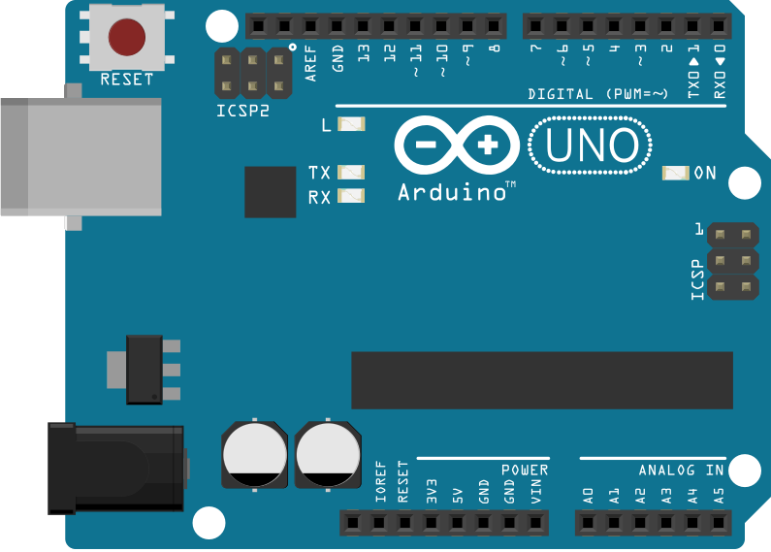
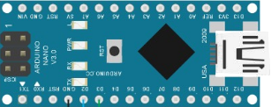
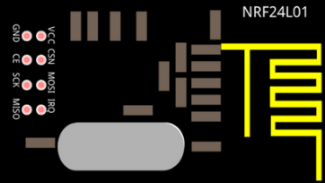

Project architecture
Content Manager

Slide 3
PC-Nano Connection
Content Manager

Slide 4
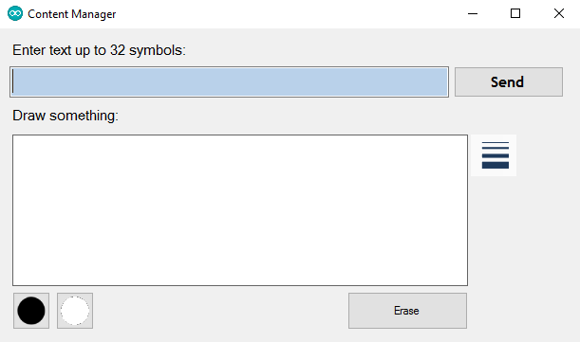
Content Manager

Slide 5
Drawing Processing (1)
?

Slide 6
Drawing Processing (2)
!

Slide 7
Drawing Processing (3)
=
+
New State
Current State

Slide 8
Drawing Processing (4)
sending

Slide 9
Packet Structure
Control
Command
Data
Length
Data
1 byte
2 bytes
0 - 65535 bytes

Slide 10
Data field if drawing transmitted
Data
Data
0 - 65535 bytes
Matrix
Number
Data
Matrix
Number
Data
etc
1 byte
8 bytes
1 byte
8 bytes

Slide 11
Function calls tree
sendData(string text)
sendData(List<byte> data, string kind_of_data)
encapsulate(List<byte> data, string kind_of_data)
sendDataToCOM(byte[] data, ushort length)
addDataLength(List<byte> data)
addControlCommand(List<byte> data, string kind_of_data)

Slide 12
Nano-UNO Connection
Content Manager

Slide 13
Control
Command
1
2
3
DisplayText(LedControl, char* text, uint8_t size_of_data)
DisplayPicture(LedControl, char* data, char quantity_of_matrix)
ClearDisplay(LedControl)
DisplayAlpha(LedControl, uint8_t number_of_matrix, uint8_t alpha_position_in_alphabet)
DisplayMatrix(LedControl, char address_of_matrix, char* matrix)

Slide 14
UNO-LED Connection
Content Manager

Slide 15
DisplayText (1)
M | E | R | A

Slide 16
DisplayText (2)
 |  |  | M | E | R | A

Slide 17
DisplayText (3)
 |  |  | M | E | R | A

Slide 18

DisplayText (3)
 |  |  | M | E | R | A

Slide 19

DisplayText (3)
 |  |  | M | E | R | A

Slide 20

DisplayText (3)
 |  |  | M | E | R | A

Slide 21

DisplayText (3)
 |  |  | M | E | R | A

Slide 22
DisplayText (3)
 |  |  | M | E | R | A

Slide 23
DisplayText (3)
 |  |  | M | E | R | A

Slide 24
DisplayText (3)
 |  |  | M | E | R | A

Slide 25
Usage

Slide 26
Demo

Slide 27
Thank You

