Slide 1
Makananku
Anggota:
Adelia - 1801384363
Aristama Budiono - 1801387163
Bernardo Laurentxius - 1801382673
Devi Kumala - 1801405374
Evelyn Yoesephine - 1801382074
Ferryanto Setiawan - 1801379703
Michael Adam - 1801384230
Mico Yohanes - 1801381701
Stevian - 1801383953

Slide 2
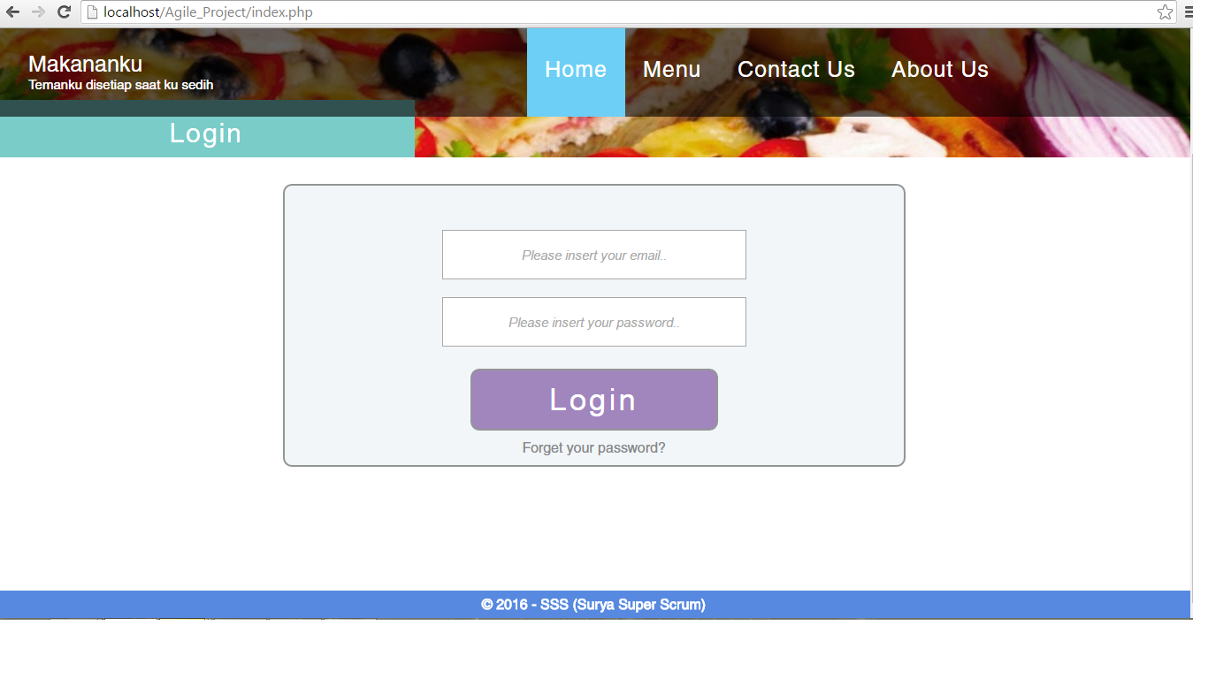
Home

Slide 3
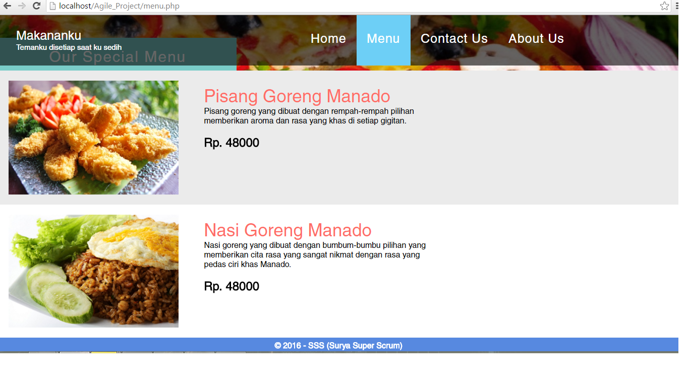
Menu

Slide 4
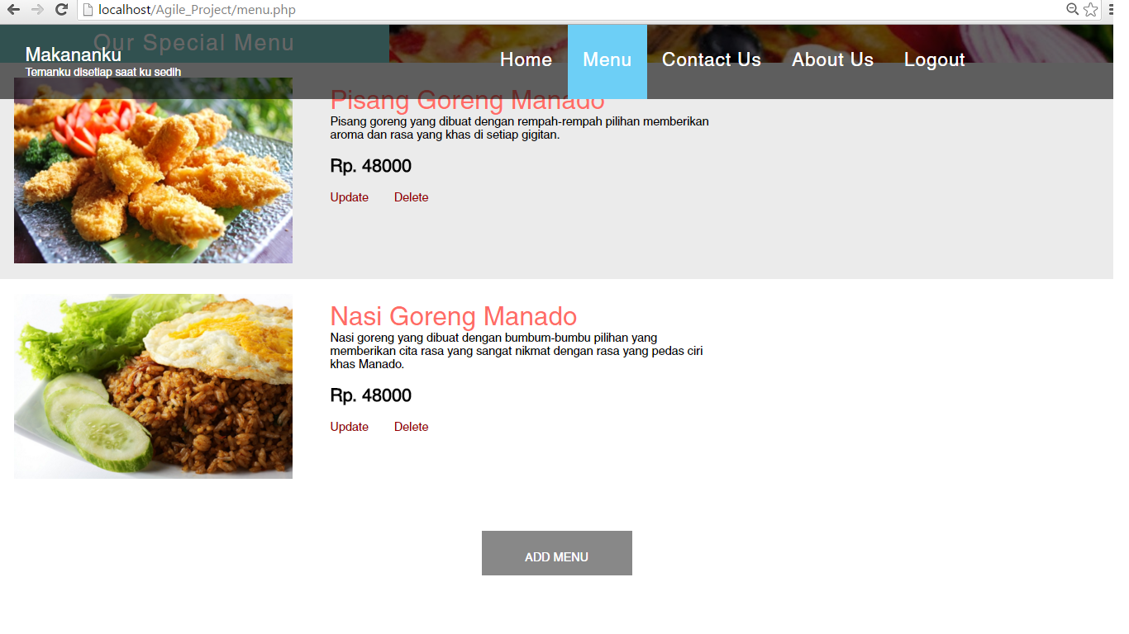
Menu (Admin)

Slide 5
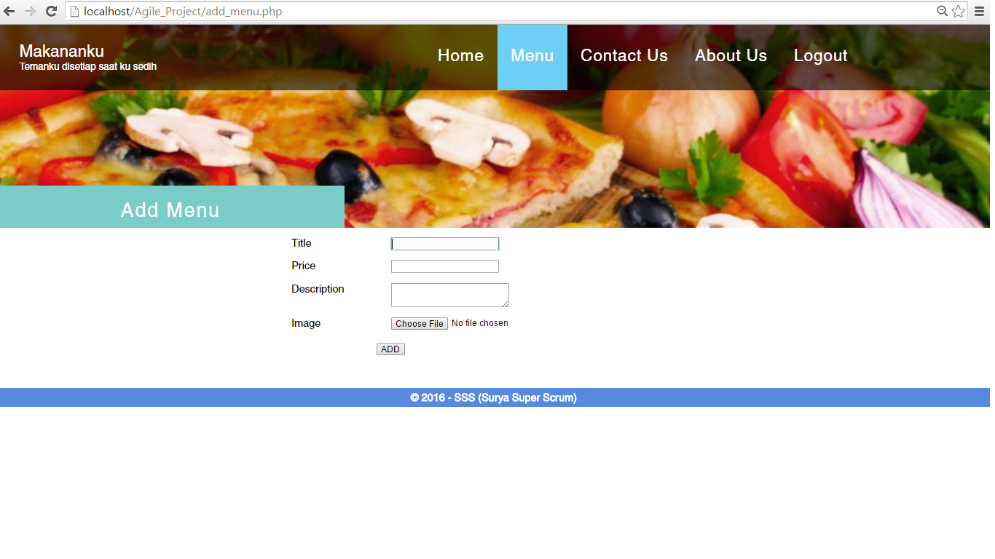
Add Menu

Slide 6
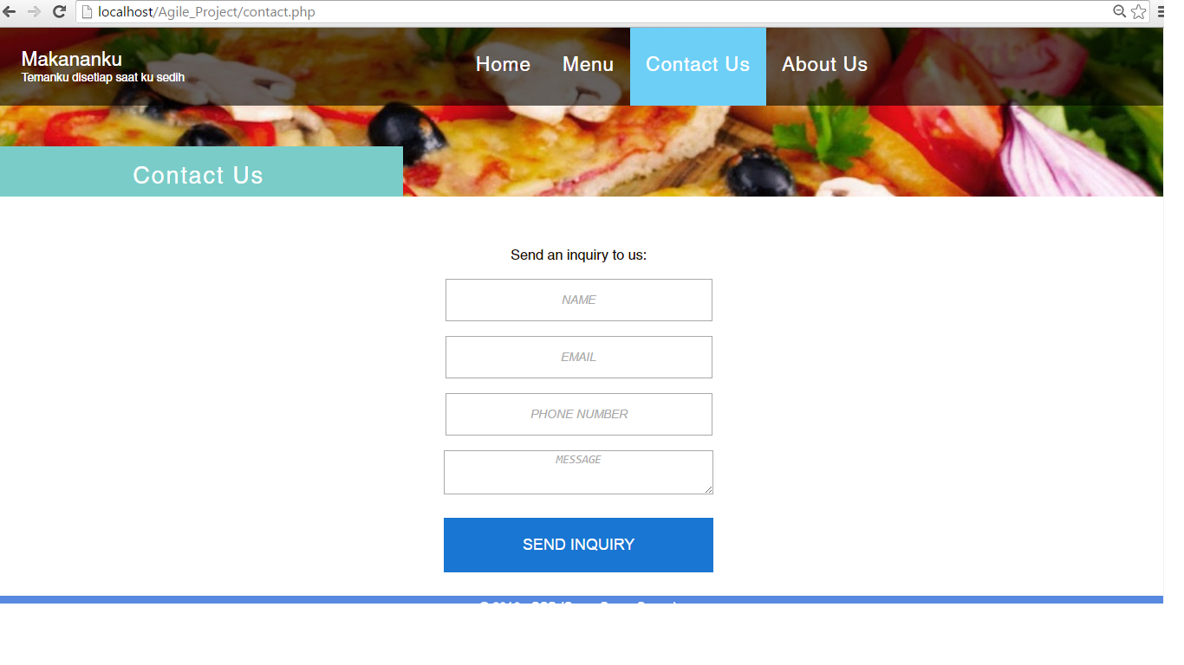
Contact Us

Slide 7
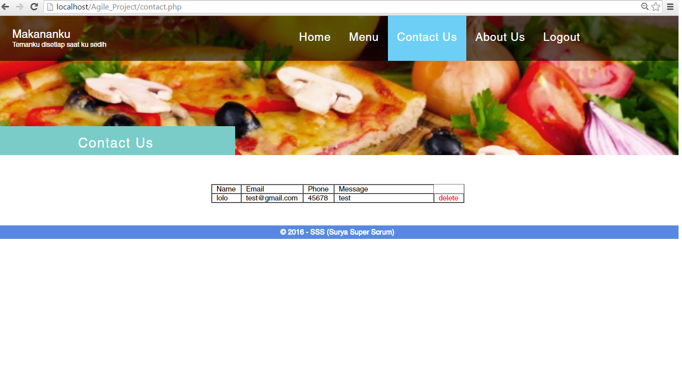
Contact Us (Admin)

Slide 8
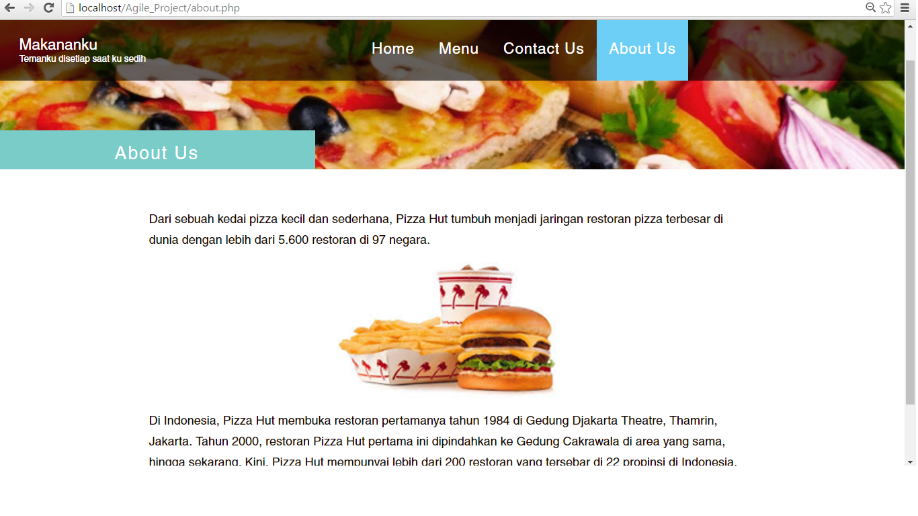
About Us

Slide 9
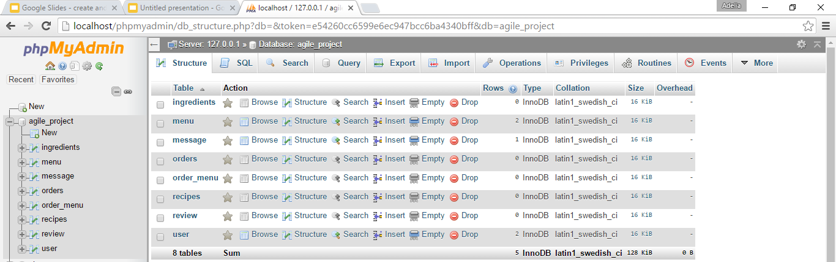
Database

Slide 10
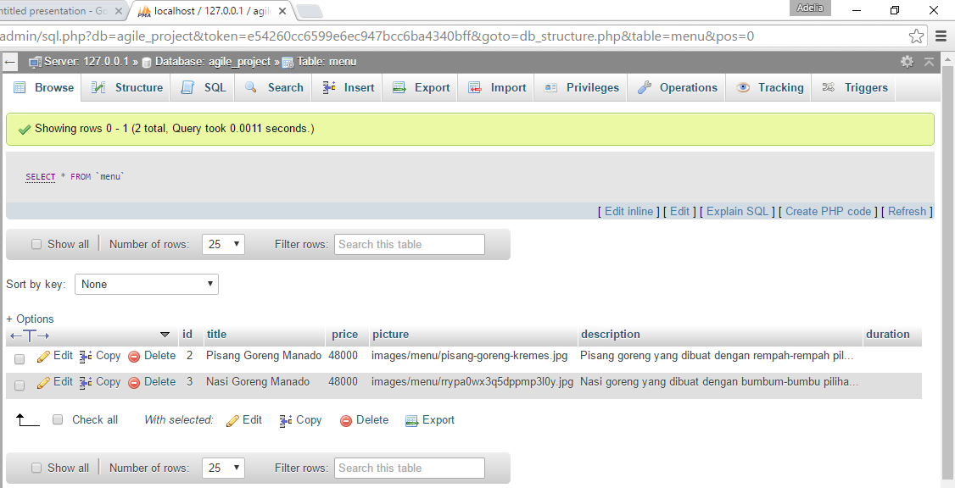
Database: Menu Table

Slide 11
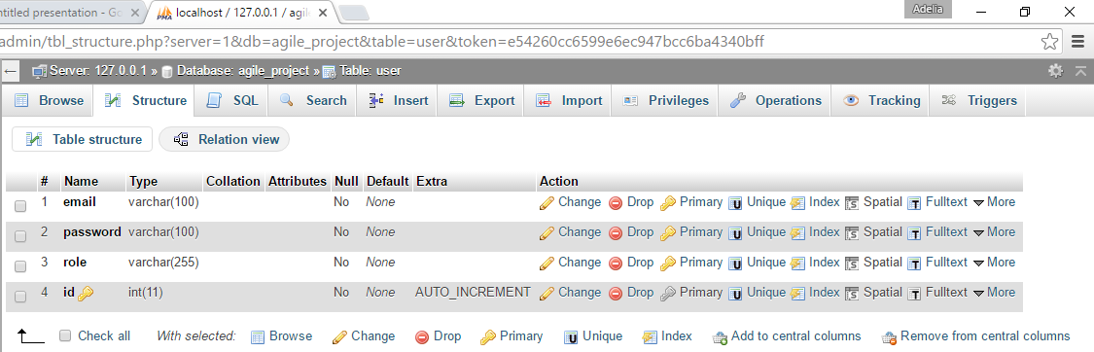
Database: User Table

Slide 12
Thank You

