Slide 1


Open Refine for Humanities
Lucia Michielin
Edinburgh University
L.Michielin@sms.ed.ac.uk

Slide 2

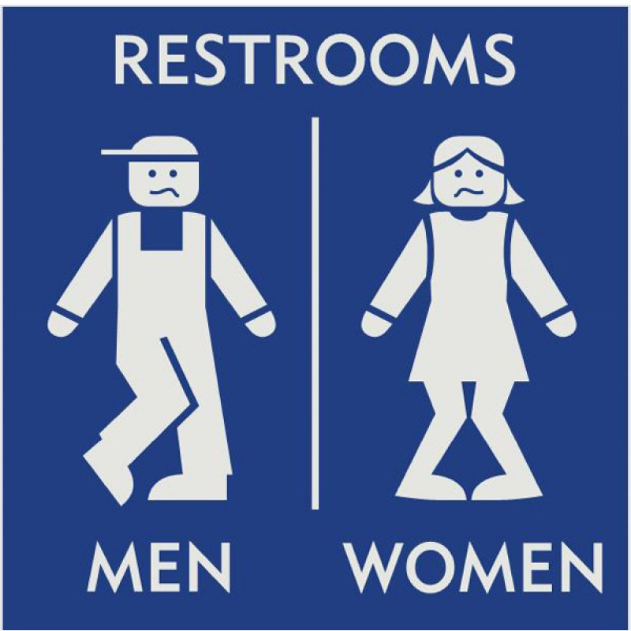

Before starting …some practical info
Coffe break
Restrooms
Stickers

Slide 3
Plan of the Workshop
1. Introduction
2. Working with OpenRefine
3. Filtering and Sorting with OpenRefine
4. Examining Numbers in OpenRefine
5. Scripts from OpenRefine
6. Exporting and Saving Data from OpenRefine
7. Other Resources in OpenRefine

Slide 4
What is it?
1. Introduction
OpenRefine is a standalone open source desktop application for data clean up and transformation to other formats, the activity known as data wrangling.
It is a Java program hence you operate it through your browser but you don’t need to be online.
Works with large-ish datasets (100,000 rows). Does not scale to many millions. (yet).
More information on the software in here.

Slide 5
Why Using Open Refine?
1. Introduction
Helps you dealing with your data (most of all when they start be a lot).
All action within the software are tracked and easily reversible.
You must save your work to a new file; OpenRefine does not modify your original dataset.
Data is often very messy, and this tool saves a lot of time on cleaning headaches (spearing a lot of time).
Data cleaning steps can be saved and applied to multiple files.
It makes clustering easy to do and understand.
Large and helpful community online. If you need help http://openrefine.org
It is important to know what you did to your data. Additionally, journals, granting agencies, and other institutions are requiring documentation of the steps you took when working with your data. With OpenRefine, you can capture all actions applied to your raw data and share them with your publication as supplemental material.

Slide 6
Sticker time!!!
1. Introduction
Do you all have Open Refine download and working and the .csv file to work on?

Slide 7

2. Working with OpenRefine
Questions
How can we bring our data into OpenRefine?
How can we sort and summarize our data?
How can we find and correct errors in our raw data?
Objectives
Create a new OpenRefine project from a CSV file.
Understand potential problems with file headers.
Use facets to summarize data from a column.
Use clustering to detect possible typing errors.
Understand that there are different clustering algorithms which might give different results.
Employ drop-downs to remove white spaces from cells.
Manipulate data using previous steps with undo/redo.

Slide 8


2. Working with OpenRefine
Creating a Project
(Start looking at your data)
More information in here
Main supported files:
TSV
CSV
*SV
Excel (XLS, XLSX)
JSON
XML
RDF as XML

Slide 9

2. Working with OpenRefine
Data Faceting
(Exploring data by applying multiple filters)
One type of Facet is called a ‘Text facet’. This groups all the identical text values in a column and lists each value with the number of records it appears in. The facet information always appears in the left hand panel in the OpenRefine interface.
Seeing the big picture of your data
Filtering down to just the subset of rows that you want to change in bulk.

Slide 10
2. Working with OpenRefine
Exercise: 1
Using faceting, find out how many different interview_date values there are in the survey results.
Is the column formatted as Number, Date, or Text? How does changing the format change the faceting display?
Use faceting to produce a timeline display for interview_date. You will need to use Edit cells > Common transforms > To date to convert this column to dates
During what period were most of the interviews collected?

Slide 11
2. Working with OpenRefine
More on Faceting
As well as ‘Text facets’ Refine also supports a range of other types of facet. These include:
Numeric facets
Timeline facets (for dates)
Custom facets
Scatterplot facets
Numeric and Scatterplot facets display graphs instead of lists of values. The numeric facet graph includes ‘drag and drop’ controls you can use to set a start and end range to filter the data displayed. These facets are explored further in Examining Numbers in OpenRefine
Custom facets are a range of different types of facets. Some of the default custom facets are:
Word facet - this breaks down text into words and counts the number of records each word appears in
Duplicates facet - this results in a binary facet of ‘true’ or ‘false’. Rows appear in the ‘true’ facet if the value in the selected column is an exact match for a value in the same column in another row
Text length facet - creates a numeric facet based on the length (number of characters) of the text in each row for the selected column. This can be useful for spotting incorrect or unusual data in a field where specific lengths are expected (e.g. if the values are expected to be years, any row with a text length more than 4 for that column is likely to be incorrect)
Facet by blank - a binary facet of ‘true’ or ‘false’. Rows appear in the ‘true’ facet if they have no data present in that column. This is useful when looking for rows missing key data.
OpenRefine Wiki: Faceting

Slide 12

Clustering (Finding groups of different values that might be the same thing)
2. Working with OpenRefine
More on clustering
Edit and control typos and different style of representing the same concept (e.g. Ruaca, Ruca, Ruca-Nhamuenda…)

Slide 13
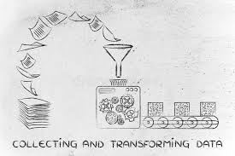
Transforming data he data in the items_owned column is a set of items in a list. The list is in square brackets and each item is in single quotes. Before we split the list into individual items in the next section, we first want to remove the brackets and the quotes.
2. Working with OpenRefine
First we will remove all of the left square brackets ([). In the Expression box type value.replace("[", "") and click OK.
What the expression means is this: Take the value in each cell in the selected column and replace all of the “[” with “” (i.e. nothing - delete).
Click OK. You should see in the items_owned column that there are no longer any left square brackets.

Slide 14

2. Working with OpenRefine
Exercise: 2
Now that we have cleaned out extraneous characters from our items_owned column, we can use a text facet to see which items were commonly owned or rarely owned by the interview respondents.
Click the down arrow at the top of the items_owned column. Choose Facet > Custom text facet...
In the Expression box, type value.split(";").
Click OK.
Use this same strategy to remove the single quote marks ('), the right square brackets (]), and spaces from the items_owned column.
Solution
value.replace("'", "")
value.replace("]", "")
value.replace(" ", "") You should now have a list of items separated by semi-colons (;).

Slide 15
2. Working with OpenRefine
Exercise: 3
Which two items are the most commonly owned? Which are the two least commonly owned?
Perform the same clean up steps and customized text faceting for the months_lack_food column. Which month(s) were farmers more likely to lack food?
Perform the same clean up steps for the months_no_water, liv_owned, res_change, and no_food_mitigation columns. Hint: To reuse a GREL command, click the History tab and then click Reuse next to the command you would like to apply to that column.

Slide 16


2. Working with OpenRefine
Undo / Redo
(Control your steps)
Trim Leading and Trailing Whitespace
(Remove blank characters from the beginning and end)

Slide 17
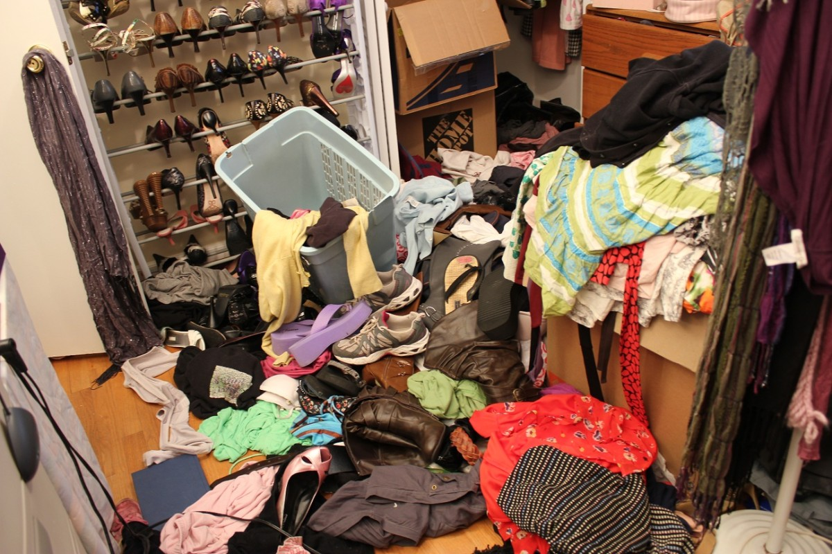
3. Filtering and Sorting with OpenRefine
Questions
How can we select only a subset of our data to work with?
How can we sort our data?
Objectives
Filter to a subset of rows by text filter or include/exclude.
Sort table by a column.
Sort by multiple columns.
Tidying Up your Data!

Slide 18
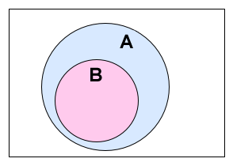

3. Filtering and Sorting with OpenRefine
Filtering
(Working on a subset)
Exercise 1
What roof type are selected by this procedure?
2. How would you restrict this to one of the roof types?
Exercise 2
Use include/exclude to select just one of these roof types

Slide 19

3. Filtering and Sorting with OpenRefine
Sorting Data
(Single column and multiple column)
Exercise 3
Sort the data by gps_Altitude. Do you think the first few entries may have incorrect altitudes?
The first few values are all 0. The altitudes are more likely ‘missing’ than incorrect. The survey is delivered by Smartphone with the gps information added automatically by the app. The lack of an altitude value suggests that the smartphone was unable to provide it and it defaulted to 0.
Sort > Sort... - This option enables you to modify your original sort.
Sort > Reverse - This option allows you to reverse the order of the sort.
Sort > Remove sort - This option allows you to undo your sort.

Slide 20
3. Filtering and Sorting with OpenRefine
Sorting Data
Exercise 4
We discovered in an earlier lesson that the value for one of the village entries was given as 49. This is clearly wrong. By looking at the GPS coordinates for the entries of the other villages can we decide what village the data in that column was collected from?
Sort on gps_Longitude as a number with the largest first.
Add a sort on gps_Latitude as a number with the largest first.
Using the drop down arrow on the village column, select Edit column > Move column to end. This will allow you to compare village names with GPS coordinates.
Scroll through the entries until you find village 49. Can you tell from it’s GPS coordinates which village it belong to?
Now sort only by interview_date as date. Move the village column to the start of the table. Does the row where village is 49 group with one particular village? Is it the same village as when comparing GPS coordinates?

Slide 21

4. Examining Numbers in OpenRefine
Questions
Objectives
Transform a text column into a number column.
Identify and modify non-numeric values in a column using facets.
How can we convert a column from one data type to another?
How can we visualize relationships among columns?

Slide 22
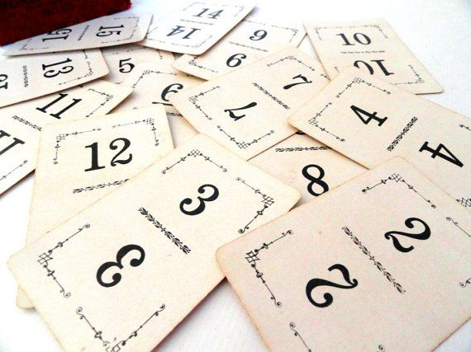
4. Examining Numbers in OpenRefine
Exercise 1:
Transform 3 columns (no_members, yrs_liv, and buildings_in_compound)
from text data to number data? What happen to the columns that are not integers?
Exercise 2:
For a column you transformed to numbers, edit one or two cells, replacing the numbers with text (such as abc) or blank (no number or text).
Use the pulldown menu to apply a numeric facet to the column you edited. The facet will appear in the left panel.

Slide 23

5. Scripts from OpenRefine
Questions
How can we document the data-cleaning steps we’ve applied to our data?
How can we apply these steps to additional data sets?
Objectives
Describe how OpenRefine generates JSON code.
Demonstrate ability to export JSON code from OpenRefine.
Demonstrate ability to import a JSON code file to apply the
analysis to another dataset.

Slide 24
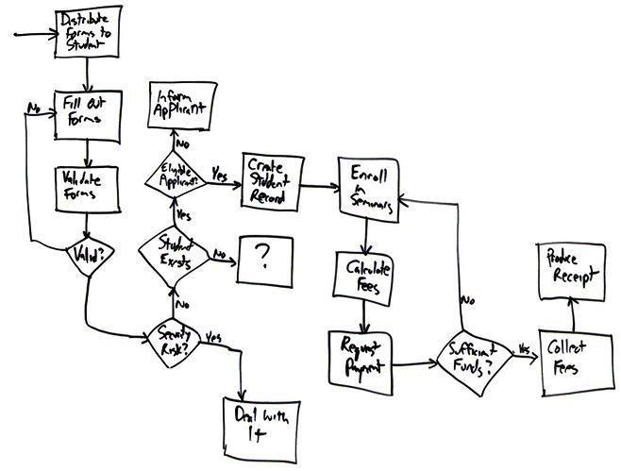
Saving the cleaning flowchart
5. Scripts from OpenRefine
As you conduct your data cleaning and preliminary analysis, Open Refine saves every change you make to the dataset. These changes are saved in a format known as JSON (JavaScript Object Notation). You can export this JSON script and apply it to other data files.
Let’s save our steps

Slide 25
5. Scripts from OpenRefine
Importing a script to use against another dataset
Let’s practice running these steps on a new dataset. We’ll test this on an uncleaned version of the dataset we’ve been working with.
Start a new project in OpenRefine using the messy dataset you downloaded before. Give the project a new name.
Click the Undo / Redo tab > Apply and paste in the contents of .txt file with the JSON code.
Click Perform operations. The dataset should now be the same as your other cleaned dataset.
For convenience, we used the same dataset. In reality you could use this process to clean related datasets. For example, data that you had collected over different fieldwork periods or data that was collected by different researchers (provided everyone uses the same column headings). The data in this file was generated from an eSurvey system with the actual survey being delivered centrally to a smartphone, so the column headings are pretty much guaranteed to be the same.

Slide 26
6. Exporting and Saving Data from OpenRefine
Questions
How can we save and export our cleaned data from OpenRefine?
Objectives
Save an OpenRefine project.
Export cleaned data from an OpenRefine project.

Slide 27


6. Exporting and Saving Data from OpenRefine
Saving
By default OpenRefine is saving your project continuously. If you close OpenRefine and open it up again, you’ll see a list of your projects. You can click on any one of them to open it up again.
Exporting
You can also export a project. This is helpful, for instance, if you wanted to send your raw data and cleaning steps to a collaborator, or share this information as a supplement to a publication.

Slide 28

7. Other Resources in OpenRefine
Questions
What other resources are available for working with OpenRefine?
Objectives
Understand that there are many online resources available for more information on OpenRefine.
Identify other resources about OpenRefine

Slide 29
7. Other Resources in OpenRefine
OpenRefine web site
OpenRefine Documentation for Users
OpenRefine documentation Wiki site
Using OpenRefine book by Ruben Verborgh, Max De Wilde and Aniket Sawant
OpenRefine history from Wikipedia
Grateful Data is a fun sight with many resources devoted to OpenRefine, including a nice tutorial.
Margaret Heller shows how she uses OpenRefine for Measuring and Counting Impact in Repositories.
Intersect Course Resources has Jared Berghold’s Cleaning & Exploring your data with Open Refine (scroll down page to find).
Enipedia OpenRefine Tutorial

Slide 30

Any Question?

