Slide 1

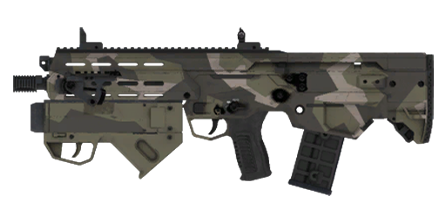
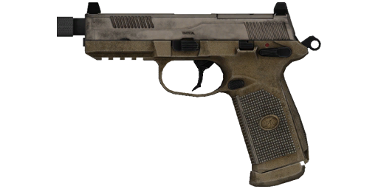
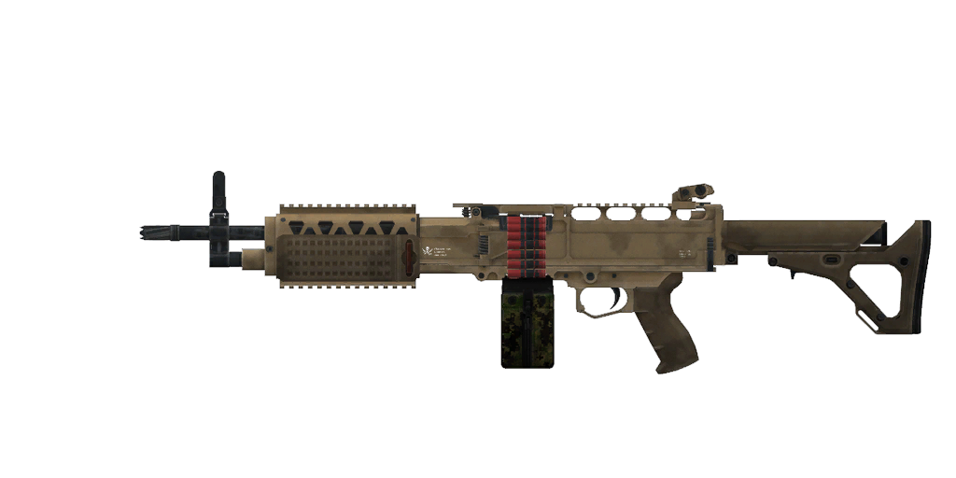
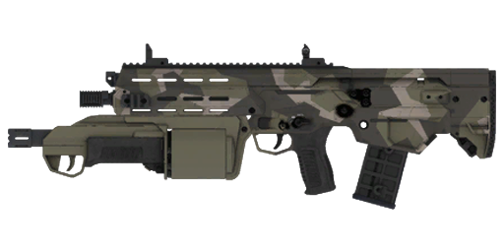
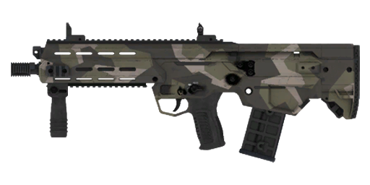
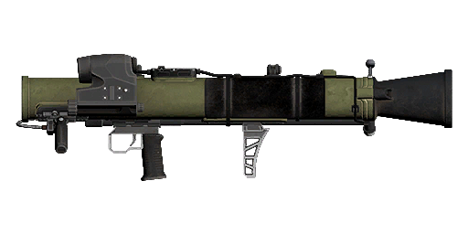
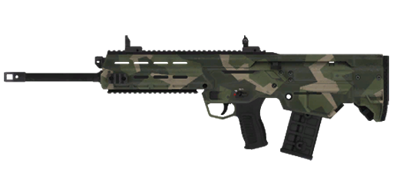
Squad Leader
Promet GL Rifle and 4-five Pistol
Fireteam Leader
Promet GL Rifle and 4-five Pistol
Automatic Rifleman
Mk200 and 4-five Pistol
Blue Team
Breacher
Promet SG Rifle and 4-five Pistol
Rifleman Light AT
Promet Rifle, 4-five Pistol
and MAAWS Mk4 Mod 1 Launcher
Fireteam Leader
Promet GL Rifle and 4-five Pistol
Automatic Rifleman
Mk200 and 4-five Pistol
Red Team
Designated Marksman
Promet MR Rifle and 4-five Pistol
Combat Life Saver
Promet Rifle and 4-five Pistol
Livonian Defense Force Ranger Squad
Livonia
(2035)

Slide 2
Squad Leader
Promet GL Rifle and 4-five Pistol
Fireteam Leader
Promet GL Rifle and 4-five Pistol
Automatic Rifleman
Mk200 and 4-five Pistol
Blue Team
Breacher
Promet SG Rifle and 4-five Pistol
Rifleman
Promet Rifleand and 4-five Pistol
Fireteam Leader
Promet GL Rifle and 4-five Pistol
Automatic Rifleman
Mk200 and 4-five Pistol
Red Team
Designated Marksman
Promet MR Rifle and 4-five Pistol
Combat Life Saver
Promet Rifle and 4-five Pistol
Livonian Defense Force Ranger Squad
Livonia
(2035)

Slide 3
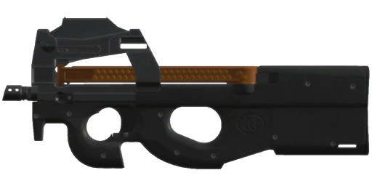
Squad Leader
Promet GL Rifle and 4-five Pistol
Gunner
ADR-97C SMG and 4-five Pistol
Crew
Driver
ADR-97C SMG and 4-five Pistol
Fireteam Leader
Promet GL Rifle and 4-five Pistol
Automatic Rifleman
Mk200 and 4-five Pistol
Grenadier
Promet GL Rifle and 4-five Pistol
Fireteam
Rifleman
Promet Rifle and 4-five Pistol
Rifleman Light AT
Promet Rifle, 4-five Pistol
and MAAWS Mk4 Mod 1 Launcher
Rifleman
Promet Rifle and 4-five Pistol
Livonian Defense Force Dragoon Squad
Livonia
(2035)

