Slide 1

Used cars information analysis
Junyu Mou

Slide 2
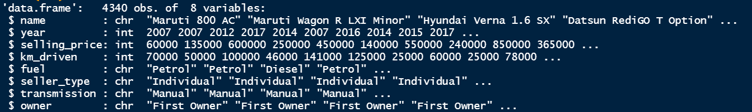
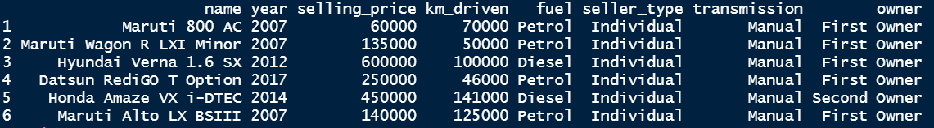
About the data
Information about used cars
Unbalanced data
Name: name for each car
Year: model year
Selling_price: price for each car
km_driven: usage
Fuel: type of fuel
Seller_type: dealer, personal, or etc
Transmission: auto or manual
Owner: how many owners before

Slide 3
Import and prepare
getwd() to locate the work dictionary
Put the file under the working dictionary
read.csv() to import
Check any NAs by sum(is.na(CDC)) #CDC is the data name
Delete any rows with NAs by na.omit()
Check the vector type

Slide 4
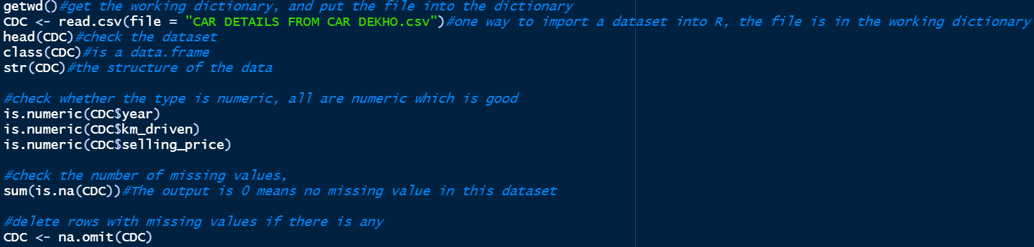
Import and prepare

Slide 5

Categorical variable: Fuel Type

Slide 6
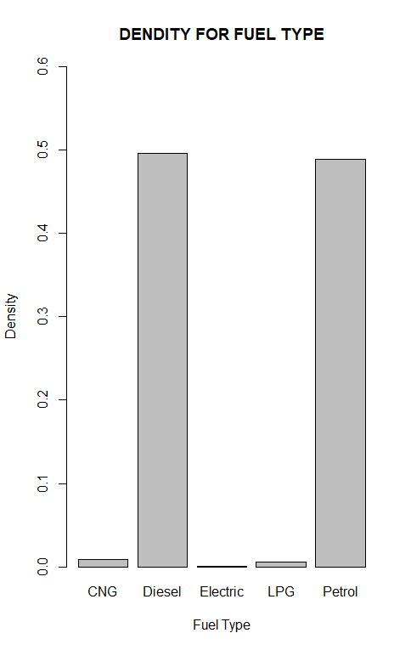
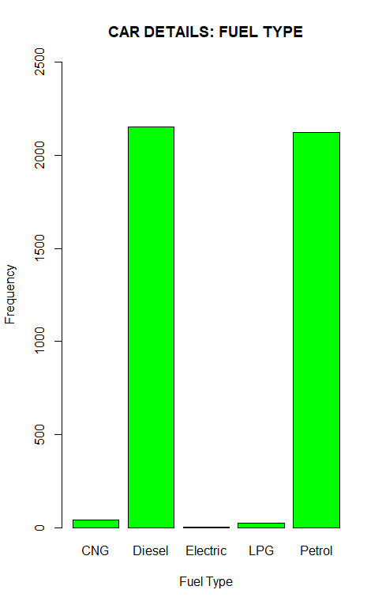
Categorical variable: Fuel Type
Density
Amount

Slide 7
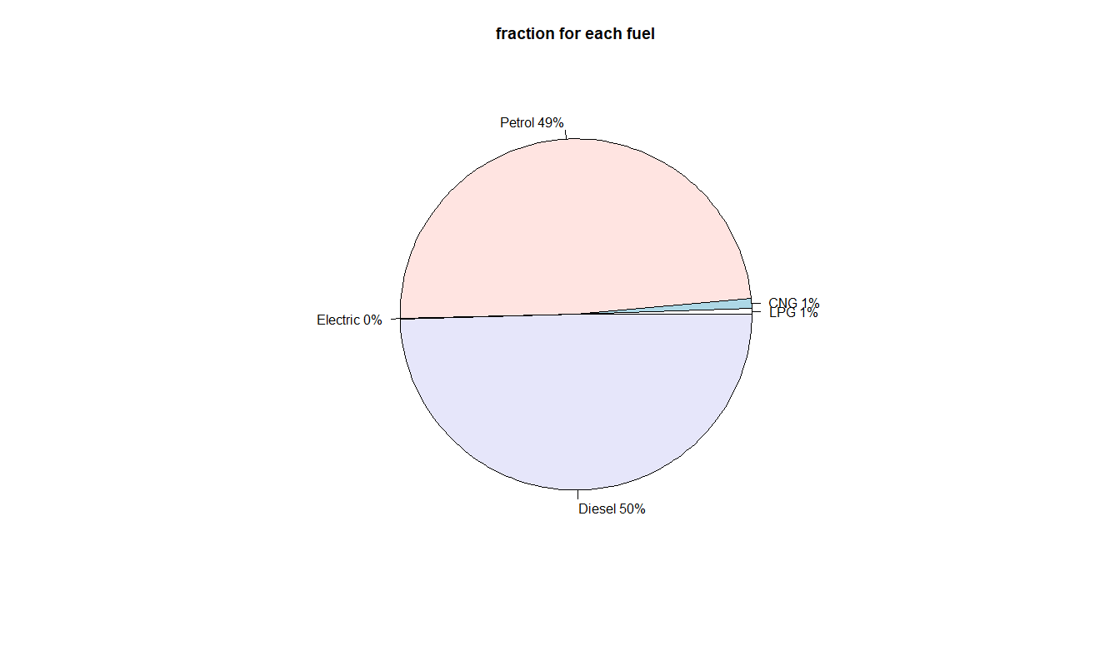
Categorical variable: Fuel Type
Ranged the sequence of each type
The percentage for each type
Electric 0%
Petrol 49%
Diesel 50%
CNG and LPG <= 1%
Most cars are diesel and petrol

Slide 8
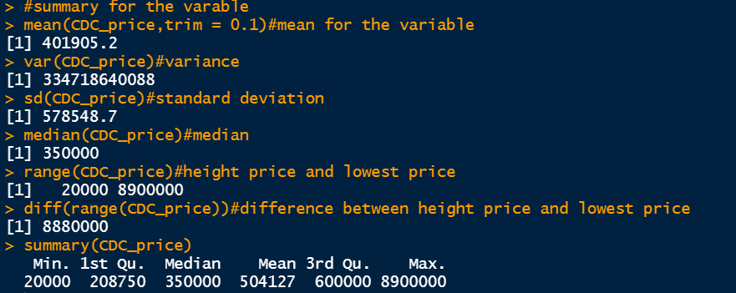
Numeric variable: car_price

Slide 9
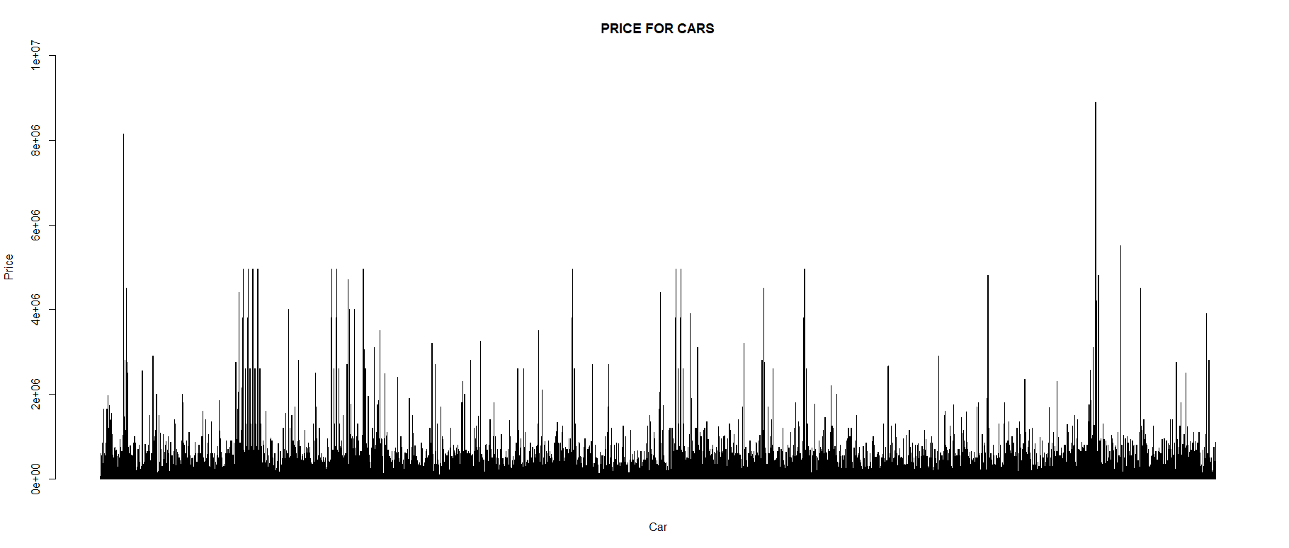
Numeric variable: car_price

Slide 10
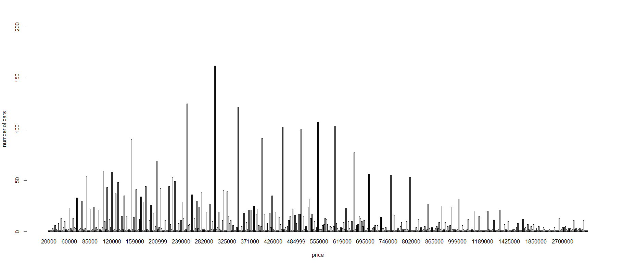
Numeric variable: car_price

Slide 11
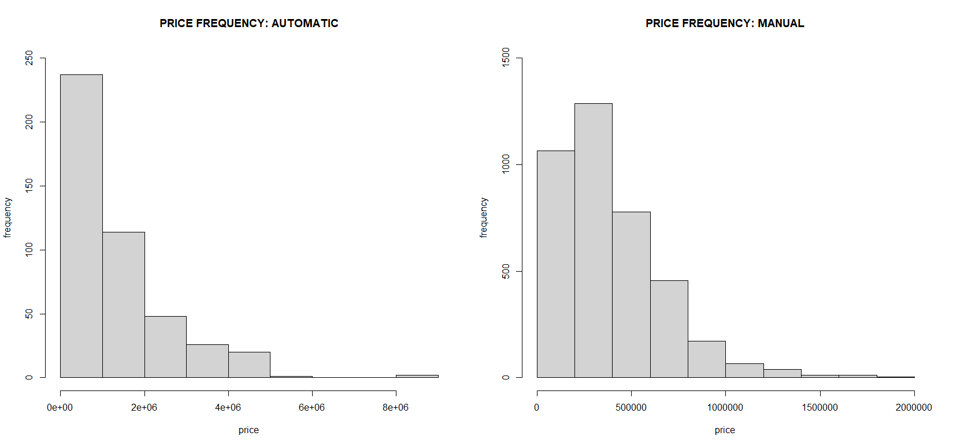
Numeric variable: car_price

Slide 12
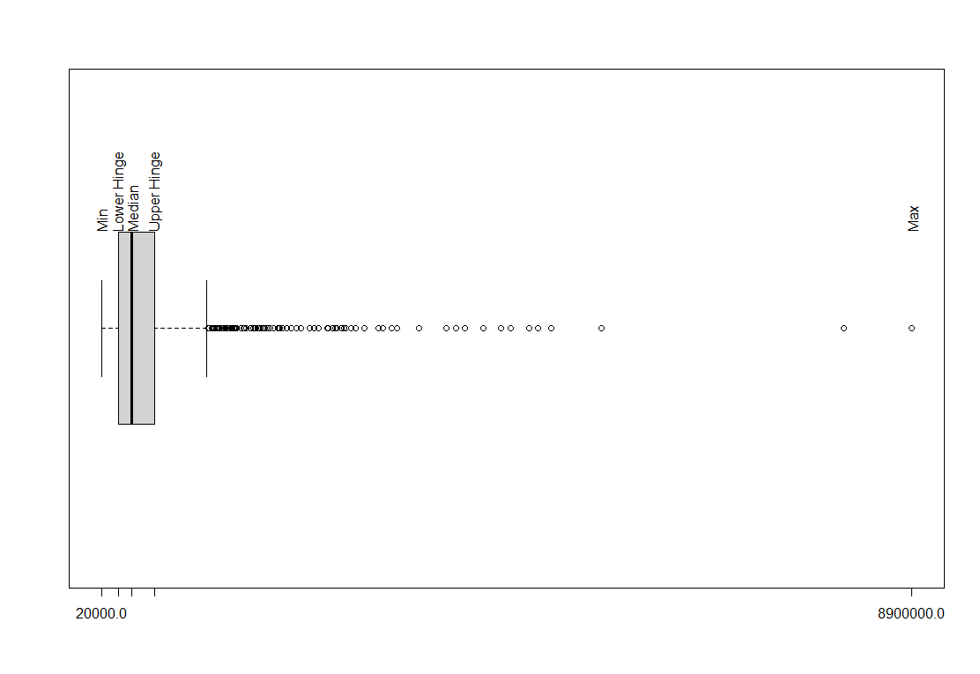
Numeric variable: car_price
smmary
Box plot
Most prices between 208750 and 600000
Median price is 350000
Many extremely high price cars
Except outliers there are more high price cars

Slide 13
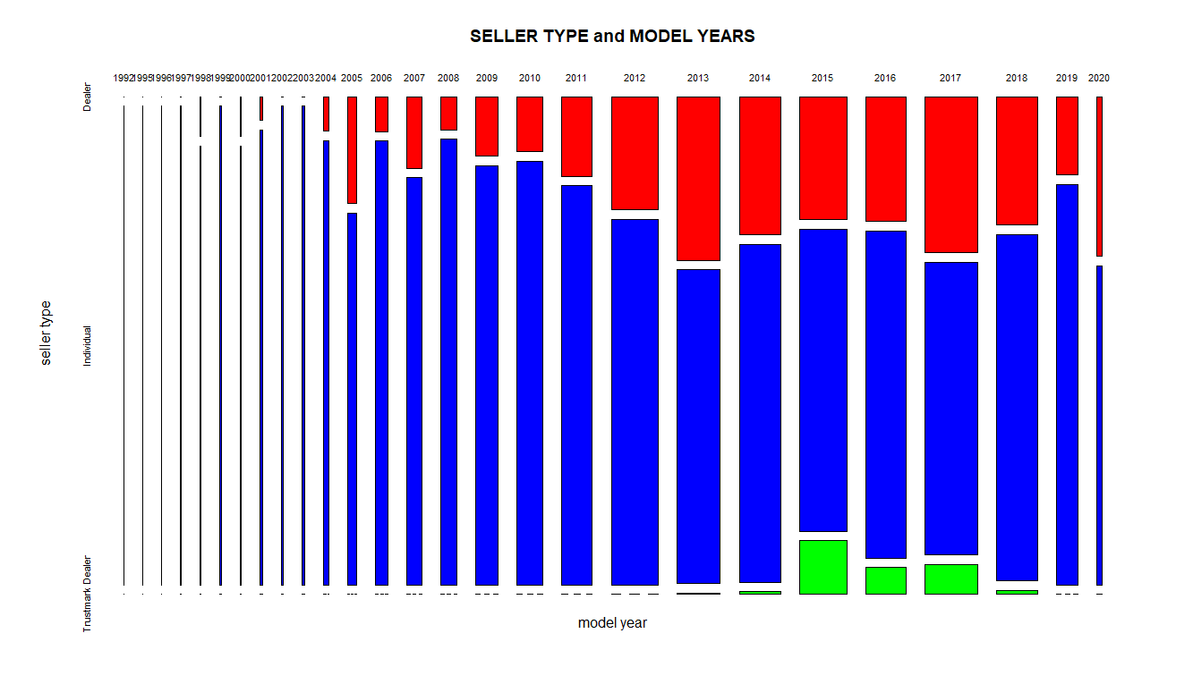
Numeric variable: car_price
Mosaic plot for model year and seller type
For cars in market, most are 2012 to 2018
In general, individual has the most cars
Dealers have cars with comprehensive model of years as same as idividual
Trustmark dealers only have cars with specific years, e.g. 2015 - 2017

Slide 14
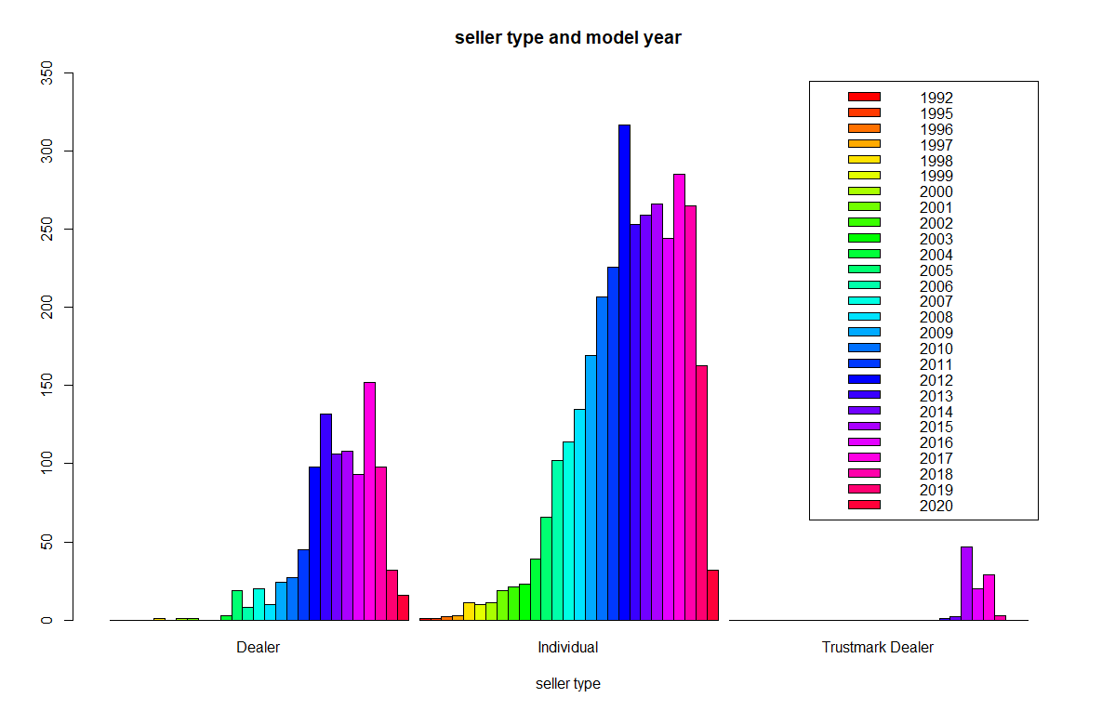
Numeric variable: car_price
Another way to express
they all have more cars with latter model
Trustmark dealers have relatively new cars

Slide 15
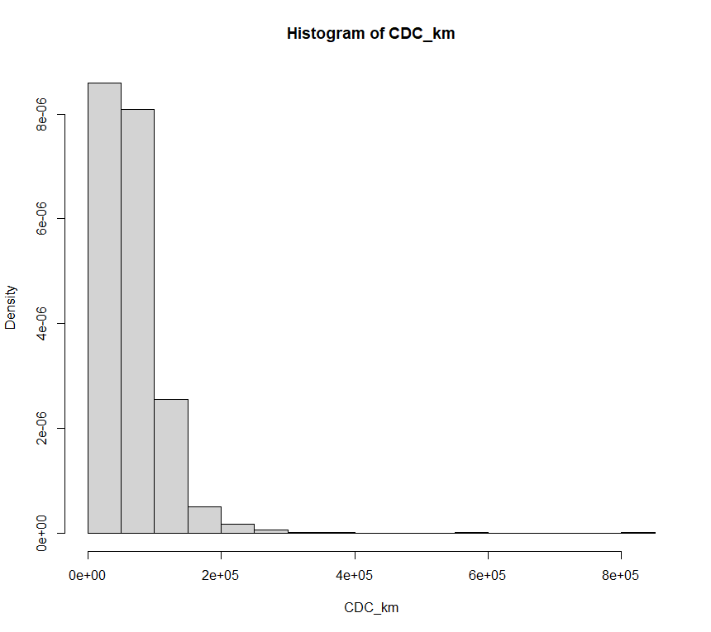
Central Limit Theorem:CDC_km
The variable for central limit theorem
Most cars are relatively new: most less than 100000km , around62,137.12mi
There are few cars over 200000km, around 124,274.24mi
Very few cars over 800000km, which is 497,096.95mi

Slide 16
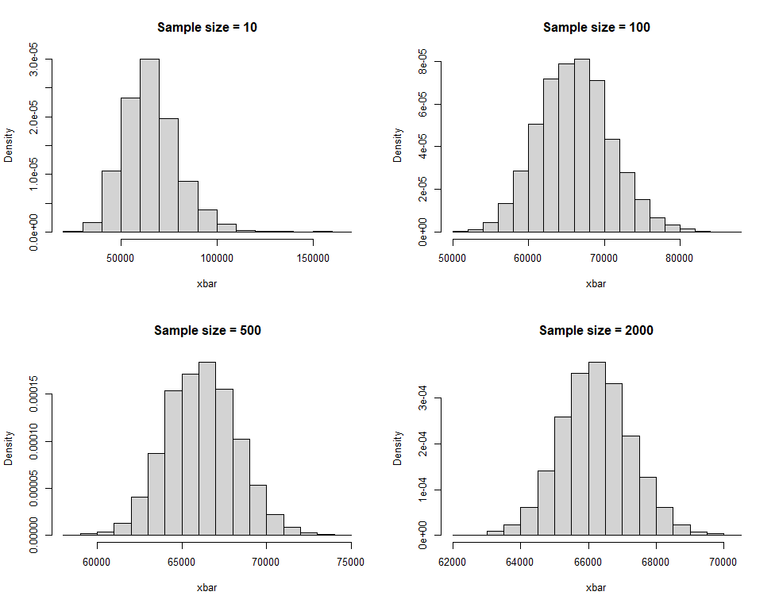
Central Limit Theorem:CDC_km
5000 samples for each
Sample size: 10, 100, 500, 2000
Close to normal distribution
means are almost identical
When sample size increase, standard deviation decrease

Slide 17
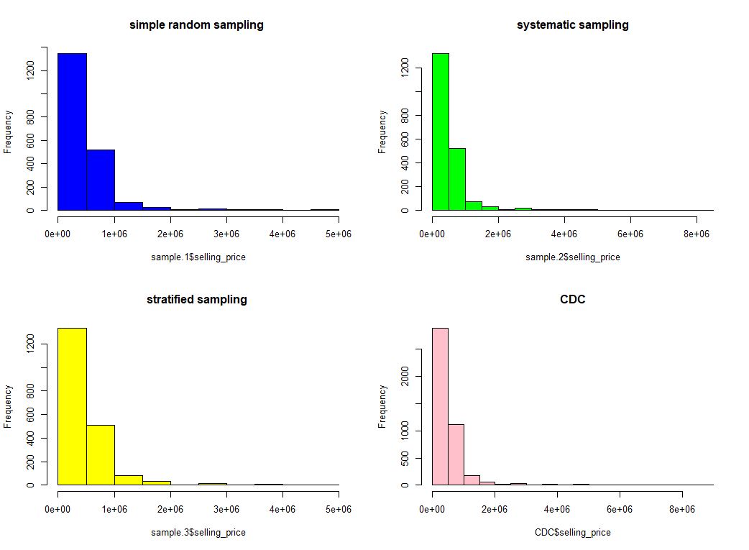
various sampling methods
Simple random sampling
Systematic sampling
Stratified sample
Results are similar
 | mean | sd
srs | 485946.7 | 517834.6
Sys_sampling | 514280.9 | 614281.6
Stra_ sample | 498014.9 | 541120.1
origin | 504127.3 | 578548.7

Slide 18
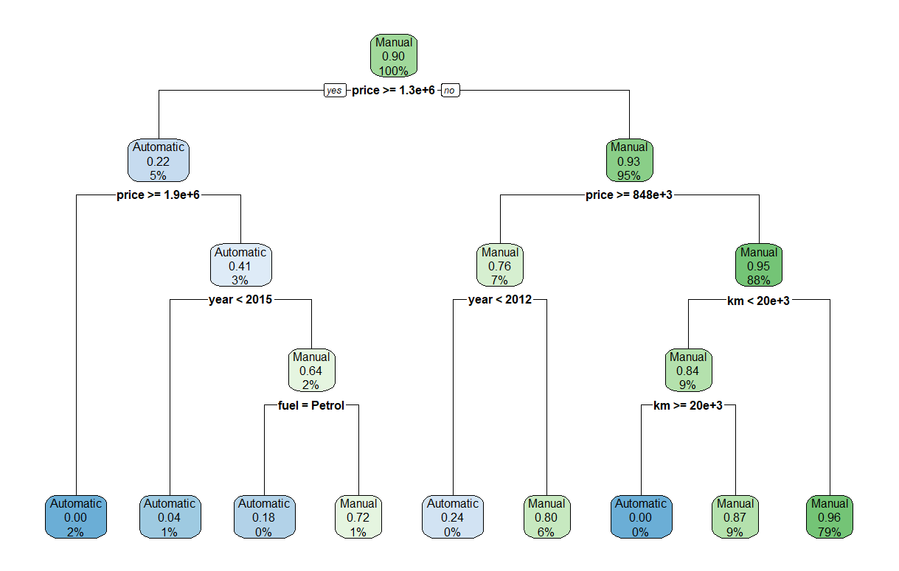
Extra work: decision tree
Reform the data
Resample the data into training dataset and test dataset
Train the model by rpart()
Test the model on test dataset by predict()
Output confusion matrix
Calculate accuracy

Slide 19
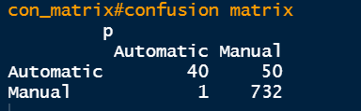

Extra work: decision tree
Confusion matrix
Accuracy

