Slide 1


CS 677 Project
Junyu Mou

Slide 2


Research Scenario
Covid-19 pandemic
Case distribution and death rate
Developed country and developing countries
Exploratory data analysis
Apply Machine learning algorithms

Slide 3
About the dataset
Covid-19 Dataset
10 features 255 values each
Country names, ISO code, population: for each country, continent name, total cases, total death, total cases and deaths per 1 M population, death rate

Slide 4
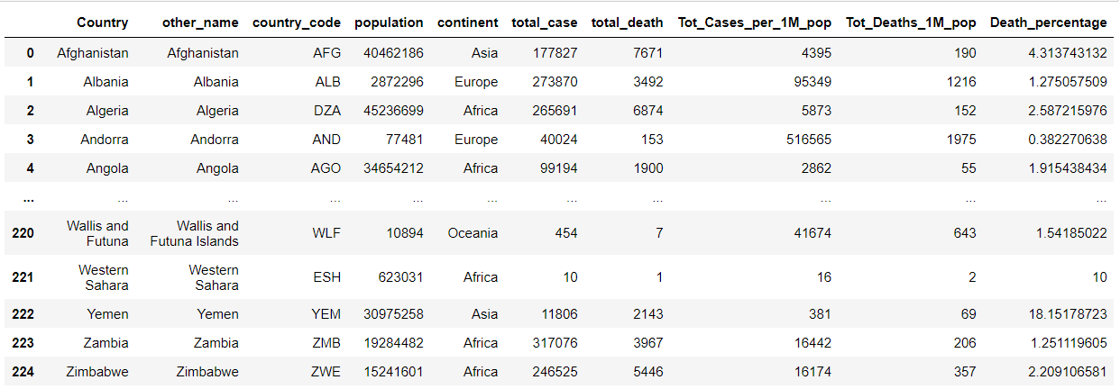
First step
Import data
Modify data type
Removing missing values
Normalization for machine learning

Slide 5
Data analysis
Questions:
The world’s total cases distribution
The world’s total death distribution
The world’s death rate distribution
Total cases comparison among continent
Total death comparison among continent
Data distribution for countries

Slide 6
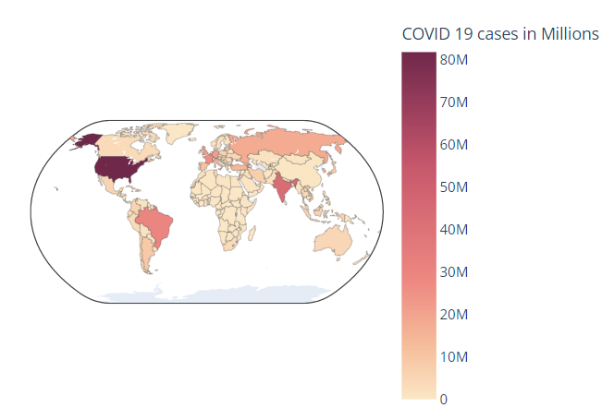
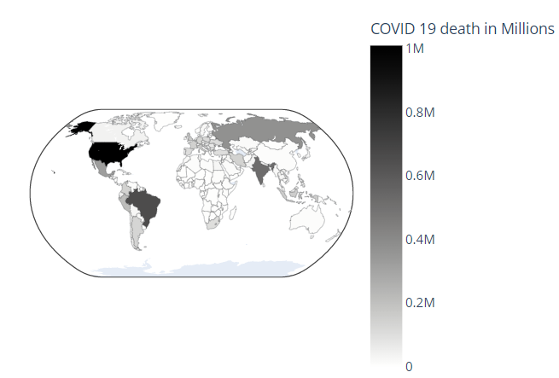
Total cases and deaths distribution
Total cases
Total deaths

Slide 7
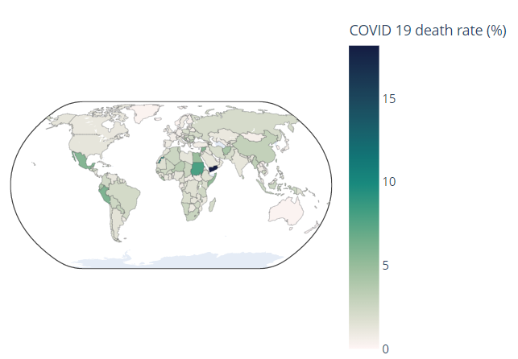
World death rate
Yemen and Sudan has the highest death rate
Most cases doesn’t mean highest death rate
More cases means more death in general

Slide 8
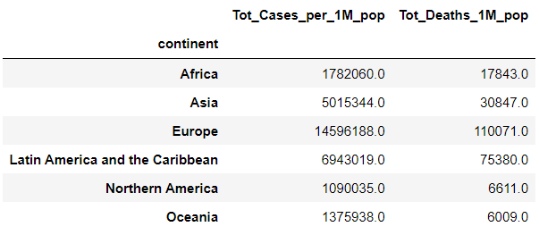
Average cases and deaths by continents
The average cases and deaths based on population
Europe has most cases and deaths, then Latin America and the Caribbean
North America has least cases, Oceania has least death

Slide 9
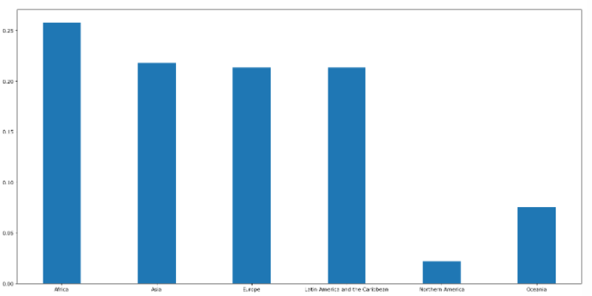
Sample distribution
Histogram for countries in each continent
Number of countries is not balance
If the average base is number of countries the result will be biased

Slide 10
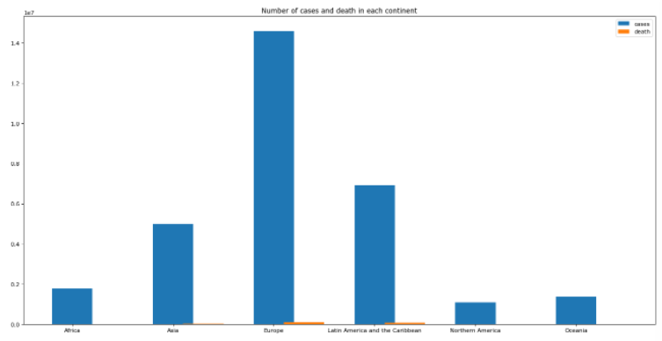
Total cases and deaths

Slide 11
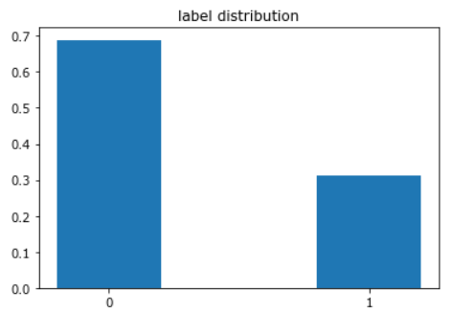
Developed and developing countries
Assumption:
Manually assign labels for developed countries and developing countries
use population, total case, and total death to predict the label
Reference: www.un.org/en/development/desa/policy/wesp/wesp_current/2014wesp_country_classification.pdf

Slide 12
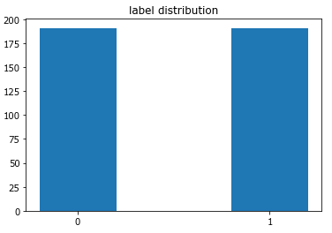
Oversampling
The original data is significantly imbalanced
The dataset is small: oversampling
Minority and majority class have equal number of labels after resample
Use new dataset for machine learning

Slide 13
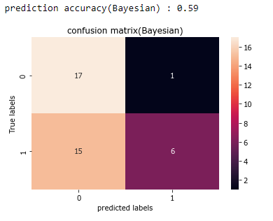
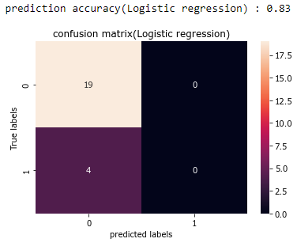
Machine learning
Naive Bayesian
Logistic regression

Slide 14
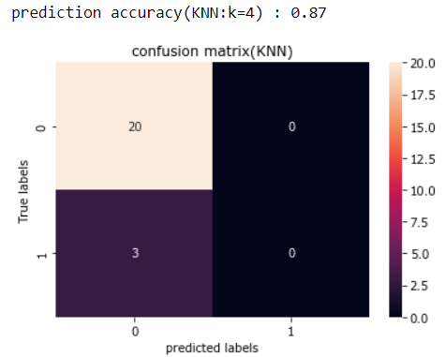
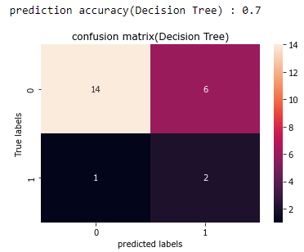
Machine learning
KNN
Decision Tree

Slide 15
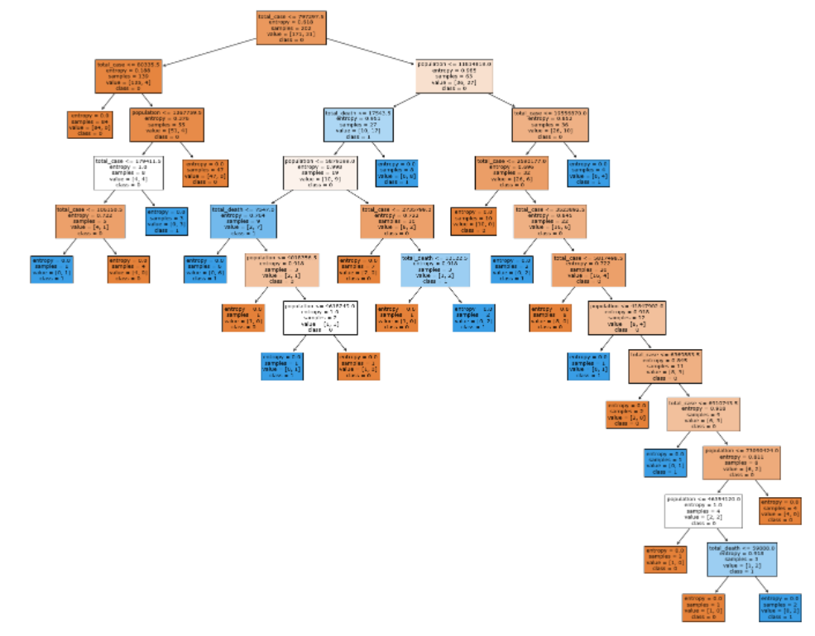
Tree graph

Slide 16
Prediction
With best classifier: KNN k = 4
There is a country
Population: 25653599
Total cases: 250000
Total death: 5000
The country is: developing country

