Slide 1

Russian letters classification
Junyu Mou

Slide 2
The project is to classify handwriting Russian letters with a CNN model. There are three essential goals for this project: Use the CNN model to classify images; Optimizing the model to achieve good accuracy without overfitting
- Project description

Slide 3
Requirements
The model should recognize 32 x 32 x 3 pictures
The accuracy should be at least 60%
At least two sets up designs should be applied
The accuracy is desired to be over 90% without over fitting

Slide 4
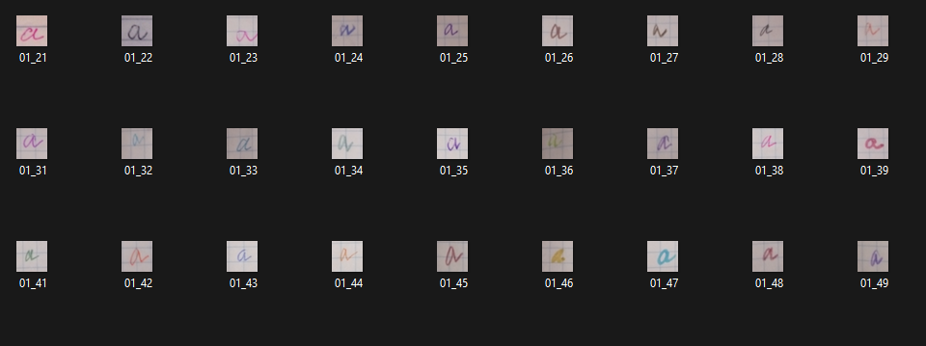
Describe the data
14190 PNG images handwriting of 33 Russian letters in Cyrillic.

Slide 5
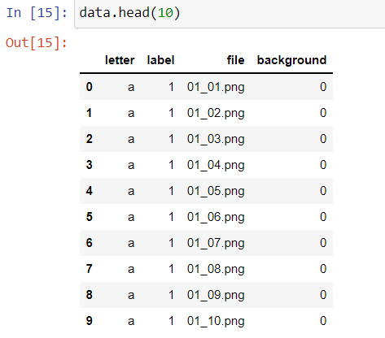
Describe the data
Separate .csv file contain all information: letter, label, file name and background

Slide 6
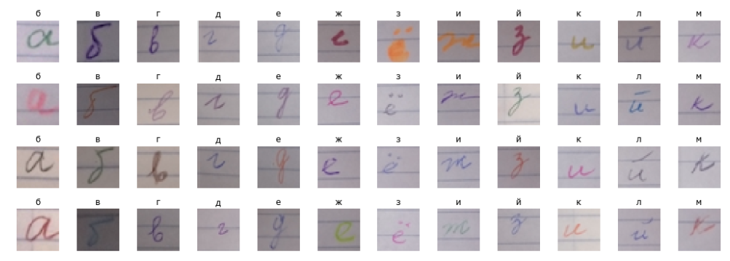
Data visualization and plots
I plot some of letters with 4 samples each. There are 12 out of 33 letters as example. For each letter, the handwriting are in different colors, style and back grounds.

Slide 7
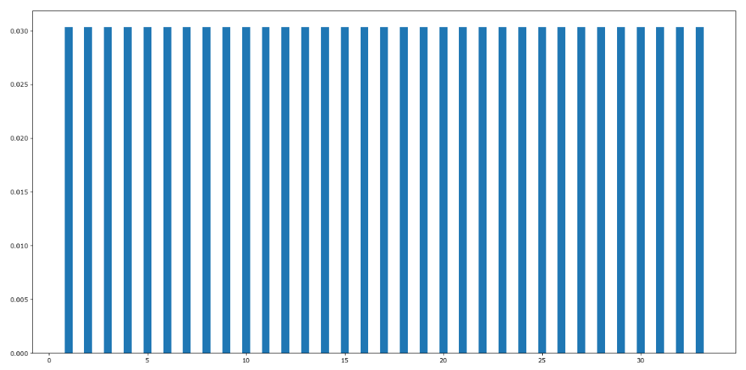
Class distribution

Slide 8
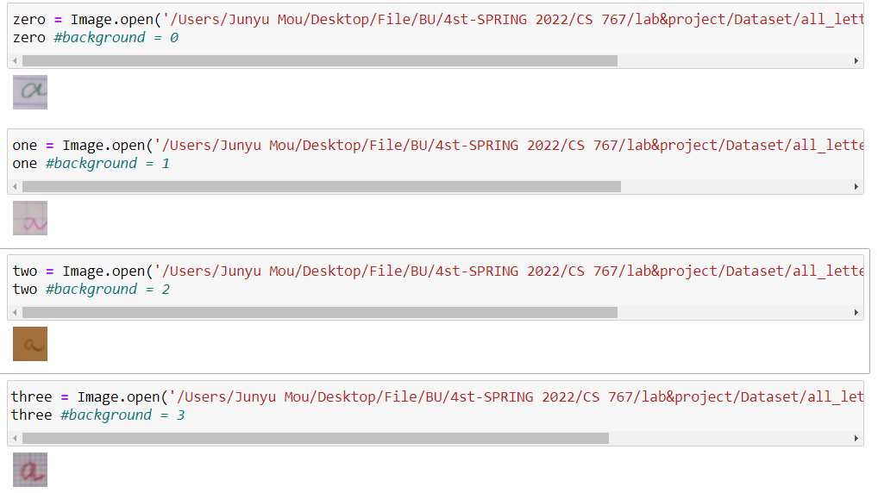
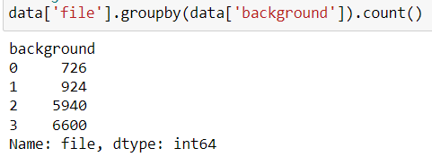
Data visualization and plots

Slide 9
Preprocessing
Import dataset by keras.preprocessing.image.load_img()
Convert images to array by keras.preprocessing.image_to_array()
Min- Max Normalization
Encode the class by one-hot encoding
The dimension for training (14190, 32, 32, 3)
The dimension for label (14190, 33)
Split data: 70% training 30% testing

Slide 10
The initial model
Image Augmentation
6 Conv2D layers [16, 32, 32, 64, 64, 128] with 3x3 knernel_size
Two fully connected Dense layers, two for [256,128] and one output layer with SoftMax
MaxPooling2D layers after every two Conv2D layers
Batch Normalization layers
Dropout layers
Activation: ReLU
Power scheduling decay = 1e-3

Slide 11
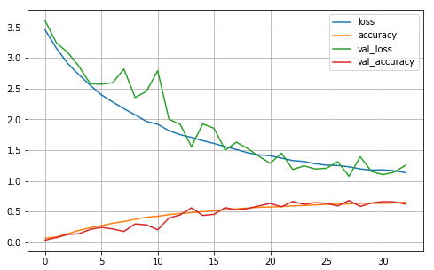
Result for initial model
Training accuracy: 65%
Testing accuracy: 65.5%
No sign of overfitting
Basic requirements fulfilled
Further try to improve the model

Slide 12
Different designs
Design | Train | Test | Description
No batch normalization and drop out | 3.3% | 2.5% | The training is fast, only take 7 steps before stop with EarlyStopping patient = 5. The model failed.
No ImageAugmentation | 97.9% | 92.8% | 3s for each step. It takes 23 steps before stopping.
Sigmoid, SGD | 3.2% | 3.1% | 48 steps before stop. The model failed.
Sigmoid, Adam | 95.5% | 79.2% | 38 steps before stop, while the val_loss is going apart from loss, the model is overfitted.
ELU,Adam | 99.0% | 92.4% | 25 steps before stop

Slide 13
Different designs
Designs | Train | Test | Description
ReLU,Adam,power scheduling,Glorot Initialization | 97.9% | 90.4% | 17 steps before stop
ReLU,Adam,power scheduling,He Initialization | 97.0% | 91.9% | 17 steps before stop, no sign of overfitting
ReLU,Adam,exponential scheduling, He Initialization | 99.6% | 95.7% | 57 epochs, no sign of overfitting
ReLU,Adam,performance scheduling, He Initialization | 99.9% | 95.5% | 77 epochs, no sign of overfitting
ReLU,Adam,exponential scheduling | 99.5% | 94.9% | 36 steps before stop, no sign of over fitting

Slide 14
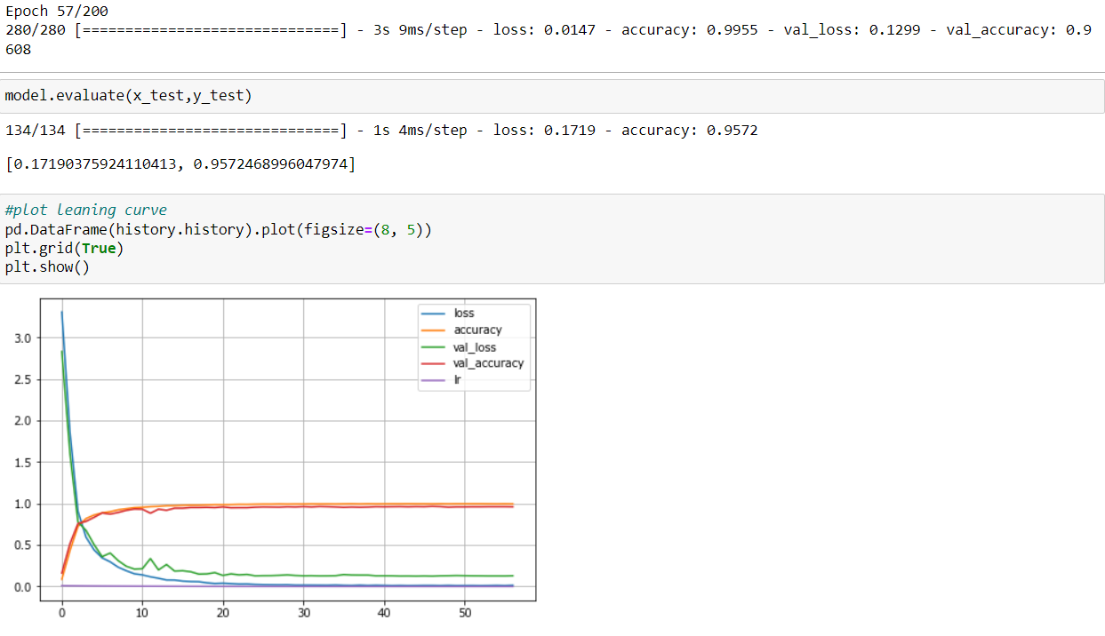
Final Model
High Accuracy for both train and test. No sign of overfitting.

Slide 15
Discussion
Batch Normalization and Drop out
Why image augmentation make decrease the accuracy?
Overfitting: reason and cure
Loss function

