Slide 1

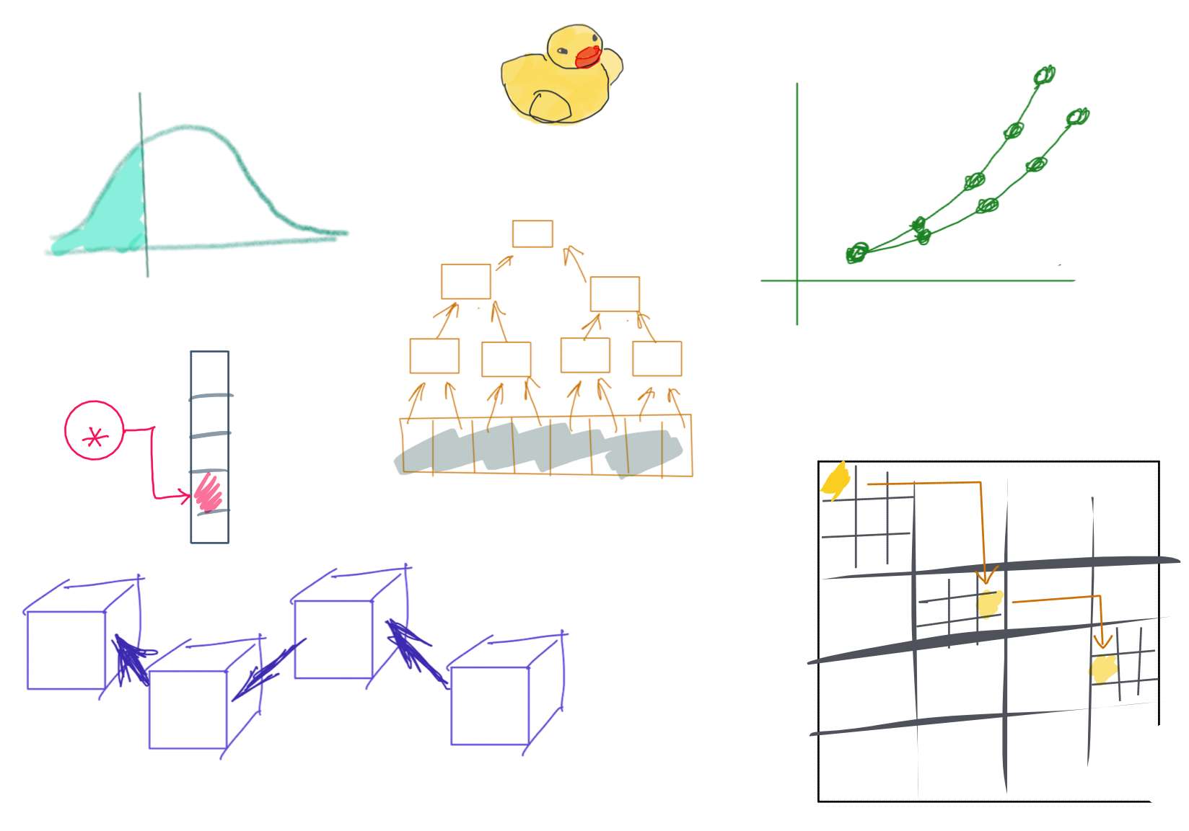

Slide 2
CSS342 Data Structures, Algorithms, and Discrete Mathematics (I)

Slide 3
Where are we at now?
ADT (array vs list)
One-dimensional ADT
ArrayList
Stack
LinkedList
Queue
Hash table
Recursion
Search Problem
Sorting
Binary tree
multi-dimensional ADT

Slide 4
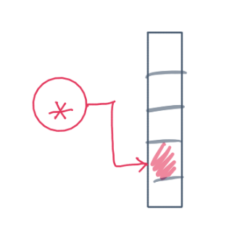
^{6th} Week Schedule
Homework 3 Review (Wed)
ADT hashtable (Wed)
Midterm review (Wed)
Midterm (Friday, 5:45pm, 1-1.5 hrs)
No lecture after midterm on Friday

