Slide 1
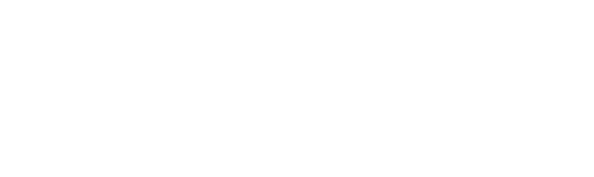
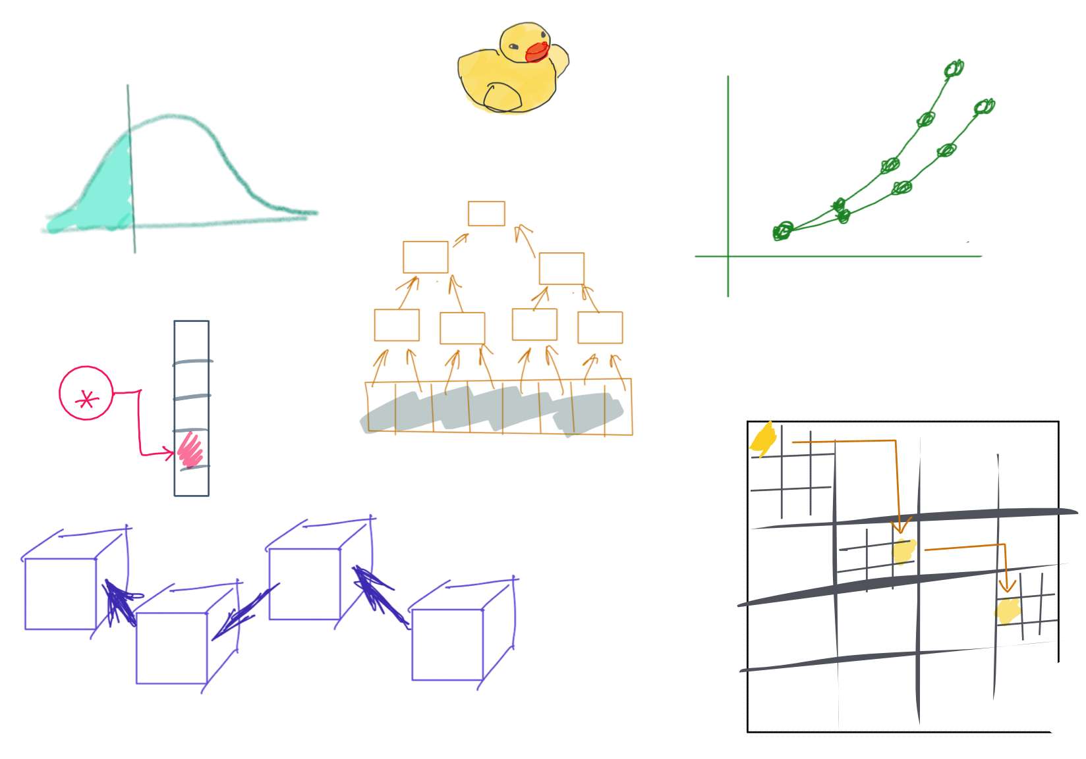

Slide 2
CSS342 Data Structures, Algorithms, and Discrete Mathematics (I)

Slide 3
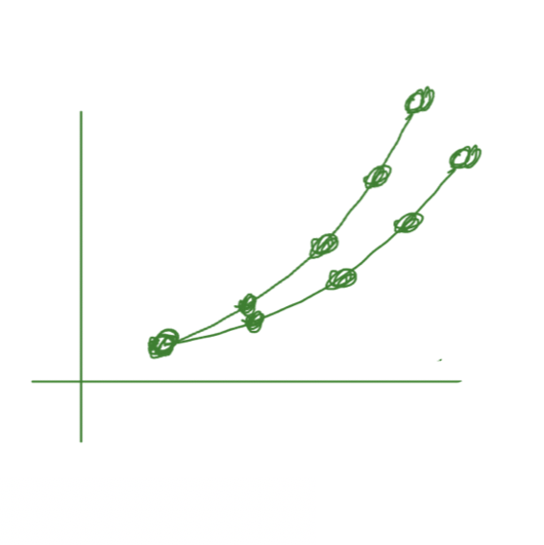
^{4th} Week Schedules
Quiz-1 review (Wed)
Homework 2 Q/A (Wed)
Common submission mistake from homework 1
New bot check for added files
Use test as manual
C++
Template class
Linux Platform(Wed)
Makefile, CMake
Debug memory leak
Using AWS virtual machine (get an account, free)
Learn VIM basics
Quiz-2 next Thursday (4/22, same format as before)

Slide 4
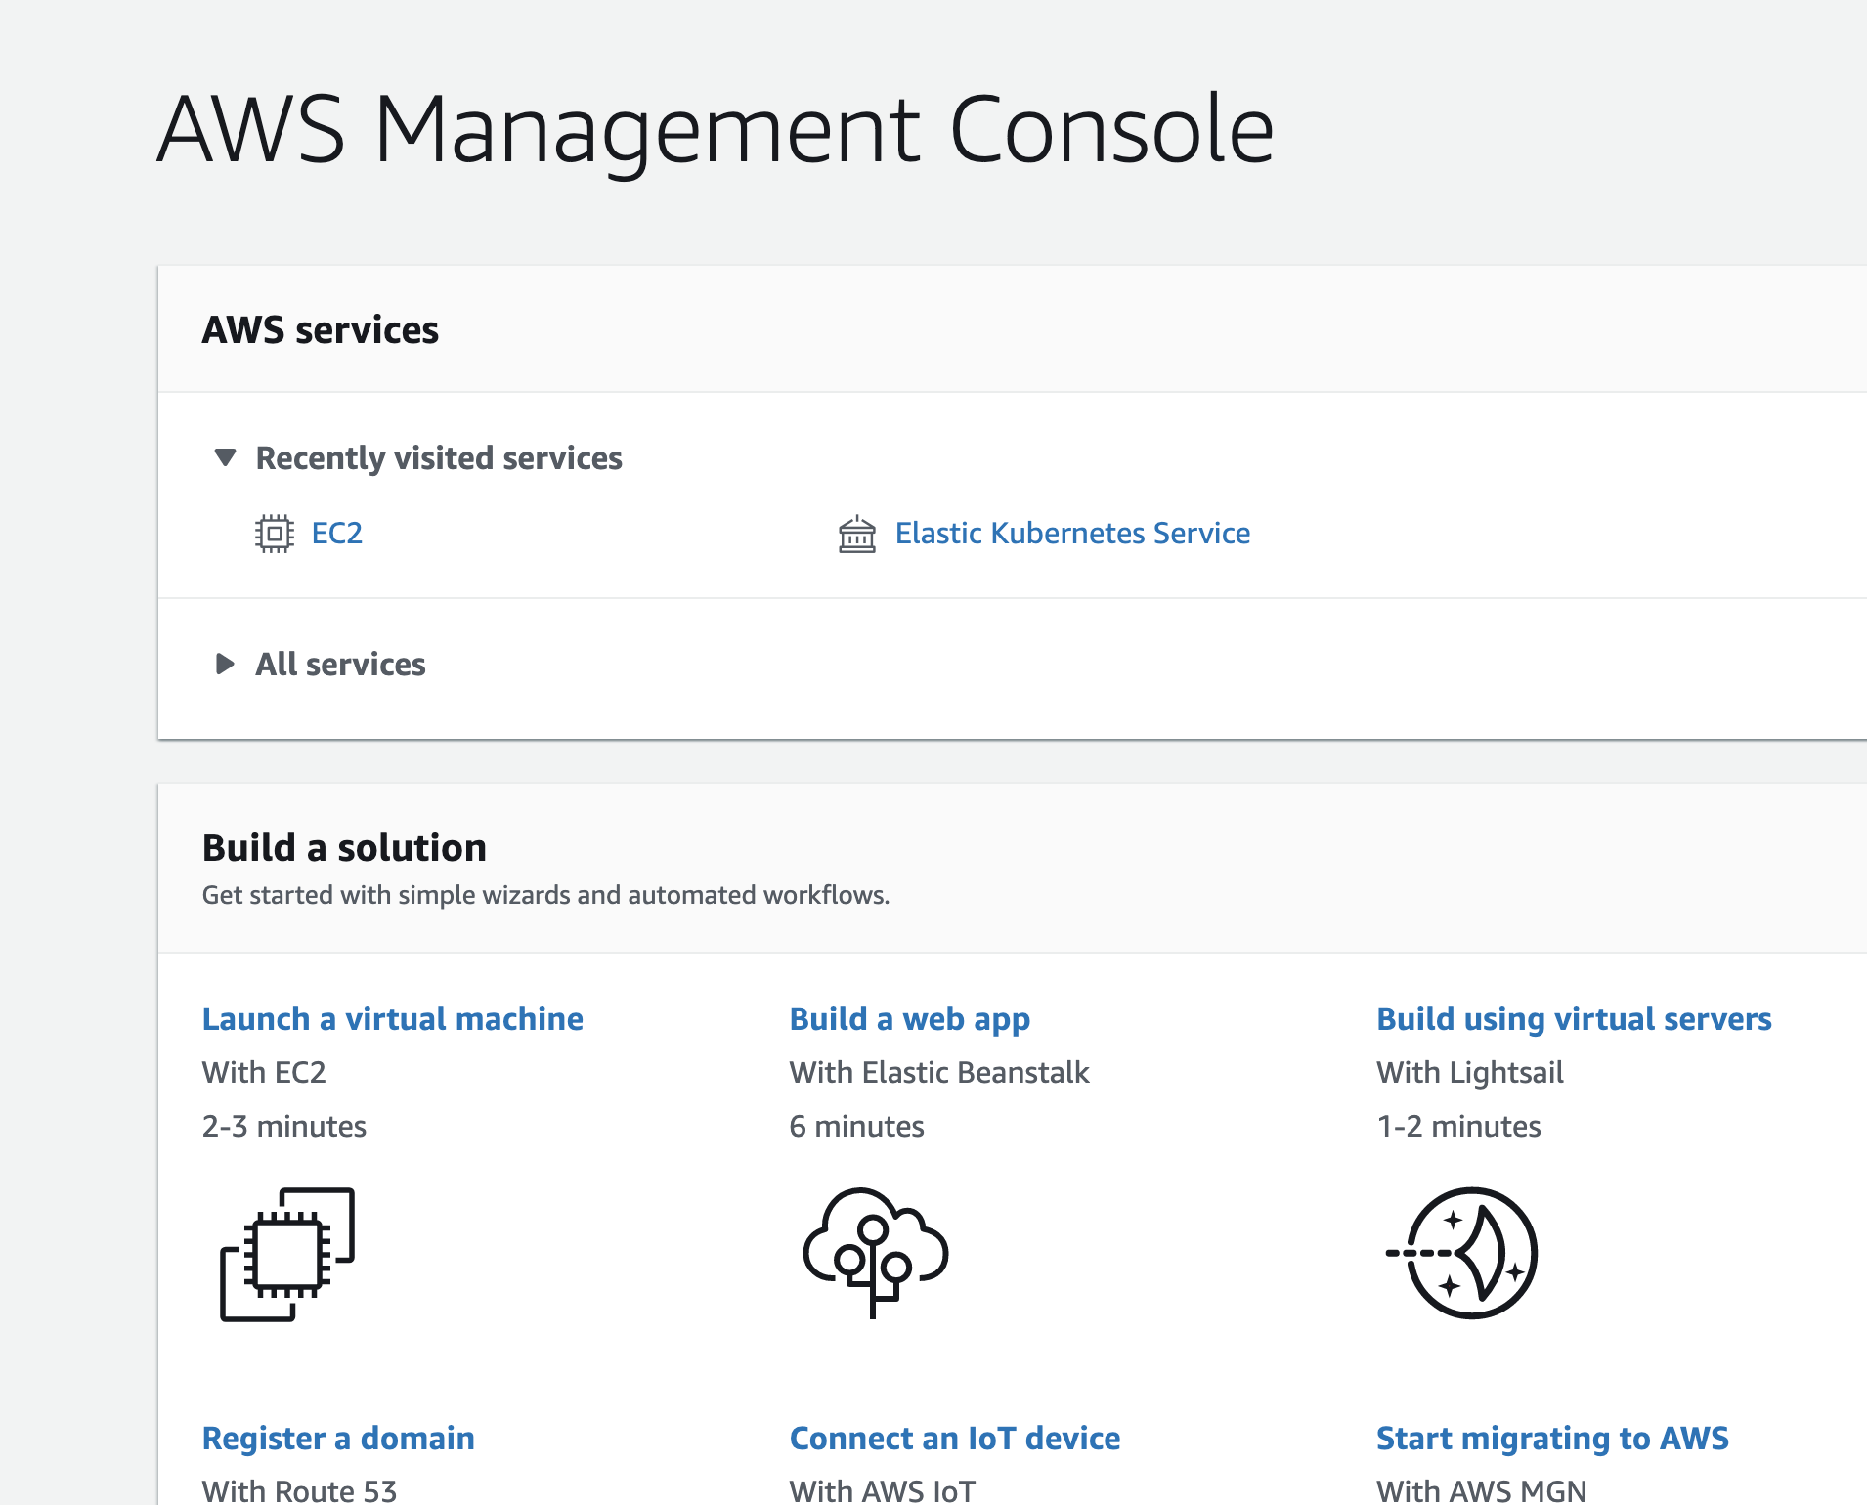
Virtual machine
Detailed guide here

Slide 5
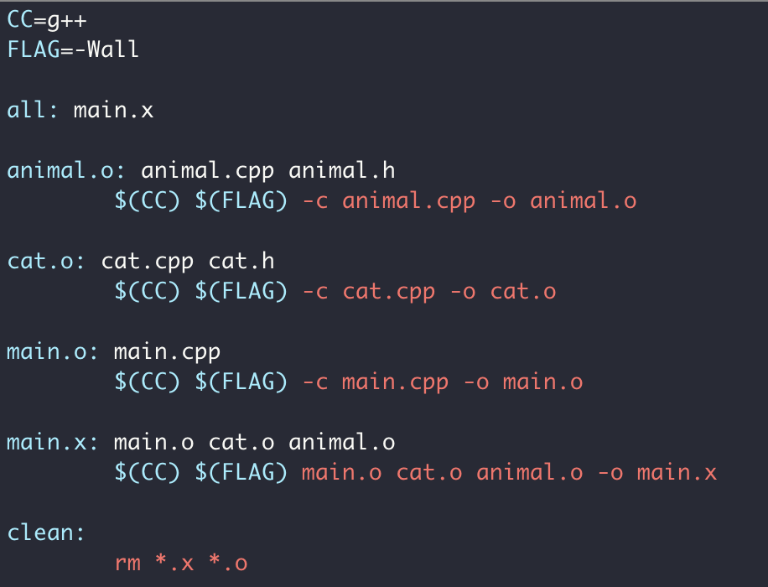
Makefile

Slide 6
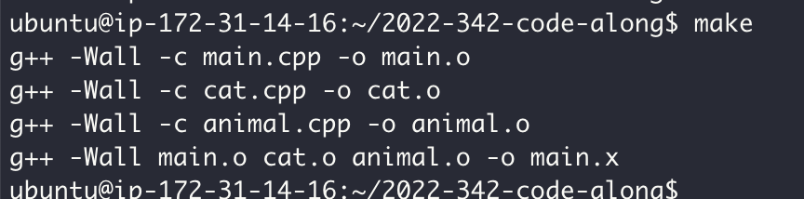
Makefile

Slide 7
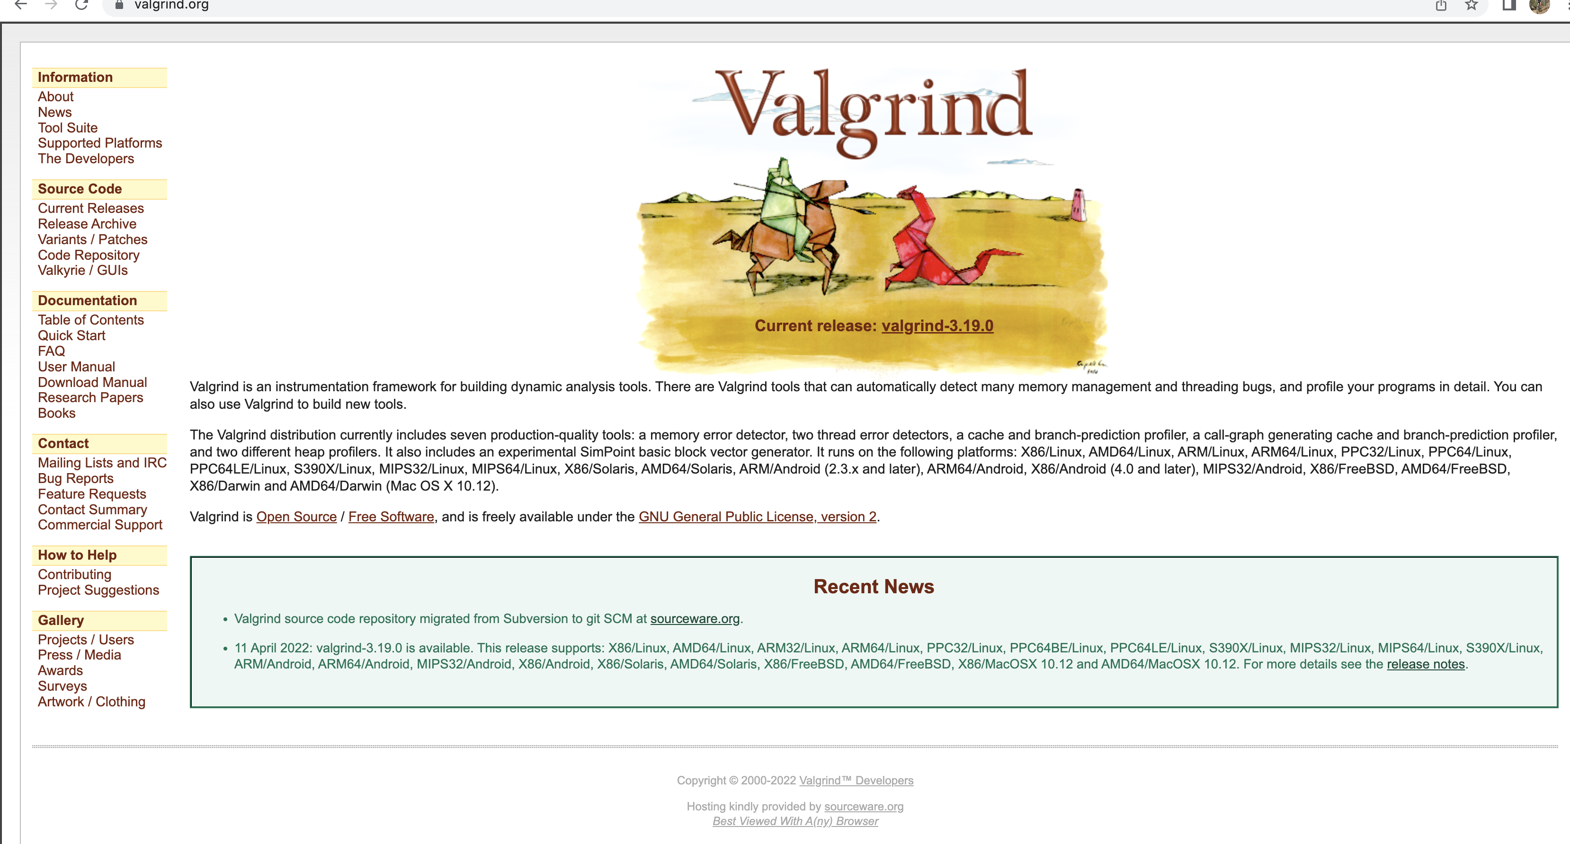
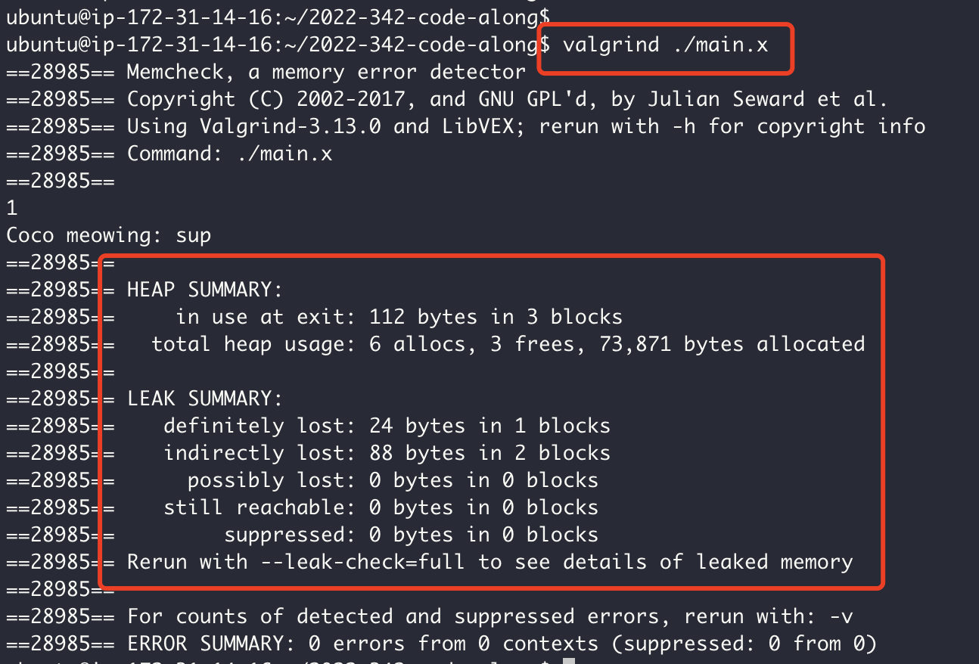
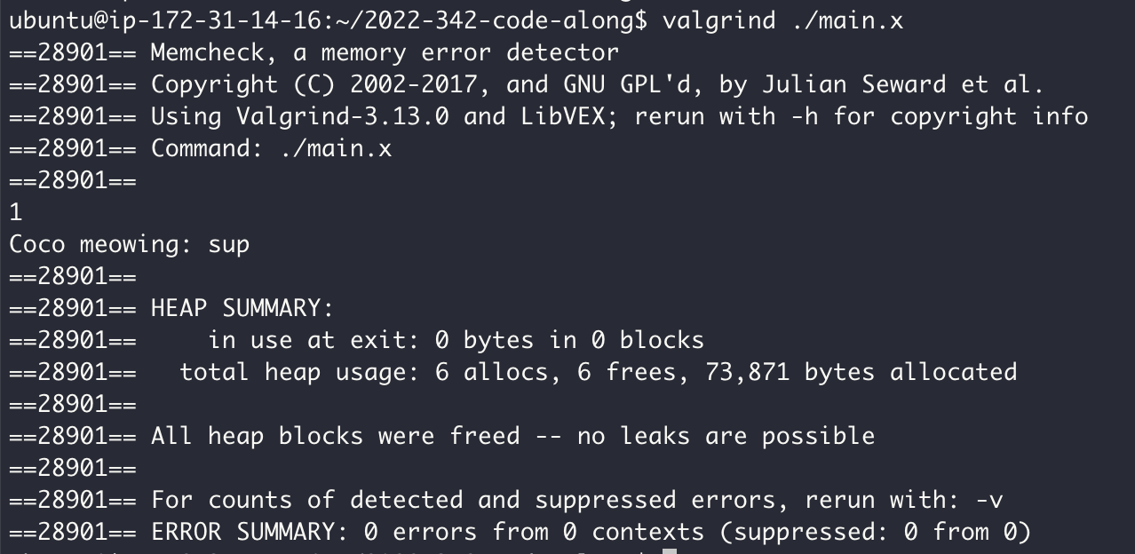
Memory Checker

Slide 8
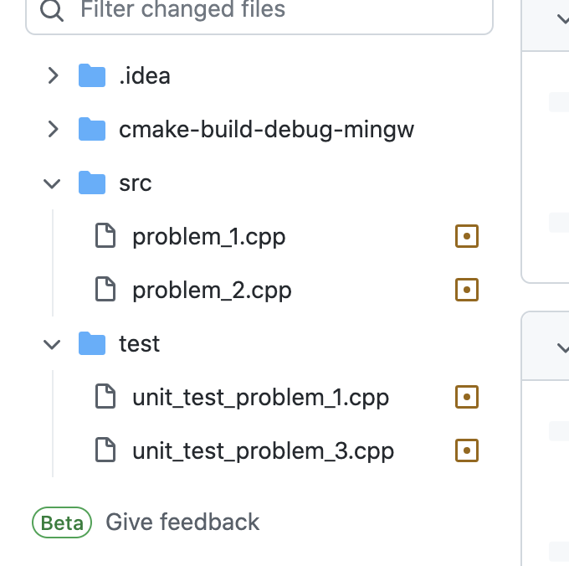
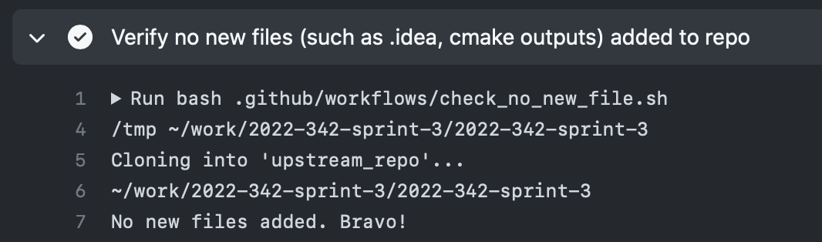
Homework 1
New bot!

Slide 9
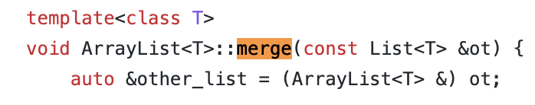
Homework 2

