Slide 1

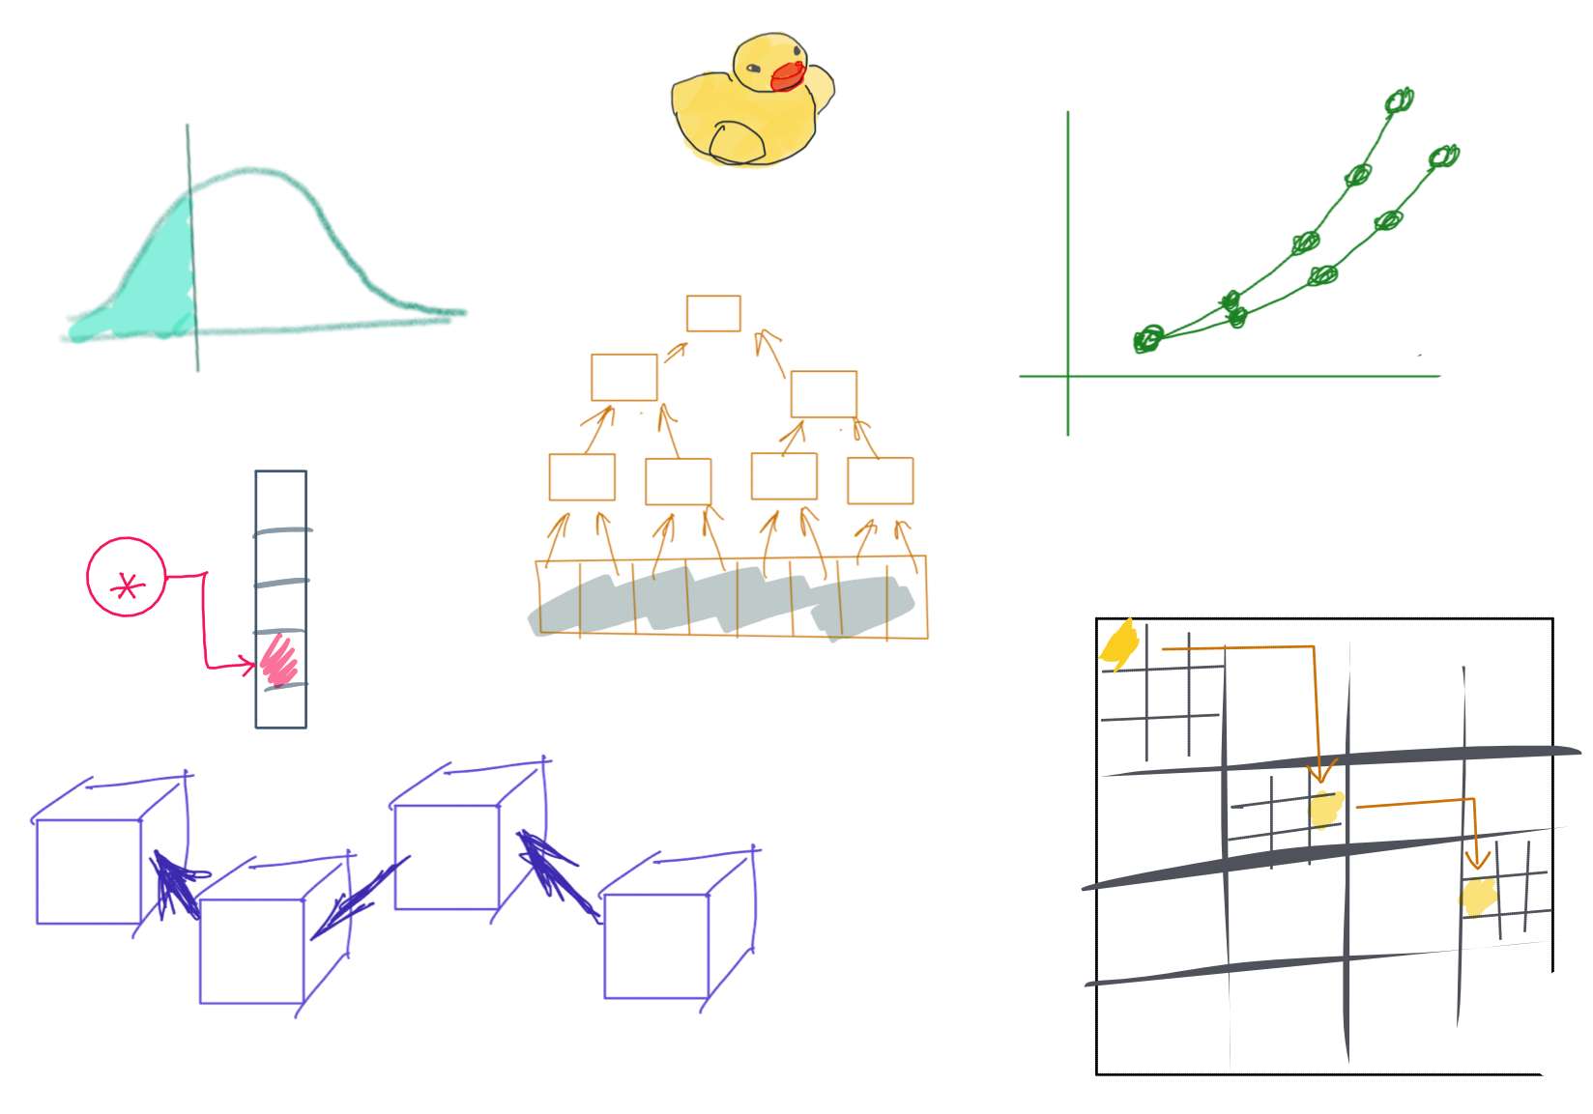

Slide 2
CSS342 Data Structures, Algorithms, and Discrete Mathematics (I)

Slide 3
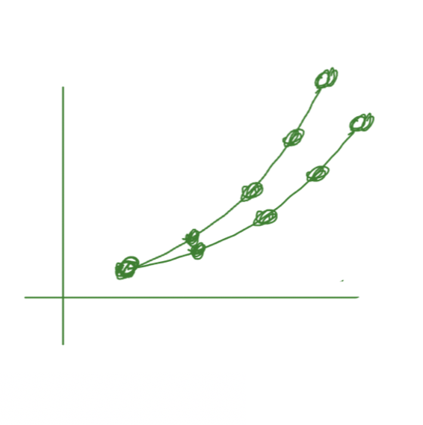
^{4th} Week Schedules
Quiz-1 review (Wed)
Homework 2 Q/A (Wed)
Common submission mistake from homework 1
New bot check for added files
Use test as manual
C++
Template class
Linux Platform(Wed)
Makefile, CMake
Debug memory leak
Using AWS virtual machine (get an account, free)
Learn VIM basics
Quiz-2 next Thursday (4/28, same format as before)

Slide 4
Where are we at now?
ADT (array vs list)
One-dimensional ADT
Stack
Single linked list
Queue
Hash table
Recursion
Search Problem
Sorting
Binary tree
multi-dimensional ADT

Slide 5

Linux
How to compile and run C++ code
Without IDE (CLion)
How to run memory checker (used by Github Bot)
Linux Basics

Slide 6
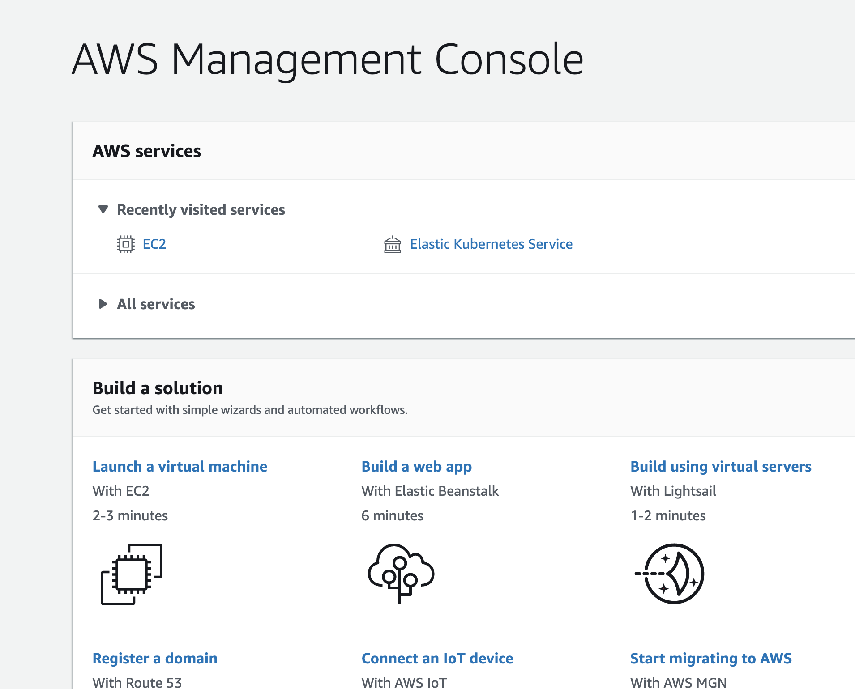
Virtual machine
Detailed guide here
If you use Windows, watch this too

Slide 7

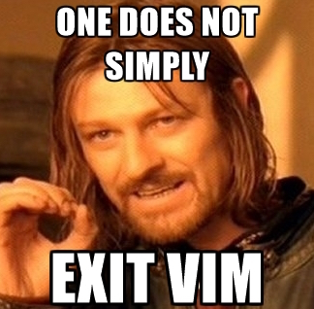
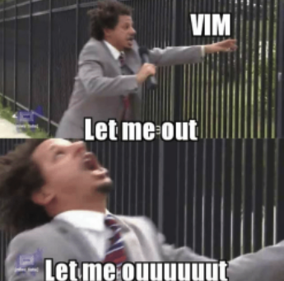
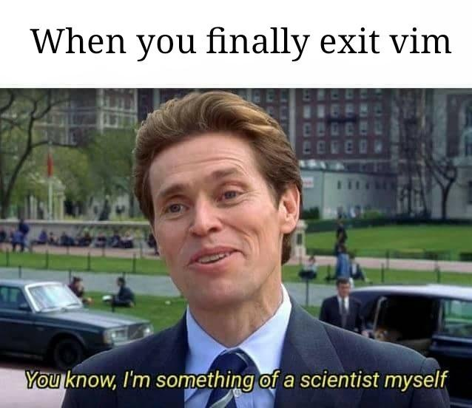
Editor on Linux

Slide 8
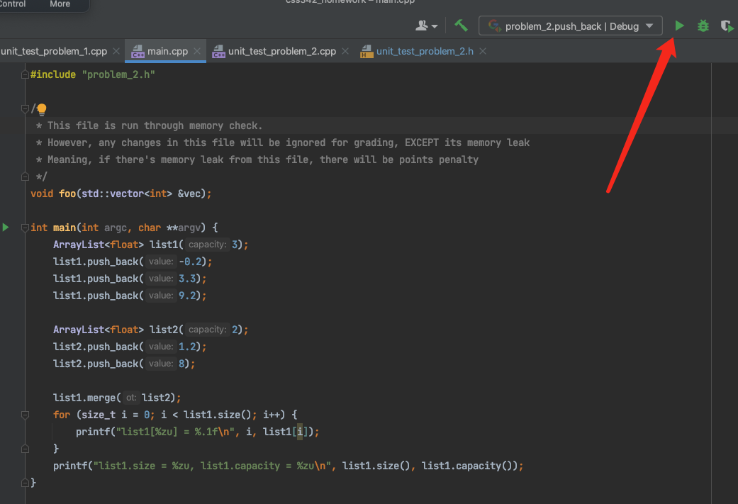
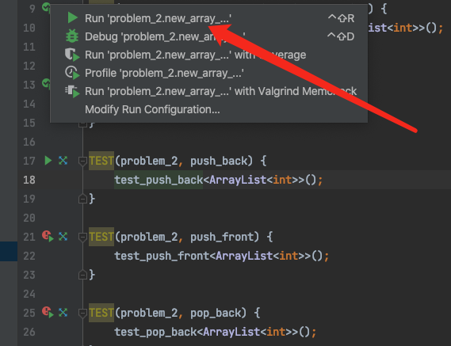
Code -> Binary
What happens when you click

Slide 9
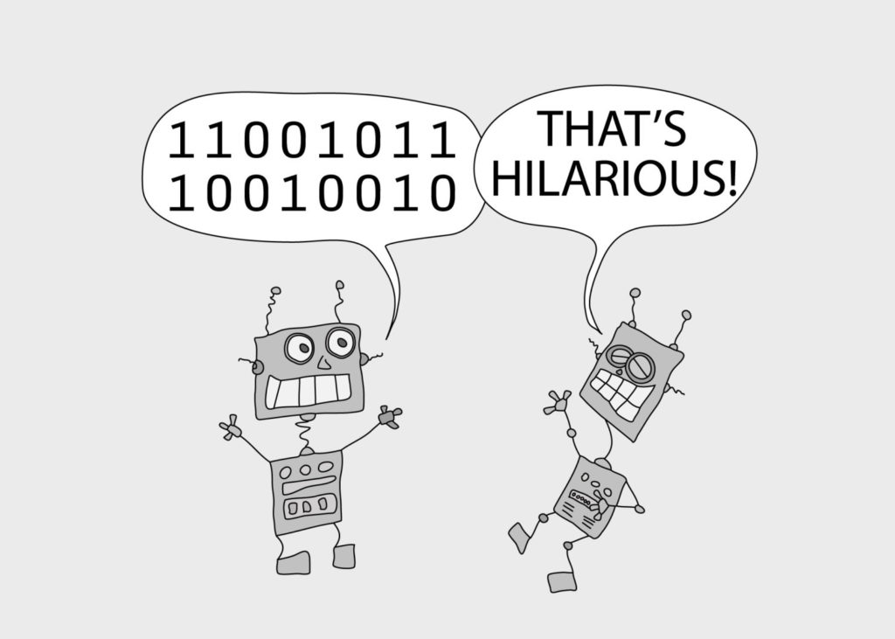
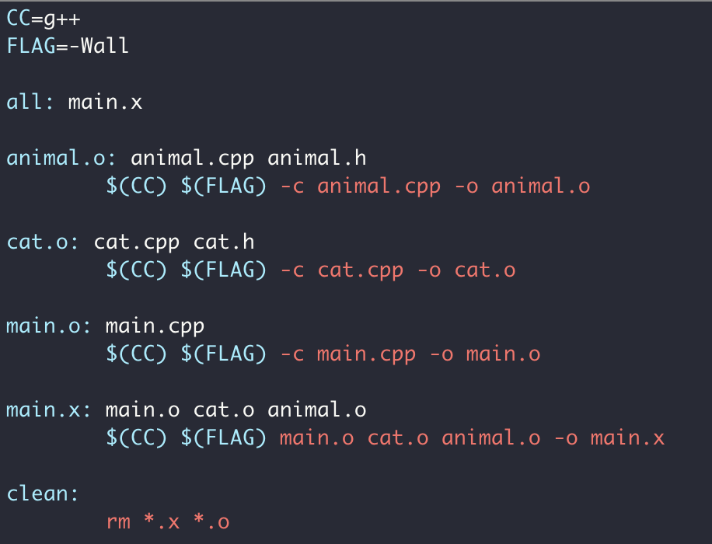
Makefile

Slide 10
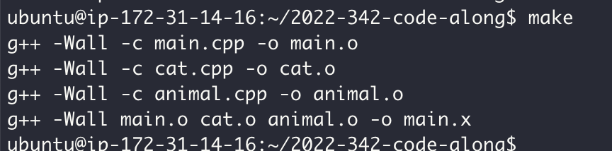
Makefile

Slide 11
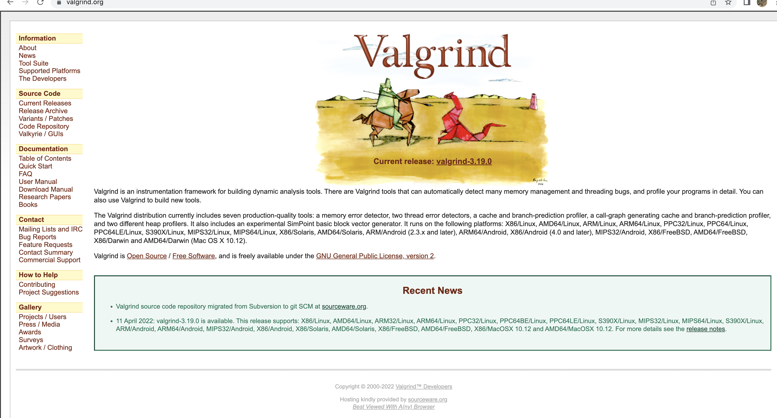
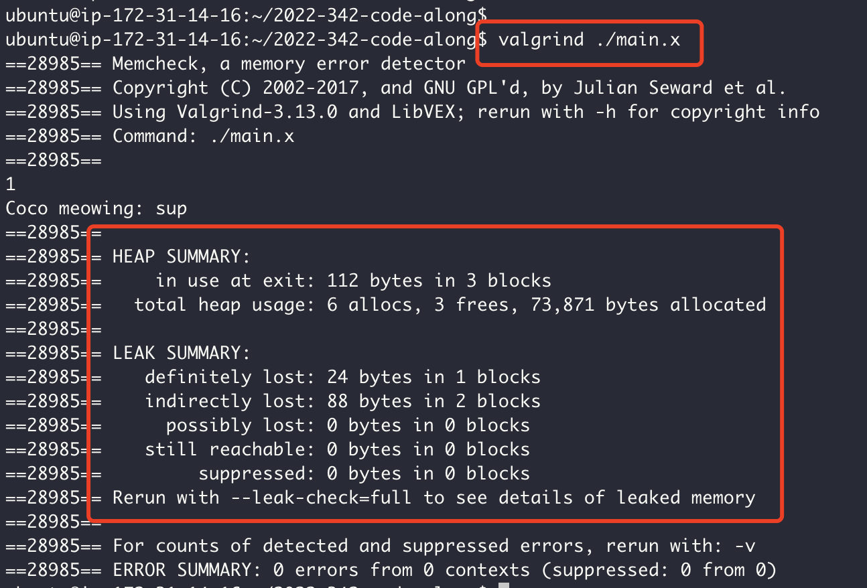
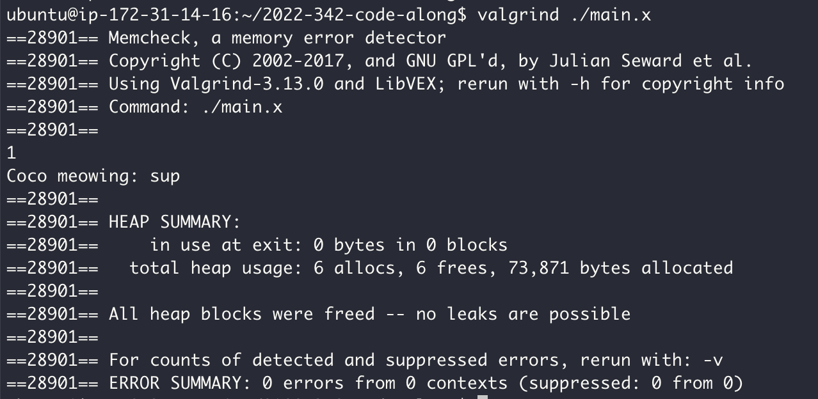
Memory Checker

Slide 12
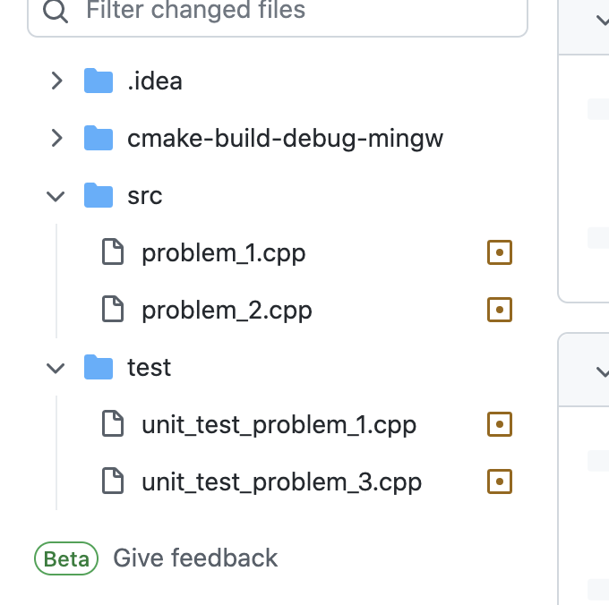
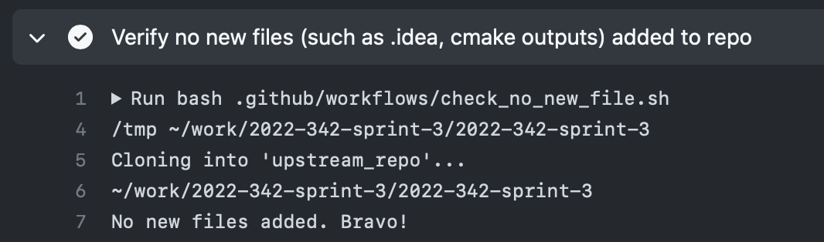
Homework 1
New bot!

Slide 13
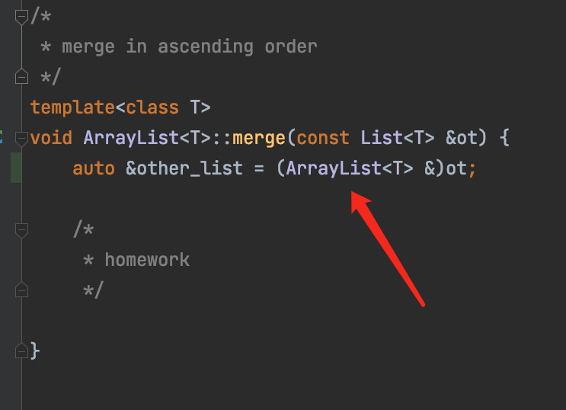
Homework 2
More discussion here

