Slide 1

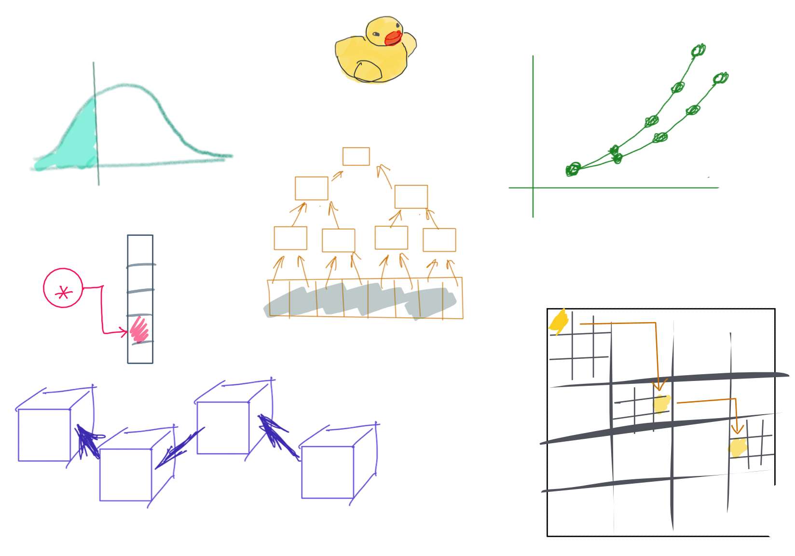

Slide 2
CSS342 Data Structures, Algorithms, and Discrete Mathematics (I)

Slide 3
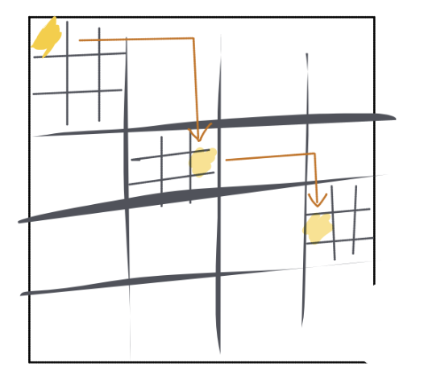
^{8th} Week Schedule
Midterm Review (Wed)
Homework 4 review (Wed)
Recursion practice
Quiz – 3, due next week
Percentile, Tree ADT (Friday)
Homework 5 to go live on Friday

Slide 4

Study Right

Slide 5

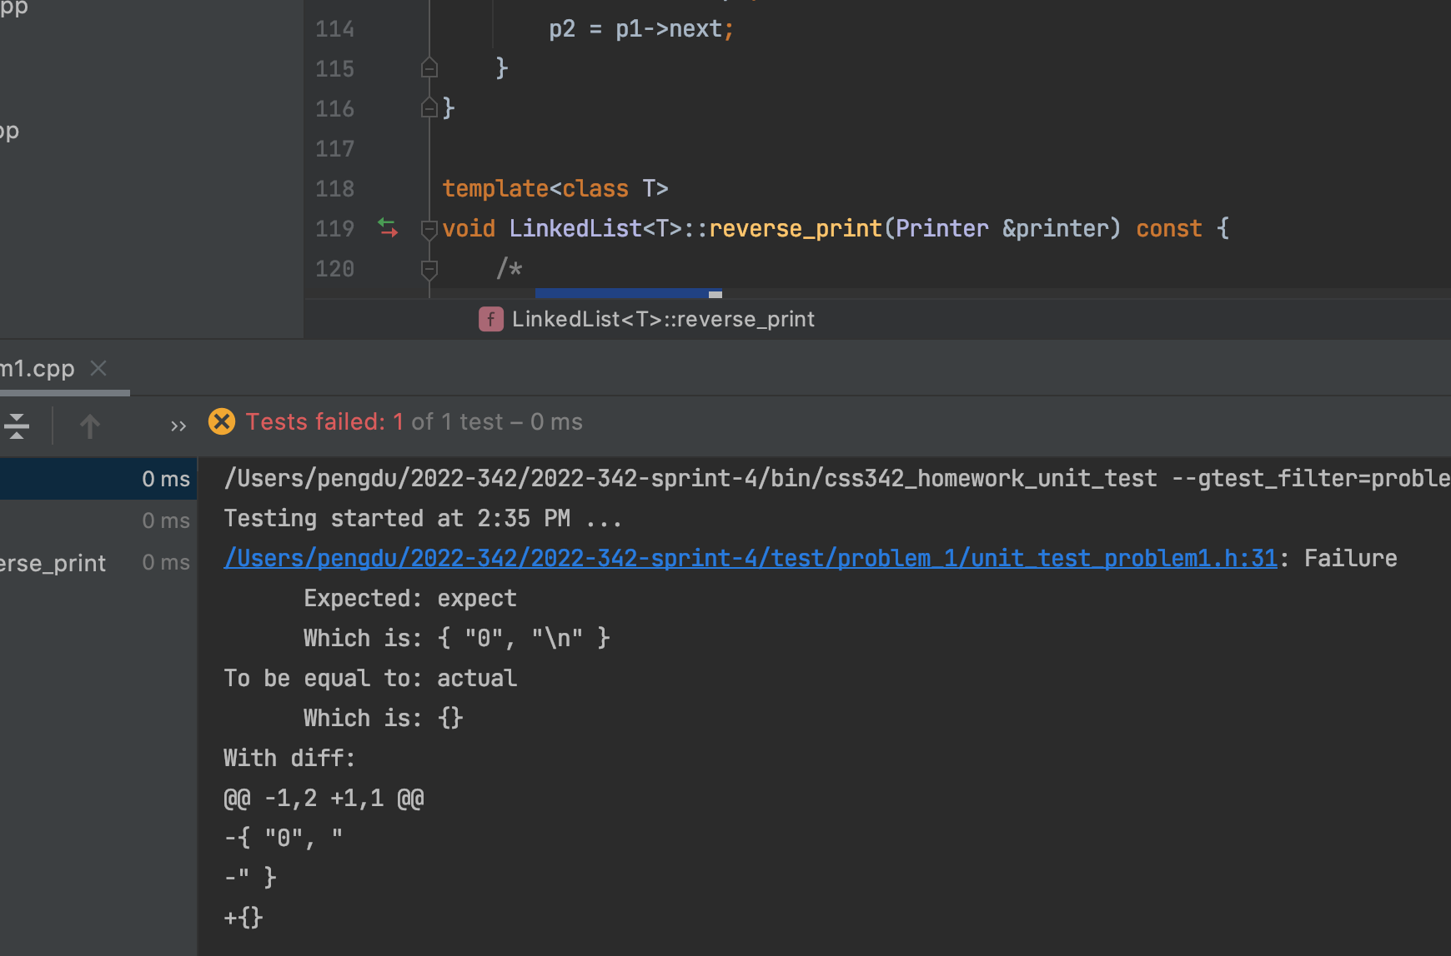
Ask The Right Question
“Professor. My test is failing. What’s wrong?”

Slide 6
Ask The Right Question
“My code doesn’t work.”
Which test case is failing?
What’s the specific error/failure?
What have your tried?
Breakpoint?
stackoverflow.com?
Google?

Slide 7
Ask the Right Question
“my code is failing with test case # ….
The specific error is …
I have checked … and ….”
Compiler error
Test case log
Code Logic
Debugger (breakpoint, stepping)
Memory issue (Linux)
Just google the damn error message!

Slide 8
Study Priority
Lecture PPT
Homework Code
Your code
Given code, e.g. tests
C++
Textbook
In-lecture demo
Code-along
Example code
Your technical debt items

Slide 9
Study Priority For Exams
C++
Sample Exam
Textbook
Code-along
Homework Code
Your code
Provided solution
Your technical debt items

Slide 10
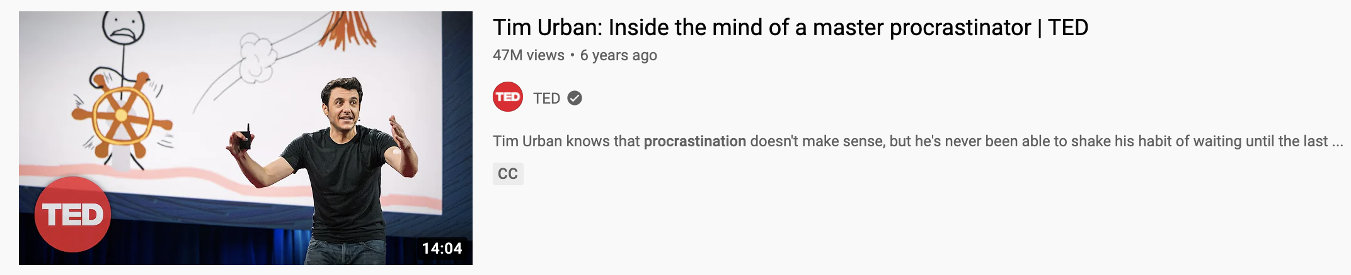
Beat Parkinson’s law
LINK
Have a plan
Have an estimate
Keep track of how long it takes for you to do a homework
Baby steps
Low hanging fruits
Fork, clone, new branch and PR
Compile code
Run tests

Slide 11
The “NOT MY FAULT” mindset
“What will I do differently if I can’t change what others do?”
Self-evaluation feedback loop

Slide 12
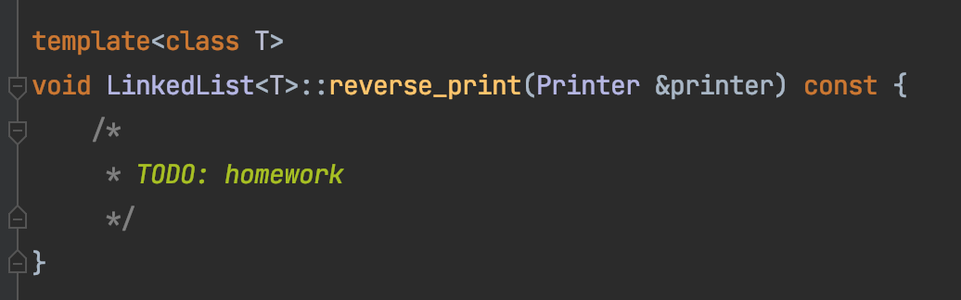
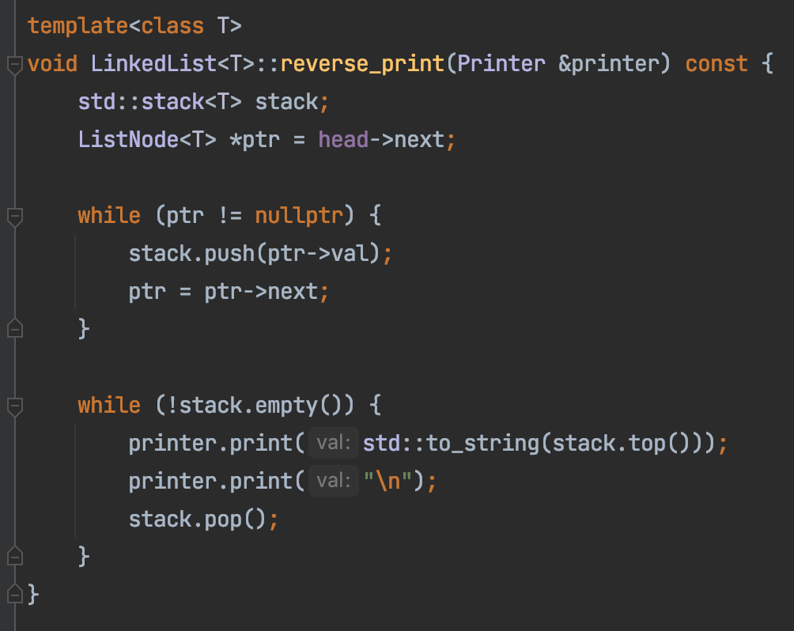
Homework 4 – Task 1
h
1
2
3
4
n
Create a stack
Traverse the list front to end, push each element onto a stack
Loop till the stack is empty,
Pop out every element from the stop
print the element

Slide 13
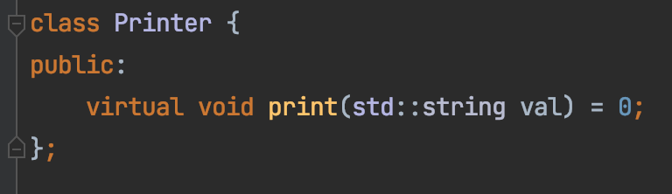
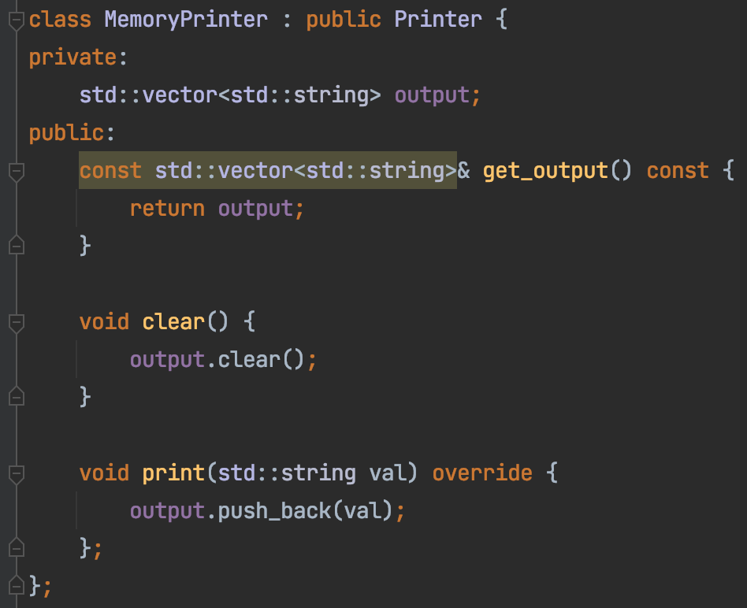

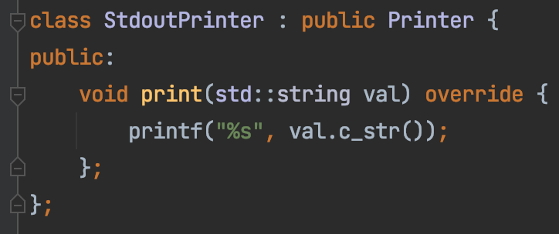
Homework 4 – Task 1
Decouple our code from how print is done
Interface
Implementation – For real use
Implementation – For testing

Slide 14
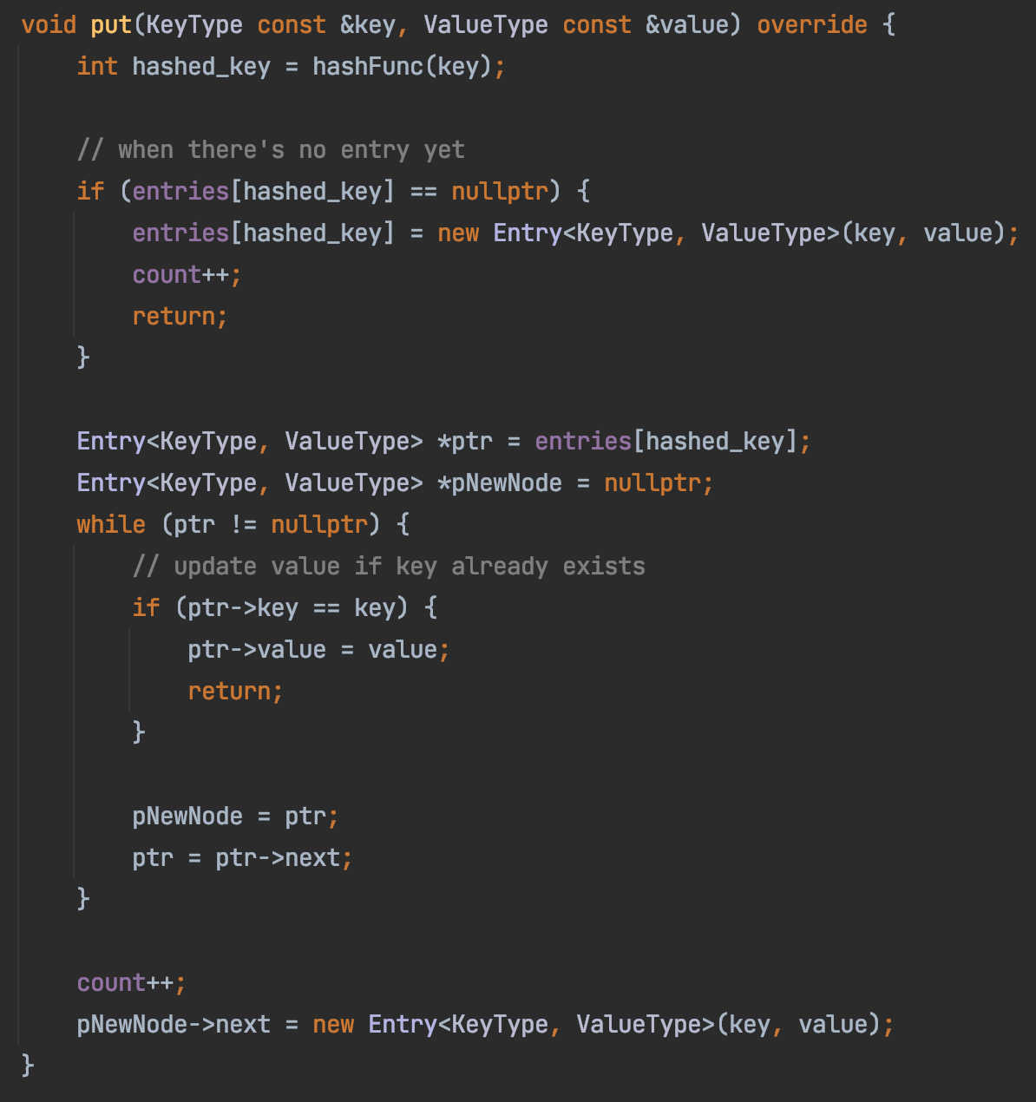
Homework 4
Tom
ArrayMap
Sam
Ron
Alex
Jerry
Joe
Tim
Hank

Slide 15
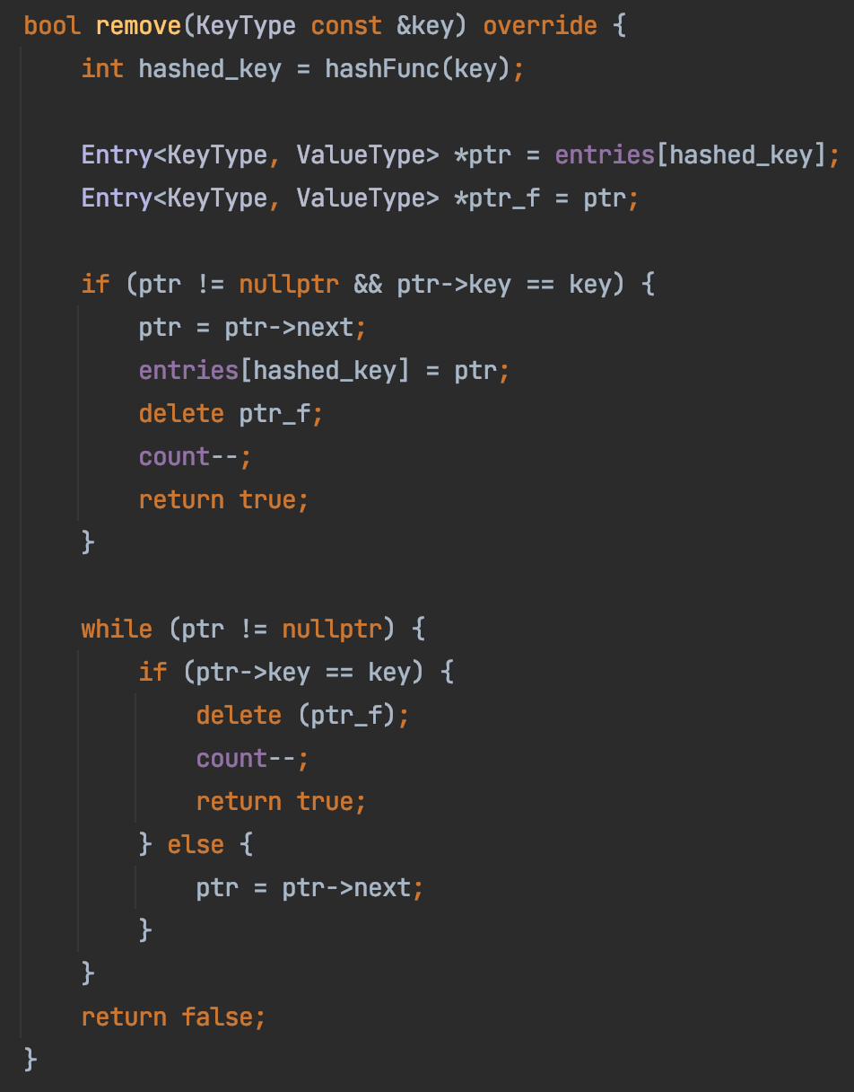
Homework 4
ArrayMap
Sam
Ron
Alex
Jerry
Joe
Tim
Hank

Slide 16
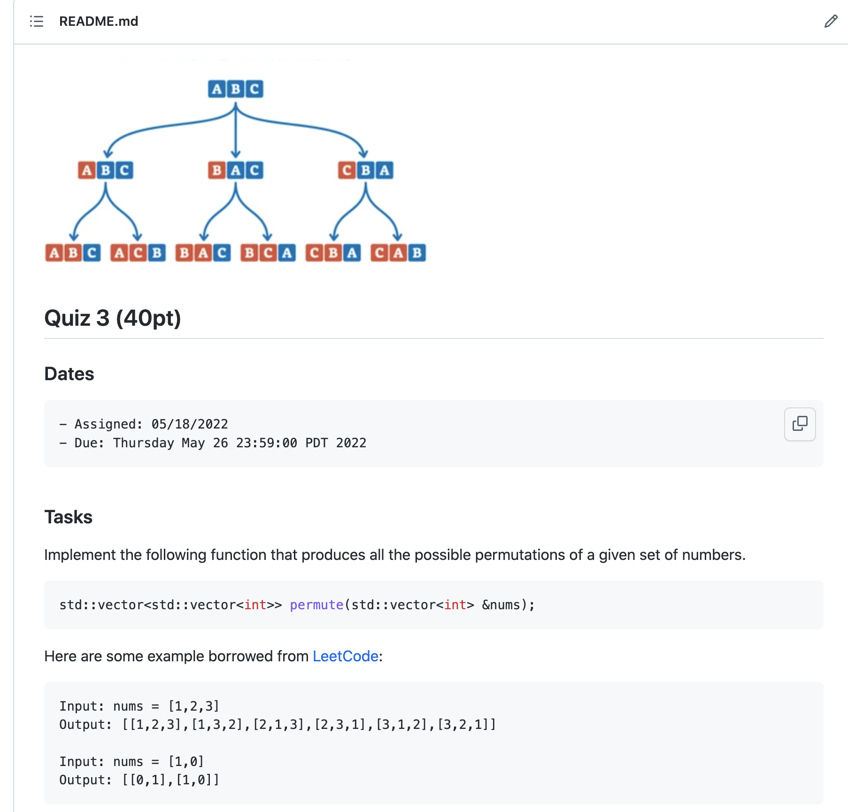
In-class Practice & Quiz-3
Based on https://leetcode.com/problems/permutations

Slide 17
1
1
1
2
1
2
2
1

Slide 18
2
3
1
3
2
1
3
2
1
2
3
3
1
1
2
3
2
1

Slide 19
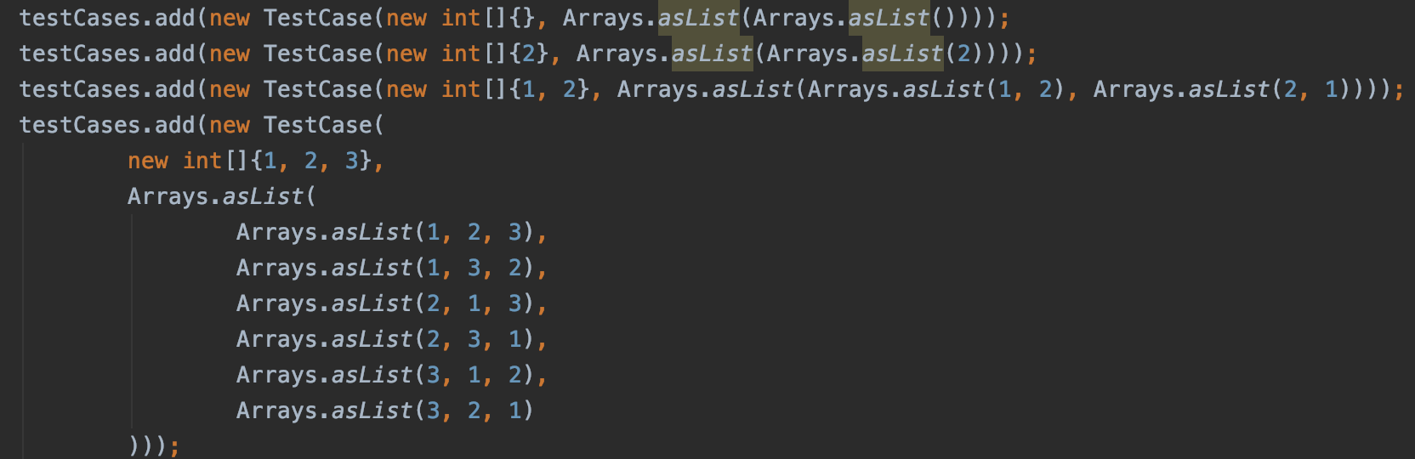

Slide 20




$$P([1])$$
1
1
1
2
$$P([2])$$
$$P([1,2])$$
1
2
2
1
$$P([1])$$

Slide 21















$$x_{0}$$
$$⋮$$
$$x_{k−3}$$
$$x_{k−2}$$
$$x_{k−1}$$
$$P([x_{0},x_{1},{⋯,x}_{n−1}])$$
$$=$$
$$x_{k}$$
$$,$$
$$P([x_{0},{⋯,x}_{k−1}{{,x}_{k+1,}⋯,x}_{n−1}])$$
$$x_{k+1}$$
$$x_{k+2}$$
$$x_{k+3}$$
$$⋮$$
$$x_{n−1}$$

Slide 22




2
3
1
$$P([2,3])$$
3
2
$$P([1,2,3])$$
1
3
2
1
2
3
$$P([1,3])$$
3
1
1
2
3
$$P([1,2])$$
2
1

