Slide 1


Intelligent Operation Center (IOC) for Fire Safety
Mid-Term Progress Review – Edge AI & IoT Sensor Fusion CLEMENT Andy (Electronics) / MARTINI Alexis (IT)
TRAN Van Lic (Supervisor)

Slide 2

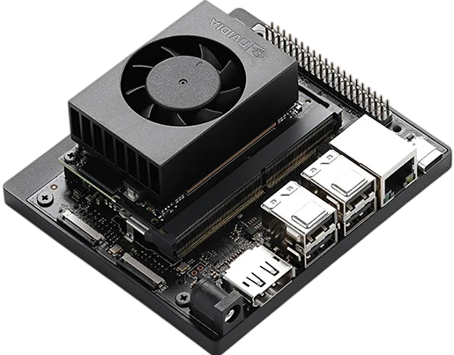
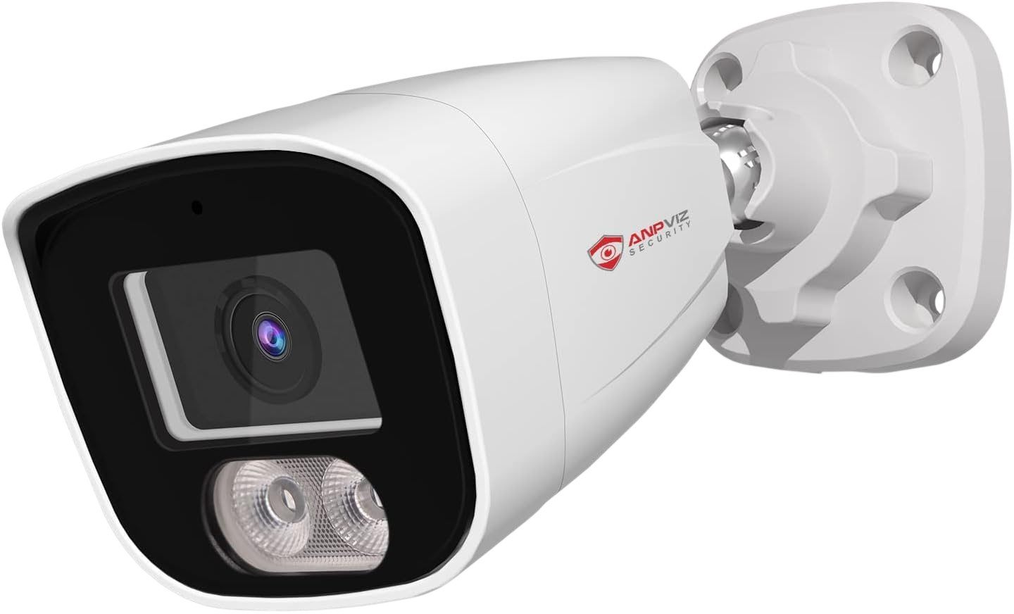
Project Goal & Work Sharing
Goal: Create an AI Camera fire detector.
Merge this solution with a smoke detector to avoid false alarm. Monitored by a Dashboard
IA-Model Used
Work Sharing:
Alexis - IT : AI Model (YOLOV11m), Dataset creation, False-positive reduction.
Andy - Electronics : Set-Up Hardware of the project (Jetson Orin Nano, IP Camera)
Our work is available on GitHub
IP-Camera
Jetson Orin nano

Slide 3
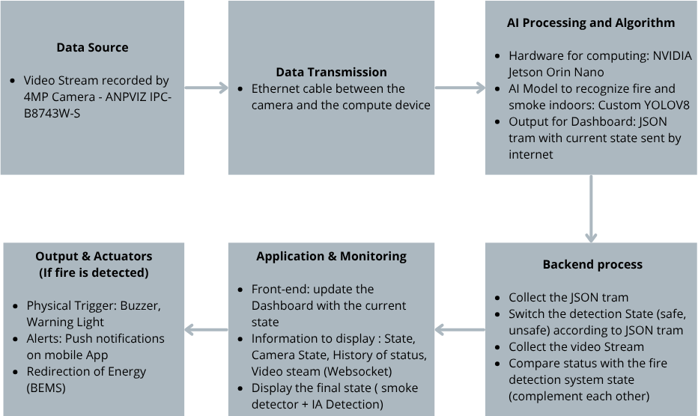
Methods, Tools & Development Plan
Development Plan:
Phase 1: Scientific research & YOLOv8 baseline
Phase 2: Hardware implementation & System integration
Hardware :
AI comput: Jetson Orin Nano use Ultralitycs
Use GStreamer to read the video Stream
Use Python Script to run AI detection
Software : YOLO11m Model + TensorRT (FP16).
Network : Local WebSocket & JSON.
Overall System Graph

Slide 4
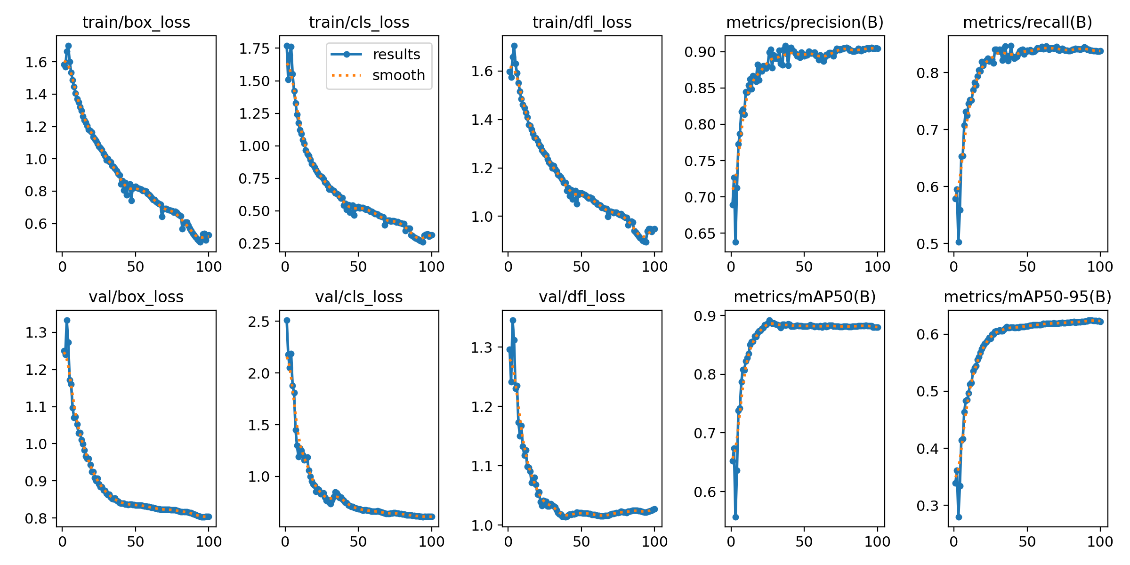
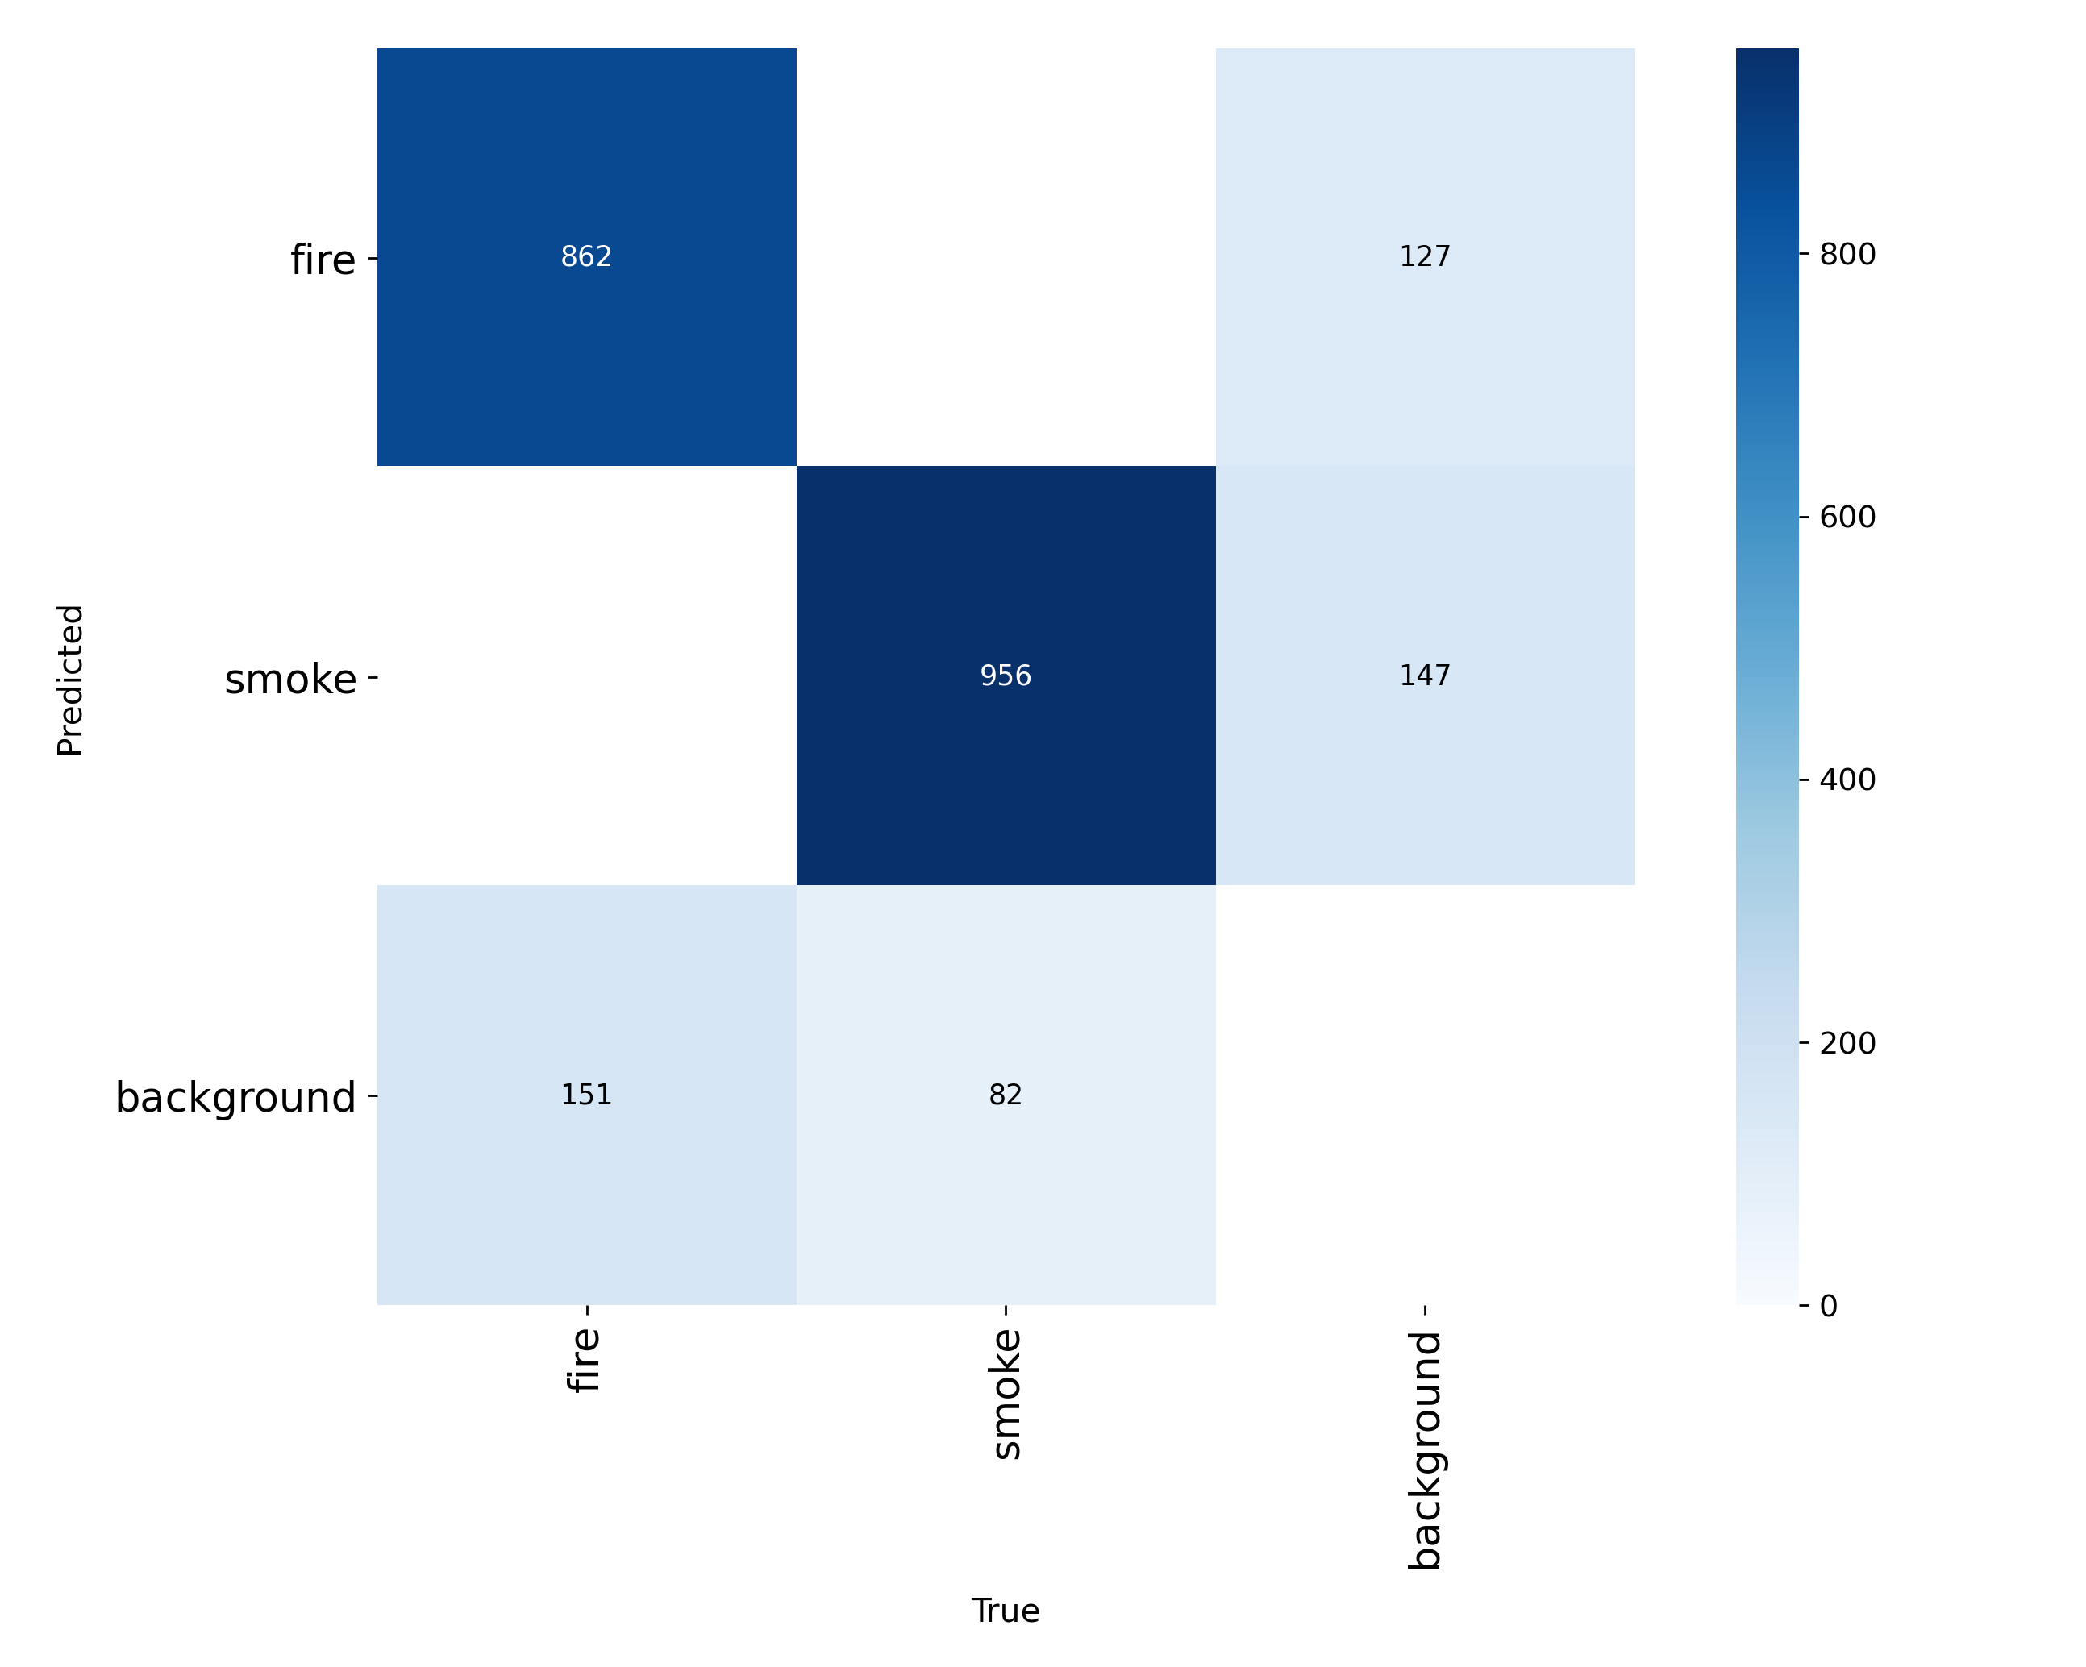
Results Obtained
AI Results: 26,000 images dataset ->
89,5% accuracy (mAP50). No more false
alarms from lights.
Training and Validation Metrics
Integration Results: Edge AI successfully
connected to the Vietnamese React
Dashboard.
Network stability: 4-second JSON
"Heartbeat" implemented to stay connected
Confusion Matrix

Slide 5
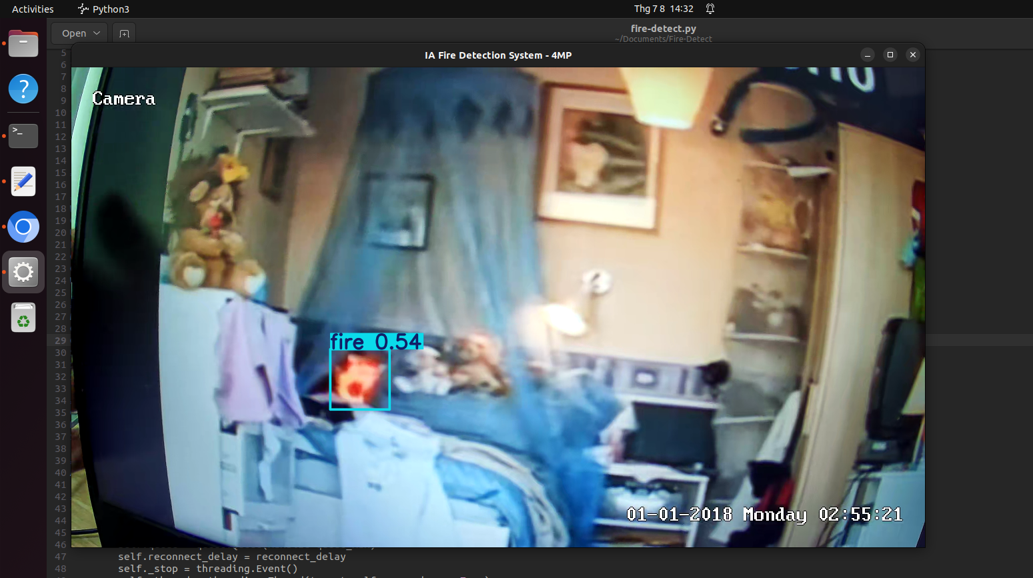
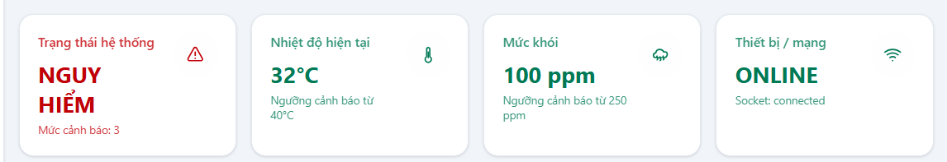
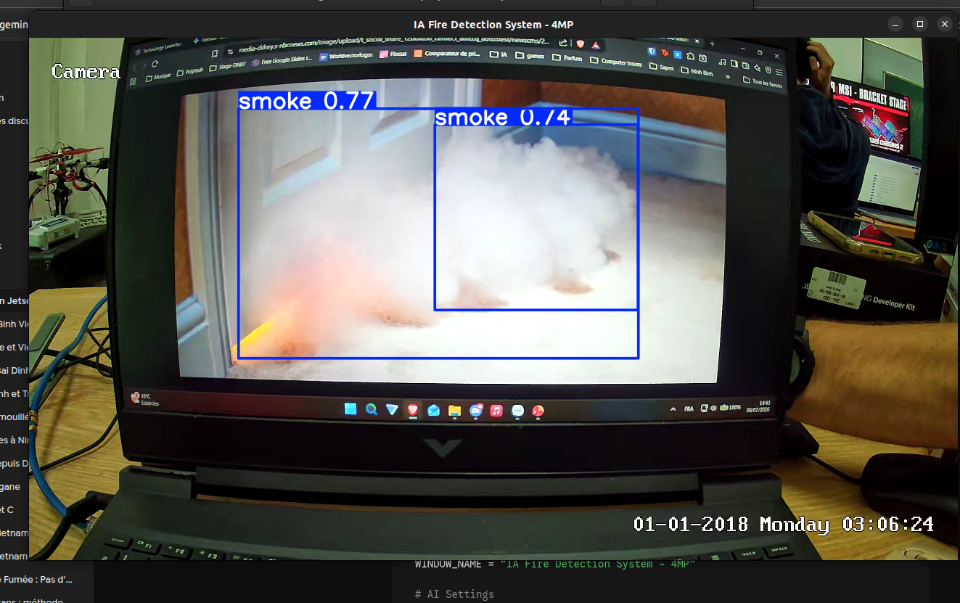
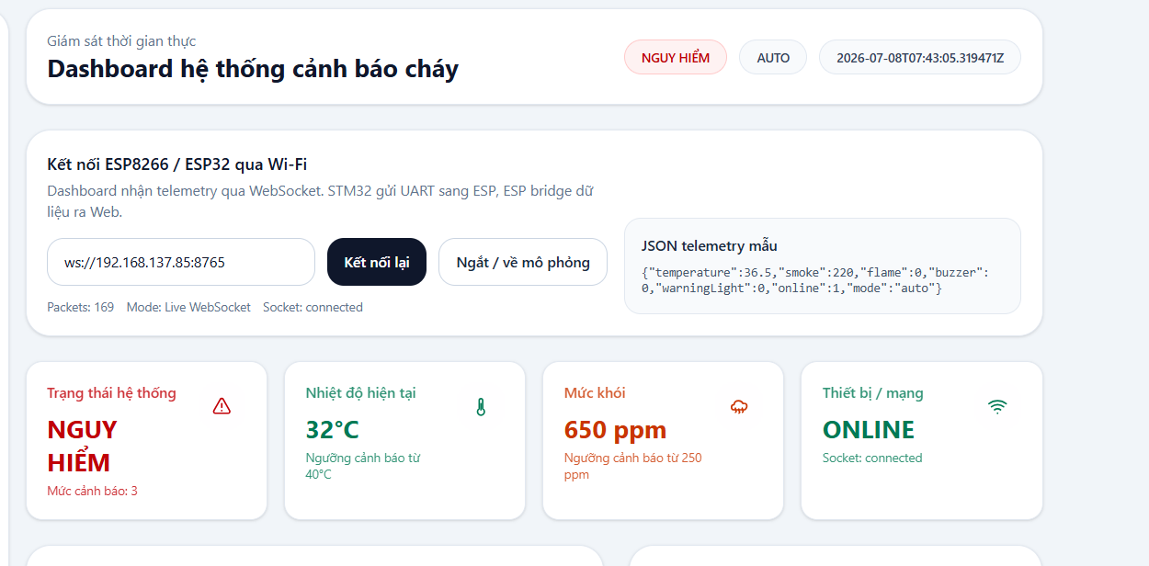
Results Obtained
AI Fire detection : On video tests, our AI can recognize fire and show it in the dashboard
AI Smoke Detection: On video tests, our AI can recognize smoke and show it in the dashboard
Fire Detection
Smoke Detection

Slide 6

Work Remaining
Phase 3 - Testing : Transition from training metrics to real-time live testing
Phase 3 - Validation : Validate the full system (Camera + Jetson + Sensors).
Phase 3 - Paper : Complete the IEEE research paper (Results).
Phase 4 - Handover : Code packaging & Knowledge transfer to the Vietnamese team.

Slide 7

Conclusion & Feedback
Work progress: AI and devices are ready for use. Some tests must be done IRL
Teamwork: Task and are perfectly shared and the group has a good synergy between IT & Electronics.
Experience: Amazing human and cultural experience in Vietnam.

