Slide 1
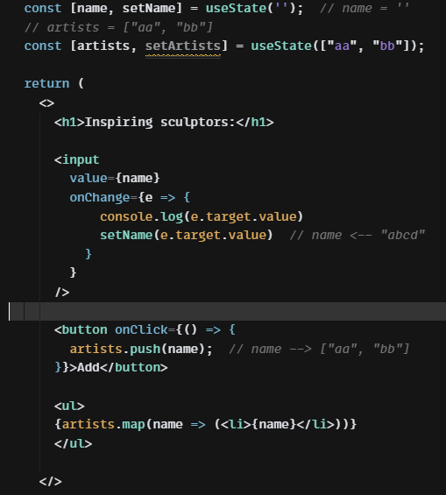
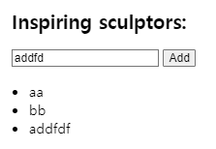
name
React.useState()
setName()
var
If var changes, React re-draw the screen
initial value, it uses name
name = “addfd” (latest input string)
<li>{artists[0]}</li>
<li>{artists[1]}</li>
<li>{artists[2]}</li>
…
<li>{artists[n-1]}</li>
aa
bb

Slide 2
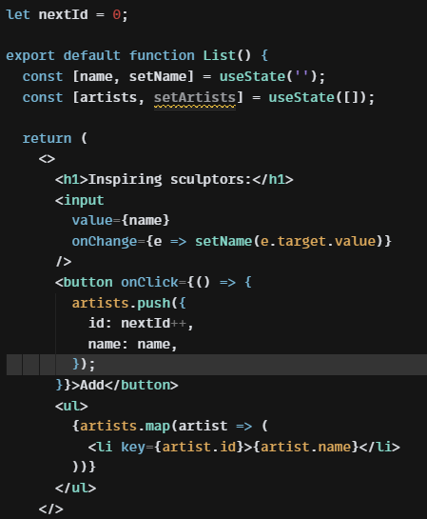
artists = [ {id:1, name: “aaa”},
{id:2, name: “bbb”},
{id:3, name: “ccc”}]
<Ii>aaa</li>
<li>bbb</li>
<li>ccc</li>
artists = [“aaa”, “bbb”, “ccc”]

Slide 3
cell
{id:2, row:1, col:2, hitOrMiss:ture, ..}
arr = [
{id:1, row:0, col:0, text:’’, hit: false, ..},
{id:2, row:1, col:,0 text: ‘X’, hit: ture, ..},
{id:3, row:2, col:0, text: ‘’, hit: false, ..},
]
arr.map(elm => {
<Cell
row = {elm.row}
col = {elm.col}
text = {elm.text}
>} )
<Cell key={id} row={row}, col={col}, text={‘X’} />
col
0 | 1 | 2 | 3
4
 |  |  | 15
row
artists = [ {id:1, name: “aaa”},
{id:2, name: “bbb”},
{id:3, name: “ccc”}]
aaa
bbb
ccc

