Slide 1

EEscape
2018
Brief Introduction to
Python

Slide 2

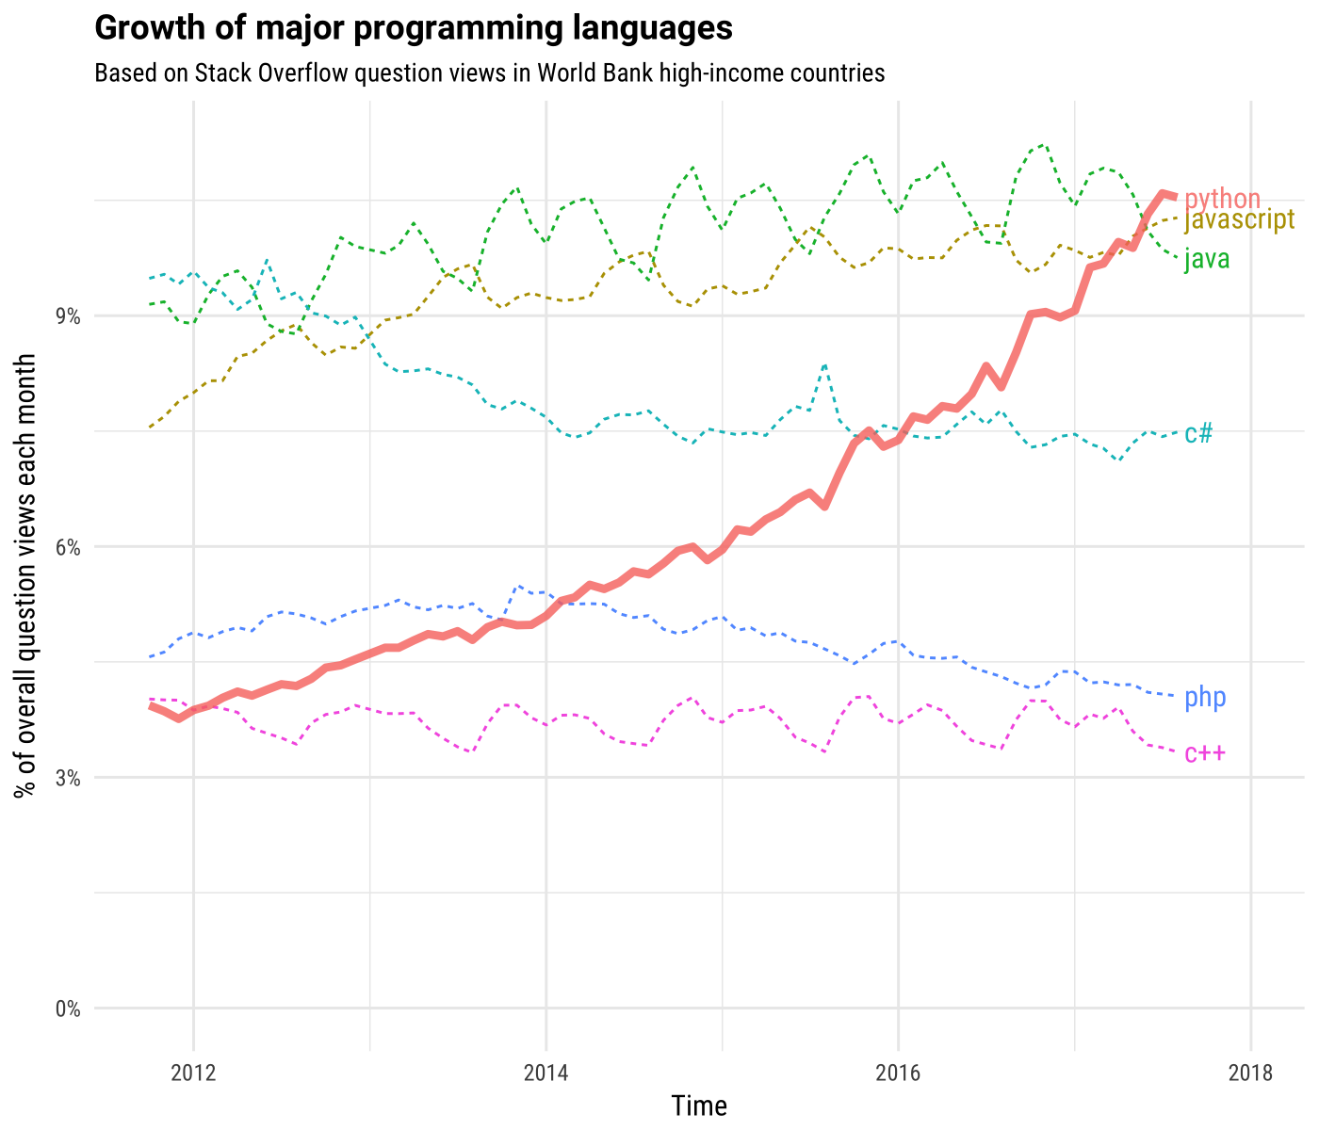

Why Python ?
Simple, intuitive syntax
Amazing libraries
Machine Learning / Data Visualization / Data Analysis
Easy !

Slide 3





Python
Basics
$$αβγ$$
Variables and
types
Logical
Operations
[ ]
O / X
Conditional
Statements
Lists
-
+
Arithmetic
operations
Loops and
iterations
$$×$$
$$÷$$

Slide 4

More
Python
{ }
def :
Dictionaries
Functions
‘ Hello ’
Basic I / O and Strings
‘time’ module

Slide 5

$$αβγ$$
Variables and types

Slide 6


$$αβγ$$
Variables and types
A variable is … ?
x

Slide 7


$$αβγ$$
Variables and types
An assignment is … ?
x = 5
The ‘value’ 5
The ‘variable’ X

Slide 8
$$αβγ$$
Variables and types
x = 5
The ‘assignment’ operator

Slide 9
$$αβγ$$
Variables and types
Ways to assign values to variables :
x = 1
y = 2
x, y = 1, 2
is equivalent to :

Slide 10
?
Practice 1
Swap the values of two variables x and y
Variables

Slide 11
?
Solution
1.
temp = x
x = y
y = temp
2.
x, y = y, x
Try to memorize this

Slide 12
?
Food for thought
What’s wrong with the following code :
x = y
y = x

Slide 13
$$αβγ$$
Variables and types
Check the type of a variable using type( )
x = 1
x = 2.2
x = ‘Hello’
x = True
x = [1, 2, 3]
type(x) int
type(x) float
type(x) str
type(x) bool
type(x) list

Slide 14
[ ]
Lists

Slide 15
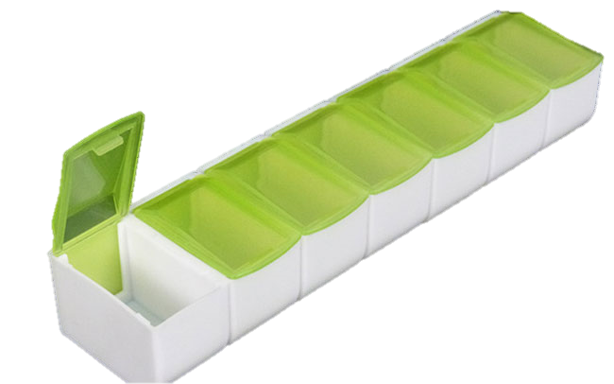
[ ]
Lists
Put anything into a list
6
5
4
3
2
1
0
Da Fuq?

Slide 16
[ ]
Lists
Initialize and empty list
L = [ ]

Slide 17
[ ]
Lists
Get items in a list by indexing
L = [1, ‘A’, [1,2,3], 4.56, True]
L[i]
Indexing

Slide 18
[ ]
Lists
Change elements in list
L = [1, ‘A’, [1,2,3], 4.56, True]
L[1] = ‘B’

Slide 19
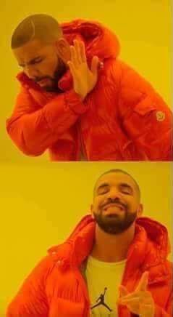
[ ]
Lists : Getting 1st item in list
L[1]
L[0]

Slide 20
[ ]
Lists
Find out the length of the list
L = [1, ‘A’, [1,2,3], 4.56, True]
len(L) 5

Slide 21
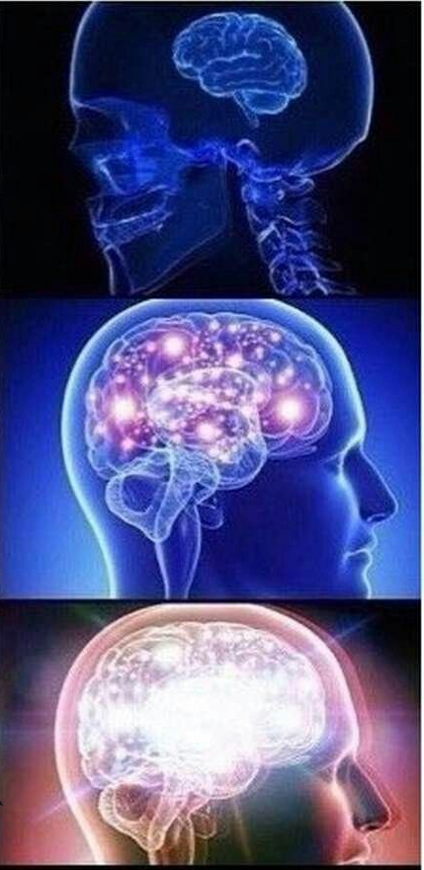
[ ]
Lists : Getting last item of a list
Count indices starting from 0
L[len(L) – 1]
L[ – 1]

Slide 22
[ ]
Lists
Add item to list
L = [1, ‘A’, [1,2,3], 4.56, True]
L.append(78)
L.insert(2,9)
Append 78 to the end of the list
Insert 9 after ‘A’
(2) is the index

Slide 23
[ ]
Lists
Remove item from list
L = [1, ‘A’, [1,2,3], 4.56, True]
L.pop(1)
L.remove([1,2,3])
Remove item at index 1
Remove element ‘A’

Slide 24
[ ]
Lists
List splicing
L = [1, ‘A’, [1,2,3], 4.56, True]
L[1 : 4] [‘A’, [1,2,3], 4.56]
L[2 :] [[1,2,3], 4.56, True]
L[ : 1] [1]

Slide 25
[ ]
Lists
Concatenate two lists
L = [1, ‘A’, [1,2,3], 4.56, True]
K = [‘Hello’, False, 7]
L.extend(K)
Concatenate lists L and K

Slide 26

Logical Operations

Slide 27
Logical Operations
You can manipulate Boolean variables using keyword ‘and’ and ‘or’
and
or
True
False
True
False
True
True
True
False
True
False
False
True
False
False
True
False

Slide 28
Logical Operations
Just elementary school stuff
x = 1
y = 2
z = 1
x > y
x < y
x == y
x == z
x >= z
x != y
False
True
False
True
True
True

Slide 29
Logical Operations
not means ‘complement’
not True False
not False True
x = 1
y = 2
z = 1
not x > y
not x < y
True
False

Slide 30


+
-
$$×$$
$$÷$$
Arithmetic
operations

Slide 31


-
+
$$×$$
$$÷$$
Arithmetic operations
Still elementary school stuff
x = 1 + 1
x = 3 - 2
x = 3 * 4
x = 5 / 8
x = 19 % 7
2
1
12
0.625
5

Slide 32
-
+
$$×$$
$$÷$$
Arithmetic operations
Probably not elementary school stuff
x = 2**3
x = 3**4
x = math.sqrt(4)
8
81
2.0

Slide 33
-
+
$$÷$$
Add 100 to a variable
$$×$$
for i in range(100) :
x = x + 1
x = x + 100
New operator !
( same for -, *, / )
x += 100

Slide 34

x += 1
x += 1
x += 1
x += 1
x += 1
x += 1
x += 1
x += 1
x += 1
x += 1
x += 1
x += 1
x += 1
x += 1
x += 1
x += 1
x += 1
x += 1
x += 1
x += 1
x += 1
x += 1
x += 1
x += 1
x += 1
x += 1
x += 1
x += 1
x += 1
x += 1
x += 1
x += 1
x += 1
x += 1
x += 1
x += 1
x += 1
x += 1
x += 1
x += 1
x += 1
x += 1
x += 1
x += 1
x += 1
x += 1
x += 1
x += 1
x += 1
x += 1
x += 1
x += 1
x += 1
x += 1
x += 1
x += 1
x += 1
x += 1
x += 1
x += 1
x += 1
x += 1
x += 1
x += 1
x += 1
x += 1
x += 1
x += 1
x += 1
x += 1
x += 1
x += 1
x += 1
x += 1
x += 1
x += 1
x += 1
x += 1
x += 1
x += 1

Slide 35
O / X
Conditional Statements

Slide 36
O / X
Conditional Statements
Just remember 3 keywords :
if
elif
else

Slide 37
O / X
Conditional Statements
if boolean expression:
……
elif boolean expression :
……
else:
……

Slide 38
O / X
Conditional Statements
x = 5
if x < 4:
print(‘yEE’)
elif x > 10:
print(‘Yee’ )
else:
print(‘yEe’ )

Slide 39
if …… :
……
elif …… :
……
elif …… :
……
elif …… :
……
elif …… :
……
elif …… :
……
elif …… :
……
elif …… :
……
else:
print(‘YEE’)
O / X
Conditional Statements
use multiple elifs if needed

Slide 40
O / X
Conditional Statements
Cascaded ‘if’s
if …… :
if …… :
if …… :
if …… :
……

Slide 41

Loops and iterations

Slide 42
Loops and iterations
Introduce 2 kinds of loops :
for
while

Slide 43
for
for i in range(10) :
print(i)
Remember the indent

Slide 44
for
L = [3, 4, 1, 5, 2]
for i in L:
print(i)

Slide 45
for
for i in iterable :
do stuff

Slide 46
?
Practice 2
Find the 20th Fibonacci Number f(20) using a for loop
Note that f(1) = f(2) = 1
for loop

Slide 47
while
while True:
print(‘yEE’)

Slide 48
while
while Boolean Expression :
do stuff

Slide 49
?
Practice 3
Bob does the following operations on a number x:
1. If x is divisible by 2, divide x by 2
2. If x is not divisible by 2, x becomes 3x + 1
3. Repeat until x becomes 1
How many operations does Bob has to do if the initial value of x is 100 ?
while loop

Slide 50
?
Let’s take a Break
FizzBuzz !
For any number x,
If x is divisible by 3, output is ‘fizz’
If x is divisible by 5, output is ‘buzz’
If x if divisible in 15, output is ‘fizzbuzz’
Otherwise, output is x

Slide 51
FizzBuzz in Tensorflow

Slide 52
More
Python
{ }
def :
Dictionaries
Functions
‘ Hello ’
Basic I / O and Strings
‘time’ module

Slide 53
{ }
Dictionaries

Slide 54
{ }
Dictionaries
Similar to list, but index can be any type ( ‘key’ )
… …
45
[1,2,3]
‘ Hi ’
True
1.1

Slide 55
{ }
Dictionaries
Initialize an empty dictionary
D = { }

Slide 56
{ }
Dictionaries
Elements in a dictionary
‘EE Camp’ : 2018
string : int
key : value

Slide 57
{ }
Dictionaries
Access element by key
D = {‘one’: 1, ‘two’: 2, ‘three’: 3}
D[‘two’] 2
Indexing by key

Slide 58
{ }
Dictionaries
Change value of key in dictionary
D = {‘one’: 1, ‘two’: 2, ‘three’: 3}
D[‘three’] = ‘tres’

Slide 59
{ }
Dictionaries
Add new element to dictionary
D = {‘one’: 1, ‘two’: 2, ‘three’: 3}
D.setdefault(‘four’, 4)

Slide 60
{ }
Dictionaries
Error when you try to access non-existing elements
D = {‘one’: 1, ‘two’: 2, ‘three’: 3}
print(D[‘four’])
KeyError : ‘four’

Slide 61
{ }
Dictionaries
Get all keys or all values in dictionary
D = {‘one’: 1, ‘two’: 2, ‘three’: 3}
D.keys() [‘one’, ‘two’, ‘three’]
D.values() [1, 2, 3]

Slide 62
‘ Hello ’
Basic I / O and Strings

Slide 63
‘ Hello ’
Basic I / O and Strings
Output stuff on the console
print(‘Hello, World!’)
print(1)
print([1, 2, 3])

Slide 64
‘ Hello ’
Basic I / O and Strings
string is an immutable type
s = ‘Hello, World!’
type(s) <class ‘str’>
Single or double quotes

Slide 65
‘ Hello ’
Basic I / O and Strings
Operations similar to list
s = ‘Hello, World!’
len(s) 13
s[2:8] ‘llo, W’
s[9] ‘o’

Slide 66
‘ Hello ’
Basic I / O and Strings
string is an immutable type
s = ‘Hello, World!’
s[9] = ‘a’
TypeError : ‘str’ object does not support item assignment

Slide 67
‘ Hello ’
Basic I / O and Strings
String operations
s = ‘Hello, World!’
2 * s ‘Hello, World!Hello, World!’
s + ‘ yee.’ ‘Hello, World! yee.’

Slide 68
‘ Hello ’
Basic I / O and Strings
Still printing stuff
print(‘I have {} apple. I have {} pen...’.format(1, 1))

Slide 69
?
Practice 4
Print a 10-level pyramid on the console.
eg. A 3-level pyramid
*
***
*****
Basic I / O and Strings

Slide 70
def :
Functions

Slide 71
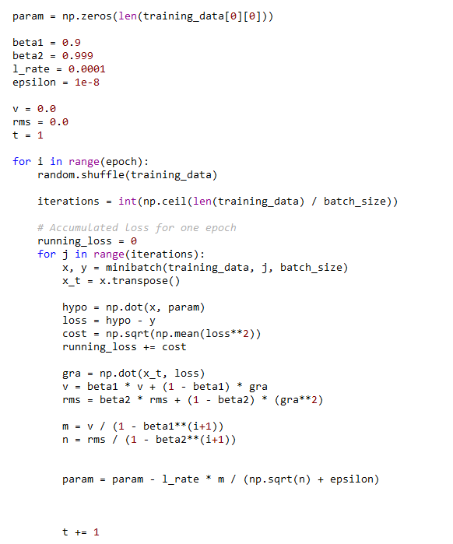
def :
Functions
Pack a chunk of code into a function
foo()

Slide 72
def :
Functions
?
Why functions?

Slide 73

def :
Functions
Cleaner, more readable code
Modularize code, code reuse

Slide 74
def :
Functions
Defining a function
def foo(parameters) :
……
conditional statements
return ……
……
return ……

Slide 75
def :
Functions
def add(a, b) :
return a + b
x = 4
y = 5
z = add(x, y) 9
a, b are parameters
a + b is the return value
Calling the function

Slide 76
def :
Functions
def say_hello() :
print(‘Hello’)
return
No parameters
Actions
No return value

Slide 77
?
Practice 5
Define a function that takes a string as an argument and returns the reversed string.
Functions

Slide 78

‘time’ module

Slide 79
‘time’ module
import time
time.sleep(5)

Slide 80
‘time’ module
time.time()
1970 ~ current time

