Slide 1
DigiDooky
A CarbonaraCoders production

Slide 2
Content
UML diagram
Code review
Key Takeaways

Slide 3
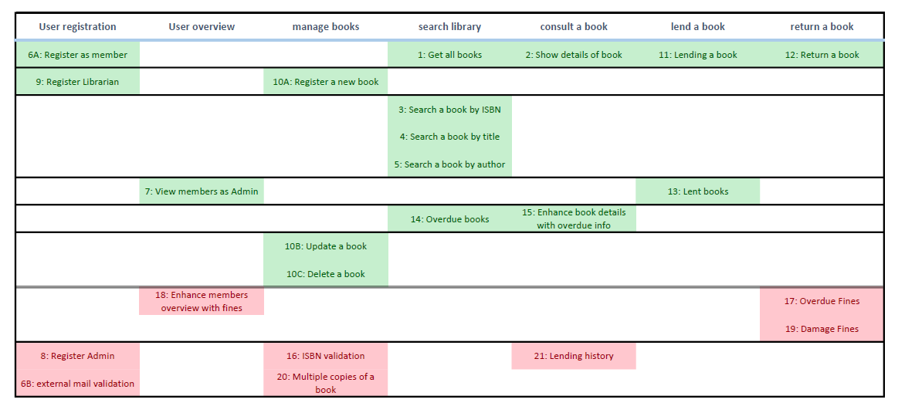
Story Map

Slide 4
UML diagram

Slide 5
UML Diagram

Slide 6
Code review
Behold our code!

Slide 7
Key Takeaways – working areas
Proper planning prevents poor execution.
  (YEET planning in early stages)
Naming conventions start at the planning phase.
  (no planning == no conventions)
Don’t use design patterns for the sake of using design patterns.
TDD vs Implement then test
Implement one functionality at a time (prevent sprawl)
Take limited mental capacity into account. (Don’t write a massive bit of code in one go. Run tests after every small component)
Keycloak
Kanban / Trello was ok
Pairprogramming was ok

Slide 8

Key Takeaways – what went well
Kanban / Trello was ok
Pair programming / mob programming was ok
Choosing team name was
Immediate feedback from Ben, good cooperation with frontend.
Frontend was interesting to work with.
  (some room for improvement, especially with regards to how the stories implement certain functionality. E.g. return book doesn’t use unique lending ID)
Sum IQ of team members is greater than average of shoe size.

Slide 9
