Slide 1



TAXI IN NYC
ANALYSIS

Slide 2

Contents
Exploratory Data Analysis
Fare and Tip Prediction
Data Distribution
Reflection
01
02
03
04
05
06
07
08
Busiest Hour & Location
Taxi Driver
Categorisation
How to Maximse
Earnings
Motivation

Slide 3

Motivations
01
How can we maximize earnings for 10 taxi drivers?
How can a taxi driver maximize his earning in a day?
02
Notes:
So, what’s the motivation of our project? Since Bitcoin can be used as an investment while its price keeps changing, we are interested to compare different methods such as time series, machine learning and deep learning to select an efficient and accurate model to predict future prices of Bitcoin.
The potential beneficiaries of our project can be cryptocurrency investors, academic researchers and regulators. The investors can use our trading indicators to make investment choices and academic researchers can use our models and comparisons to do further analysis

Slide 4

Exploratory Data Analysis
Feature Correlation
Analysis
Feature
Generation
Scatter Plot
Data Distribution
Analysis
Handling Null/Invalid
Values
2
4
Removing
Outliers
Probability Density Function
BoxPlot
1
3
5

Slide 5



Feature Generation
Time
Location
Fare
Pickup Day
Pickup Hour
Pickup Weekday
Is Night Shift (pickup hour between 5pm-4am)
Pickup borough
Dropoff borough
Is pickup airport
Is droppoff airport
Fare per minute Fare per mile
Earning per minute
Earning per mile
(JFK, EWR, LaGuardia)
Earning = fare + tip + surcharge

Slide 6
Data Cleaning
Invalid Data
Outliers
Passenger Count > 6
Fare < $2.5
Trip distance or time = 0
Latitude/Longitude outside NYC
Same pickup, dropoff location
Rate code outside 1-5 range
Driving speed > 30mph
Fare per minute > $3
Earning per minute > $15
Fare per mile > $30 and not airport trips

Slide 7
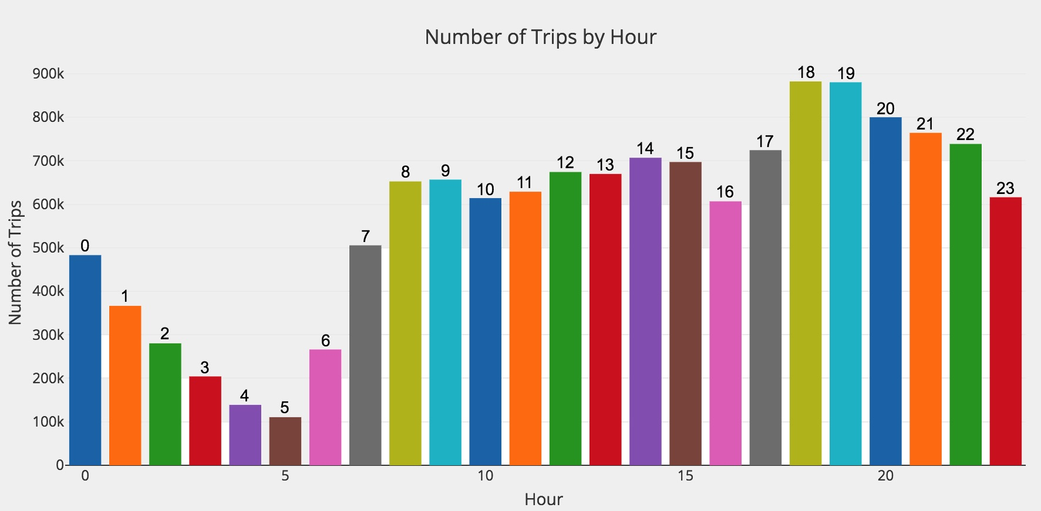
Busiest Hours

Slide 8
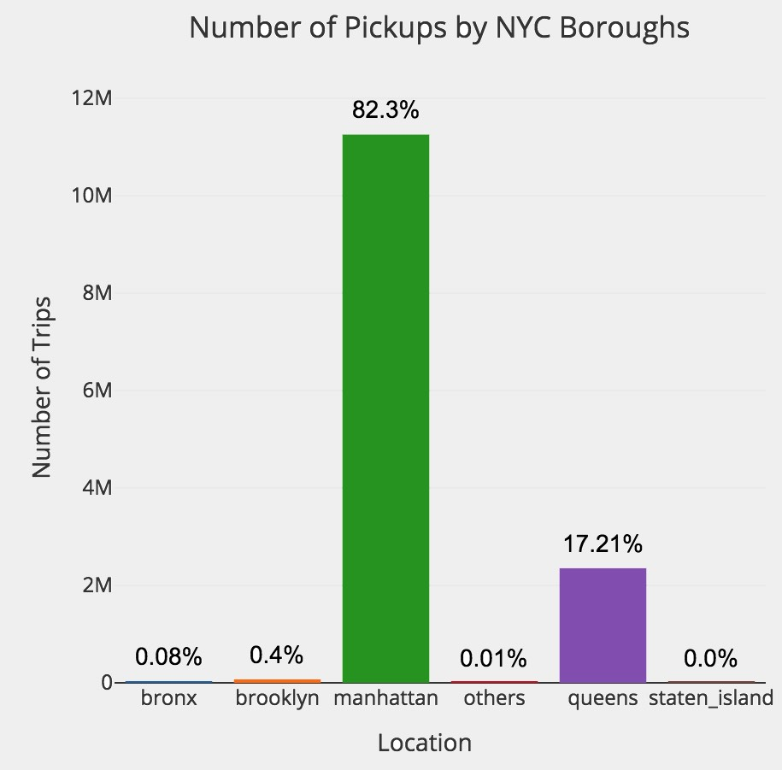
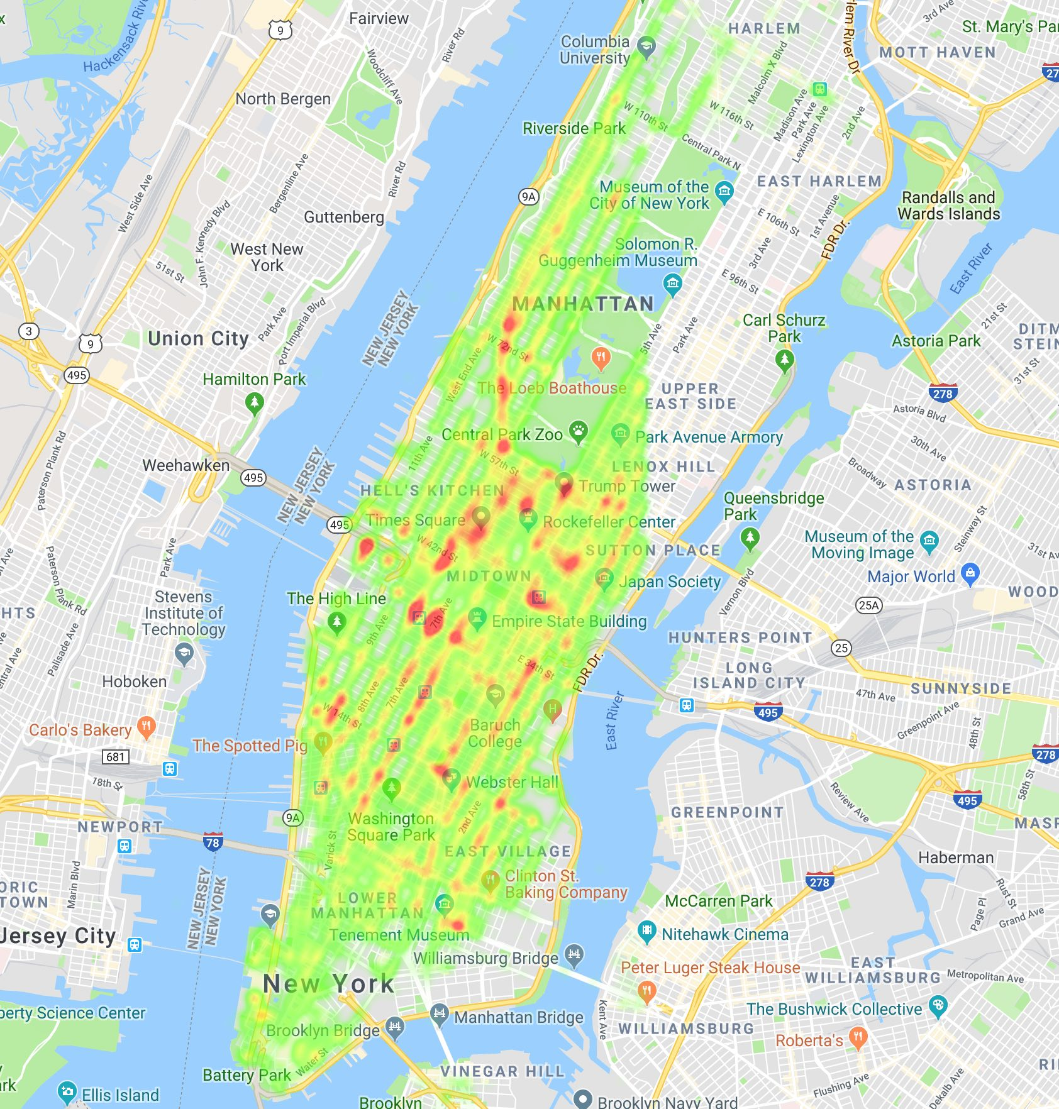
Busiest Locations

Slide 9
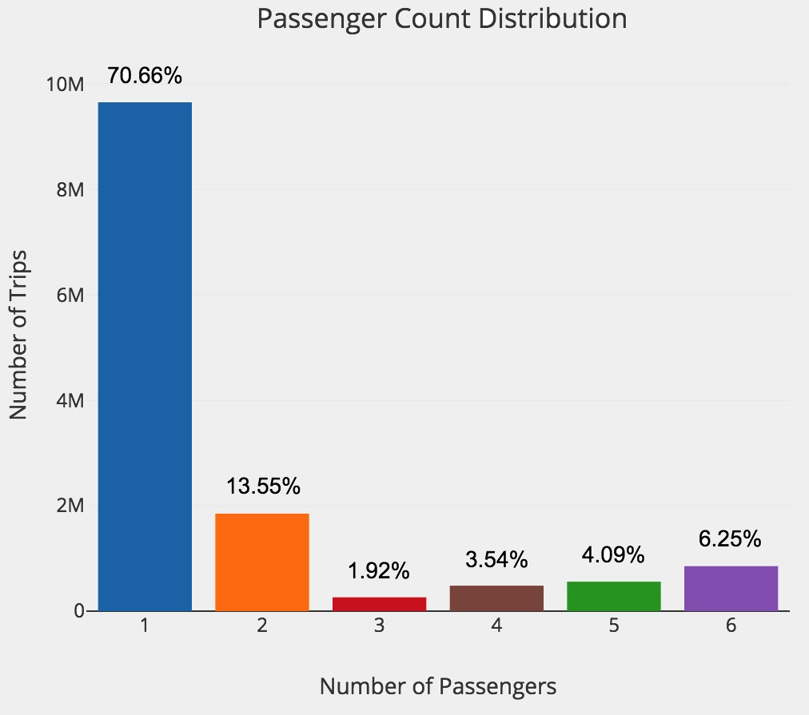
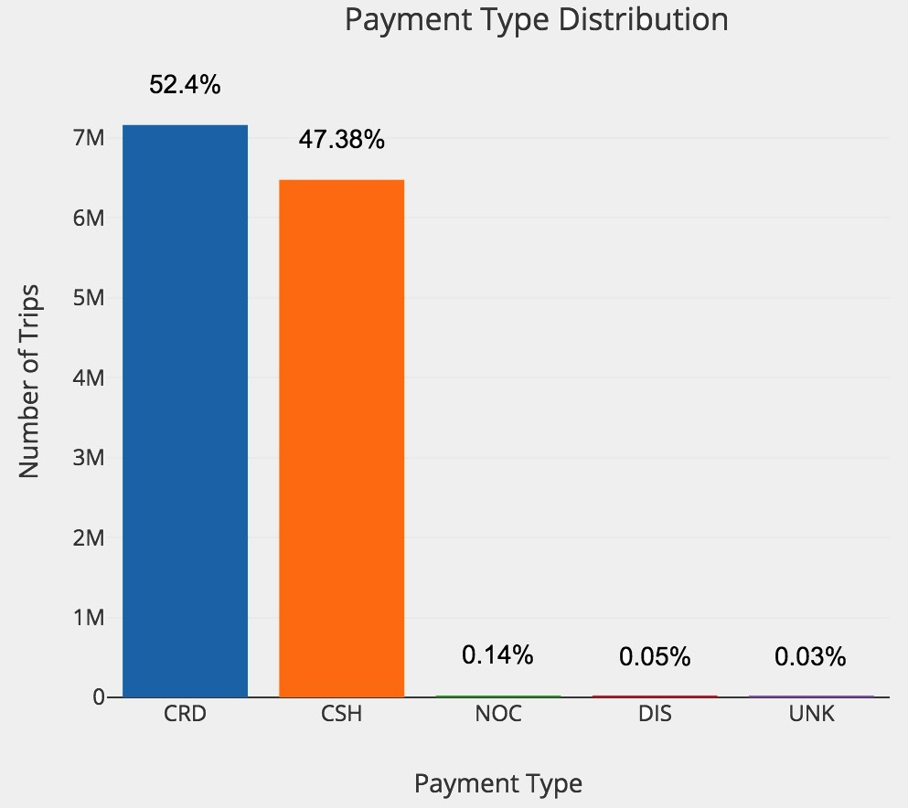
Passenger Count & Payment Type Distribution

Slide 10
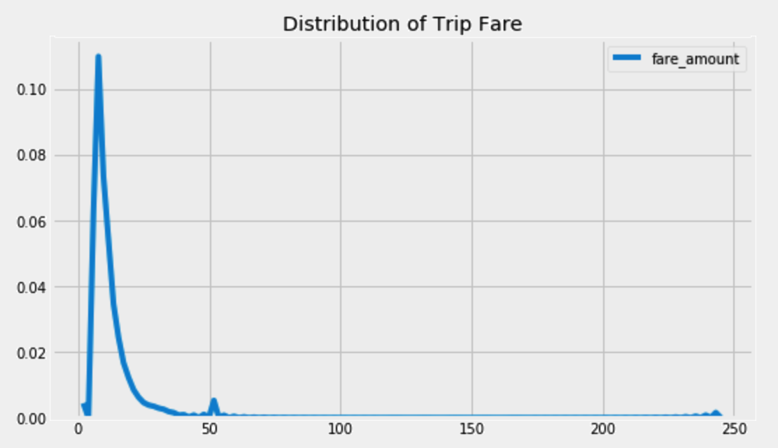
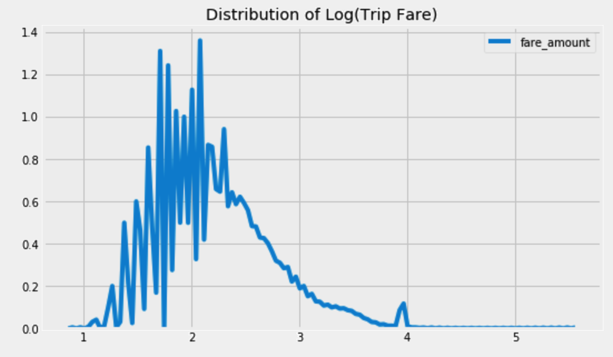
Fare Distribution
Min: $2.5
Max: $244.5
Median: $8.5
Standard Deviation: $7.5

Slide 11
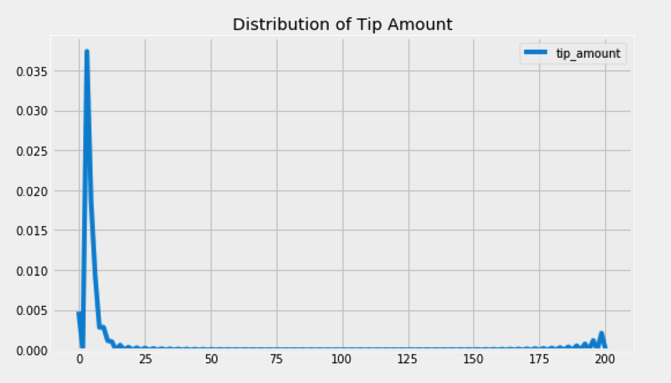
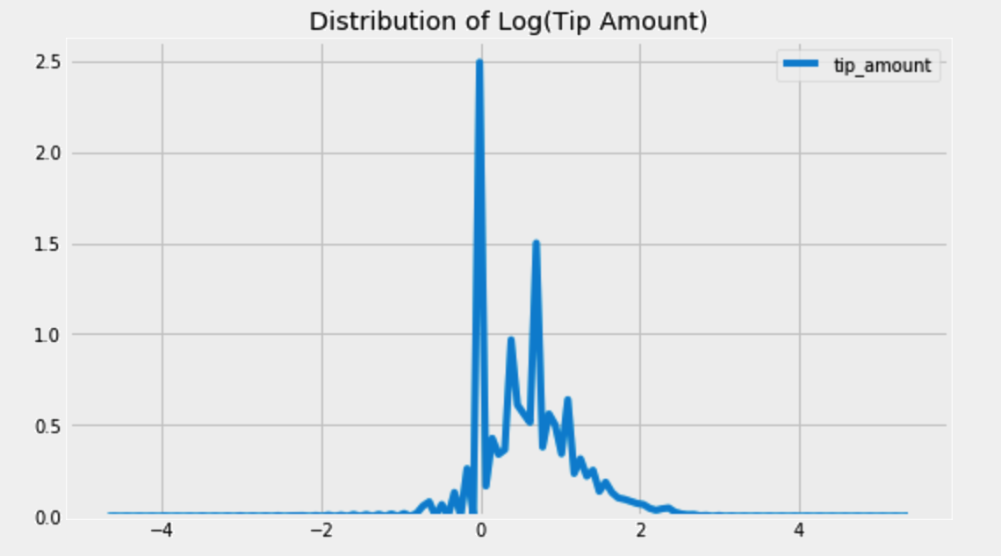
Tip Distribution
Min: $0
Max: $200
Median: $0.87
Standard Deviation: $1.7

Slide 12
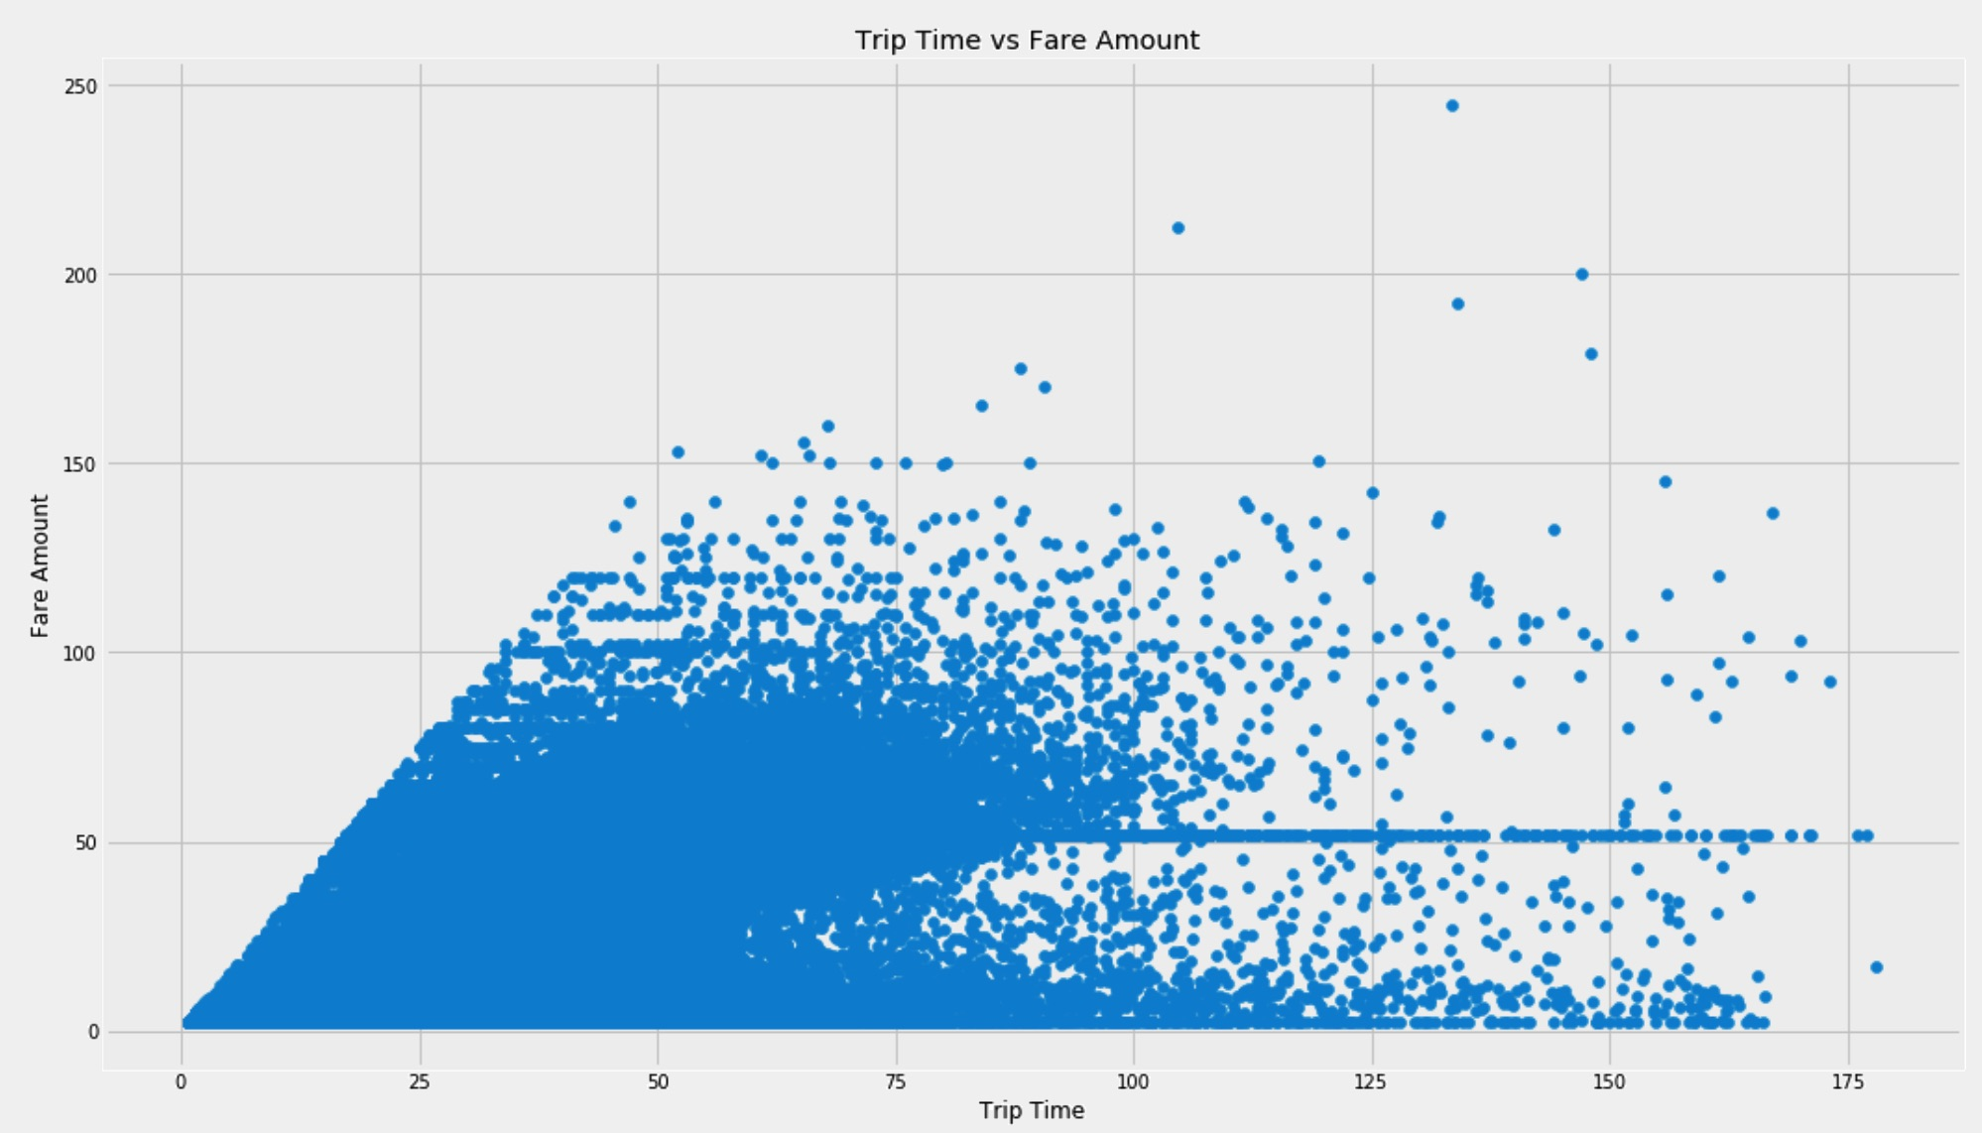
Trip Time and Fare Correlation
JFK Airport
Flat Fare: $52
Pearson Correlation: 0.91
Spearman Correlation: 0.96

Slide 13
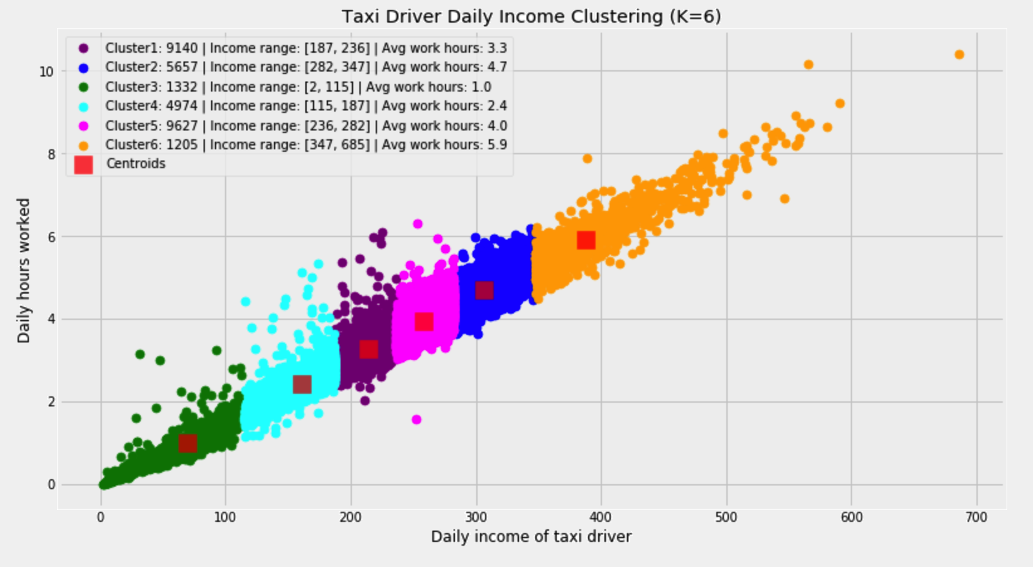
Categories Taxi Drivers

Slide 14
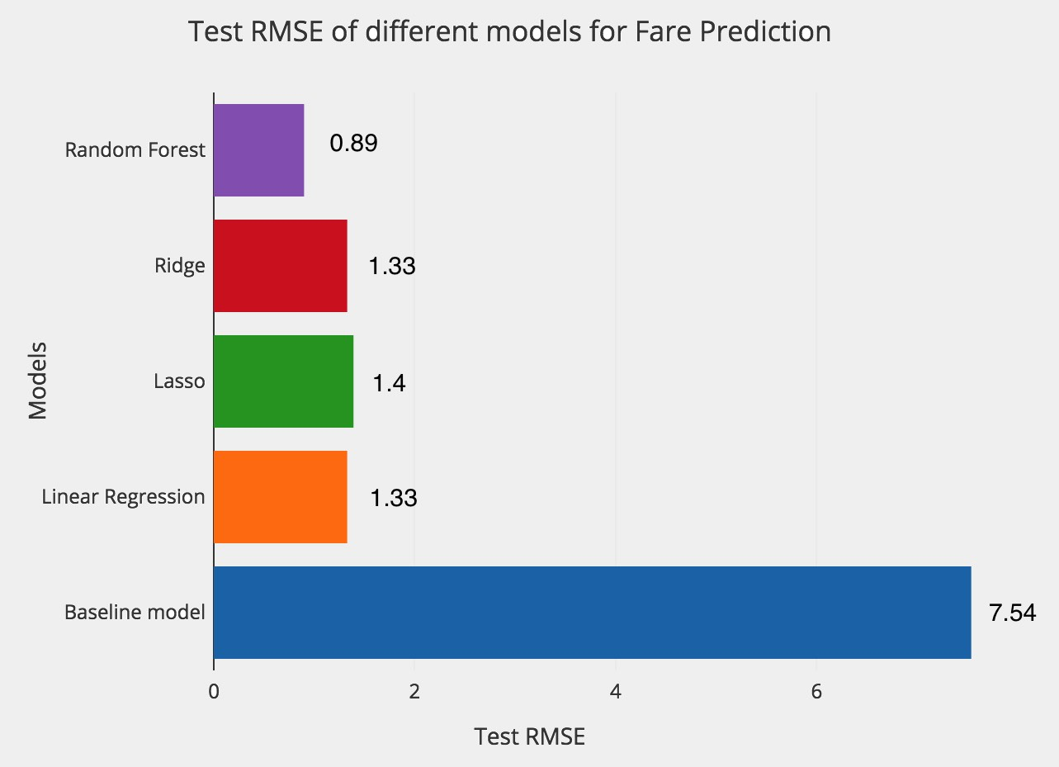
Fare Prediction Results

Slide 15
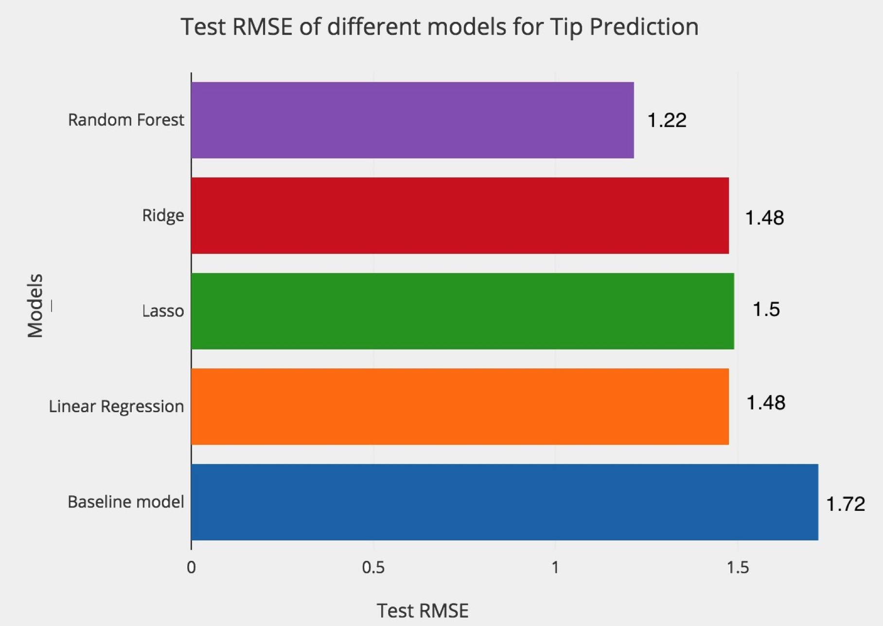
Tip Prediction Results

Slide 16
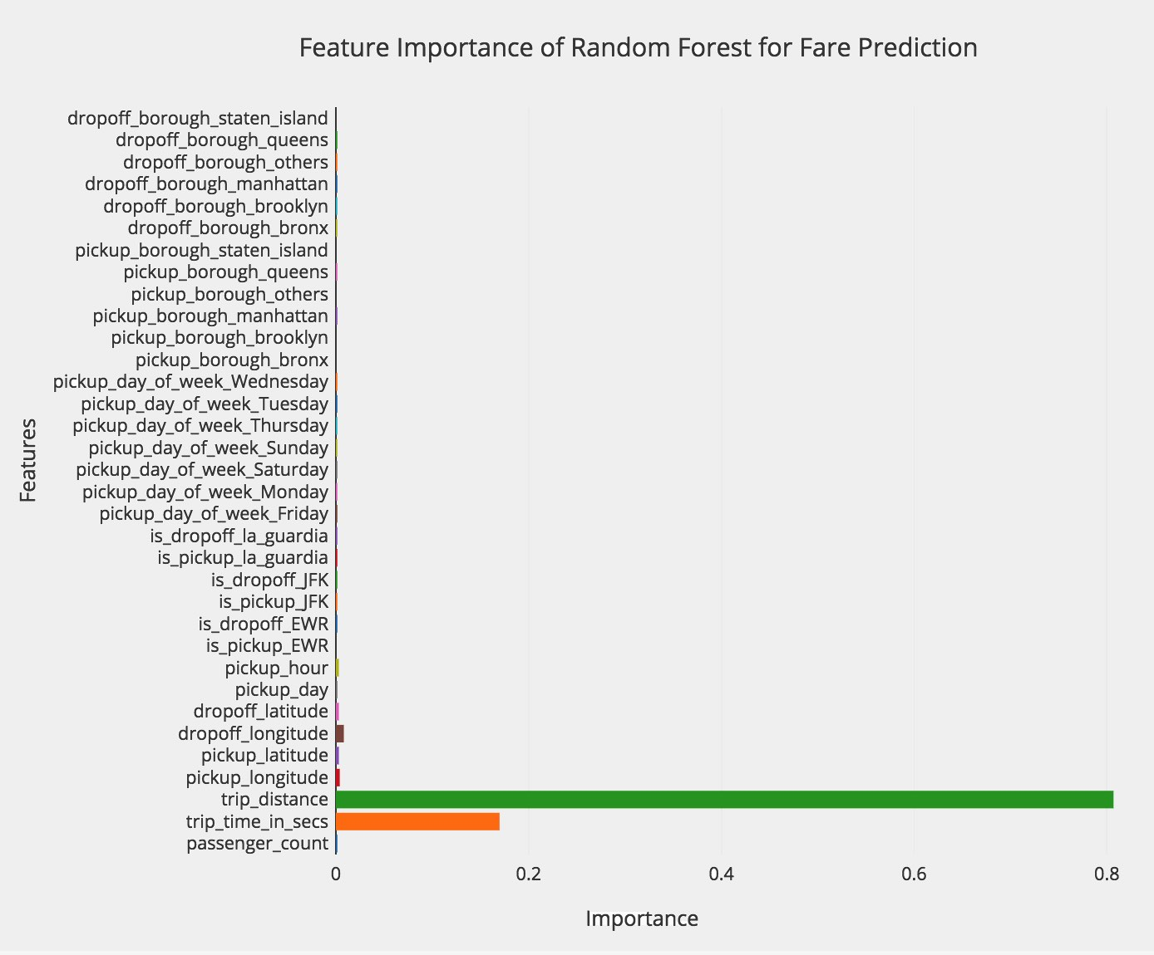
What Influence Trip Fare?

Slide 17
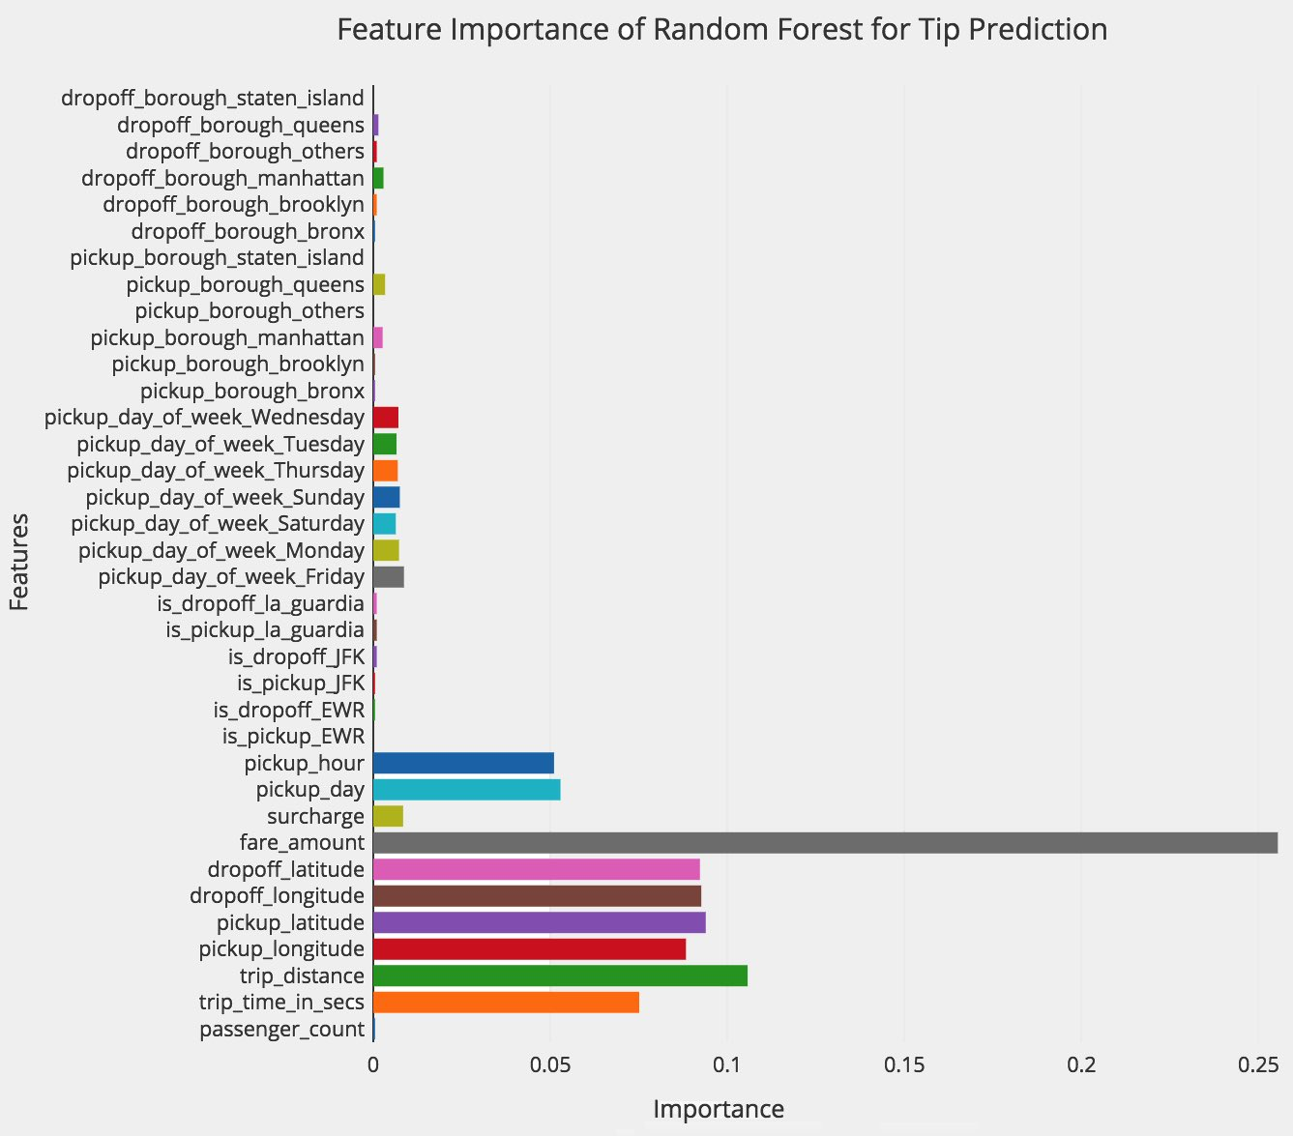
What Influence Tip Amount?

Slide 18
How to maximize a taxi earnings
Time
Midtown & Lower Manhattan
LaGuardia Airport
Hours of the day
Location
Notes:
So, what’s the motivation of our project? Since Bitcoin can be used as an investment while its price keeps changing, we are interested to compare different methods such as time series, machine learning and deep learning to select an efficient and accurate model to predict future prices of Bitcoin.
The potential beneficiaries of our project can be cryptocurrency investors, academic researchers and regulators. The investors can use our trading indicators to make investment choices and academic researchers can use our models and comparisons to do further analysis

Slide 19
How to maximize a taxi earnings
Time
Midtown & Lower Manhattan
LaGuardia Airport
Hours of the day
Location
Notes:
So, what’s the motivation of our project? Since Bitcoin can be used as an investment while its price keeps changing, we are interested to compare different methods such as time series, machine learning and deep learning to select an efficient and accurate model to predict future prices of Bitcoin.
The potential beneficiaries of our project can be cryptocurrency investors, academic researchers and regulators. The investors can use our trading indicators to make investment choices and academic researchers can use our models and comparisons to do further analysis

Slide 20
How to maximize 10 taxi earnings
Time
Midtown & Lower Manhattan
LaGuardia Airport
Weekday vs Weekend
Day Shift vs Night Shift
Hours of the day
Location
Notes:
So, what’s the motivation of our project? Since Bitcoin can be used as an investment while its price keeps changing, we are interested to compare different methods such as time series, machine learning and deep learning to select an efficient and accurate model to predict future prices of Bitcoin.
The potential beneficiaries of our project can be cryptocurrency investors, academic researchers and regulators. The investors can use our trading indicators to make investment choices and academic researchers can use our models and comparisons to do further analysis

Slide 21

Reflection
Limitations
Future Work
Used only data in January for training models
Random Forest has long running time
Use all data of 2013 to re-train the models
Try neural networks for fare and tip prediction

Slide 22

THANK YOU!
ANY QUESTIONS?

