Slide 1
Sankofa Website Project
Domain Name ($9.00 year)
Server Space and Hosting ($200 per year)
SSL Key ($13 per year)
Development of software ($762)
Deployment of system (free)
NB: Domain name sankofa.gh, sankofa.com, sankofa.com.gh, sankofagh.org are all taken and purchased already by people. However sankofagh.biz, sankofagh.co is available, which we need to purchase as soon as possible before someone gets it.
Also below are screenshots of price proof from godaddy.com which are higher but when all are purchased in bulk it reduces to the summary above.
https://uk.godaddy.com/web-security/ssl-certificate

Slide 2
Sankofa Project Structure
Section for displaying various projects
Blog for writing articles about project and events, just like news with people being able to write comments and share thoughts on various projects.
Shop for selling sankofa products on platform
Gallery for showcasing every activity or event.
Contact section for making people reach out to sankofa

Slide 3
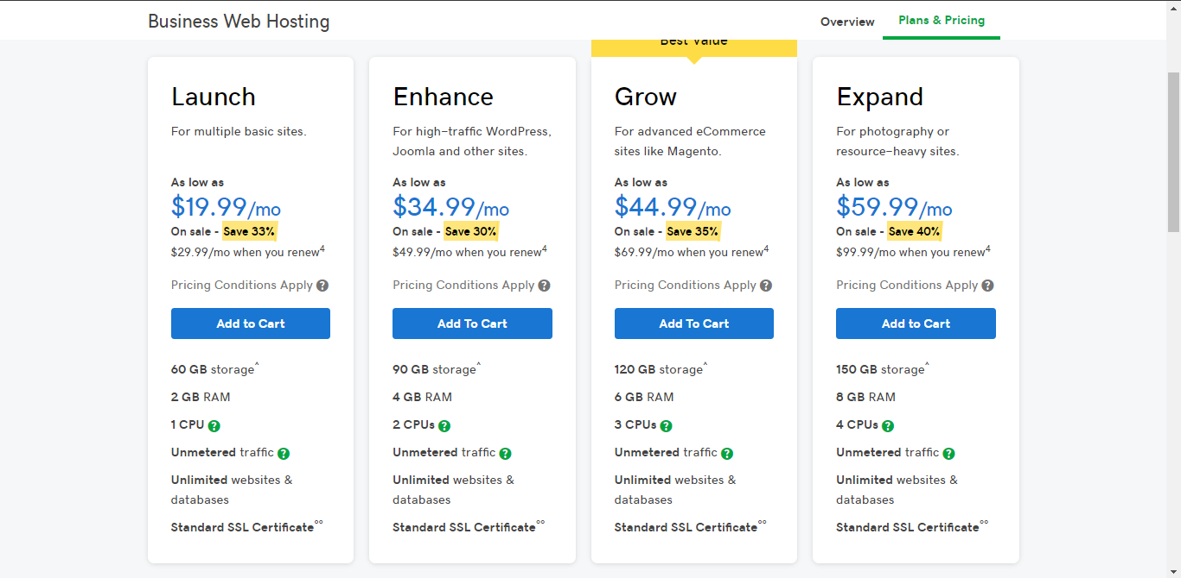

Slide 4
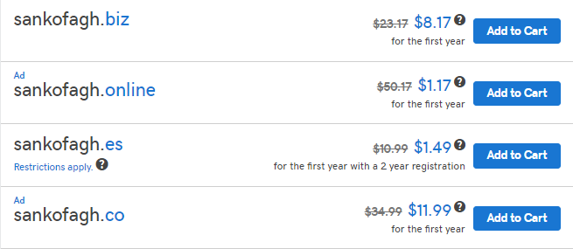

Slide 5
