Slide 1
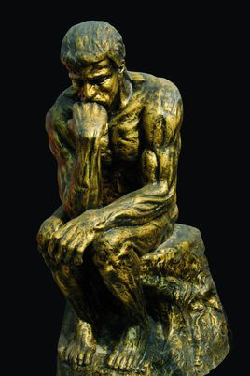



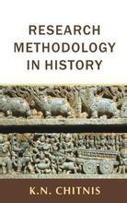



CSCI940
CS Research Methodology Spring Session 2022

Slide 2
Highlights of Lecture 02
  Some Required Traits of the Researcher
  Brief Talk on Creatology
  Relationship btw Critical and Creative Thinking
  Some Common Knowledge of CS
  Research Measurement : Index, Citation, etc

Slide 3
Some Required Traits of Researchers
Research is the locomotive of innovation

Slide 4
1. Personal Ideal
2. Altitude
3. Vision
4. Aims and Plan
5. Time Usage
6. Learn and Change
7. Integrity
Characteristics of Good Researchers

Slide 5
Academic Integrity at MIT.
At MIT, pushing the boundaries of knowledge and possibility is our joyful obsession, and we celebrate fundamental discoveries and practical applications alike. As educators, we also value research as a potent form of learning by doing.
Characteristics of Good Researchers

Slide 6
1. Fear to success
2. Laziness in Physics and Thinking
3. Ignorance
Reasons Leading Failure

Slide 7
Big Five Personality Traits
The Big Five personality traits, also known as the five factor model (FFM), is a model based on common language descriptors of personality.
Conscientiousness
Openness
Extraversion
Agreeableness
Neuroticism

Slide 8
Openness to experience: (inventive/curious vs. consistent/cautious). Appreciation for art, emotion, adventure, unusual ideas, curiosity, and variety of experience.
Conscientiousness: (efficient/organized vs. easy-going/careless). A tendency to be organized and dependable, show self-discipline, act dutifully, aim for achievement, and prefer planned rather than spontaneous behavior.
Extraversion: (outgoing/energetic vs. solitary/reserved). Energy, positive emotions, surgency, assertiveness, sociability and the tendency to seek stimulation in the company of others, and talkativeness.
Agreeableness: (friendly/compassionate vs. challenging/detached). A tendency to be compassionate and cooperative rather than suspicious and antagonistic towards others.
Neuroticism: (sensitive/nervous vs. secure/confident). The tendency to experience unpleasant emotions easily, such as anger, anxiety, depression, and vulnerability.

Slide 9
Academic Science – Who is Successful?

Slide 10
Characteristics of Successful Academic Researchers…
Success depends on balance of…
  Personal preparation, characteristics, focus, effort
  Assistance and support from others
  Characteristics of local environment

Slide 11
Characteristics of Successful Academic Researchers – Personal I
Know and enjoy what they are getting into!
  Socialized to career and activities
  Enjoy academic freedom and research
Have a focused area of research
  Also, know literature of this field
Work Habits
  Strive for high productivity in first five years/then …
    Papers – at least 2 per year
    Grants – At least one National /Federal or foundation in last two years…
    Reading – keeping up with the literature!

Slide 12
Characteristics of Successful Academic Researchers – Personal II
Simultaneous projects - Multiple at different stages!
  Research
    Planning
    Under review for funding
    Data collection
    Data analysis
  Manuscripts
    In preparation
    Under review
    Awaiting publication
Focuses on internal and external business
    External- collaborate and conferences
    Internally – govern department or institution/curriculum

Slide 13
Characteristics of Successful Academic Researchers – Interpersonal
Have mentors
  Collaborations
  Networks
  Understanding of academic culture
  Emotional support
Tend to Communicate with Others and Network
  Tend to develop collegial NETWORKs!
  Involved in and out of university
  Go to conferences and become known!
  Provides access “hot” fields, etc
  Provides brain power- Bounce ideas off of others

Slide 14
Characteristics of Successful Academic Researchers – Environment I
Sufficient Work Time
  Must limit committees and prep time for teaching
Supportive Environment
  Autonomy…
  Senior Faculty/Dept Chairs who help with…
    Grants
    Publications
    Professional contacts
    Advice
    Finding local mentors
  Peer Support
    Individual
    Groups
  Recognize what the individual researcher needs
  Recognizes strengths of individual researcher

Slide 15
Creatology

Slide 16
The science of creativity is the study of the complex phenomenon of creativity.
Creatology

Slide 17
As with any new field of research, the creativity research at a certain moment of time develops into a science. If scientists create new methods of research, new models, new hypotheses, new theories, new devices, new experiments, and these are all creative acts, then the creation of a science can be considered one of the largest creative acts in the field of science. In the history of science, the founders of new sciences are often referred to as “fathers,” such as Gregor Mendel, the father of genetics, or Norbert Wiener, the father of cybernetics.
Creatology

Slide 18
Every one is creative
Training can enhance creativity ability
More knowledge does not mean higher creativity ability
Conclusions of Creatology

Slide 19
Creativity in Science and Engineering:
Sometimes Easier,
Sometimes Harder,
Than You Expect
Notes:
1995 NOBEL PRIZE IN PHYSICS
Slide 1
File Format: Microsoft Powerpoint - View as HTML
Creativity in Science and Engineering: Sometimes Easier,. Sometimes Harder,. Than You Expect". Martin L. Perl. Stanford Linear Accelerator Center ...
kondor.etf.rs/~vm/razno/Creativity-Perl-3-21-07.ppt
Powerpoint Lectures by Nobel Laureates at Supercourse www.pitt.edu/~super1
Source: http://www.pitt.edu/~super1/Science/nobelprizelaureatesbyyear.htm
Date: April 20, 2010
Author: Eric Marler M.D.
http://www.pitt.edu/~super1/Science/main.htm#WHO

Slide 20
TOPICS
Creativity in Science and Engineering
How to Get a Good Idea
The Art of Obsession

Slide 21
Creativity in Science and Engineering:

Slide 22
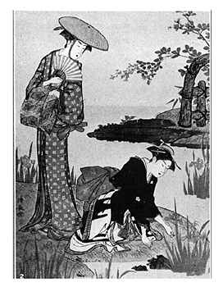
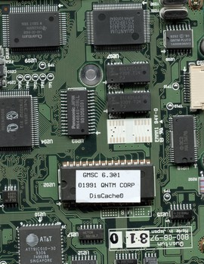
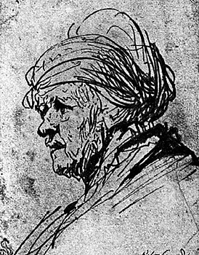
Creativity
Creativity is sought everywhere: in the arts, in entertainment, in business, in mathematics, in engineering, in medicine, in the social sciences, in the physical sciences.
Common elements in creativity are originality and imagination.
Creativity carries feelings of wide ranging freedom to design and to invent and to dream. But in engineering and science creativity is useful only if it fits into the realities of the physical world.

Slide 23
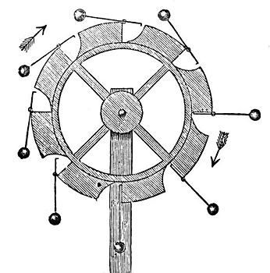
Example of Constraint on Creativity
A creative idea in science or engineering must conform to the law of conservation of energy (including the mass energy mc²). If an inventor thinks that they know how to violate the conservation of energy, he or she will have to overcome a vast amount of laboratory measurements and accepted theory.
A perpetual motion machine violates the conservation of energy

Slide 24
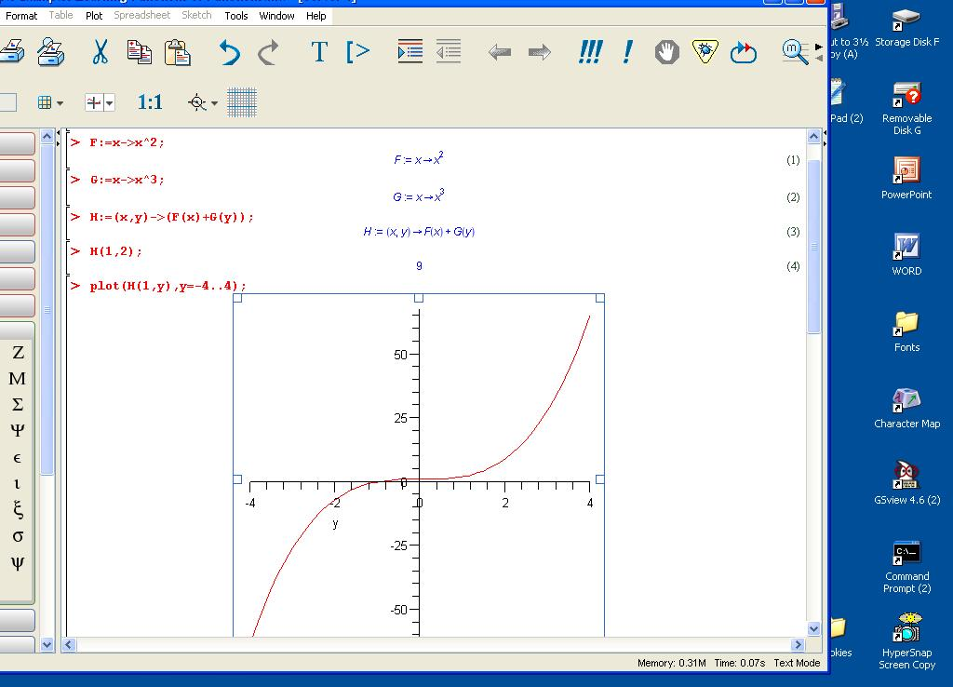
Example of Constraint on Creativity
A creative idea in computer science must obey the laws of mathematics and logic.

Slide 25
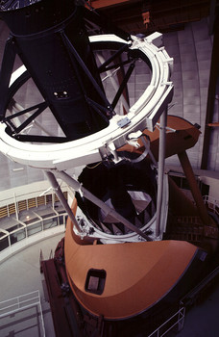

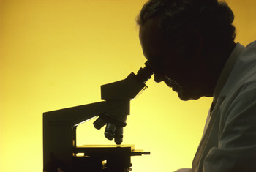
Observations and Rules of Thumb
Your idea may be in an area where the basic science or mathematics is not known, then begin by paying attention to the known observations and rules of thumb in the area.
But the observations and rules of thumb may be wrong. Example: Remember when doctors thought that ulcers were caused by spicy food and stress, but now know most ulcers are bacterial infections.
Notes:
The English phrase rule of thumb refers to a principle with broad application that is not intended to be strictly accurate or reliable for every situation. It refers to an easily learned and easily applied procedure or standard, based on practical experience rather than theory.

Slide 26
Rules of Thumb
The English phrase rule of thumb refers to a principle with broad application that is not intended to be strictly accurate or reliable for every situation. It refers to an easily learned and easily applied procedure or standard, based on practical experience rather than theory.
Notes:
The English phrase rule of thumb refers to a principle with broad application that is not intended to be strictly accurate or reliable for every situation. It refers to an easily learned and easily applied procedure or standard, based on practical experience rather than theory.

Slide 27
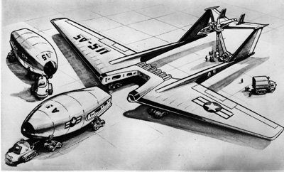
Practicality and Feasibility Constraints
Creativity in science, engineering and computer science is constrained by feasibility and practicality.
Consider the work in the US on a nuclear reactor powered airplane in the 1950’s
The reactor was to be in the front and the crew in the rear.

Slide 28
How To Get A Good Idea

Slide 29
For every good idea, expect to have five or ten bad or wrong or useless ideas
Astrology
Phlogiston model of combustion
Lamarckian evolution
Homeopathic medicine
Electromagnetic ether
Everyone will own a flying automobile
Steam powered automobiles
Cold fusion

Slide 30
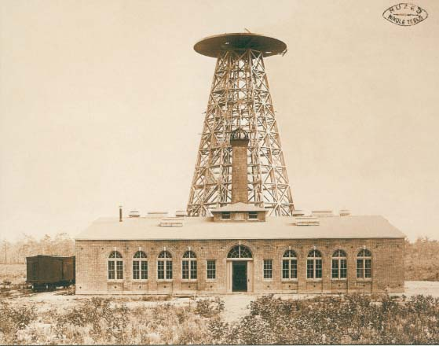
Creative engineers and scientists get bad ideas along with the good ideas.
Nikola Tesla (10 July 1856 – 7 January 1943, a Serbian-American inventor, electrical engineer, mechanical engineer, physicist, and futurist) was a pioneer in long distance wireless, a good idea, but he also thought he could use the same tower to transmit large amounts of low frequency power.

Slide 31
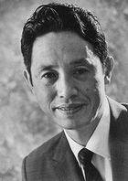
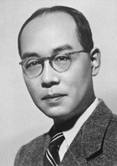
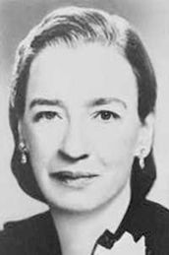
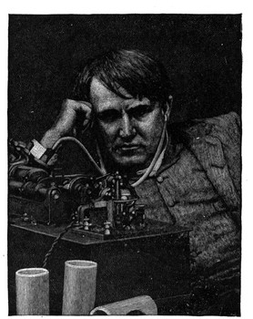
Take account of your personality and temperament
To get good ideas you must take account of your personality and temperament in choosing your technical field or science and your interests in that field. Be yourself.
Creative scientists and engineers have a many different types of personalities
Yukawa Hideki( 湯川 秀樹, 23 Jan 1907 – 8 Sept 1981, Theoretical Physicist , Nobel laureate)
Esaki (Nobel laureate, Physicist, Tunnel)
Hopper (compiler inventor)
Edison

Slide 32
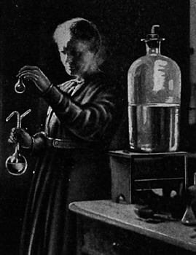
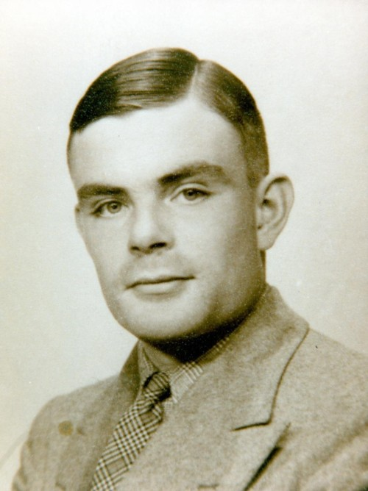
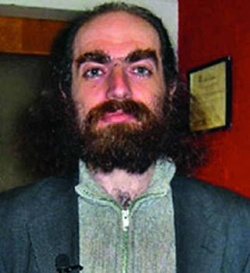
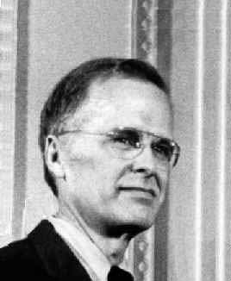
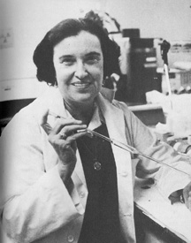
Curie
Turing
Perelman
Yalow
Backus, FORTRAN inventor

Slide 33
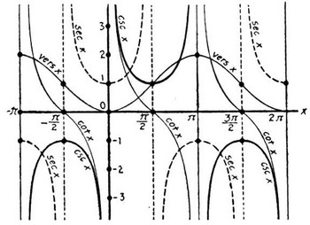
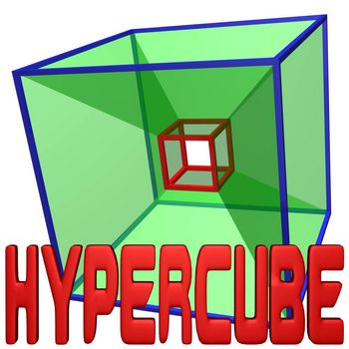
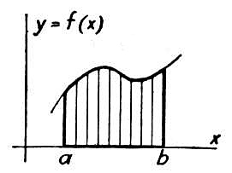
Mathematics and getting good ideas
Don’t try to fit yourself into any particular image of what a scientist or an engineer should be. You don’t have to be a mathematical genius. There are lots of fields where mathematics is secondary. But you should be competent in mathematics.

Slide 34
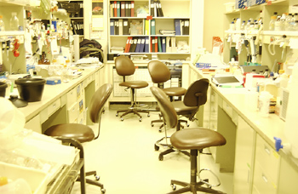
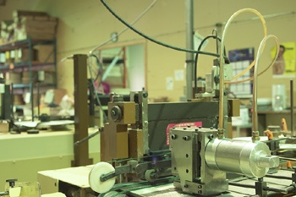
Hand-on skills, lab skills and getting good ideas
Evaluate the extent of your hands-on skills and laboratory skills. Are you good at working with tools, at building equipment, at running equipment – electronics, microscopes, telescopes ,…? This is my strength. I am an experimenter in physics because I like to work on equipment, because I am mechanically handy and because I get great pleasure when an experiment works. But hands-on skills do not have to be your strength.
Isadore Rabi, who was professor at Columbia University in the 1950’s had no laboratory skills. Yet Rabi won a Nobel Prize for advancing experimental atomic physics.
When choosing what you work on in engineering and science honestly evaluate the extent of your hands-on and laboratory skills.

Slide 35
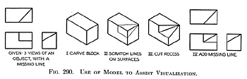
Visualization and getting good ideas/Tangible
In engineering and scientific work it is crucial to be able to visualize how the work could be accomplished. The intended work might be the invention of a mechanical or electronic device, it might be the synthesis of a complicated molecule, it might be the design of an experiment to evaluate the efficacy of a new drug, it might be the full modeling of how proteins fold and unfold.
Different kinds of work require different kinds of visualization. Spread sheets or flow charts may be best. Drawings might be best. Always, the importance of visualization is to find the best way to proceed and to avoid mistakes and to perhaps find alternative solutions and related good ideas. Do not go into engineering or science if you are do not have visualization ability. Visualization is crucial for creativity in engineering and science

Slide 36

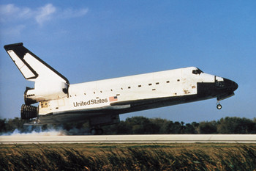

Imagination and getting good ideas
Imagination is a second crucial ability required to be creative in engineering and science, imagination with the constraints I have talked about: known physical laws, correct observation and experimentation, feasibility, practicality. Begin with the far reaches of imagination at the science fiction level, then apply the constraints gradually.

Slide 37

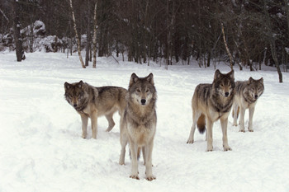
Lone wolf or leader of the pack
There are two opposite personality traits that can contribute to getting good ideas. One personality trait is to be a lone wolf, a contrarian in your field. The opposite is to lead the pack of colleagues and competitors. I prefer the contrarian style. If others are successfully developing a new technology I’d rather copy it or buy it.

Slide 38
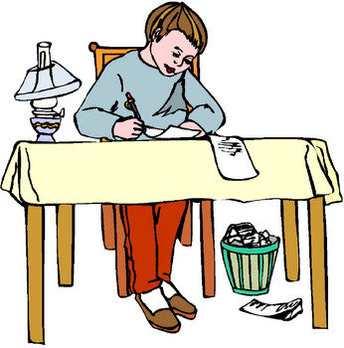
Keep busy between good ideas by computing or designing or building even if it is routine.

Slide 39
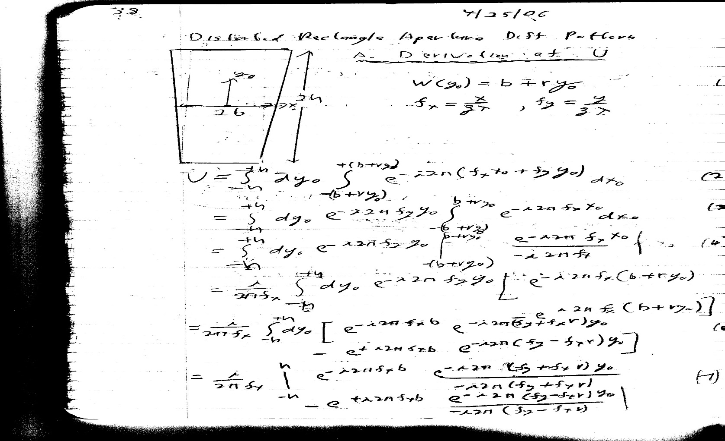
Keep a notebook

Slide 40
The Art of Obsession In Computing, Engineering and Science

Slide 41

Obsession is important when you have a good computing, engineering or science idea
When you are imagining and visualizing an idea that you expect to be fruitful it is important to be obsessed with the idea. Think about the idea as much as possible, neglecting boyfriends, girlfriends, children spouses. Obsession will bring immersion of your mind into all the aspects of the idea: what has been done on related ideas, compatibility with physical laws and mathematics and logic, feasibility, practicality, extensions, variations.

Slide 42
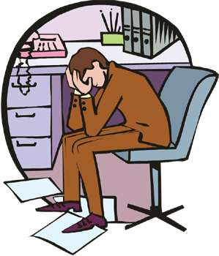

But if the course of the work you find that someone has a better idea or that you have run out of money or that the idea has a serious flaw. Give up the obsession
and move on

Slide 43
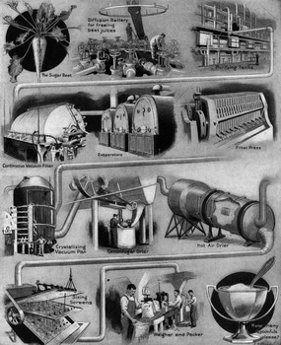
You must be interested in, even enchanted by some of the technology or software or mathematics you use. Then the bad days are not so bad

Slide 44
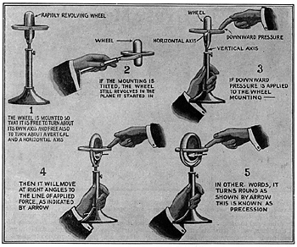
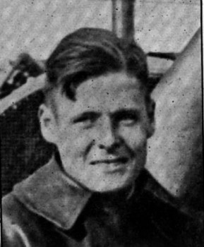
Another advantage of being enchanted by the technology or the programming or the mathematics is that you will be more likely to think of improvements and variations.
Sperry

Slide 45
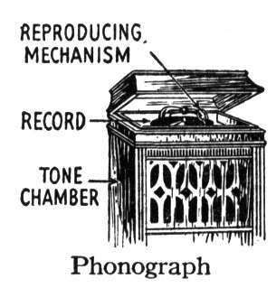

You should be fond of the technology or mathematics or programs that you use, but not too much in love with the technology or mathematics or programs. There may be a better way.

Slide 46
Understanding the Relationship Between Critical and Creative Thinking
an integrated relationship

Slide 47
“The critical & creative functions of the mind are so interwoven
That neither can be separated from the other without an essential loss to both.”
anonymous

Slide 48
In Webster’s Dictionary of Synonyms
“The word ‘critical’ when applied to persons who judge and to their judgments, not only may, but in very precise use does, imply an effort to see a thing clearly and truly so that not only the good in it may be distinguished from the bad and the perfect from the imperfect, but also that it as a whole may be fairly judged and valued.”

Slide 49
In Webster’s New World Dictionary, the word ‘creative’ has three interrelated meanings:
Creating or able to create,
Having or showing imagination or artistic or intellectual inventiveness
Stimulating the imagination and inventive powers

Slide 50
Criticality assesses; creativity originates
Critical and creative thought are both achievements of thought.

Slide 51
Creativity masters a process of making or producing
Criticality masters a process of assessing or judging

Slide 52
Intellectual discipline and rigor are at home with originality & productivity
In critical thinking we assess thinking to make improvements.
In creative thinking we generate thinking based on our sense of how to make things better.

Slide 53
Thus critical thinking has a creative component to produce a better product of thought
And creative thinking has a critical component to reshape thinking in keeping with criteria of excellence.

Slide 54
Critical thinking without a creative output is merely negative thinking.
Creative thinking without a critical component is merely novel thinking.
It is easy to be merely negative or novel in one’s thought.

Slide 55
Achieving quality requires standards of quality---and hence criticality
Achieving useful produces of one’s thinking requires a sense of how to make, or recast, one’s thinking at a higher level.

Slide 56
To achieve any challenging end, we must have:
criteria, gauges, measures, models, principles, standards, or tests to use in judging whether we are approaching that end.

Slide 57
We don’t achieve excellence in thinking with no end in view. We design for a reason
With standards that enable us to generate a product that meets crucial criteria. Our creative thinking must be tested against critical standards.

Slide 58
The generative power of our thought represents its creativity
The judiciousness of our thought represents its criticality.
Generativeness must be married to judiciousness to achieve excellence.

Slide 59
A Necessary Condition to the Development of Critical and Creative Thinking is:
A Questioning Mind

Slide 60
Some Common Knowledge of Computer Science

Slide 61
Algorithm
In mathematics and computer science, an algorithm is a self-contained step-by-step set of operations to be performed. Algorithms perform calculation, data processing, and/or automated reasoning tasks.
Given an input produces a definite output.

Slide 62
Turing machine
A Turing machine is an abstract machine that manipulates symbols on a strip of tape according to a table of rules; to be more exact, it is a mathematical model of computation that defines such a device. Despite the model's simplicity, given any computer algorithm, a Turing machine can be constructed that is capable of simulating that algorithm's logic.

Slide 63
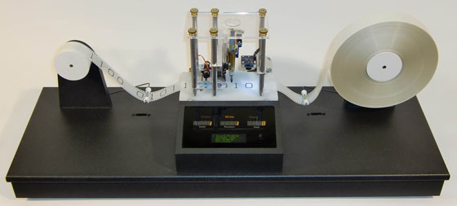
Turing machine

Slide 64
halting problem
In computability theory, the halting problem is the problem of determining, from a description of an arbitrary computer program and an input, whether the program will finish running or continue to run forever.
Alan Turing proved in 1936 that a general algorithm to solve the halting problem for all possible program-input pairs cannot exist. A key part of the proof was a mathematical definition of a computer and program, which became known as a Turing machine; the halting problem is undecidable over Turing machines. It is one of the first examples of a decision problem.

Slide 65
Complexity Classes
Class P: problems that can be solved in polynomial time by a deterministic TM.
  O (n^{k}) for some constant k.
Class NP: problems that can be solved in polynomial time by a nondeterministic TM
  Hard problems like the binpacking are in NP (as well as all problems in P).

Slide 66
Problem Classes
Simulating Universe: O(n³)
Undecidable
NP
P
Decidable
Halting Problem
Sorting: Θ(n log n)
Packing: O(2^{n})

Slide 67
P = NP?
Is there a polynomial-time solution to the “hardest” problems in NP?
No one knows the answer!
The most famous unsolved problem in computer science and math
Listed first on Millennium Prize Problems
  win $1M if you can solve it
  (also an automatic A+ in this course )

Slide 68
Traveling Salesperson Problem
  Input: a graph of cities and roads with distance connecting them and a minimum total distant
  Output: either a path that visits each with a cost less than the minimum, or “no”.
If given a path, easy to check if it visits every city with less than minimum distance traveled

Slide 69
Graph Coloring Problem
  Input: a graph of nodes with edges connecting them and a minimum number of colors
  Output: either a coloring of the nodes such that no connected nodes have the same color, or “no”.
If given a coloring, easy to check if it no connected nodes have the same color, and the number of colors used.

Slide 70
Decision and Optimization Problems
Decision Problem: computational problem with intended output of “yes” or “no”, 1 or 0
Optimization Problem: computational problem where we try to maximize or minimize some value
Transformation of two problems: Introduce parameter k and ask if the optimal value for the problem is a most or at least k. Turn optimization into decision

Slide 71
Complexity Class P
Deterministic in nature
Solved by conventional computers in polynomial time
  O(1) Constant
  O(log n) Sub-linear
  O(n) Linear
  O(n log n) Nearly Linear
  O(n²) Quadratic
Polynomial upper and lower bounds

Slide 72
Polynomial-Time Reducibility
Language L is polynomial-time reducible to language M if there is a function computable in polynomial time that takes an input x of L and transforms it to an input f(x) of M, such that x is a member of L if and only if f(x) is a member of M.
Shorthand, L^{poly}M means L is polynomial-time reducible to M


Slide 73
NP-Hard and NP-Complete
Language M is NP-hard if every other language L in NP is polynomial-time reducible to M
For every L that is a member of NP, L^{poly}M
If language M is NP-hard and also in the class of NP itself, then M is NP-complete


Slide 74
NP-Hard and NP-Complete
Restriction: A known NP-complete problem M is actually just a special case of L
Local replacement: reduce a known NP-complete problem M to L by dividing instances of M and L into “basic units” then showing each unit of M can be converted to a unit of L
Component design: reduce a known NP-complete problem M to L by building components for an instance of L that enforce important structural functions for instances of M.

Slide 75
Research Measurement

Slide 76
Are these papers good?
How to measure whether papers are good or not?
Check the outlet (where the paper was published)
Check the “level” of journals/conferences
  Web of Science
  Journal Citations Index

Slide 77
Journal Impact Factor
The impact factor (IF) of an academic journal is a measurement to reflect the average number of citations to recent articles published in that journal.
The notion of IF was proposed by Eugene Garfield, the founder of the Institute for Scientific Information.
The impact factors have been calculated annually from 1975. The results are indexed in the Journal Citation Reports.

Slide 78
Journal Impact Factor
An example: IEEE Transactions on Software Engineering has an impact factor of 2.59 in 2012.
This means, the papers published in IEEE Transactions on Software Engineering in 2010 and 2011 received 2.59 citations each on average in 2012.
Hence, there is a notion of five-year IF.

Slide 79
H-index
The h-index is an index that is used to measure both impact and productivity of a scientist’s published work.
The index is measured based on the set of most cited papers and the number of citations on those papers.
This index was proposed by Jorge E. Hirsch, and therefore it is known as the Hirsch index.

Slide 80
H-index
A scholar has an index h if h of N papers have at least h citations each, and the rest of (N-h) papers have no more than h citations each.
That means, a scholar with an index of h has published h papers, where each of those papers has been cited by at least h times.

Slide 81
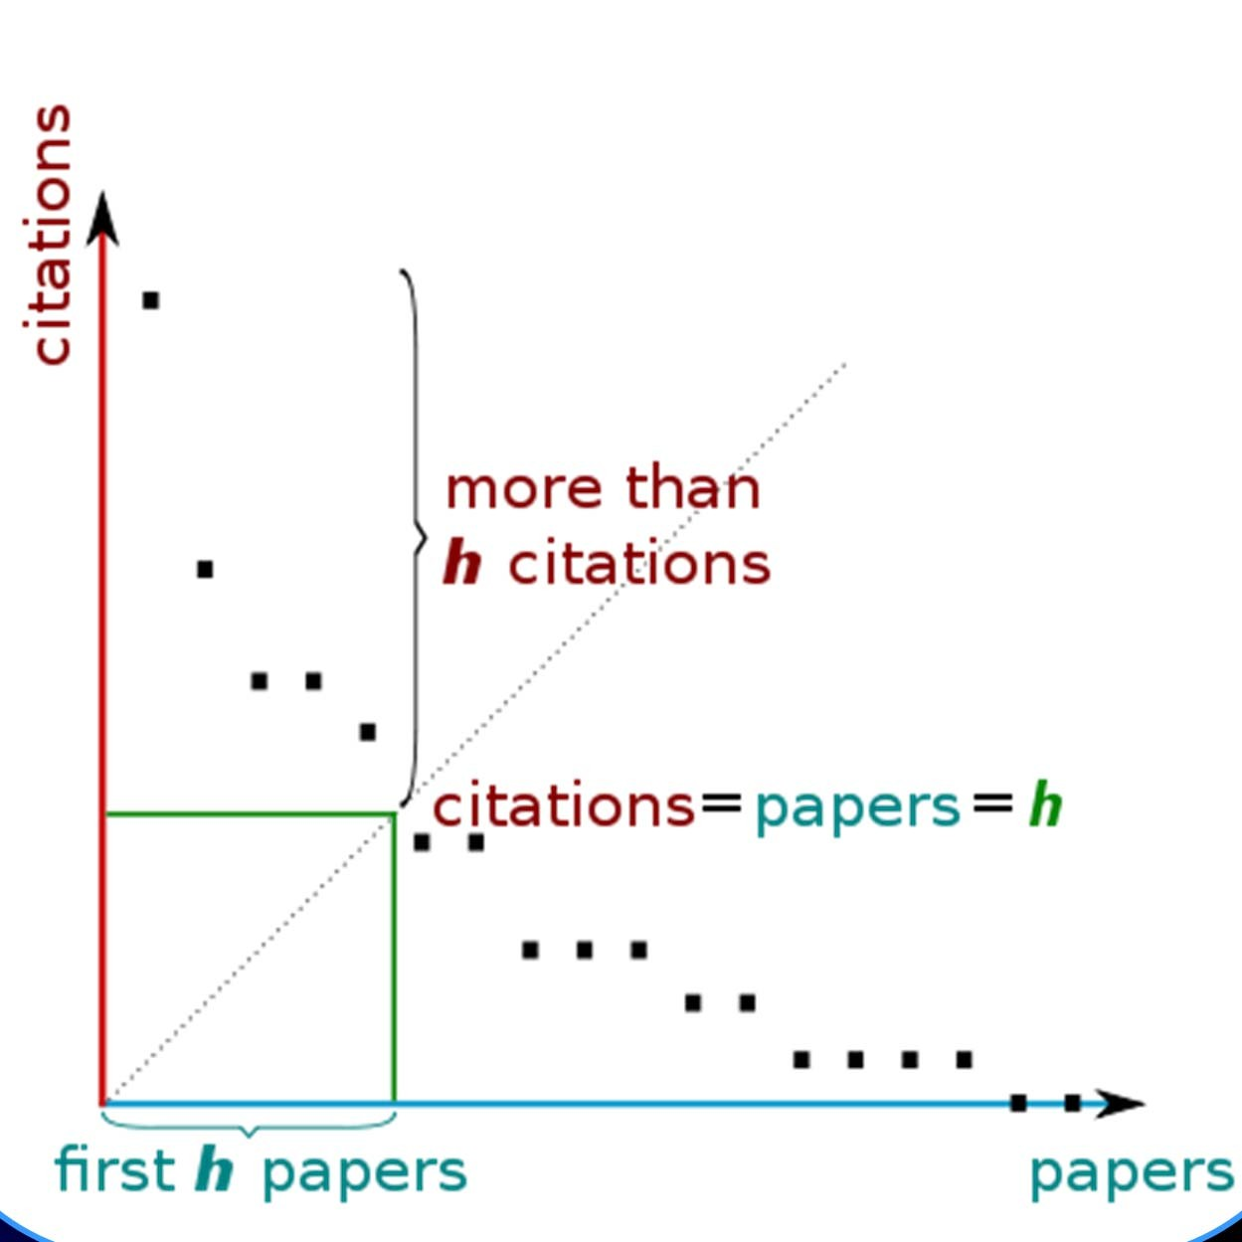
H-index
Wikipedia

Slide 82
G-index
g-index is used for quantifying scientific productivity based on publication record, which was suggested in 2006 by Leo Egghe.
“Given a set of articles ranked in decreasing order of the number of citations that they received, the g-index is the (unique) largest number such that the top g articles received (together) at least g² citations.” (Wikipedia)

Slide 83
Finally
Select your papers CAREFULLY!
Only find GOOD papers – published in GOOD outlet and written by GOOD authors – in order to acquire a good literature review.

Slide 84


