Slide 1
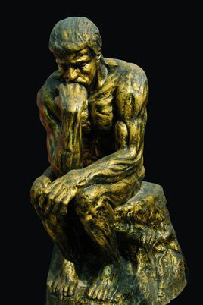



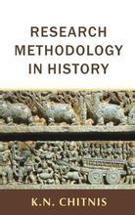
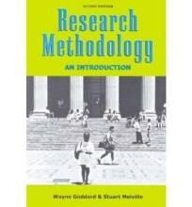


CSCI940
CS Research Methodology Autumn Session 2022

Slide 2
CS Research Methodology
Time: Thursday 14:00-16:00
Venue: N327

Slide 3
Questions
What are students’ backgrounds?
What is Computer Science?
What is research?
Who have conducted a research?
What is research methodology?
What is the objective of research?

Slide 4
Highlights of Lecture 01
Information on this subject
Basic Terminology
Nature of research
Research steps
Appendix

Slide 5
CSCI940 Assessment
 | Assessment Name | Assessment Weight | Mapping to Subject Learning Outcome | Task Due
1 | Individual Assignment | 5% | SLO1 | 12 Mar 2022 (Saturday in Session Week 3) Final submission time: 6:00pm
2 | Individual Assignment | 20% | SLO2, SLO3, SLO4 | 9 April 2022 (Saturday in Session Week 8) Final submission time: 6:00pm
3 | Individual Assignment | 25% | SLO1, SLO2, SLO3, SLO4 | 11 May 2022 (Saturday in Session Week 12) Final submission time: 6:00pm
4 | Exam | 50% | SLO1, SLO2, SLO3, SLO4 | JI Exam Period

Slide 6
CSCI940 Assessment
NOTES:
written submissions in LaTex (pdf)
seminar criteria:
  Good introduction to the area (for novices), including statement of the problem, approaches to date and their strengths/weaknesses, remaining research questions etc.
  Use of diagrams to illustrate points
  Remaining within time limits (not too much content),
  Clear expression, handling of questions etc.

Slide 7
CSCI940 Assessment
Topic: must be around “AI (Artificial Intelligence)”
prefer being around “AI + education” .
Nominate your topic and Submit it to me
  Deadline: week 3 and discuss in tutorial session
  If you miss the deadline, you will receive 0 for presentation
  Presentation schedule: Volunteer + Random
How to find research papers related to your topic?

Slide 8
Lecture Schedule (to be revised)
Week | Lecture Topics |  | Readings/Other subject information | Task Due
1 (21 Feb) | Introduction |  | Practice LaTeX via tutorials
2 (28 Feb) | Annotating bibliographies |  | Assignment 1: Annotated bibliography Analyzing and annotating papers
3 (7 Mar) | Critical Reading |  | Effectively read research papers | Assignment 1
4 (14 Mar) | Research design |  | Methods and process of research design Assignment 2: write a survey
5 (21 Mar) | Survey Writing |  | Importance and steps of writing survey
6 (28 Mar) | Data collection |  | standard and other aspects of data
7 (4 April) | Research problems |  | Refining and defining research problem | Assignment 2
8 (11 April) | Proposal Writing |  | Assignment 3: write a proposal
9 (18 April) | Experimental design |  | Considerations of designing experiments
10 (25 April) | Case study: Problem Definition |  | Samples of defining proper research problems
11 (2 May) | Case study: Method Evolution |  | Samples of evolving methods to solve problems
12 (9 May) | Case study: Theory Building |  | Samples of building theory on solving problems | Assignment 3
13 (16 May) | Revision
 | Examinations

Slide 9
CSCI940 On-Line Material
Moodle: lecture notes (PDFs); LaTex Intro, research papers, etc.
Required software:
  Miktex (for Windows)
  MacTex (for Mac)
  Texmaker (for both Windows and Mac) Download & install on your PC prior to week # 2

Slide 10
Highlights of Lecture 01
Information on this subject
Basic Terminology
Nature of research
Research steps

Slide 11
Primary purposes of grad education
To understand thoroughly and think critically about what is known in your chosen field and its theoretical foundations
To master skills to implement software projects
To learn how to conduct research
To begin affiliating with the academic community
To master skills (including research/ experimentation/publication/etc) necessary for your career

Slide 12
7 Keys to Success in Graduate Study
1. Be proactive – take responsibility for your own grad school experience
2. Establish positive relationships with your
relevant persons in study
3. Embrace your academic community
Know your program requirements and timelines
Create and follow an annual plan
Bring a professional approach to your studies and interactions
7. Seek balance and support in your life

Slide 13
CSCI940 Aims
  Develop the skills necessary to undertake scholarly research * (research ≠ coursework!)
  Develop written communication skills through the production of a critical literature review, etc;
  Develop problem solving skills, logical thinking, and idea development techniques in the identification of appropriate research questions;
  Develop quality and quantity evaluattion skills ;
  Develop the ability to conduct independent research of new topics as well as oral communication skills through the presentation of a research seminar on contemporary computer science issues.

Slide 14
CSCI940 OUTCOMES
On successful completion of this subject, students will be able to:
Demonstrate skills necessary to undertake scholarly research through the conduct of a critical literature review.
Demonstrate written communication skill through the production of a literature review report.
Demonstrate oral communication skill through presentation of research seminars.
Demonstrate problem solving skill and idea development techniques literature review and research question identification.
Demonstrate ability to conduct independent research of new topics through the presentation of research seminar on contemporary computer science issues.

Slide 15
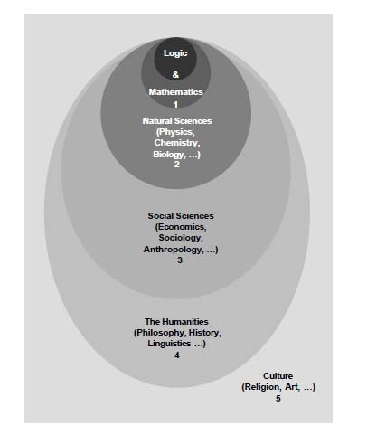
Relations of Different Studies

Slide 16
Hermeneutics: a method or principle of interpretation
Holism (from Greek ὅλος holos "all, whole, entire") is the idea that systems (physical, biological, chemical, social, economic, mental, linguistic, etc.) and their properties should be viewed as wholes, not as collections of parts. This often includes the view that systems function as wholes and that their functioning cannot be fully understood solely in terms of their component parts.

Slide 17
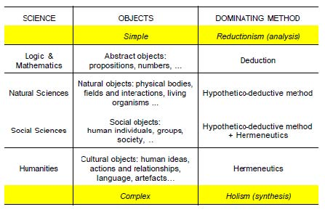

Slide 18
Methodology and Method
Methodology - the study of the methods involved in some field, endeavor, or in problem solving
Method - a systematic codified series of steps taken to complete a certain task or to reach a certain objective
Methodology refers to more than a simple set of methods; it refers to the rationale and the philosophical assumptions that underlie a particular study.
Methodology : "the analysis of the principles of methods, rules, and postulates employed by a discipline"; "the systematic study of methods that are, can be, or have been applied within a discipline"; or "a particular procedure or set of procedures."
a collection of theories, concepts or ideas
comparative study of different approaches
critique of the individual methods
In recent years methodology has been increasingly used as a pretentious substitute for method in scientific and technical contexts

Slide 19
Research and Problem
Generally, research is the organised and systematic method of finding answers to problems. It is systematic because it is a process broken up into clear steps that lead to conclusions. Research is organised because there is a planned structure or method used to reach the conclusion.
Research is only successful if we find answers/solutions, whether we like these answers/solutions or not.
Research is focused on relevant, useful and important questions. If there are no questions, there can be no research.
Research problems are the identified valuable gaps in your research area. Identifying appropriate research problems is a critical step of research.
4

Slide 20
Highlights of Lecture 01
Information on this subject
Basic Terminology
Nature of research
Research steps

Slide 21
The Nature of Research
The “scientific method” attempts to minimize the influence of the researchers' bias on the outcome of an experiment.
The researcher may have a preference for one outcome or another, and it is important that this preference not bias the results or their interpretation.
Sometimes "common sense" and "logic" tempt us into believing that no test is needed.
Another common mistake is to ignore or rule out data which do not support the hypothesis.
But there is no single, universal formal “scientific method”.
There are several variants and each researcher needs to tune the process to the nature of the problem and his / her working methods.
4

Slide 22
The Nature of Research
Some definitions of research:
“the systematic, controlled, empirical and critical investigation of natural phenomena guided by theory and hypotheses about the presumed relations among such phenomena” (Kerlinger, 1986)

Slide 23
The Nature of Research
Some definitions of research:
  “the systematic, controlled, empirical and critical investigation of natural phenomena guided by theory and hypotheses about the presumed relations among such phenomena” (Kerlinger 1986)
  “a systematic, formal, rigorous, and precise process employed to gain solutions to problems and/or to discover and interpret new facts and relationships.” (Waltz & Bausell 1981)

Slide 24
The Nature of Research
Some definitions of research:
  “an activity that contributes to the understanding of a phenomenon
i.e. a set of behaviours of some entities that are of interest to a researcher or a group of researchers (research community). The activities that a research community uses to generate understanding are its research methods (Vaishnavi & Kuechler, 2004)

Slide 25
The Nature of Research
*NB=:not be*
research is NOT “reinventing-the-wheel”, hence the importance of undertaking a (critical) survey of the published literature in the field under study, prior to starting your work.

Slide 26
The Nature of Research
*NB* research is NOT “re-inventing-the-wheel”, hence the importance of undertaking a (critical) survey of the published literature in the field under study, prior to starting your work.
It is also NOT the application of known techniques to a problem of interest; this is Development part of R&D
  it is, by its very nature, something new...
    ...not necessarily a thing; it could be a method, a new way of conceptualizing/looking at things, etc.

Slide 27
The Nature of Research
It is also NOT (just) = thesis writing, although this is an important aspect; research = the activity that precedes the “paperwork/writing paper”, as it were.

Slide 28
The Nature of Research
It is also NOT (just) = thesis writing, although this is an important aspect; research = the activity that precedes the “paperwork”, as it were.
This paperwork is important however, in that researchers are pre-disposed to write (journal articles/book chapters) and talk (conference presentations/seminars) about their findings/achievements,

Slide 29
The Nature of Research
It is also NOT (just) = thesis writing, although this is an important aspect; research = the activity that precedes the “paperwork”, as it were.
This paperwork is important however, in that researchers are pre-disposed to write (journal articles/book chapters) and talk (conference presentations/seminars) about their findings/achievements,
  Indeed, this is expected of them for a successful career in academia (i.e. “publish-or-perish” still holds!)
  However this raises the issue of publication quality versus quantity and the need for discrimination in the searching of on-line publication databases, as well as the critical evaluation of the results of these searches.

Slide 30
Highlights of Lecture 01
Information on this subject
Basic Terminology
Nature of research
Research steps

Slide 31







Classical phases
1
2
3
4
5
6
7
Research question / Problem
Background / Observation
Formulate hypothesis
Design experiment
Test hypothesis / Collect data
Interpret / Analyze results
Publish findings
© L. M. Camarinha-Matos, 2009-2012

Slide 32

The Steps in Research
The following generic process may not be applicable to all research projects but it is applicable to most:
Choose a problem/question
Review the published literature
Define the research problem/question
Develop a hypothesis [or objectives]
Choose a method
Carry out the research
Analyse your data
Write up your results AND conclusions
Identify significance, limitations and future research
NOTE: Very often we have to conduct some steps iteratively

Slide 33
Step 1: Choose a research question/problem
EXAMPLE (1 single question)
Which methods and tools should be developed to make current manufacturing control / supervision systems reusable and swiftly modifiable?
EXAMPLE (multiple questions)
Q1: What are the main components of logistics costs that determine the logistics and transport network design?
Q2: To what extent are the existing network design and evaluation models sufficient and how can collaboration be incorporated in the network design methodology?
Q3: How can economies of scale and scope, present in the newtork, be taken into account in the network design?
Q4: Is it possible to set boundaries to the development path of the network, and search for a feasible path instead of searching solely for a feasible solution?
© L. M. Camarinha-Matos, 2009-2012

Slide 34
Problem Selection
Criteria could include:
  Access to information
  Access to resources
  Theoretical background/doable by some reasoning
  Value of research
  Researcher’s skills
  Is question big enough AND small enough
    Pick a topic that is sufficiently "narrow" that your research is focused, but not so narrow that you can't find any information on the topic.
  Overall probability of successful completion
  Interest to researcher

Slide 35
Step 2 Literature Survey
How to collect the relevant materials?
How to select the collected relevant materials?
How has the work been done previously?
What similar work has been leading up to this point?
Study state of the arts (literature review, projects, informal discussions, etc).
Optional realization of preliminary experiments.
What distinguishes previous work from what you want to do?
Who / What will be impacted by this research?
© L. M. Camarinha-Matos, 2009-2012

Slide 36
Literature Survey
Golden standard: an ideal/pursuit aim.
You need to ensure that there is “a gap” in “the published literature”.
  A gap may be a problem that has not been solved, a question that has not been answered etc.
Previous articles (especially survey ones) can give you a “head start”/“launching pad” from where to commence your project; pay particular attention to the ‘Conclusion & Suggestion for Further Work’section.
See also our earlier comments are not “re-inventingthe-wheel”.

Slide 37
Literature Survey
Although it can be quite time consuming, reviewing the literature will help you to decide:
  which factors (i.e. variables) are important,
  how to measure (i.e. assess) them, and
  what findings to expect.
If you don't review the current literature, you are missing out on a lot of good information and you will be considered "lazy" by other researchers and thesis examiners!

Slide 38
Annotated Bibliography
As you read each article/source, you should make notes either on paper or on computer
  Keep the full bibliographic details for each article in case you decide to use it in your thesis
  Indicate why it is relevant to your project/research
  Indicate whether it supports your point of view or not
  Indicate if there are any errors in the article
  The bibliography should be as comprehensive as possible, given your time constraints. It should be mainly credible, current sources, but it may also include older seminal works - i.e. important foundational works in your discipline
    [we will return to this issue later in the Session]

Slide 39
e.g. Annotated Bibliography
Title of Honours Project = “Success Factors for Knowledge Management: ... in large organizations”:
JOHNSON, Cindy. Leveraging knowledge for operational excellence. The Journal of Knowledge Management. Sept.1977, V.1(1) pp.50-55.
  This article covers KM at Texas Instruments (TI). The article was written by the CKO of TI and is biased toward Texas Instruments’ KM program. It contains valuable details of the benefits gained by TI from their KM activities.
JARVENPAA, S. and STAPLES, S. Exploring perceptions of organizational ownership of information Journal of Management Information Systems. Summer, 2001, V.18(1) pp.155-183
  An interesting article on perceptions of KM in organizations. Very relevant to this project as ownership rights are an important issue with KM. The article also contains information about how culture impacts these perceptions.

Slide 40
Step 3: Research Question / Problem Identification
The most important step in research!
Often comes from the thought: “What we have now is not quite right/good enough – we can do better ...”
The research question defines the “area of interest” but it is not a declarative statement like a hypothesis.
The central research question may be complemented by a few secondary questions to narrow the focus.
Research question must be capable of being confirmed or refuted or experimented.
The study must be feasible.

Slide 41
Research Question
The research problem/question is what you want to solve or answer. The literature review will help you decide which questions are important, especially as you gain familiarity with the topic.
  E.g. you might discover while reading about OS that performance of OS is very poor, especially for proprietary OS.
  Based on this, you might decide to examine whether functional performance of proprietary OS has improved over time.

Slide 42
Research Question
Defining the research question is important because it guides your choice of methods (and research design).
  If your question was:“Has the functional performance of proprietary OS improved over time?”, you could:
    conduct a survey of users (but that would only tell you if users’ perceptions had changed, not the actual performance).
    conduct some laboratory benchmarking experiments (so this is a better method for this question)
  Your methods must be appropriate to your research question. Hence, you should understand what kind of problem you are working on and what the methods are used to this problem before.

Slide 43
Research Question
Avoid gathering data about other questions;
  e.g. about the cost of operating systems, their ease of use, their ability to run on multiple platforms.
Try to avoid overly simple inquiries such as: “Are current OS any good?”
  This question is too vague to answer and there is already a lot of information available on the question.
BUT, just because a question has been asked and answered in the past doesn't prevent you from doing more research on it; you can ask new questions or otherwise extend the usefulness of earlier research.

Slide 44
Research Question
You may replicate an existing research study. Usually, replications are undertaken to validate or generalize the findings from the first study, or apply to another time, place or population.
E.g. the most recent academic* study on the performance of OS is 3 years old. You do not believe that these findings are still valid because of the improvements in both hardware and OS.
You therefore decide to replicate an earlier benchmarking study to see if there has been a change

Slide 45
Step 4: Formulate Hypothesis
A scientific hypothesis states the ‘predicted’ (educated guess) relationship amongst variables.
Serve to bring clarity, specificity and focus to a research problem
... But are not essential
... You can conduct valid research without constructing a hypothesis
... On the other hand you can construct as many hypothesis as appropriate stated in declarative form. Brief and up to the point. A possible format (formalized):
“If ...... then .... (because ....) “
1
In the case of a PhD dissertation, one hypothesis after tested becomes a thesis being defended.
One dissertation may include more than one thesis. Sometimes people refer to the dissertation as the “thesis”.
© L. M. Camarinha-Matos, 2009-2012

Slide 46
Characteristics of a hypothesis
Should be simple, specific and conceptually clear.
... ambiguity would make verification almost impossible.
Should be capable of verification.
... i.e. There are methods and techniques for data collection and analysis.
Should be related to the existing body of knowledge.
... i.e. Able to add to the existing knowledge.
Should be operationalisable
... i.e. Expressed in terms that can be measured.
© L. M. Camarinha-Matos, 2009-2012

Slide 47
Development of a Hypothesis (or objectives)
A hypothesis = a statement of the relationships between the variables that a researcher intends to study.
Hypotheses are testable: you should be able to gather data that either confirms or rejects the hypothesis (however it may not be possible to do this in practice)
  e.g. H1: an explosion in the earth’s core will rupture the planet.

Slide 48
Development of a Hypothesis (or objectives)
In much exploratory research, we do not know enough about the variables involved to formulate a hypothesis.
In such a case: do not state a hypothesis in your research. Once you state a hypothesis, you MUST test it.
Hypotheses are formulated before we do our research. It's not valid to do the research, poke around in the data, and then write up a hypothesis that ‘fits’ what we found.

Slide 49
Development of a Hypothesis (or objectives)
Hypotheses should be based on theory and what previous researchers have found; they are not just made up ‘off the cuff.’
Hypotheses are scientifically reasonable predictions.
Good hypotheses should be falsifiable:
  E.g. “All crows are black”– can be falsified by finding a single grey crow
  E.g. “Most crows are black” – cannot be falsified unless all crows are examined and a tally kept of colour variations

Slide 50
Development of a Hypothesis (or objectives)
If you are not doing work with clear hypotheses, define your objectives:
State all the things you want to find out or achieve and describe them clearly and unambiguously
  (i) to measure the speed of 3 versions of a proprietary OS on a set of benchmark tests running on the lowest feasible hardware platform;
  (ii) to identify functions provided by 3 different versions of a proprietary OS;
  (iii) to measure the resource utilization of 3 versions of a proprietary OS on a set of benchmark tests running on the lowest feasible hardware platform.

Slide 51
Step 5 Choose a Method & Metrics
Once you have a clear hypotheses or clear objectives, decide which method(s) will allow you to test the hypotheses or achieve the objectives
Methods include:
  Formal experiments and quasi experiments
  Field studies
  Surveys: questionnaires and interviews
  Observational studies
  Case studies
    *System, method or model building ... etc.

Slide 52
Choose a Method & Metrics
Metrics are how we measure our concepts. Concepts are seldom easy to measure.
Let's say I want to measure performance of proprietary OS
  How do I define ‘proprietary’?
  What do I mean by ‘current versions of an OS’?
  What do I do about a new beta release of an OS?
  What do I mean by ‘performance’ – speed, number of correct results, ease of use?
  What do I do about hardware - e.g. could I compare Windows 2000, Windows XP and Windows Vista using an i386 PC with 256K of RAM?
  Perhaps I mean “performance per clock cycle”?

Slide 53
Choose a Method & Metrics
One way is to read the literature - see what other people did. Chances are that someone else has studied OS performance and written up how to measure it.
You could use their measures or make your own based on their ideas.
You could also use the same method as them.
If you use a different method or a new metric, you MUST justify the new method or new metric.

Slide 54

The Steps in Research
The following generic process may not be applicable to
all research projects but it is applicable to most:
  Choose a problem/question
  Review the published literature
  Define the research problem/question
  Develop a hypothesis [or objectives]
  Choose a method
  Carry out the research
  Analyse your data
  Write up your results AND conclusions
  Identify significance, limitations & future research
(*NB* we will return to 8 & 9 later in the Session)

Slide 55
Step 6 The Research ‘Story’
For all research in our broad (ICT) discipline, there is really only one “story” that you need to tell, irregardless of whether this is:
  In your research report (thesis),
  In any seminar you give,
  In any paper you write based on your project, or
  In the poster you present at the Research Showcase.
The story goes like this...

Slide 56
The Research ‘Story’
There’s an interesting problem/question that hasn’t been solved/answered but I think I know how ...
Here is what you need to know to understand all the dimensions/factors in that problem
  Now you can see that, to solve the problem, I have got to achieve certain objectives
This is the best method to achieve those objectives
This is what I did
This is what I found it (i.e. results)
  This is why it is important (i.e. discussion)
  This is what I didnot do (limitations)” (i.e. conclusion+ further work)
If you can tell that story convincingly, you have done it.
  [we will return to later in the Session re Thesis Writing]

Slide 57
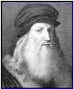
Design experiment
Includes planning in detail all the steps of the experimental phase. In engineering research it often includes the design of a prototype / system architecture.
Identify the variables that will be manipulated and measured – the research outcomes must be measurable.
In other words:
What needs to be controlled in order to get an umbiased answer to the research question.
Therefore: it is necessary to not only design a prototype / system but
also the thesis validation method !
How to validate the thesis?
The plan should allow others to repeat it. It should be feasible...!
Plan intermmediate milestones.
“All sciences are vain and full of errors that are not born of experience, Mother of all certainty, and that are not tested by experience….”
Leonardo da Vinci
If you fail to plan, you planned to fail !
© L. M. Camarinha-Matos, 2009-2012
2

Slide 58


Step 7: Collect data &Test hypothesis
Doing it !
Implementation of methods (e.g. prototyping) and auxiliary tools (e.g. simulation)
Pilot testing and refinement. Field vs. Laboratory work.
Any ethical considerations ? Confirm results by retesting !
© L. M. Camarinha-Matos, 2009-2012

Slide 59
Interpret / Analyze results
What did your experiment show? Qualitative data analysis.
Quantitative data analysis.
Descriptive and inferential statistics, clustering, ...
What might weaken your confidence in the results (critical spirit)? Discussion regarding
Literature
Research objectives Research questions.
Consider next steps
Recommendations for further research.
© L. M. Camarinha-Matos, 2009-2012

Slide 60


Step 8: Publish Findings
A research result is not a contribution to the field if no one knows about it or can use it !
Write scientific papers, make presentations
Intermediate results
<=>Conferences
Collect feedback
Publish or perish !
Consolidated results <=>Journals
Be careful in selecting where you publish !
Reviewed? Indexed? Science Citation Index?
Web of Science?
Sponsors?
IEEE? IFIP? IFAC?
28

Slide 61
Attributes of Good Papers
It should be contestable, proposing an arguable point with which people could reasonably disagree.
A strong thesis is provocative;
it takes a stand and justifies the discussion you will present.
It is specific and focused.
A strong thesis proves a point without discussing “everything about …”
Instead of music, think "American jazz in the 1930s" and your argument about it.
It clearly asserts your own conclusion based on evidence.
Note: Be flexible. The evidence may lead you to a conclusion you didn't think you'd reach. It is perfectly OK to change your thesis!
It provides the reader with a map to guide him/her through your work. It anticipates and refutes the counter-arguments
It avoids vague language (like "it seems").
It avoids the first person. ("I believe," "In my opinion")
It should pass the “So what? or Who cares?” test
(Would your most honest friend ask why he should care or respond with "but everyone knows that"?)
For instance, "people should avoid driving under the influence of alcohol“, would be unlikely to evoke any opposition.
http://www.sdst.org/shs/library/thesis.html
© L. M. Camarinha-Matos, 2009-2012
29

Slide 62
Is it a good thesis ?
How do you know if you've got a solid tentative thesis?
Try these five tests:
Does the thesis inspire a reasonable reader to ask, "How?" or Why?“
Would a reasonable reader NOT respond with "Duh!" or "So what?" or "Gee, no kidding!" or "Who cares?“
Does the thesis avoid general phrasing and/or sweeping words such as "all" or "none" or "every"?
Does the thesis lead the reader toward the topic sentences (the subtopics needed to prove the thesis)?
Can the thesis be adequately developed in the required length of the paper or dissertation?
http://www.sdst.org/shs/library/thesis.html
0
MORE:
Can you “prove” it ?

Slide 63
Proof of concept
“Proof-of-Concept Prototype is a term that (I believe) I coined in 1984. It was used to designate a circuit constructed along lines similar to an engineering prototype, but one in which the intent was only to demonstrate the feasibility of a new circuit and/or a fabrication technique, and was not intended to be an early version of a production design.
[Carsten, 1989]
http://en.wikipedia.org/wiki/Proof_of_concept
Proof of concept is a short and/or incomplete realization of a certain method or idea(s) to demonstrate its feasibility, or a demonstration in principle, whose purpose is to verify that some concept or theory is probably capable of exploitation in a useful manner. A related (somewhat synonymous) term is "proof of principle“.
[Wikipedia]
In applied research a company presented with a project or proposal will often undertake internal research initially, to prove that the core ideas are workable and feasible, before going further. This use of proof of concept helps establish viability, technical issues, and overall direction, as well as providing feedback for budgeting and other forms of commercial discussion and control.
To some extent this applies to the prototyping work done in engineering PhD thesis work.
3
© L. M. Camarinha-Matos, 2009-2012

Slide 64
Presentation languages
Is it necessary to include many formulas and equations? Is it not “scientific” if not full of mathematics?
There are different “languages” used in different disciplines.
E.g. Mathematical formulas, Logical formulas / Set theory formalism, Formal specification languages (e.g. Z, Petri Nets), charts,
semi-formal diagrams (e.g. UML), etc.
Rigor does not necessarily require formal languages.
Do not include formulas just to impress the reader ! But be rigorous and systematic with what you write !!!
Formal models are useful when the area is reaching a good maturity level and it is the time for knowledge consolidation.
When planning your research --- and also after analyzing the common practices in your field --- you need to consider the “language” to use.
2
© L. M. Camarinha-Matos, 2009-2012

Slide 65
Role of simulation
Simulation is an important tool in engineering and research.
In some areas it can cope for unafordable costs with physical experiments
It can also help when the performance of the experiment in the real world would take a long period of time (beyond the duration of the research project
But be careful with its use:
How well does the simulation model reflect the reality?
You might be inferring conclusions based on “artificial worlds” ...
3
© L. M. Camarinha-Matos, 2009-2012

Slide 66
Highlights of Lecture 01
Information on this subject
Basic Terminology
Nature of research
Research steps
Appendix

Slide 67
Artificial Intelligence Masters in History
Introduction about Turing and several master of artificial intelligence who won the Turing Award as followed.

Slide 68
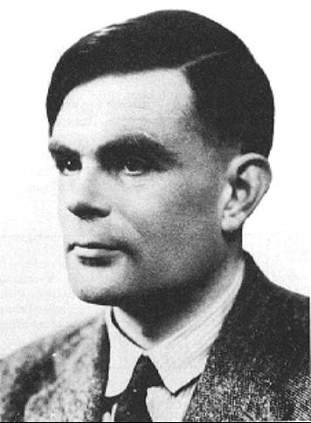
Alan Mathison Turing,
June 23, 1912—
June 7, 1954

Slide 69
Alan Turing
Alan Mathison Turing (23 June 1912 – 7 June 1954) was a pioneering English computer scientist, mathematician, logician, cryptanalyst and theoretical biologist.
He was highly influential in the development of theoretical computer science, providing a formalisation of the concepts of algorithm and computation with the Turing machine, which can be considered as a model of a general purpose computer.
Turing is widely considered to be the father of theoretical computer science and artificial intelligence.

Slide 70

Marniv Lee Minsky

Slide 71
Marniv Lee Minsky
Marvin Lee Minsky (August 9, 1927 – January 24, 2016) was an American cognitive scientist concerned largely with research of artificial intelligence (AI), co-founder of the Massachusetts Institute of Technology's AI laboratory, and author of several texts concerning AI and philosophy.
Minsky won the Turing Award (the greatest distinction in computer science) during 1969,

Slide 72
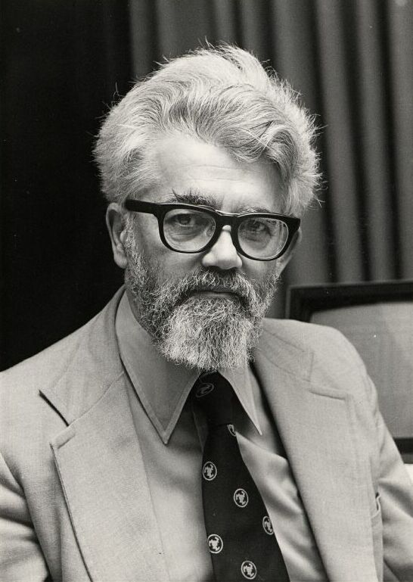
John McCarthy

Slide 73
John McCarthy
John McCarthy (September 4, 1927 – October 24, 2011) was an American computer scientist and cognitive scientist.
McCarthy was one of the founders of the discipline of artificial intelligence.
He coined the term "artificial intelligence" (AI), developed the Lisp programming language family, significantly influenced the design of the ALGOL programming language, popularized timesharing, and was very influential in the early development of AI.
McCarthy received many accolades and honors, such as the Turing Award for his contributions to the topic of AI, the United States National Medal of Science, and the Kyoto Prize.

Slide 74
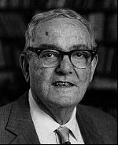
Herbert A. Simon
Notes:
绘画，钢琴，爬山，旅行
司马贺

Slide 75
Herbert A. Simon
Herbert Alexander Simon (June 15, 1916 – February 9, 2001), a Nobel Prize laureate, was an American political scientist, economist, sociologist, psychologist, and computer scientist
With almost a thousand highly cited publications, he was one of the most influential social scientists of the twentieth century.
He was awarded the ACM's Turing Award for making "basic contributions to artificial intelligence, the psychology of human cognition, and list processing" (1975)

Slide 76
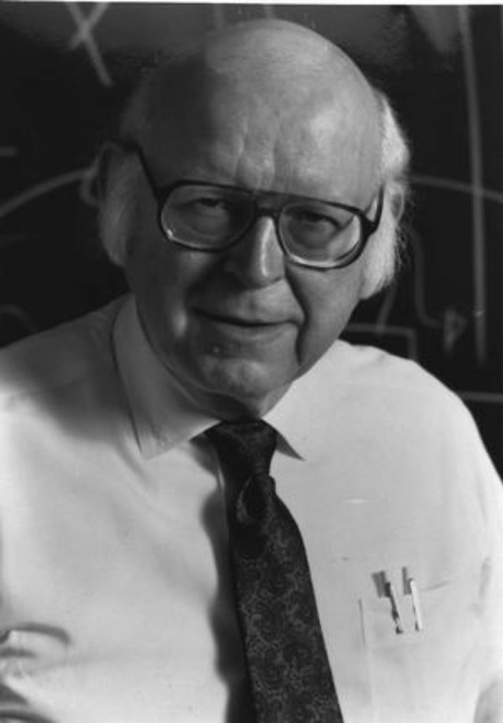
Allen Newell

Slide 77
Allen Newell
Allen Newell (March 19, 1927 – July 19, 1992) was a researcher in computer.
He contributed to the Information Processing Language (1956) and two of the earliest AI programs, the Logic Theory Machine (1956) and the General Problem Solver (1957) (with Herbert A. Simon).
He was awarded the ACM's A.M. Turing Award along with Herbert A. Simon in 1975 for their basic contributions to artificial intelligence and the psychology of human cognition.

Slide 78
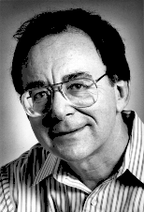
Richard M. Karp

Slide 79
Richard M. Karp
Richard Manning Karp (born January 3, 1935) is an American computer scientist and computational theorist at the University of California, Berkeley.
He is most notable for his research in the theory of algorithms, for which he received a Turing Award in 1985, The Benjamin Franklin Medal in Computer and Cognitive Science in 2004, and the Kyoto Prize in 2008.

Slide 80
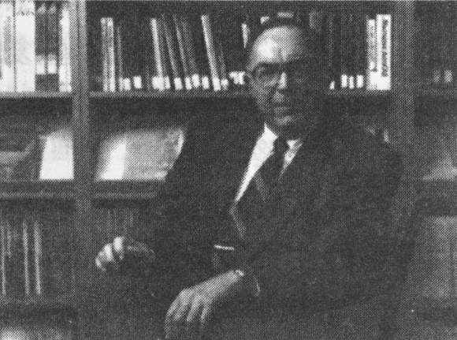
Edward A. Feigenbaum

Slide 81
Edward A. Feigenbaum
Edward Albert Feigenbaum (born January 20, 1936) is a computer scientist working in the field of artificial intelligence, and joint winner of the 1994 ACM Turing Award.
He is often called the "father of expert systems."

Slide 82
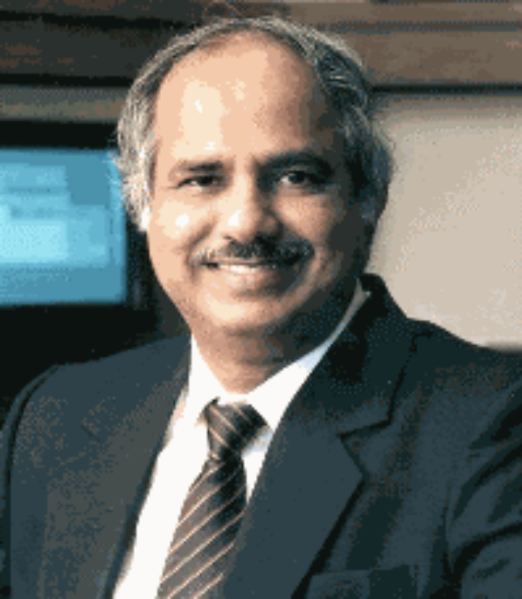
Raj Reddy

Slide 83
Raj Reddy
Dabbala Rajagopal "Raj" Reddy (born June 13, 1937) is an Indian-American computer scientist and a winner of the Turing Award.
He is one of the early pioneers of Artificial Intelligence and has served on the faculty of Stanford and Carnegie Mellon University for over 40 years.
He was the founding director of the Robotics Institute at Carnegie Mellon University.

Slide 84
历史上的人工智能大师
下面介绍图灵和几位获得图灵奖的人工智能大师

Slide 85
阿伦•图灵
（Alan Turing）
计算机科学理论的创始人

Slide 86
阿伦•图灵（Alan Turing）
1912年出生于英国伦敦，1954年去世
1936年发表论文“论可计算数及其在判定问题中的应用”，提出图灵机理论
1950年发表论文“计算机与智能”，阐述了计算机可以具有智能的想法，提出图灵测试
1966年为纪念图灵的杰出贡献，ACM设立图灵奖

Slide 87
马文•明斯基
（Marniv Lee Minsky）
人工智能之父
框架理论的创立者
首位获得图灵奖的人工智能学者

Slide 88
马文•明斯基
（Marniv Lee Minsky）
1927年出生于美国纽约
1951年提出思维如何萌发并形成的基本理论
1956年达特茅斯会议的发起人之一
1958年在MIT创建世界上第一个AI实验室
1969年获得图灵奖
1975年首创框架理论

Slide 89
约翰•麦卡锡
（John McCarthy）
人工智能之父
LISP语言的发明人
首次提出AI的概念

Slide 90
约翰•麦卡锡
（John McCarthy）
1927年出生于美国波士顿
1956年发起达特茅斯会议，并提出“人工智能”的概念
1958年与明斯基一起创建世界上第一个人工智能实验室
发明α－β剪枝算法
1959年开发LISP语言
开创逻辑程序研究，用于程序验证和自动程序设计
1971年获得图灵奖

Slide 91
赫伯特•西蒙
（Herbert A. Simon）
符号主义学派的创始人
爱好广泛的全能科学家
中国科学院外籍院士
Notes:
绘画，钢琴，爬山，旅行
司马贺

Slide 92
赫伯特•西蒙(Herbert A. Simon）
1916年出生于美国的威斯康辛州
1943年在匹兹堡大学获政治学博士学位
1969年因心理学方面的贡献获得杰出科学贡献奖
1975年和他的学生艾伦•纽厄尔共同获得图灵奖
1978年获得诺贝尔经济学奖
1986年因行为学方面的成就获得美国全国科学家奖章

Slide 93
艾伦•纽厄尔（Allen Newell）
符号主义学派的创始人之一
西蒙的学生与同事
1975年与西蒙同获图灵奖

Slide 94
查理德•卡普
（Richard M. Karp）
Proposed“Branch and Bound Method”的三栖学者

Slide 95
查理德•卡普（Richard M. Karp）
1935年出生于美国波士顿
是加州大学伯克利分校三个系的教授：
  电气工程和计算机系
  数学系
  工业工程和运筹学系
60年代提出“分枝界限法”，成功求解含有65个城市的旅行商问题，创当时的记录
1985年获得图灵奖

Slide 96
爱德华•费根鲍姆
（Edward A. Feigenbaum）
知识工程的提出者
大型人工智能系统的开拓者

Slide 97
爱德华•费根鲍姆
（Edward A. Feigenbaum）
1936年出生于美国的新泽西州
通过实验和研究，证明了实现智能行为的主要手段是知识
1977年提出知识工程，使人工智能从理论转向应用
名言：知识蕴藏着力量
1994年和劳伊•雷迪共同获得图灵奖

Slide 98
1963年主编了《计算机与思想》一书，被认为是世界上第一本有关人工智能的经典性专著
1965年开发出世界上第一个专家系统
开发出著名的专家系统MYCIN
80年代合著了四卷本的《人工智能手册》
开设Teknowledge和IntelliGenetics两个公司，是世界上第一家以开发和将专家系统商品化的公司

Slide 99
劳伊•雷迪
（Raj Reddy）
大型人工智能系统的开拓者

Slide 100
劳伊•雷迪（Raj Reddy）
37年出生于印度，66年在美国获得博士
1994年与费根鲍姆共同获得图灵奖
主持过一系列大型AI系统的开发
  Navlab 能在道路行驶的自动车辆项目
  LISTEN 用于扫盲的语音识别系统
  以诗人但丁命名的火山探测机器人项目
  自动机工厂项目，提出“白领机器人学”

Slide 101


