Slide 1
Daisy intelligence Hackathon Presentation
Andy Wang
Jake Sullivan

Slide 2
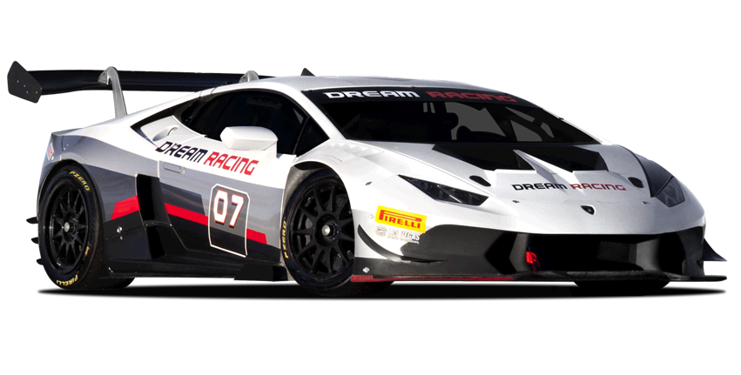
Problem / context
Given 8 race-car tracks, “design” a race-car that optimizes the speed to complete all tracks
With limited budget, choose parts that most likely shorten drive duration
Return a list of instructions for tangential acceleration at each point
At its core a machine learning (ML) problem

Slide 3


Initial approaches
Created an environment that allows for ML using TensorFlow library
Adapted reinforcement learning code from Stack Exchange
Gave positive incentive for accelerating, and negative incentive for crashing
Used Bellman equation to iteratively update policy
Challenges:
Difficulty of programming an environment
Novelty of ML to us

Slide 4


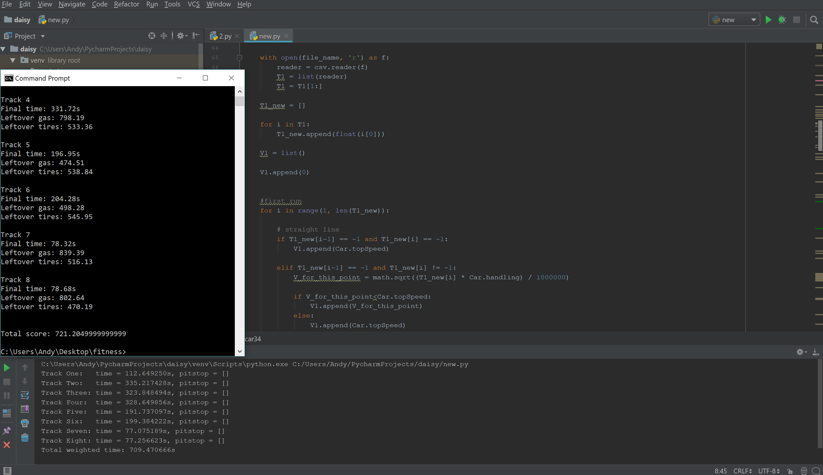
Alternate approaches
Prioritize the vehicle stats that most directly decrease time, ie handling
Steps
Read CSV file as an array, and convert radius to maximum allowable speed
‘Smooth out’ speed, eliminates sudden changes that’re impossible to accelerate to
Calculate acceleration for each point
For each segment, subtract away fuel and tire costs. Add pit stop when either is low.
Manually adjust the vehicle stats to achieve best time, for each track

Slide 5

Result for Alternate approaches
Stats:
Tire: tier 4
Gas: tier 5
Handling: tier 5
Max velocity: tier 2
Acceleration and braking: tier 1
Result: 721.2s

Slide 6
Thank you!

