Slide 1
Logic and Computer Design Fundamentals
Chapter 6 – Registers and Register Transfers
College of Computer Science and Technology, Zhejiang University

Slide 2
Overview
Registers and load enable
Register transfer operations
Multiplexer and bus-based transfers for multiple registers
Shift registers
Counters
Chapter 7 - <number>

Slide 3
7.1 Registers
Register – a collection of binary storage elements
In theory, a register is sequential logic which can be defined by a state table
More often think of a register as storing a vector of binary values
Frequently used to perform simple data storage and data movement and processing operations
Chapter 7 - <number>

Slide 4
Example: 2-bit Register
How many states are there?
How many input combinations?
Output combinations
What is the output function?
What is the next state function?
Moore or Mealy?
What are the the quantities above for an n-bit register?
A1
In1
D
Q
Y1
C
A0
In0
D
Q
Y0
CP
C
Present State
Next State
Output
State Table:
A1(t+
1
) A0(t+
1
)
(=A1 A0)
当I1 I0 =
A1 A0
00 01 10 11
Y1 Y0
0 0
00 01 10 11
0 0
0 1
00 01 10 11
0 1
1 0
00 01 10 11
1 0
1 1
00 01 10 11
1 1
Chapter 7 - <number>

Slide 5
7.1.1 Register Design Models
Due to the large numbers of states and input combinations as n becomes large, the state diagram/state table model is not feasible!
What are methods we can use to design registers?
  Add predefined combinational circuits to registers
    Example: To count up, connect the register flip-flops to an incrementer
  Design individual cells using the state diagram/state table model and combine them into a register
    A 1-bit cell has just two states
    Output is usually the state variable
Chapter 7 - <number>

Slide 6
7.1.2 Register Storage Save/Load
Expectations:
  A register can store information for multiple clock cycles
  To “store” or “load” information should be controlled by a signal
Reality:
  A D flip-flop register loads information on every clock cycle
Realizing expectations:
  Use a signal to block the clock to the register,
  Use a signal to control feedback of the output of the register back to its inputs, or
  Use other SR or JK flip-flops which for (0,0) applied store their state
Load is a frequent name for the signal that controls register storage and loading
  Load = 1: Load the values on the data inputs
  Load = 0: Store the values in the register
Chapter 7 - <number>

Slide 7
7.1.3 Registers with Clock Gating
Load signal is used to enable the clock signal to pass through if 1 and prevent the clock signal from passing through if 0.
Example: For Positive Edge-Triggered or Negative Pulse Master-Slave Flip-flop:
What logic is needed for gating?
What is the problem?
Clock
Load
Gated Clock to FF
Gated Clock = Clock + Load
Clock Skew of gated clocks with respect to clock or each other
Chapter 7 - <number>

Slide 8
7.1.4 Registers with Load-Controlled Feedback
A more reliable way to selectively load a register:
  Run the clock continuously, and
  Selectively use a load control to change the register contents.
Example: 2-bit register
with Load Control:
For Load = 0,
loads register contents
(hold current values)
For Load = 1,
loads input values
(load new values)
Hardware more complex
than clock gating, but
free of timing problems
2-to-1 Multiplexers
A1
D
Q
Y1
Load
In1
C
A0
D
Q
Y0
C
In0
Clock
Chapter 7 - <number>

Slide 9
7.2 Register Transfer Operations
Register Transfer Operations – The movement and processing of data stored in registers
Three basic components:
  set of registers
  operations
  control of operations
Elementary Operations -- load, count, shift, add, bitwise "OR", etc.
  Elementary operations called microoperations
  Register Transfer Language: RTL
Control signals
Datapath
Control
unit
Control
inputs
Status signals
Data
outputs
Control
outputs
Data
inputs
Chapter 7 - <number>

Slide 10
7.3 Register Transfer Operations
Letters and numbers – denotes a register (ex. R2, PC, IR)
Parentheses ( ) – denotes a range of register bits (ex. R1(1), PC(7:0), AR(L))
Arrow (←) – denotes data transfer (ex. R1 ← R2, PC(L) ← R0)
Comma – separates parallel operations
Brackets [ ] – Specifies a memory address (ex. R0 ← M[AR], R3 M[PC] )
7.3.1 Register Notation
R
7 6 5 4 3 2 1 0
15 8
7 0
15 0
PC(H)
PC(L)
R2
Chapter 7 - <number>

Slide 11
7.3.2 Conditional Transfer
If (K1 =1) then (R2 ← R1) is shortened to
K1: (R2 ← R1)
where K1 is a control variable specifying a conditional execution
of the microoperation.
K
1
n
Load
R1
R2
Clock
Clock
K₁
Transfer Occurs Here
No Transfers Occur Here
Chapter 7 - <number>

Slide 12
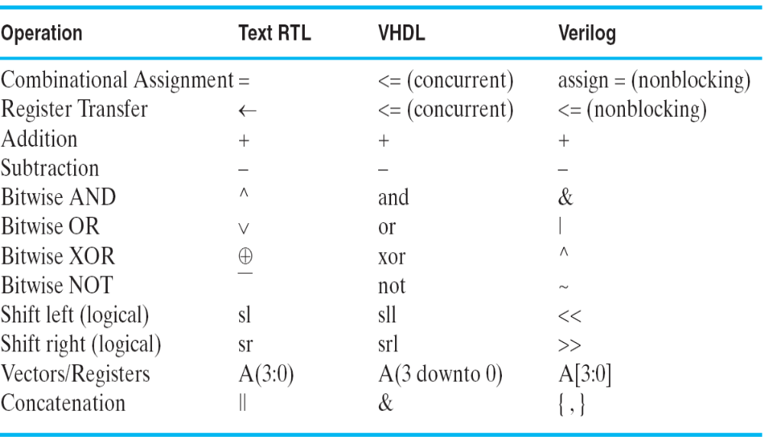
7.4 Comparison of Hardware Description Language
Chapter 7 - <number>

Slide 13
7.5 Microoperations
Logical Groupings:
  Transfer - move data from one set of registers to another
  Arithmetic - perform arithmetic on data in registers
  Logic - manipulate data or use bitwise logical operations
  Shift - shift data in registers
Arithmetic operations
+ Addition
– Subtraction
* Multiplication
/ Division
Logical operations
∨ Logical OR
∧ Logical AND
⊕ Logical Exclusive OR
‾ Not
Chapter 7 - <number>

Slide 14
Control Expressions
The control expression for an operation appears to the left of the operation and is separated from it by a colon
Control expressions specify the logical condition for the operation to occur
Control expression values of:
  Logic "1" -- the operation occurs.
  Logic "0" -- the operation does not occur.
Example:
X K1 : R1 ← R1 + R2
X K1 : R1 ← R1 + R2 + 1
Variable K1 enables the add or subtract operation.
If X =0, then X =1 so X K1 = 1, activating the addition of R1 and R2.
If X = 1, then X K1 = 1, activating the addition of R1 and the two's complement of R2 (subtract).
Chapter 7 - <number>

Slide 15
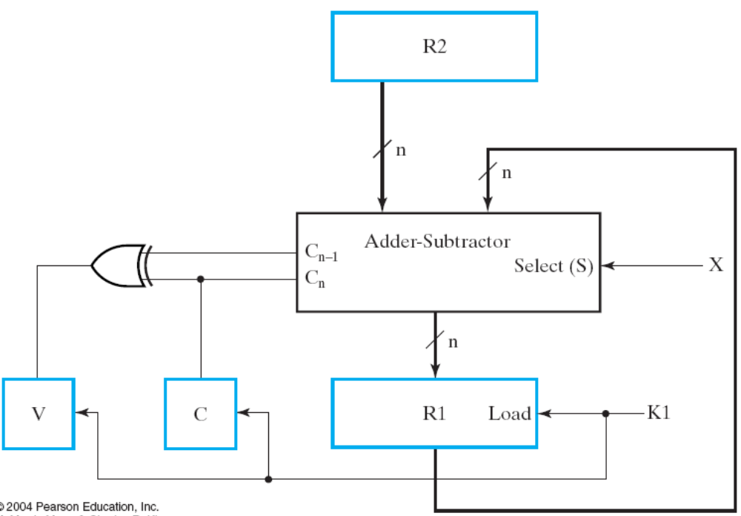
Implementation of Add and Subtract Microoperations
X K1 : R1 ← R1 + R2
X K1 : R1 ← R1 + R2 + 1
Chapter 7 - <number>

Slide 16
7.5.1 Arithmetic Microoperations
From
Table
7-3:
Note that any register may be specified for source 1, source 2, or destination.
These simple microoperations operate on the whole word
Symbolic Designation
Description
R0
←
R1 + R2
Addition
R0
←
R1
Ones Complement
R0
←
R1 + 1
Two's Complement
R0
←
R2 +
R1 + 1
R2 minus R1 (2's Comp)
R1
←
R1 + 1
Increment (count up)
R1
←
R1
–
1
Decrement (count down)
Chapter 7 - <number>

Slide 17
7.5.2 Logical Microoperations
From Table 7-4:
Symbolic
Designation
Description
R0
←
R1
Bitwise NOT
R0
←
R1
∨
R2
Bitwise OR (sets bits)
R0
←
R1
∧
R2
Bitwise AND (clears bits)
R0
←
R1
⊕
R2
Bitwise EXOR (complements bits)
Chapter 7 - <number>

Slide 18
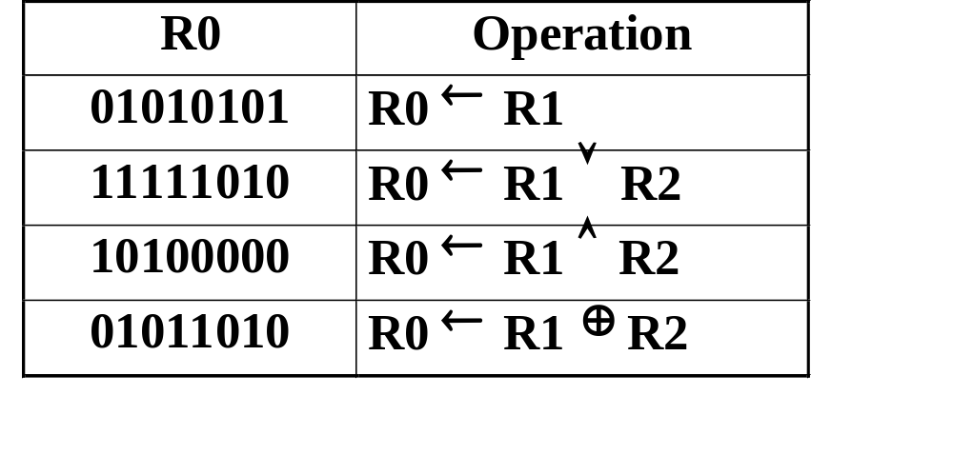
Logical Microoperations (continued)
Let R1 = 10101010,
and R2 = 11110000
Then after the operation, R0 becomes:
Chapter 7 - <number>

Slide 19
7.5.3 Shift Microoperations
From Table 7-5:
Let R2 = 11001001
Then after the operation, R1 becomes:
Symbolic
Designation
Description
R1
←
sl R2
Shift Left
R1
←
sr R2
Shift Right
R1
Operation
10010010
R1
←
sl R2
01100100
R1
←
sr R2
Note: These shifts "zero fill". Sometimes a separate flip-flop is used to provide the data shifted in, or to “catch” the data shifted out.
Other shifts are possible (rotates, arithmetic) (see Chapter 10).
Chapter 7 - <number>

Slide 20
7.6 Register Transfer Structures
Multiplexer-Based Transfers - Multiple inputs are selected by a multiplexer dedicated to the register
Bus-Based Transfers - Multiple inputs are selected by a shared multiplexer driving a bus that feeds inputs to multiple registers
Three-State Bus - Multiple inputs are selected by
3-state drivers with outputs connected to a bus that feeds multiple registers
Other Transfer Structures - Use multiple multiplexers, multiple buses, and combinations of all the above
Chapter 7 - <number>

Slide 21
7.6.1 Multiplexer-Based Transfers
Multiplexers connected to register inputs produce flexible transfer structures (Note: Clocks are omitted for clarity)
The transfers are: K2K1: R0 ← R1
K2 K1: R0 ← R2
Load
K
2
R2
K
1
S
Load
n
0
n
MUX
R0
Load
n
1
R1
Chapter 7 - <number>

Slide 22
Multiplexer and Bus-Based Transfers for Multiple Registers
Multiplexer dedicated to each register
Shared transfer paths for registers
  A shared transfer object is a called a bus (Plural: buses)
Bus implementation using:
  multiplexers
  three-state nodes and drivers
In most cases, the number of bits is the length of the receiving register
Chapter 7 - <number>

Slide 23
Dedicated MUX-Based Transfers
Multiplexer connected to each register input produces a very flexible transfer structure =>
Characterize the simultaneous transfers possible with this structure.
18 gate inputs per bit plus 3 shared inverters with total of 3 inputs
S0
L0
n
S
n
Load
0
n
1
MUX
R0
S1
L1
n
S
n
Load
0
n
1
MUX
R1
S2
L2
n
S
n
Load
0
n
1
MUX
R2
Chapter 7 - <number>
Notes:
二选一多路复用器的门成本为18，见图3-25

Slide 24
Multiplexer Bus
L0
A single bus driven by a multiplexer lowers cost, but limits the available transfers =>
Characterize the simultaneous transfers impossible with this structure.
Characterize the cost savings compared to dedicated multiplexers
9 gate inputs per bit + shared decoder with 8 inputs
n
Load
R0
S1
S0
L1
n
S1 S0
0
Load
n
1
n
n
n
2
MUX
R1
L2
n
Load
R2
Chapter 7 - <number>
Notes:
Can have only one register as a source at a time. Thus a set of simultaneous transfers
can have only one register source. Could require up to three clock cycles if three different sources needed.
Costs:
Dedicated 18 gate inputs per bit plus 3 shared inverters with total of 3 inputs
Bus: 9 gate inputs per bit + shared decoder with 8 inputs
Bus clearly less costly.

Slide 25
Three-State Bus
The 3-input MUX can be replaced by a 3-state node (bus) and 3-state buffers.
Cost is further reduced, but transfers are limited
Characterize the simultaneous transfers possible with this structure.
Characterize the cost savings and compare
3 gate inputs per three state driver = 9 gate inputs
Other advantages?
L0
n
Load
n
R0
E0
L1
n
Load
n
R1
E1
L2
n
Load
n
R2
E2
Chapter 7 - <number>
Notes:
Same simultaneous transfer capability as multiplexer bus
Cost: 3 gate inputs per three state driver = 9 gate inputs
If decoder desired, 8 shared gate inputs.
Clearly least costly.
The “bus” is unique in that it is “bidirectional.” This is a significant advantage
since it cuts connections between chips for bus paths to 1/2.

Slide 26
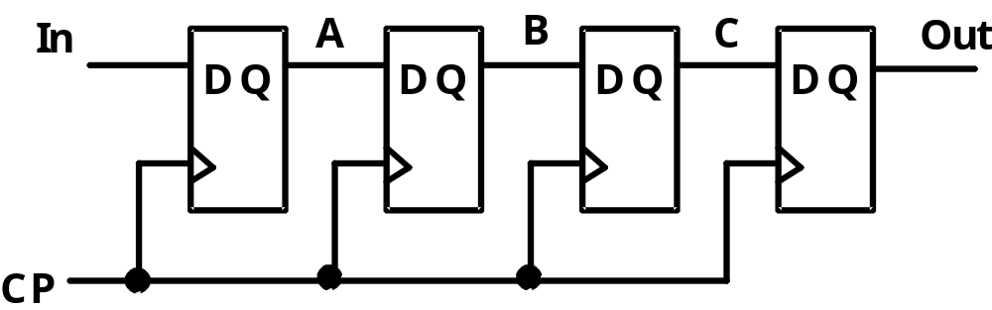
7.6.2 Shift Registers
Shift Registers move data laterally within the register toward its MSB or LSB position
In the simplest case, the shift register is simply a set of
D flip-flops connected in a row like this:
Data input, In, is called a serial input or the shift right input.
Data output, Out, is often called the serial output.
The vector (A, B, C, Out) is called the parallel output.
Chapter 7 - <number>

Slide 27
Shift Registers (continued)
The behavior of the
serial shift register
is given in the listing
on the lower right
T0 is the register
state just before
the first clock
pulse occurs
T1 is after the
first pulse and
before the second.
Initially unknown
states are denoted by “?”
Complete the last three
rows of the table
In
A
B
C
Out
D
Q
D
Q
D
Q
D
Q
Clock CP
CP | In | A | B | C | Out
T0 | 0 | ? | ? | ? | ?
T1 | 1 | 0 | ? | ? | ?
T2 | 1 | 1 | 0 | ? | ?
T3 | 0 | 1 | 1 | 0 | ?
T4 | 1
T5 | 1
T6 | 1
Chapter 7 - <number>
Notes:
ROW T4: 10110
Row T5: 11011
Row T6: 11101

Slide 28
Parallel Load Shift Registers
By adding a mux
between each shift register
stage, data can be
shifted or loaded
If SHIFT is low,
A and B are
replaced by the data on D_{A} and D_{B} lines, else data shifts right on each clock.
By adding more bits, we can make n-bit parallel load shift registers.
D_{A}
D_{B}
A
B
IN
D
Q
D
Q
SHIFT
CP
Chapter 7 - <number>

Slide 29
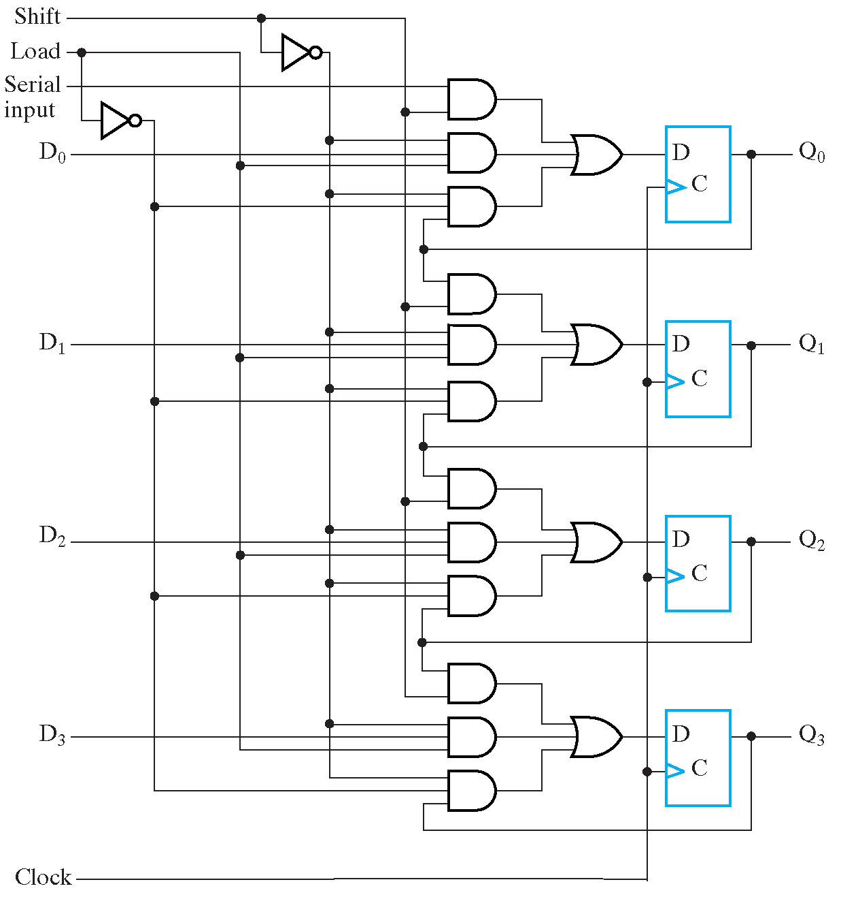
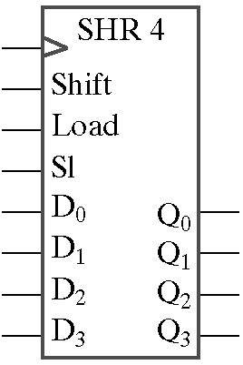
Parallel Load Shift Registers (Cont.)
A parallel load shift register with an added “hold” operation
Shift | Load | Operation
0 | 0 | No Change
0 | 1 | Load
1 | x | Shift down
Symbol
Chapter 7 - <number>

Slide 30
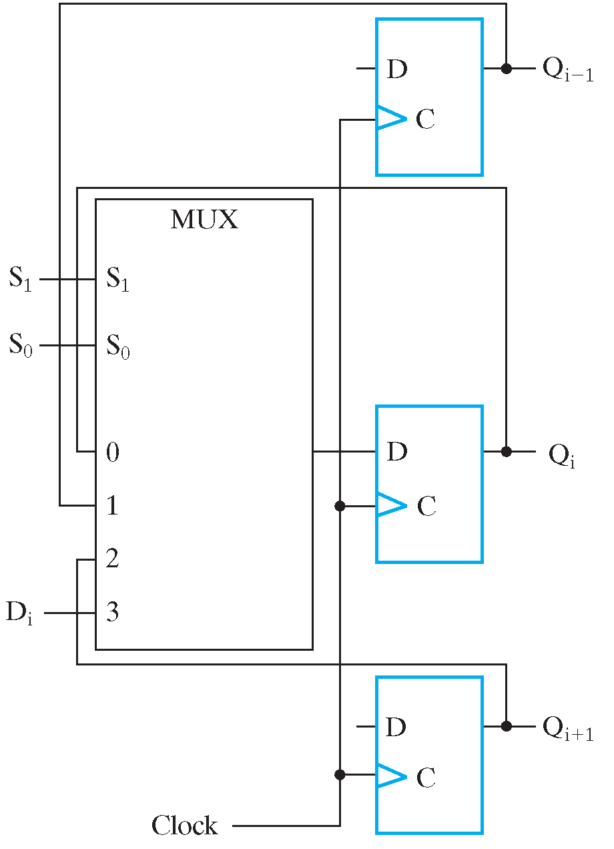
Shift Registers with Additional Functions
By placing a 4-input multiplexer in front of each D flip-flop in a shift register, we can implement a circuit with shifts right, shifts left, parallel load, hold.
Mode Control |  | Register Operation
S₁ | S₀
0 | 0 | No change
0 | 1 | Shift down
1 | 0 | Shift up
1 | 1 | Parallel load
Chapter 7 - <number>

Slide 31
7.6.3 Counters
Counters are sequential circuits which "count" through a specific state sequence. They can count up, count down, or count through other fixed sequences. Two distinct types are in common usage:
Ripple Counters
  Clock is connected to the flip-flop clock input on the LSB bit flip-flop
  For all other bits, a flip-flop output is connected to the clock input, thus circuit is not truly synchronous
  Output change is delayed more for each bit toward the MSB.
  Resurgent because of low power consumption
Synchronous Counters
  Clock is directly connected to the flip-flop clock inputs
  Logic is used to implement the desired state sequencing
Chapter 7 - <number>

Slide 32
Ripple Counter
How does it work?
  When there is a positive
  edge on the clock input
  of A, A complements
  The clock input for flip-
  flop B is the complemented
  output of flip-flop A
  When flip A changes
  from 1 to 0, there is a
  positive edge on the
  clock input of B
  causing B to
  complement
D
A
Clock
C_{R}
D
B
C_{R}
Reset
CP
A
B
0
1
2
3
0
1
Chapter 7 - <number>

Slide 33
Ripple Counter (continued)
The arrows show the
cause-effect relation-
ship from the prior
slide =>
The corresponding
sequence of states =>
(B,A) = (0,0),
Each additional bit, C, D, …behaves like bit B, changing half as frequently as the bit before it.
For 3 bits: (C,B,A) = (0,0,0), (0,0,1), (0,1,0), (0,1,1),
(1,0,0), (1,0,1), (1,1,0), (1,1,1), (0,0,0), …
CP
A
B
0
1
2
3
0
1
(0,1),
(1,0),
(1,1),
(0,0),
(0,1), …
Chapter 7 - <number>

Slide 34
Ripple Counter (continued)
These circuits are called ripple counters because each edge sensitive transition (positive in the example) causes a change in the next flip-flop’s state.
The changes “ripple” upward through the chain of flip-flops, i. e., each transition occurs after a clock-to-output delay from the stage before.
To see this effect in detail look at the waveforms on the next slide.
Chapter 7 - <number>

Slide 35
Ripple Counter (continued)
Starting with C = B = A = 1, equivalent to (C,B,A) = 7 base 10, the next clock increments the count to (C,B,A) = 0 base 10. In fine timing detail:
  The clock to output delay
  t_{PHL} causes an increasing
  delay from clock edge for
  each stage transition.
  Thus, the count “ripples”
  from least to most
  significant bit.
  For n bits, total worst case
  delay is n t_{PHL}.
t_{PHL}
CP
t_{PHL}
A
t_{PHL}
B
C
Chapter 7 - <number>

Slide 36
7.6.4 Synchronous Counters
To eliminate the "ripple" effects, use a common clock for each flip-flop and a combinational circuit to generate the next state.
For an up-counter,
use an incrementer =>
Incrementer
A3
S3
D3
Q3
A2
S2
D2
Q2
A1
S1
D1
Q1
A0
S0
D0
Q0
Clock
Chapter 7 - <number>
Notes:
S=A+1

Slide 37
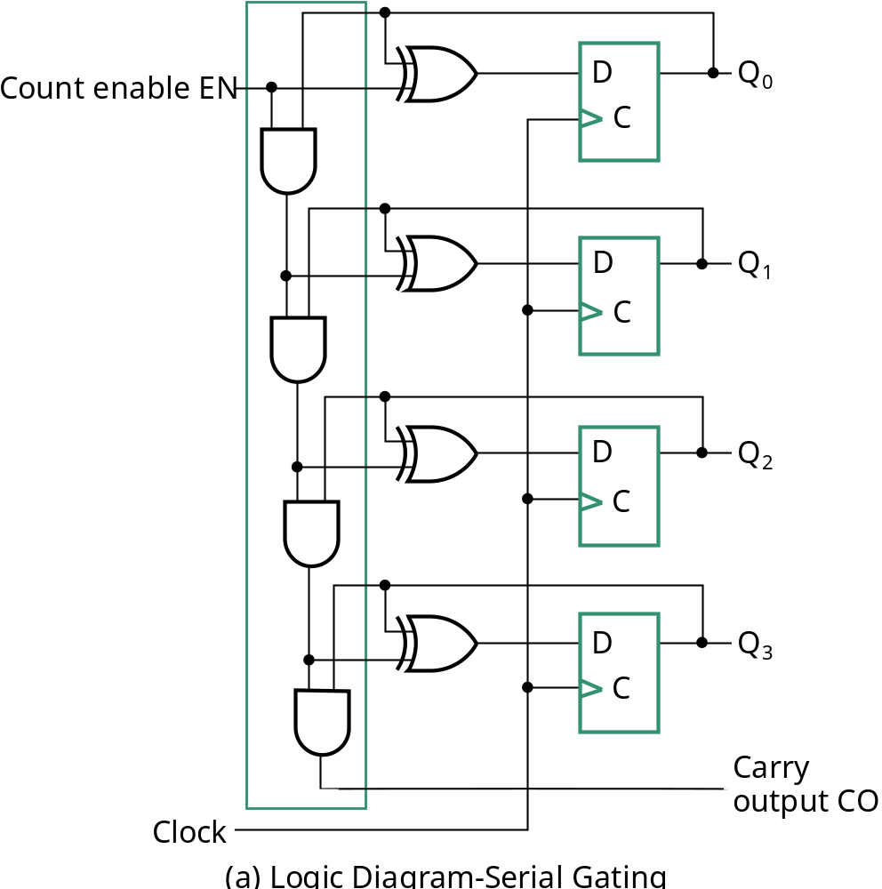
Synchronous Counters (continued)
Internal details =>
Internal Logic
  XOR complements each bit
  AND chain causes complement
  of a bit if all bits toward LSB
  from it equal 1
Count Enable
  Forces all outputs of AND
  chain to 0 to “hold” the state
Carry Out
  Added as part of incrementer
  Connect to Count Enable of
  additional 4-bit counters to
  form larger counters
Incrementer
Chapter 7 - <number>

Slide 38
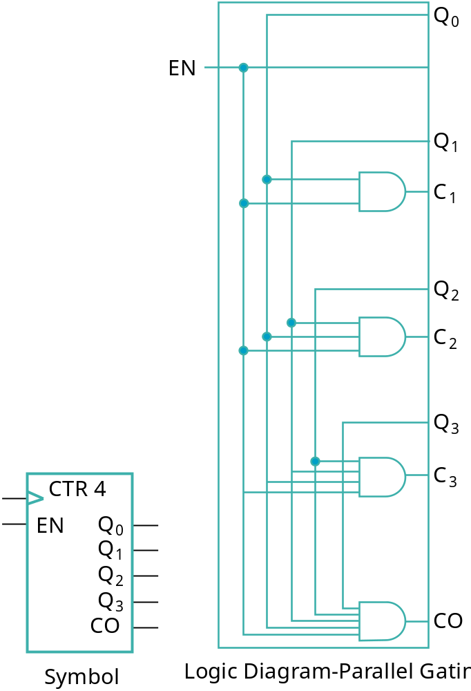
Synchronous Counters (continued)
Carry chain
  series of AND gates through which the
  carry “ripples”
  Yields long path delays
  Called serial gating
Replace AND carry chain with ANDs =>
in parallel
  Reduces path delays
  Called parallel gating
  Like carry lookahead
  Lookahead can be used on COs
  and ENs to prevent long paths in
  large counters
Symbol for Synchronous Counter
Chapter 7 - <number>

Slide 39
7.6.5 Other Counters
See text for:
  Down Counter - counts downward instead of upward
  Up-Down Counter - counts up or down depending on value a control input such as Up/Down
  Parallel Load Counter - Has parallel load of values available depending on control input such as Load
Divide-by-n (Modulo n) Counter
  Count is remainder of division by n which n may not be a power of 2 or
  Count is arbitrary sequence of n states specifically designed state-by-state
  Includes modulo 10 which is the BCD counter
Chapter 7 - <number>

Slide 40
Counter with Parallel Load
Add path for input data
  enabled for Load = 1
Add logic to:
  disable count logic for Load = 1
  disable feedback from outputs
  for Load = 1
  enable count logic for Load = 0
  and Count = 1
The resulting function table:
Load
Count
D
0
D
Q
0
C
D
1
D
Q
1
C
D
2
D
Q
2
Load | Count | Action
0 | 0 | Hold Stored Value
0 | 1 | Count Up Stored Value
1 | X | Load D
C
D
3
D
Q
3
C
Carry
Clock
Output CO
Chapter 7 - <number>

Slide 41
Design Example: Synchronous BCD
Use the sequential logic model to design a synchronous BCD counter with D flip-flops
State Table =>
Input combinations
1010 through 1111
are don’t cares
Current State | Next State
Q8 Q4 Q2 Q1 | Q8' Q4' Q2' Q1'
0 0 0 0 | 0 0 0 1
0 0 0 1 | 0 0 1 0
0 0 1 0 | 0 0 1 1
0 0 1 1 | 0 1 0 0
0 1 0 0 | 0 1 0 1
0 1 0 1 | 0 1 1 0
0 1 1 0 | 0 1 1 1
0 1 1 1 | 1 0 0 0
1 0 0 0 | 1 0 0 1
1 0 0 1 | 0 0 0 0
Chapter 7 - <number>

Slide 42
Synchronous BCD (continued)
Use K-Maps to two-level optimize the next state equations and manipulate into forms containing XOR gates:
D1 = Q1
D2 = Q2 + Q1Q8
D4 = Q4 + Q1Q2
D8 = Q8 + (Q1Q8 + Q1Q2Q4)
The logic diagram can be draw from these equations
  An asynchronous or synchronous reset should be added
What happens if the counter is perturbed by a power disturbance or other interference and it enters a state other than 0000 through 1001?
Chapter 7 - <number>

Slide 43
Synchronous BCD (continued)
Find the actual values of the six next states for the don’t care combinations from the equations
Find the overall state diagram to assess behavior for the don’t care states (states in decimal)
0
9
1
Present State | Next State
Q8 Q4 Q2 Q1 | Q8' Q4' Q2' Q1'
1 0 1 0 | 1 0 1 1
1 0 1 1 | 0 1 1 0
1 1 0 0 | 1 1 0 1
1 1 0 1 | 0 1 0 0
1 1 1 0 | 1 1 1 1
1 1 1 1 | 0 0 1 0
14
8
2
15
12
7
11
13
3
6
10
4
5
Chapter 7 - <number>

Slide 44
Synchronous BCD (continued)
For the BCD counter design, if an invalid state is entered, return to a valid state occurs within two clock cycles
Is this adequate? If not:
  Is a signal needed that indicates that an invalid state has been entered? What is the equation for such a signal?
  Does the design need to be modified to return from an invalid state to a valid state in one clock cycle?
  Does the design need to be modified to return from a invalid state to a specific state (such as 0)?
The action to be taken depends on:
  the application of the circuit
  design group policy
Chapter 7 - <number>
Notes:
Error = Q8 Q4 + Q8 Q2

Slide 45
Counting Modulo N
The following techniques use an n-bit binary counter with asynchronous or synchronous clear and/or parallel load:
  Detect a terminal count of N in a Modulo-N count sequence to asynchronously Clear the count to 0 or asynchronously Load in value 0 (These lead to counts which are present for only a very short time and can fail to work for some timing conditions!)
  Detect a terminal count of N - 1 in a Modulo-N count sequence to Clear the count synchronously to 0
  Detect a terminal count of N - 1 in a Modulo-N count sequence to synchronously Load in value 0
  Detect a terminal count and use Load to preset a count of the terminal count value minus (N - 1)
Alternatively, custom design a modulo N counter as done for BCD
Chapter 7 - <number>

Slide 46
Counting Modulo 7: Detect 7 and Asynchronously Clear
A synchronous 4-bit binary counter
with an asynchronous Clear is
used to make a Modulo
7 counter.
Use the Clear feature to
detect the count 7 and
clear the count to 0. This
gives a count of 0, 1, 2, 3, 4,
5, 6, 7(short)0, 1, 2, 3, 4, 5,
6, 7(short)0, etc.
DON’T DO THIS! Referred to as a “suicide” counter! (Count “7” is “killed,” but the designer’s job may be dead as well!)
D3
Q3
D2
Q2
D1
Q1
D0
Q0
Clock
CP
0
LOAD
CLEAR
Chapter 7 - <number>

Slide 47
Counting Modulo 7: Synchronously Load on Terminal Count of 6
A synchronous 4-bit binary
counter with a synchronous
load and an asynchronous
clear is used to make a
Modulo 7 counter
Use the Load feature to
detect the count "6" and
load in "zero". This gives
a count of 0, 1, 2, 3, 4, 5, 6,
0, 1, 2, 3, 4, 5, 6, 0, ...
Using don’t cares for states
above 0110, detection of 6 can be done with Load = Q2 Q1
0
D3
Q3
0
D2
Q2
0
D1
Q1
0
D0
Q0
Clock
CP
LOAD
Reset
CLEAR
Chapter 7 - <number>

Slide 48
Counting Modulo 6: Synchronously Preset 9 on Reset and Load 9 on Terminal Count 14
A synchronous, 4-bit binary
counter with a synchronous
Load is to be used to make a
Modulo 6 counter.
Use the Load feature to
preset the count to 9 on
Reset and detection of
count 14.
This gives a count of 9, 10, 11, 12, 13, 14, 9, 10, 11, 12, 13, 14, 9, …
If the terminal count is 15 detection is usually built in as Carry Out (CO)
1
D3
Q3
0
D2
Q2
0
D1
Q1
1
D0
Q0
Clock
CP
Reset
LOAD
1
CLEAR
Chapter 7 - <number>

Slide 49

Assignment
6-6、6-13、6-16、6-17、6-19, 6-23、6-27、6-34
Chapter 7 - <number>

