Slide 1
Logic and Computer Design Fundamentals
Chapter 7 – Memory Basics
College of Computer Science and Technology, Zhejiang University

Slide 2
Overview
Memory definitions
Random Access Memory (RAM)
Static RAM (SRAM) integrated circuits
  Cells and slices
  Cell arrays and coincident selection
Arrays of SRAM integrated circuits
Dynamic RAM (DRAM) integrated circuits
DRAM Types
  Synchronous (SDRAM)
  Double-Data Rate (DDR SDRAM)
  RAMBUS DRAM (RDRAM)
Arrays of DRAM integrated circuits
Chapter 9 - Part 1 <number>

Slide 3
Memory Definitions
Memory ─ A collection of storage cells together with the necessary circuits to transfer information to and from them.
Memory Organization ─ the basic architectural structure of a memory in terms of how data is accessed.
Random Access Memory (RAM) ─ a memory organized such that data can be transferred to or from any cell (or collection of cells) in a time that is not dependent upon the particular cell selected.
Memory Address ─ A vector of bits that identifies a particular memory element (or collection of elements).
Chapter 9 - Part 1 <number>

Slide 4
Memory Definitions (Continued)
Typical data elements are:
  bit ─ a single binary digit
  byte ─ a collection of eight bits accessed together
  word ─ a collection of binary bits whose size is a typical unit of access for the memory. It is typically a power of two multiple of bytes (e.g., 1 byte, 2 bytes, 4 bytes, 8 bytes, etc.)
Memory Data ─ a bit or a collection of bits to be stored into or accessed from memory cells.
Memory Operations ─ operations on memory data supported by the memory unit. Typically, read and write operations over some data element (bit, byte, word, etc.).
Chapter 9 - Part 1 <number>

Slide 5
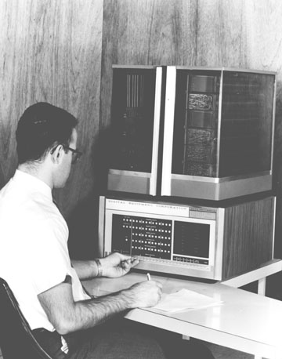
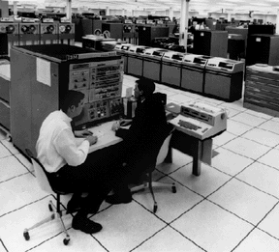
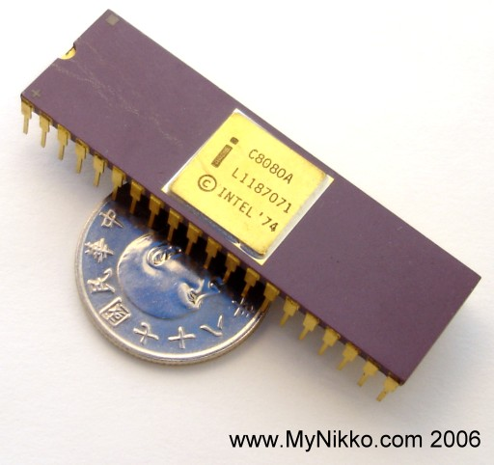
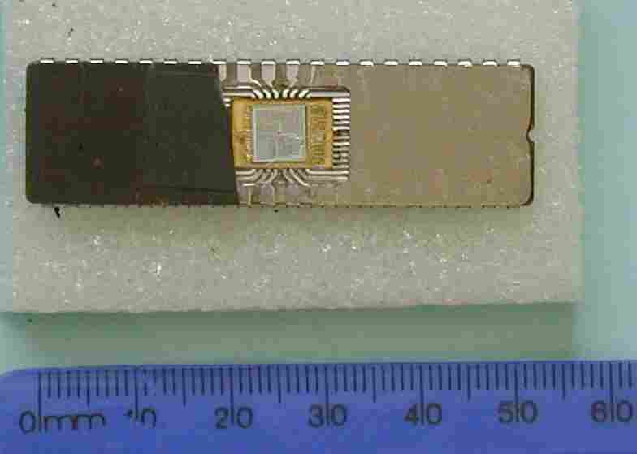
Memory Organization
PDP-8
Intel 8080
Organized as an indexed array of words. Value of the index for each word is the memory address.
Often organized to fit the needs of a particular computer architecture. Some historically significant computer architectures and their associated memory organization:
  Digital Equipment Corporation PDP-8 – used a 12-bit address to address 4096 12-bit words.
  IBM 360 – used a 24-bit address to address 16,777,216 8-bit bytes, or 4,194,304 32-bit words.
  Intel 8080 – (8-bit predecessor to the 8086 and the current Intel processors) used a 16-bit address to address 65,536 8-bit bytes.
IBM 360
Intel 8086
Chapter 9 - Part 1 <number>

Slide 6
Memory Block Diagram
A basic memory system is shown here:
k address lines are decoded to address 2^{k} words of memory.
Each word is n bits.
Read and Write are single control lines defining the simplest of memory operations.
n Data Input Lines
n
k Address Lines
Memory Unit
k
2^{k} Words
1
n Bits per Word
Read
1
Write
n
n Data Output Lines
Chapter 9 - Part 1 <number>

Slide 7
Memory Organization Example
Example memory contents:
  A memory with 3 address bits & 8 data bits has:
  k = 3 and n = 8 so 2³ = 8 addresses labeled 0 to 7.
  2³ = 8 words of 8-bit data
Memory Address |  | Memory Content
Binary | Decimal
000 | 0 | 1 0 0 0 1 1 1 1
001 | 1 | 1 1 1 1 1 1 1 1
010 | 2 | 1 0 1 1 0 0 0 1
011 | 3 | 0 0 0 0 0 0 0 0
100 | 4 | 1 0 1 1 1 0 0 1
101 | 5 | 1 0 0 0 0 1 1 0
110 | 6 | 0 0 1 1 0 0 1 1
111 | 7 | 1 1 0 0 1 1 0 0
Chapter 9 - Part 1 <number>

Slide 8
Basic Memory Operations
Memory operations require the following:
  Data ─ data written to, or read from, memory as required by the operation.
  Address ─ specifies the memory location to operate on. The address lines carry this information into the memory. Typically: n bits specify locations of 2^{n} words.
  An operation ─ Information sent to the memory and interpreted as control information which specifies the type of operation to be performed. Typical operations are READ and WRITE. Others are READ followed by WRITE and a variety of operations associated with delivering blocks of data. Operation signals may also specify timing info.
Chapter 9 - Part 1 <number>

Slide 9
Basic Memory Operations (continued)
Read Memory ─ an operation that reads a data value stored in memory:
  Place a valid address on the address lines.
  Wait for the read data to become stable.
Write Memory ─ an operation that writes a data value to memory:
  Place a valid address on the address lines and valid data on the data lines.
  Toggle the memory write control line
Sometimes the read or write enable line is defined as a clock with precise timing information (e.g. Read Clock, Write Strobe).
  Otherwise, it is just an interface signal.
  Sometimes memory must acknowledge that it has completed the operation.
Chapter 9 - Part 1 <number>

Slide 10
Memory Operation Timing
Most basic memories are asynchronous
  Storage in latches or storage of electrical charge
  No clock
Controlled by control inputs and address
Timing of signal changes and data observation is critical to the operation
Read timing: (read cycle is 65ns)
20 ns
Clock
T1
T2
T3
T4
T1
Address
Address valid
Memory
enable
Read/
Write
Data
Output
Data valid
65 ns
Read cycle
Chapter 9 - Part 1 <number>

Slide 11
Memory Operation Timing
Write timing: (write cycle is 75ns)
Critical times measured with respect to edges of write pulse (1-0-1):
  Address must be established at least a specified time before 1-0 and held for at least a specified time after 0-1 to avoid disturbing stored contents of other addresses
  Data must be established at least a specified time before 0-1 and held for at least a specified time after 0-1 to write correctly
20 ns
Clock
T1
T2
T3
T4
T1
Address
Address valid
Memory
enable
Read/
Write
Data
Input
Data valid
75 ns
Write cycle
Chapter 9 - Part 1 <number>

Slide 12
RAM Integrated Circuits
Types of random access memory
  Static – information stored in latches
  Dynamic – information stored as electrical charges on capacitors
    Charge “leaks” off
    Periodic refresh of charge required
Dependence on Power Supply
  Volatile – loses stored information when power turned off
  Non-volatile – retains information when power turned off
Chapter 9 - Part 1 <number>

Slide 13
Static RAM Cell
Array of storage cells used to implement static RAM
Storage Cell
  SR Latch
  Select input for
  control
  Dual Rail Data
  Inputs B and B
  Dual Rail Data
  Outputs C and C
Select
B
S
Q
C
C
B
R
Q
RAM cell
Chapter 9 - Part 1 <number>

Slide 14

Static RAM Bit Slice
Represents all circuitry that is required for 2^{n} 1-bit words
  Multiple RAM cells
  Control Lines:
    Word select i
    – one for each word
    Bit Select
  Data Lines:
    Data in
    Data out
Word
Select
select
0
B
S
Q
X
C
X
C
Word
B
R
Q
select
RAM cell
0
RAM cell
Word
select
1
Word
Select
RAM cell
select
2
n
- 1
S
Q
X
Word
select
2
n
- 1
R
Q
X
RAM cell
RAM cell
Read/Write Logic
Q
Data in
Data in
S
Read/
Data out
Write
Bit
R
Q
select
(b) Symbol
Write logic
Read logic
Data out
Read/
Bit
Write
select
Chapter 9 - Part 1 <number>
(a) Logic diagram

Slide 15
2^{n}-Word × 1-Bit RAM IC
To build a RAM IC
from a RAM slice,
we need:
  Decoder decodes
  the n address lines to 2^{n} word select lines
  A 3-state buffer on the data output
  permits RAM ICs to be combined into a RAM with c × 2^{n} words
4-to-16
Word select
Decoder
0
A
3
A
3
2
3
1
2
RAM cell
A
2
A
2
2
2
3
4
A
1
A
1
2
1
5
6
RAM cell
l
A
0
A
0
2
0
7
16 x
1
8
RAM
9
10
Data
Data
11
input
output
12
13
14
Read/
15
Write
Memory
RAM cell
enable
(a) Symbol
Read/Write Logic
Data input
Data in
Data
Data out
output
Read/
Bit
Write
select
Read/Write
Chapter 9 - Part 1 <number>
Chip select
(b) Block diagram

Slide 16

Cell Arrays and Coincident Selection
Memory arrays can be very large =>
  Large decoders
  Large fanouts for the bit lines
  The decoder size and fanouts can be reduced by approximately by using a coincident selection in
  a 2-dimensional array
  Uses two decoders, one for words and one for bits
  Word select becomes Row select
  Bit select becomes Column select
See next slide for example
  A₃ and A₂ used for Row select
  A₁ and A₀ for Column select
Chapter 9 - Part 1 <number>

Slide 17
Cell Arrays and Coincident Selection (continued)
Row decoder
2-to-4
Decoder
0
A
3
2
1
RAM cell
RAM cell
RAM cell
RAM cell
A
2
2
0
0
1
2
3
1
Row
RAM cell
RAM cell
RAM cell
RAM cell
select
4
5
6
7
2
RAM cell
RAM cell
RAM cell
RAM cell
8
9
10
11
3
RAM cell
RAM cell
RAM cell
RAM cell
12
13
14
15
Read/Write
Read/Write
Read/Write
Read/Write
logic
logic
logic
logic
Data in
Data in
Data in
Data in
Data out
Data out
Data out
Data out
Read/
Bit
Read/
Bit
Read/
Bit
Read/
Bit
Write
select
Write
select
Write
select
Write
select
Data input
Read/Write
X
X
X
X
Column select
Data
0
1
2
3
output
Column
2-to-4 Decoder
decoder
with enable
2
1
2
0
Enable
A
1
A
0
Chapter 9 - Part 1 <number>
Chip select

Slide 18
RAM ICs with > 1 Bit/Word
Word length can be quite high.
To better balance the number of words and word length, use ICs with > 1 bit/word
See Figure on the next page for example
  2 Data input bits
  2 Data output bits
  Row select selects 4 rows
  Column select selects 2 pairs of columns
Chapter 9 - Part 1 <number>

Slide 19
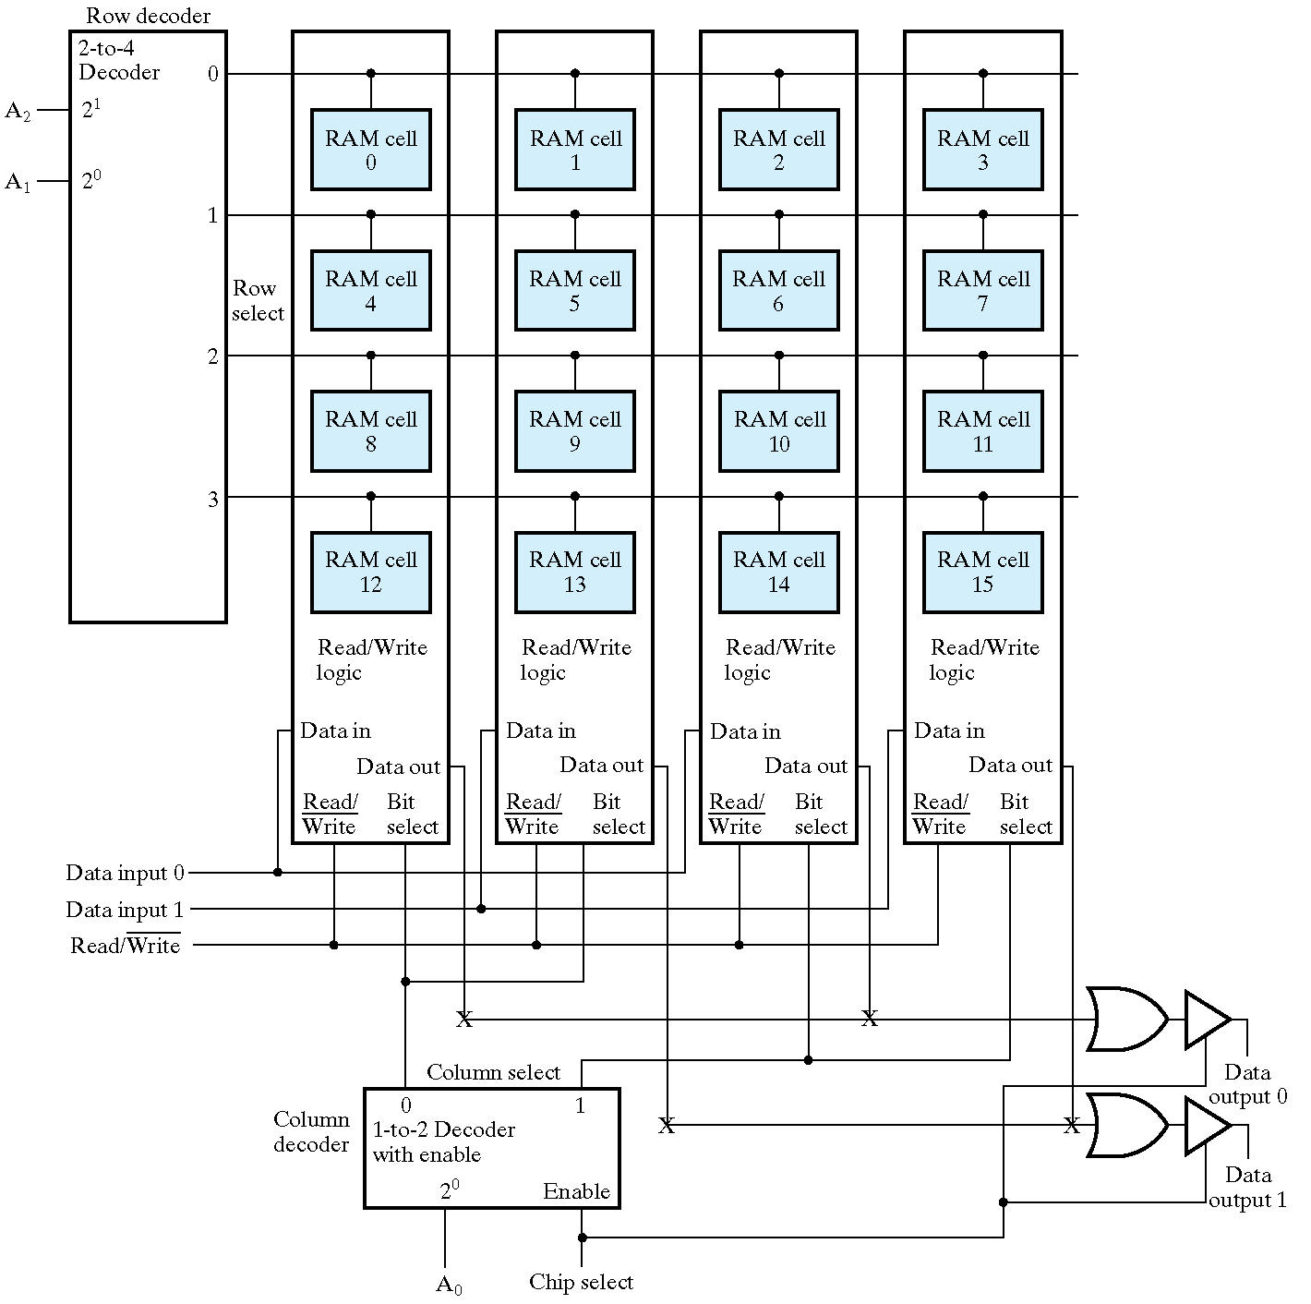
Chapter 9 - Part 1 <number>

Slide 20
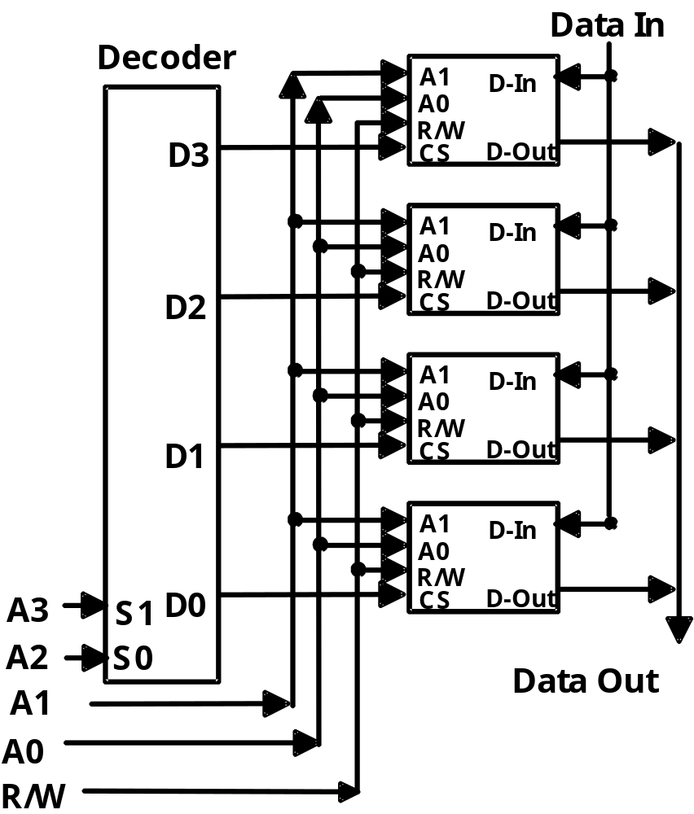
Making Larger Memories
Using the CS lines, we can make larger memories from smaller ones by tying all address, data, and R/W lines in parallel, and using the decoded higher order address bits to control CS.
Using the 4-Word by 1-Bit memory from before, we construct a 16-Word by
1-Bit memory. ⇒
Chapter 9 - Part 1 <number>

Slide 21
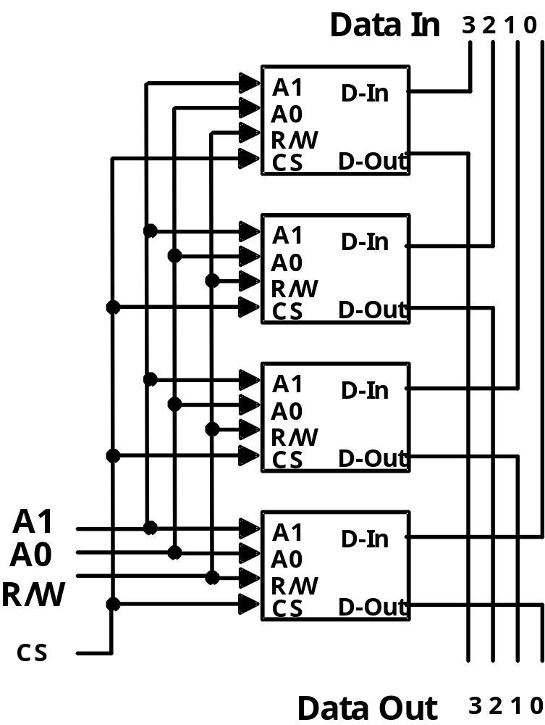
Making Wider Memories
To construct wider memories from narrow ones, we tie the address and control lines in parallel and keep the data lines separate.
For example, to make a 4-word by 4-bit memory from 4, 4-word by 1-bit memories ⇒
Note: Both 16x1 and 4x4 memories take 4-chips
and hold 16 bits of data.
Chapter 9 - Part 1 <number>

Slide 22
Dynamic RAM (DRAM)
Basic Principle: Storage of information on capacitors.
Charge and discharge of capacitor to change stored value
Use of transistor as “switch” to:
  Store charge
  Charge or discharge
Characteristic:
  destructive read
  Periodically refresh
Select
B
T
C
DRAM cell
(a) Circuit
Select
B
D
Q
C
C
DRAM Cell
Model
(b) Logical Model
Chapter 9 - Part 1 <number>

Slide 23
Dynamic RAM - Bit Slice
C is driven by 3-state drivers
Sense amplifier is used to change the small voltage change on C into H or L
In the electronics, B, C, and the sense amplifier output are connected to make destructive read into non-destructive read
Word
Select
select
0
B
D
Q
C
C
DRAM cell
Word
model
select
0
DRAM cell
Word
select
1
Word
Select
DRAM cell
select
2
n
2
1
D
Q
Word
select
C
DRAM cell
2
n
2
1
model
DRAM cell
Read/Write
logic
Sense
Data in
amplifier
Read/
Data out
Data in
Write
Bit
select
(b) Symbol
Write logic
Read logic
Data out
Read/
Bit
Write
select
(a) Logic diagram
Chapter 9 - Part 1 <number>

Slide 24
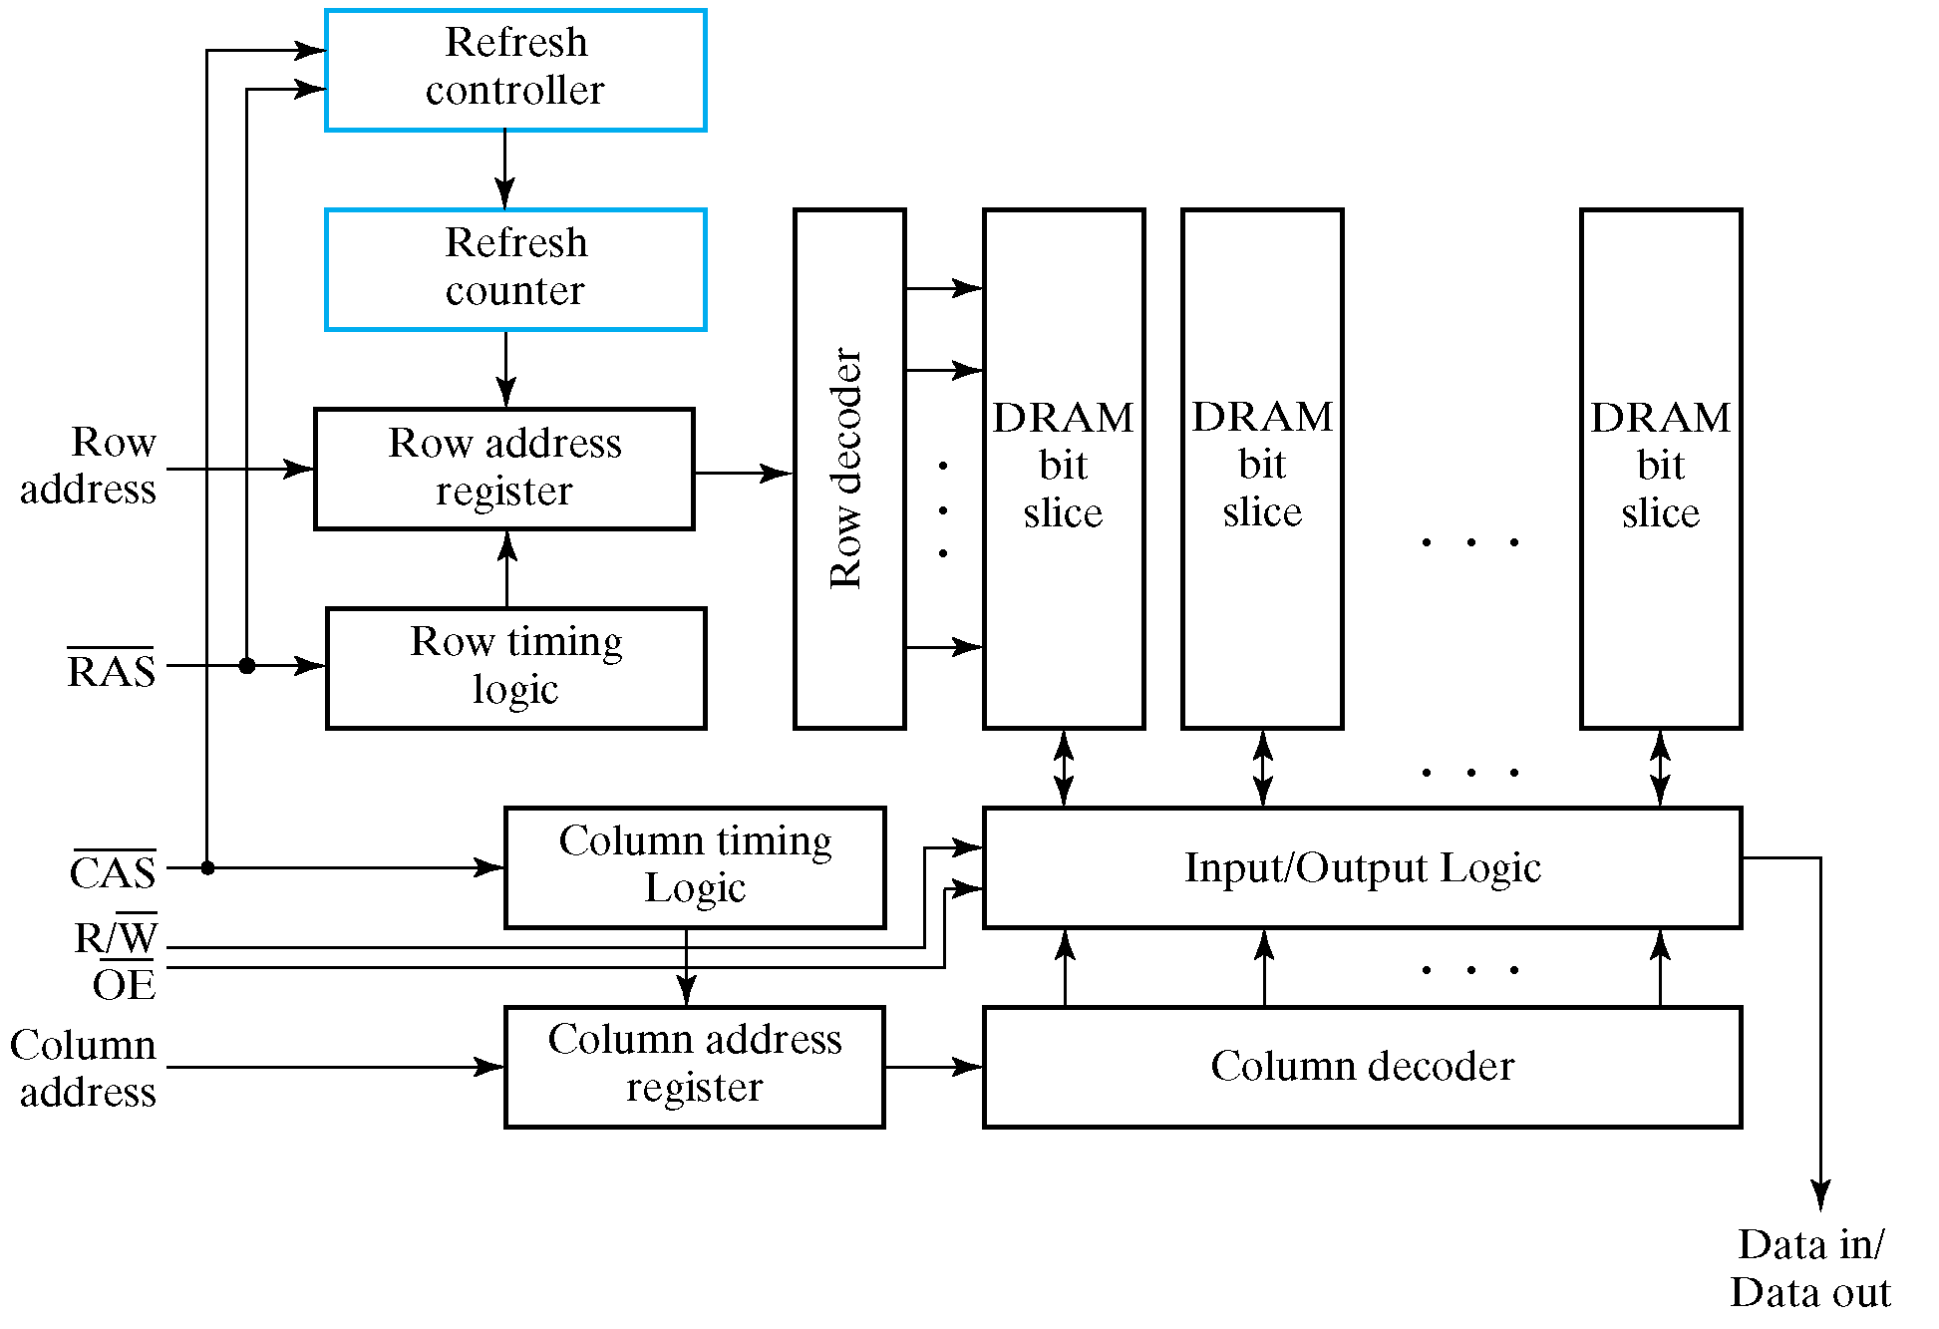
Dynamic RAM - Block Diagram
Chapter 9 - Part 1 <number>
Notes:
The address is split to roughly halve the large number of address pins on the typical RAM IC.
The row address is used to select the row of cells to be read within the memory.
The column address is used to select the word to be placed on the output from the data read
from the row of cells. Since the data must be read from the cells before it can be selected, the
row address must be applied first.

Slide 25
Dynamic RAM - Block Diagram
Refresh Controller and Refresh Counter
Read and Write Operations
  Application of row address
  Application of column address
  Why is the address split?
  Why is the row address applied first?
Chapter 9 - Part 1 <number>
Notes:
The address is split to roughly halve the large number of address pins on the typical RAM IC.
The row address is used to select the row of cells to be read within the memory.
The column address is used to select the word to be placed on the output from the data read
from the row of cells. Since the data must be read from the cells before it can be selected, the
row address must be applied first.

Slide 26
Dynamic RAM Read Timing
20 ns
Clock
T1
T2
T3
T4
T1
Address
Row
Column
Address
Address
RAS
CAS
Output
enable
Read/
Write
Data
Hi-Z
Data valid
output
65 ns
Read cycle
Chapter 9 - Part 1 <number>

Slide 27
DRAM Types
Types to be discussed
  Synchronous DRAM (SDRAM)
  Double Data Rate SDRAM (DDR SDRAM)
  RAMBUS® DRAM (RDRAM)
Justification for effectiveness of these types
  DRAM often used as a part of a memory hierarchy (See details in chapter 14)
  Reads from DRAM bring data into lower levels of the hierarchy
  Transfers from DRAM involve multiple consecutively addressed words
  Many words are internally read within the DRAM ICs using a single row address and captured within the memory
  This read involves a fairly long delay
Chapter 9 - Part 1 <number>

Slide 28
DRAM Types (continued)
Justification for effectiveness of these types (continued)
  These words are then transferred out over the memory data bus using a series of clocked transfers
  These transfers have a low delay, so several can be done in a short time
  The column address is captured and used by a synchronous counter within the DRAM to provide consecutive column addresses for the transfers
burst read – the resulting multiple word read from consecutive addresses
Chapter 9 - Part 1 <number>

Slide 29
DRAM Types (continued)
Transfers to and from the DRAM are synchronize with a clock
Synchronous registers appear on:
  Address input
  Data input
  Data output
Column address counter
  for addressing internal data to be transferred on each clock cycle
  beginning with the column address counts up to column address + burst size – 1
Chapter 9 - Part 1 <number>

Slide 30
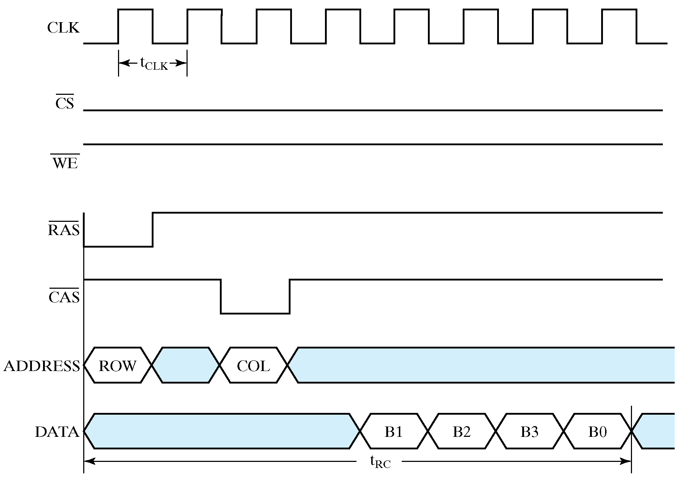
Synchronous DRAM (Continuous)
Chapter 9 - Part 1 <number>

Slide 31
Synchronous DRAM (Continuous)
The Memory Bandwidth of SDRAM is related with burst size
Example: Memory data path width: 1 byte
Memory clock period: 7.5 ns
Latency time (from application of row address until first word available): 4 clock cycles
If burst size: 8 bytes
Read cycle time: (4 + 8) x 7.5 ns = 90 ns
Memory Bandwidth: 8/(90 x 10⁻⁹) = 88.89 Mbytes/sec
If burst size: 2048 bytes
Read cycle time: (4 + 2048) x 7.5 ns = 15390 ns
Memory Bandwidth: 2048/(15390 x 10⁻⁹) = 133.07 Mbytes/sec
Chapter 9 - Part 1 <number>

Slide 32
Double Data Rate Synchronous DRAM
Transfers data on both edges of the clock
Provides a transfer rate of 2 data words per clock cycle
Example: Same as for synchronous DRAM
  Read cycle time = 15390 ns
  Memory Bandwidth: 2 x 2048/(15390 x 10⁻⁹) = 266.14 Mbytes/sec
Chapter 9 - Part 1 <number>

Slide 33
Rambus DRAM (RDRAM)
Uses a packet-based bus for interaction between the RDRAM ICs and the memory bus to the processor
The bus consists of:
  A 3-bit row address bus
  A 5-bit column address bus
  A 16 or 18-bit (for error correction) data bus
The bus is synchronous and transfers on both edges of the clock
Packets are 4-clock cycles long giving 8 transfers per packet representing:
  A 12-bit row address packet
  A 20-bit column address packet
  A 128 or 144-bit data packet
Multiple memory banks are used to permit concurrent memory accesses with different row addresses
The electronic design is sophisticated permitting very fast clock speeds
Chapter 9 - Part 1 <number>

Slide 34
Arrays of DRAM Integrated Circuits
Similar to arrays of SRAM ICs, but there are differences typically handled by an IC called a DRAM controller:
  Separation of the address into row address and column address and timing their application
  Providing RAS and CAS and timing their application
  Performing refresh operations at required intervals
  Providing status signals to the rest of the system (e.g., indicating whether or not the memory is active or is busy performing refresh)
Chapter 9 - Part 1 <number>

Slide 35

Assignment
7-1、7-4、7-5、7-8,
Chapter 9 - Part 1 <number>

