Slide 1
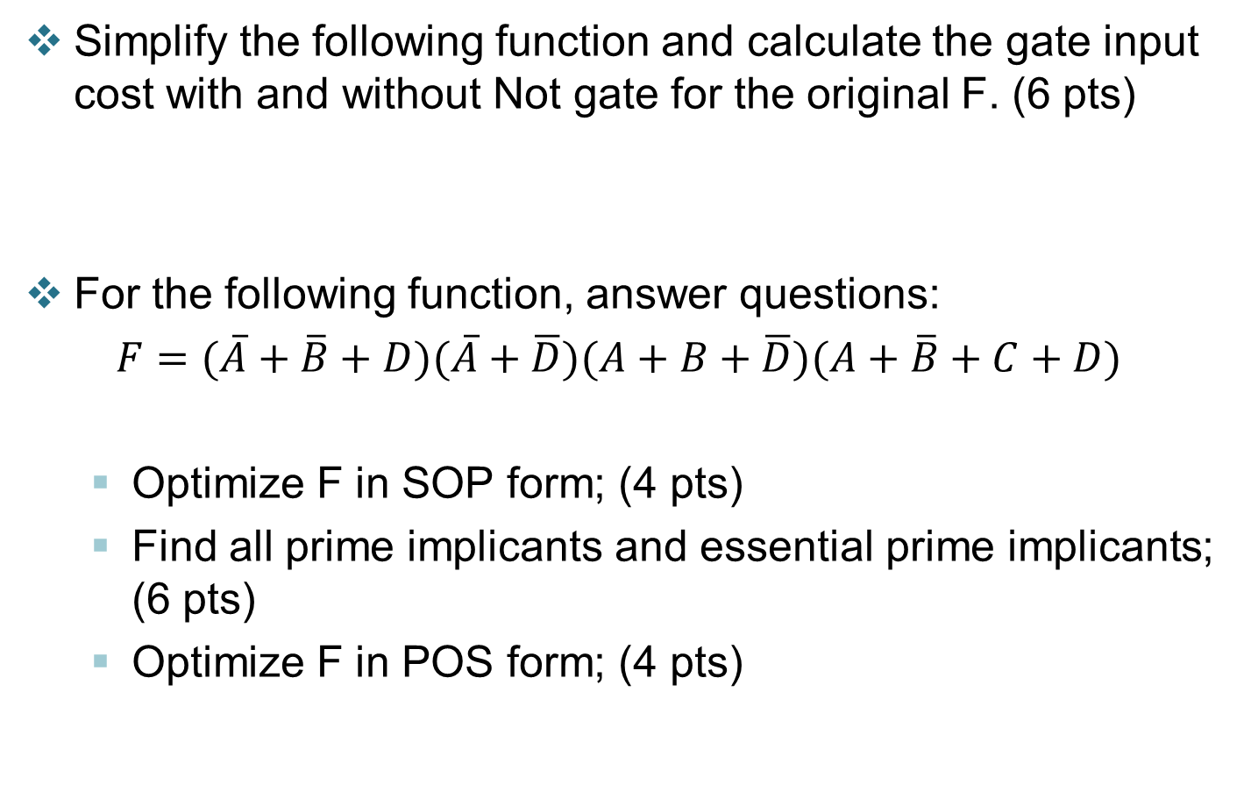
Quiz
Simplify the following function and calculate the gate input cost with and without Not gate for the original F. (6 pts)
For the following function, answer questions:
$F=(\overline{A}+\overline{B}+D)(\overline{A}+\overline{D})(A+B+\overline{D})(A+\overline{B}+C+D)$
Optimize F in SOP form; (4 pts)
Find all prime implicants and essential prime implicants; (6 pts)
Optimize F in POS form; (4 pts)

Slide 2


Answer
1. Simply the function (6 points)
(G=15)
$=X\overline{Z}+\overline{Y}W+\overline{X}ZW+YZW$ (GN=18) $=X\overline{Z}+\overline{Y}W+\overline{X}ZW+ZW$
$=X\overline{Z}+\overline{Y}W+ZW$
2.
1 |  |  | 1
 | 1 | 1 | 1
1 |  |  | 1
SOP. $F=\overline{B}\overline{D}+\overline{A}BD+\overline{A}BC$ or
$=\overline{B}\overline{D}+\overline{A}BD+\overline{A}C\overline{D}$
Primes: $\overline{B}\overline{D}$, $\overline{A}BD$, $\overline{A}BC, \overline{A}C\overline{D}$
essentials: $\overline{B}\overline{D}$, $\overline{A}BD$,
POS. $F=(\overline{A}+\overline{B})(B+\overline{D})(\overline{B}+C+D)$

Slide 3
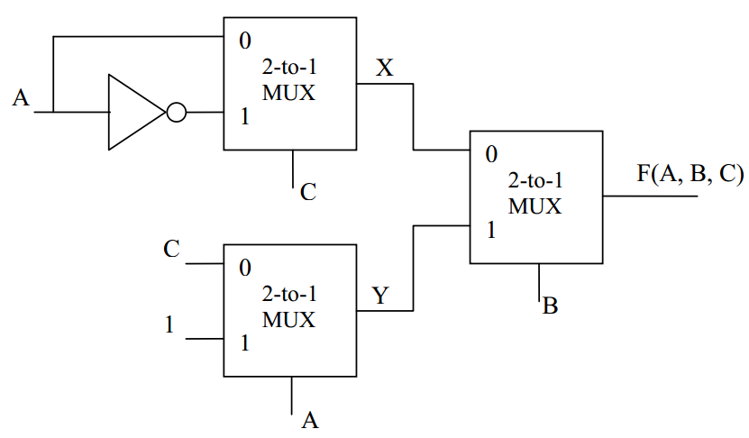
Quiz
Given the following logic circuits implemented with three 2-to-1 multiplexors and inputs A, B and C, please find the logic expressions of X, Y and F in its SOM form.
Design a circuit with a 8-to-1 multiplexer to generate a odd-parity bit for binary code (b3,b2,b1,b0). Write down the truth table, and the circuit.

Slide 4
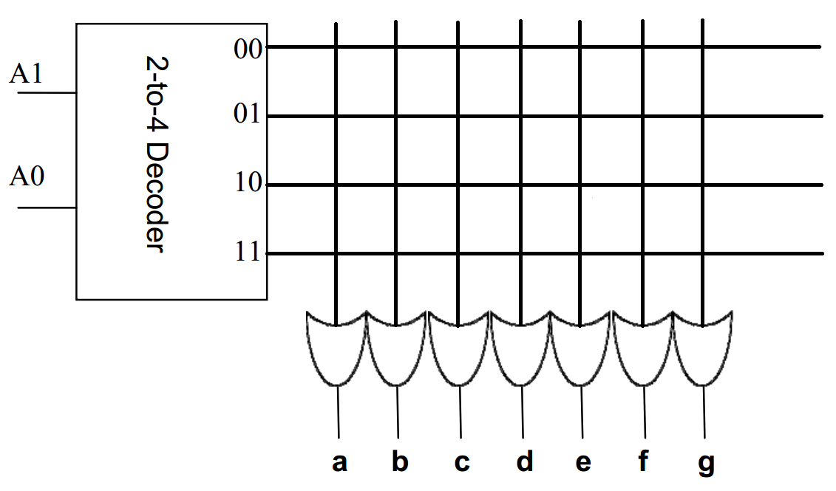
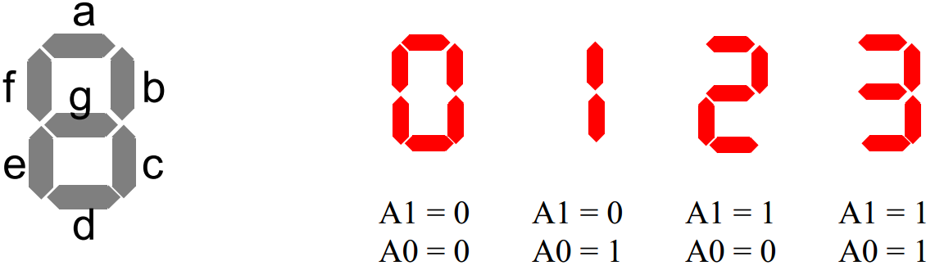
Quiz
Design a circuit with a 8-to-1 multiplexer to decide whether a 4-bits binary number can be divided by 4, output 1 if yes, otherwise output 0. Write down the truth table, logic function and the circuit.
Design a 7-segment display using a 22 x 7 ROM. There is 2 Inputs: A1 and A0 and 7 Outputs: a ~ g; if a ~ g = 1, LED light is on, and if a ~ g = 0, the light is off. You only need to display 0, 1, 2, 3 as follows. Draw the circuit design on the ROM plane.

Slide 5
Quiz
Design a circuit which implements 4-bit incrementing/decrementing use a 4-bits full adder: when the input S=0, the circuit performs increment, when S=1, the circuit performs decrement.
Design a counter, when the control signal C=1, the counting sequence is 000→100→110→111→011→000; when C=0, the counting sequence is 000→100→110→010→011→000. Please write the state diagram, state table, next state function, output function and draw the circuit.

Slide 6
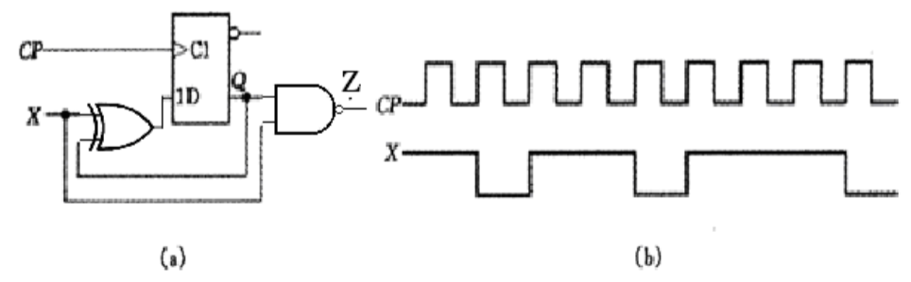
Quiz
Given a circuit in figure (a):
write down its state table and state diagram.
Assume the initial state is 0 and input X waveform is shown in (b), write down the waveform of Q and Z.
Design a counter, when the control signal C=1, the counting sequence is 000→100→110→111→011→000; when C=0, the counting sequence is 000→100→110→010→011→000. Please write the state diagram, state table, next state function, output function and draw the circuit.

Slide 7
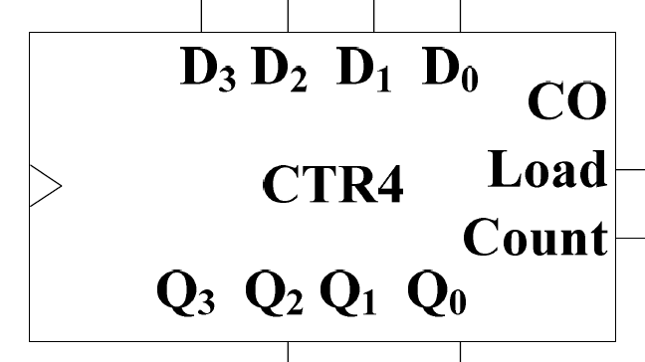
Quiz 4
Use two 4-bit synchronous binary counters and logic gates to implement a 2-bits date counter that counts from decimal “01” through decimal “31”. (and “28”)
Give two register transfer operations (R1 unchanged except for the following cases):
C1: R1←R1 + R2
(~C1)C2: R1←R1 - 1
Use two 4-bits registers, one 4-bit adder, and other necessary gates to implement the above operations.

