Slide 1
10月25日随堂练习
3.8
2.16（a) 2.24(b)
2.19(c)
2.34

Slide 2
11月日随堂练习

Slide 3
Quiz2
Simplify the following with formulas and calculate the gate input cost for the original F and the simplified result. (6 pts)
For the following function, answer questions:
F(A, B, C, D) = ∑m(0,1,2,3,6,8) + ∑d (10,11,12,13,14,15)
Draw the K-map and express F in product-of-maxterms algebraic form (∏_{M}(…)); (4 pts)
Circle the essential prime implicants and list the corresponding AND terms; (6 pts)
Perform the optimization in the form of SOP and POS; (4 pts)

Slide 4
一、填空题
三态缓冲器的输出有________个状态，若将几个三态缓冲器的输出端并联在一起，则最多允许__________个三态缓冲器输出使能。
数制转换：(17.5)₈ = (______)₁₀= (________)₁₆。
(-7.7)₁₀的8位机器数（3位小数，1位符号位）是_______；反码是_____________；补码是____________。
一个10位地址码、8位输出的ROM，其存储容量为_____________位。

Slide 5
已知某函数
该函数的简形式的反函数
可以被用作可控门的逻辑门是_______________门。

Slide 6
二. 选择题
二值逻辑处理二进制的变量，其变量只取____________个离散值。
A. 1个 B. 2个 C. 3个 D. 4个

Slide 7
函数
的门输入成本G_________。
A. 9 B. 10 C. 11 D. 12
在四变量卡诺图中有___________个小格是“1”。
A. 13 B. 12 C. 6 D. 5

Slide 8
下列卡诺图表示的函数中，质蕴涵项共有__________个。
A. 4 B. 5 C. 6 D. 7
 |  |  | Y
 | 1 |  | 1 | 1
 |  |  | 1 |  | X
W |  | 1 | 1
 | 1 | 1 | 1 | 1
 |  | Z

Slide 9
只读存储器 (ROM) 是由________与门陈列和_________或门陈列组成的组合逻辑结构。
可编程，固定的
B. 可编程，可编程
C. 固定的，可编程
D. 固定的，固定的

Slide 10
（用公式化简，注明每步的主要公式）。
用卡诺图化简以下函数为最简与非-与非表达式：F = ∑m(0, 1, 5, 7, 8, 11, 13) + ∑d (3, 9, 12, 15)。（标出最大维块及对应的与项）

Slide 11
分析下列逻辑电路，其中A、B、C、D为输入，F为输出。请列出F的真值表，写出F的逻辑表达式，分析此电路最大可能的功能。

Slide 12
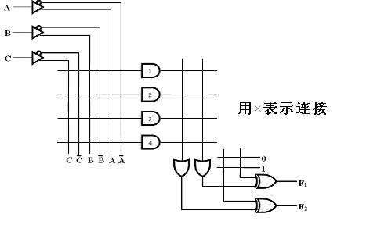
在下图的可编程逻辑阵列PLA上实现下列逻辑函数功能并作简要的设计说明（12分）：

Slide 13
随堂练习3:
12月6日

Slide 14
时序电路的次态不仅与当前输入有关，而且还与_______________有关。
通常情况下，主从触发器的建立时间要_____边沿触发器
电路输出方程只与电路现态相关的时序电路是_______________型电路。
如果对键盘上108个符号进行二进制编码，则至少要______位二进制数码。
传输延迟（Propagation Delay）是指变化的信号从_______________传输到____________所需要的时间，电路的处理速度与电路门的最大传输延迟成反比例关系。
用2个或非门构成的基本S-R锁存器两个输入同时为0时，其功能 为输出Q_____________________。

Slide 15
基本R-S型触发器不具有___________功能。
保持 B. 翻转 C. 置1 D. 置0
存在“一次性采样”问题的触发器是________
A. S-R锁存器 B. D锁存器
C. 边沿触发的D触发器 D. S-R主从触发器

Slide 16
A. 8.5ns B. 7.5ns
C. 6.5ns D. 5.5ns
设下图时序电路中门与触发器的参数如下：异或门的延时t_{pd}=3.0ns，与门的延时t_{pd}=1.5ns，触发器延时t_{pd}=3.0ns，建立时间t_{s}=1.0ns，保持时间t_{h}=0.25ns。外部输入需要在时钟脉冲上升沿的___________之前就需要确定下来。
A. 8.5ns B. 7.5ns
C. 6.5ns D. 5.5ns

Slide 17
根据下图写出电路的输出方程、次态方程，
列出状态表，画出状态图。

Slide 18
采用米利模型设计一个电路，来识别两个序列101和110。当识别到序列101时，电路输出10，当识别到序列110时，输出11。否则，电路输出00。请画出状态图、状态表、次态方程和输出方程，并画出电路图。

Slide 19
随堂练习4
12月20日 (题中所有公式及图都需要化简，必须去掉等价状态）

Slide 20
填空
Using a 4-bit synchronous binary counter to design a Module-8 counter, the activation of Load signal can be _____B_____.
A. Q2Q1Q0 B. Q2Q1Q0
C. Q2 Q1 Q0 D. Q2+Q1+Q0
1 Given two 8-bit registers R1 and R2, with R1 = (1011 0101)₂
and R2 = (0111 0110)₂. After two microoperations:
R1 ← sr R1 and b) R1 ← R1⊕R2,
R1= (_ _)₂.
2 74LS153 is a dual 4-to-1-line multiplexer, if the data input lines I₀ ~ I₃ = 1010, selection inputs S₁S₀ = 10, then the output of the multiplexer is Y=__________, if the output Y is required to be square wave, then the selection inputs S₁S₀ could be_______________.

Slide 21
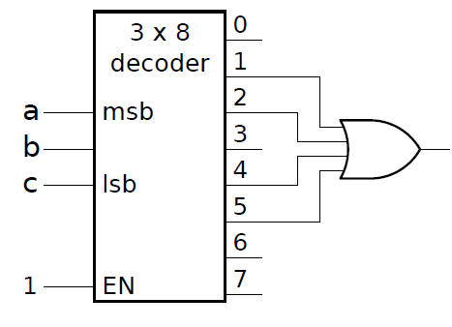
3 (2%) How many flip flops will be complemented in a 8-bit binary up counter to reach the next count after the count 10100011: _________.
4 What is the output function implemented by the following circuit： .

Slide 22
选择
1 Using a 4-bit synchronous binary counter to design a Module-8
counter, the activation of Load signal can be ________.
A. Q2Q1Q0 （上划线） B. Q2Q1Q0
C. ~Q2 ~Q1 ~Q0 D. Q2+Q1+Q0
2 Q₃Q₂Q₁Q₀ are the outputs of a synchronous BCD counter，Q₃ is the most significant bit，then the output period of Q₃ and its width of the positive pulse (HIGH voltage value) are_________.
10 clock periods, its width of the positive pulse is 1 clock period
10 clock periods, its width of the positive pulse is 2 clock period
16 clock periods, its width of the positive pulse is 2 clock periods
D. 16 clock periods, its width of the positive pulse is 10 clock periods

Slide 23
3 Using synchronous binary counter to design a Module-N counter, the activation of Load signal is to make the counter_________ under the control of clock.
A. load the initial non-zero number at one time
B. initialize the starting states for all flip-flops at one time
C. load the initial number on the next clock transition before starting counting or when counting to N-1
D. none of the above
4 至少__________个4位二进制计数器可以构成N=2010的计数器。
A. 12 B. 11 C. 3 D. 2

Slide 24
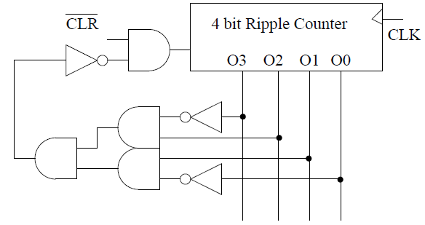
5 Given the Mod-N counter with synchronous reset signal shown below, N =
A 6 B 7 C 8 D 9

Slide 25
Circuit design
1 Magnitude comparators.
(1) Construct the Truth Table for a one-bit unsigned magnitude comparator. There are two inputs: A and B with three outputs: X, Y, Z, and X is Boolean value for logic A>B, Y for logic A<B and Z for logic A==B.
A | B | X (A>B) | Y (A<B) | Z (A==B)
0 | 0
0 | 1
1 | 0
1 | 1

Slide 26
2) Use “one 2-to-4 decoder” and some “logic gates” (i.e., OR, AND, and such) to implement this one-bit comparator.
(3) Take the 1-bit comparator you design as a building block (i.e., draw it as a box with 2 inputs and 3 outputs), now use two of these and other logic gates to design a 2-bit unsigned magnitude comparator. The new comparator consists of 4 inputs: A[1:0] and B[1:0], and 3 outputs: A>B, A<B, and A==B. Please show your logic circuits schematic and label the inputs and outputs properly.

Slide 27
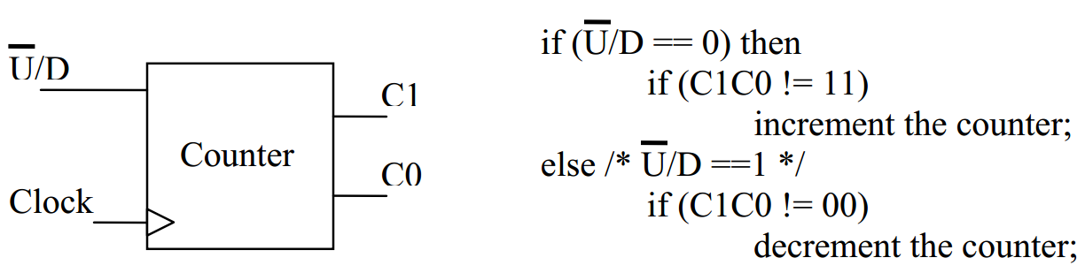
Sequential circuits design.
2 Design a 2-bit up/down saturating counter using D Flip-Flops and other basic gates: derive the state diagram, state table, and draw the circuits. The counter consists of 2 inputs (one for controlling direction, the other one is the clock) and 2 outputs that represent the current count value. The functionality of this counter is described in the pseudo code on the right.

Slide 28
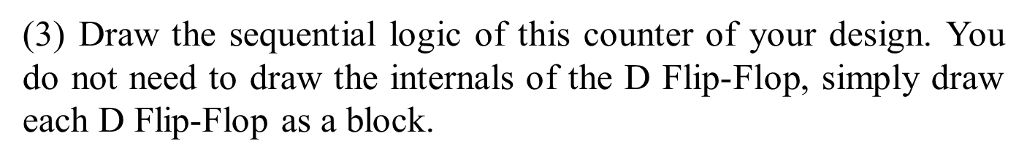
(1) Draw the State Diagram (Mealy or Moore)
(2) Derive the State Table, write down next state equations and output equations, and simplify them.

