Slide 1
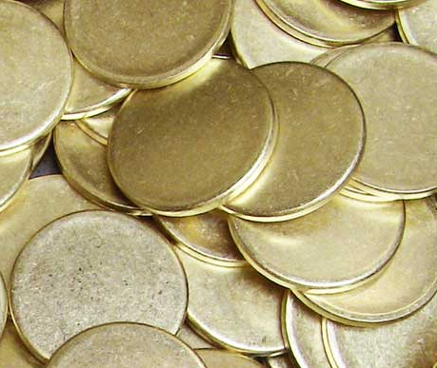

The Yorkshire BrassBitCoin

Slide 2
Adam Pridmore
Average Developer
Below average BitCoin expert person
Notes:
I’ve been interest in the implementation of BitCoin for as long as 3 or 4, maybe longer – months.

Slide 3
What is a BitCoin?
“It’s a cryptocurrency or a specific implementation of a block chain”
“Money”
Notes:
Just like pounds or dollars, it only have value because people think it has value.
The may be very relevant to any Yorkshire BrassBitCoins you may be taking home with you tonight…

Slide 4
What is a Block Chain?
“a digital ledger in which transactions made in bitcoin or another cryptocurrency are recorded chronologically and publicly.”
“A public ledger. An immutable record which cannot be changed, even by the authors of the transactions”

Slide 5
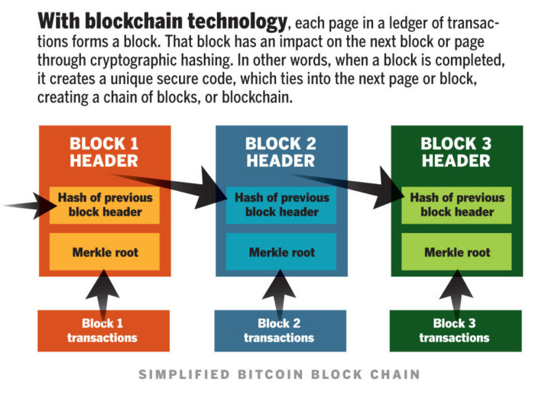
Each block has
Transactions
Hash of previous block
Its own hash
Other meta data
Notes:
We won’t be dealing with Merkle Tree

Slide 6
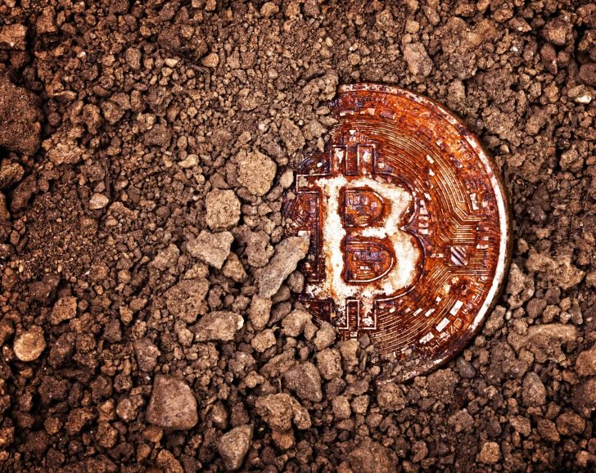
I’ve heard about this thing called ‘mining’?

Slide 7
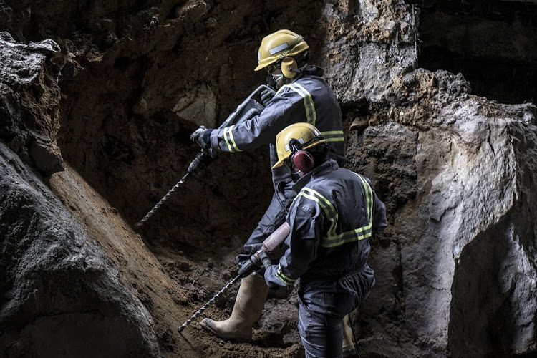
Bitcoin mining
Is creating a new valid block
Hash of a bunch of transactions and the previous hash
The hash has some (hard) criteria
Starts with 18 zeros
~2.7 Million billion hashes tried to find one
Real Example:
00000000000000000058dd9b08732c8f376188bd85a46e93167b772ee51c34d6
Why do it?
You get some bitcoins (12.5)
And you get all the transaction fees in the block => more $$$
~1 coin is mined every 10 minutes
The network self adjusts this to be true every two weeks.
Notes:
AKA “proof of work”

Slide 8
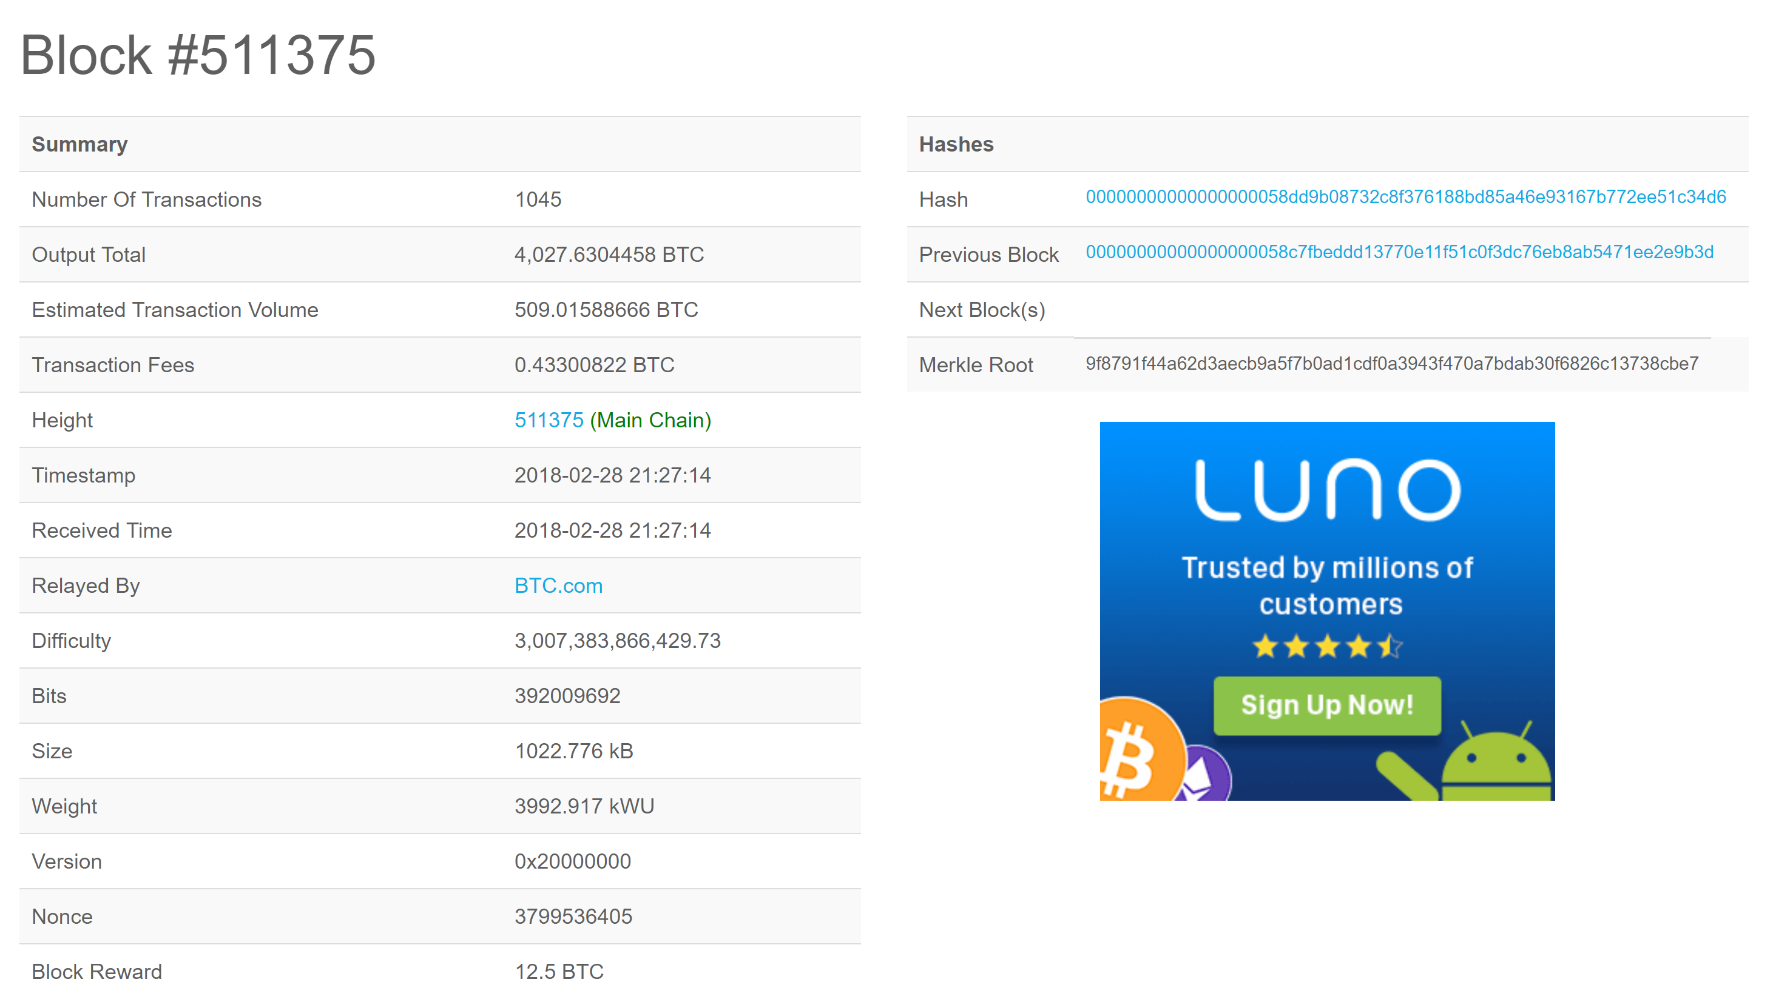
https://blockchain.info/block/00000000000000000058dd9b08732c8f376188bd85a46e93167b772ee51c34d6

Slide 9
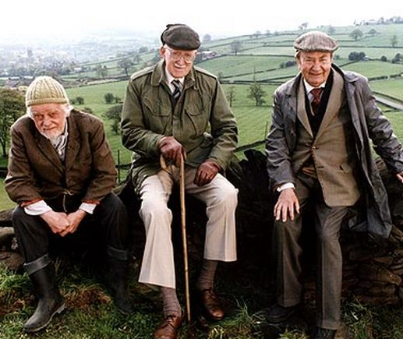
The Yorkshire BrassBitCoin
Notes:
A rare photo of the three inventors of BrassBitCoin

Slide 10
The Yorkshire BrassBitCoin
Each BrassBitCoin block is made up of
index | Integer
minedBy | String
data | String
previousHash | String
nonce* | Integer
Hash | string
* A nonce word (also called an occasionalism) is a lexeme created for a single occasion to solve an immediate problem of communication - wikipedia
Notes:
A simplified version of the BitCoin (possibly to the point that it’s not secure / works / worth any real money. Or is it?

Slide 11
Hash is calculated by
The hash value is the SHA-256 hash of all the fields concatenated in order (excluding the hash) with a single space between as an upper case hex string. e.g
index | index
minedBy | Adam
data | 4
previousHash | 0000CA2C984CDF70E03269309026979A18FA25EBBAB16BD90C88F92985992609
nonce | 22889
5 Adam 4 0000CA2C984CDF70E03269309026979A18FA25EBBAB16BD90C88F92985992609 22889
Makes this hash
hash | 0000cbfe51be34fad0de5720d6253dd23556b909b2d9f1d412cf552cdb76eb91
http://www.xorbin.com/tools/sha256-hash-calculator

Slide 12
More details on the Block in the notes
Genesis block - the special first block
What all the fields are
What a valid hash is (it starts with four 0’s)

Slide 13
Transactions
See the notes

Slide 14

The Yorkshire BrassBitCoin Server
https://yorkshire-brassbitcoin.azurewebsites.net/

Slide 15
void*
Let’s Build the Tiniest Blockchain - (In Less Than 50 Lines of Python) https://medium.com/crypto-currently/lets-build-the-tiniest-blockchain-e70965a248b
https://yorkshire-brassbitcoin.azurewebsites.net/
https://blockchain.info/
https://passwordsgenerator.net/sha256-hash-generator/

