Slide 1

TDD
Hacking

Slide 2
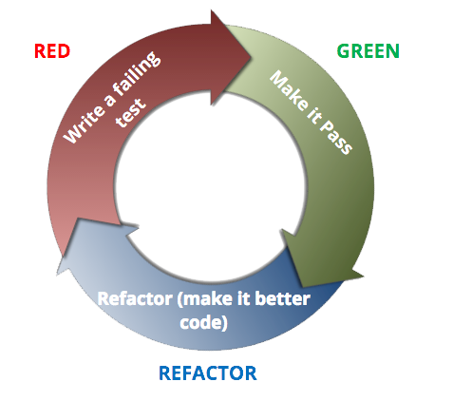
What is TDD?

Slide 3
What is TDD?
Uncle Bob Martin’s Three Laws of TDD:
1) You may not write production code until you have written a failing unit test.
2) You may not write more of a unit test than is sufficient to fail, and not compiling is failing.
3) You may not write more production code than is sufficient to pass the currently failing test.

Slide 4
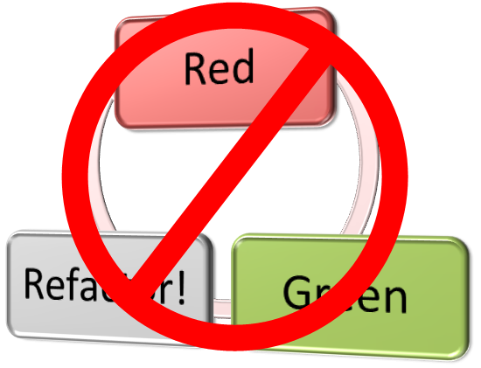
What is Hacking?

Slide 5
Everyone loves TDD.. ?
“..it has become infeasible (…) for a software developer to consider himself ‘professional’ if he does not practice test driven development.”
- Uncle Bob Martin
“Test-first fundamentalism is like abstinence-only sex ed: An unrealistic, ineffective morality campaign for self-loathing and shaming.”
- DHH

Slide 6

Time for SCIENCE!
Split into groups: TDD & Hacking
Within each group, split into pairs
Solve a problem following the rules
See, inconclusively, which approach is best*

Slide 7
The Rules
TDD
You must follow Red/Green/Refactor
Each step is mandatory every cycle. Including refactor!
You must follow Uncle Bob’s Three Rules of TDD
No code without a failing test
Only as much code as needed to make the test pass

Slide 8
The Rules
Hacking
No testing
You can run the program once per use case implemented to check that use case.
No static analysis
Compiling is OK

Slide 9
The Rules
Points will be deducted for breaking the rules!
Multiple breaks will result in DISQUALIFICATION!
Feel free to check other team's adherence to the rules and tell the teacher about any wrongdoing!

Slide 10
The Problem
Based on Roy Osherove’s String Calculator
http://osherove.com/tdd-kata-1/
See handouts.

Slide 11
Go!

Slide 12
Scoring the solutions
Swap with a pair in the other group
Give a mark out of ten for each of:
Completeness (Use cases implemented, even if problems)
Maintainability (use your judgement..)
Deduct marks for:
Quality (Test some cases!) - deduct a point for each defect.
Scores will be aggregated
See handouts for details

Slide 13


Slide 14
Remember!
Solutions here:
https://github.com/LeedsCodeDojo/TDDvsHacking
Next Dojo:
Functional vs OO
Tuesday 25th April
Tech//Connect @ Leeds Digital Festival
No session on Wed 3rd May!

