Slide 1
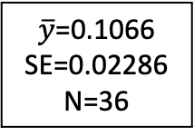
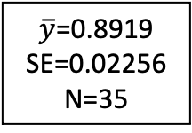
x
<=0
>0
$\overline{y}$=0.1066
SE=0.02286
N=36
$\overline{y}$=0.8919
SE=0.02256
N=35

Slide 2
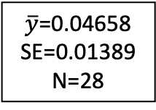
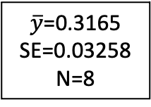
x
<=0
>0
x
$\overline{y}$=0.8919
SE=0.02256
N=35
<=-1.5
>-1.5
$\overline{y}$=0.04658
SE=0.01389
N=28
$\overline{y}$=0.3165
SE=0.03258
N=8

