Slide 1
Lab 15 Static Library v.s Dynamic Library
TA:Yung-Tung Chou
Professor: Hsung-Pin Chang
Operating System Lab

Slide 2
Outline
Library Overview
Static Library
Overview
Creating Static Library
Exercise I
Dynamic(shared) Library
Overview
Creating Dynamic(shared) Library
Exercise II

Slide 3
Library Overview
A library is a collection of implementations of behavior, written in terms of a language, that has a well-defined interface by which the behavior is invoked.
For instance, people who want to write a higher level program can use a library to make system calls.

Slide 4
Static Library Overview

Slide 5
Overview
Static library (also known as archives): libxxx.a
Object files and libraries are linked into the binary program image, at compiler time, i.e., static linking.
Waste disk and memory space if many programs use the same library.
If a library function is changed, we need to re-link the applications using this library function.

Slide 6
Overview(cont.)
#include <stdio.h>
extern int add(int);
extern int sub(int);
extern int sum(int, int);
main()
{
int ret1, ret2, ret3;
ret1 = add(5);
ret2 = sub(5);
ret3 = sum(ret1, ret2);
printf("\n ret from add()= %d", ret1);
printf("\n ret from sub()= %d", ret2);
printf("\n ret from sum()= %d", ret3);
}
main.c
int add(int arg)
{
arg++;
return arg;
}
int sub(int arg)
{
arg--;
return arg;
}
a.c
b.c
int sum(int arg1, int arg2)
{
return (arg1+arg2);
}

Slide 7
Overview(cont.)
#include “lib.h”
int add(int arg)
{
arg++;
return arg;
}
int sub(int arg)
{
arg--;
return arg;
}
#include <stdio.h>
#include “lib.h”
main()
{
int ret1, ret2, ret3;
ret1 = add(5);
ret2 = sub(5);
ret3 = sum(ret1, ret2);
printf("\n ret from add()= %d", ret1);
printf("\n ret from sub()= %d", ret2);
printf("\n ret from sum()= %d", ret3);
}
main.c
a.c
b.c
#include “lib.h”
int sum(int arg1, int arg2)
{
return (arg1+arg2);
}
int sum (int arg1,int arg2);
int add(int arg);
Int sub(int arg);
lib.h

Slide 8
Overview(cont.)
Source file
Object file
main.c
Compiler
main.o
a.c
Compiler
a.o
linker
b.c
Compiler
b.o
Executable
file

Slide 9
Overview(cont.)
Process a
#include<stdio.h>
extern int add(int);
extern int sub(int);
int main()
{
:
}
a.o
a.o
Process b
#include<stdio.h>
extern int add(int);
extern int sub(int);
int main()
{
:
}
Memory

Slide 10
Static Library Creating Static Library

Slide 11
Creating Static Library
ar - create, modify, and extract from archives
-c: create the archive
-r: insert a file member into archive with replacement
-d: delete a file member from library
-t: list contents of library
eg.
ar –t libtest.a
ar –d libtest.a b.o

Slide 12
Creating Static Library(cont.)
First, compile source programs to object files
gcc –c main.c
gcc –c a.c
gcc –c b.c
Then, create/add/replace object programs into library
ar –r libtest.a a.o b.o

Slide 13
Creating Static Library(cont.)
Finally, to link with the library
gcc –o main main.o libtest.a
or
gcc –o main main.o –L. –ltest
-L. : . = add current directory to the search directory
-ltest: means libtest.so or libtest.a
Notes:
-Ldir' 參數用來指定要搜尋程式庫的目錄，`.' 表示搜尋現在所在的目 錄。 通常預設會搜/usr/lib 或/lib 等目錄。 -llibrary' 參數用來指定要連結的程式庫，'mylib' 表示要與mylib進 行連結

Slide 14
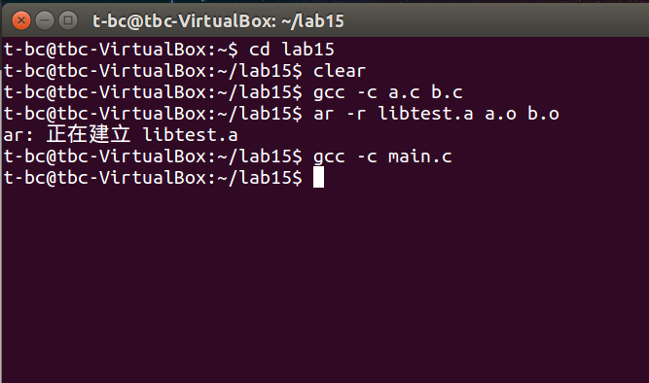
Creating Static Library(cont.)

Slide 15
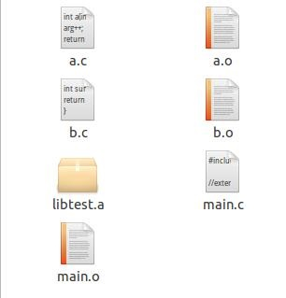
Creating Static Library(cont.)
ar –r libtest.a a.o b.o
gcc –c a.c b.c main.c

Slide 16
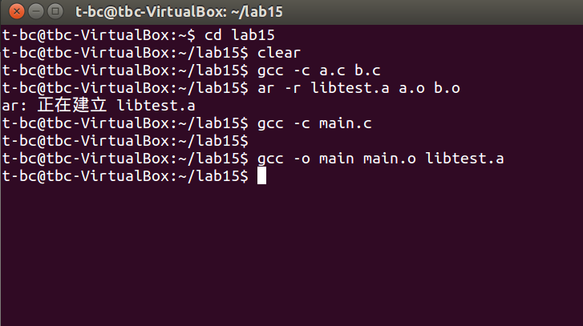
Creating Static Library(cont.)

Slide 17
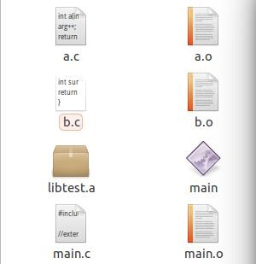
Creating Static Library(cont.)
gcc –o main main.o libtest.a

Slide 18
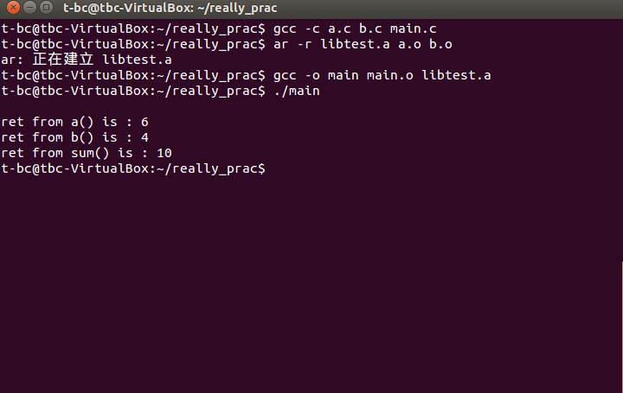
Creating Static Library(cont.)

Slide 19
Static Library Exercise I

Slide 20
Exercise1(60%)
Create a static library consists of a object files. The object file should include selection_sort function.
Create a C program to call the function of the object files and sort the array : 15, 22, 41, 8, 35.

Slide 21
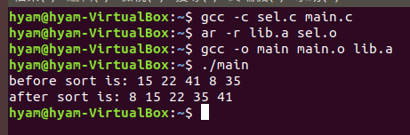
Result

Slide 22
Dynamic(shared) Library Overview

Slide 23
Overview
Shared library: libxxx.so
A single copy of the library is loaded into memory, many programs can link to the same shared library.
The use of shared libraries means that executable programs require less space on memory.
The linking will not start until execution time, i.e., dynamic linking.

Slide 24
Dynamic (shared) Library Creating Dynamic Library

Slide 25
Creating Dynamic Library
First, compile source programs to object files
gcc –c -fPIC main.c
gcc –c -fPIC a.c
gcc –c –fPIC b.c
Then, create shared library
gcc a.o b.o –shared –o libtest.so
Finally, to link with shared library
gcc –o main main.o libtest.so
-fPIC : generate position-independent code

Slide 26
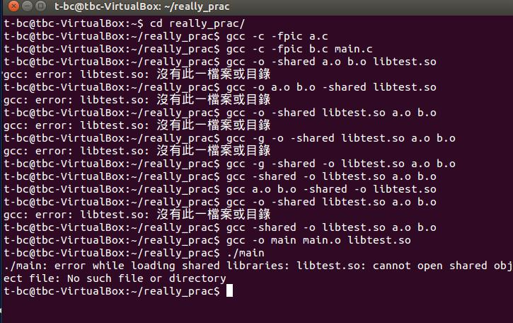
Error!
Notes:
Red use .libtest.so

Slide 27
Error!
Many shared libraries reside in /lib and /usr/lib.
The error message above occurs because our library resides in the current working directory, which is not part of the standard list searched by the dynamic linker.

Slide 28
Solution
Method 1:
Method 2:
Method 3:
Copy the libtest.so to /lib
Notes:
The dynamic linker searches for the shared library in the directories it lists before looking in the standard library directories.

Slide 29
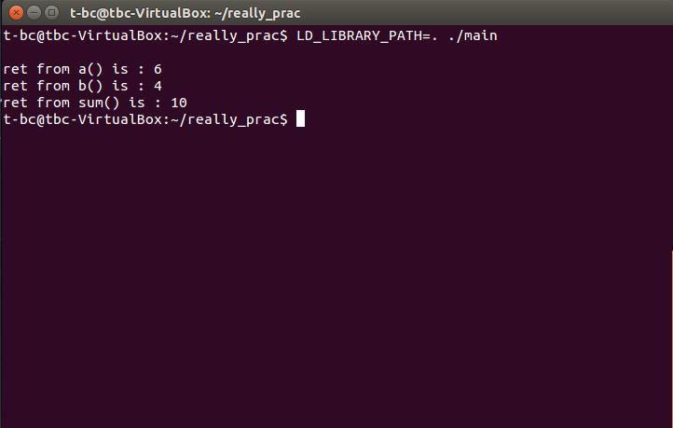
Done!

Slide 30
list dynamic dependencies
ldd:
Display the shared libraries that a program used.
In this example, you can type:
ldd main(your .out file name)

Slide 31
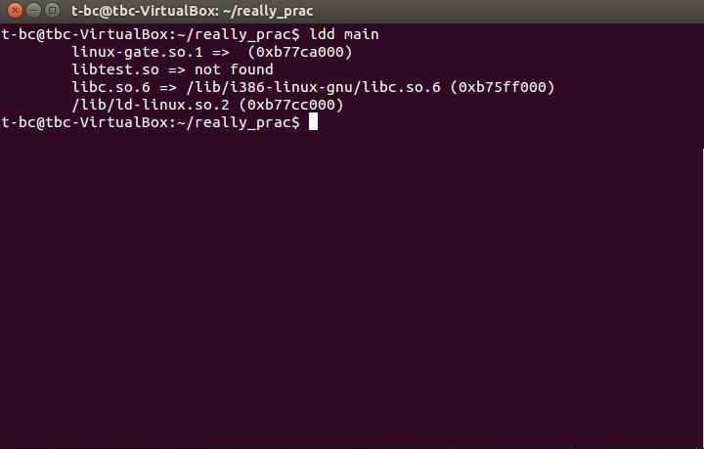
Not found!

Slide 32
Solution
This error occurs because of the same reason above we have got.
So you can also type:
LD_LIBRARY_PATH=. ldd main

Slide 33
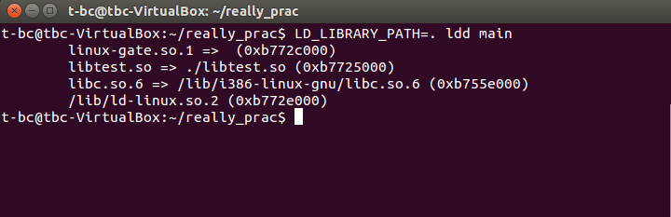
Solution

Slide 34
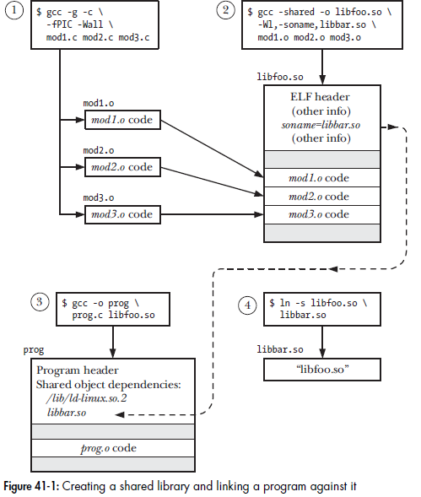

Slide 35
Dynamic Library Exercise II

Slide 36
Exercise2(30%)
Use the exercise1’s code to create another library, the library is created as shared library.
Compare two executable(.out) files size, using the command ls -l and size to show the file information.

Slide 37
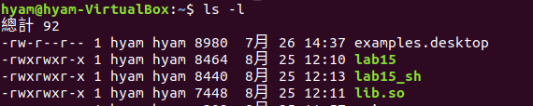
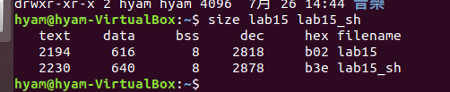
Result

Slide 38
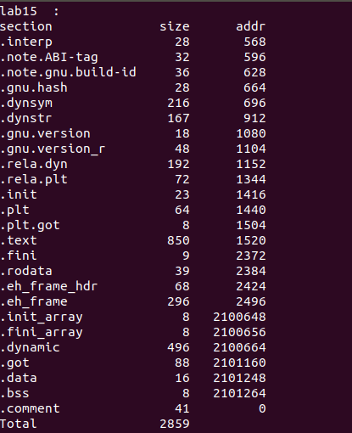
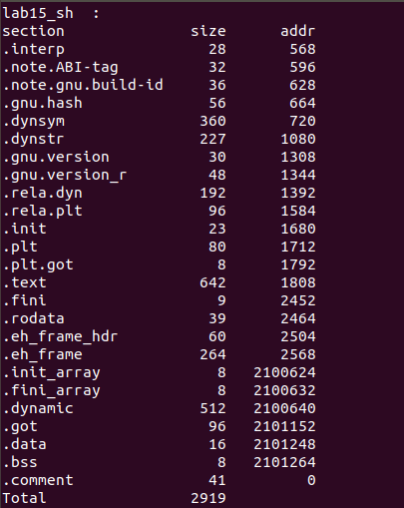
Result
Result

Slide 39
Reference
https://kopu.chat/2017/06/20/%E9%81%B8%E6%93%87%E6%8E%92%E5%BA%8F-selection-sort/
https://stackoverflow.com/questions/29016166/dynamic-library-size-bigger-than-static-library-and-sum-of-linked-objects-size

