Slide 1
Lab 10 Fork-Join Model
TA：Yu Chen Jheng
Professor：Hsung-Pin Chang
Operating System Lab

Slide 2
Outline
Fork-Join Model
Java Fork-Join Framework
Fork-Join Example
Exercise

Slide 3
Fork-Join Model
Fork-Join Model is a popular synchronous model.
The main thread which has a big task to solve creates (forks) one or more child threads ,will be assigned a small task divided by the big task.
After that, the main thread waits for the children to terminate and join with it,and it can retrieve and combine their results.

Slide 4
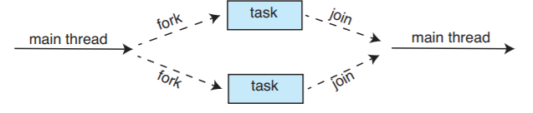
Fork-Join Model
This is a basic Fork-Join Model. We can see a main thread fork two child threads to handle with it big task, after finishing task they will join the main thread.

Slide 5
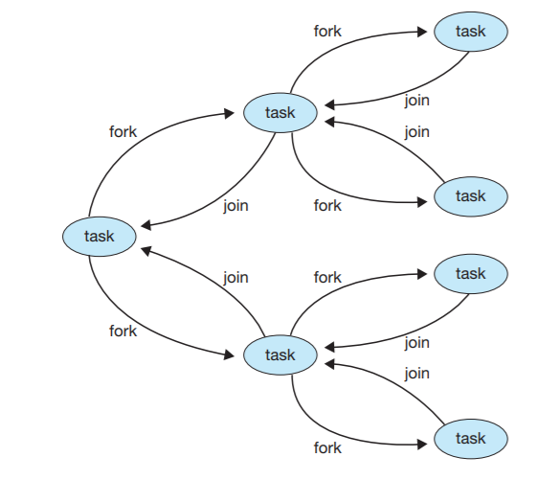
Fork-Join Model
Beside a main thread fork many child threads, we also can make a multiple level Fork-Join Model.

Slide 6
Outline
Fork-Join Model
Java Fork-Join Framework
Fork-Join Example
Exercise

Slide 7
Java Fork-Join Framework
The fork/join framework is an implementation of the ExecutorService interface that helps you take advantage of multiple processors. It is designed for work that can be broken into smaller pieces recursively. The goal is to use all the available processing power to enhance the performance of your application.

Slide 8
Java Fork-Join Framework
Write the ForkJoinTask class
1.With return value use RecursiveTask
2.Without return value use RecursiveAction
Write the compute() function in ForkJoinTask class
Write the code to do what you want to do
Initialize the ForkJoinPool and invoke the ForkJoinTask
Run the task

Slide 9
Java Fork-Join Framework
First we extends a ForkJoinTask class ,there are two type of ForkJoinTask,and in it we will write a code that performs a segment of the work.
1.RecursiveAction：
This won’t return result when ForkJoinTask.join()
Ex: public class Forktask extends RecursiveAction{}
2.RecursiveTask：
This will return result when ForkJoinTask.join()
Ex: public class Forktask extends RecursiveTask{}

Slide 10
Java Fork-Join Framework
Second you implement the abstract compute() method in the ForkJoinTask class you just extends.
In compute(),you write a code split a work to small works until it is small enough to execute.
protected void compute() {
if (work < Threshold) {
computeDirectly();return;
}
else{
int split=work/2;

Slide 11
//when you need to handle with return value
Forktask f1 = new Forktask(split);
Forktask f2 = new Forktask(split);
f1.fork();
return f2.compute() + f1.join();}}
//when you don’t need to handle with return value ,or don’t have return value.
invokeAll(new Forktask(split),
new Forktask(split));

Slide 12
Java Fork-Join Framework
fork()：
Arranges to asynchronously execute this task in the pool the current task is running in, if applicable, or using the ForkJoinPool.commonPool() if not inForkJoinPool().
join()
Returns the result of the computation when it is done.
invokeAll(Collection<T> tasks)：
Forks all tasks in the specified collection, returning when isDone holds for each task or an (unchecked) exception is encountered, in which case the exception is rethrown.

Slide 13
Final setting up the task to run in a ForkJoinPool.
ForkJoinPool：
An ExecutorService for running ForkJoinTasks. A ForkJoinPool provides the entry point for submissions from non-ForkJoinTask clients, as well as management and monitoring operations.
Create a task that represents all of the work to be done.
Forktask ft = new Forktask(work);
Create the ForkJoinPool that will run the task.
ForkJoinPool pool = new ForkJoinPool();
Run the task.
pool.invoke(ft);

Slide 14
Outline
Fork-Join Model
Java Fork-Join Framework
Fork-Join Example
Exercise

Slide 15
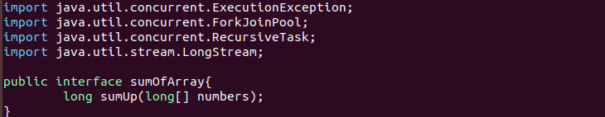
Fork-Join Example
sumOfArray.java

Slide 16
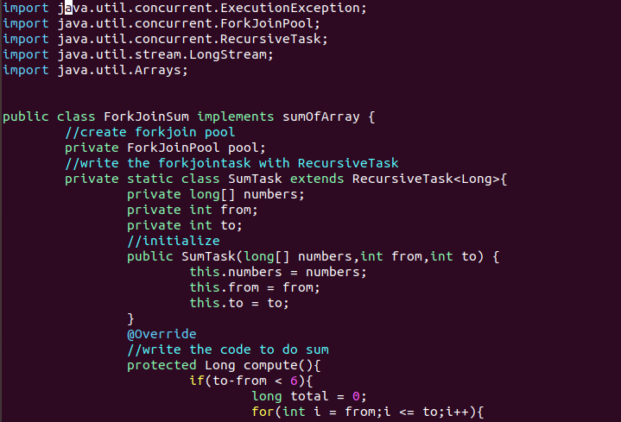
Fork-Join Example
ForkJoinSum.java

Slide 17
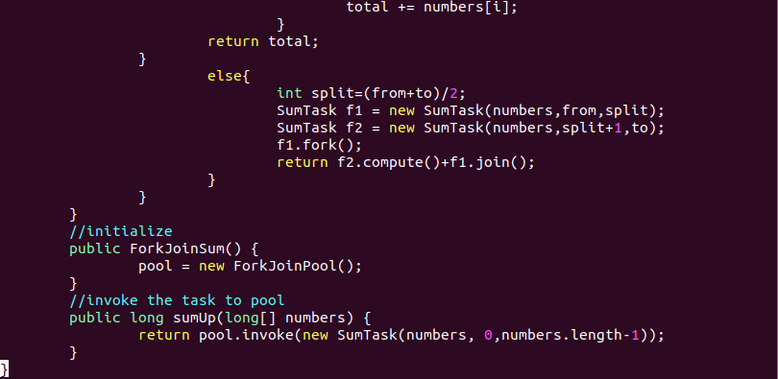
Fork-Join Example

Slide 18
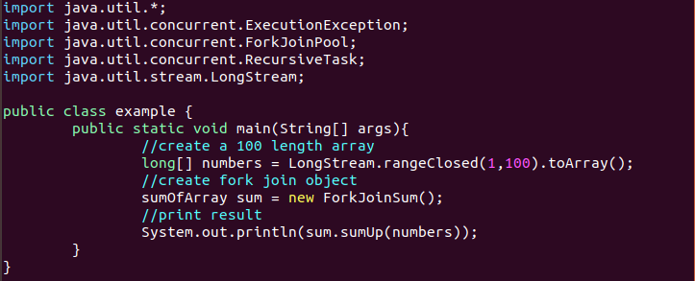

Fork-Join Example
example.java

Slide 19
Outline
Fork-Join Model
Java Fork-Join Framework
Fork-Join Example
Exercise

Slide 20
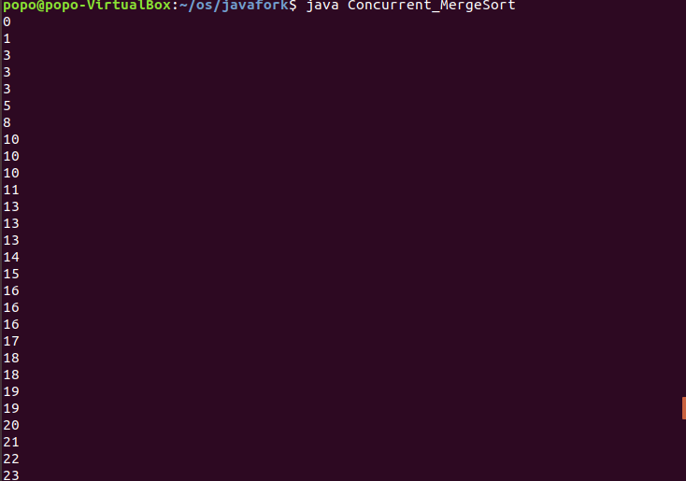
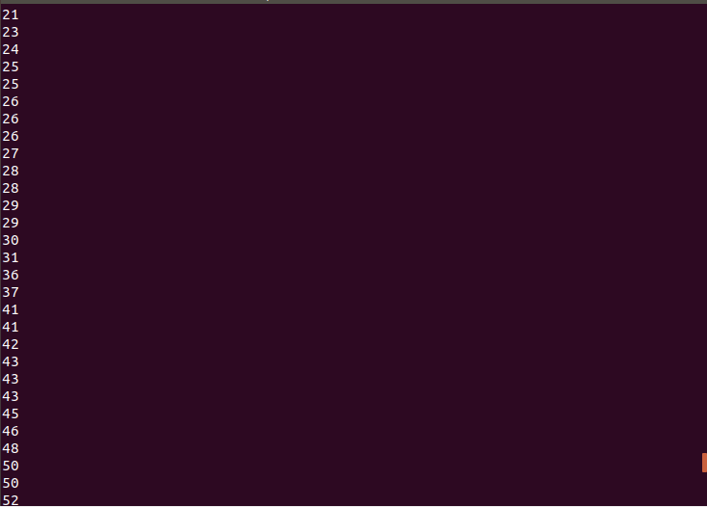
Exercises
Write a merge sort program to merge a 100 length array with fork/join Framework.
Notes:
Server 先收到 client的訊息 再傳welcome訊息給client 然後 client關閉(close(sockfd)。

Slide 21


Exercises

Slide 22
Reference
The Java Tutorial
https://docs.oracle.com/javase/tutorial/essential/concurrency/forkjoin.html
OS concepts 10th chapter 4 4.5.2
https://coderanch.com/t/696561/java/Faster-Merge-Sort-Fork-Join

