Slide 1
Lab 11 Signals
TA: Yung-Tung Chou
Professor: Hsung-Pin Chang
Operating System Lab

Slide 2
What Are Signals?
A signal is used by the OS to notify a process that a particular event has occurred.
Every signal may be handled by one of two possible handlers:
A default signal handler
A user-defined signal handler

Slide 3
Linux Signals
Every signal has a symbolic name starting with SIG.
The signal names are defined in signal.h
Each signal is represented by small integers greater than 0.

Slide 4
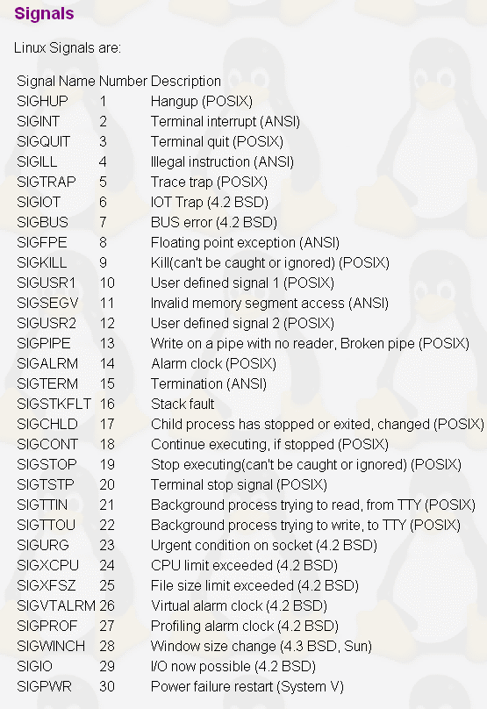
Linux Signals

Slide 5
Sending Signals
Using the keyboard
There are certain key presses that are interpreted by the system as requests to send signals to the process.
Ctrl+C
The interrupt signal, sends SIGINT to the job running in the foreground.
Ctrl+Y
The delayed suspend character.
Ctrl+Z
The suspend signal, sends a SIGTSTP to a running program, thus stopping it and returning control to the shell.

Slide 6
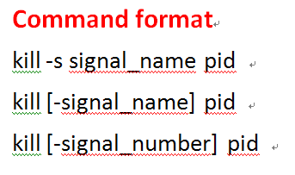
Sending Signals
Using command line
signal_name
By omitting the leading SIG from the corresponding symbolic signal name.
If no signal_name is specified, the TERM signal is sent.

Slide 7
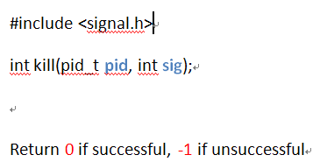
Sending Signals
Using system calls
This is the normal way of sending a signal from one process to another.
Example: A child process sends the SIGTERM signal to its parent process.
kill(getppid(), SIGTERM);

Slide 8
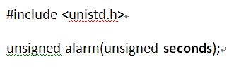
Sending Signals
alarm() Function
Causes a SIGALRM signal to be sent to the calling process after a specified number of real seconds has elapsed.

Slide 9
Exercise 1
Step1: Using the fork() function to create a new process.
Step2: Using command line to kill the process.[+30pt.]
Step3: Repeat step1 and use system calls to kill process.[+30pt.]

Slide 10
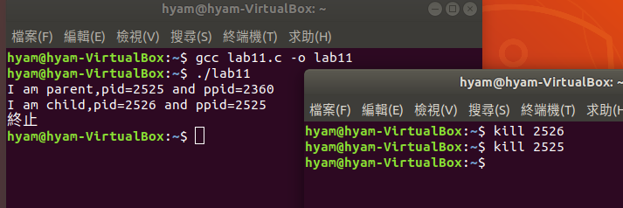
Result
step2

Slide 11

Result
step3

Slide 12
Handling Signals
Default Signal Handlers
If you install no signal handlers of your own, the runtime environment sets up a set of default signal handlers for your program.
For example, the default signal handler for the TERM signal calls the exit()system call.
NCHU System & Network Lab

Slide 13
Handling Signals (cont.)
Installing signal handlers
signal(), sigaction()
signal(): used to set a signal handler for a single signal type.
pause(): causes the process to halt execution, until a signal is received. It is surely better than a 'busy wait' infinite loop.
SYNOPSIS
#include <signal.h>
void (*signal(int sig, void (*func)(int)))(int);
SYNOPSIS
#include <unistd.h>
int pause(void);

Slide 14
Handling Signals (cont.)
Example
/* here is the signal handler */
void catch_int(int sig_num) /* the argument is signal number */
{
/* re-set the signal handler again to catch_int, for next time */
signal(SIGINT, catch_int);
printf(“Ouch! – I got signal %d\n“,sig_num);
}
int main(int argc, char* argv[])
{
/* set the INT (Ctrl-C) signal handler to 'catch_int' */
signal(SIGINT, catch_int);
/* now, lets get into an infinite loop of doing nothing. */
for ( ;; )
pause();
}
NCHU System & Network Lab

Slide 15
Handling Signals (cont.)
Pre-defined signal handlers: we can use two pre-defined signal handler functions, instead of writing our own.
SIG_IGN: Ignore the specified signal.
SIG_DFL: Restore default behavior.
One problem with the early versions of UNIX is that the action of a signal was reset to its default each time the signal occurred.
NCHU System & Network Lab

Slide 16
Handling Signals(cont.)
sigaction(): allows the caller to examine or specify the action associated with a specific signal.
The sigaction structure: used to define the actions to be taken on receipt of the signal specified by sig.
SYNOPSIS
#include <signal.h>
int sigaction(int sig, const struct sigaction *act, struct sigaction *oact);
Return 0 if successful, -1 if unsuccessful
struct sigaction {
void (*) (int) sa_handler; /* pointer to function, SIG_DFL or SIG_IGN */
sigset_t sa_mask; /* additional signals to be blocked during execution of handler */
int sa_flags; /* signal action modifiers */
}
NCHU System & Network Lab

Slide 17
Handling Signals(cont.)
sig: specifies the signal number for the action
act: a pointer to a struct sigaction structure that specifies the action to be taken
If act is NULL, the call to sigaction() does not change the action associated with the signal.
oact: a pointer to a struct sigaction structure that receives the previous action associated with the signal
If oact is NULL, the call to sigaction() does not return the previous action associated with the signal.
NCHU System & Network Lab

Slide 18
Examples
1. The following code segment sets the signal handler for SIGINT to mysighand.
struct sigaction newact;
newact.sa_handler = mysighand; /* set the new handler */
sigemptyset(&newact.sa_mask); /* initialize the signal mask */
newact.sa_flags = 0; /* no special options */
sigaction(SIGINT, &newact, NULL);
2. The following code segment causes the process to ignore SIGINT if the default action is in effect for this signal.
struct sigaction act;
sigaction(SIGINT, NULL, &act); /* Find current SIGINT handler */
if (act.sa_handler == SIG_DFL) { /* if SIGINT handler is default */
act.sa_handler = SIG_IGN; /* set new SIGINT handler to ignore */
sigaction(SIGINT, &act, NULL);
}
NCHU System & Network Lab

Slide 19
Exercise 2 – Dynamically change your handler
NCHU System & Network Lab
Writing handler1 : show “How are you?” message.
Writing handler2 : show ”I am fine!” message.
In the first 3 seconds, you have to maintain handler1 as your SIGINT handler.
Next 3 seconds, you have to maintain handler2 as your SIGINT handler.
Then you set SIGINT handler to “default” handler.[+30pt.]
Note: you should use alarm()!!![+10pt.]

Slide 20
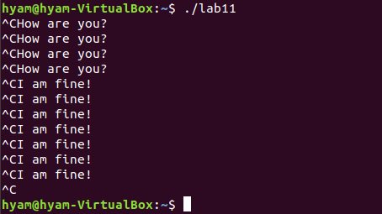
Result

Slide 21
References
Avi Silberschatz, Peter Baer Galvin and Greg Gagne, “Operating System Concepts,” John Wiley & Sons, 10th Edition, 2001
“Unix Systems Programming: Communication, Concurrency, and Threads” by Kay A. Robbins, Steven Robbins
Neil Matthew and Richard Stones, “Beginning Linux Programming,” Wiley publishing, 3rd Edition, 2004
W. Richard Stevens, “Advanced Programming in the UNIX Environment,” Addison-Wesley, 1992

