Slide 1
Lab 12
Semaphores
TA: Yung-Tung Chou
Professor: Hsung-Pin Chang
Operating System Lab

Slide 2
Race Condition
A situation that several threads access and manipulate the same data concurrently and the outcome of the execution depends on the particular order in which the access take place.
Notes:
多個線程同時訪問和操作相同數據且執行結果取決於訪問發生的特定順序的情況

Slide 3
Race Condition (cont.)
“counter++” is implemented as
register₁ = counter
register₁ = register₁ + 1
counter = register₁
“counter--” is implemented as
register₂ = counter
register₂ = register₂ - 1
counter = register₂
The concurrent execution of “counter++” and “counter--” is equivalent to a sequential execution where the low-level statements are interleaved in some arbitrary order.

Slide 4
Race Condition (cont.)
Thread 1 | register₁ | Thread 2 | register₂ | counter
register₁ =counter | 5 | --- | --- | 5
register₁=register₁ + 1 | 6 | --- | --- | 5
--- | --- | register₂ =counter | 5 | 5
--- | --- | register₂=register₂ − 1 | 4 | 5
counter =register₁ | 6 | --- | --- | 6
--- | --- | counter =register₂ | 4 | 4
NCHU System & Network Lab

Slide 5
Process Synchronization
To guard against the race condition mentioned above, we need to ensure that only one thread at a time can be manipulating the variable counter.
To make such a guarantee, we require some form of synchronization for the threads--semaphore

Slide 6
Process Synchronization (cont.)
Semaphore S
  An integer variable that, apart from initialization, is accessed only through two standard atomic operations.
    wait()
    signal()

Slide 7
Process Synchronization (cont.)
A blocking implementation of semaphores.
typedef struct {
int value;
struct thread *L;
}semaphore;
void wait(semaphore S) {
S.value--;
if(S.value < 0) {
add this thread to S.L;
block();
}
}
void signal(semaphore S) {
S.value++;
if(S.value <= 0) {
remove a thread P from S.L;
wakeup(P);
}
}

Slide 8
Process Synchronization (cont.)
The following pseudocode protects a critical section if the semaphore variable S is initially 1.
wait(&S); /* entry section */
<critical section>
signal(&S); /* exit section */
<remainder section>
NCHU System & Network Lab

Slide 9
Normal Execution
Critical Section
Blocked on
semaphore
S.L
S.value
A
B
1
wait(S)
0
Critical Section
wait(S)
B
-1
signal(S)
Critical Section
0
signal(S)
1
NCHU System & Network Lab

Slide 10
POSIX Semaphores
POSIX Semaphores allow processes and threads to synchronize access to shared resources.
  Unnamed semaphores
  Named semaphores

Slide 11
Unnamed Semaphores
This type of semaphore doesn’t have a name.
  Lacking any name or handle to locate them
  Thus, the semaphore must exist in some pre-existing memory location that processes or threads share.
Unnamed semaphores can be shared between processes or between a group of threads
  When shared between processes: the semaphore must reside in a region of shared memory
  When shared between threads: the semaphore may reside in an area of memory shared by the threads (e.g., on the heap or in a global variable)

Slide 12
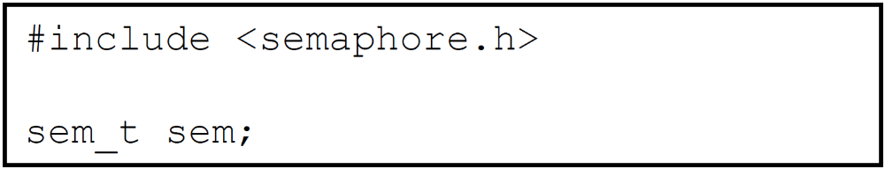
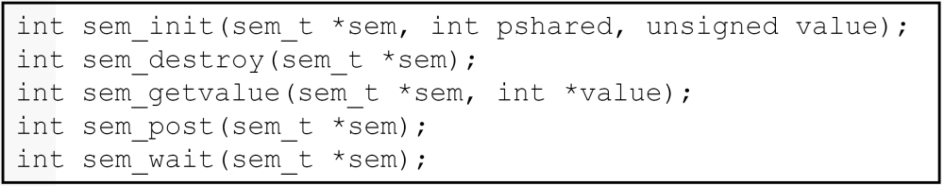
Unnamed Semaphores
Declare a semaphore variable called sem.
Operations:

Slide 13
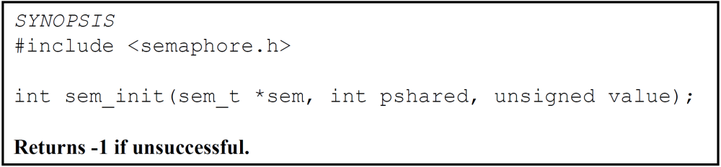
Unnamed Semaphores
sem_init(): Initialize the semaphore referenced by sem to value. The semaphores must be initialized before they used.
pshared:
  A flag indicating whether or not the semaphore should be shared with forked processes.
  Pshared == 0 only threads of process creating semaphore can use semaphore.
value: cannot be negative.

Slide 14
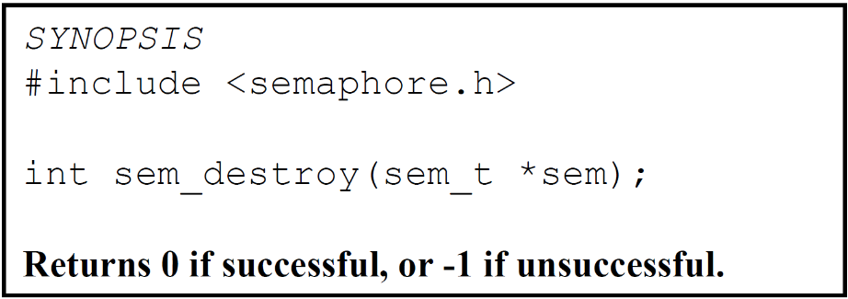
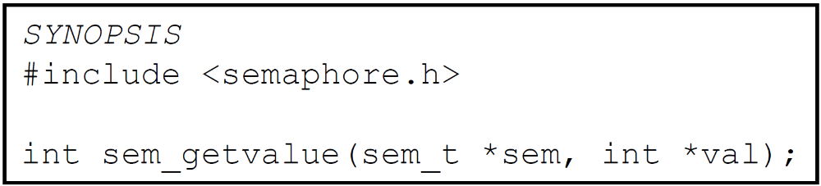
Unnamed Semaphores
sem_destroy(): Destroy a previously initialized semaphore referenced by the sem parameter.
sem_getvalue(): Get the current value of sem and places it in the location pointed to by val

Slide 15
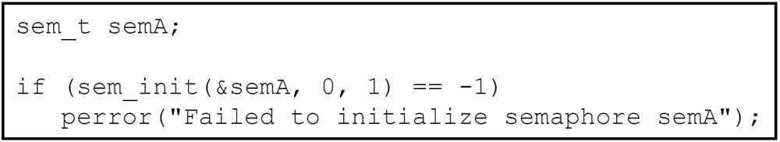
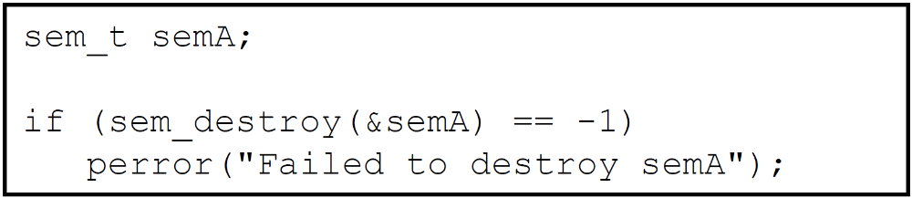
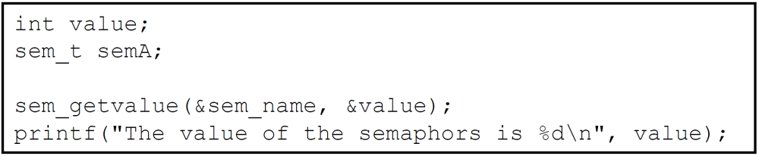
Unnamed Semaphores_Examples
sem_init()
sem_destroy()
sem_getvalue()

Slide 16
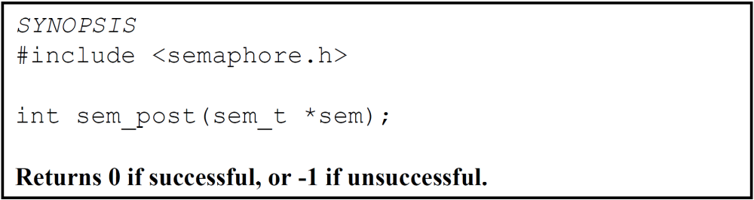
Unnamed Semaphores
sem_post(): Implement classic semaphore signaling.
  It increments the value of the semaphore and wakes up a blocked process waiting on the semaphore, if any.

Slide 17
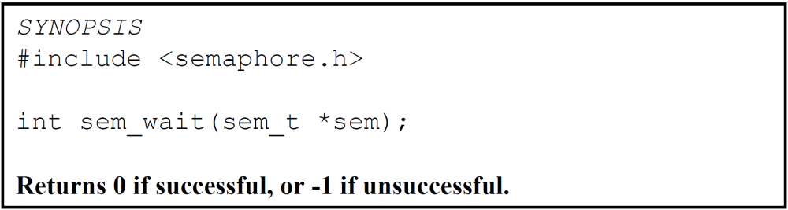
Unnamed Semaphores
sem_wait(): Implement the classic semaphore wait operation.
NCHU System & Network Lab

Slide 18
Sample
#include <stdio.h>
#include <pthread.h>
#include <semaphore.h>
#include <unistd.h> //for sleep API
sem_t mutex;
void* thread(void* arg)
{
//wait
sem_wait(&mutex);
printf("Entered..\n");
//critical section
sleep(4);
//signal
printf("Exiting...\n");
sem_post(&mutex);
}
Unnamed Semaphores

Slide 19
Sample (cont.)
int main()
{
sem_init(&mutex, 0, 1);
pthread_t t1,t2;
pthread_create(&t1,NULL,thread,NULL);
sleep(2);
pthread_create(&t2,NULL,thread,NULL);
pthread_join(t1,NULL);
pthread_join(t2,NULL);
sem_destroy(&mutex);
return 0;
}
Unnamed Semaphores

Slide 20
Named Semaphores
This type of semaphore has a name. By calling sem_open() with the same name, unrelated processes can access the same semaphore.
processA
processB
named semaphore

Slide 21
Named Semaphore Operations
sem_open() | opens or creates a semaphore
sem_post(sem) | increment a semaphore’s value
sem_wait(sem) | decrement a semaphore’s value
sem_getvalue() | retrieves a semaphore’s current value.
sem_close() | removes the calling process’s association with a semaphore
sem_unlink() | removes a semaphore name and marks the semaphore for deletion when all processes have closed it

Slide 22
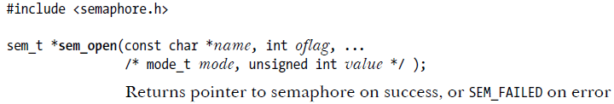
Named Semaphores
sem_open() :opens or creates a semaphore, initializes the semaphore if it is created by the call, and returns a handle for use in later calls.
name : identifies the semaphore.

Slide 23
Named Semaphores
oflag : a bit mask that determines whether we are opening an existing semaphore or creating a new semaphore.
  0 for accessing an existing semaphore. Requires only two arguments, name and oflag.
  O_CREAT for creating a new semaphore, and also needs the rest of arguments.
Mode : permissions.
  4 bits for user, owner, group, and other.
Value : the initial value to be assigned to the new semaphore.

Slide 24
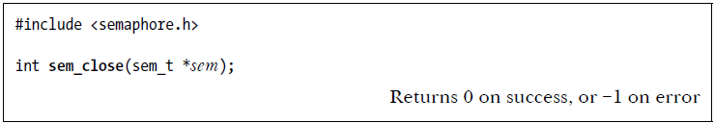
Named Semaphores
sem_close() : the system records the association between the process and the semaphore. The function terminates this association.

Slide 25
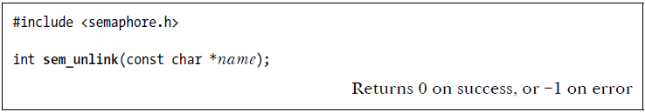
Named Semaphores
sem_unlink() : it removes the semaphore once all processes cease using it.

Slide 26
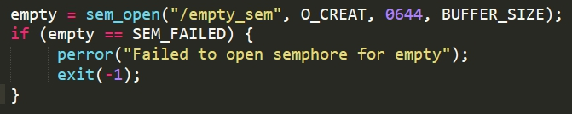
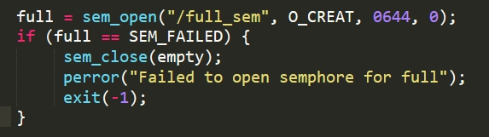
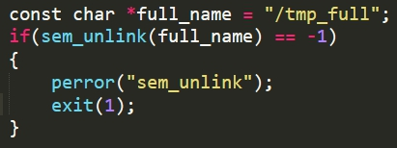
Named Semaphores_Examples
sem_open()
sem_close()
sem_unlink()

Slide 27
Sample
#include <semaphore.h>
#include <pthread.h>
#include <stdio.h>
#include <unistd.h>
#include <fcntl.h>
//#include <stdlib.h>
sem_t *mutex;
int main()
{
mutex = sem_open("/mysem", O_CREAT, S_IRUSR | S_IWUSR, 1);
sem_wait(mutex); printf("Waiting.. \n");
sleep(1); printf("Sleeping.. \n");
sem_close(mutex);
printf("Finished task. \n");
sem_unlink("/mysem");
return 0;
}
Named Semaphores

Slide 28
Solution to the Race Condition
Thread 1 | register₁ | Thread 2 | register₂ | counter
sem_wait(&semA); |  | --- |  | 5
--- |  | sem_wait(&semA); |  | 5
register₁ =counter | 5 | /* blocked */ | --- | 5
register₁=register₁ + 1 | 6 | /* blocked */ | --- | 5
counter =register₁ | 6 | /* blocked */ |  | 6
sem_post(&semA); |  | /* blocked */ |  | 6
 | --- | register₂ =counter | 6 | 6
 | --- | register₂=register₂ − 1 | 5 | 6
 | --- | counter =register₂ | 5 | 5
 |  | sem_post(&semA);

Slide 29
Example
#include <semaphore.h>
#include <pthread.h>
#include <stdio.h>
int count=0;
void inc(void);
void dec(void);
int main(void){
int i=0;
pthread_t id[4];
pthread_create(&id[0],NULL,(void*)dec,NULL); pthread_create(&id[1],NULL,(void*)inc,NULL); pthread_create(&id[2],NULL,(void*)dec,NULL); pthread_create(&id[3],NULL,(void*)inc,NULL); for(i=0;i<4;i++){
pthread_join(id[i],NULL);
}
printf("\noutput is %d\n",count);
pthread_exit(NULL);
}

Slide 30
Example (cont.)
void inc(void){
int i=0;
for(i=0;i<25000000;i++){
count++;
}
pthread_exit(NULL);
}
void dec(void){
int i=0;
for(i=0;i<25000000;i++){
count--;
}
pthread_exit(NULL);
}

Slide 31
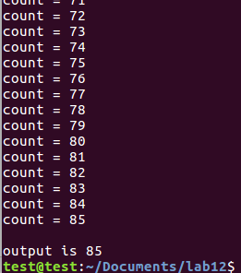
Race Condition

Slide 32
Exercise1
Using the Sample of unnamed semaphore to solve the race condition occurred in previous Example code.
[+50pt.]

Slide 33
Exercise2
Using the Sample of named semaphore to solve the race condition occurred in previous Example code.
[+40pt.]

Slide 34
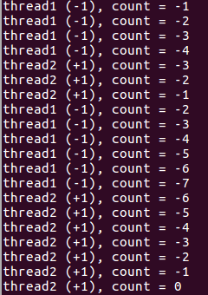
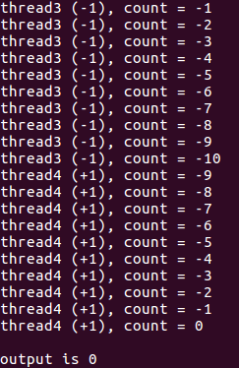
Exercise1&2- Result

Slide 35
References
IBM
http://publib.boulder.ibm.com/infocenter/iseries/v5r3/index.jsp?topic=/rzahw/rzahwsemco.htm
Synchronizing Threads with POSIX Semaphores
http://www.csc.villanova.edu/~mdamian/threads/posixsem.html
NCHU System & Network Lab

