Slide 1
NYCU Deep Learning
2024 Spring
林廷翰
Feb. 22, 2024
Notes:
‹#›

Slide 2
Outline
Basic rules
LAB requirements
Paper presentation & final project
Notes:
‹#›

Slide 3
Outline
Basic rules
LAB requirements
Paper presentation & final project
Notes:
‹#›

Slide 4
Basic rules
There are 6 labs with demo
Explain your code and answer some questions
Plagiarism is prohibited
If you have any problems, please contact TA with email
Use new E3 email system
Send emails to all TAs (except the lab questions)
For lab questions, ask the TA responsible for the lab
Clarify your problem

Slide 5
Outline
Basic rules
LAB requirements
Paper presentation & final project
Notes:
‹#›

Slide 6
LAB timetable
 | LAB1 Back-Propagation | LAB2 CNN | LAB3 CNN | LAB4 RNN+VAE | LAB5 MaskGIT | LAB6 Generative Models
Announce | 3/12 (Tabc) | 3/26 (Tabc) | 4/2 (Tabc) | 4/11 (Rn56) | 5/7 (Tabc) | 5/21 (Tabc)
DEMO | 3/26 (Tabc) | 4/11 (Rn56) | 4/11 (Rn56) | 5/7 (Tabc) | TBD | No demo

Slide 7
LAB requirements
Upload your work to new E3
Contain code (.py) and report (.pdf)
Zip all files in one file and name it like DL_LAB1_yourstudentID_name.zip
E.g. DL_LAB1_311605003_林廷翰.zip
Do not send it to TA
Do not upload your model weight and dataset
If there is any conflict, follow the rule of lab announcement
Notes:
‹#›

Slide 8
LAB requirements
Lab score
Lab report score + Lab demo score
The criterion details will be listed in each lab specification
Delayed report
Hand in before 6/11 (score * 0.8)
Again, no cheating!
Please follow the rules, or you will get punished
Please do your assignment as early as possible
Notes:
‹#›

Slide 9
Outline
Basic rules
LAB requirements
Paper presentation & final project
Notes:
‹#›

Slide 10
Group
Group deadline: 3/28
Three people in one group, if you have any issue, please contact TA.
Form: will release in the future
Randomly assign group if you hasn’t decided it before deadline
No adjustment about the random group will be accept

Slide 11
Final project proposal
Date: 4/16, 4/23
Project Proposal: motivation, input & output
Make sure that you have the dataset
Do not plan to naively use the open-source code
We will announce the google docs/drive link to let you fill in/upload
Paper presentation topic (deadline: 4/9)
PPT slide (deadline: a day before your proposal)

Slide 12
Final project proposal
Share the main idea of the paper for paper presentation first, and it’s suggested that the topic is related to your final project
Propose your project idea, which should contain some novelty or extra implementation
Project proposal should be at most 8 minutes + 2 minutes Q&A

Slide 13
Paper presentation
Date: 5/28, 5/30, 6/4, 6/6
The papers should be published to the top conference (e.g. CVPR, NIPS, ACL, AAAI, ICCV, ECCV, ICLR etc.) in recent years (< 3 years)
Paper presentation should be at most 15 minutes + 5 minutes Q&A
We will announce the google drive link to let you upload
PPT slide (deadline: a day before your proposal)

Slide 14
Final Project
Project Presentation: Details of your project
Date: 6/18
Prepare your poster for exhibition (in person, A1 size)
Project score
Proposal score + Poster score (affect by workload ratio)

Slide 15
Final Project
Workload Ratio
DO NOT BE the freerider!!!
Scores will be based on your effort
Group 1 take 100 in their final project
Workload Ratio Student 1 : Student 2 : Student 3 = 1 : 1: 1
Student 1 : 100
Student 2 : 100
Student 3 : 100

Slide 16
Final Project
Workload Ratio
DO NOT BE the freerider!!!
Scores will be based on your effort
Group 1 take 100 in their final project
Workload Ratio Student 1 : Student 2 : Student 3 = 2 : 1: 1
Student 1 : 100
Student 2 : 50
Student 3 : 50

Slide 17
Final Project
Workload Ratio
DO NOT BE the freerider!!!
Scores will be based on your effort
Group 1 take 100 in their final project
Workload Ratio Student 1 : Student 2 : Student 3 = 4: 2: 1
Student 1 : 100
Student 2 : 50
Student 3 : 25

Slide 18
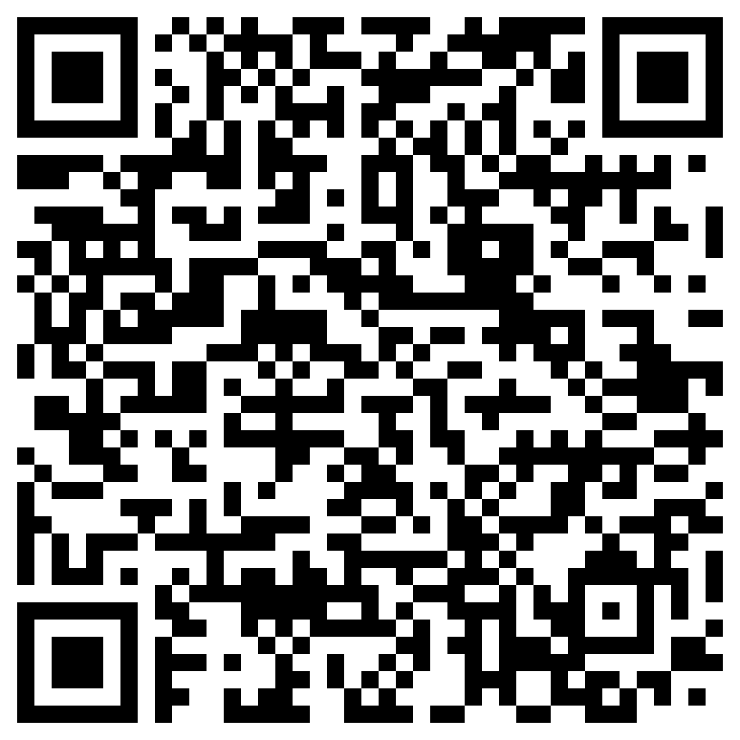
Course registration form
Notes:
‹#›

