Slide 1
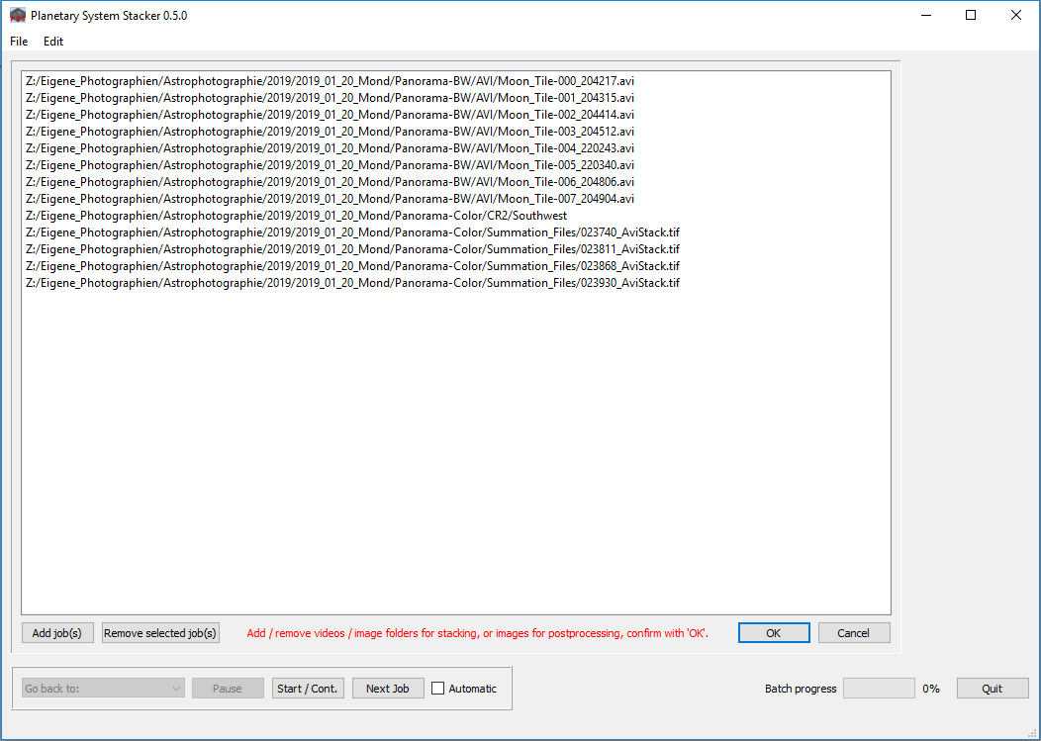
video files
images for postprocessing
directory with images
for stacking

