Slide 1


Shift-left Performance Automated ‘self-healing’
Anand Ahire
Senior Director Product Management
Electric Cloud
aahire@electric-cloud.com
LinkedIn : https://www.linkedin.com/in/anand-ahire-b000a61

Slide 2
Electric Cloud
Our View
Who We Are
1
Singular goal to help the world deliver better software faster
1
Every Business is a Software Business
DevOps and Continuous Delivery = new Agile
Automation & Acceleration are essential
15
Years of experience accelerating software delivery
2
60
Fortune 500 Customers operating in many verticals
3
85
% Average Reduction in release cycle time

Slide 3















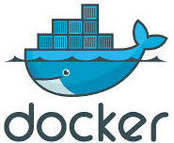


Electric Cloud in DevOps Landscape
DEV | OPS
DEV
BUILD
TEST
DEPLOY
PROVISION
MONITOR
OPERATE
APPS
Dev Tools
CI
CT
Release
Automation
Service Mgmt
& Monitoring
Electric Cloud
INFRA
Configuration Mgmt
SW-Defined Infrastructure
3

Slide 4

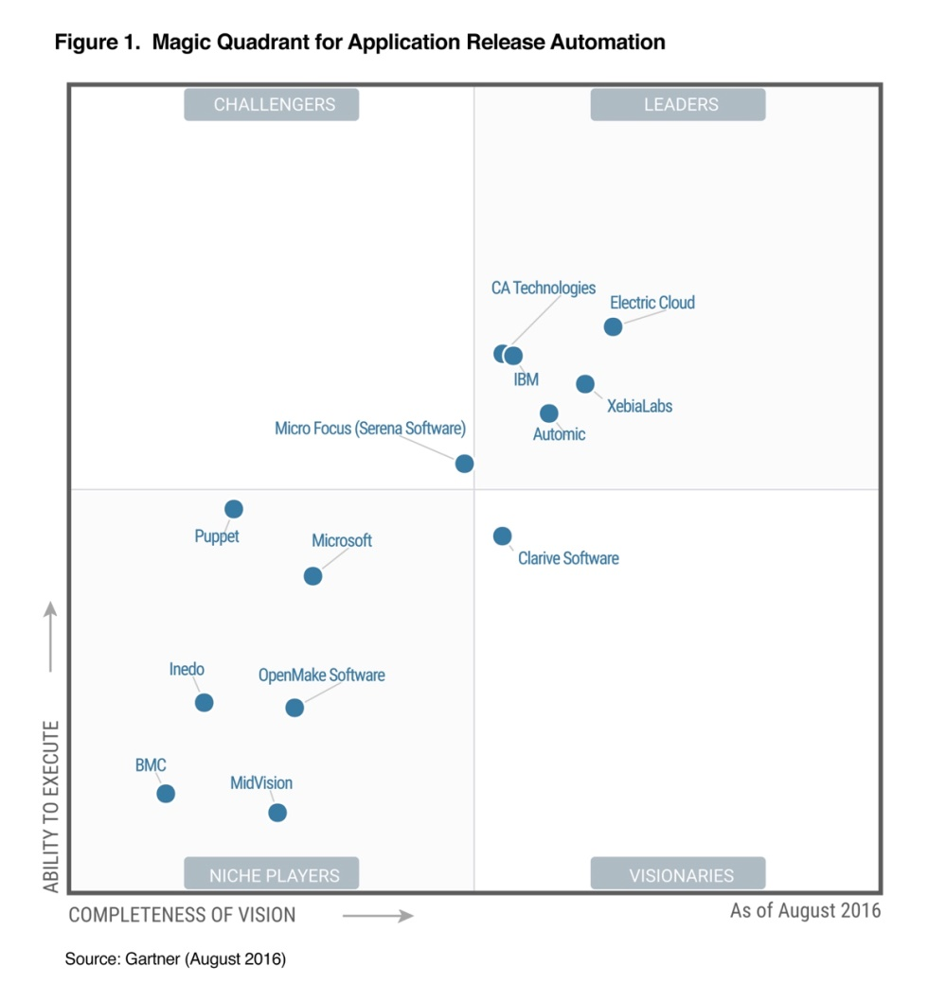
EC Highest Ranked in Gartner ARA MQ
Electric Cloud
CLEAR LEADER
"Gartner's survey of EC customers indicated that the primary reasons for selecting Electric Cloud’s ARA solution included strong customer focus, functional breadth and/or maturity, and because they view the company as a technology innovator.”
(ARA: Application Release Automation)

Slide 5
Shift-left Performance
Dynatrace
Compare new version’s performance to baseline
Notice degradation overtime on QA environment
Inform EFLOW about service degradation
EFLOW is invoked to start a Pipeline
Deploy to QA / Pre-production
Register Tests in Dynatrace;
Run tests
Receive notice and block this version from moving forward to production
Notify Release Manager, QA Manager, Dev Manager, IT Manager
Electric Cloud

Slide 6
Automated rollback for “self healing”
Dynatrace monitors new version in Production
Service degradation is noticed on the new release
EFLOW is informed automatically to trigger Rollback to restore service
Service is restored to how it was before the deployment
Dynatrace
EFLOW is invoked to start a Pipeline
New version is deployed into production
A deployment incident is created automatically in Dynatrace
Rollback flow is initiated automatically n EFLOW
Rollback is completed and Dynatrace is updated
Electric Cloud

Slide 7
Demo

Slide 8
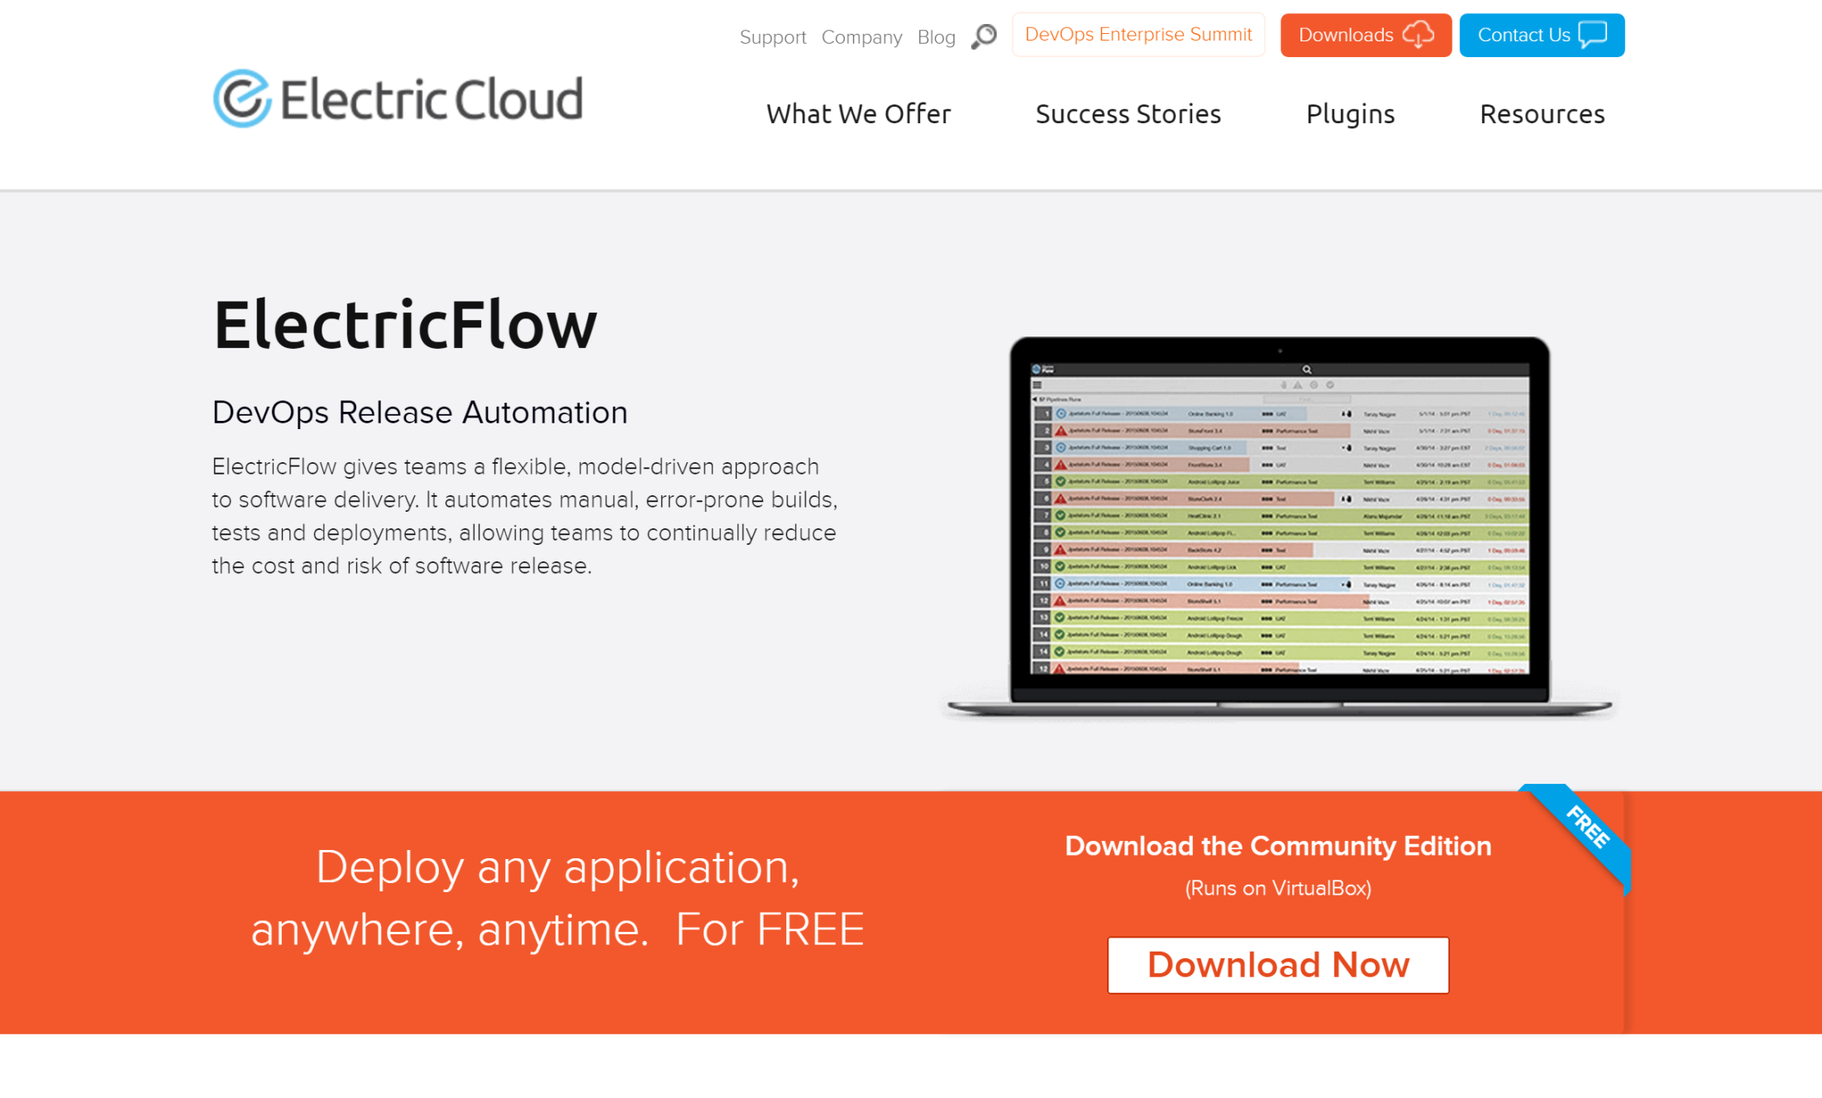

Slide 9

DevOps Use Cases ElectricFlow enables
COMMIT PIPELINE [“N”]
Pipeline Orchestration
Build/Test Automation
Deployment Automation
Release Management
Environment Provisioning
DEV
BUILD
TEST
COMMIT PIPELINE [B]
DEV
BUILD
TEST
COMMIT PIPELINE [A]
RELEASE PIPELINE
DEV
BUILD
TEST
INTEGRATION
PRE-PROD
PROD
Build
OPTIONAL ACCEPTANCE
OPTIONAL ACCEPTANCE
OPTIONAL ACCEPTANCE
OPTIONAL ACCEPTANCE
Unit / Other Tests
Provision
Provision
Provision
Provision
. . .
Configure
Configure
Configure
Configure
Publish Artifact
Deploy
Deploy (1…N)
Deploy (1…N)
Deploy (1…N)
OPTIONAL APPROVAL
Functional, Other Tests
Smoke, Performance, Other Tests
Smoke, Other Tests
Smoke, Other Tests
. . .
. . .
. . .
. . .
OPTIONAL APPROVAL
OPTIONAL APPROVAL
OPTIONAL APPROVAL
De-provision
De-provision

Slide 10
Thank you
Anand Ahire
Senior Director Product Management
Electric Cloud
aahire@electric-cloud.com

