Slide 1
Amazon QA Bot
Group members:
Andy(Xiangyu) Cui, cui.xiangyu@northeastern.edu
Zichong Meng, meng.zic@northeastern.edu
Xichen Liu, liu.xic@northeastern.edu
Xueyan Feng, feng.xuey@northeastern.edu

Slide 2
Introduction
Objective: To develop an AI-driven Question and Answer system focusing on Amazon's toy product category.
Purpose: Facilitate customers in making informed decisions by providing detailed and accurate responses to their inquiries about toy products.
Significance: Enhancing customer experience and engagement, reducing confusion, and aiding in better product selection.

Slide 3
Methods
Retrieve dataset
Data cleaning up and preprocessing
Models
Training
Discussion

Slide 4
Dataset
Toy Products on Amazon from Kaggle
https://www.kaggle.com/datasets/PromptCloudHQ/toy-products-on-amazon/data
Product Names and Manufacturers
Pricing and Stock Information
Customer Reviews and Answered Questions
Insight into Customer Buying Patterns
Detailed Product Descriptions

Slide 5
Dataset and Data Preprocessing
Content of original dataset:
product_name
manufacturer - The item manufacturer, as reported on Amazon. Some common "manufacturers", like Disney, actually outsource their assembly line.
price
number_available_in_stock
number_of_reviews
number_of_answered_questions - Amazon includes a Question and Answer service on all or most of its products. This field is a count of how many questions that were asked actually got answered.
average_review_rating
amazon_category_and_sub_category - A tree-based, >>-delimited categorization for the item in question.
customers_who_bought_this_item_also_bought - References to other items that similar users bought. This is a recommendation engine component that played a big role in making Amazon popular initially.
description
product_information
product_description
items_customers_buy_after_viewing_this_item
customer_questions_and_answers - A string entry with all of the product's JSON question and answer pairs.
customer_reviews - A string entry with all of the product's JSON reviews.
sellers - A string entry with all of the product's JSON seller information (many products on Amazon are sold by third parties).
Required data for training:
Product names
Descriptions
Customer questions
Answers

Slide 6
Dataset and Data Preprocessing
For Training Language Models
Data Cleaning and Preparation:
Removal of Missing Values
Correction of Text Anomalies
Reformatting for Model Compatibility
Saved in JSON Format for Ease of Use

Slide 7
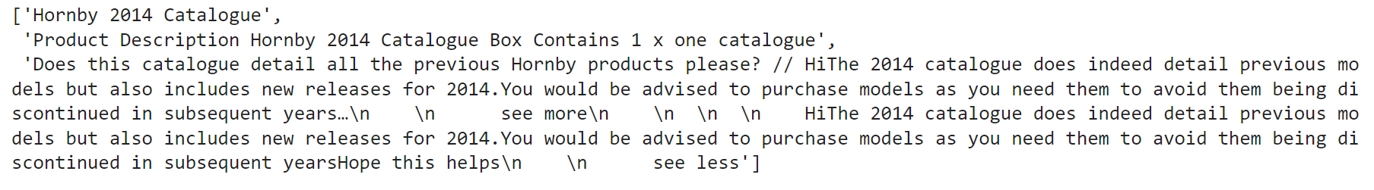
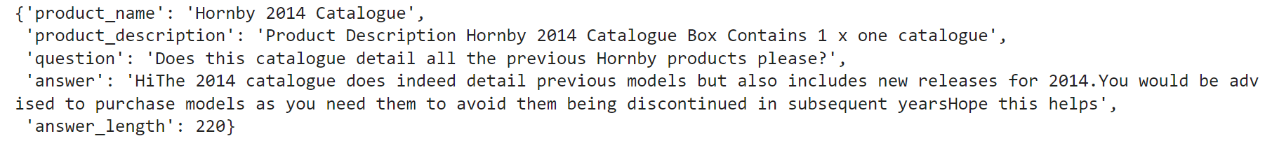
Data before cleaning up and preprocessing
Data after cleaning up and preprocessing

Slide 8
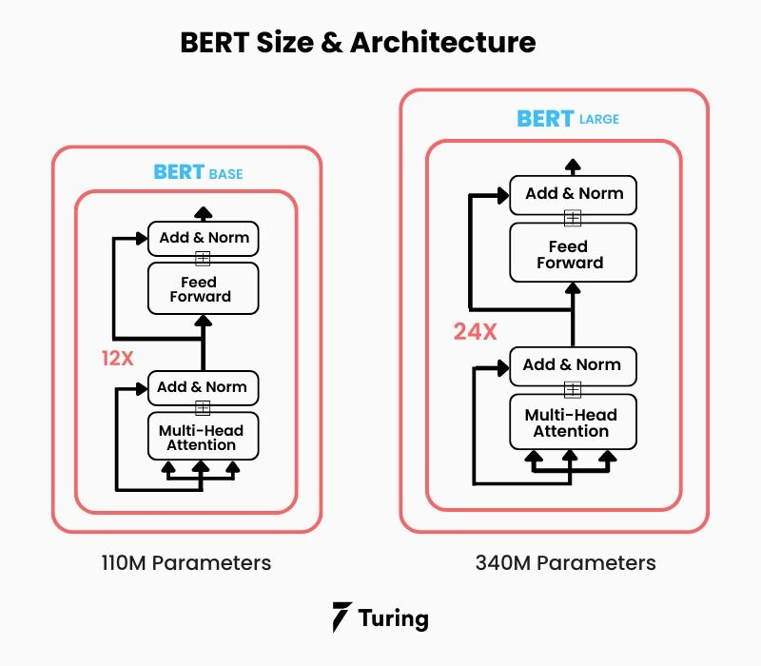
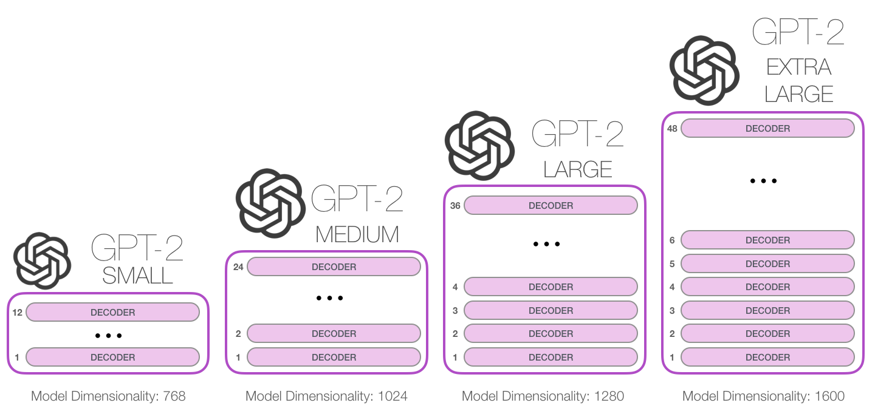
Models
BERT
GPT-2

Slide 9
BERT
Load data
Preprocess and tokenize data
Initialize BERT model
Customize dataset and dataloaders
Set up optimizer and learning rate scheduler
Train model using cross-entropy loss
Save model checkpoints
Perform inference on test data
Evaluate using accuracy and possibly other metrics (e.g., F1 score)
K-Fold Cross Validation
Ablation
(2 batch sizes * 2 epoch sizes * 2 learning rates + 2 random = 10 total)

Slide 10
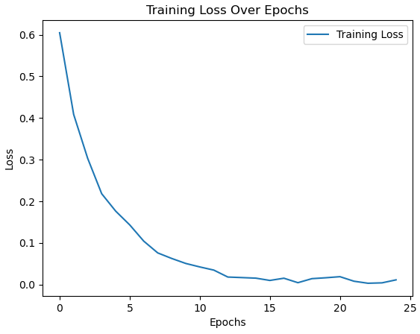
BERT Result
Using the AdamW optimizer with a Learning Rate of 1e-6 and a Batch Size of 2 over 25 epochs, our fine-tuned BERT model has demonstrated a significant reduction in loss as depicted in the provided training curve. Besides accuracy on test set is 90% base on classification accuracy.

Slide 11
BERT K-Fold Cross-Validation
Model | Hyperparameters | Fold number | Accuracy (F1)
Bert | 25 Epoch LR = 2e-5 BS = 8 | Fold 0 | 0.9464
Bert | 25 Epoch LR = 2e-5 BS = 8 | Fold 1 | 0.9246
Bert | 25 Epoch LR = 2e-5 BS = 8 | Fold 2 | 0.9642
Bert | 25 Epoch LR = 2e-5 BS = 8 | Fold 3 | 0.8769
Bert | 25 Epoch LR = 2e-5 BS = 8 | Fold 4 | 0.9107

Slide 12
BERT Ablation Studies
Model | Hyperparameters | Accuracy (F1)
Bert | 25 Epoch LR = 1e-5 BS = 4 | 0.9570
Bert | 25 Epoch LR = 1e-4 BS = 4 | 0.9468
Bert | 30 Epoch LR = 1e-5 BS = 4 | 0.9366
Bert | 30 Epoch LR = 1e-4 BS = 4 | 0.9263
Bert | 25 Epoch LR = 1e-5 BS = 8 | 0.9427
Bert | 25 Epoch LR = 1e-4 BS = 8 | 0.9346
Bert | 30 Epoch LR = 1e-5 BS = 8 | 0.9366
Bert | 30 Epoch LR = 1e-4 BS = 8 | 0.9305
Bert | 25 Epoch LR = 1e-6 BS = 2 | 0.9080
Bert | 25 Epoch LR = 2e-5 BS = 8 | 0.9264
The ablation studies for the BERT model underscore the nuanced impact of hyperparameter configurations on model performance. Notably, the results indicate that adjusting the batch size and learning rate can lead to significant variations in model accuracy. A learning rate of 1e-5, paired with a smaller batch size of 4, has culminated in a noteworthy increase in accuracy (F1 score), underscoring the model's enhanced ability to generalize from the training data. Nevertheless, this comes with the trade-off of increased average training loss, suggesting that careful calibration of the learning rate is critical to balance model precision and loss minimization.

Slide 13
GPT-2
Load data
Tokenize and initialize model
Customize dataset
Create training(70%) and testing(30%) set
Optimizer
Train over epochs using cross-entropy
Save model checkpoints
Evaluate the BLEU score on test data
K-Fold Cross Validation
Ablation
(2 batch sizes * 2 epoch sizes * 2 learning rates + 2 random = 10 total)

Slide 14
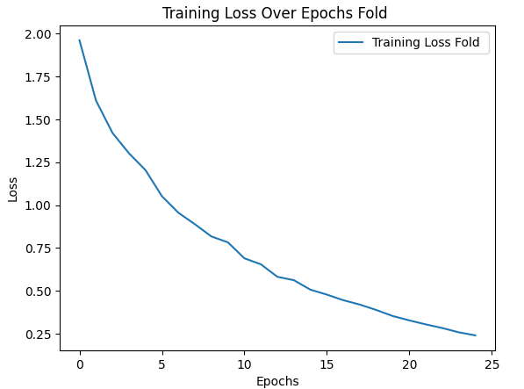
GPT2 Result
Using AdamW optimizer with Learning Rate = 5e-5 and Batch Size of 8 and training for 25 epochs,
The fine-tuned GPT-2-small model’s average loss for the final epoch is 0.2404 utilizing Cross Entropy Loss.
The fine-tuned GPT-2-small model’s average accuracy (BLEU) is 0.7695 which pretty well for a generative model.

Slide 15
GPT2 K-Fold Cross-Validation
Model | Hyperparameters | Fold number | Accuracy (BLEU)
GPT2 | 25 Epoch LR = 5e-5 BS = 8 | Fold 0 | 0.7627
GPT2 | 25 Epoch LR = 5e-5 BS = 8 | Fold 1 | 0.7622
GPT2 | 25 Epoch LR = 5e-5 BS = 8 | Fold 2 | 0.7548
GPT2 | 25 Epoch LR = 5e-5 BS = 8 | Fold 3 | 0.7486
GPT2 | 25 Epoch LR = 5e-5 BS = 8 | Fold 4 | 0.7781

Slide 16
GPT2 Ablation Studies
Model | Hyperparameters | Accuracy (BLEU) | Training Loss
GPT2 | 25 Epoch LR = 5e-5 BS = 8 | 0.7695 | 0.2404
GPT2 | 25 Epoch LR = 1e-5 BS = 4 | 0.7922 | 0.9685
GPT2 | 25 Epoch LR = 1e-5 BS = 8 | 0.7912 | 1.0014
GPT2 | 25 Epoch LR = 1e-4 BS = 4 | 0.7570 | 0.0725
GPT2 | 25 Epoch LR = 1e-4 BS = 8 | 0.7592 | 0.0764
GPT2 | 30 Epoch LR = 1e-5 BS = 4 | 0.7873 | 0.8580
GPT2 | 30 Epoch LR = 1e-5 BS = 8 | 0.7923 | 0.9002
GPT2 | 30 Epoch LR = 1e-4 BS = 4 | 0.7611 | 0.0632
GPT2 | 30 Epoch LR = 1e-5 BS = 8 | 0.7435 | 0.0646
GPT2 | 25 Epoch LR = 1e-6 BS = 2 | 0.7901 | 2.4099
The ablation studies for GPT2
shows that a smaller learning rate can possible improve the model performance in few percent.
However, we still need to be cautious about which configuration of hyperparameters to use because of the in our experiment small lr comes with larger average training loss.

Slide 17
Discussion
BERT-base’s accuracy is a little bit higher than GPT-2-small’s performance on the testing set.
GPT2 focused more on the generative part vs. BERT focused on understanding part and extract information to present as output.
The K-Fold Cross Validation studies for both BERT and GPT-2 results show near the same average accuracy for all folds for each model.
The ablation studies for GPT2 shows that a smaller learning rate than 5e-5 can improve the model performance by a few percent. However, smaller learning rates in the ablation studies results in a very large average training loss compared to LR=5e-5, therefore, we would need to be cautious about which configuration of hyperparameters to use.
The ablation studies for BERT shows that learning rate of 1e-5, paired with a smaller batch size of 4, 25 epoch can achieve better result, but we would still need to be careful.

Slide 18
Conclusion
In this project:
We explore training BERT and GPT-2 models as a QA bot using Amazon Customer QA dataset and test their performance as a customer QA bot.
In the future:
we would like to explore larger customer QA datasets, so that it can not only answer questions about amazon products but also explore how customer QA bot trained on larger datasets perform on different categories of products.

Slide 19
Thank you

