Slide 1
BFS Algorithm
By Andy Cui

Slide 2
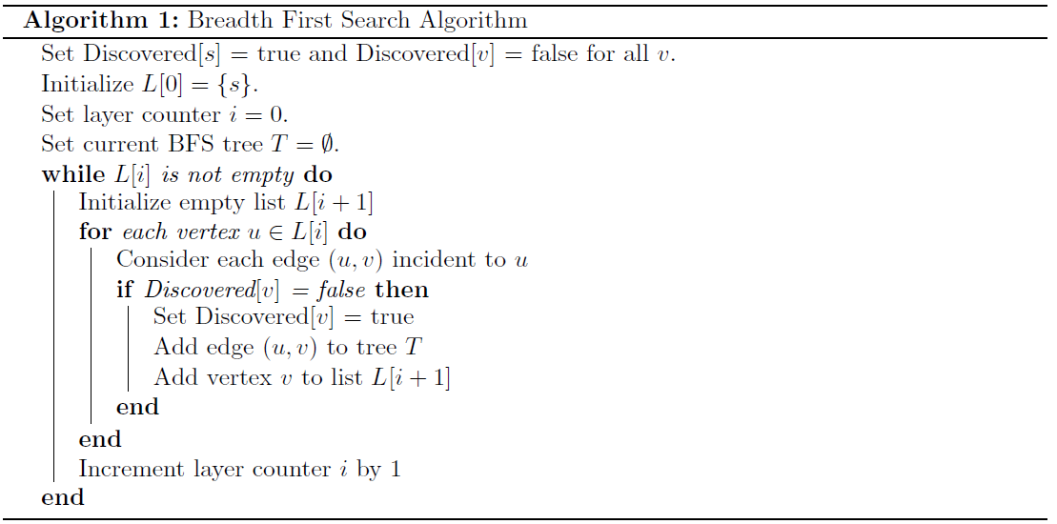
What is BFS
Graph connectivity is concerned with finding an efficient algorithm that answers the question: Is there a path from u to v in G? BFS explores outward from vertex u in all possible directions, adding vertices one \layer" at a time:

Slide 3
Example for a graph:
B
D
A
F
C
E
A -> B A -> C B -> A B -> C B -> D C -> A C -> B C -> D C -> E
D -> B D -> C D -> E D -> F E -> C E -> D

Slide 4
For DFS processing
Start from A
B
D
A
F
C
E

Slide 5



For DFS processing
A
B
C
B
D
A
F
C
E
A -> B -> C

Slide 6

For DFS processing
A
B
C
B
D
D
A
F
C
E
A -> B -> C -> D

Slide 7
For DFS processing
A
B
C
D
E
B
D
A
F
C
E
A -> B -> C -> D -> E

Slide 8
For DFS processing
A
B
C
D
E
B
D
F
A
F
C
E
A -> B -> C -> D -> E -> F

Slide 9
Implement in data structure?
A
Hint: Queue data structure
Queue: First In First Out (FIFO)
B
C
D
E
F
Queue:
A
Head
Tai
l
Pop: A

Slide 10
Implement in code?
A
Hint: Queue data structure
Queue: First In First Out (FIFO)
B
C
D
E
F
Queue:
B
C
Head
Tai
l
Pop: A -> B -> C

Slide 11
Implement in code?
A
Hint: Queue data structure
Queue: First In First Out (FIFO)
B
C
D
E
F
Queue:
B
C
D
Head
Tai
l
Pop: A -> B -> C -> D

Slide 12
Implement in code?
A
B
C
Hint: Queue data structure
Queue: First In First Out (FIFO)
D
E
F
Queue:
C
D
E
Head
Tai
l
Pop: A -> B -> C -> D -> E

Slide 13
Implement in code?
A
Hint: Queue data structure
Queue: First In First Out (FIFO)
B
C
D
E
F
Queue:
C
D
E
Head
Tai
l
Pop: A -> B -> C -> D -> E

Slide 14
Implement in code?
A
Hint: Queue data structure
Queue: First In First Out (FIFO)
B
C
D
E
F
Queue:
D
E
F
Head
Tai
l
Pop: A -> B -> C -> D -> E -> F

Slide 15
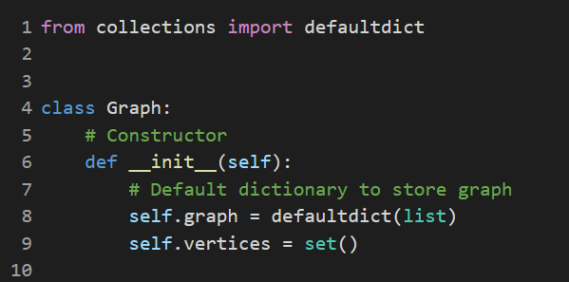
Code Implement(Constructor):
Use the python default dictionary
Use the set to store the vertices

Slide 16
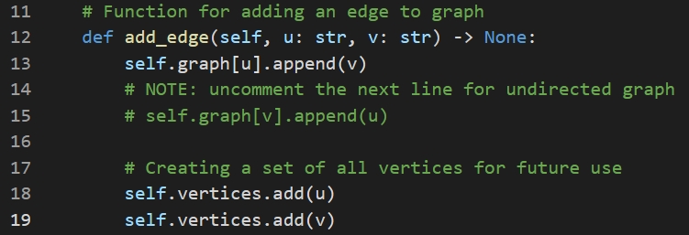
Code Implement (Add elements):
Since we need to add edge to graph, so we need to add like A -> B

Slide 17
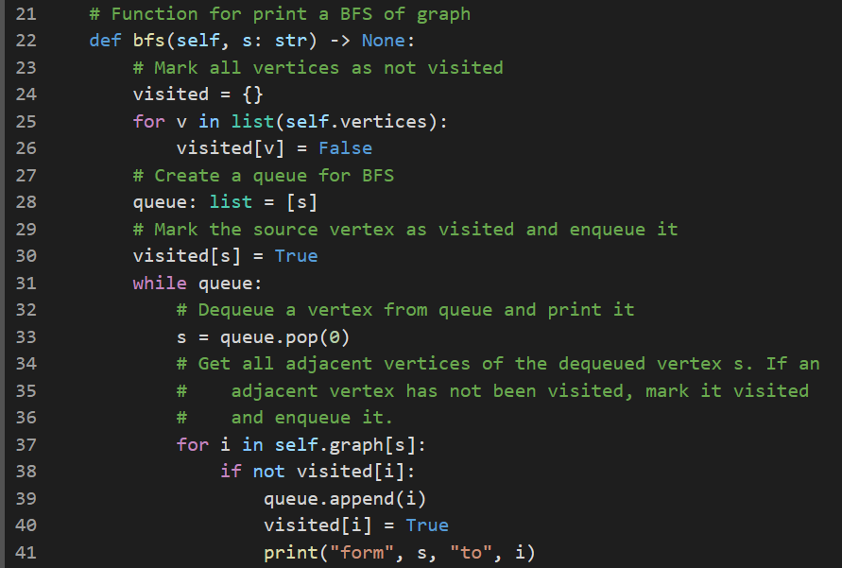
Code Implement(BFS):
Create the visited set
Check the visited status
Pop from queue

Slide 18
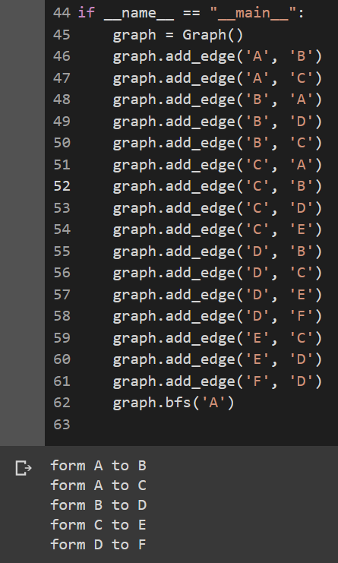
Enter our graph and check output:
B
D
A
F
C
E
Code resource: https://github.com/AndyFCui/bfs

Slide 19
Thanks for watching

