Slide 1
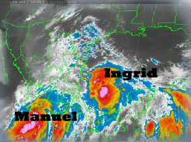
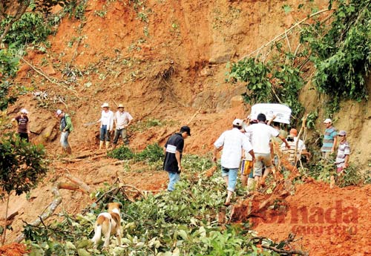
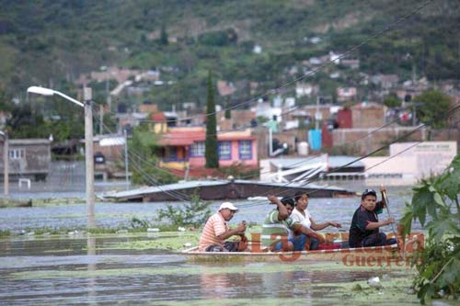
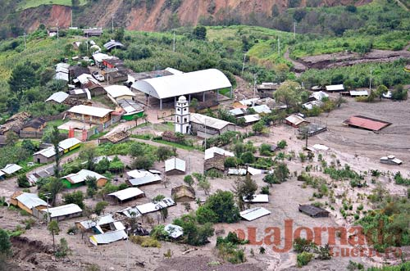
Manuel and Ingrid (2013) over Mexico: effects and impacts
G.B. Raga¹, Luis M. Farfán², Myriam De la Parra³, S.M. Olivera⁴,
S. F. Abarca⁵ and J. C.Marín⁶
Effects: precipitation, winds
¹Centro de Ciencias de la Atmósfera, Universidad Nacional Autónoma de México
² Centro de Investigación Científica y de Educación Superior de Ensenada, Mexico
³Centro de Investigaciones y Estudios Superiores en Antropología Social, Mexico
⁴Universidad Autónoma Metropolitana, Campus Cuajimalpa, México
⁵ Naval Posgraduate School, Monterey, CA.
⁶Departamento de Meteorología, Universidad de Valparaíso, Chile
Impacts: flooding, landslides, crop damage

Slide 2
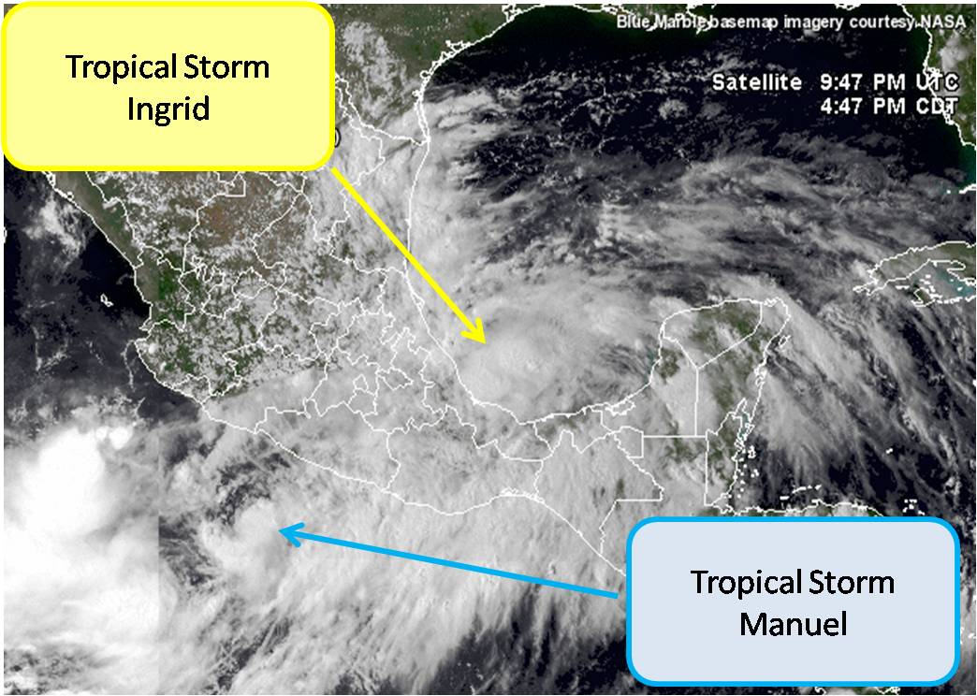
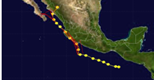
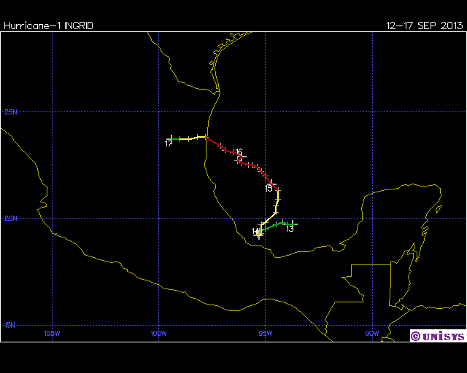
On 13 September 2013, the 2 simultaneous Tropical Storms caused most of central and southern Mexico to be affected by clouds and precipitation
TS Manuel made landfall for the first time on 15 September, after affecting the state of Guerrero for 2 days prior when it was close to the coast.
Hurricane Ingrid made landfall on 16 September in Tamaulipas, after having affected Veracruz 3 days earlier when it was close to the coast.

Slide 3
Accumulated precipitation from surface stations for the period 12-20 September, provided by the Mexican Meteorological Service (SMN)
Cat-1 Manuel Second
Landfall, 19 Sept.
Cat-1 Ingrid Landfall,
16 Sept.
TS Manuel First Landfall, 15 Sept
The heaviest precipitation associated with Manuel happened in Oaxaca and Guerrero!

Slide 5
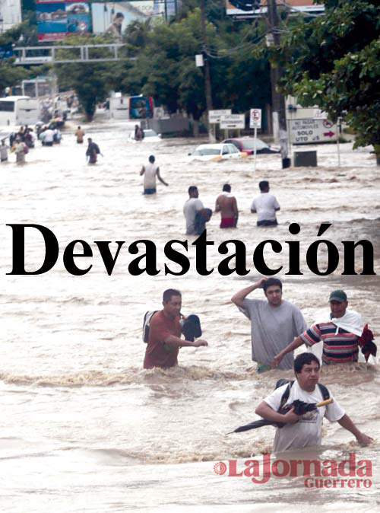

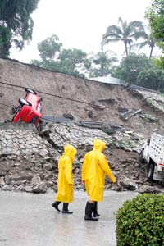
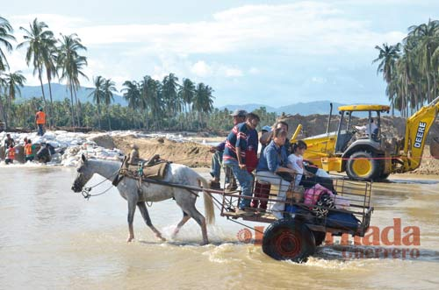
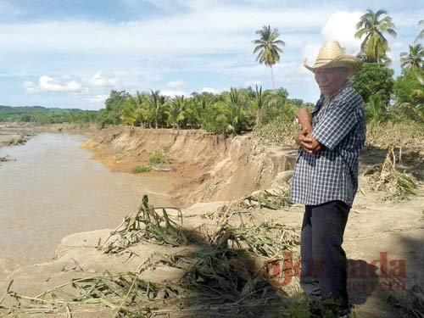
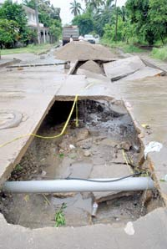
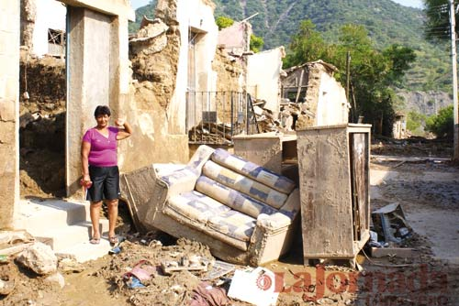
The large amounts of precipitation caused massive damages in Guerrero
Newspaper reports on Sunday 15 September

Slide 6

Economic impact of the large amounts of precipitation: crop damage in regions of subsistence agriculture (small parcels, for self-consumption)
The econometric model developed by Olivera et al (2011) was applied to the state of Guerrero to estimate losses of maize at municipal level in 62 of the 81, into which the state is divided (due to lack of meteorological data in the remainder).
The model estimates the variation in yield as a function of climatic variables w (T, P and extreme events):
(1)
where g(w) represents the growth of crops that depend upon climatic variables w and φ_{it} (w) is the time distribution of those variables over the growing seasons in county i and year t.
The variable z_{it} is a vector that includes technological change (cost) in county i and year t.
The term c_{i} represents county characteristics (e.g. soil type, basins, land use, height above sea level).
For a crop x, the yield can be estimated as:
where is the total production (in tons) of crop x in county i and year t and is the corresponding land area (in hectares) initially sowed
(2)

Slide 7
Results of the econometric model:
When incorporating 9 days of rain in 62 counties (ranging in accumulated precipitation from 0.3 to 796 mm), the econometric model results indicate a total loss of production in 54 counties!!!
The yield of maize lost in those 54 counties is 850,523 tons from a sowed area of 384,852 ha.
Note that 75% of the farmers in the state of Guerrero consume up to 50% of their own production (which on average in the region is 2.78 tons/ha), so that the loss in yield translates into less food for their families. This loss due to the rains, severely affected the livelihood of more than 1,7 million people in those counties.
The estimated economic loss amounts to $ 4,762 million Mexican pesos (approx. 353 million USD at current rate)

Slide 8
Results of the econometric model:
Maize (corn) represents 69% of the total agricultural production in Guerrero; other crops, such as beans, squash, chilis and feed for their animals, account for most of the remainder. While the losses in those other staple foods were not estimated in this model, those crops also suffer from too much water, so it is safe to assume that all agricultural production in those 54 counties was totally lost.
The loss in self-consumption agricultural production relates to food security in several ways:
Direct loss of food until the following growing season
Loss of seeds adapted to the different microclimates and soil conditions
Temporal internal migration of farmers to other rural areas not affected by the extreme event or even to small cities in the region
Definite internal migration, relocating to major cities, resulting in a net decline of total cropland and manpower in the countryside
The model results indicate no loss of production of maize in 8 of the 62 counties analyzed, those that had received accumulated precipitation of less than 22 mm per day.

Slide 9
The rains this past September caused a very large death toll (157 people) in a country that is very used to respond to the impacts of tropical cyclones, even with forced evacuations by military personnel.
So what happened this time?
We explore the flow of information from the federal level of government to the local and the political situation in the State of Guerrero, to evaluate where the flaws might have happened.

Slide 10
Flow of information:
It starts at the Federal Level with warnings issued by the National Center for the Prevention of Disasters (CENAPRED ):
-- Color-coded warnings (blue through red) for states
--Warnings for states as the TC approaches them and then as it moves away from each state
--Potentially affected states are notified by email and by fax
--Provides a forecast of precipitation in 3 categories (light, moderate and heavy) and also winds and waves for potentially affected states
--Agencies are notified to stand by to activate their emergency plans (e.g. Federal Electricity Commission; CONAGUA; Federal Police; Transport and Communications Ministry; National Defense Ministry; PEMEX, etc…)

Slide 11
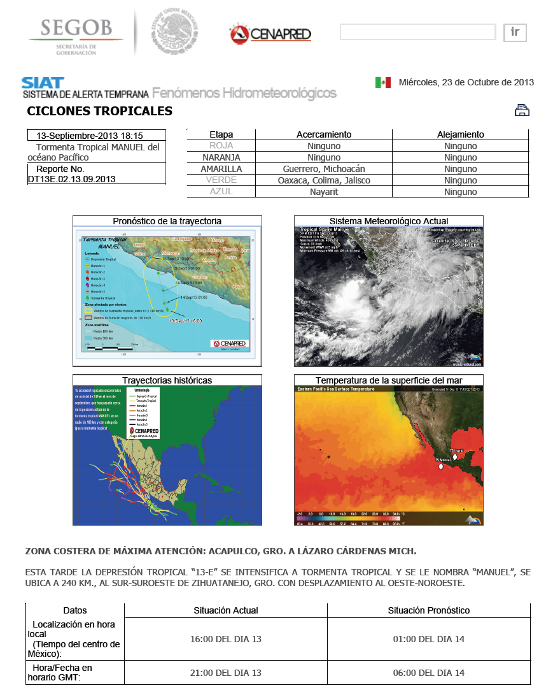
Example of warning issued
on 13 Sept. for TS Manuel
Color-coded warning:
YELLOW for Guerrero
and Michoacan
Brief status of system, forecast of trajectory of the center, satellite image, SST conditions and similar trajectories in the past

Slide 12
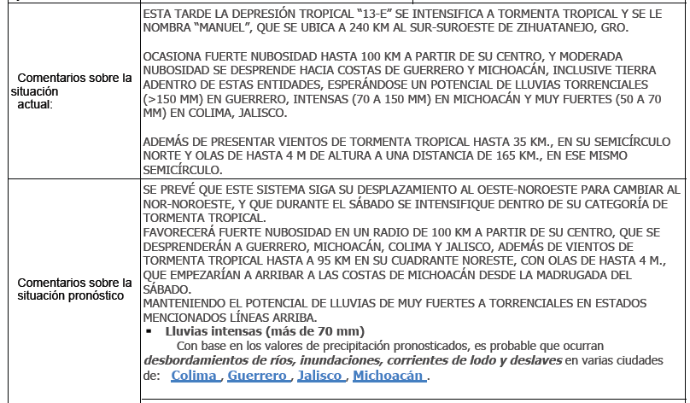
Example of warning issued
on 13 Sept. for TS Manuel (cont.)
Comments on current situation, possible torrential rains (> 150 mm!) in Guerrero
Comments on forecast, heavy rains (>70mm) up to 100km from center, 4m waves, with probability of flooding and landslides for selected states

Slide 13
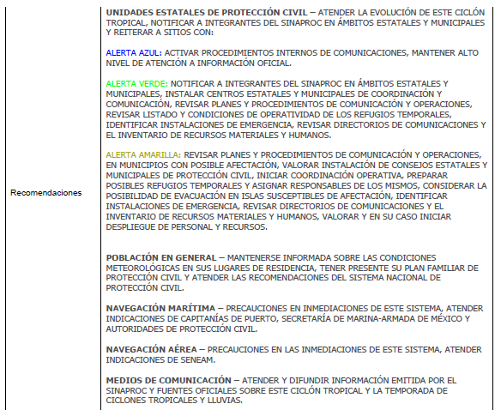
Example of warning issued on 13 Sept. for TS Manuel (cont)
Recommendations to state agencies of Civil Defense to activate plans according to color-coded warning level
Notified Agencies:
Comisión Federal de Electricidad, Comisión Nacional del Agua, Policía Federal Preventiva, Secretaría de Comunicaciones y Transporte, Secretaría de Turismo, Secretaría de Marina, Secretaría de Defensa Nacional, Secretaría de Desarrollo Social, Secretaría de Gobernación, Seguriadad Nacional, PEMEX, Secretaría de Educación Pública, Secretaría de Salud, Hidalgo, S-lll EMDN, UEPC, Fed. Mex. Radio-Exps., TELECOM.

Slide 14
In total CENAPRED at the federal level issued:
22 warnings for Manuel, since 15UTC on 13 September for TD13E in the eastern Pacific until 03UTC 20 Sept. when it was dissipating after landfall in Sinaloa.
15 warnings for Ingrid, since 21UTC on 12 September for TD10 in the Gulf of Mexico until 09 UTC on 17 Sept. when it was dissipating after landfall in Tamaulipas.
Did all these warning get to the local level and the public?
One caveat in this case: the systems were NOT very intense in the Saffir-Simpson scale and often Tropical Storms are not perceived as a serious threat (compared to hurricanes Cat 4 or 5) by the public and even local authorities. This may lead to a lack of adequate preparedness for emergencies.

Slide 15
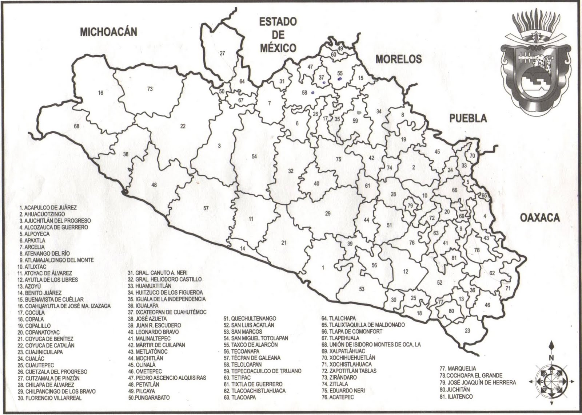
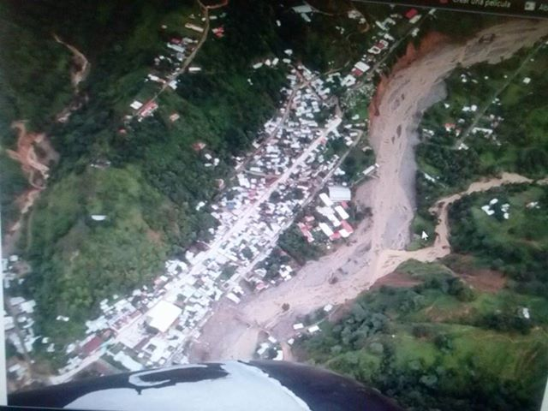
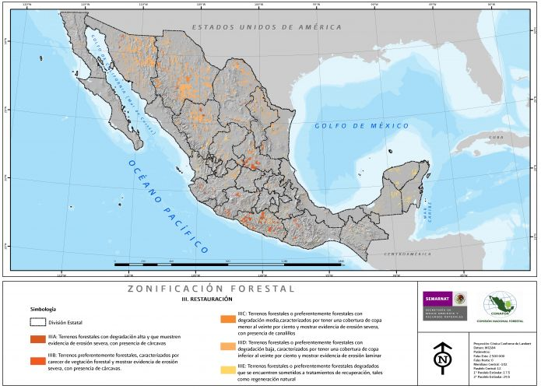
Just one of many examples…
Tlacoapa, Guerrero (63)
Lat, long: 17⁰ 15’ 50”N; 98⁰ 44’ W
Population : 9967 (2010)
Landslide and Flood through town, burst of riverbanks.
Guerrero shows (in red) severe degradation of
tropical forests, which may accelerate landslides.
(Source: SEMARNAT)

Slide 16
At state and local levels it is more difficult to assess the role of the local authorities, since often there are no protocols in place, especially in small communities. The review was done through newspaper reports. Many articles focused on:
Mutual accusations between local majors and civil defense officials in several communities, about communicating the threat to public
No evidence of a protocol having been implemented in many areas
Lack of coordination in the rescue operations
Landslides continued to occur several days after the rains
Late and not enough medical attention to survivors
Reports by human rights NGOs of delays and negligence in the distribution of bottled water and food to survivors, particularly in the counties in the mountainous regions.
No power and water in many areas for weeks, no distribution of gasoline for generators
Food still needed in January, 4 months after the disaster.
Incredible: the Director of Civil Defense at the State level is the same person that held the position during the events of Pauline in 1997!

Slide 17
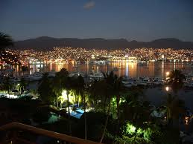

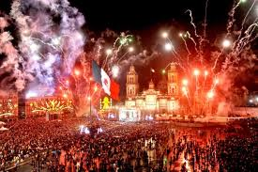
Social context during which Manuel and Ingrid evolved:
Long-weekend from 13 to 16 September
Celebration of Independence Day, from evening of 15-16 Sept.
Many tourist moved to the coasts and beaches for the long weekend (hotels in Acapulco at 85% capacity)
Boxing match evening of 15 Sept. (Canelo vs Pacquiao)
Federal civil defense official (Mr. Luis Felipe Puente) acknowledged in a press interview that “historical mistakes were made” at the three levels of government (federal, state and municipal) that led to the severe losses and damages due to Manuel and Ingrid.
The official mentioned that the fact that these phenomena occurred during the long weekend of Independence Day made the situation much worse.
(http://www.cronica.com.mx/notas/2013/787873.html)

Slide 18
Conclusions
We have evaluated the effects of Manuel and Ingrid over Mexico, particularly focusing on the State of Guerrero
We have estimated the impact of the large accumulated precipitation on maize production, resulting in a total loss in 54 of the 62 counties analyzed in Guerrero; most of the production is for self-consumption leading to serious issues of food security
We reviewed the role of the warnings issued at the federal level, which appear very adequate.
We reviewed the role of the local authorities in communicating those warnings to the public in their communities and gaps emerge at this level, that were could be linked to the large death toll reported.
This work was carried out with the aid of the Inter-American Institute for Global Change Research (IAI, Grant CRNII-2048) which is supported by the U.S. National Science Foundation (Grant GEO-0452325)

