Slide 1
@RunWith(Arquillian.class) "Production Near" JavaEE Testing
Andy Gumbrecht
@AndyGeeDe
#TomEE
@AndyGeeDe | #TomEE

Slide 2

Don't be a Fmek
@AndyGeeDe | #TomEE

Slide 3
Don't be a Fmek
Befriend Arquillians – That's är-ki-lē-əns
@AndyGeeDe | #TomEE

Slide 4
Don't be a Fmek
Befriend Arquillians – That's är-ki-lē-əns
  They're not going to destroy the Earth
@AndyGeeDe | #TomEE

Slide 5
Don't be a Fmek
Befriend Arquillians – That's är-ki-lē-əns
  They're not going to destroy the Earth
Aslak Knutsen
@AndyGeeDe | #TomEE

Slide 6
Don't be a Fmek
Befriend Arquillians – That's är-ki-lē-əns
  They're not going to destroy the Earth
Aslak Knutsen
  Project Lead, Co-founder @aslakknutsen
@AndyGeeDe | #TomEE

Slide 7
Don't be a Fmek
Befriend Arquillians – That's är-ki-lē-əns
  They're not going to destroy the Earth
Aslak Knutsen
  Project Lead, Co-founder @aslakknutsen
Pete Muir
@AndyGeeDe | #TomEE

Slide 8
Don't be a Fmek
Befriend Arquillians – That's är-ki-lē-əns
  They're not going to destroy the Earth
Aslak Knutsen
  Project Lead, Co-founder @aslakknutsen
Pete Muir
  Co-founder @plmuir
@AndyGeeDe | #TomEE

Slide 9
Don't be a Fmek
Befriend Arquillians – That's är-ki-lē-əns
  They're not going to destroy the Earth
Aslak Knutsen
  Project Lead, Co-founder @aslakknutsen
Pete Muir
  Co-founder @plmuir
Alex Soto
@AndyGeeDe | #TomEE

Slide 10
Don't be a Fmek
Befriend Arquillians – That's är-ki-lē-əns
  They're not going to destroy the Earth
Aslak Knutsen
  Project Lead, Co-founder @aslakknutsen
Pete Muir
  Co-founder @plmuir
Alex Soto
  Arquillian Cube @alexsotob
@AndyGeeDe | #TomEE

Slide 11

Don't be a Fmek
Befriend Arquillians – That's är-ki-lē-əns
  They're not going to destroy the Earth
Aslak Knutsen
  Project Lead, Co-founder @aslakknutsen
Pete Muir
  Co-founder @plmuir
Alex Soto
  Arquillian Cube @alexsotob
@AndyGeeDe | #TomEE

Slide 12
@Test
@AndyGeeDe | #TomEE

Slide 13
@Test
Do you test?
@AndyGeeDe | #TomEE

Slide 14
@Test
Do you test?
  Testing facilitates change, with correctness as a side effect
@AndyGeeDe | #TomEE

Slide 15
@Test
Do you test?
  Testing facilitates change, with correctness as a side effect
What type of test?
@AndyGeeDe | #TomEE

Slide 16
@Test
Do you test?
  Testing facilitates change, with correctness as a side effect
What type of test?
  Unit?
@AndyGeeDe | #TomEE

Slide 17
@Test
Do you test?
  Testing facilitates change, with correctness as a side effect
What type of test?
  Unit?
  Integration?
@AndyGeeDe | #TomEE

Slide 18
@Test
Do you test?
  Testing facilitates change, with correctness as a side effect
What type of test?
  Unit?
  Integration?
  Functional?
@AndyGeeDe | #TomEE

Slide 19
@Test
Do you test?
  Testing facilitates change, with correctness as a side effect
What type of test?
  Unit?
  Integration?
  Functional?
  All of the above?
@AndyGeeDe | #TomEE

Slide 20
@Test
Do you test?
  Testing facilitates change, with correctness as a side effect
What type of test?
  Unit?
  Integration?
  Functional?
  All of the above? You are on the right path!
@AndyGeeDe | #TomEE

Slide 21
@RunWith(Arquillian.class)
@AndyGeeDe | #TomEE

Slide 22
@RunWith(Arquillian.class)
Tests should be portable
@AndyGeeDe | #TomEE

Slide 23
@RunWith(Arquillian.class)
Tests should be portable
  On any supported container
@AndyGeeDe | #TomEE

Slide 24
@RunWith(Arquillian.class)
Tests should be portable
  On any supported container
  Jboss, IBM WebSphere, Tomcat, TomEE, TomEE, etc.
@AndyGeeDe | #TomEE

Slide 25
@RunWith(Arquillian.class)
Tests should be portable
  On any supported container
  Jboss, IBM WebSphere, Tomcat, TomEE, TomEE, etc.
Tests should be executable
@AndyGeeDe | #TomEE

Slide 26
@RunWith(Arquillian.class)
Tests should be portable
  On any supported container
  Jboss, IBM WebSphere, Tomcat, TomEE, TomEE, etc.
Tests should be executable
  On the developer IDE
@AndyGeeDe | #TomEE

Slide 27
@RunWith(Arquillian.class)
Tests should be portable
  On any supported container
  Jboss, IBM WebSphere, Tomcat, TomEE, TomEE, etc.
Tests should be executable
  On the developer IDE
  On the build tool
@AndyGeeDe | #TomEE

Slide 28
@RunWith(Arquillian.class)
Tests should be portable
  On any supported container
  Jboss, IBM WebSphere, Tomcat, TomEE, TomEE, etc.
Tests should be executable
  On the developer IDE
  On the build tool
  Within existing test frameworks
@AndyGeeDe | #TomEE

Slide 29
The Basics
@AndyGeeDe | #TomEE

Slide 30
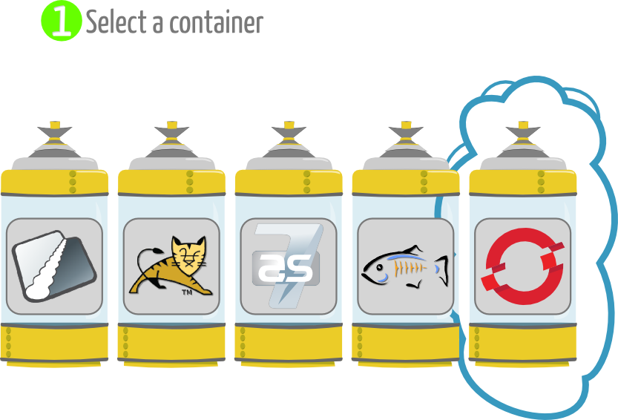
The Basics
@AndyGeeDe | #TomEE

Slide 31
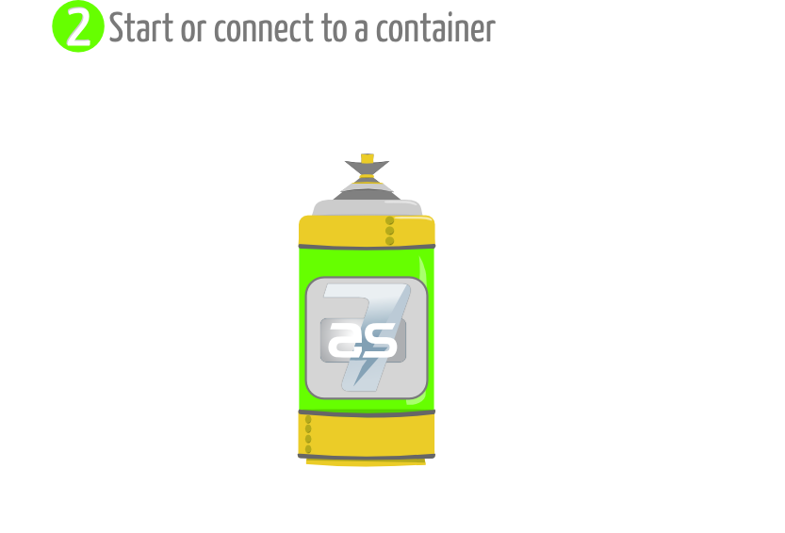
The Basics
@AndyGeeDe | #TomEE

Slide 32
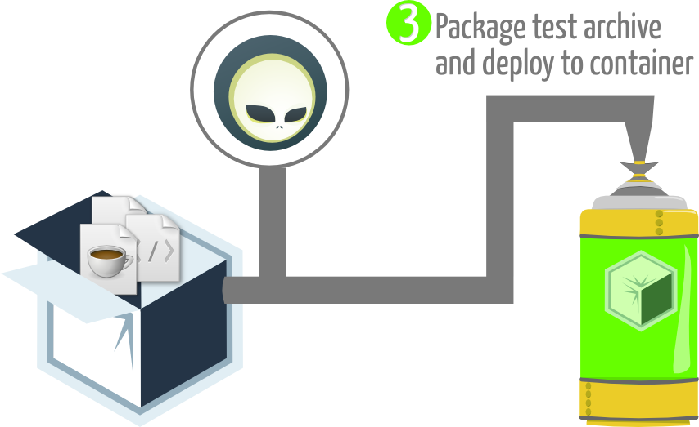
The Basics
@AndyGeeDe | #TomEE

Slide 33
The Basics
ShrinkWrap.create(JavaArchive.class)
.addClasses(x)
.addPackages(x.z)
ShrinkWrap.create(WebArchive.class)
.addAsLibraries(x)
.addAsWebInfResource(x)
.setWebXML(z)
ShrinkWrap.create(EnterpriseArchive.class)
.addAsModules(war, jar)
.setApplicationXML(x)
@AndyGeeDe | #TomEE

Slide 34
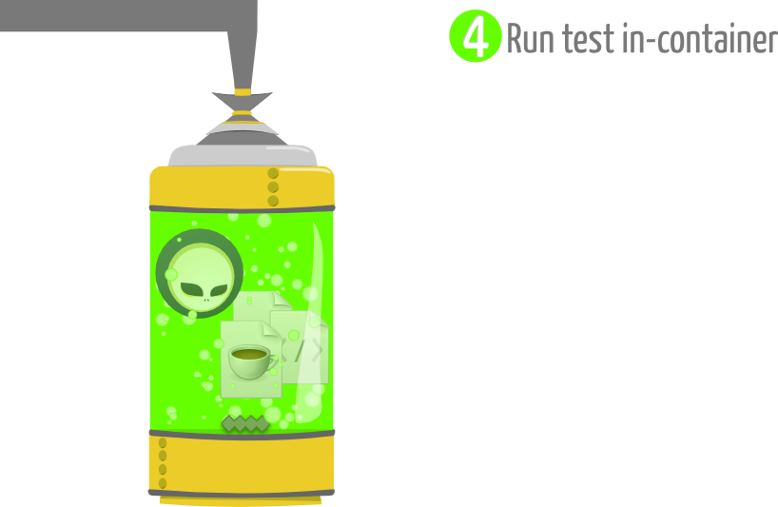
The Basics
@AndyGeeDe | #TomEE

Slide 35
The Basics
@RunWith(Arquillian.class)
public class ArquillianSimple {
@Deployment
public static WebArchive deploy() {
return ShrinkWrap.create(WebArchive.class
, ArquillianSimple.class.getName() + ".war")
.addClasses(
BookService.class,
Book.class,
BookBean.class
)
.addAsWebInfResource(EmptyAsset.INSTANCE, "beans.xml");
}
@Test
public void test(){
}
}
@AndyGeeDe | #TomEE

Slide 36
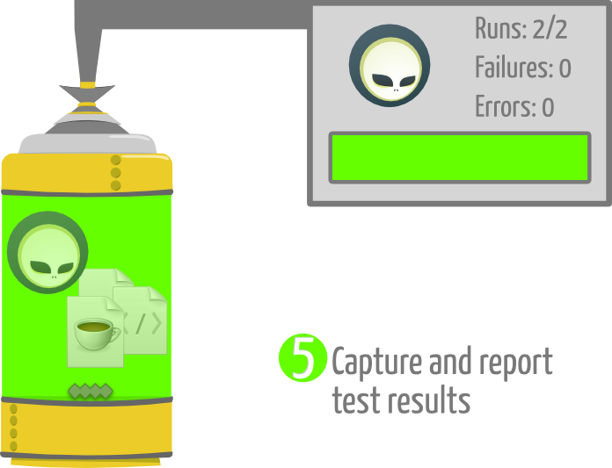
The Basics
@AndyGeeDe | #TomEE

Slide 37
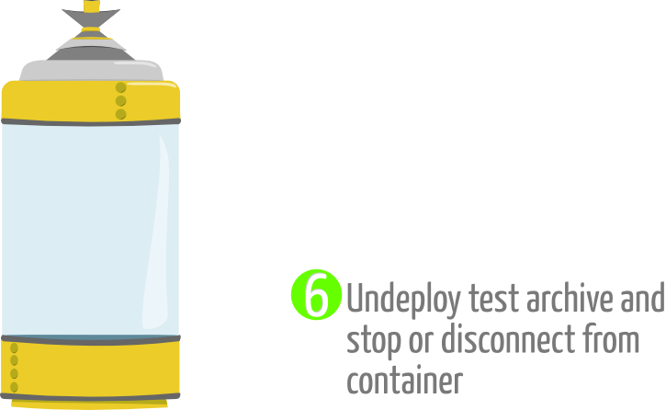
The Basics
@AndyGeeDe | #TomEE

Slide 38
@RunWith(Arquillian.class) "Production Near" JavaEE Testing
https://github.com/AndyGee/JAX
Let's see some code...
@AndyGeeDe | #TomEE

