Slide 1
Andy Gumbrecht - @AndyGeeDe
Apache Tomcat to Apache TomEE
in 1 to n Steps
A guide on opening the doorway to Java EE in Apache TomEE
from an Apache Tomcat perspective

Slide 2
Who is This Guy?
He's Andy Gumbrecht, @AndyGeeDe
Does anyone else remember the Sinclair ZX81? He does!
Employed developer since 1997
Unemployed developer as long as he can remember
User and abuser of OpenEJB since 2007
Apache OpenEJB / TomEE committer since 2010

Slide 3
Is Apache TomEE for Me?
Kathryn Janeway
Jonathan Archer
James T. Kirk
Jean-Luc Picard
Benjamin Sisko
You Yourchoice
The new guy who is going to die (The one in the red top!)

Slide 4
A Look at Apache Tomcat
A legacy application, maybe yours...
JSP
The scary stuff everyone said
was the next big thing...
Servlets
Apache Tomcat

Slide 5
A Look at Apache TomEE
A Legacy Application, Maybe Yours...
JSP
CDI
JSF
JPA
Servlets
JMA
EJB
JTA
JSTL
JAAS
JAAC
Servlets
Apache Tomcat

Slide 6
A Look at Apache TomEE
A Legacy Application, Maybe Yours...
JSP
CDI
WS
REST
Servlets
JPA
EJB
JMS
JTA
Apache Tomcat
More...

Slide 7
Maintaining 'Status quo' - EE6
Latin phrase meaning 'the existing state of affairs'
JSR-245 JavaServer Pages 2.2
JSR-344 JavaServer Faces 2.2
JSR-341 Expression Language 3.0
JSR-339 The Java API for RESTful Web Services 2.0
JSR-340 Java Servlet 3.1
JSR-250 Common Annotations for Java Platform 1.1
JSR-318 Interceptors 1.1
JSR 346 Contexts and Dependency Injection for Java EE 1.1
JSR-345 Enterprise JavaBeans 3.2
JSR-322 Java EE Connector Architecture 1.7
JSR-338 Java Persistence 2.1
JSR-907 Java Transaction API 1.2
JSR-343 Java Message Service 2.0
JSR-349 Bean Validation 1.1
EJB Entity Beans Support
JAX-RPC 1.1 Support
JAXR 1.0
Java EE Application Deployment 1.2

Slide 8
Moving on, 'Tempora mutantur'
Latin phrase meaning 'times change'
JSR-245 JavaServer Pages 2.2
JSR-344 JavaServer Faces 2.2
JSR-341 Expression Language 3.0
JSR-339 The Java API for RESTful Web Services 2.0
JSR-340 Java Servlet 3.1
JSR-250 Common Annotations for Java Platform 1.1
JSR-318 Interceptors 1.1
JSR 346 Contexts and Dependency Injection for Java EE 1.1
JSR-345 Enterprise JavaBeans 3.2
JSR-322 Java EE Connector Architecture 1.7
JSR-338 Java Persistence 2.1
JSR-907 Java Transaction API 1.2
JSR-343 Java Message Service 2.0
JSR-349 Bean Validation 1.1
EJB Entity Beans Support
JAX-RPC 1.1 Support
JAXR 1.0
Java EE Application Deployment 1.2

Slide 9
Focus on the Future – EE7, EE8
Roadmap EE7
JSR 356 - Java API for WebSockets
JSR 353 - Java API for JSON Processing (JSON-P)
JSR 352 - Batch Applications for the Java Platform
JSR 236 - Concurrency Utilities for Java EE
JSR-299 - CDI Portable Extensions
Roadmap EE8
JCache (JSR-107)
Java API for JSON Binding (JSR-TBD)
Java Configuration (JSR-TBD)

Slide 10
Still Thinking “Is it for Me”?
Jakarta Tomcat, aka Apache Tomcat is quite old (1999)
It is basically just a Web Server and Servlet Container
Tomcat extension is Ad-hoc at best
Old is actually good! Apache Tomcat is a very stable platform
Tomcat is 'the' platform upon which Apache TomEE sits
Apache TomEE is not in competition with Apache Tomcat
Apache TomEE is the opposite of Ad-hoc, it's certified
Notes:
End of Deepspace Nine, beginning Voyager

Slide 11
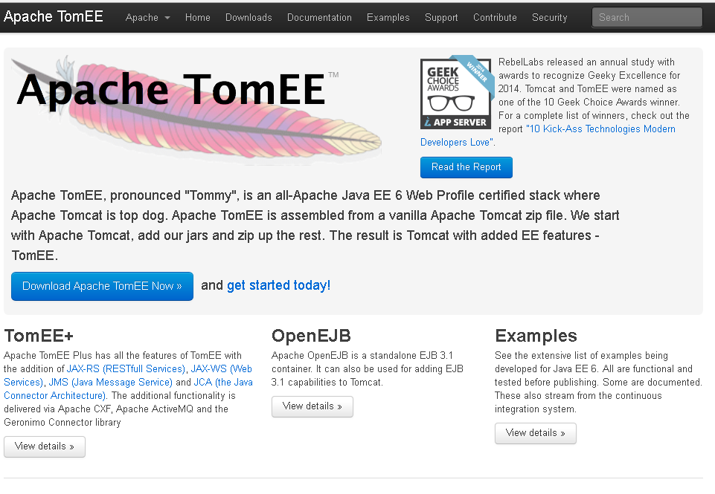

Slide 12
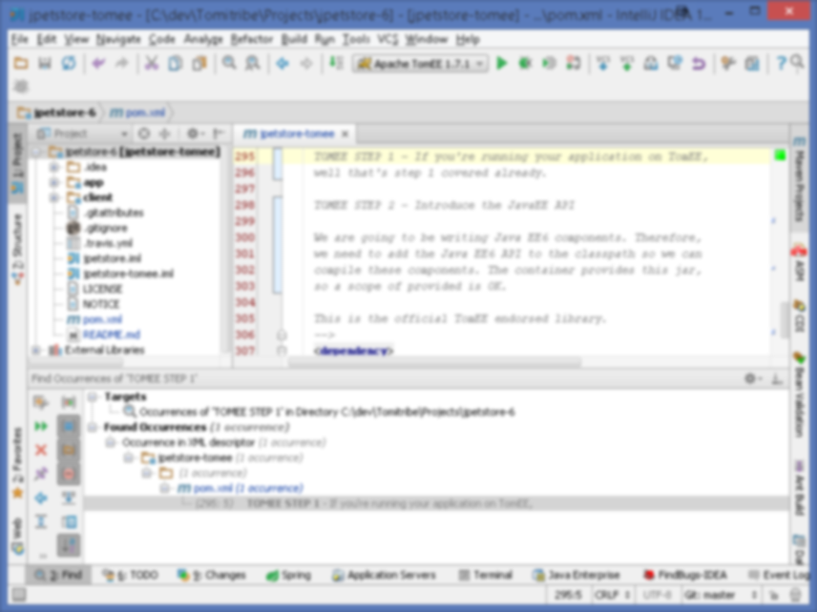
Enough already, it's code time...

Slide 13
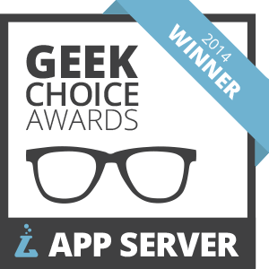


A Winning Choice

Slide 14
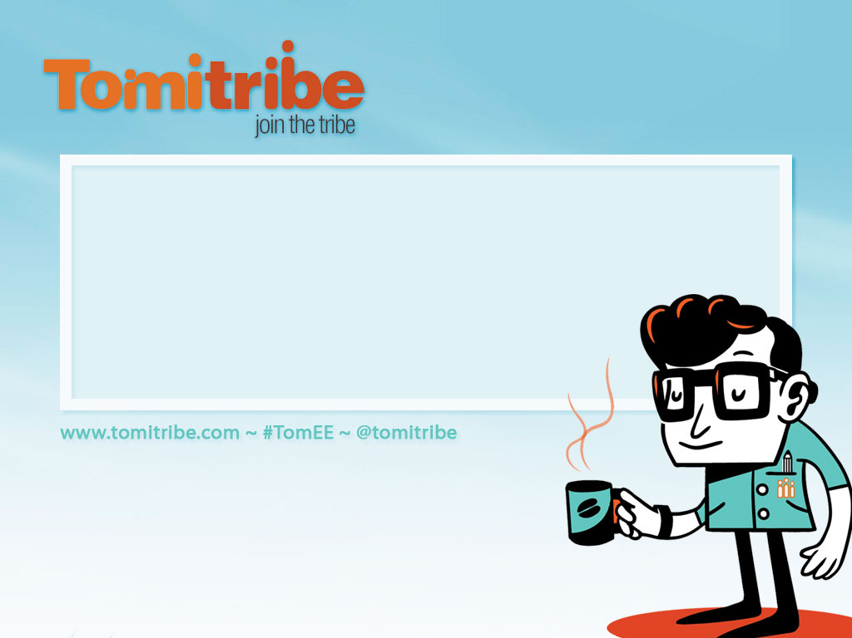
Andy Gumbrecht agumbrecht@tomitribe.com
@AndyGeeDe
Tomitribe Corporation
Leading Open Source Enterprise Service
Support Provider for Apache TomEE

Slide 15
Who are the tribe?
Tomitribe Corporation founded in Spring 2013
CEO David Blevins – Project lead on Apache- TomEE, OpenEJB and Geronimo projects. Member of the EJB 3.0 / 1 / 2 and Java EE 6 / 7 and 8 expert groups
Employees are Apache TomEE / OpenEJB developers
OpenWebBeans, DeltaSpike, Camel, CXF, Sirona, BatchEE and CREST committers
Community leaders

