Slide 1
Cluster your application with CDI and JCache
Jonathan Gallimore
@jongallimore
#TomEE
@jongallimore | #TomEE

Slide 2
CDI and JCache
What is CDI?
What is JCache?
Demo - using Hazelcast to add caching to a Java EE application
Other approaches
Q and A
@jongallimore | #TomEE

Slide 3
CDI
Contexts and Dependency Injection
Introduced in Java EE 6 (both Web & Full Profile)
Integrated with other specifications in Java EE (EJB, JAX-RS, Servlets, JSF…)
Provides the bean lifecycle management and typesafe injection
Largely annotation-based
Uses
Injection (with scoping, names, qualifiers, stereotypes and alternatives)
Producers (factory methods)
Interceptors
Observers
Can be extended with portable extensions
@jongallimore | #TomEE

Slide 4
JCache
JSR-107 - https://github.com/jsr107
Hazelcast implements the JCache specification as of version 3.3.1 (released October ‘14)
Basic concepts
Caching provider
CacheManager
Cache
Entry
CachingProvider cachingProvider = Caching.getCachingProvider();
CacheManager cacheManager = cachingProvider.getCacheManager();
Cache<Object, Object> cache = cacheManager
.getCache( "default", Object.class, Object.class );
cache.put( “world”, “Hello, world” );
@jongallimore | #TomEE

Slide 5
JCache and Java EE
Can be included in Java EE applications
Add javax.cache api and implementation jars in WEB-INF/lib
You can use Jcache in the same way a Java SE application would use it
JSR-107 provides standard annotations for caching, but these are not yet implemented by containers. Hopefully this will be part of Java EE 8
CDI can provide dependency injection and interceptors for JCache
@jongallimore | #TomEE

Slide 6
Hazelcast as a JCache Provider
Hazelcast is a fully compliant implementation of Jcache
Very easy to add to your Java EE application
Add com.hazelcast:hazelcast:3.4.1 and javax.cache:cache-api:1.0.0 to your POM.xml
Add declarative configuration to hazelcast.xml on the application’s classpath
Use JCache or Hazelcast API directly
<cache name="mycache"> <key-type class-name="java.lang.Object" /> <value-type class-name="java.lang.Object" /> <statistics-enabled>true</statistics-enabled> <management-enabled>true</management-enabled> </cache>
final MutableConfiguration<Object, Object> config = new MutableConfiguration<Object, Object>() .setTypes(Object.class, Object.class) .setExpiryPolicyFactory(AccessedExpiryPolicy.factoryOf(Duration.ONE_HOUR)) .setStatisticsEnabled(true); cache = mgr.createCache("mycache", config);
@jongallimore | #TomEE

Slide 7
What is TomEE?
Tomcat + Java EE = TomEE
Pronounced “Tommy”
Java EE 6 Web Profile certified
Java EE 7 in progress
Built from All-Apache Components
What we’ve all been building ourselves
... for years
@jongallimore | #TomEE

Slide 8
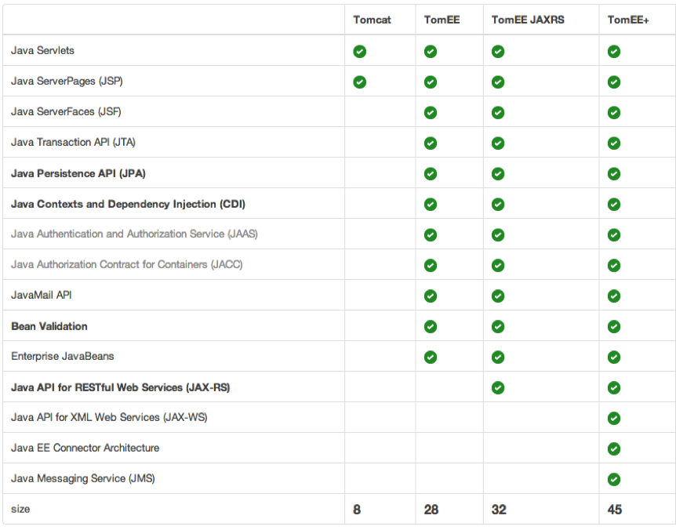
@jongallimore | #TomEE

Slide 9
TomEE Goals
Be simple
Avoid complexity and making users work
Be Tomcat
Should work with Tomcat tools and apps
Be Certified
Drop-in replacement for any Java EE Web Profile server
@jongallimore | #TomEE

Slide 10
Show me the code!
@jongallimore | #TomEE

Slide 11
Other approaches
Use Hazelcast directly as opposed to using the JCache API
Non-portable, but, exposes a lot more functionality in Hazelcast
Can still use CDI Producers and create your own interceptors
@Produces
@Singleton
@Hazelcast
public HazelcastInstance createHazelcastInstance() {
final String configFile = "META-INF/hazelcast.xml";
ClassLoader loader = Thread.currentThread().getContextClassLoader();
URL location = loader.getResource(configFile);
final Config config = new Config();
config.setConfigurationUrl(location);
config.setInstanceName("ExampleInstance");
return Hazelcast.newHazelcastInstance(config);
}
@jongallimore | #TomEE

Slide 12
Other approaches
Session replication filter
http://hazelcast.com/use-cases/web-session-clustering/generic-web-session-replication/
Native version for Tomcat / Jetty for Enterprise users
POC to share state for Stateful EJBs in TomEE using Hazelcast
@jongallimore | #TomEE

Slide 13
Thank you!
@jongallimore | #TomEE

