Slide 1


Microsoft 365 Copilot
Cowork
Agentic AI at work
Five general-purpose scenarios showing how Copilot executes across apps, shows a risk level before medium/high-risk actions, and waits for your approval
Training deck · client-ready

Slide 2
AGENDA
What we'll cover
01
Meet Cowork
What agentic AI is, and how it differs from Copilot Chat
02
Core capabilities
Skills, workspace, approval before action, self-verification
03
Set up your practice environment
Download the samples and drop them into the chat; note which scenarios touch your mailbox and calendar
04
Five hands-on scenarios
Inbox, client visit, data, research deck, custom skill — one workflow at a time
05
Make it your own
How to extend these scenarios to your own work
Microsoft 365 Copilot Cowork
1

Slide 3



WHAT IS COWORK
From "chat" to "agentic execution"
Cowork is Copilot's agentic working mode.
You hand it a goal; it breaks the work into steps, reads your cloud files, loads the skills it needs, produces results across apps and checks its own work — pausing for your approval, with a risk level shown, before any medium or high-risk action. You move from quick single-turn answers to handing over a task that actually gets done.
Copilot Chat
Cowork agent
You stay in charge
Quick single-turn answers; great for instant replies and brainstorming.
You give a goal; it executes autonomously across apps, for minutes to hours.
Anything outbound or affecting others pauses for your approval.
Microsoft 365 Copilot Cowork
2

Slide 4
COMPARISON
Cowork vs. Copilot Chat
Copilot Chat
Copilot Cowork
Quick single-turn Q&A
Quick single-turn Q&A
Hand over a goal; autonomous multi-step work across apps
Seconds to minutes
Seconds to minutes
Minutes to hours (autonomous)
Single step, single session
Single step, single session
Multi-step workflows across tasks and sources
Paste in a snippet
Paste in a snippet
Reads cloud attachments and creates new files; no access to local files
One conversational capability
One conversational capability
Loads 14 built-in skills plus your custom ones automatically
Text in the chat window
Text in the chat window
Real documents, spreadsheets and decks in OneDrive
You have to open it and prompt every time
You have to open it and prompt every time
Scheduled prompts / event-driven: runs on incoming mail or an @mention
Grounded in M365 data
Grounded in M365 data
Connects to external systems via Plugins / MCP — the partner catalogue now lists 92 plugins (D365, SAP, Fabric and more)
You judge for yourself
You judge for yourself
Medium/high-risk actions show a risk level and run only after approval
Microsoft 365 Copilot Cowork
3

Slide 5




CORE CAPABILITIES
Four things that set Cowork apart
14 built-in skills
Workspace
Word, Excel, PowerPoint, PDF, Email, Scheduling, Calendar Management, Meetings, Daily Briefing, Enterprise Search, Deep Research, Communications, Adaptive Cards, App (Frontier).
The side panel shows progress, input files, output files, loaded skills, schedules and granted permissions all at once — the process stays traceable.
Approval before action
What's new
Medium/high-risk actions show a RISK-LEVEL; approve, cancel, or set don't-ask-again per recipient, per domain or always; multiple pending actions can be approved together.
Scheduled prompts (up to 25) and event-driven tasks; five Effort levels to balance quality against cost; every custom skill gets an automatic Skill Report (0–100 across four dimensions, plus five separate gates including a Safety and RAI scan); local Edge browser (GA since Aug 2026); image generation; Plugins / MCP for external systems.
Microsoft 365 Copilot Cowork
4

Slide 6




HOW IT WORKS
What happens inside one agentic workflow
Take the goal
Plan
Load skills
Execute
Self-verify
Approval before action
Upload files
Give the instruction
Understand the task
Break it into steps
14 built-in
+ custom
Create documents
spreadsheets / mail
Check the numbers
and consistency
Outbound actions
wait for you
The whole process is visible in the "Workspace" panel; you can soft/hard pause, resume or cancel a task.
It doesn't only start from chat: you can also have it fire automatically when a matching email arrives or you're @mentioned (event-driven tasks) — with the same self-verification and approval flow.
Microsoft 365 Copilot Cowork
5

Slide 7

BEFORE YOU START
Set up your practice environment
Download the samples and drop them into the chat — no need to put them in OneDrive first · Setup time about 8 minutes
📥
Download the sample files
📧
Mailbox: it drafts, it does not send on its own
Every scenario has download links in its “Reference file…
Several scenarios have Cowork draft emails. It always sa…
📅
Calendar: leave some room this week
📁
Output lands in your OneDrive
Some scenarios have Cowork schedule meetings or reminder…
Files Cowork creates are saved to your own OneDrive, and…
🧩
Skills folder: you build it live, so do not pre-load it
⏰
Automations page: clear out anything left over
One scenario walks you through creating a custom skill l…
Some scenarios create a scheduled prompt or an event-dri…
🔎
Enterprise Search: your tenant needs something to find
🔬
⚠️ Deep Research is slow and costly — dry-run it first
Some scenarios have Cowork run Enterprise Search across …
One scenario uses Deep Research. It genuinely searches a…
Final check before the session
The reference files for the scenario you are about to run are downloaded
You know to check the recipient on every approval card so no practice email reaches a real person
Your calendar has room this week for test entries
Microsoft 365 Copilot Cowork
6

Slide 8




5 SCENARIOS
Five hands-on scenarios
Productivity / Personal
Sales / Pre-sales
Data / Operations
Strategy / Account
Knowledge work / Automation
Client Visit End-to-End
Multi-Format Sales Analysis
Internal & External Intelligence
Inbox Triage on Schedule
Custom Skills & Event Triggers
Word · Email · Scheduling · Calendar Management
Excel · Adaptive Cards · PDF
Email · Daily Briefing · Scheduled prompt
Enterprise Search · Deep Research · PowerPoint
Custom skill · Skill Report · Event-driven task
~12 min
★☆☆
~10 min
★☆☆
~10 min
★☆☆
~15 min
★★☆
~18 min
★★☆
Microsoft 365 Copilot Cowork
7

Slide 9
Scenario 01
Hand Cowork a single triage ruleset and let it sweep your inbox by the same standard, sort mail into four quadrants, surface the must-reply emails, and produce a 5-minute morning brief — then put the whole flow on a schedule at 08:30 every day, so from tomorrow it is already done before you sit down.
Agentic workflow
Productivity / Personal
Upload the rules & ask it to triage today's inbox
1
Inbox Triage on Schedule
Upload the triage rules md from the reference files and …
2
Watch it read mail & apply rules per message
Expand the thinking trace and watch how it maps each mes…
⏱ ~10 min · Level ★☆☆
Email
Daily Briefing
3
Receive your daily morning brief
Read through your morning brief and check it against the…
Scheduled prompt
4
⭐ Put it on a schedule at 08:30 daily
Send the prompt below to hand the whole flow over to a s…
Microsoft 365 Copilot Cowork
8

Slide 10
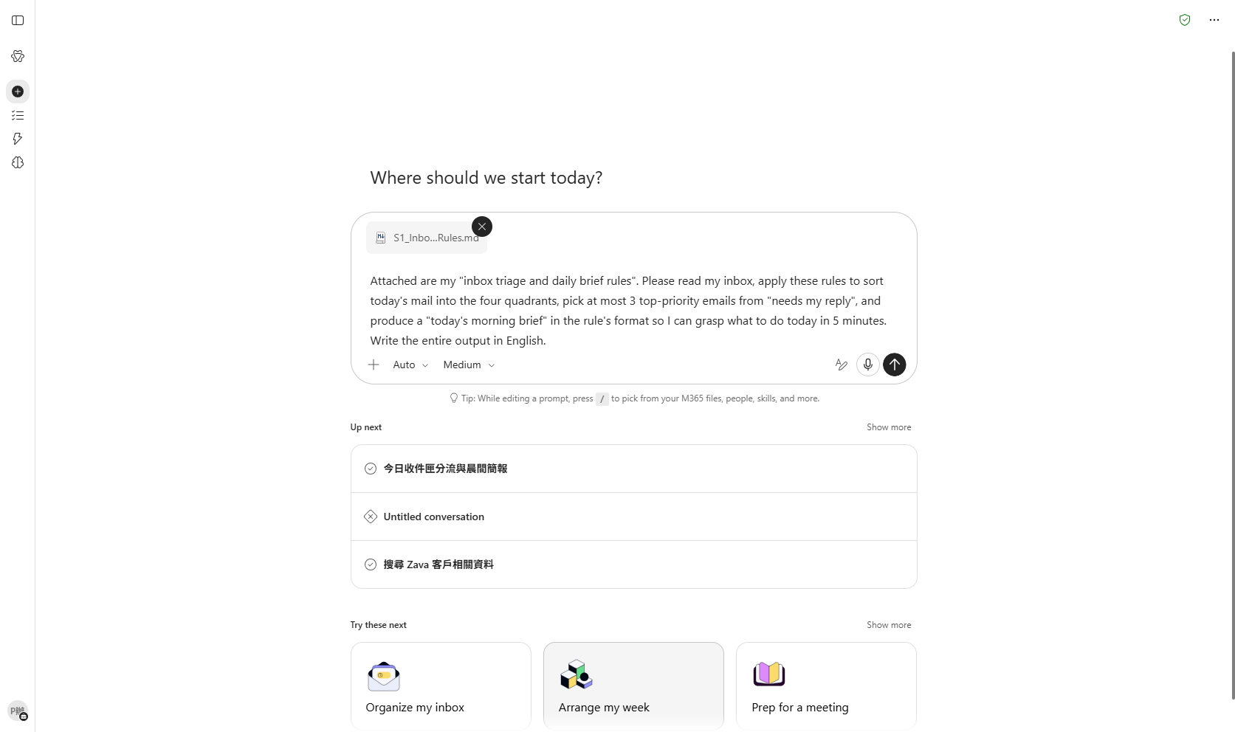
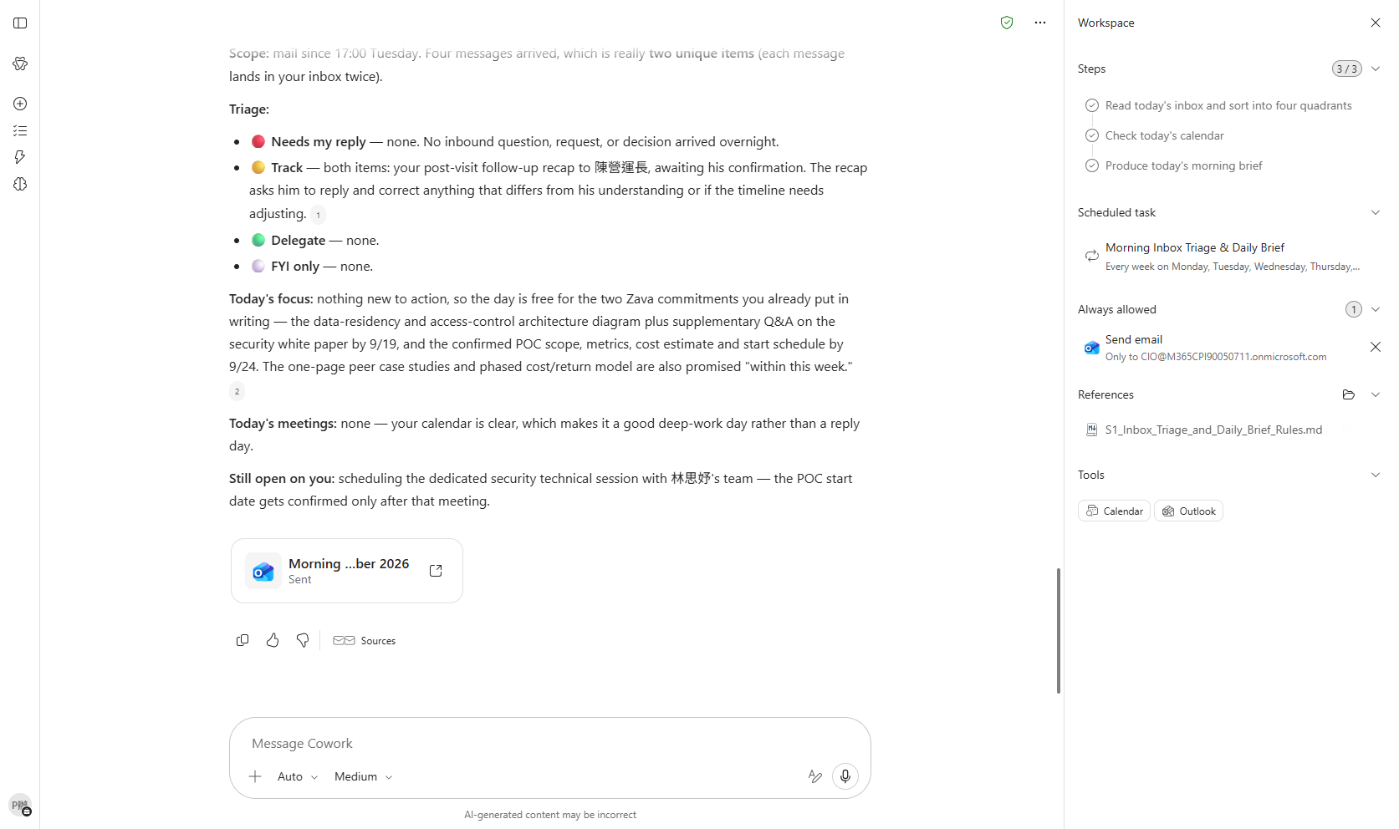

Scenario 01 · Live demo
What Cowork does, and what it produces
① Your input and prompt
② The result
Check the output
[Operation] Triage-rules md was uploaded and Cowork read your actual inbox
[Judgment] At most 3 emails are flagged ⭐ and it can name the rule it applied to each
[Output] The morning brief has all five sections from part 4 of your rules (focus / meetings / must-reply / waiting on / reminders)
Microsoft 365 Copilot Cowork
9

Slide 11
Scenario 02
Start from a single client background file: let Cowork auto-generate a pre-meeting brief, draft the follow-up email after the meeting and send it once you approve, then put the next meeting straight into the calendar — prep, wrap-up and next step in one run.
Agentic workflow
Sales / Pre-sales
Upload the background file & give the instruction
1
Client Visit End-to-End
Click the attachment button and upload the client backgr…
2
Watch the agentic workflow & output
Expand the Workspace panel and watch the self-validation…
⏱ ~12 min · Level ★☆☆
Word
Email
Scheduling
3
After: draft the follow-up & approve to send
Confirm the Word brief draft looks right, then send the …
Calendar Management
4
⭐ Put the next meeting on the calendar
With the follow-up sent, send the prompt below so the ne…
Microsoft 365 Copilot Cowork
10

Slide 12
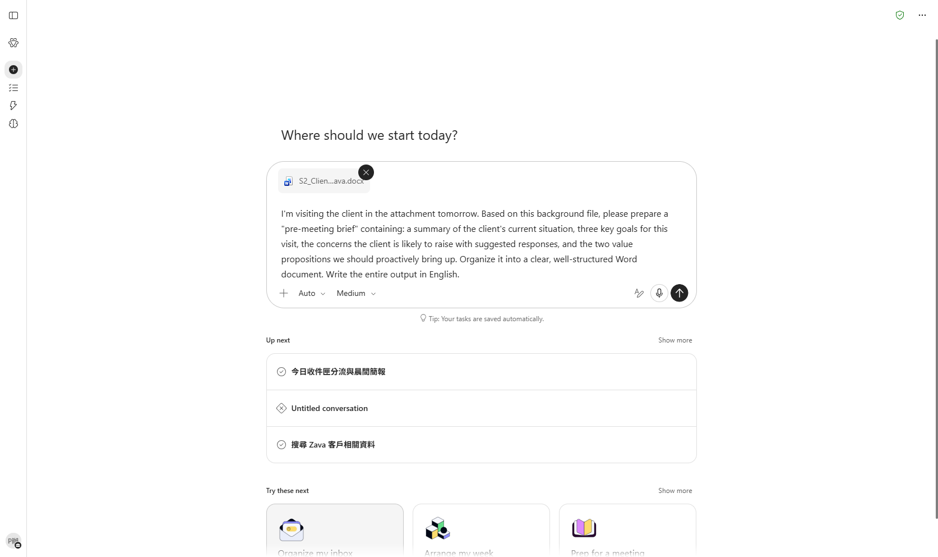
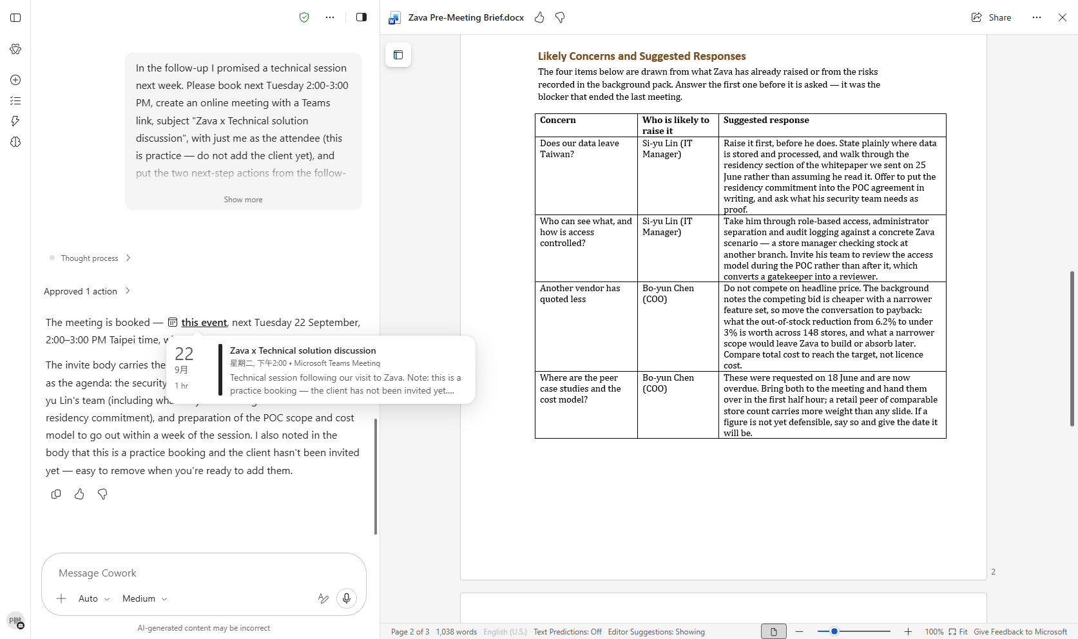

Scenario 02 · Live demo
What Cowork does, and what it produces
① Your input and prompt
② The result
Check the output
[Operation] Client background docx was uploaded
[Output] Word pre-meeting brief has four sections matching the background
[Judgment] You asked whether it found contradictions or gaps, and confirmed the final version is correct
Microsoft 365 Copilot Cowork
11

Slide 13
Scenario 03
Hand Cowork a raw sales ledger and let it auto-compute pivot summaries, wire up live formulas, flag best and worst performers, and write the key findings — then turn the top three into an interactive card you can read right in the conversation and a PDF you can forward as-is. One analysis, three ways to share it.
Data / Operations
Agentic workflow
Multi-Format Sales Analysis
1
Upload the data & spell out the analysis
Upload the raw sales xlsx from the reference files and s…
2
Watch it self-verify the numbers
⏱ ~10 min · Level ★☆☆
Expand the thinking trace and watch the alternating Pyth…
Excel
Adaptive Cards
3
Open the dashboard to verify
PDF
Open the generated xlsx preview and check the sheet stru…
4
⭐ Same analysis, two more ways to share it
With the dashboard verified, send the prompt below to tu…
Microsoft 365 Copilot Cowork
12

Slide 14
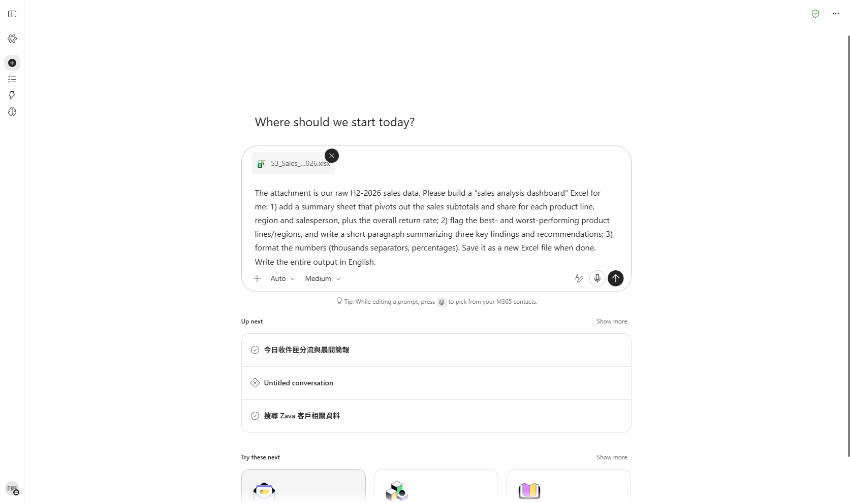
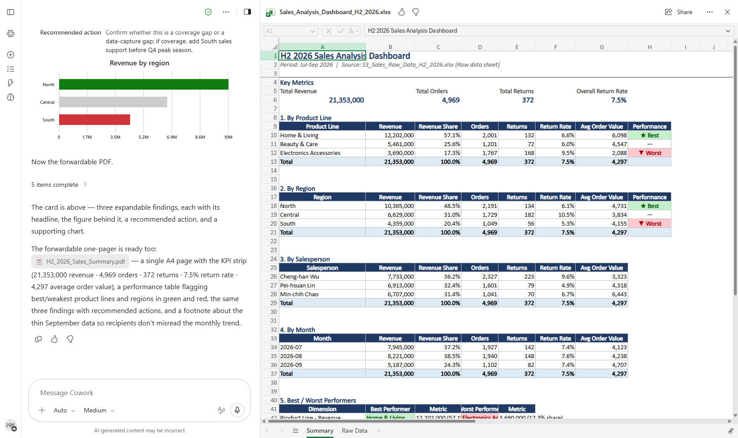

Scenario 03 · Live demo
What Cowork does, and what it produces
① Your input and prompt
② The result
Check the output
[Operation] Raw sales xlsx was uploaded
[Output] Output file has a "Sales Dashboard" and "Raw Data" sheet, with three pivot tables each showing subtotals, share and return rate, wired by SUMIF formulas
[Output] Three key findings and recommendations are included
Microsoft 365 Copilot Cowork
13

Slide 15
Scenario 04
Before building a client deck, ask the question people skip: what does my own company already know? Let Cowork first run Enterprise Search across your organization for existing meeting notes and correspondence, then go online with Deep Research to fill the external gaps, and finally relay both into a properly-sourced PowerPoint.
Strategy / Account
Agentic workflow
Internal & External Intelligence
1
⭐ Ask inside first: what do we already know?
Don't upload anything yet, and don't go to the web yet. …
2
Then ask outside: fill the gaps
⏱ ~15 min · Level ★★☆
Upload the research deck outline md from the reference f…
Enterprise Search
3
Multi-skill relay: internal + external → slides
Deep Research
PowerPoint
Confirm the research summary research-report.md has been…
4
Verify: what you can say, what to check first
Open the PowerPoint preview, confirm the 8-slide structu…
Microsoft 365 Copilot Cowork
14

Slide 16
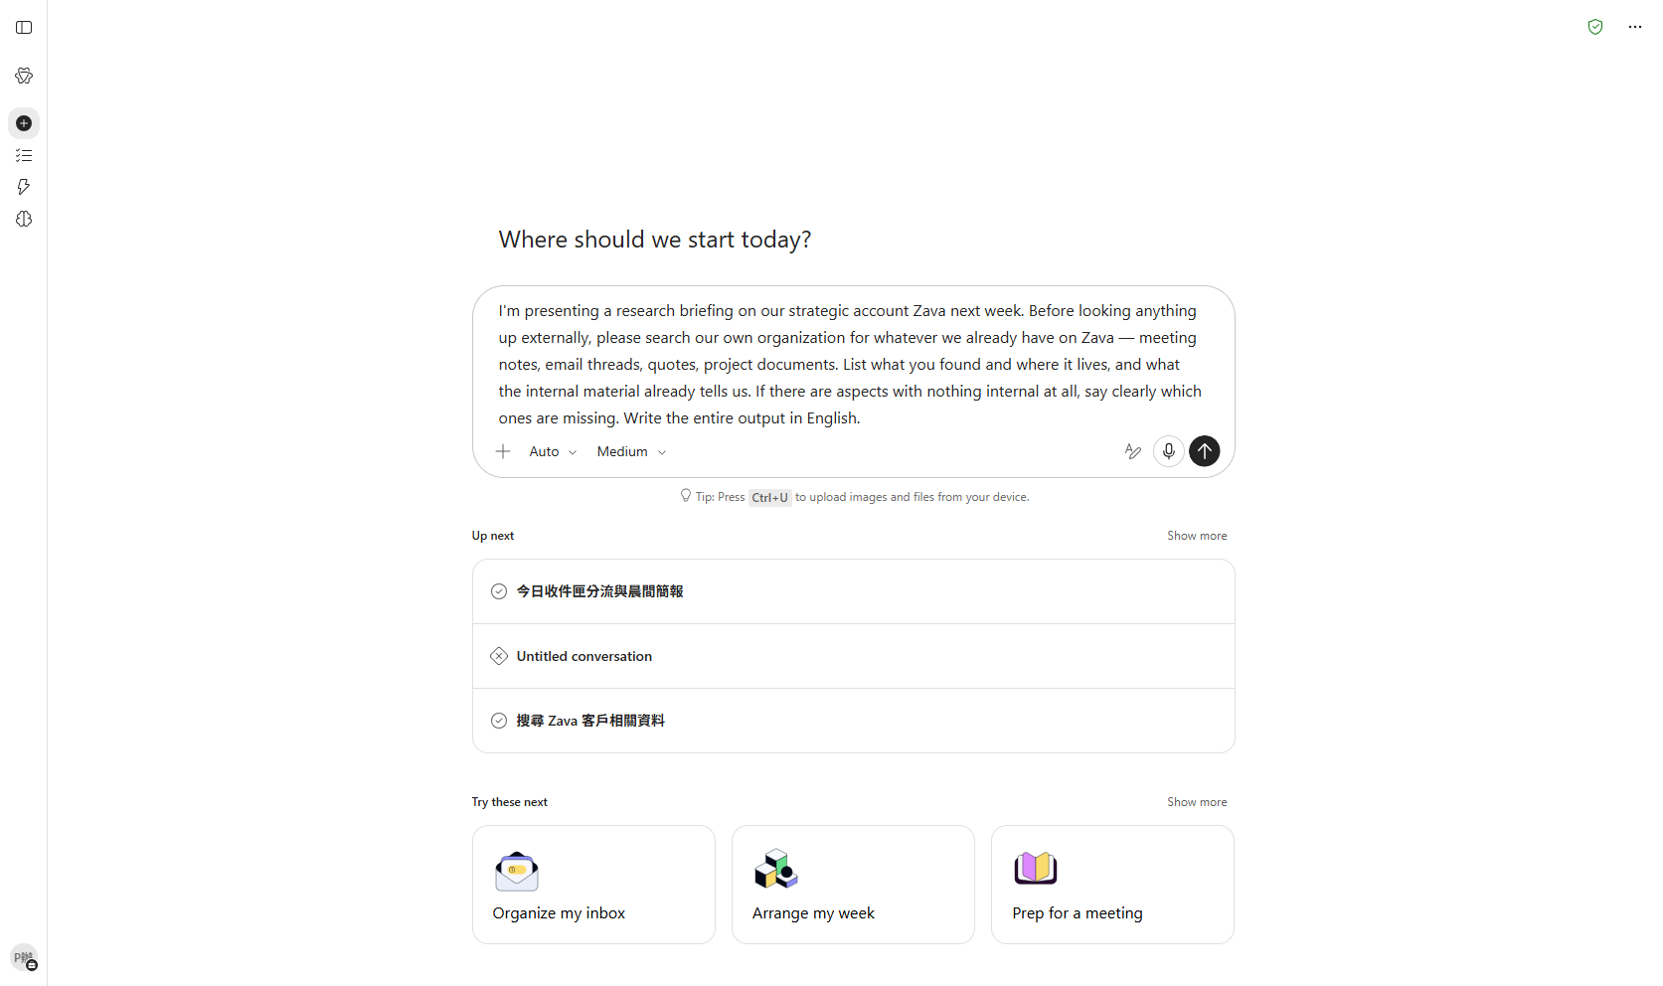
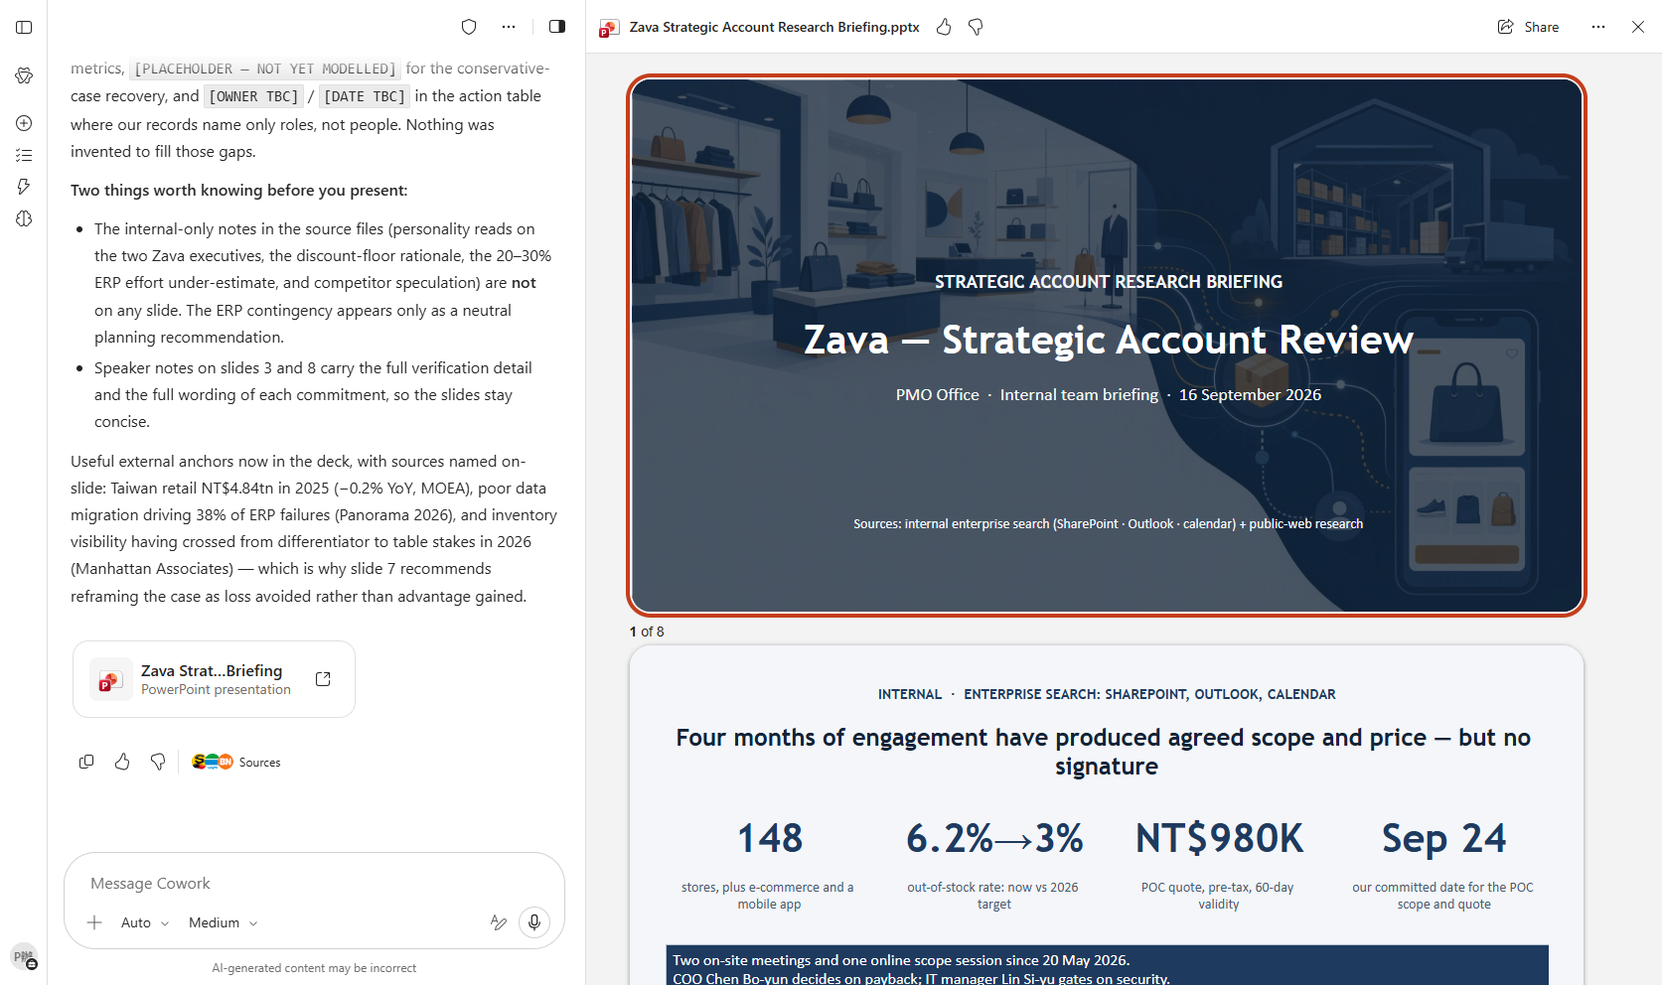

Scenario 04 · Live demo
What Cowork does, and what it produces
① Your input and prompt
② The result
Check the output
[Operation] Without uploading anything, Cowork used Enterprise Search to surface what your organization already holds on the client
[Judgment] You can see what was already known internally and what was missing, and that shaped what you researched externally
[Output] Deep Research produced a summary (.md) with real, verifiable source links
Microsoft 365 Copilot Cowork
15

Slide 17
Scenario 05
Teach Cowork a recurring weekly task once, watch it score your skill automatically, then let that skill start itself — triggered by an incoming email, so you never even type the trigger phrase.
Agentic workflow
1
Ask Cowork: how do skills work?
Knowledge work / Automation
Custom Skills & Event Triggers
Send the prompt below and let Cowork explain its own ski…
2
Let Cowork build the skill conversationally
Upload S5_SKILL.md from the reference files for referenc…
⏱ ~18 min · Level ★★☆
3
Open a new session & trigger with one phrase
Custom skill
Skill Report
Close the current Cowork chat and open a brand-new one, …
Event-driven task
4
⭐ Make the skill start itself: set an event-driven task
Send the prompt below to attach the skill you just built…
Microsoft 365 Copilot Cowork
16

Slide 18
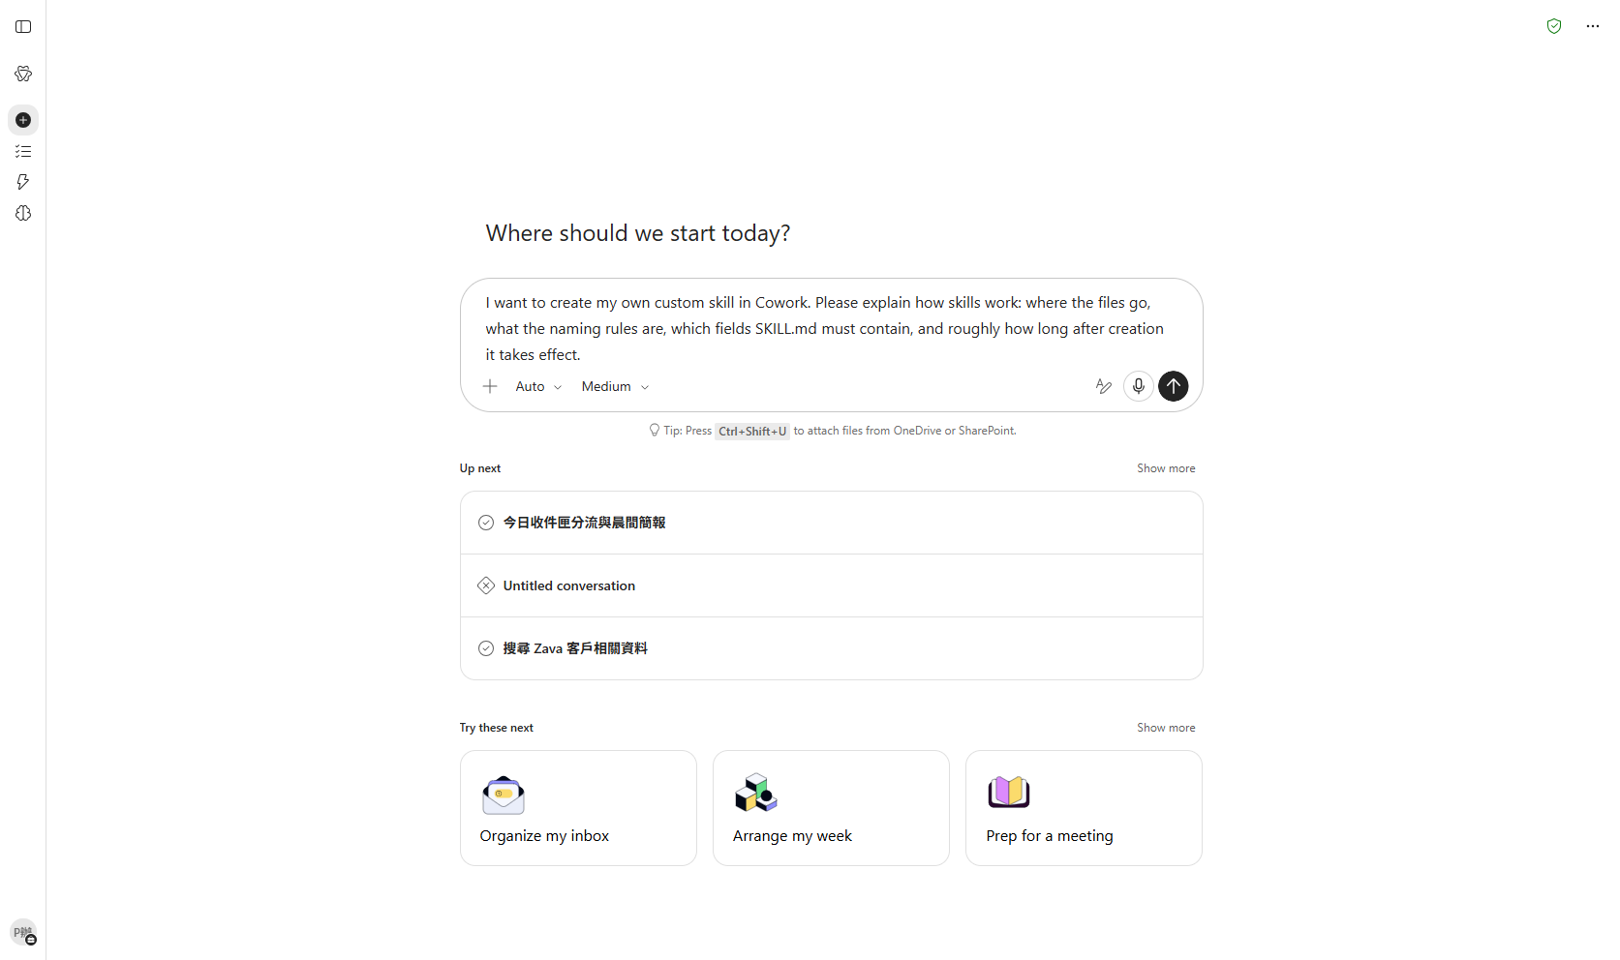
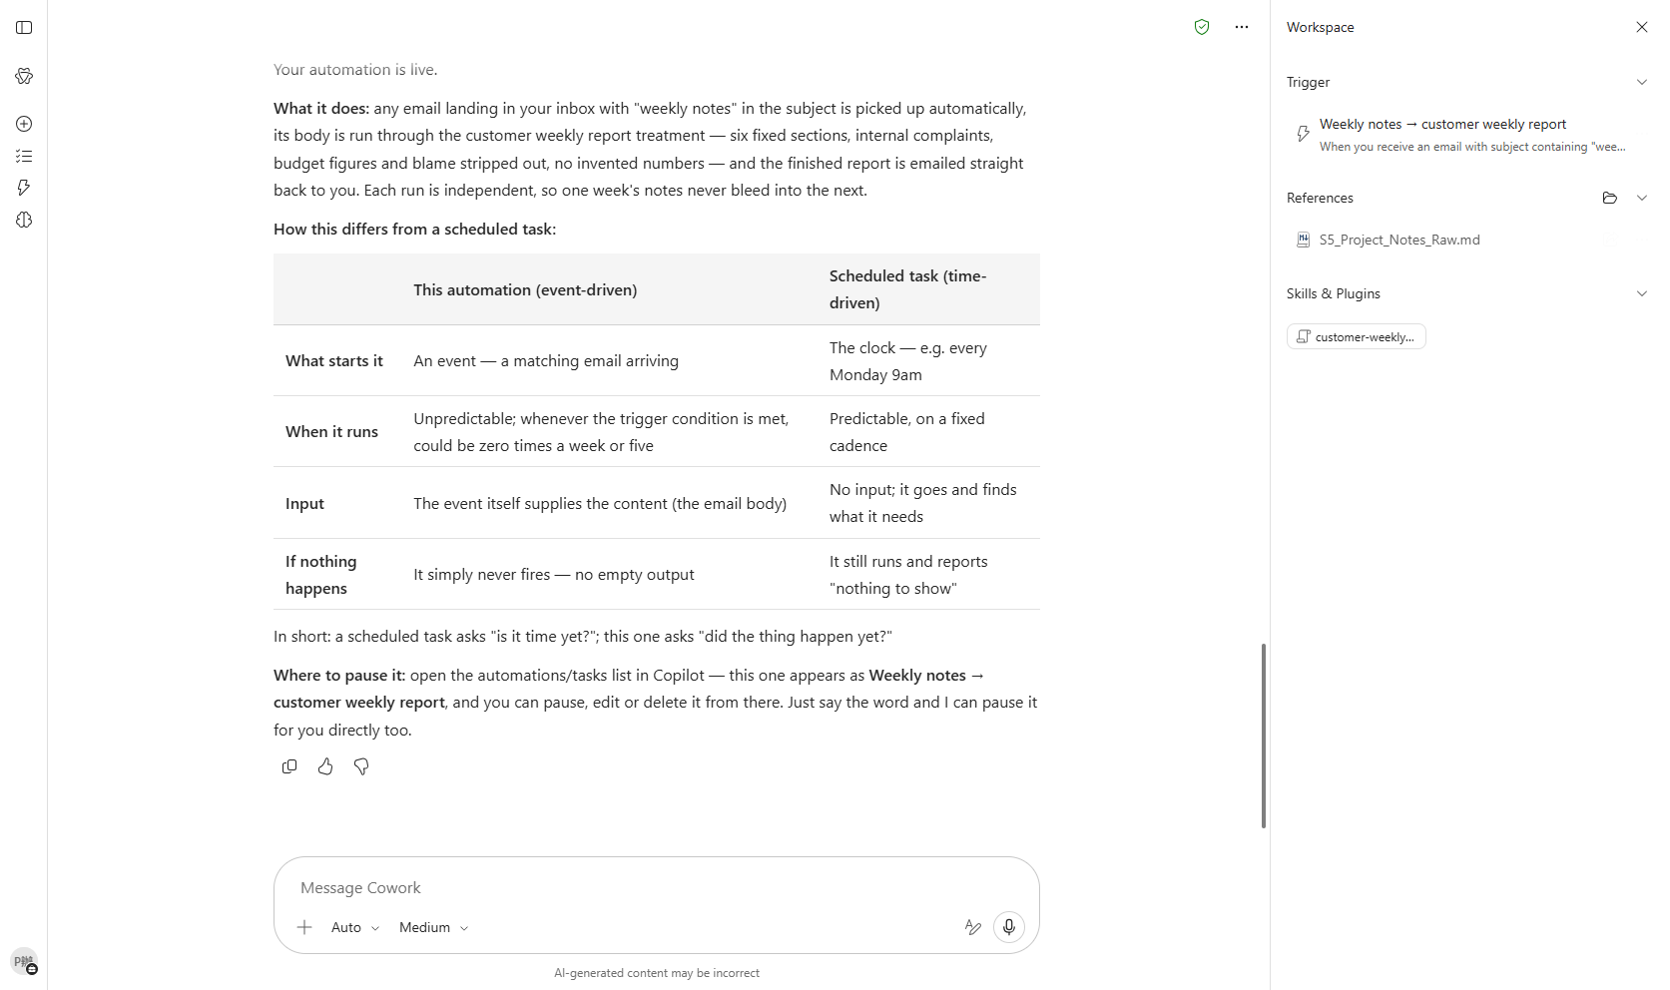

Scenario 05 · Live demo
What Cowork does, and what it produces
① Your input and prompt
② The result
Check the output
[Operation] The customer-weekly-report skill is created and synced to Documents/Cowork/skills in OneDrive
[Evaluation] You have seen the Skill Report score and can say what each of the four dimensions measures
[Judgment] You understand a high score is not a pass, because the Safety and RAI scan is a separate gate
Microsoft 365 Copilot Cowork
17

Slide 19
MAKE IT YOURS
Extend it to your own work
Productivity / Personal
💡 Adapt the rules to your own criteria (your VIP list, your quadrant definitions) for a personal triage logic.
Sales / Pre-sales
💡 Swap in your real (de-identified) client data and let Cowork build the brief for your next visit.
Data / Operations
💡 Swap in your own sales or operations data to generate your team's dashboard.
Strategy / Account
💡 Swap in an account you actually own and run Enterprise Search first — you may be surprised how much your company already holds that you did not know about.
Knowledge work / Automation
💡 Swap the sections and wording for your company's real report format to make your own version.
Microsoft 365 Copilot Cowork
18

Slide 20





TRUST & CONTROL
Automated — but you're still the decision maker
Approval before action
Medium/high-risk actions show a RISK-LEVEL; sending mail, posting to Teams or creating meetings all open as an editable preview and go out only after approval.
Scope you control
Don't-ask-again can be limited to a recipient, a domain, or always; tasks can be soft/hard paused, resumed or cancelled.
Automated tasks have guardrails too
Scheduled prompts and event-driven tasks have run-frequency limits and loop protection; they always run with the creator's permissions, and are recorded in the unified audit log alongside all other Cowork activity, under Microsoft Purview policy.
Know the limits
No access to local files, no deleting OneDrive/SharePoint files, no reading encrypted files; attachments under 200MB; custom skills and third-party plugins aren't validated by Microsoft, so review the output yourself. Microsoft explicitly lists it as unsuitable where accuracy must be guaranteed without human review.
Microsoft 365 Copilot Cowork
19

Slide 21


Start practising now
Cowork Playbook
aka.ms/CoworkPlaybook
Start with the scenario closest to your own work
Custom skills live in OneDrive at /Documents/Cowork/skills/ as SKILL.md (up to 50, 1MB each)
Model picker: Auto (default), GPT 5.5 Frontier, GPT 5.6 Sol/Terra, GPT 6 Astra, Opus 5, Claude Sonnet 5, Claude Fable 5.1
Effort: Light / Medium (default) / High / Extra High / Max — higher is more thorough, but slower and uses more credits
Want it to fire by itself? Set a scheduled prompt (up to 25) or an event-driven task (incoming mail / @mention) on the "Automations" page

Slide 22
Thank you
From asking to delegating — you set the standard, Cowork does the work.
Microsoft 365 Copilot Cowork · Training deck

