Slide 1


Microsoft 365 Copilot
Cowork
Agentic AI at work
Six real advanced-packaging scenarios showing how Copilot executes across apps, shows a risk level before medium/high-risk actions, and waits for your approval
Training deck · client-ready

Slide 2
AGENDA
What we'll cover
01
Meet Cowork
What agentic AI is, and how it differs from Copilot Chat
02
Core capabilities
Skills, workspace, approval before action, self-verification
03
Set up your practice environment
Seed the material into OneDrive and your mailbox first, so Cowork finds it itself
04
Six hands-on scenarios
Shift handover, yield hunt, customer QBR, discontinuation impact, audit findings, sample release — one workflow at a time
05
Make it your own
How to extend these scenarios to your own work
Microsoft 365 Copilot Cowork
1

Slide 3



WHAT IS COWORK
From "chat" to "agentic execution"
Cowork is Copilot's agentic working mode.
You hand it a goal; it breaks the work into steps, reads your cloud files, loads the skills it needs, produces results across apps and checks its own work — pausing for your approval, with a risk level shown, before any medium or high-risk action. You move from quick single-turn answers to handing over a task that actually gets done.
Copilot Chat
Cowork agent
You stay in charge
Quick single-turn answers; great for instant replies and brainstorming.
You give a goal; it executes autonomously across apps, for minutes to hours.
Anything outbound or affecting others pauses for your approval.
Microsoft 365 Copilot Cowork
2

Slide 4
COMPARISON
Cowork vs. Copilot Chat
Copilot Chat
Copilot Cowork
Quick single-turn Q&A
Quick single-turn Q&A
Hand over a goal; autonomous multi-step work across apps
Seconds to minutes
Seconds to minutes
Minutes to hours (autonomous)
Single step, single session
Single step, single session
Multi-step workflows across tasks and sources
Paste in a snippet
Paste in a snippet
Reads cloud attachments and creates new files; no access to local files
One conversational capability
One conversational capability
Loads 14 built-in skills plus your custom ones automatically
Text in the chat window
Text in the chat window
Real documents, spreadsheets and decks in OneDrive
You have to open it and prompt every time
You have to open it and prompt every time
Scheduled prompts / event-driven: runs on incoming mail or an @mention
Grounded in M365 data
Grounded in M365 data
Connects to external systems via Plugins / MCP — the partner catalogue now lists 92 plugins (D365, SAP, Fabric and more)
You judge for yourself
You judge for yourself
Medium/high-risk actions show a risk level and run only after approval
Microsoft 365 Copilot Cowork
3

Slide 5




CORE CAPABILITIES
Four things that set Cowork apart
14 built-in skills
Workspace
Word, Excel, PowerPoint, PDF, Email, Scheduling, Calendar Management, Meetings, Daily Briefing, Enterprise Search, Deep Research, Communications, Adaptive Cards, App (Frontier).
The side panel shows progress, input files, output files, loaded skills, schedules and granted permissions all at once — the process stays traceable.
Approval before action
What's new
Medium/high-risk actions show a RISK-LEVEL; approve, cancel, or set don't-ask-again per recipient, per domain or always; multiple pending actions can be approved together.
Scheduled prompts (up to 25) and event-driven tasks; five Effort levels to balance quality against cost; every custom skill gets an automatic Skill Report (0–100 across four dimensions, plus five separate gates including a Safety and RAI scan); local Edge browser (GA since Aug 2026); image generation; Plugins / MCP for external systems.
Microsoft 365 Copilot Cowork
4

Slide 6




HOW IT WORKS
What happens inside one agentic workflow
Take the goal
Plan
Load skills
Execute
Self-verify
Approval before action
Upload files
Give the instruction
Understand the task
Break it into steps
14 built-in
+ custom
Create documents
spreadsheets / mail
Check the numbers
and consistency
Outbound actions
wait for you
The whole process is visible in the "Workspace" panel; you can soft/hard pause, resume or cancel a task.
It doesn't only start from chat: you can also have it fire automatically when a matching email arrives or you're @mentioned (event-driven tasks) — with the same self-verification and approval flow.
Microsoft 365 Copilot Cowork
5

Slide 7

BEFORE YOU START
Set up your practice environment
Seed the material into OneDrive under Documents/Cowork_Lab/AdvancedPackaging/ before the session, and Cowork will find it itself · Setup time about 15 minutes
📁
Create the OneDrive folders and upload the material for all six scenarios
📇
Put the contact list in the parent folder — with addresses that really receive mail
Create Documents/Cowork_Lab/AdvancedPackaging/ in OneDri…
Contact_List.md belongs in the AdvancedPackaging parent …
📧
Send yourself one supplier discontinuation notice — the starting point for scenario 4
💬
Create the Quality War Room channel — where scenario 2 posts
Send it to yourself from your own account, copying the s…
Create a channel called Quality War Room in any team you…
💾
Download the three files in 上傳用/ to your PC — do not put them in OneDrive
🧩
Check the skills path is writable, and do scenario 6 on desktop or in a browser
MFGX2_FB820_Lot_Yield_Detail.csv (scenario 2), MFGX5_Fab…
Scenario 6 has Cowork create a custom skill at OneDrive/…
Final check before the session
The AdvancedPackaging folder in OneDrive has six subfolders with the files in the right places
The contact list is in the parent folder, with addresses that really receive mail
The PCN notice is in the inbox with the subject copied exactly
Microsoft 365 Copilot Cowork
6

Slide 8





6 SCENARIOS
Six hands-on scenarios
High-Tech Mfg · Product Engineering
High-Tech Mfg · Product Engineering
High-Tech Mfg · Product Engineering
High-Tech Mfg · Product Engineering
High-Tech Mfg · Product Engineering
High-Tech Mfg · Product Engineering
Shift Handover: Which Lot Can Actually Move Today
A Yield Excursion Whose Common Factor Is Not the Obvious One
Quarterly Business Review: What the Closure Rate Hides
Assess Every Discontinuation Notice the Moment It Lands
Eight Audit Findings That Look Like Eight Problems
Sample Release Checks, Turned into a Lasting Asset
Daily Briefing · Enterprise Search · Excel · Calendar Management · Scheduled prompt
File upload · Excel · Enterprise Search · Adaptive Cards · Communications
PowerPoint · Excel · Enterprise Search · Communications · Email
Event trigger · Email · Excel · Enterprise Search
File upload · PDF · Enterprise Search · Word · Scheduling
File upload · Excel · Enterprise Search · Custom skill
~18 min
★★★
~20 min
★★★
~20 min
★★★
~20 min
★★★
~22 min
★★★
~15 min
★★☆
Microsoft 365 Copilot Cowork
7

Slide 9
Scenario 01
You get in at 7:50. The night shift has left one page of handover notes and the hold list has eight entries. The notes say "W-2614 released from hold, day shift can resume" — that sentence is only half true, and the lot has been sitting after mold for too long anyway.
Agentic workflow
High-Tech Mfg · Product Engineering
Run the morning handover briefing once
1
Shift Handover: Which Lot Can Actually Move Today
Nothing to upload. The material is already in Cowork_Lab…
2
Ask about the lot the handover says is clear
Ask this in the same session — do not start a new one.。
⏱ ~15 min · Level ★★☆
Daily Briefing
3
Now check queue time: even if it were clear, is it still in time?
Keep going in the same session.。
Enterprise Search
Excel
Calendar Management
4
Turn the briefing into a daily schedule
Scheduled prompt
A schedule card appears — read it before you agree. Choo…
Microsoft 365 Copilot Cowork
8

Slide 10
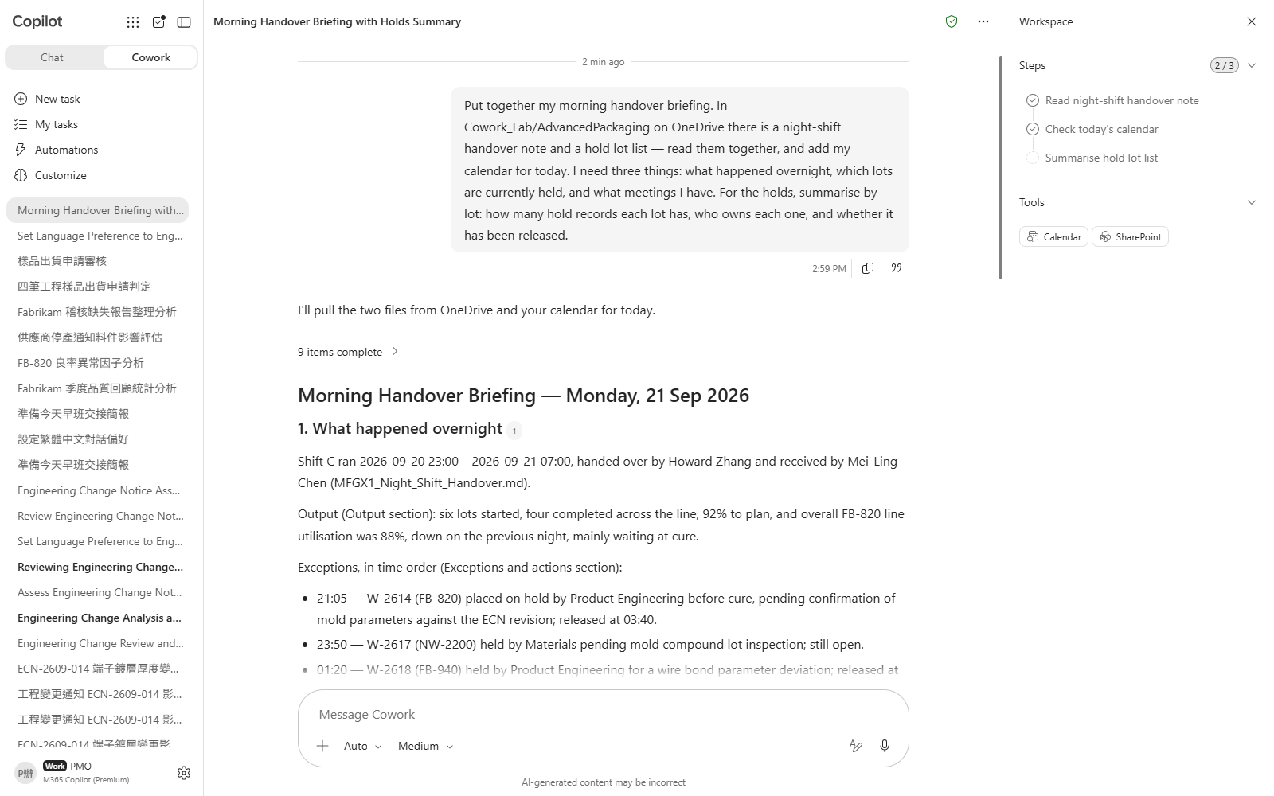
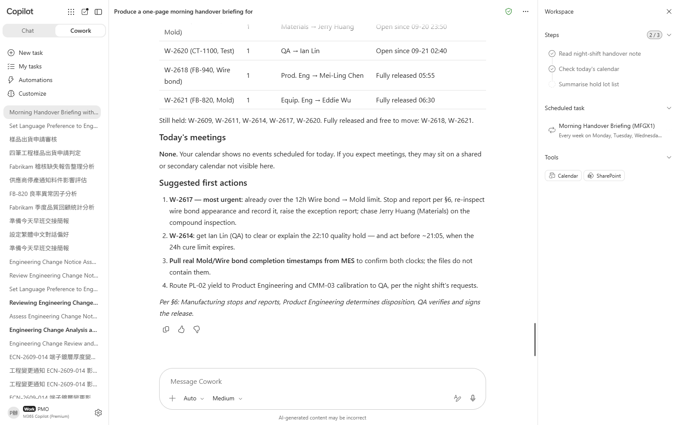

Scenario 01 · Live demo
What Cowork does, and what it produces
① Your input and prompt
② The result
Check the output
Holds are summarised by lot, not just the eight rows copied out
It spots that W-2614 carries two holds while the handover note mentions only one
It says plainly that the engineering hold is cleared but the quality hold is not — not a vague "the records disagree"
Microsoft 365 Copilot Cowork
9

Slide 11
Scenario 02
Six FB-820 lots have come in under 92% over the past fortnight, more than five points below the normal lots. The line's first instinct is "we changed substrate lot". Lay all twelve lots side by side and the common factor turns out to be something else entirely — and the maintenance log has the fingerprint.
Agentic workflow
1
Upload the yield detail and let it find the common factor
High-Tech Mfg · Product Engineering
Drag MFGX2_FB820_Lot_Yield_Detail.csv into the chat box …
A Yield Excursion Whose Common Factor Is Not the Obvious One
2
With the factor pinned down, go back to the maintenance log
Keep going in the same session.。
3
Produce the root-cause workbook
⏱ ~18 min · Level ★★★
The file appears under Output folder in the side panel a…
File upload
Excel
4
Make a summary card you can read in three seconds
Enterprise Search
The card renders inline in the conversation — it is not …
Adaptive Cards
5
Post it to the quality war-room channel
Communications
An approval card appears showing the full text of the po…
Microsoft 365 Copilot Cowork
10

Slide 12
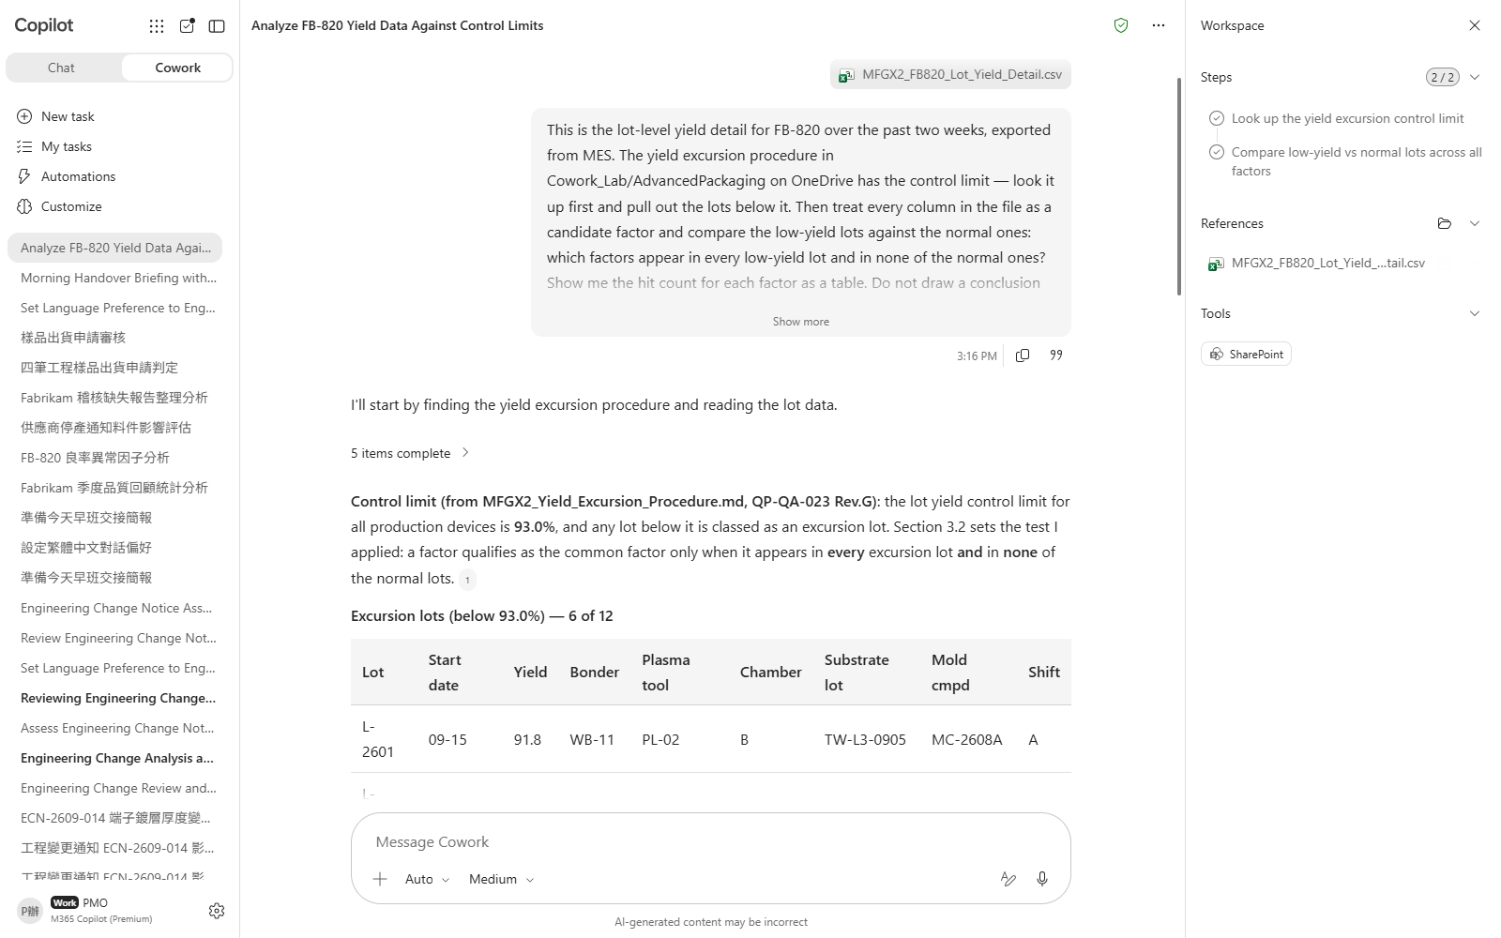
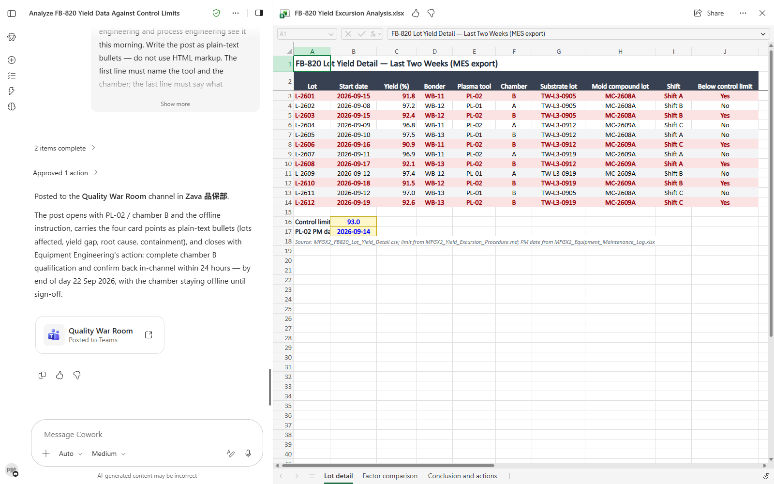

Scenario 02 · Live demo
What Cowork does, and what it produces
① Your input and prompt
② The result
Check the output
It looked the control limit up in the procedure instead of taking the rough 92% from the conversation
All six low-yield lots are identified — none missed, none added
The comparison runs both ways — not just what the bad lots share, but whether the good lots share it too
Microsoft 365 Copilot Cowork
11

Slide 13
Scenario 03
The quarterly business review with Fabrikam is next week. Fourteen complaints this quarter, thirteen closed — a 92.9% closure rate, which presents nicely. The trouble is the customer can do that arithmetic too. What they will actually ask about is something else, and the answer is hiding inside the thirteen you closed.
Agentic workflow
1
Start with the complaint statistics for the quarter
High-Tech Mfg · Product Engineering
Nothing to upload — everything is in Cowork_Lab/Advanced…
Quarterly Business Review: What the Closure Rate Hides
2
Check for repeat failure modes, as the standard requires
Keep going in the same session.。
3
Work out the risk forecast: where the next one lands
⏱ ~20 min · Level ★★★
Keep going in the same session.。
PowerPoint
Excel
4
Build the QBR deck to the six required sections
Enterprise Search
The deck appears under Output folder in the side panel a…
Communications
Email
5
Send the quality manager a review request
Address it to yourself or a colleague agreed in advance.…
Microsoft 365 Copilot Cowork
12

Slide 14
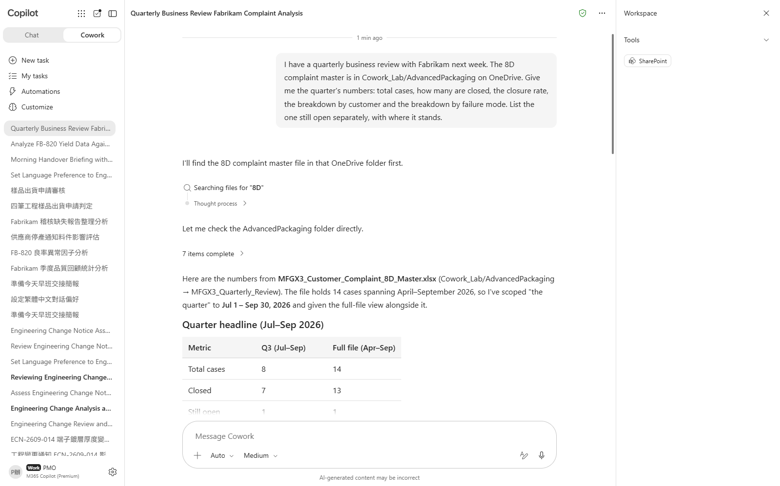
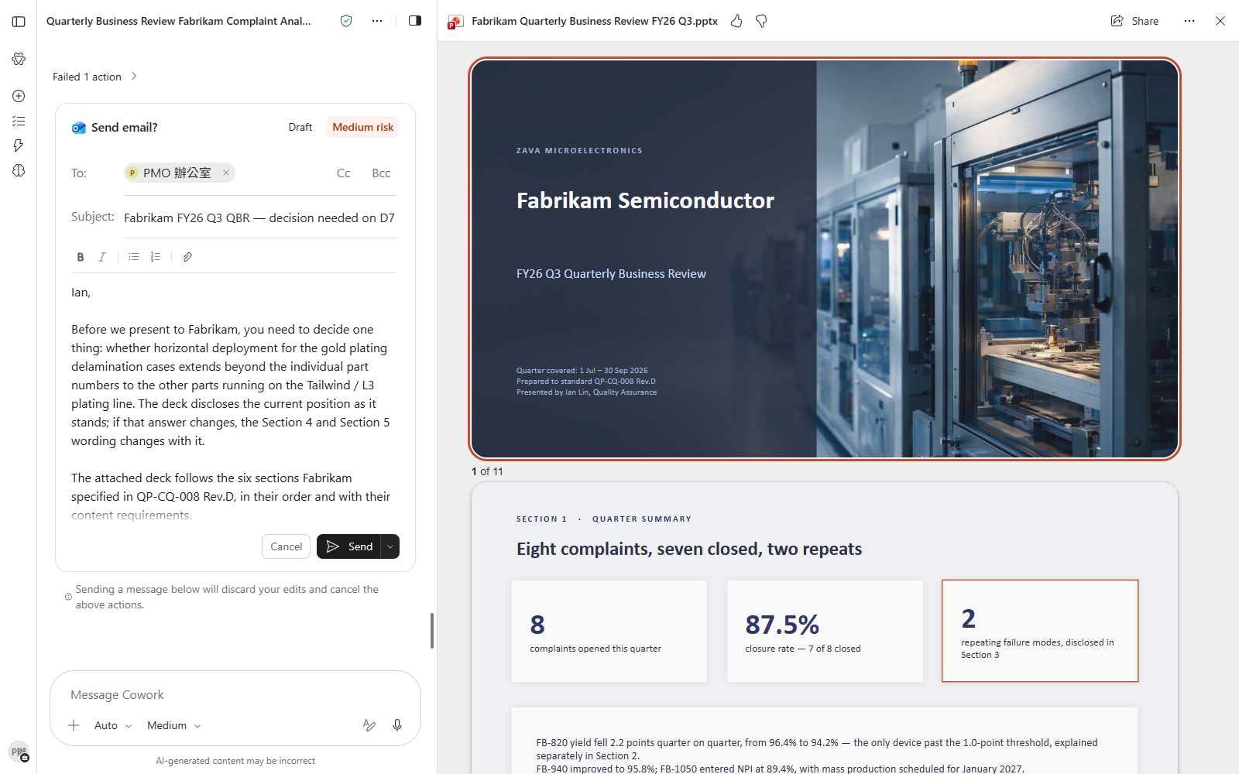

Scenario 03 · Live demo
What Cowork does, and what it produces
① Your input and prompt
② The result
Check the output
The closure rate is 13 of 14, 92.9% — the open case is not counted as closed
It found in the QBR standard that section three also has to disclose repeating failure modes
It picks out that substrate gold-plating delamination occurs three times, rather than letting it disappear into the spread of fourteen cases
Microsoft 365 Copilot Cowork
13

Slide 15
Scenario 04
The gold wire supplier has issued a discontinuation notice with a last time buy of 30 November 2026. You have 1,250 spools and burn 88 a month, so there is over a year of cover and nothing to worry about — until you open the BOM and find the part is also attached to a product that has not started production yet.
Agentic workflow
1
Do one assessment by hand, to see what the job involves
High-Tech Mfg · Product Engineering
Nothing to upload. The PCN is in your inbox; the BOM and…
Assess Every Discontinuation Notice the Moment It Lands
2
Recalculate as the standard requires — count the product not yet in production
Keep going in the same session.。
3
Work out the last time buy quantity and the timeline
⏱ ~20 min · Level ★★★
Keep going in the same session.。
Event trigger
Email
4
Arm the trigger so the next PCN assesses itself
Excel
Enterprise Search
A Set up trigger? card appears with three fields: When (…
5
Send the second mail and prove the trigger fires
Only now send yourself MFGX4_Trigger_Test_Email.md, copy…
Microsoft 365 Copilot Cowork
14

Slide 16
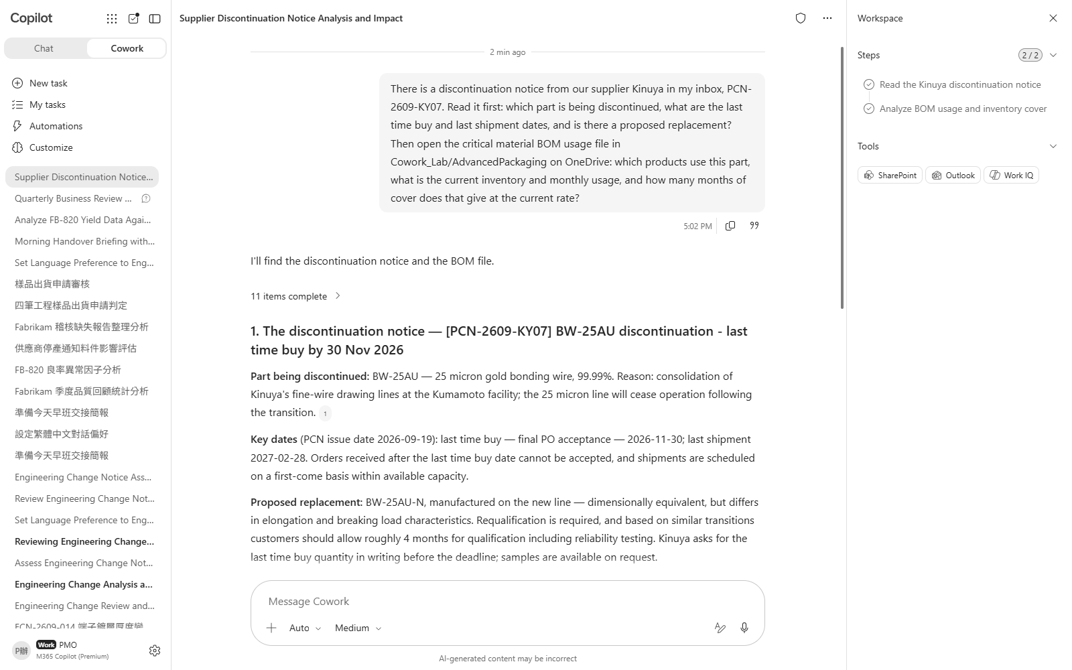
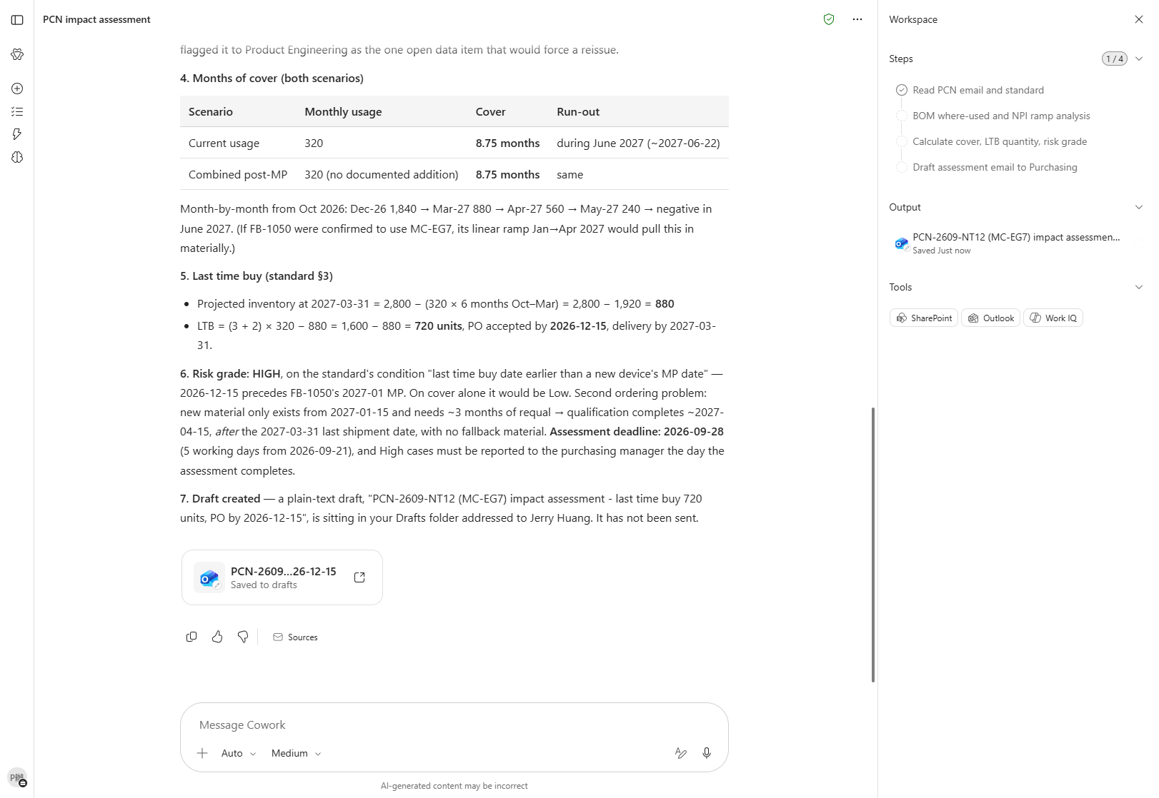

Scenario 04 · Live demo
What Cowork does, and what it produces
① Your input and prompt
② The result
Check the output
The first pass gives roughly fourteen months of cover, consistent with inventory divided by current monthly usage
It goes and reads the PCN handling standard for the requirements instead of waiting to be told what to calculate
It spots that where-used lists three products while current usage covers only two, and names the missing one
Microsoft 365 Copilot Cowork
15

Slide 17
Scenario 05
Fabrikam's audit has left you a PDF with eight findings spread across document control, wire bond, mold and shipping, and a corrective action plan due in ten working days. The instinct is to answer them one by one — under the customer's own response standard, that gets the whole submission rejected.
Agentic workflow
1
Upload the audit report and turn it into a table
High-Tech Mfg · Product Engineering
Drag MFGX5_Fabrikam_Audit_Findings_Report.pdf into the c…
Eight Audit Findings That Look Like Eight Problems
2
Check each one against the procedure: not written, or written and ignored?
Keep going in the same session.。
3
Find the common root cause: how many problems are these really?
⏱ ~20 min · Level ★★★
Keep going in the same session.。
File upload
PDF
4
Produce the CAP to the response standard
Enterprise Search
Word
The Word file appears under Output folder in the side pa…
Scheduling
5
Schedule the cross-functional CAP review
Attendees come from the audit response contact list — th…
Microsoft 365 Copilot Cowork
16

Slide 18
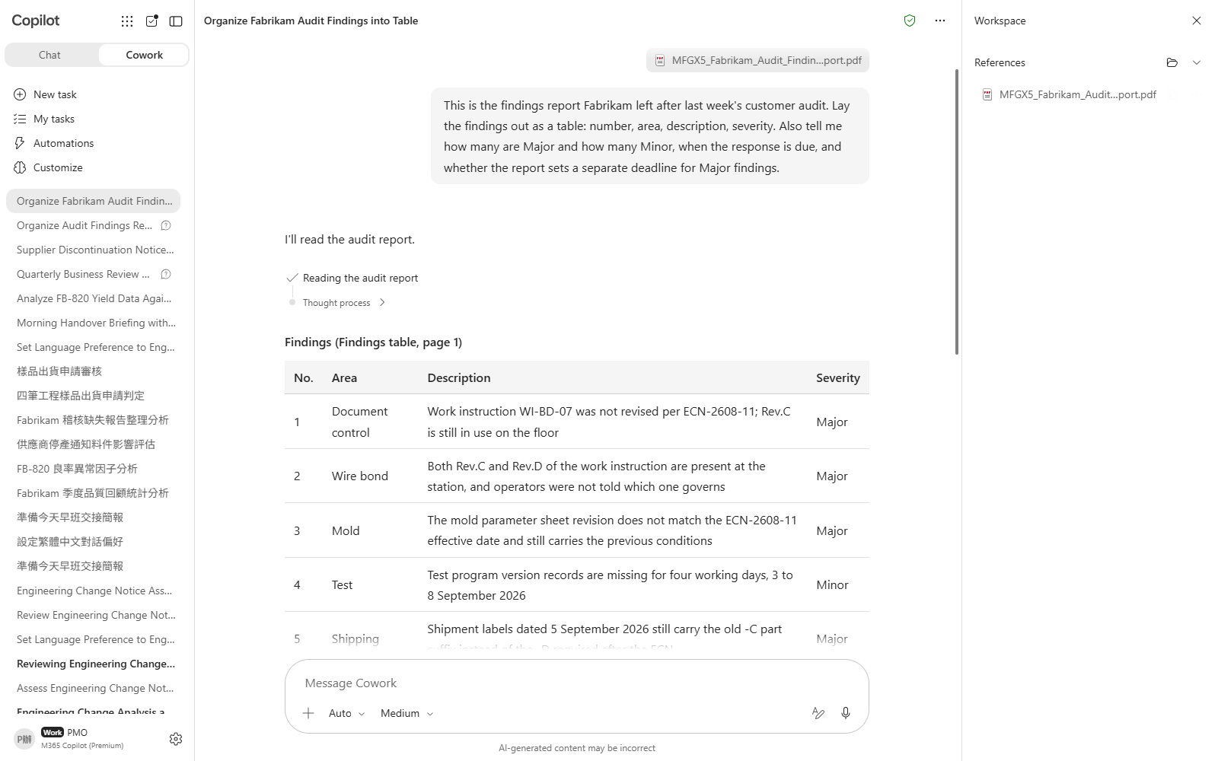
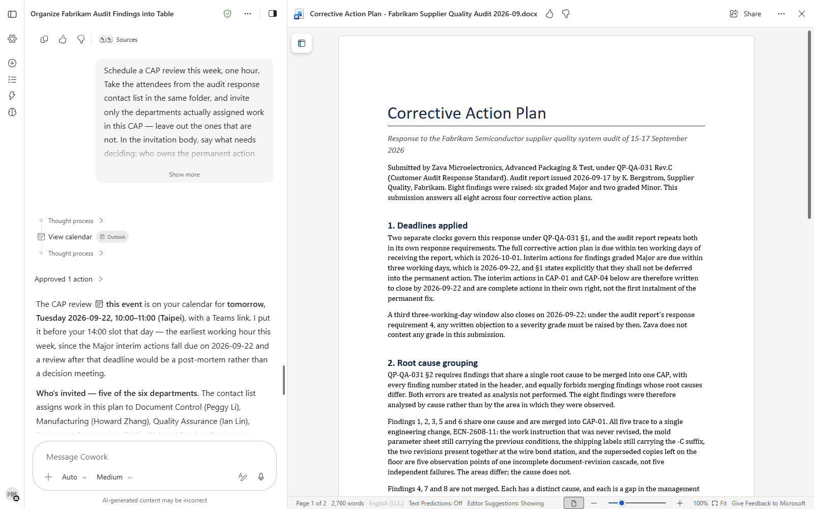

Scenario 05 · Live demo
What Cowork does, and what it produces
① Your input and prompt
② The result
Check the output
All eight findings are extracted, including the ones buried mid-paragraph
The Major and Minor counts are right, and both the response deadline and the interim-action deadline for Majors are picked up
It separates written-but-not-followed from not-written-at-all, rather than lumping everything together
Microsoft 365 Copilot Cowork
17

Slide 19
Scenario 06
Engineering sample release means rereading the criteria every single time. One of today's four requests is annotated "customer approval obtained in writing" — the approval genuinely exists, and the request still cannot be released. Once you have worked through them, turn the criteria into a skill.
Agentic workflow
1
Upload the requests and rule on them one by one
High-Tech Mfg · Product Engineering
Drag MFGX6_Sample_Shipment_Requests_0921.csv into the ch…
Sample Release Checks, Turned into a Lasting Asset
2
Ask about the second one: the customer agreed, so why not?
Keep going in the same session.。
3
Turn the criteria into a custom skill
⏱ ~22 min · Level ★★★
⚠️ Custom skills are not supported on mobile. Do this in…
File upload
Excel
4
Read the skill report it produces by itself
Enterprise Search
Cowork evaluates the skill automatically after creating …
Custom skill
5
Start a fresh session and prove the skill loads
Go back to the home page and start a completely new sess…
Microsoft 365 Copilot Cowork
18

Slide 20
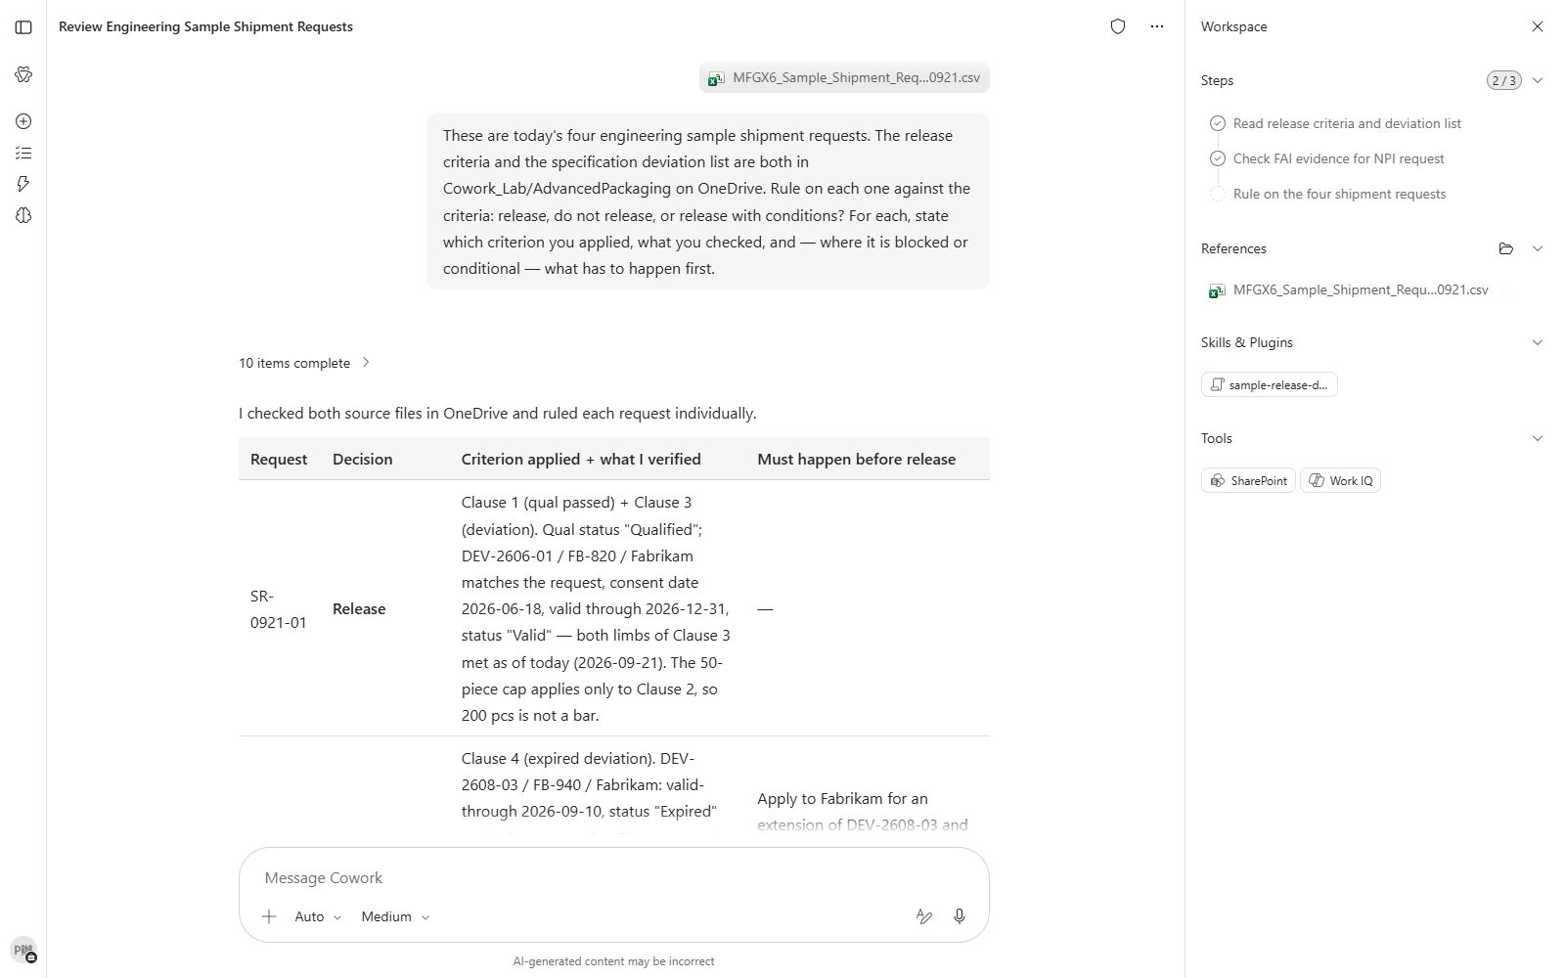
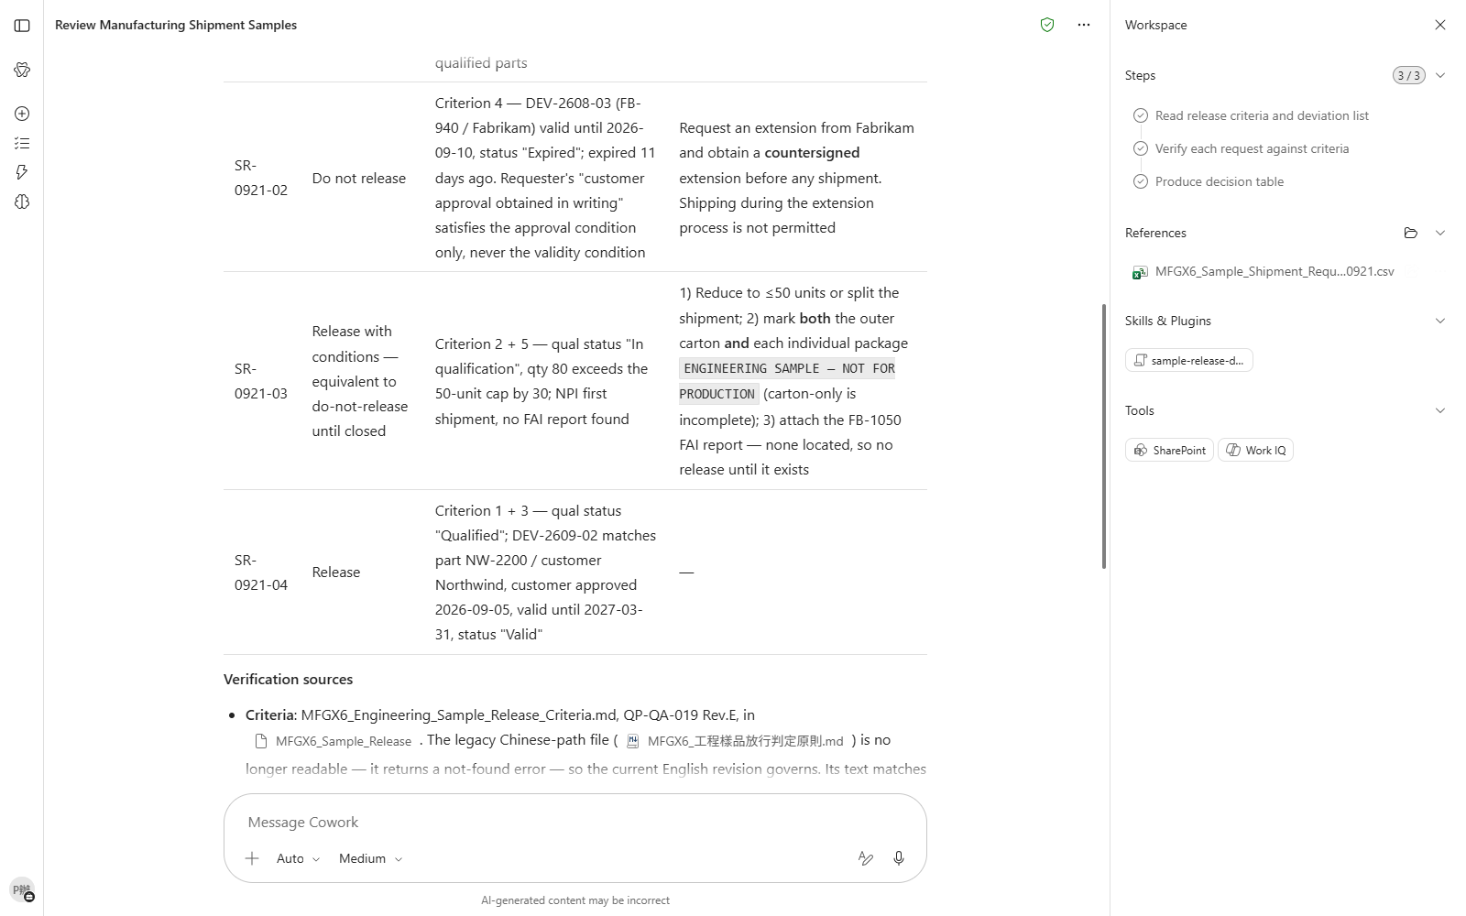

Scenario 06 · Live demo
What Cowork does, and what it produces
① Your input and prompt
② The result
Check the output
All four get a clear verdict — none fudged or punted to "needs manual review"
The second is blocked — it does not take the requester's "customer approval obtained" note at face value
It articulates that a valid customer approval and a deviation still inside its validity period are two separate conditions
Microsoft 365 Copilot Cowork
19

Slide 21
MAKE IT YOURS
Extend it to your own work
High-Tech Mfg · Product Engineering
💡 Change the calendar section to "only meetings where I have to decide something today" and see how it judges which ones those are.
High-Tech Mfg · Product Engineering
💡 Add two more lots that used the same chamber but came out normal, and see whether it overturns its own conclusion.
High-Tech Mfg · Product Engineering
💡 Ask for two versions of the risk forecast — one for the customer, one for internal use — and compare how they differ.
High-Tech Mfg · Product Engineering
💡 Narrow the trigger to mail from specific supplier domains, so internally forwarded copies do not set it off.
High-Tech Mfg · Product Engineering
💡 Ask it to draft the missing clause for the change control procedure — buffer period, withdrawal timing and owner.
High-Tech Mfg · Product Engineering
💡 Add a rule warning when a deviation expires within 30 days, and see whether it flags the next one early.
Microsoft 365 Copilot Cowork
20

Slide 22





TRUST & CONTROL
Automated — but you're still the decision maker
Approval before action
Medium/high-risk actions show a RISK-LEVEL; sending mail, posting to Teams or creating meetings all open as an editable preview and go out only after approval.
Scope you control
Don't-ask-again can be limited to a recipient, a domain, or always; tasks can be soft/hard paused, resumed or cancelled.
Automated tasks have guardrails too
Scheduled prompts and event-driven tasks have run-frequency limits and loop protection; they always run with the creator's permissions, and are recorded in the unified audit log alongside all other Cowork activity, under Microsoft Purview policy.
Know the limits
No access to local files, no deleting OneDrive/SharePoint files, no reading encrypted files; attachments under 200MB; custom skills and third-party plugins aren't validated by Microsoft, so review the output yourself. Microsoft explicitly lists it as unsuitable where accuracy must be guaranteed without human review.
Microsoft 365 Copilot Cowork
21

Slide 23


Start practising now
Cowork Playbook
aka.ms/CoworkPlaybook
Start with the scenario closest to your own work
Custom skills live in OneDrive at /Documents/Cowork/skills/ as SKILL.md (up to 50, 1MB each)
Model picker: Auto (default), GPT 5.5 Frontier, GPT 5.6 Sol/Terra, GPT 6 Astra, Opus 5, Claude Sonnet 5, Claude Fable 5.1
Effort: Light / Medium (default) / High / Extra High / Max — higher is more thorough, but slower and uses more credits
Want it to fire by itself? Set a scheduled prompt (up to 25) or an event-driven task (incoming mail / @mention) on the "Automations" page

Slide 24
Thank you
From asking to delegating — you set the standard, Cowork does the work.
Microsoft 365 Copilot Cowork · Training deck

