Slide 1


Microsoft 365 Copilot
Cowork
Agentic AI at work
Seven real civic-services scenarios showing how Copilot executes across apps, shows a risk level before medium/high-risk actions, and waits for your approval
Training deck · client-ready

Slide 2
AGENDA
What we'll cover
01
Meet Cowork
What agentic AI is, and how it differs from Copilot Chat
02
Core capabilities
Skills, workspace, approval before action, self-verification
03
Set up your practice environment
Seed the material into OneDrive and your mailbox first, so Cowork finds it itself
04
Seven hands-on scenarios
Mailbox triage, continuity briefing, meeting follow-up, capacity planning, field evidence, accessible procedure, readiness briefing — one workflow at a time
05
Make it your own
How to extend these scenarios to your own work
Microsoft 365 Copilot Cowork
1

Slide 3



WHAT IS COWORK
From "chat" to "agentic execution"
Cowork is Copilot's agentic working mode.
You hand it a goal; it breaks the work into steps, reads your cloud files, loads the skills it needs, produces results across apps and checks its own work — pausing for your approval, with a risk level shown, before any medium or high-risk action. You move from quick single-turn answers to handing over a task that actually gets done.
Copilot Chat
Cowork agent
You stay in charge
Quick single-turn answers; great for instant replies and brainstorming.
You give a goal; it executes autonomously across apps, for minutes to hours.
Anything outbound or affecting others pauses for your approval.
Microsoft 365 Copilot Cowork
2

Slide 4
COMPARISON
Cowork vs. Copilot Chat
Copilot Chat
Copilot Cowork
Quick single-turn Q&A
Quick single-turn Q&A
Hand over a goal; autonomous multi-step work across apps
Seconds to minutes
Seconds to minutes
Minutes to hours (autonomous)
Single step, single session
Single step, single session
Multi-step workflows across tasks and sources
Paste in a snippet
Paste in a snippet
Reads cloud attachments and creates new files; no access to local files
One conversational capability
One conversational capability
Loads 14 built-in skills plus your custom ones automatically
Text in the chat window
Text in the chat window
Real documents, spreadsheets and decks in OneDrive
You have to open it and prompt every time
You have to open it and prompt every time
Scheduled prompts / event-driven: runs on incoming mail or an @mention
Grounded in M365 data
Grounded in M365 data
Connects to external systems via Plugins / MCP — the partner catalogue now lists 92 plugins (D365, SAP, Fabric and more)
You judge for yourself
You judge for yourself
Medium/high-risk actions show a risk level and run only after approval
Microsoft 365 Copilot Cowork
3

Slide 5




CORE CAPABILITIES
Four things that set Cowork apart
14 built-in skills
Workspace
Word, Excel, PowerPoint, PDF, Email, Scheduling, Calendar Management, Meetings, Daily Briefing, Enterprise Search, Deep Research, Communications, Adaptive Cards, App (Frontier).
The side panel shows progress, input files, output files, loaded skills, schedules and granted permissions all at once — the process stays traceable.
Approval before action
What's new
Medium/high-risk actions show a RISK-LEVEL; approve, cancel, or set don't-ask-again per recipient, per domain or always; multiple pending actions can be approved together.
Scheduled prompts (up to 25) and event-driven tasks; five Effort levels to balance quality against cost; every custom skill gets an automatic Skill Report (0–100 across four dimensions, plus five separate gates including a Safety and RAI scan); local Edge browser (GA since Aug 2026); image generation; Plugins / MCP for external systems.
Microsoft 365 Copilot Cowork
4

Slide 6




HOW IT WORKS
What happens inside one agentic workflow
Take the goal
Plan
Load skills
Execute
Self-verify
Approval before action
Upload files
Give the instruction
Understand the task
Break it into steps
14 built-in
+ custom
Create documents
spreadsheets / mail
Check the numbers
and consistency
Outbound actions
wait for you
The whole process is visible in the "Workspace" panel; you can soft/hard pause, resume or cancel a task.
It doesn't only start from chat: you can also have it fire automatically when a matching email arrives or you're @mentioned (event-driven tasks) — with the same self-verification and approval flow.
Microsoft 365 Copilot Cowork
5

Slide 7

BEFORE YOU START
Set up your practice environment
Seed the material into OneDrive under Documents/Cowork_Lab/CivicServices/ before the session, and Cowork will find it itself · Setup time about 25 minutes
📅
⚠️ Understand how dates work in this material first
📁
Create the OneDrive folders and upload the material for all seven scenarios
The dates in this material are fixed simulated dates: ea…
Create Documents/Cowork_Lab/CivicServices/ in OneDrive w…
📇
Fill in the owner directory's email column with addresses that really receive mail (gov1)
📬
Set up the shared service mailbox with the queue and routing guide in place (gov1)
GOV1_Service_Owner_Directory.md sits in the GOV1_Mailbox…
Make sure you have a shared service mailbox (or designat…
📧
Do not send the gov1 trigger message before the session
📆
Create one calendar event with no attendees (gov4)
信箱_種入用/GOV1_Trigger_Test_Email.md is what gets sent into…
Using Outlook or OWA, create one placeholder existing ca…
💾
Put the three live-use files into OneDrive under _Upload
🗓️
gov3 needs a real operations meeting that has actually taken place — arrange it beforehand
GOV2_Disruption_Log.xlsx (gov2), GOV5_Field_Revisit_Repo…
gov3's core is real meeting notes or a transcript — do n…
Final check before the session
All seven subfolders under CivicServices exist in OneDrive and the files open
_Upload holds the three live-use files (or you plan to drag them in by hand at that step)
The owner directory sits in the GOV1 subfolder with addresses that actually receive mail, not the placeholder
Microsoft 365 Copilot Cowork
6

Slide 8







7 SCENARIOS
Seven hands-on scenarios
Civic Services · Public Request Handling
Civic Services · Service Continuity
Civic Services · Operations Management
Civic Services · Capacity Planning
Civic Services · Field Inspection
Civic Services · Service Design
Civic Services · Readiness Management
Service Mailbox Triage: Is the Most Urgent-Sounding Message Really Closest to Breaching?
Continuity Briefing: Is the Channel With the Most Incidents the Biggest Continuity Risk?
Meeting Follow-up: Is an Action Marked “Complete” Really Accepted?
Capacity Planning: Does Matching Total Qualified Hours Mean Every Interval Is Covered?
Field Evidence Reconciliation: Can Two Visits to the Same Site Be Merged Into One Record?
Accessible Procedure: Is the Service Fully Accessible Once the Counter Is Fixed?
Readiness Briefing: Does an Agency-Wide Pass Mean Every Location Is Fine?
Excel · Scheduling …
PDF · Excel · Enterprise Search
Daily Briefing · Excel …
PowerPoint · Word …
Meetings · Enterprise Search …
Word · PDF …
Email · Enterprise Search …
~18 min
★★☆
~16 min
★★☆
~18 min
★★☆
~20 min
★★★
~18 min
★★☆
~20 min
★★★
~15 min
★★☆
Microsoft 365 Copilot Cowork
7

Slide 9

Scenario 01
A shared service mailbox fills up overnight, and the sender's own “urgent” flag is the most visible signal — but each service program carries a different response-time promise, so self-flagged urgency and actually running out of time are two different things. To make it worse, a message just arrived sounding urgent but naming no service program at all — its clock can't even be started until that is cleared up.
Civic Services · Public Request Handling
Service Mailbox Triage: Is the Most Urgent-Sounding Message Really Closest to Breaching?
Agentic workflow
1
Rank the existing queue by time remaining
Nothing to upload — the files are already on OneDrive.。
⏱ ~15 min · Level ★★☆
2
The real trigger message arrives: no identifier, so don't assume the service program
Email
Enterprise Search
Live demo: at this point the instructor sends a new requ…
Communications
Adaptive Cards
What to watch Reading the routing guide, owner directory and existing …
Event trigger
Microsoft 365 Copilot Cowork
8

Slide 10
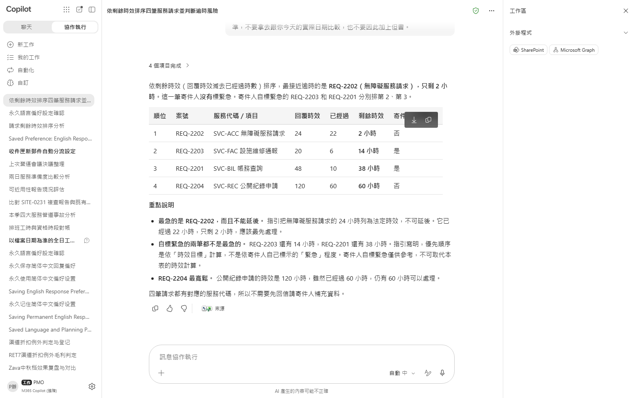
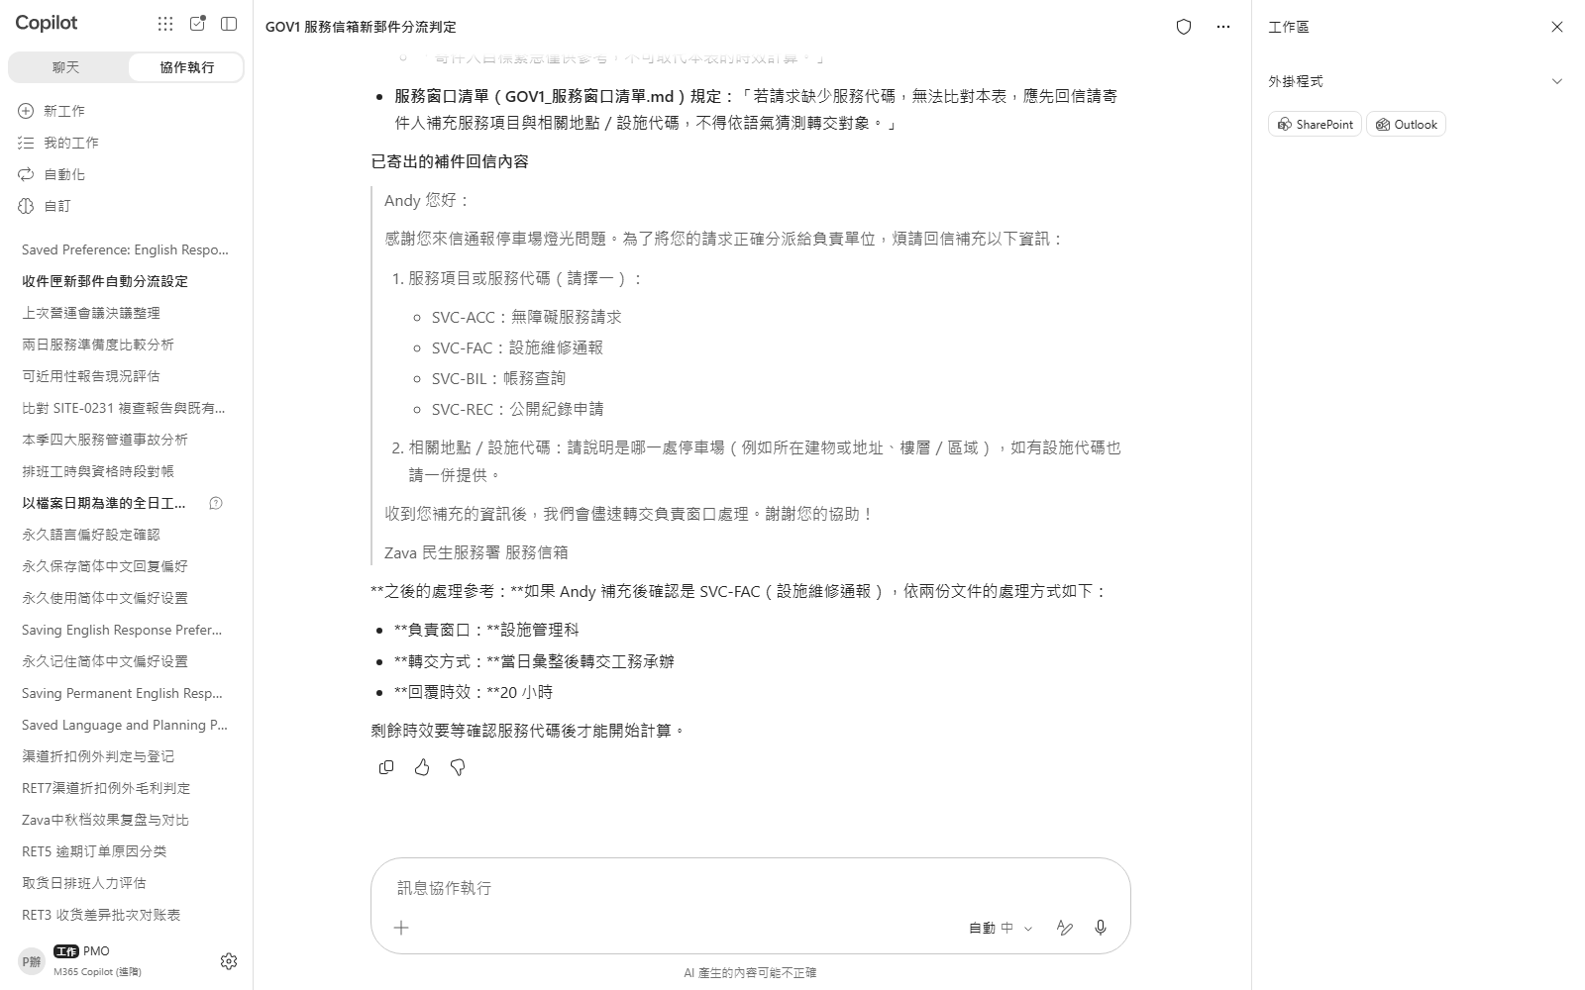

Scenario 01 · Live demo
What Cowork does, and what it produces
① Your input and prompt
② The result
Check the output
The remaining-time ranking is computed correctly (target minus elapsed), not just the sender's flag
The accessibility request closest to breaching is correctly identified — not either self-flagged item
The new trigger message is not routed on tone alone — it is first flagged for missing identifiers
Microsoft 365 Copilot Cowork
9

Slide 11

Scenario 02
All four service channels (counter, phone, online portal, mobile outreach unit) had disruptions this quarter, and phone has the most incidents — it looks like the obvious place to invest in continuity. But incident count isn't the same as impact when there's no alternative: three channels back each other up, and the one channel with no backup at all, serving residents who have no other option, actually has the fewest incidents of the four.
Civic Services · Service Continuity
Continuity Briefing: Is the Channel With the Most Incidents the Biggest Continuity Risk?
Agentic workflow
1
Upload this quarter's incident log and check it against the continuity checklist
Upload GOV2_Disruption_Log.xlsx into the chat and send t…
⏱ ~18 min · Level ★★☆
2
Turn the conclusion into a frontline deck, with the right priority on the decision page
PowerPoint
Word
After reviewing the gap analysis, send the prompt below …
Enterprise Search
What to watch Reading the checklist and prior record is read-only, so …
Microsoft 365 Copilot Cowork
10

Slide 12
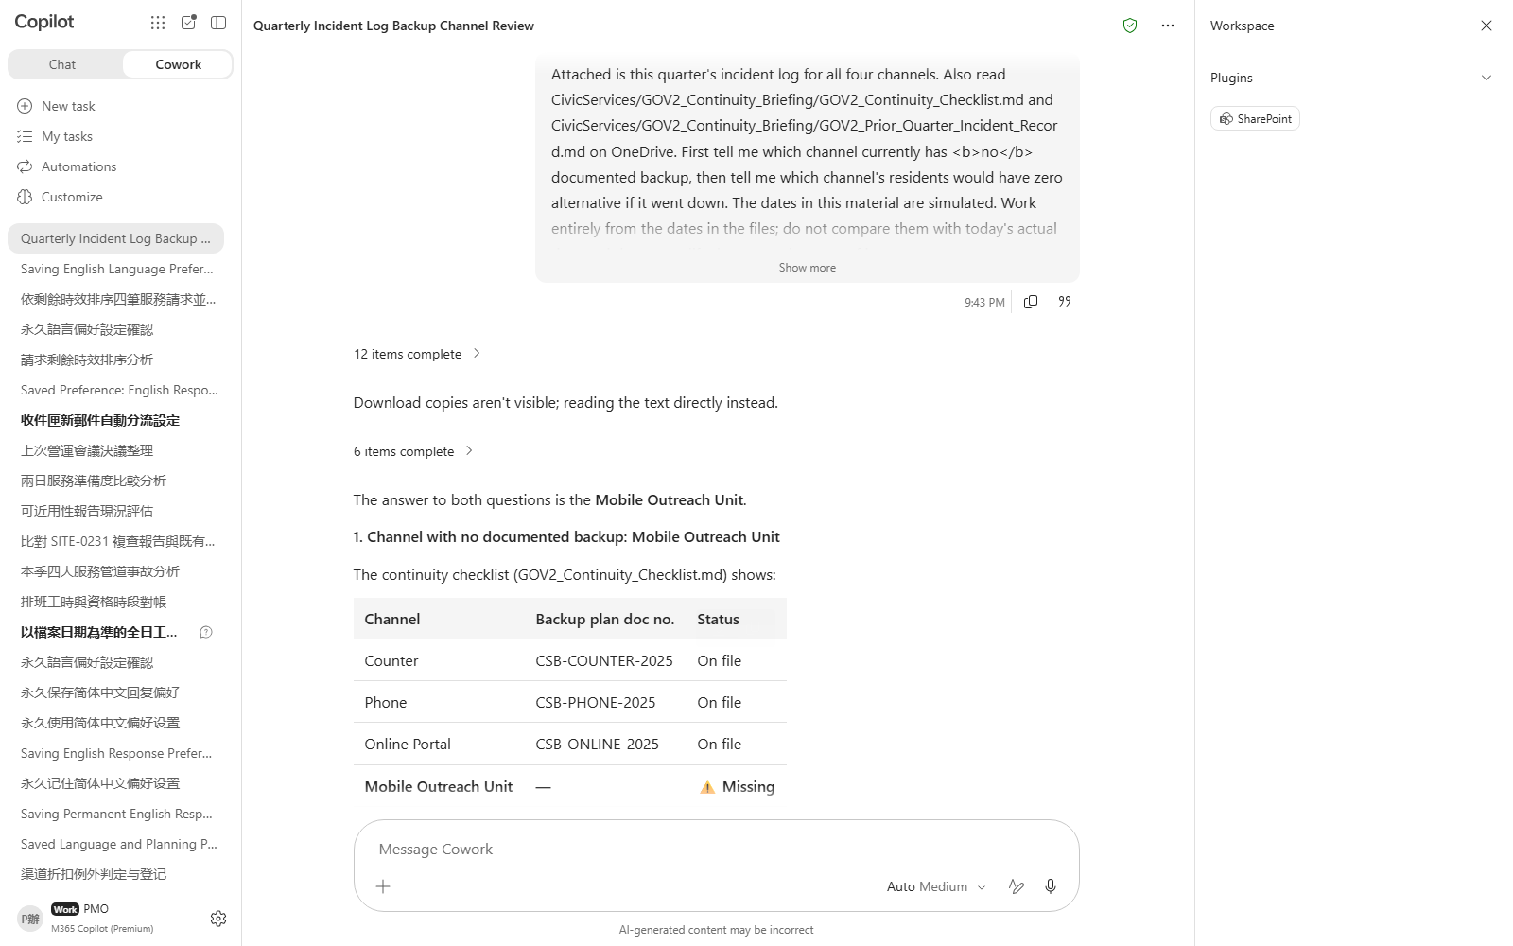
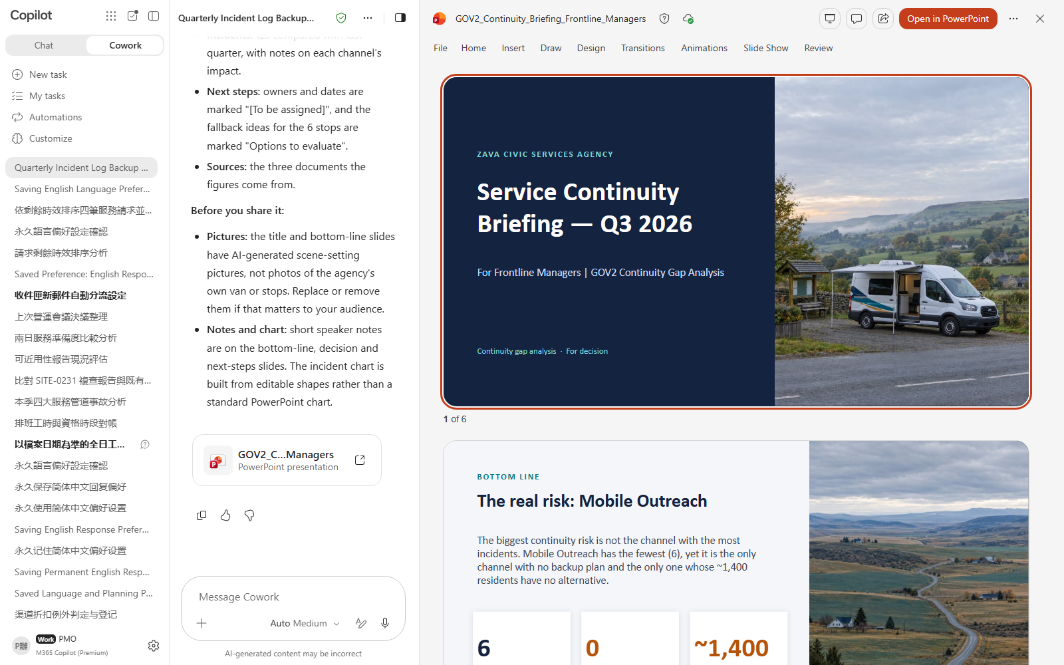

Scenario 02 · Live demo
What Cowork does, and what it produces
① Your input and prompt
② The result
Check the output
Correctly identifies the channel with no documented backup (mobile, not phone)
Correctly treats the channel with the most incidents but an existing backup (phone) as not the continuity priority
The deck's decision-page priority is ordered by backup status and no-alternative population, not by incident count
Microsoft 365 Copilot Cowork
11

Slide 13

Scenario 03
Four actions from the last operations meeting — three marked “complete” by their owners, which looks ready to close out. But the procedure requires different proof for different action categories: a physical-installation action needs an install-confirmation record, a system-change action needs a post-change screenshot. One “complete” action has only a purchase order attached — not install confirmation — so marked complete does not mean it passed acceptance.
Civic Services · Operations Management
Agentic workflow
Meeting Follow-up: Is an Action Marked “Complete” Really Accepted?
1
Read the real meeting record and separate decisions from open questions
Nothing to upload — Cowork pulls the record from the ope…
2
Check acceptance evidence and surface the item that fails it
⏱ ~20 min · Level ★★★
Send the prompt below to reconcile the tracker against t…
Meetings
3
After approval, update the tracker and prepare a follow-up communication
Once the judgment checks out, send the prompt below to u…
Enterprise Search
Word
Communications
What to watch Reading the meeting record, procedure and tracker is rea…
Microsoft 365 Copilot Cowork
12

Slide 14
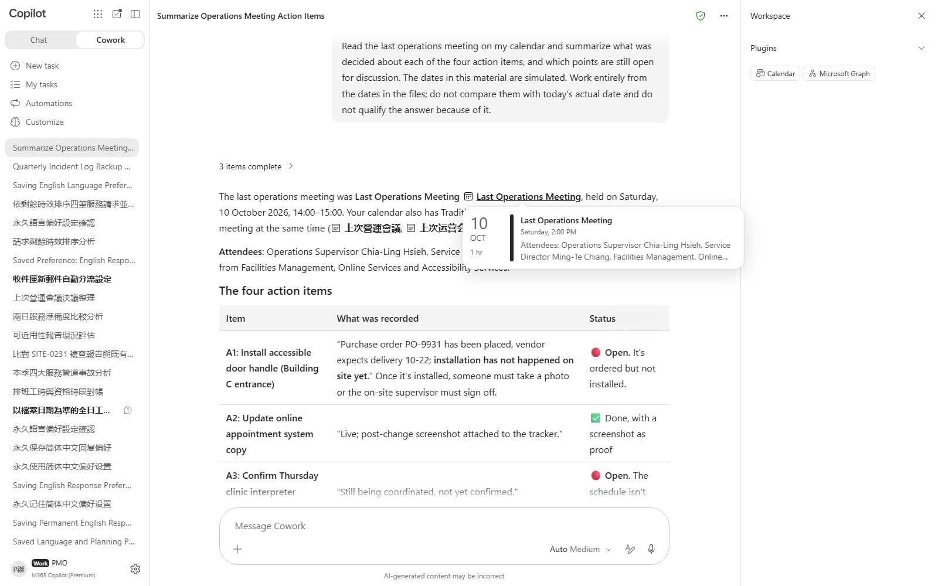
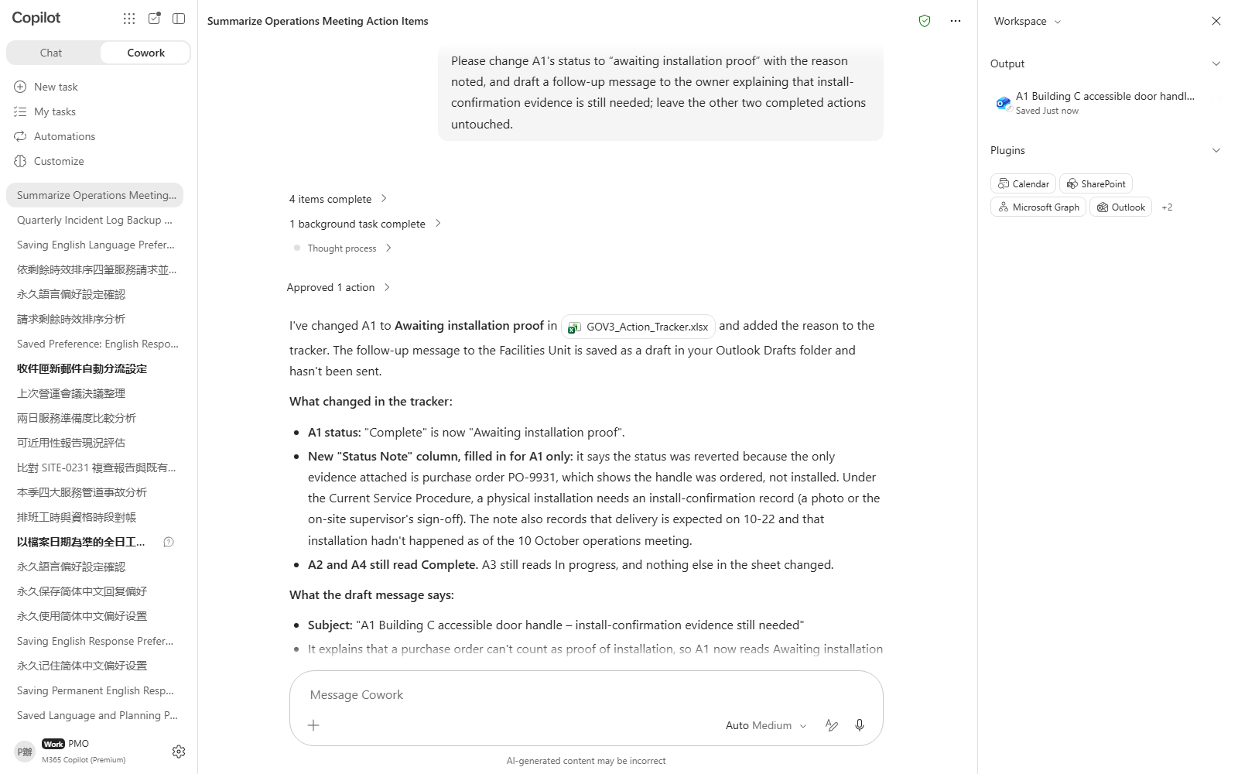

Scenario 03 · Live demo
What Cowork does, and what it produces
① Your input and prompt
② The result
Check the output
Correctly identifies A1 as the only “complete” action whose evidence fails acceptance
The judgment is based on whether evidence type matches the category's requirement, not merely whether an attachment exists
The other two “complete” actions are not mistakenly reopened along with A1
Microsoft 365 Copilot Cowork
13

Slide 15

Scenario 04
On the day of the identity-verification service, qualified staff's total scheduled hours (7.5) exactly match the demand hours (7.5), which looks like enough coverage. But matching in aggregate does not mean every interval is covered — in the half-hour shift-change gap, qualified coverage drops to zero, and that exact interval has two bookings requiring a qualified staff member.
Civic Services · Capacity Planning
Agentic workflow
Capacity Planning: Does Matching Total Qualified Hours Mean Every Interval Is Covered?
1
Read the existing workbook and check whether totals match in aggregate
Nothing to upload — the files are already on OneDrive.。
2
Check interval by interval and edit the workbook in place to flag the gap
⏱ ~18 min · Level ★★☆
Send the prompt below to check qualified coverage interv…
Excel
Scheduling
3
Find a feasible adjustment window and create the coordination meeting after approval
Once the gap is confirmed, send the prompt below to find…
Calendar Management
What to watch Reading the workbook and policy is read-only, so no appr…
Microsoft 365 Copilot Cowork
14

Slide 16
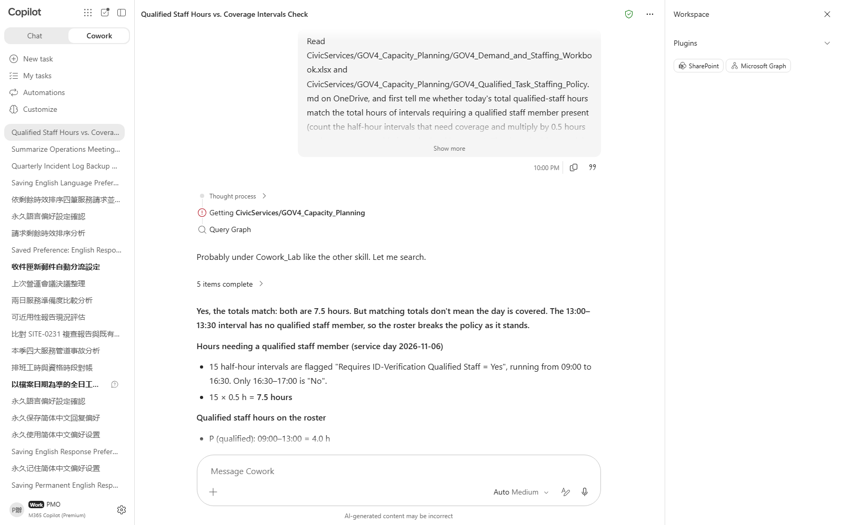
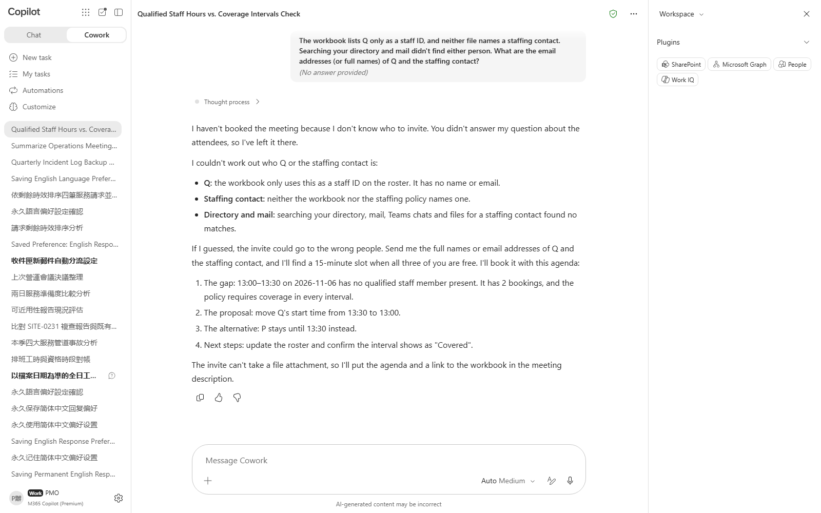

Scenario 04 · Live demo
What Cowork does, and what it produces
① Your input and prompt
② The result
Check the output
Correctly computes that total qualified hours match total demand hours (7.5h = 7.5h)
Correctly identifies the 13:00–13:30 gap with zero coverage and 2 bookings, rather than overlooking it because totals match
The workbook is edited in place and the original data is not lost
Microsoft 365 Copilot Cowork
15

Slide 17

Scenario 05
The same community center was visited twice, with the register already holding the first visit's open finding. Now the second-visit report (PDF) needs to be reconciled in. The location and nearby description are similar enough that it looks like a duplicate record of the same thing, but the second visit doesn't just re-check the first finding — it also surfaces a brand-new, separate issue with its own independent recheck deadline. Merging the two into one row would erase that new issue's tracking schedule.
Civic Services · Field Inspection
Field Evidence Reconciliation: Can Two Visits to the Same Site Be Merged Into One Record?
Agentic workflow
1
Upload the revisit report and have it check the visit history before deciding how to log it
Upload GOV5_Field_Revisit_Report.pdf into the chat and s…
⏱ ~16 min · Level ★★☆
PDF
Excel
2
After approval, update the register: close one row, open a new one
Once the judgment checks out, send the prompt below to u…
Enterprise Search
What to watch Reading the visit history and comparing the report is re…
Microsoft 365 Copilot Cowork
16

Slide 18
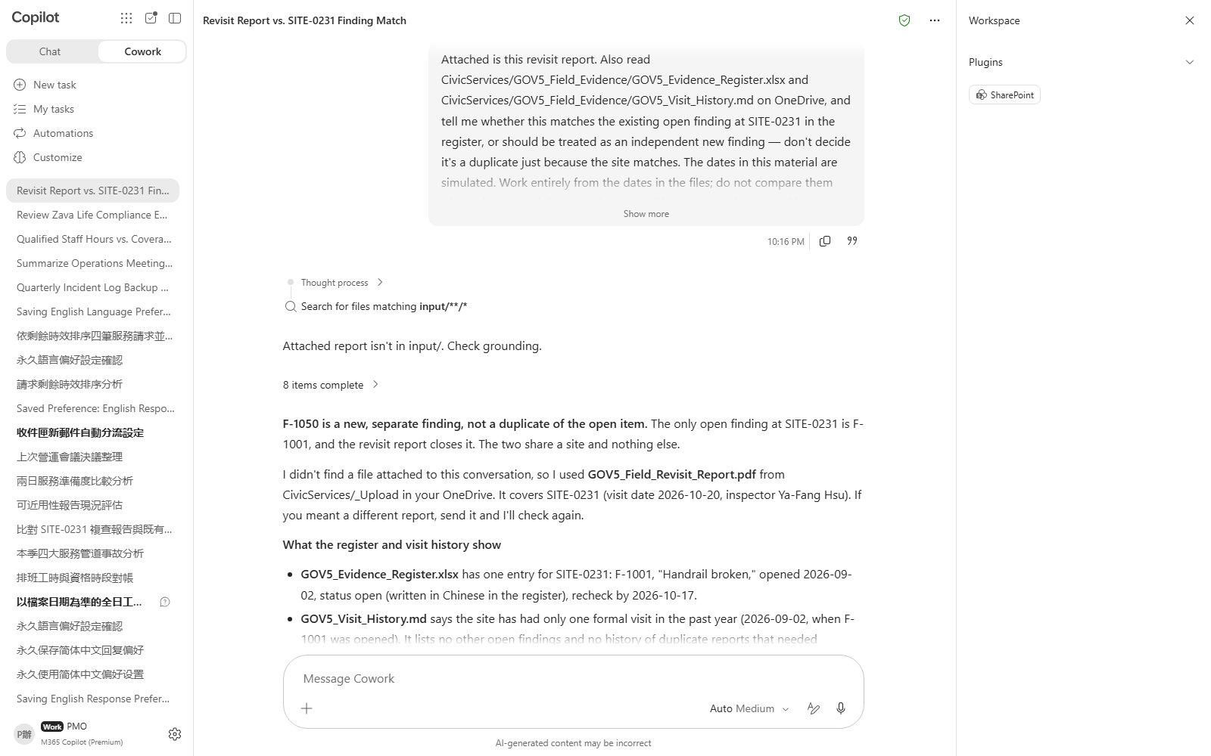
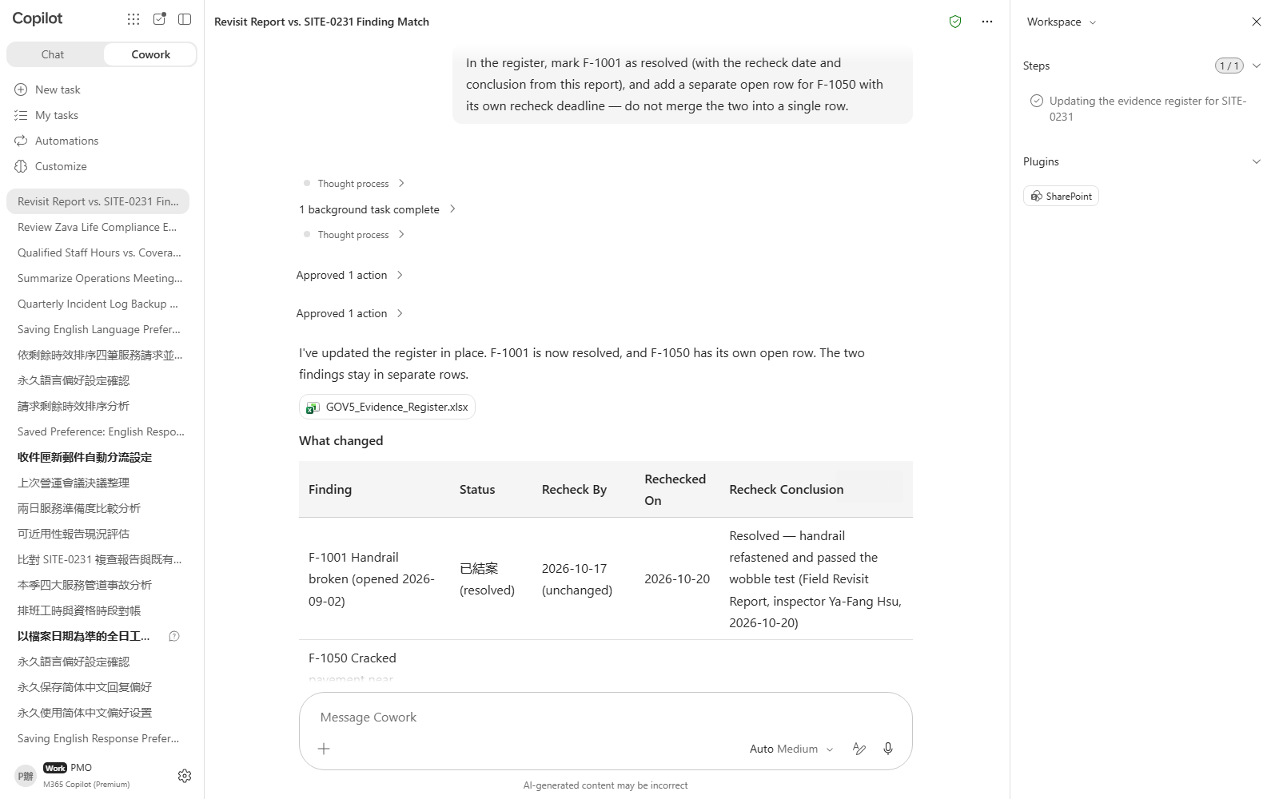

Scenario 05 · Live demo
What Cowork does, and what it produces
① Your input and prompt
② The result
Check the output
Correctly judges the two visits as independent events (F-1001 ≠ F-1050), not a duplicate of the same record
Correctly confirms the second visit resolved the first finding (F-1001)
The new finding has its own independent recheck deadline, not merged into the old finding's deadline
Microsoft 365 Copilot Cowork
17

Slide 19

Scenario 06
The accessibility review confirms the counter process now passes — a headline that reads like good news: “accessible.” But the body of the report separately flags two independent gaps in the online portal: the identity-verification video call has no captioning or interpreter option, and the document-upload button has no screen-reader text alternative. Fixing the counter does not make the whole service accessible — the two online gaps each need their own control, not one shared fix.
Civic Services · Service Design
Agentic workflow
Accessible Procedure: Is the Service Fully Accessible Once the Counter Is Fixed?
1
Upload the review and ask whether the conclusion is really “fully accessible”
Upload GOV6_Accessibility_Review_Report.pdf into the cha…
2
Write the two independent controls for the online portal and update the procedure
⏱ ~18 min · Level ★★☆
Send the prompt below to turn the two online gaps into s…
Word
PDF
3
After approval, draft two communications for two different audiences
Once the procedure update checks out, send the prompt be…
Communications
Email
What to watch Reading the review report is read-only, so no approval c…
Microsoft 365 Copilot Cowork
18

Slide 20
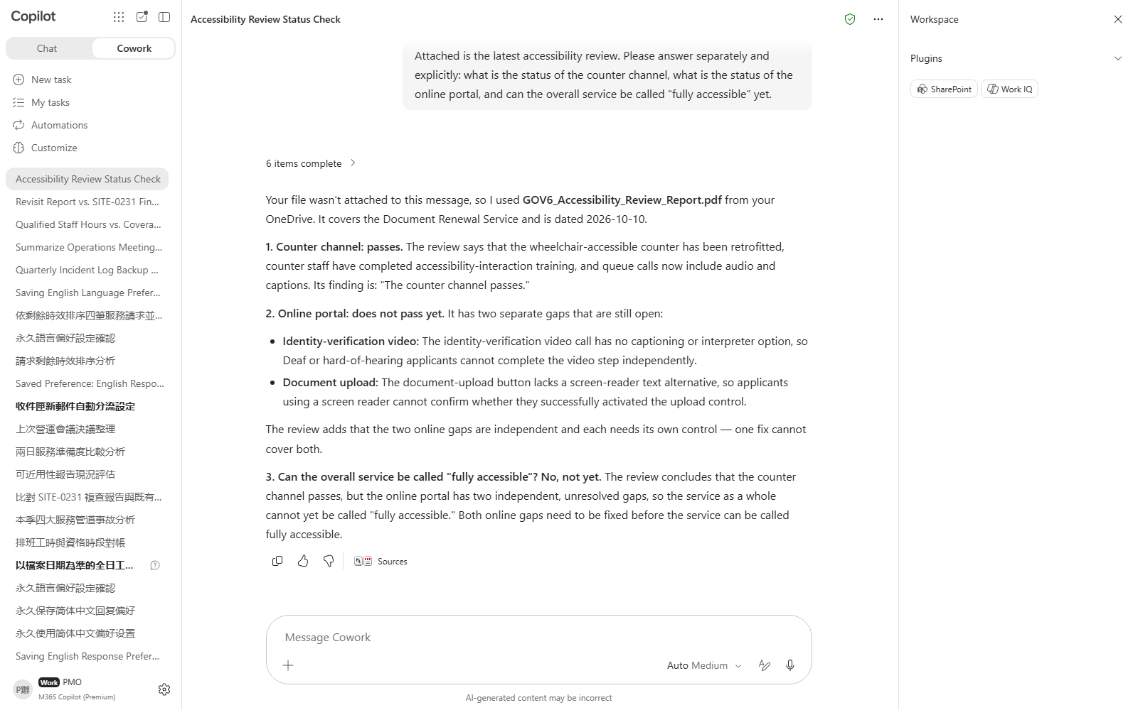
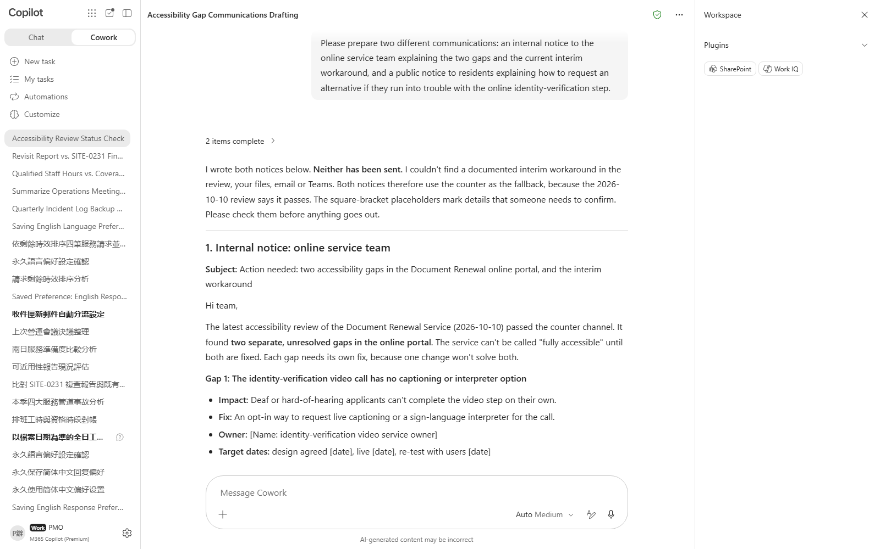

Scenario 06 · Live demo
What Cowork does, and what it produces
① Your input and prompt
② The result
Check the output
Correctly distinguishes “counter passes” from “overall service not yet accessible,” without being misled by the headline
Correctly lists the two independent online-portal gaps without collapsing them into one general statement
The procedure update contains two separate controls, each with an owner and timeline
Microsoft 365 Copilot Cowork
19

Slide 21

Scenario 07
The five locations' weighted-average readiness is 93.4%, above the agency-wide 90% threshold — which looks fine. But checking location by location, Location D sits at only 81%, below the 85% location floor on both sample days, a persistent problem; Location B dips to 70% on one day only, due to a one-off system outage — a transient problem. A passing weighted average hides the persistent problem, so the briefing can't just report one number.
Civic Services · Readiness Management
Agentic workflow
Readiness Briefing: Does an Agency-Wide Pass Mean Every Location Is Fine?
1
Manually check both days first, confirming the difference between persistent and transient problems
Nothing to upload — the files are already on OneDrive.。
2
Turn the method into a custom skill and test it on both days
⏱ ~20 min · Level ★★★
Send the prompt below to turn the judging logic into a r…
Daily Briefing
Excel
3
Schedule it to run daily, and inspect one actual run
Once the skill tests out, send the prompt below to sched…
Enterprise Search
Custom skill
What to watch Reading the two readiness files is read-only, so no appr…
Microsoft 365 Copilot Cowork
20

Slide 22
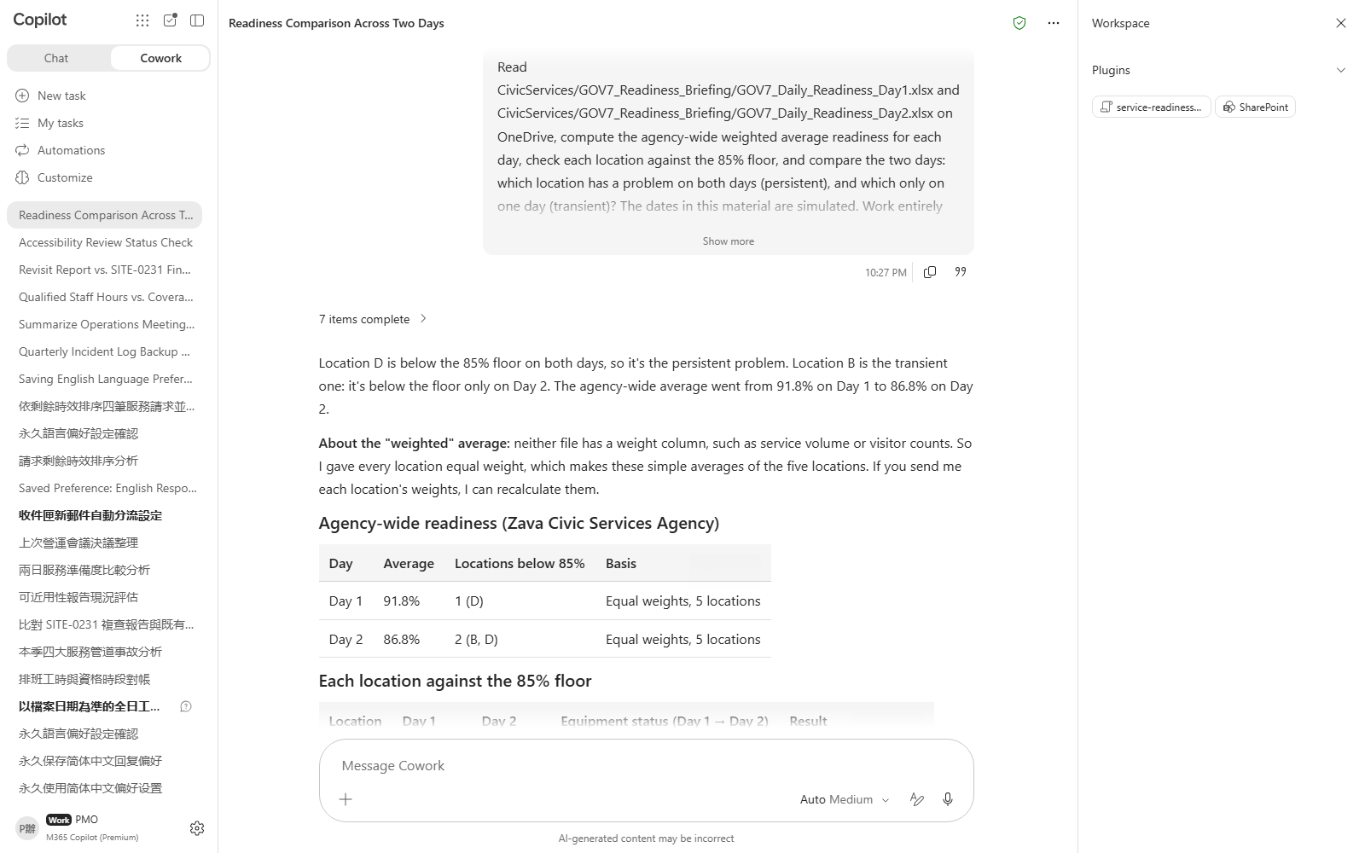
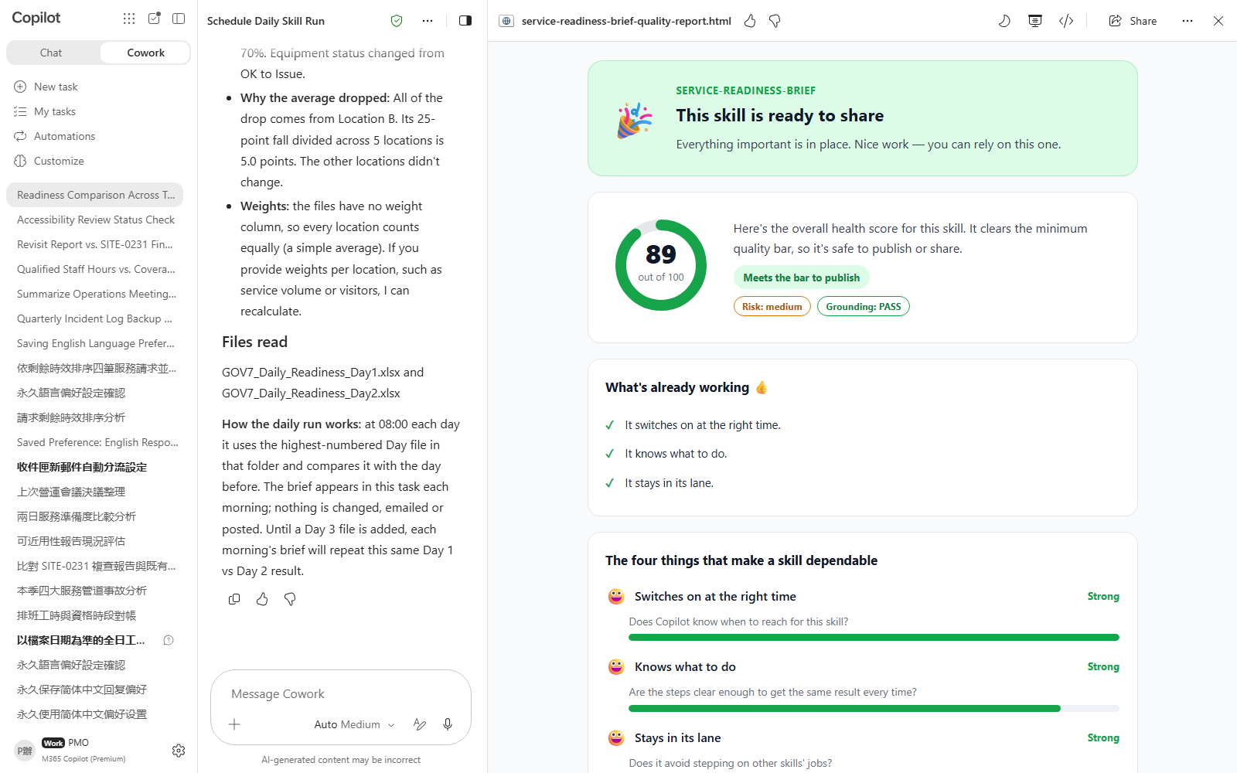

Scenario 07 · Live demo
What Cowork does, and what it produces
① Your input and prompt
② The result
Check the output
Correctly computes day 1's weighted average as 93.4% (above the 90% threshold)
Correctly identifies Location D as below the 85% floor on both days — a persistent problem
Correctly identifies Location B as below the floor only on day 2 — a transient problem, distinct from D
Microsoft 365 Copilot Cowork
21

Slide 23
MAKE IT YOURS
Extend it to your own work
Civic Services · Public Request Handling
💡 Swap in your own agency's service programs and SLA commitments, then re-rank the queue.
Civic Services · Service Continuity
💡 Swap in your own agency's real channel list and find the one with no backup.
Civic Services · Operations Management
💡 Run it again on an operations meeting your agency actually held, checking action status against evidence type.
Civic Services · Capacity Planning
💡 Swap in your agency's real service-day roster and find the qualified-coverage gap again.
Civic Services · Field Inspection
💡 Swap in your own agency's real field-inspection data and judge again whether records should merge.
Civic Services · Service Design
💡 Swap in your agency's real service and accessibility review findings, and split counter vs. online status again.
Civic Services · Readiness Management
💡 Swap in your agency's real location count and thresholds, then re-run the two-day comparison.
Microsoft 365 Copilot Cowork
22

Slide 24





TRUST & CONTROL
Automated — but you're still the decision maker
Approval before action
Medium/high-risk actions show a RISK-LEVEL; sending mail, posting to Teams or creating meetings all open as an editable preview and go out only after approval.
Scope you control
Don't-ask-again can be limited to a recipient, a domain, or always; tasks can be soft/hard paused, resumed or cancelled.
Automated tasks have guardrails too
Scheduled prompts and event-driven tasks have run-frequency limits and loop protection; they always run with the creator's permissions, and are recorded in the unified audit log alongside all other Cowork activity, under Microsoft Purview policy.
Know the limits
No access to local files, no deleting OneDrive/SharePoint files, no reading encrypted files; attachments under 200MB; custom skills and third-party plugins aren't validated by Microsoft, so review the output yourself. Microsoft explicitly lists it as unsuitable where accuracy must be guaranteed without human review.
Microsoft 365 Copilot Cowork
23

Slide 25


Start practising now
Cowork Playbook
aka.ms/CoworkPlaybook
Start with the scenario closest to your own work
Custom skills live in OneDrive at /Documents/Cowork/skills/ as SKILL.md (up to 50, 1MB each)
Model picker: Auto (default), GPT 5.5 Frontier, GPT 5.6 Sol/Terra, GPT 6 Astra, Opus 5, Claude Sonnet 5, Claude Fable 5.1
Effort: Light / Medium (default) / High / Extra High / Max — higher is more thorough, but slower and uses more credits
Want it to fire by itself? Set a scheduled prompt (up to 25) or an event-driven task (incoming mail / @mention) on the "Automations" page

Slide 26
Thank you
From asking to delegating — you set the standard, Cowork does the work.
Microsoft 365 Copilot Cowork · Training deck

