Slide 1


Microsoft 365 Copilot
Cowork
Agentic AI at work
Seven retail-channel operations scenarios showing how Copilot turns channel promises into store, lot, cost and data-boundary decisions
Training deck · client-ready

Slide 2
AGENDA
What we'll cover
01
Meet Cowork
What agentic AI is, and how it differs from Copilot Chat
02
Core capabilities
Skills, workspace, approval before action, self-verification
03
Set up your practice environment
Download the samples and drop them into the chat; note which scenarios touch your mailbox and calendar
04
Seven retail-channel scenarios
Cold-chain quarantine, promotion allocation, launch margin, returns policy, opening date, supplier net cost and KPI review
05
Make it your own
How to extend these scenarios to your own work
Microsoft 365 Copilot Cowork
1

Slide 3



WHAT IS COWORK
From "chat" to "agentic execution"
Cowork is Copilot's agentic working mode.
You hand it a goal; it breaks the work into steps, reads your cloud files, loads the skills it needs, produces results across apps and checks its own work — pausing for your approval, with a risk level shown, before any medium or high-risk action. You move from quick single-turn answers to handing over a task that actually gets done.
Copilot Chat
Cowork agent
You stay in charge
Quick single-turn answers; great for instant replies and brainstorming.
You give a goal; it executes autonomously across apps, for minutes to hours.
Anything outbound or affecting others pauses for your approval.
Microsoft 365 Copilot Cowork
2

Slide 4
COMPARISON
Cowork vs. Copilot Chat
Copilot Chat
Copilot Cowork
Quick single-turn Q&A
Quick single-turn Q&A
Hand over a goal; autonomous multi-step work across apps
Seconds to minutes
Seconds to minutes
Minutes to hours (autonomous)
Single step, single session
Single step, single session
Multi-step workflows across tasks and sources
Paste in a snippet
Paste in a snippet
Reads cloud attachments and creates new files; no access to local files
One conversational capability
One conversational capability
Loads 14 built-in skills plus your custom ones automatically
Text in the chat window
Text in the chat window
Real documents, spreadsheets and decks in OneDrive
You have to open it and prompt every time
You have to open it and prompt every time
Scheduled prompts / event-driven: runs on incoming mail or an @mention
Grounded in M365 data
Grounded in M365 data
Connects to external systems via Plugins / MCP — the partner catalogue now lists 92 plugins (D365, SAP, Fabric and more)
You judge for yourself
You judge for yourself
Medium/high-risk actions show a risk level and run only after approval
Microsoft 365 Copilot Cowork
3

Slide 5




CORE CAPABILITIES
Four things that set Cowork apart
14 built-in skills
Workspace
Word, Excel, PowerPoint, PDF, Email, Scheduling, Calendar Management, Meetings, Daily Briefing, Enterprise Search, Deep Research, Communications, Adaptive Cards, App (Frontier).
The side panel shows progress, input files, output files, loaded skills, schedules and granted permissions all at once — the process stays traceable.
Approval before action
What's new
Medium/high-risk actions show a RISK-LEVEL; approve, cancel, or set don't-ask-again per recipient, per domain or always; multiple pending actions can be approved together.
Scheduled prompts (up to 25) and event-driven tasks; five Effort levels to balance quality against cost; every custom skill gets an automatic Skill Report (0–100 across four dimensions, plus five separate gates including a Safety and RAI scan); local Edge browser (GA since Aug 2026); image generation; Plugins / MCP for external systems.
Microsoft 365 Copilot Cowork
4

Slide 6




HOW IT WORKS
What happens inside one agentic workflow
Take the goal
Plan
Load skills
Execute
Self-verify
Approval before action
Upload files
Give the instruction
Understand the task
Break it into steps
14 built-in
+ custom
Create documents
spreadsheets / mail
Check the numbers
and consistency
Outbound actions
wait for you
The whole process is visible in the "Workspace" panel; you can soft/hard pause, resume or cancel a task.
It doesn't only start from chat: you can also have it fire automatically when a matching email arrives or you're @mentioned (event-driven tasks) — with the same self-verification and approval flow.
Microsoft 365 Copilot Cowork
5

Slide 7

BEFORE YOU START
Set up your practice environment
Download the samples and drop them into the chat — no need to put them in OneDrive first · Setup time ~10 min
📁
Create the retail channels folder
👤
Validate with CIO only
Create Documents/Cowork_Lab/RetailChannels in OneDrive a…
This edition does not require a second account; validate…
Final check before the session
All seven RET folders are searchable by Cowork
Any tested trigger or schedule is disabled
Microsoft 365 Copilot Cowork
6

Slide 8







7 SCENARIOS
Seven retail-channel scenarios
Retail Channels · Operations Decisions
Retail Channels · Operations Decisions
Retail Channels · Operations Decisions
Retail Channels · Operations Decisions
Retail Channels · Operations Decisions
Retail Channels · Operations Decisions
Retail Channels · Operations Decisions
Cold-chain excursion: not every over-temperature reading means disposal
Promotion allocation: enough total stock does not mean stores can take it
Product launch: hitting revenue target can still miss the margin floor
Returns policy: an opened personal-care item is not an unconditional refund
Store opening: only one date survives every blackout
Supplier renewal: the lowest quoted price is not always the lowest net cost
Weekly operations: higher same-store sales do not mean healthy margin
OneDrive / Enterprise Search · Excel · Scheduled prompt
OneDrive / Enterprise Search · Excel …
OneDrive / Enterprise Search · Excel
OneDrive / Enterprise Search · Excel …
OneDrive / Enterprise Search · Word …
~15 min
★★★
OneDrive / Enterprise Search · Excel …
OneDrive / Enterprise Search · Excel …
~15 min
★★★
~15 min
★★★
~15 min
★★★
~15 min
★★★
~15 min
★★★
~15 min
★★★
Microsoft 365 Copilot Cowork
7

Slide 9

Scenario 01
A chilled display case has one excursion. Join store, lot and distribution-centre data to separate the quarantine scope from releasable stock.
Agentic workflow
1
Group readings by store and lot
Retail Channels · Operations Decisions
Read the RET1 data in OneDrive.。
Cold-chain excursion: not every over-temperature reading means disposal
2
Produce quarantine and release recommendations
Do not dispose of the entire lot.。
⏱ ~15 min · Level ★★★
3
Confirm decision boundaries and next steps
List the items requiring human confirmation, owners and …
OneDrive / Enterprise Search
Excel
Approvals & governance
What to watch For external sending, refunds, schedules or triggers, ch…
Microsoft 365 Copilot Cowork
8

Slide 10
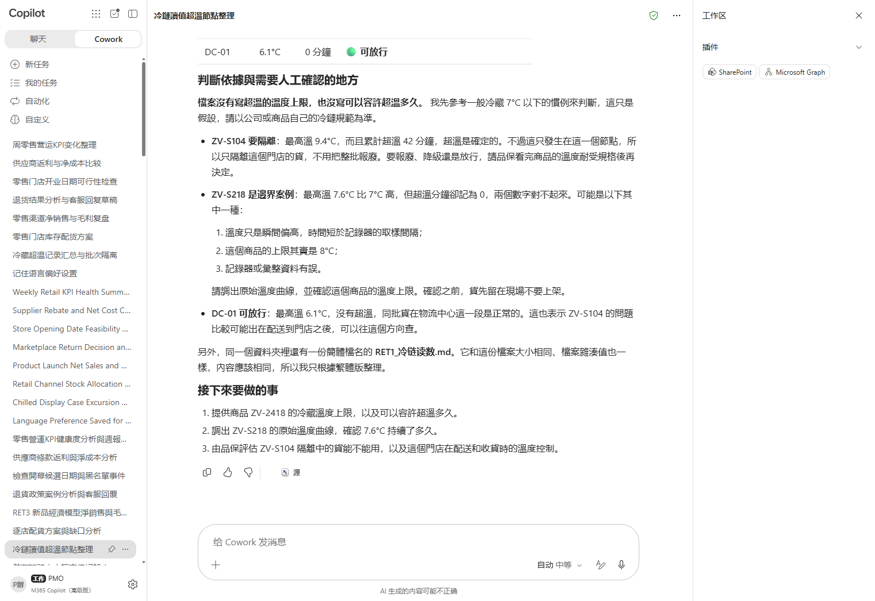

Scenario 01 · Live demo
What Cowork does, and what it produces
① Your input and prompt
② The result
Check the output
Quarantine only nodes supported by excursion evidence
Keep the human approval boundary
State data limitations and assumptions clearly
Microsoft 365 Copilot Cowork
9

Slide 11

Scenario 02
The promotion requests 1,920 units and total stock looks sufficient; the real constraint is store capacity, carton size and last-mile allocation.
Agentic workflow
1
Find infeasible allocations
Retail Channels · Operations Decisions
Read RET2 and do not allocate evenly yet.。
Promotion allocation: enough total stock does not mean stores can take it
2
Propose an executable allocation
Give a full-carton allocation that stays within capacity…
⏱ ~15 min · Level ★★★
3
Confirm decision boundaries and next steps
List the items requiring human confirmation, owners and …
OneDrive / Enterprise Search
Excel
What to watch For external sending, refunds, schedules or triggers, ch…
Microsoft 365 Copilot Cowork
10

Slide 12
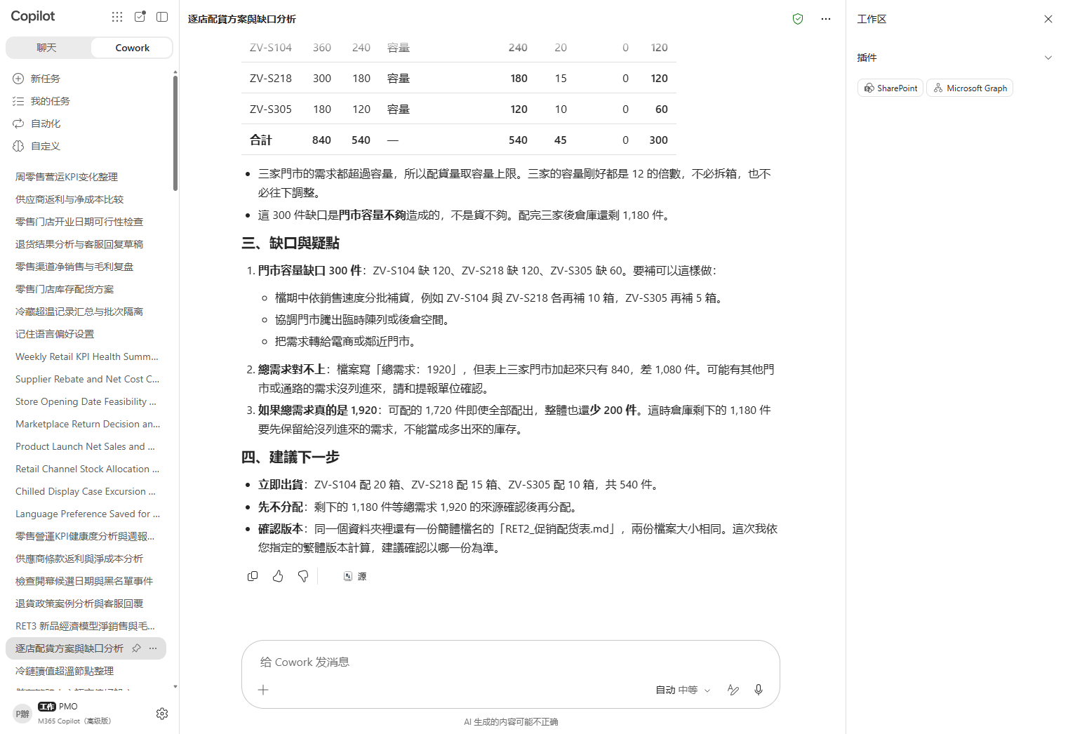

Scenario 02 · Live demo
What Cowork does, and what it produces
① Your input and prompt
② The result
Check the output
Do not violate capacity or carton constraints
Show the shortfall transparently
State data limitations and assumptions clearly
Microsoft 365 Copilot Cowork
11

Slide 13

Scenario 03
Direct revenue beats target, but after cannibalization and promotion cost, the decision is whether phase two still clears the margin floor.
Agentic workflow
1
Recalculate net sales and margin decision
Retail Channels · Operations Decisions
Read RET3, subtract cannibalization and promotion cost f…
Product launch: hitting revenue target can still miss the margin floor
2
Write an executive decision brief
Write a three-part brief: what is achieved, what risk re…
⏱ ~15 min · Level ★★★
3
Confirm decision boundaries and next steps
List the items requiring human confirmation, owners and …
OneDrive / Enterprise Search
Excel
PowerPoint
What to watch For external sending, refunds, schedules or triggers, ch…
Microsoft 365 Copilot Cowork
12

Slide 14
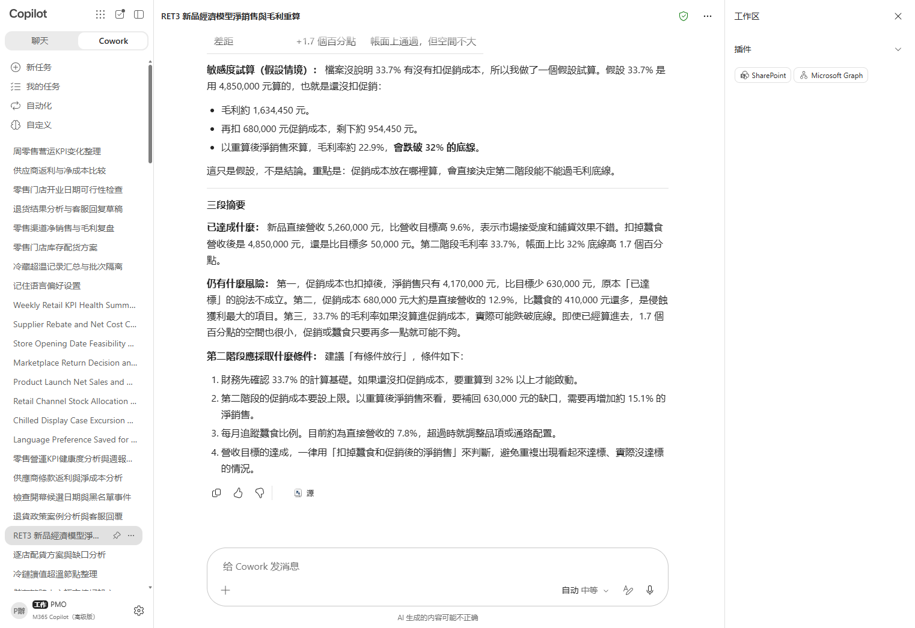

Scenario 03 · Live demo
What Cowork does, and what it produces
① Your input and prompt
② The result
Check the output
Do not equate revenue attainment with margin attainment
State data limitations and assumptions clearly
Do not automate high-risk actions
Microsoft 365 Copilot Cowork
13

Slide 15

Scenario 04
A marketplace order is opened but has a receipt. Use channel policy and product category to decide exchange, refund or review rather than the customer's request alone.
Agentic workflow
1
Extract the applicable clauses
Retail Channels · Operations Decisions
Read RET4 and list how channel, category, opened status …
Returns policy: an opened personal-care item is not an unconditional refund
2
Draft the customer-service reply
Give the exchange, refund and review decision, then draf…
⏱ ~15 min · Level ★★★
3
Confirm decision boundaries and next steps
List the items requiring human confirmation, owners and …
OneDrive / Enterprise Search
Word
Approvals & governance
What to watch For external sending, refunds, schedules or triggers, ch…
Microsoft 365 Copilot Cowork
14

Slide 16
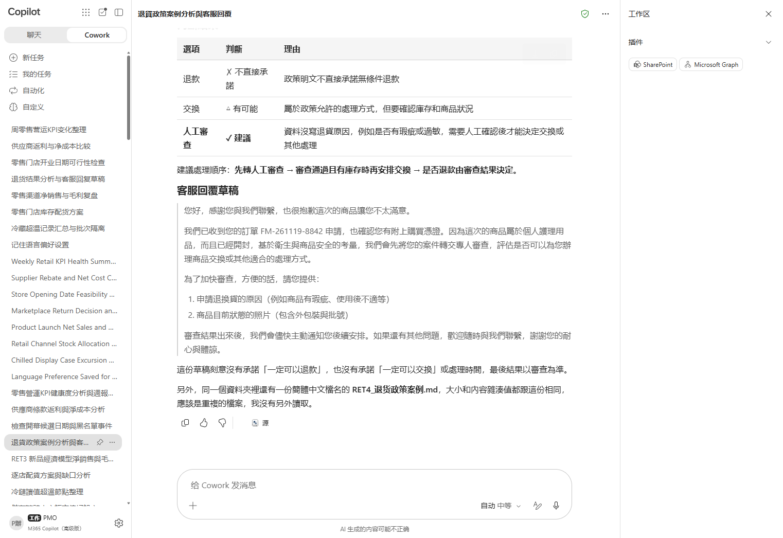

Scenario 04 · Live demo
What Cowork does, and what it produces
① Your input and prompt
② The result
Check the output
Map each policy condition explicitly
State data limitations and assumptions clearly
Do not automate high-risk actions
Microsoft 365 Copilot Cowork
15

Slide 17

Scenario 05
Three opening dates collide with an inventory-count blackout or a mall fire drill. Combine event constraints and operational readiness in one decision table.
Agentic workflow
1
Build a date-feasibility matrix
Retail Channels · Operations Decisions
Read RET5 and check each candidate against blackout even…
Store opening: only one date survives every blackout
2
Write the decision and rationale
Select only the date that passes every constraint and ex…
⏱ ~15 min · Level ★★★
3
Confirm decision boundaries and next steps
List the items requiring human confirmation, owners and …
OneDrive / Enterprise Search
Excel
Scheduled prompt
What to watch For external sending, refunds, schedules or triggers, ch…
Microsoft 365 Copilot Cowork
16

Slide 18
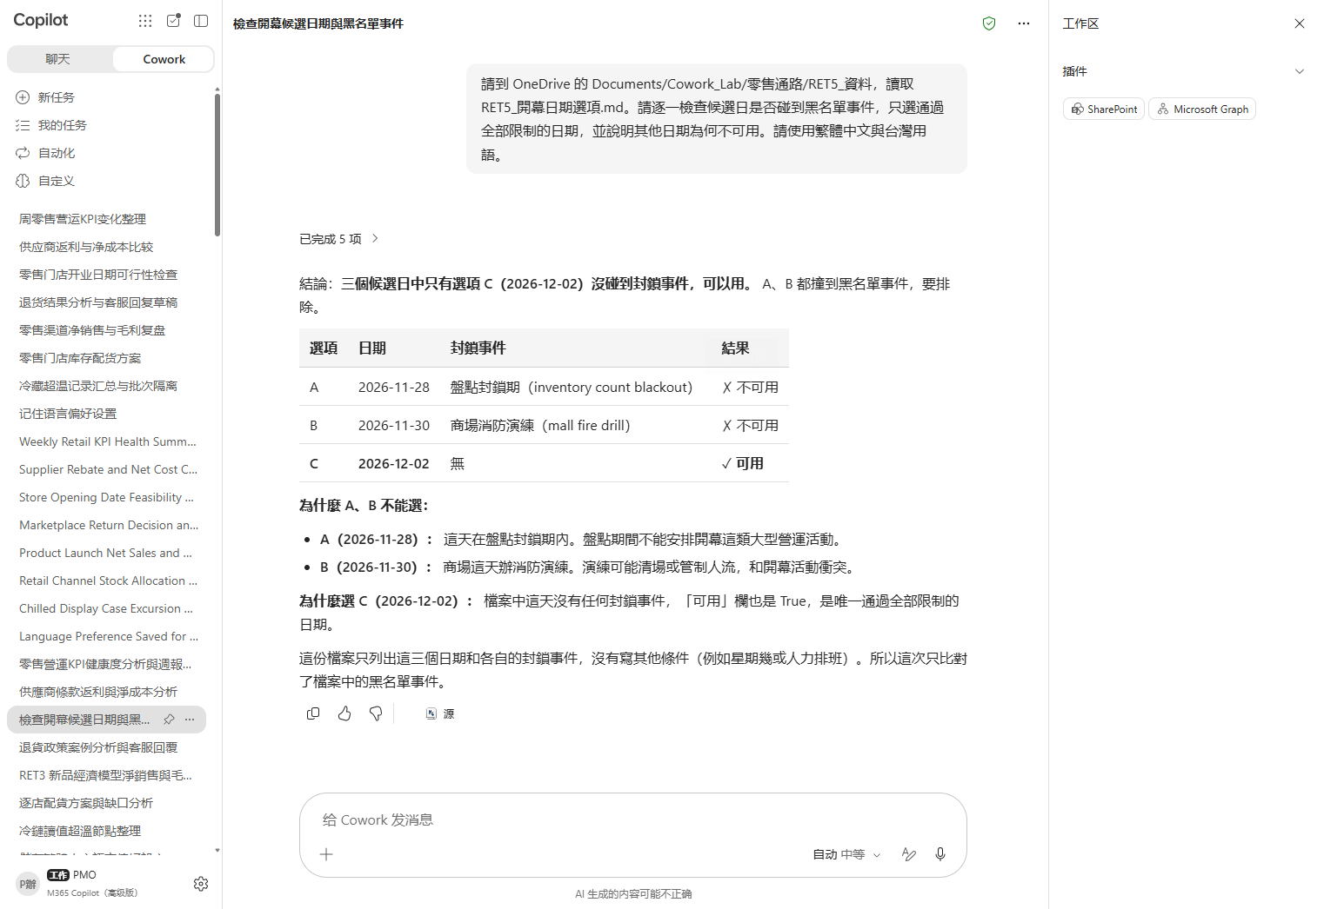

Scenario 05 · Live demo
What Cowork does, and what it produces
① Your input and prompt
② The result
Check the output
An unavailable date cannot be rescued by an average score
State data limitations and assumptions clearly
Do not automate high-risk actions
Microsoft 365 Copilot Cowork
17

Slide 19

Scenario 06
Two suppliers differ in list price, rebate threshold, freight and forecast quantity. Calculate net cost, then write the renewal brief with its conditions.
Agentic workflow
1
Calculate comparable net cost
Retail Channels · Operations Decisions
Read RET6, determine whether the rebate applies at the a…
Supplier renewal: the lowest quoted price is not always the lowest net cost
2
Write the renewal recommendation
Show the formula, sensitive assumptions and recommended …
⏱ ~15 min · Level ★★★
3
Confirm decision boundaries and next steps
List the items requiring human confirmation, owners and …
OneDrive / Enterprise Search
Excel
Word
Approvals & governance
What to watch For external sending, refunds, schedules or triggers, ch…
Microsoft 365 Copilot Cowork
18

Slide 20
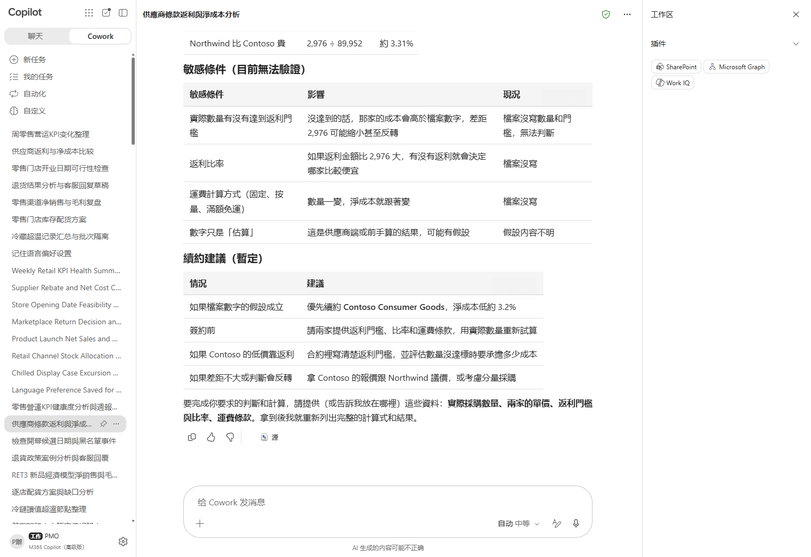

Scenario 06 · Live demo
What Cowork does, and what it produces
① Your input and prompt
② The result
Check the output
Count a rebate only when the threshold is met
State data limitations and assumptions clearly
Do not automate high-risk actions
Microsoft 365 Copilot Cowork
19

Slide 21

Scenario 07
Same-store sales are up, but margin is down and markdown mix is rising. The weekly brief must put the revenue and margin signals together.
Agentic workflow
1
Find the conflicting signals
Retail Channels · Operations Decisions
Read RET7, put the three KPIs in one table, and mark the…
Weekly operations: higher same-store sales do not mean healthy margin
2
Write the weekly operations brief
State the apparent good news first, then the margin risk…
⏱ ~15 min · Level ★★★
3
Confirm decision boundaries and next steps
List the items requiring human confirmation, owners and …
OneDrive / Enterprise Search
Excel
PowerPoint
Scheduled prompt
What to watch For external sending, refunds, schedules or triggers, ch…
Microsoft 365 Copilot Cowork
20

Slide 22
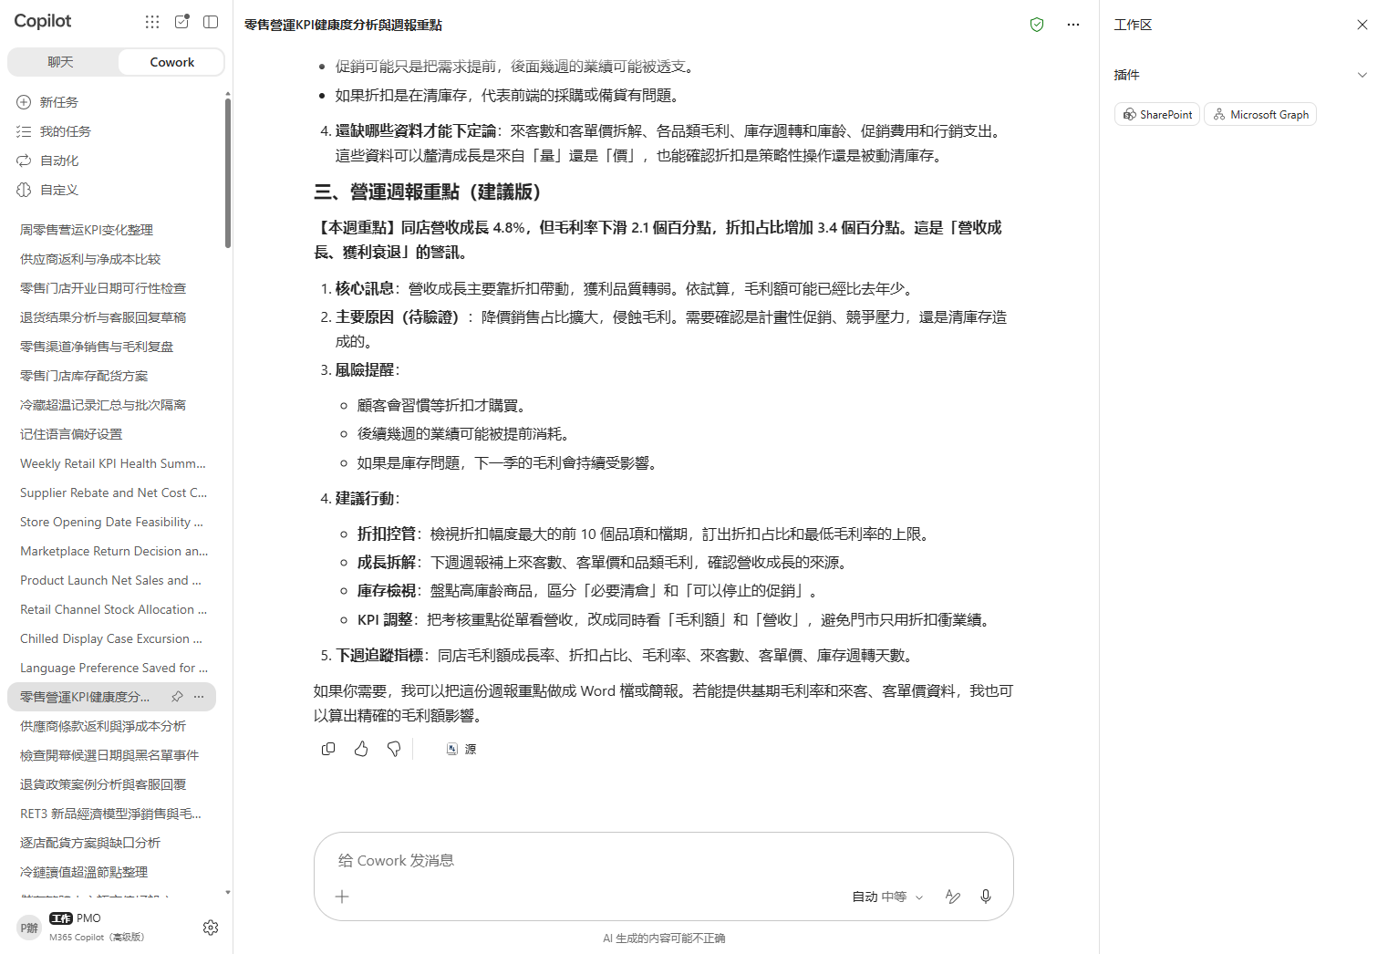

Scenario 07 · Live demo
What Cowork does, and what it produces
① Your input and prompt
② The result
Check the output
Do not use a single metric for revenue and margin
State data limitations and assumptions clearly
Do not automate high-risk actions
Microsoft 365 Copilot Cowork
21

Slide 23
MAKE IT YOURS
Extend it to your own work
Retail Channels · Operations Decisions
💡 As an extension, make it an event trigger that summarizes each cold-chain alert email.
Retail Channels · Operations Decisions
💡 Extend it into a weekly promotion-allocation scheduled prompt.
Retail Channels · Operations Decisions
💡 Turn the brief into a one-slide PowerPoint decision card.
Retail Channels · Operations Decisions
💡 Extend it into a customer-service custom skill while retaining human approval for refunds.
Retail Channels · Operations Decisions
💡 Extend it into a meeting schedule or reminder task.
Retail Channels · Operations Decisions
💡 Turn the terms brief into a draft attachment to an existing Word contract.
Retail Channels · Operations Decisions
💡 Set a Monday-morning scheduled prompt to produce a first draft.
Microsoft 365 Copilot Cowork
22

Slide 24





TRUST & CONTROL
Automated — but you're still the decision maker
Approval before action
Medium/high-risk actions show a RISK-LEVEL; sending mail, posting to Teams or creating meetings all open as an editable preview and go out only after approval.
Scope you control
Don't-ask-again can be limited to a recipient, a domain, or always; tasks can be soft/hard paused, resumed or cancelled.
Automated tasks have guardrails too
Scheduled prompts and event-driven tasks have run-frequency limits and loop protection; they always run with the creator's permissions, and are recorded in the unified audit log alongside all other Cowork activity, under Microsoft Purview policy.
Know the limits
No access to local files, no deleting OneDrive/SharePoint files, no reading encrypted files; attachments under 200MB; custom skills and third-party plugins aren't validated by Microsoft, so review the output yourself. Microsoft explicitly lists it as unsuitable where accuracy must be guaranteed without human review.
Microsoft 365 Copilot Cowork
23

Slide 25


Start practising now
Cowork Playbook
aka.ms/CoworkPlaybook
Start with the scenario closest to your own work
Custom skills live in OneDrive at /Documents/Cowork/skills/ as SKILL.md (up to 50, 1MB each)
Model picker: Auto (default), GPT 5.5 Frontier, GPT 5.6 Sol/Terra, GPT 6 Astra, Opus 5, Claude Sonnet 5, Claude Fable 5.1
Effort: Light / Medium (default) / High / Extra High / Max — higher is more thorough, but slower and uses more credits
Want it to fire by itself? Set a scheduled prompt (up to 25) or an event-driven task (incoming mail / @mention) on the "Automations" page

Slide 26
Thank you
From asking to delegating — you set the standard, Cowork does the work.
Microsoft 365 Copilot Cowork · Training deck

