Slide 1


Microsoft 365 Copilot
Cowork
Agentic AI at work
Seven real telecom network operations scenarios showing how Copilot executes across apps, shows a risk level before medium/high-risk actions, and waits for your approval
Training deck · client-ready

Slide 2
AGENDA
What we'll cover
01
Meet Cowork
What agentic AI is, and how it differs from Copilot Chat
02
Core capabilities
Skills, workspace, approval before action, self-verification
03
Set up your practice environment
Seed the material into OneDrive and your mailbox first, so Cowork finds it itself
04
Seven hands-on scenarios
Alarm triage, maintenance window, circuit SLA, regulatory notification, tariff capacity, disclosure order, quality reporting — one workflow at a time
05
Make it your own
How to extend these scenarios to your own work
Microsoft 365 Copilot Cowork
1

Slide 3



WHAT IS COWORK
From "chat" to "agentic execution"
Cowork is Copilot's agentic working mode.
You hand it a goal; it breaks the work into steps, reads your cloud files, loads the skills it needs, produces results across apps and checks its own work — pausing for your approval, with a risk level shown, before any medium or high-risk action. You move from quick single-turn answers to handing over a task that actually gets done.
Copilot Chat
Cowork agent
You stay in charge
Quick single-turn answers; great for instant replies and brainstorming.
You give a goal; it executes autonomously across apps, for minutes to hours.
Anything outbound or affecting others pauses for your approval.
Microsoft 365 Copilot Cowork
2

Slide 4
COMPARISON
Cowork vs. Copilot Chat
Copilot Chat
Copilot Cowork
Quick single-turn Q&A
Quick single-turn Q&A
Hand over a goal; autonomous multi-step work across apps
Seconds to minutes
Seconds to minutes
Minutes to hours (autonomous)
Single step, single session
Single step, single session
Multi-step workflows across tasks and sources
Paste in a snippet
Paste in a snippet
Reads cloud attachments and creates new files; no access to local files
One conversational capability
One conversational capability
Loads 14 built-in skills plus your custom ones automatically
Text in the chat window
Text in the chat window
Real documents, spreadsheets and decks in OneDrive
You have to open it and prompt every time
You have to open it and prompt every time
Scheduled prompts / event-driven: runs on incoming mail or an @mention
Grounded in M365 data
Grounded in M365 data
Connects to external systems via Plugins / MCP — the partner catalogue now lists 92 plugins (D365, SAP, Fabric and more)
You judge for yourself
You judge for yourself
Medium/high-risk actions show a risk level and run only after approval
Microsoft 365 Copilot Cowork
3

Slide 5




CORE CAPABILITIES
Four things that set Cowork apart
14 built-in skills
Workspace
Word, Excel, PowerPoint, PDF, Email, Scheduling, Calendar Management, Meetings, Daily Briefing, Enterprise Search, Deep Research, Communications, Adaptive Cards, App (Frontier).
The side panel shows progress, input files, output files, loaded skills, schedules and granted permissions all at once — the process stays traceable.
Approval before action
What's new
Medium/high-risk actions show a RISK-LEVEL; approve, cancel, or set don't-ask-again per recipient, per domain or always; multiple pending actions can be approved together.
Scheduled prompts (up to 25) and event-driven tasks; five Effort levels to balance quality against cost; every custom skill gets an automatic Skill Report (0–100 across four dimensions, plus five separate gates including a Safety and RAI scan); local Edge browser (GA since Aug 2026); image generation; Plugins / MCP for external systems.
Microsoft 365 Copilot Cowork
4

Slide 6




HOW IT WORKS
What happens inside one agentic workflow
Take the goal
Plan
Load skills
Execute
Self-verify
Approval before action
Upload files
Give the instruction
Understand the task
Break it into steps
14 built-in
+ custom
Create documents
spreadsheets / mail
Check the numbers
and consistency
Outbound actions
wait for you
The whole process is visible in the "Workspace" panel; you can soft/hard pause, resume or cancel a task.
It doesn't only start from chat: you can also have it fire automatically when a matching email arrives or you're @mentioned (event-driven tasks) — with the same self-verification and approval flow.
Microsoft 365 Copilot Cowork
5

Slide 7

BEFORE YOU START
Set up your practice environment
Seed the material into OneDrive under Documents/Cowork_Lab/TelecomOps/ before the session, and Cowork will find it itself · Setup time about 20 minutes
📅
⚠️ Understand how dates work in this material first
📁
Create the OneDrive folders and upload the material for all seven scenarios
The dates in this material are fixed simulated dates: th…
Create Documents/Cowork_Lab/TelecomOps/ in OneDrive with…
📇
Put the contact list in the parent folder — with addresses that really receive mail
📧
Send yourself one email — the background for scenario 1
Contact_List.md belongs in the TelecomOps parent folder …
Send it to yourself from your own account, copying the s…
💬
Create the network operations channel and post the first message (scenario 1)
💾
Download the two files in 上傳用/ to your PC — do not put them in OneDrive
Create a channel called Network Operations in any team y…
TEL5_Existing_Plan_Usage.csv (scenario 5) and TEL6_Discl…
🧩
Check the skills path is writable, and do scenario 3 on desktop
♻️
Scenario 3 edits a file in place — restore it before running again
Scenario 3 has Cowork create a custom skill at OneDrive/…
Step four of scenario 3 modifies TEL3_Circuit_Outage_Log…
Final check before the session
All seven subfolders under TelecomOps exist in OneDrive and the files open
The contact list sits in the TelecomOps parent folder, not inside a subfolder, and the email column contains addresses that actually receive mail
The night shift handover email is in the inbox, not in junk
Microsoft 365 Copilot Cowork
6

Slide 8







7 SCENARIOS
Seven hands-on scenarios
Telecom · Network Operations
Telecom · Network Operations
Telecom · Network Operations
Telecom · Network Operations
Telecom · Network Operations
Telecom · Network Operations
Telecom · Network Operations
Forty Alarms at Three in the Morning: the Loudest Is Not the Cause
The Maintenance Window: the Quietest Three Hours Are the Ones You Cannot Use
Availability Met, Compensation Due: the Second Threshold in the Contract
Below the Subscriber Threshold — and the Two-Hour Clock Is Already Running
On the Average, This Tariff Is Perfectly Safe
This Order Cannot Be Fully Answered — and Cannot Be Refused
The Month the Network Met Target and One Region Fell Apart
Adaptive Cards · Excel · Teams · Event trigger
File upload · Excel · PowerPoint
Daily Briefing · Excel · Enterprise Search
Excel · Scheduling …
Excel · Edit existing file …
Communications · Excel · Email …
File upload · PDF · Word
~20 min
★★★
~25 min
★★★
~20 min
★★☆
~15 min
★★☆
~25 min
★★★
~20 min
★★★
~20 min
★★★
Microsoft 365 Copilot Cowork
7

Slide 9
Scenario 01
At 03:12 the alarm console throws up thirty-eight alarms in half an hour. There is one engineer on shift and two crews available. The hard part is not reading the alarms — it is that alarm count has nothing to do with cause. The element that actually failed raised one alarm; the twenty-three cells it took down with it raised thirty-five between them. Work the list by count and you will send out twenty-odd crews to fix symptoms. This scenario ends by setting it up to run itself the next time an alarm email arrives.
Agentic workflow
1
Start by collapsing thirty-eight alarms into events
Telecom · Network Operations
Nothing to upload. All three files are in Cowork_Lab/Tel…
Forty Alarms at Three in the Morning: the Loudest Is Not the Cause
2
⭐ Now ask for the root cause — and for the test it used
Ask only after the grouping. What matters here is not th…
3
Turn it into a dispatch card you can act on
⏱ ~20 min · Level ★★★
Nobody reads prose at three in the morning. This step wa…
Adaptive Cards
Excel
4
Post it to the operations channel so the next shift sees it
Teams
Event trigger
This really does post to Teams, so an approval card appe…
5
⭐ Make it run itself on the next alarm email
This really does create an event trigger. Pause it when …
Microsoft 365 Copilot Cowork
8

Slide 10
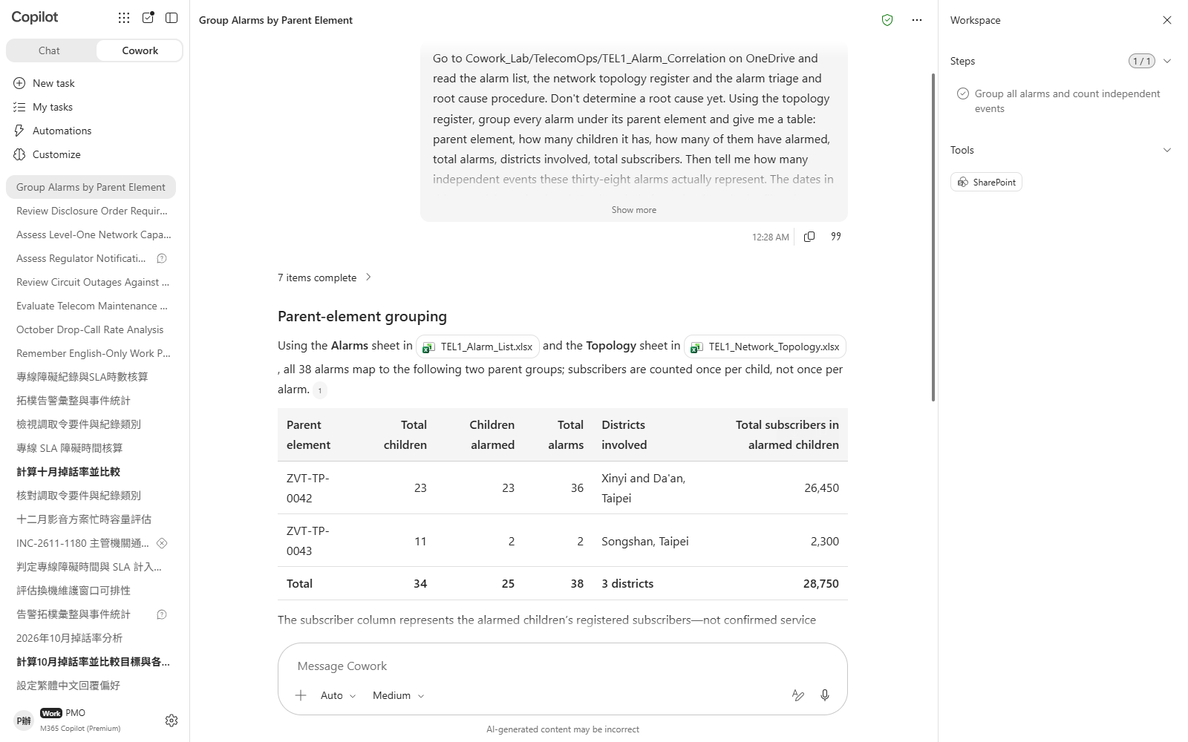
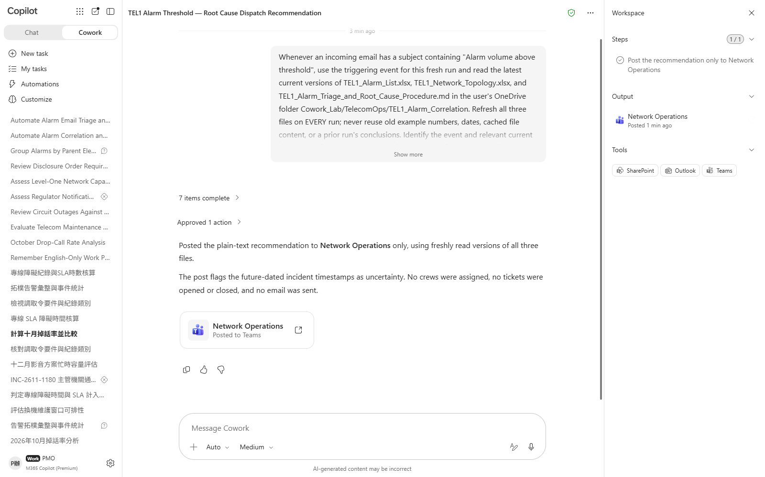

Scenario 01 · Live demo
What Cowork does, and what it produces
① Your input and prompt
② The result
Check the output
The event count after grouping is far below thirty-eight, and every alarm is attached to a parent element
The root cause is the parent whose children have **all** alarmed, not the element with the most alarms
It names “all versus some” as the test, rather than just asserting “because it is the parent”
Microsoft 365 Copilot Cowork
9

Slide 11
Scenario 02
The upgrade is on the same aggregation node that failed in the previous scenario. Three hours of work, and the service has to go down. Instinct says overnight — fewest consumers awake. But a telco has two customer bases and their peaks fall at opposite ends of the clock: the consumer trough is the enterprise batch peak, and overnight also sits inside the residential noise restriction. Three conditions each kill one option, and they kill them for unrelated reasons — so an unusually low consumer count cannot buy you anything elsewhere. The scenario ends by putting the viable option into a real meeting.
Telecom · Network Operations
Agentic workflow
The Maintenance Window: the Quietest Three Hours Are the Ones You Cannot Use
1
Make it run each option through all three gates — not score them
Nothing to upload. Both files are in TEL2_Maintenance_Wi…
2
⭐ Press on why the quietest window is the one you cannot use
⏱ ~15 min · Level ★★☆
Ask after the three verdicts are in; otherwise it folds …
Excel
Scheduling
3
Put the viable option into a real coordination meeting
Email
This really does send a meeting invitation; recipients c…
4
Ask for a customer notice as a draft — but don't send it
Leave the draft in the conversation. The point of this s…
Microsoft 365 Copilot Cowork
10

Slide 12
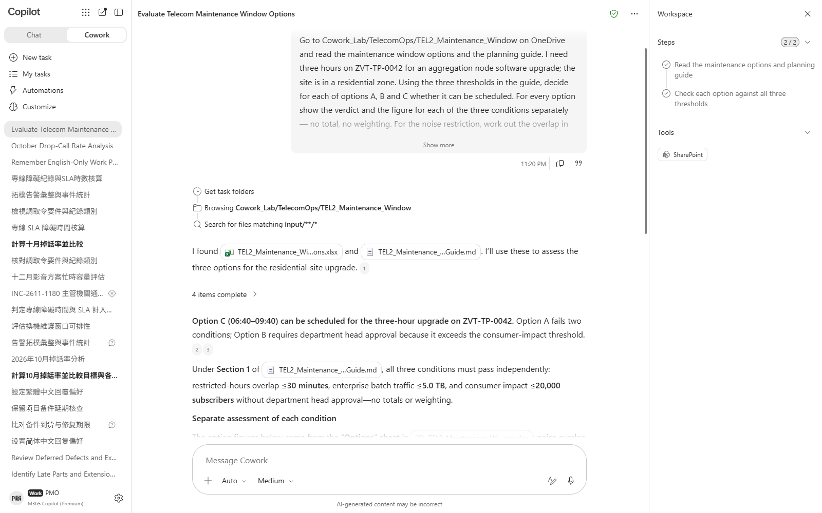
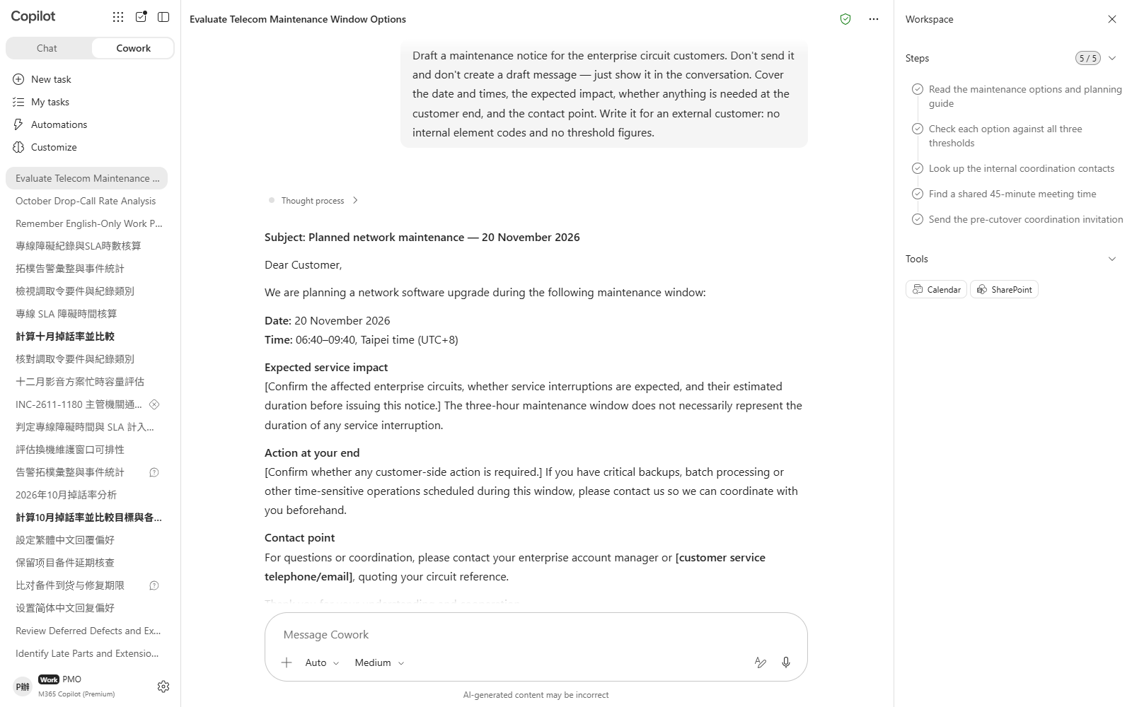

Scenario 02 · Live demo
What Cowork does, and what it produces
① Your input and prompt
② The result
Check the output
All three options were tested against all three gates, each with its own figure and verdict — not collapsed into a score
Exactly one option survives, and it is not the one with the fewest consumers affected
The noise restriction was decided on overlap in minutes, not on whether the window merely touches the restricted hours
Microsoft 365 Copilot Cowork
11

Slide 13
Scenario 03
The customer writes in: five hours of downtime last month, please compensate. The outage log says 312 minutes of interruption, which looks like a certain breach. But an SLA is not measured on interruption, it is measured on counted outage — planned maintenance, customer premises equipment and force majeure come out first. What remains is 32 minutes, and monthly availability is comfortably met. So you could reply that nothing is owed — except the contract has a second threshold, and it is assessed separately from the first. The scenario ends by turning the whole assessment into a skill you can reuse on the next circuit.
Agentic workflow
1
Separate “went down” from “counts as down”, line by line
Telecom · Network Operations
Nothing to upload. Both files are in TEL3_Circuit_SLA.。
Availability Met, Compensation Due: the Second Threshold in the Contract
2
⭐ Now assess both thresholds — separately
This is the turn of the whole scenario. Watch whether it…
3
Work out the compensation — and ask the thing people get wrong
⏱ ~25 min · Level ★★★
The bands apply to the minutes in excess of the threshol…
Excel
Edit existing file
4
⭐ Write the verdict back into the outage log itself
Custom skill
This modifies the file on OneDrive in place — it is not …
5
Turn it into a skill for next month's circuit
Custom skills are not supported on mobile — use a deskto…
Microsoft 365 Copilot Cowork
12

Slide 14
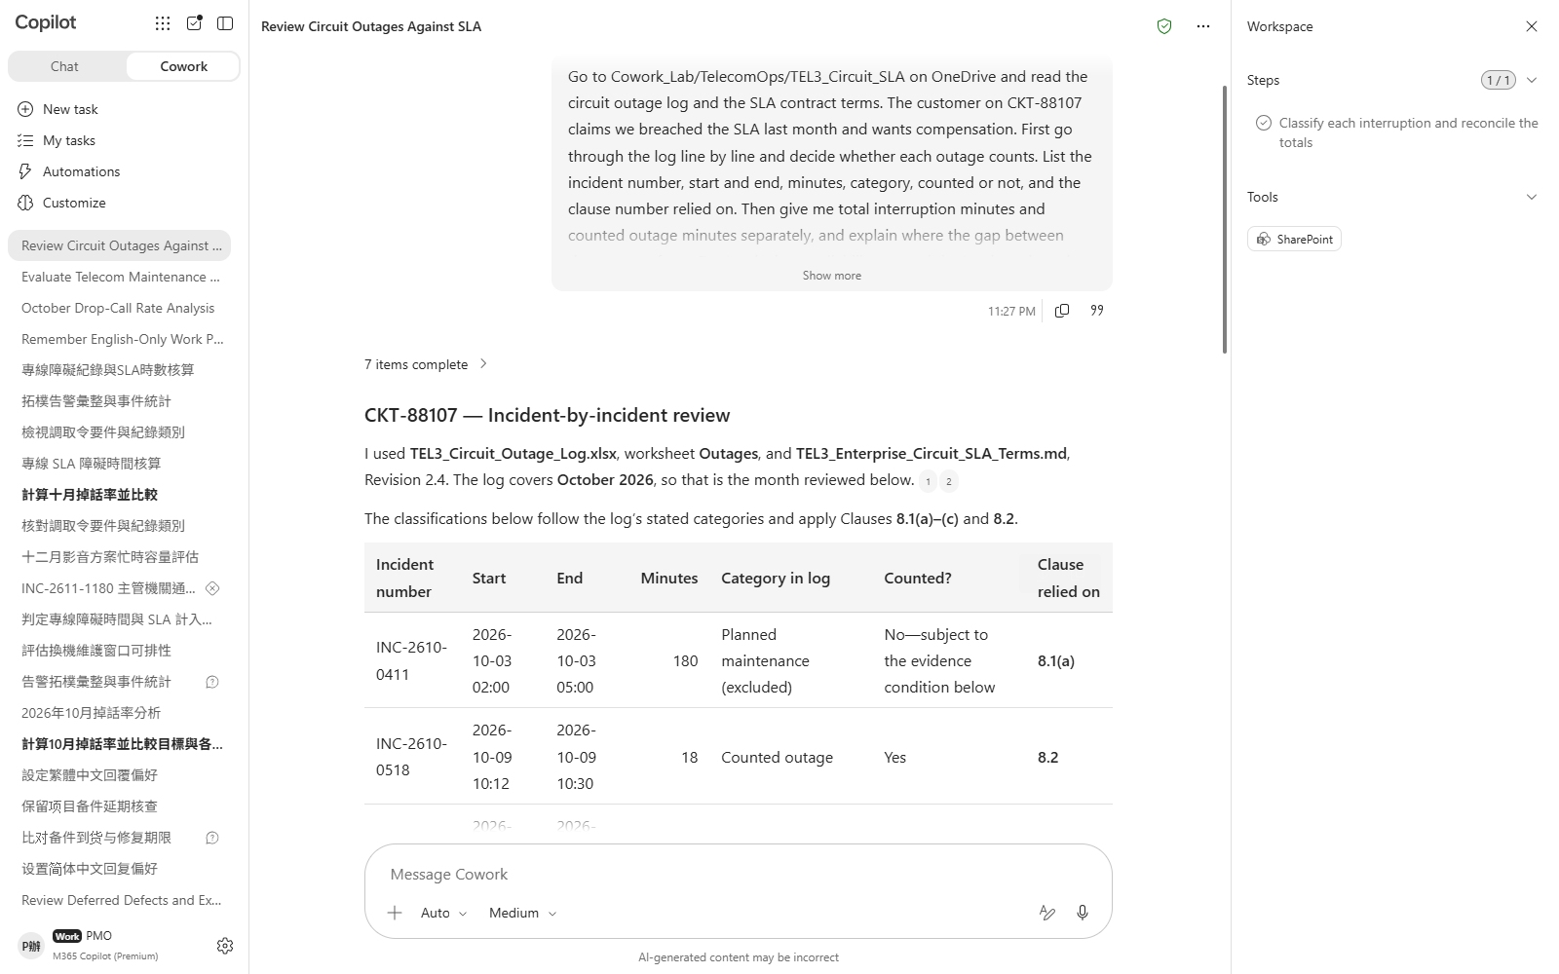
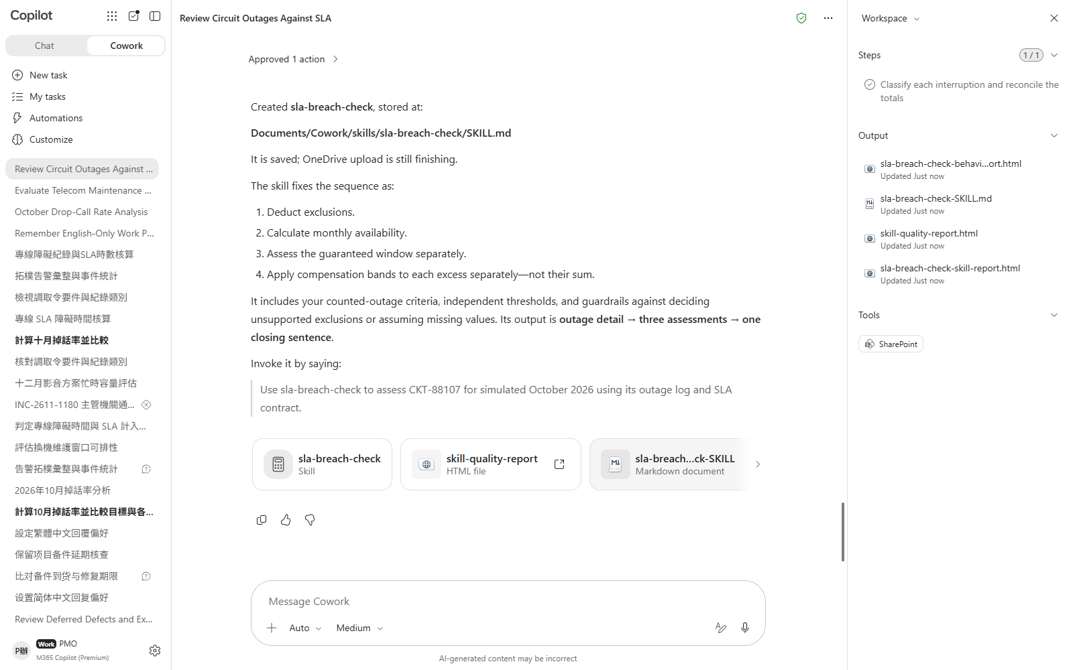

Scenario 03 · Live demo
What Cowork does, and what it produces
① Your input and prompt
② The result
Check the output
All six outages were judged counted or excluded, each with the clause it relies on
Total interruption and counted outage are two different numbers, and far apart
The monthly availability verdict is **met** — it did not rule breach just because the total interruption was long
Microsoft 365 Copilot Cowork
13

Slide 15
Scenario 04
The overnight failure affected 8,400 subscribers. The general reporting threshold is 10,000, so on that basis no report is due. Nine times out of ten the regulatory desk stops right there. The problem is the second limb: if emergency call access was affected, the obligation applies regardless of subscriber numbers — and on a far shorter clock. On top of which the clock runs from the moment the NOC raised the alarm, not from when regulatory affairs was told, so by the time the email lands on the desk most of the window is already gone. The scenario ends by putting “check what is about to run out” on a schedule.
Agentic workflow
1
Start with the simple question: is this reportable?
Telecom · Network Operations
Nothing to upload. Both files are in TEL4_Regulator_Noti…
Below the Subscriber Threshold — and the Two-Hour Clock Is Already Running
2
⭐ Press on the clock: when did it start, how much is left
The answer here decides whether the next step is an init…
3
Draft the notification itself
⏱ ~20 min · Level ★★★
Formal register, item by item against section 3 of the g…
Communications
Excel
4
Send it to the department head for sign-off — not to the regulator
Email
Scheduled prompt
This really does send mail; recipients come from Contact…
5
⭐ Put the deadline sweep on a schedule
This really does create a scheduled prompt. Pause it whe…
Microsoft 365 Copilot Cowork
14

Slide 16
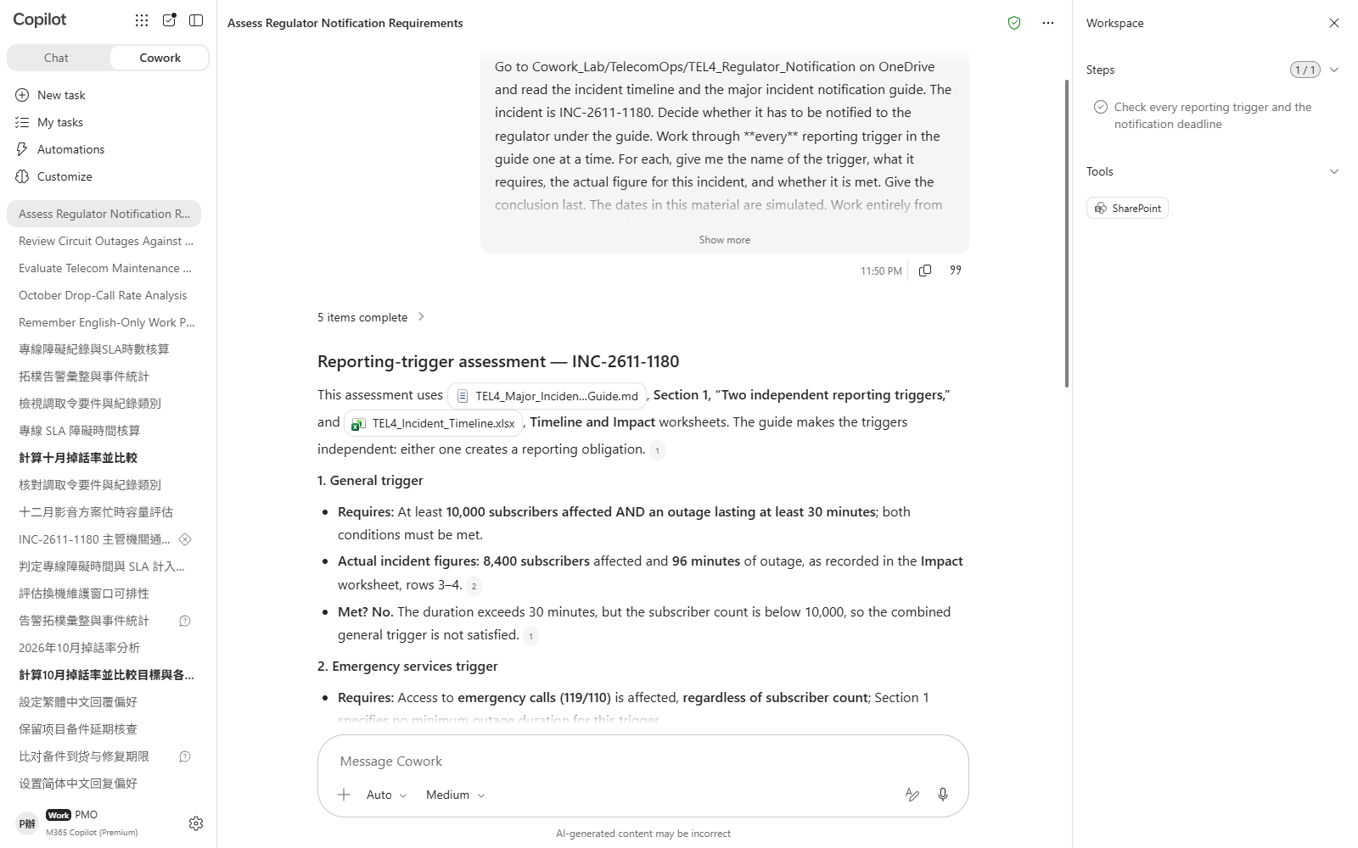
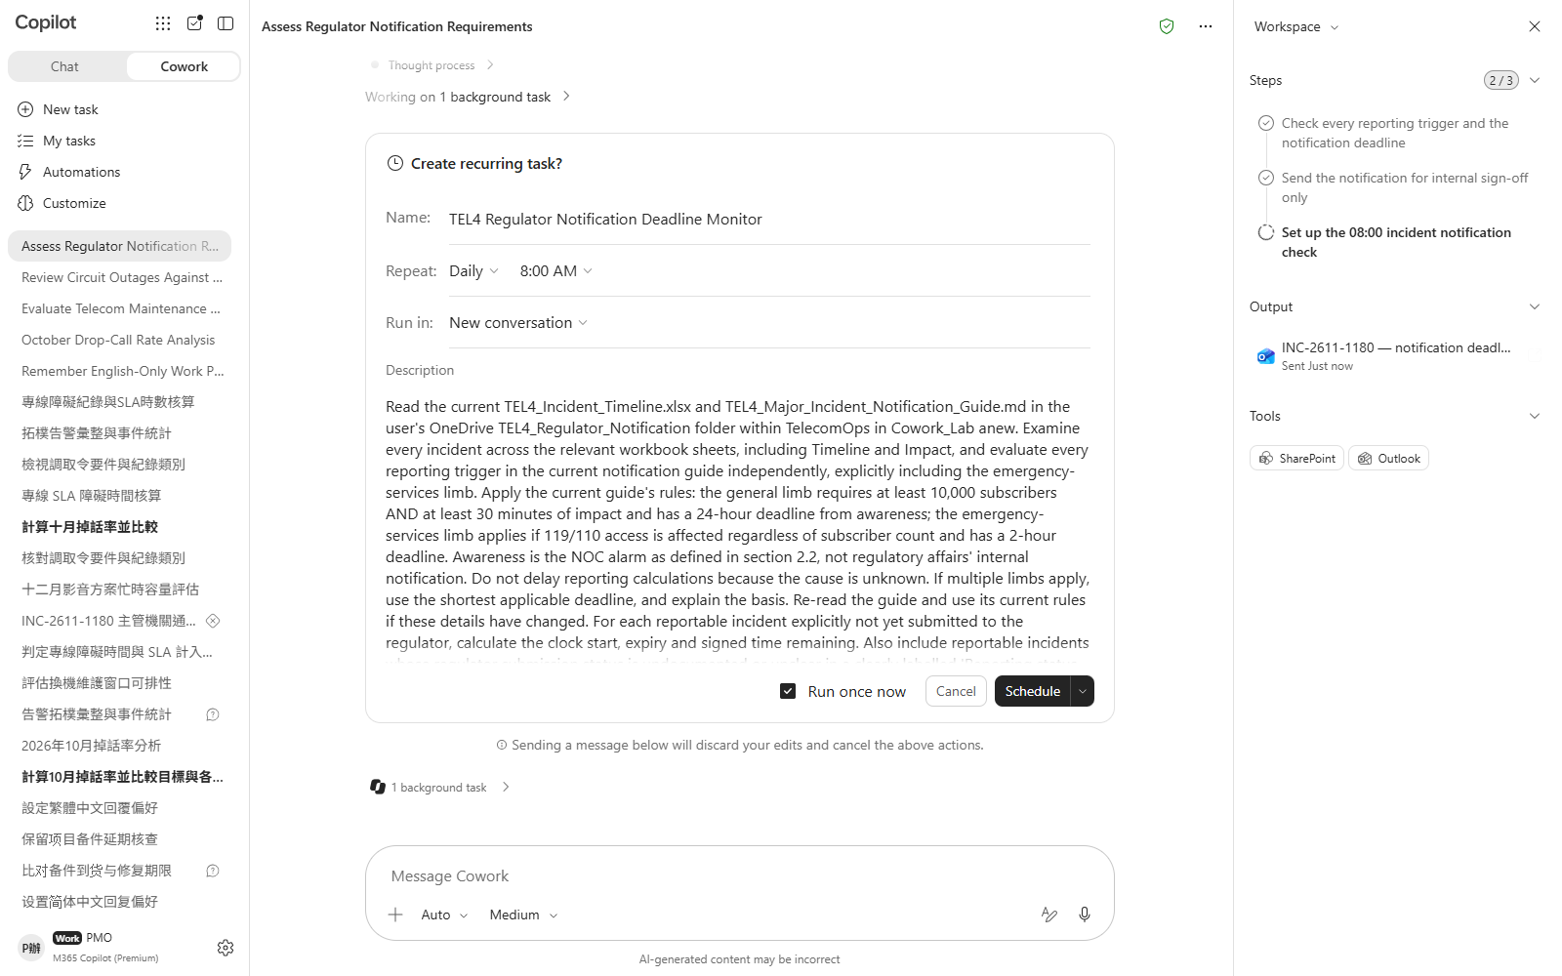

Scenario 04 · Live demo
What Cowork does, and what it produces
① Your input and prompt
② The result
Check the output
**Both** triggers were checked — it did not stop once the subscriber count fell short
It states that the general limb is not met on subscriber numbers but the emergency limb is
It can say that the emergency limb has **no subscriber floor**
Microsoft 365 Copilot Cowork
15

Slide 17
Scenario 05
Marketing wants to launch Unlimited Streaming in December, with 120,000 new subscribers expected. Multiply that by the expected average usage and the network has headroom to spare — one slide and you are done. But mobile data usage is heavily skewed: the top 5% take more than thirty per cent of the traffic, and they are not spread evenly across the country. Redo it by region, on the P95 rather than the mean, and three regions will not hold. What this scenario produces is a deck that puts the bad news in front of the decision forum.
Telecom · Network Operations
Agentic workflow
On the Average, This Tariff Is Perfectly Safe
1
Do it marketing's way first, and confirm that it passes
Drag TEL5_Existing_Plan_Usage.csv into the chat. The oth…
2
⭐ Now do it by region, on the P95
⏱ ~25 min · Level ★★★
Same data, different cut. This is the turn of the whole …
File upload
Excel
3
Build the deck for the decision forum
PowerPoint
Section 4 of the standard lists five things the deck mus…
4
Rehearse the question you will actually be asked
Marketing will say “but the network has headroom”. Have …
Microsoft 365 Copilot Cowork
16

Slide 18
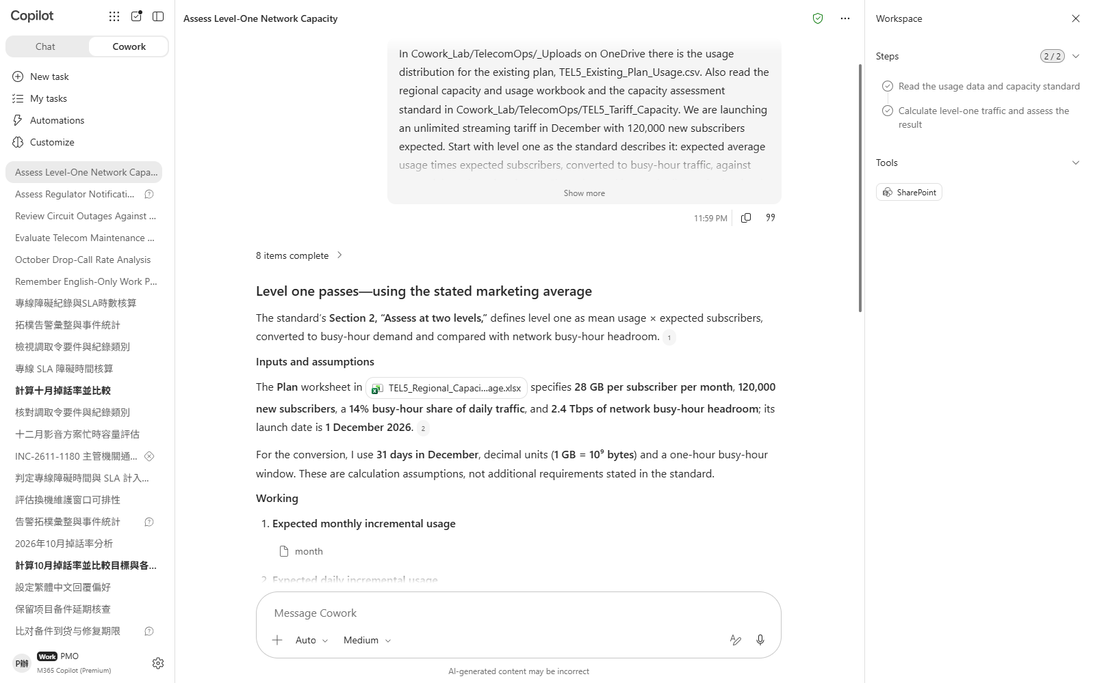
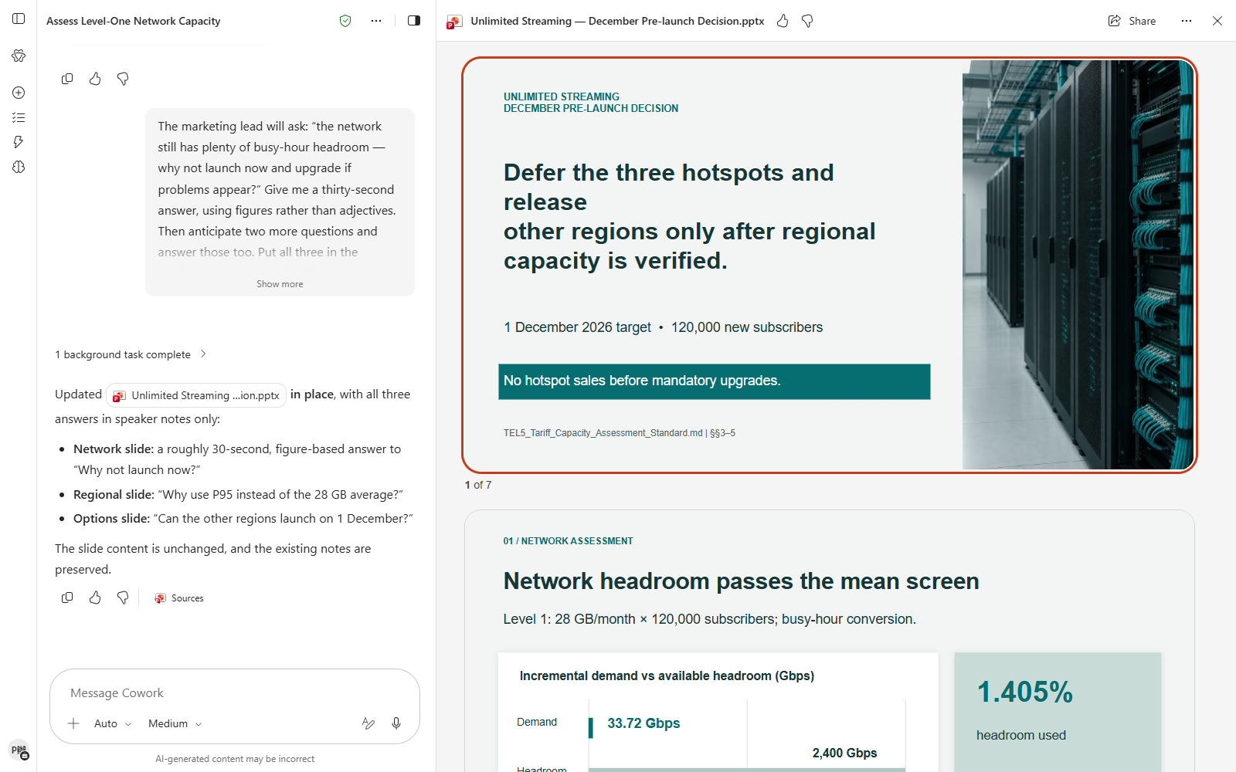

Scenario 05 · Live demo
What Cowork does, and what it produces
① Your input and prompt
② The result
Check the output
Level one really does come out as a pass — it did not jump straight to “there's a problem”
Level two covers all six regions — none skipped
A region is high risk only when **both** tests are met, not one of them
Microsoft 365 Copilot Cowork
17

Slide 19
Scenario 06
A disclosure order arrives: everything on one number from February to November, reply within seven days. There are two instinctive responses — hand over everything, or write back that the period is too long and refuse. Both are wrong, because retention periods differ by record type: call records are kept twelve months and billing five years, but internet session logs and cell site location are kept only six. On one order, some categories can be answered in full while for others the first half of the period has already been lawfully deleted. The reply has to go category by category, and the withheld part needs its legal basis stated.
Telecom · Network Operations
Agentic workflow
This Order Cannot Be Fully Answered — and Cannot Be Refused
1
Read the order and take apart what it actually asks for
Drag TEL6_Disclosure_Order.pdf into the chat. The other …
2
⭐ Work out each category's retention start and see which ones fall short
⏱ ~20 min · Level ★★★
This is the turn of the scenario: there is not one answe…
File upload
PDF
Word
3
Write the reply as a Word document
This is a formal letter that goes out under seal — neith…
4
Finally, have it check itself for overreach
Overreach is worse than a shortfall: that one is our own…
Microsoft 365 Copilot Cowork
18

Slide 20
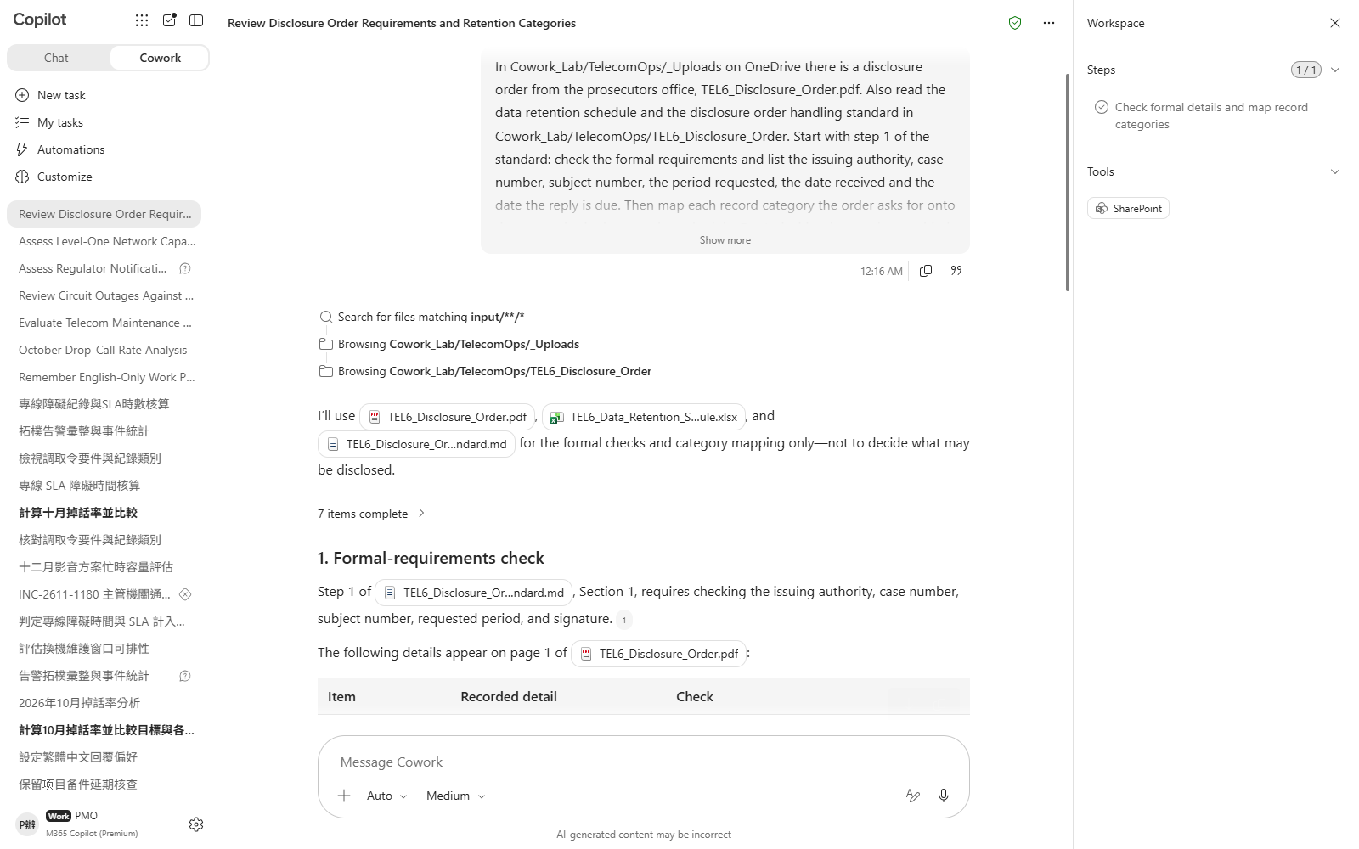
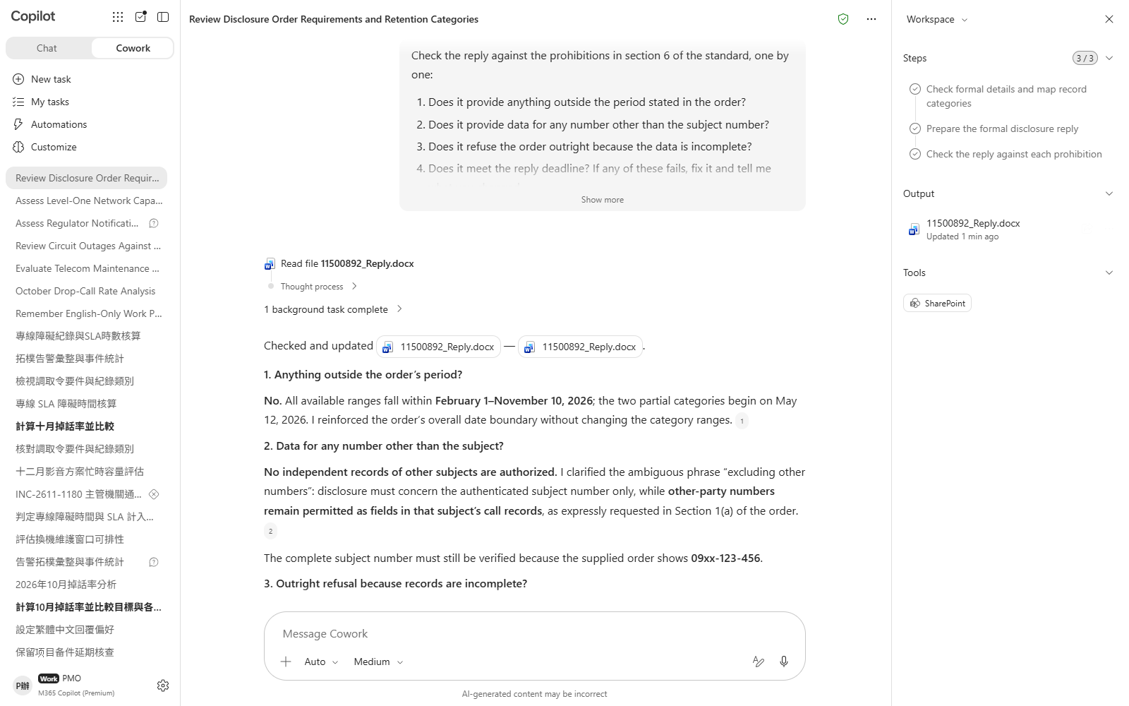

Scenario 06 · Live demo
What Cowork does, and what it produces
① Your input and prompt
② The result
Check the output
A retention start was calculated for each of the four categories — not one date applied to all
The retention start is counted back from the **date received**, not from today or from the order's own start date
The outcome is **partial**: some categories in full, others only from the retention start
Microsoft 365 Copilot Cowork
19

Slide 21
Scenario 07
October's network drop-call rate was 0.43% against a 0.5% target. Target met. A monthly report could stop right there — and that is exactly the problem. The network figure is a traffic-weighted average, and a low-volume region can triple its rate without moving it. Taichung came in at 1.38%, four and a half times the average of the others, and accounted for six in every ten complaints that month. Take it out and the network reads 0.31%. This scenario is about making the report say what the average is hiding, with complaint volume brought in to corroborate it.
Telecom · Network Operations
Agentic workflow
The Month the Network Met Target and One Region Fell Apart
1
Start by getting the “nothing to see here” network figure
Nothing to upload. Both files are in TEL7_Quality_Report…
2
⭐ Run the exclusion test and measure what the average hid
⏱ ~20 min · Level ★★☆
Section 2 of the guide describes this. It is the turn of…
Daily Briefing
Excel
3
Bring complaints in to corroborate
Enterprise Search
KPIs are what we measure; complaints are what subscriber…
4
Turn it into the standing monthly briefing format
Section 2 of the guide lists four views; none may be dro…
Microsoft 365 Copilot Cowork
20

Slide 22
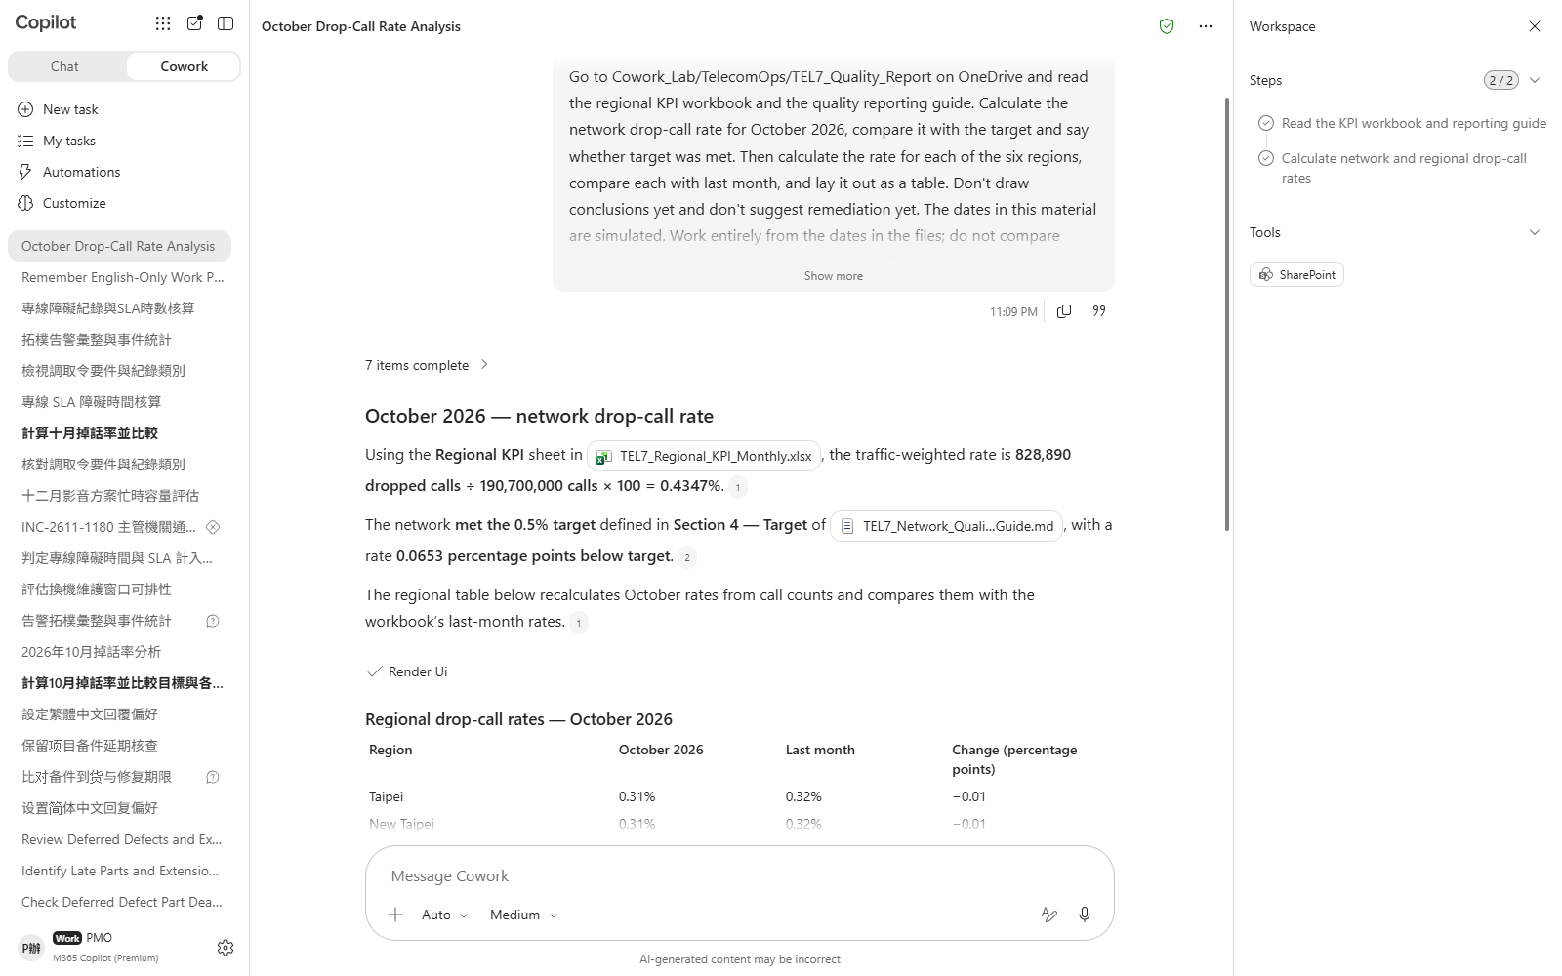
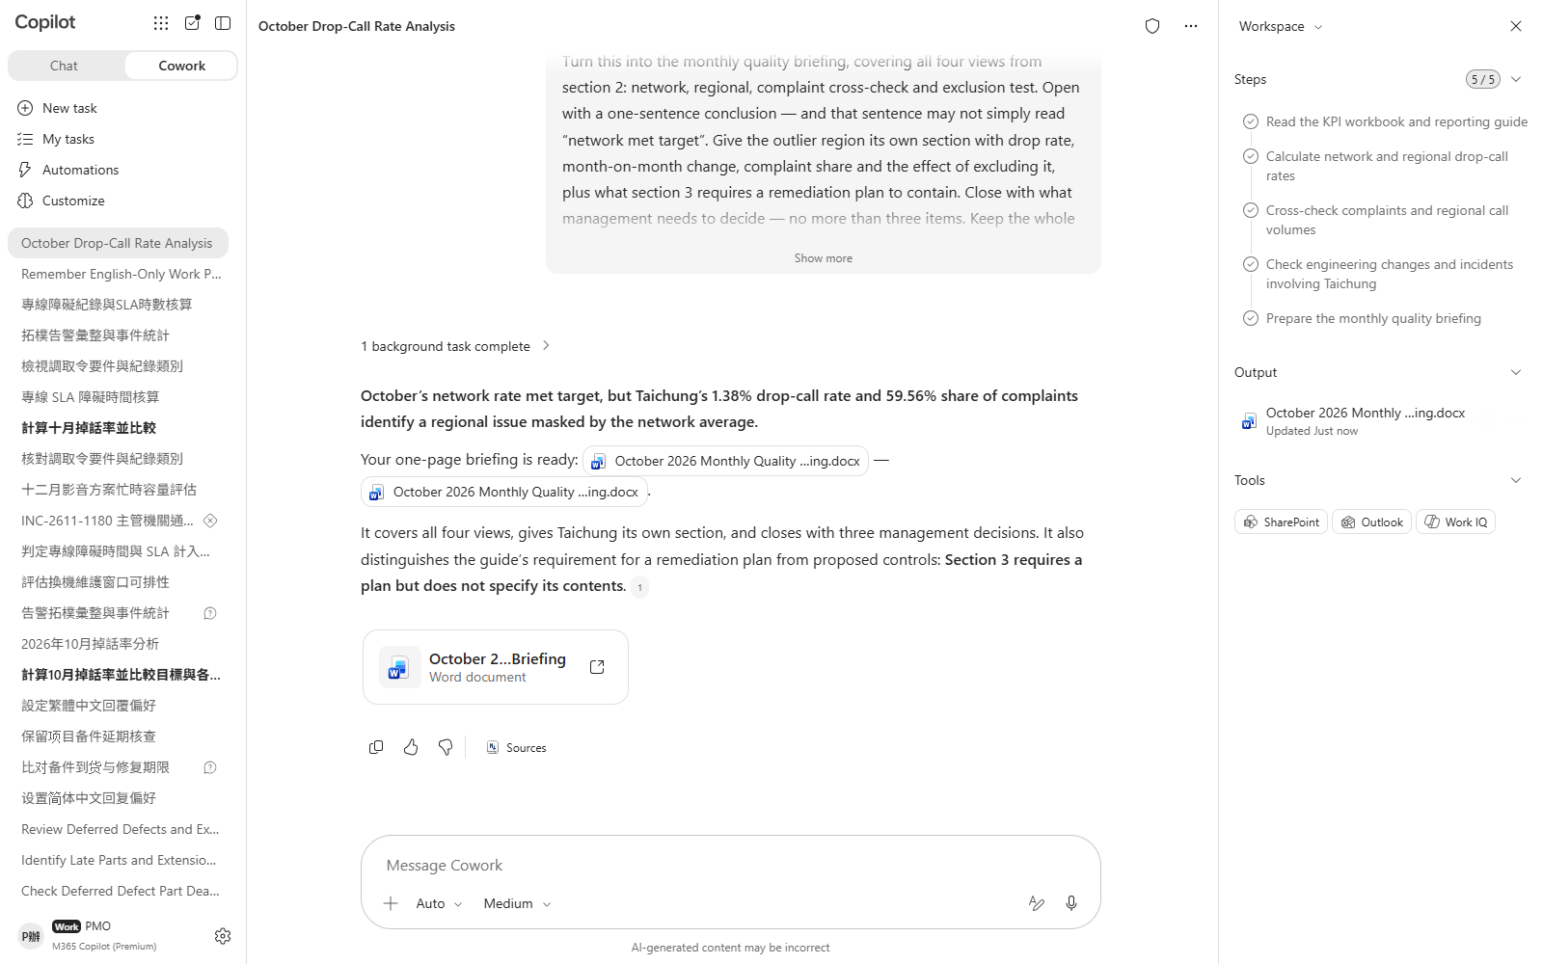

Scenario 07 · Live demo
What Cowork does, and what it produces
① Your input and prompt
② The result
Check the output
The network rate comes out as **meeting target** — it did not overstate the problem to make a point
All six regional rates were calculated and compared with the prior month
The exclusion test was run, with the resulting figure and the gap in points
Microsoft 365 Copilot Cowork
21

Slide 23
MAKE IT YOURS
Extend it to your own work
Telecom · Network Operations
💡 Reassign one cell to a different parent in the topology register and see whether the verdict follows.
Telecom · Network Operations
💡 Cut the work from three hours to two and see whether more windows become viable.
Telecom · Network Operations
💡 Raise the guaranteed window threshold to 25 minutes and see whether the verdict flips to nothing owed.
Telecom · Network Operations
💡 Change the subscriber count to 12,000 and see whether it switches to the general limb's deadline.
Telecom · Network Operations
💡 Halve the expected new subscribers and see whether one of the high-risk regions drops out.
Telecom · Network Operations
💡 Move the order's start date to August and see whether all four categories become fully answerable.
Telecom · Network Operations
💡 Make the outlier the highest-volume region and see whether the exclusion test still finds it.
Microsoft 365 Copilot Cowork
22

Slide 24





TRUST & CONTROL
Automated — but you're still the decision maker
Approval before action
Medium/high-risk actions show a RISK-LEVEL; sending mail, posting to Teams or creating meetings all open as an editable preview and go out only after approval.
Scope you control
Don't-ask-again can be limited to a recipient, a domain, or always; tasks can be soft/hard paused, resumed or cancelled.
Automated tasks have guardrails too
Scheduled prompts and event-driven tasks have run-frequency limits and loop protection; they always run with the creator's permissions, and are recorded in the unified audit log alongside all other Cowork activity, under Microsoft Purview policy.
Know the limits
No access to local files, no deleting OneDrive/SharePoint files, no reading encrypted files; attachments under 200MB; custom skills and third-party plugins aren't validated by Microsoft, so review the output yourself. Microsoft explicitly lists it as unsuitable where accuracy must be guaranteed without human review.
Microsoft 365 Copilot Cowork
23

Slide 25


Start practising now
Cowork Playbook
aka.ms/CoworkPlaybook
Start with the scenario closest to your own work
Custom skills live in OneDrive at /Documents/Cowork/skills/ as SKILL.md (up to 50, 1MB each)
Model picker: Auto (default), GPT 5.5 Frontier, GPT 5.6 Sol/Terra, GPT 6 Astra, Opus 5, Claude Sonnet 5, Claude Fable 5.1
Effort: Light / Medium (default) / High / Extra High / Max — higher is more thorough, but slower and uses more credits
Want it to fire by itself? Set a scheduled prompt (up to 25) or an event-driven task (incoming mail / @mention) on the "Automations" page

Slide 26
Thank you
From asking to delegating — you set the standard, Cowork does the work.
Microsoft 365 Copilot Cowork · Training deck

