Slide 1


Microsoft 365 Copilot
Cowork
Agentic AI at work
Seven real financial-holding compliance scenarios showing how Copilot executes across apps, shows a risk level before medium/high-risk actions, and waits for your approval
Training deck · client-ready

Slide 2
AGENDA
What we'll cover
01
Meet Cowork
What agentic AI is, and how it differs from Copilot Chat
02
Core capabilities
Skills, workspace, approval before action, self-verification
03
Set up your practice environment
Seed the material into OneDrive and your mailbox first, so Cowork finds it itself
04
Seven hands-on scenarios
Sign-off triage, staff training, cross-subsidiary meeting, group exposure, incident reporting, cross-marketing check, sign-off skill — one workflow at a time
05
Make it your own
How to extend these scenarios to your own work
Microsoft 365 Copilot Cowork
1

Slide 3



WHAT IS COWORK
From "chat" to "agentic execution"
Cowork is Copilot's agentic working mode.
You hand it a goal; it breaks the work into steps, reads your cloud files, loads the skills it needs, produces results across apps and checks its own work — pausing for your approval, with a risk level shown, before any medium or high-risk action. You move from quick single-turn answers to handing over a task that actually gets done.
Copilot Chat
Cowork agent
You stay in charge
Quick single-turn answers; great for instant replies and brainstorming.
You give a goal; it executes autonomously across apps, for minutes to hours.
Anything outbound or affecting others pauses for your approval.
Microsoft 365 Copilot Cowork
2

Slide 4
COMPARISON
Cowork vs. Copilot Chat
Copilot Chat
Copilot Cowork
Quick single-turn Q&A
Quick single-turn Q&A
Hand over a goal; autonomous multi-step work across apps
Seconds to minutes
Seconds to minutes
Minutes to hours (autonomous)
Single step, single session
Single step, single session
Multi-step workflows across tasks and sources
Paste in a snippet
Paste in a snippet
Reads cloud attachments and creates new files; no access to local files
One conversational capability
One conversational capability
Loads 14 built-in skills plus your custom ones automatically
Text in the chat window
Text in the chat window
Real documents, spreadsheets and decks in OneDrive
You have to open it and prompt every time
You have to open it and prompt every time
Scheduled prompts / event-driven: runs on incoming mail or an @mention
Grounded in M365 data
Grounded in M365 data
Connects to external systems via Plugins / MCP — the partner catalogue now lists 92 plugins (D365, SAP, Fabric and more)
You judge for yourself
You judge for yourself
Medium/high-risk actions show a risk level and run only after approval
Microsoft 365 Copilot Cowork
3

Slide 5




CORE CAPABILITIES
Four things that set Cowork apart
14 built-in skills
Workspace
Word, Excel, PowerPoint, PDF, Email, Scheduling, Calendar Management, Meetings, Daily Briefing, Enterprise Search, Deep Research, Communications, Adaptive Cards, App (Frontier).
The side panel shows progress, input files, output files, loaded skills, schedules and granted permissions all at once — the process stays traceable.
Approval before action
What's new
Medium/high-risk actions show a RISK-LEVEL; approve, cancel, or set don't-ask-again per recipient, per domain or always; multiple pending actions can be approved together.
Scheduled prompts (up to 25) and event-driven tasks; five Effort levels to balance quality against cost; every custom skill gets an automatic Skill Report (0–100 across four dimensions, plus five separate gates including a Safety and RAI scan); local Edge browser (GA since Aug 2026); image generation; Plugins / MCP for external systems.
Microsoft 365 Copilot Cowork
4

Slide 6




HOW IT WORKS
What happens inside one agentic workflow
Take the goal
Plan
Load skills
Execute
Self-verify
Approval before action
Upload files
Give the instruction
Understand the task
Break it into steps
14 built-in
+ custom
Create documents
spreadsheets / mail
Check the numbers
and consistency
Outbound actions
wait for you
The whole process is visible in the "Workspace" panel; you can soft/hard pause, resume or cancel a task.
It doesn't only start from chat: you can also have it fire automatically when a matching email arrives or you're @mentioned (event-driven tasks) — with the same self-verification and approval flow.
Microsoft 365 Copilot Cowork
5

Slide 7

BEFORE YOU START
Set up your practice environment
Seed the material into OneDrive under Documents/Cowork_Lab/GroupCompliance/ before the session, and Cowork will find it itself · Setup time about 20 minutes
📁
Create the OneDrive folders and upload the material for all seven scenarios
📇
Put the compliance contact roster in the parent folder — with addresses that really receive mail
Create Documents/Cowork_Lab/GroupCompliance/ in OneDrive…
Compliance_Contact_Roster.md belongs in the GroupComplia…
📧
Send yourself the five product confirmation emails — the starting point for scenario 1
📎
Keep the five upload files on your own device — don't put them in OneDrive
Send them to yourself from your own account. Subjects an…
The five files under 上傳用/ — the three position sheets fo…
📅
Check the dates in the material against today before you start
The meeting window (scenario 3), the go-live and launch …
Final check before the session
All seven subfolders exist, and each scenario's files are in the right one
The contact roster is in the parent folder, with real, reachable addresses in the email column
All five product confirmation emails are in the inbox with their case numbers intact
Microsoft 365 Copilot Cowork
6

Slide 8





7 SCENARIOS
Seven hands-on scenarios
Financial Holding HQ · Compliance & Risk
Financial Holding HQ · Compliance & Risk
Financial Holding HQ · Compliance & Risk
Financial Holding HQ · Compliance & Risk
Financial Holding HQ · Compliance & Risk
Financial Holding HQ · Compliance & Risk
Financial Holding HQ · Compliance & Risk
Triaging the Shared Compliance Mailbox
Compliance Training: On Target Overall, Off Target Where It Matters
The Quarterly Coordination Meeting That Cannot Be One Meeting
Group Exposure: Four Subsidiaries Within Limit, One Group Over
Incident Reporting: The Two-Hour Clock Does Not Start Where You Think
Cross-Marketing Lists: Consent Is Not a Yes/No Field
A Product Sign-off Skill, Built on Channels Rather Than Products
Email · Enterprise Search · Daily Briefing · Adaptive Cards · Scheduled prompt
Enterprise Search · File upload · Excel · Communications · Email
Scheduling · Calendar Management …
File upload · Excel …
PowerPoint · Image generation …
Event trigger · Email …
Custom skill · Skill Report …
~20 min
★★★
~12 min
★★☆
~15 min
★★★
~18 min
★★★
~18 min
★★★
~20 min
★★★
~20 min
★★☆
Microsoft 365 Copilot Cowork
7

Slide 9
Scenario 01
Zava Life has sent five "product compliance confirmation" emails on the same day, with almost identical subject lines. Which of them actually need a compliance opinion? The answer is not in the emails — it is in the filing-versus-approval matrix. And the two marked URGENT happen to be the ones that are not.
Agentic workflow
Financial Holding HQ · Compliance & Risk
Let it work out what the five emails actually are
1
Triaging the Shared Compliance Mailbox
Nothing to upload. The five emails are in your inbox; th…
2
Work out the due date for the only one that counts
Ask this in the same session — don't start a new one.。
⏱ ~12 min · Level ★★☆
Email
Enterprise Search
3
File them, and turn the result into a card
This step really creates folders in your mailbox and mov…
Daily Briefing
Adaptive Cards
4
Turn it into a scheduled prompt that runs every morning
Scheduled prompt
Once it's set, check the Automations page in the left na…
Microsoft 365 Copilot Cowork
8

Slide 10
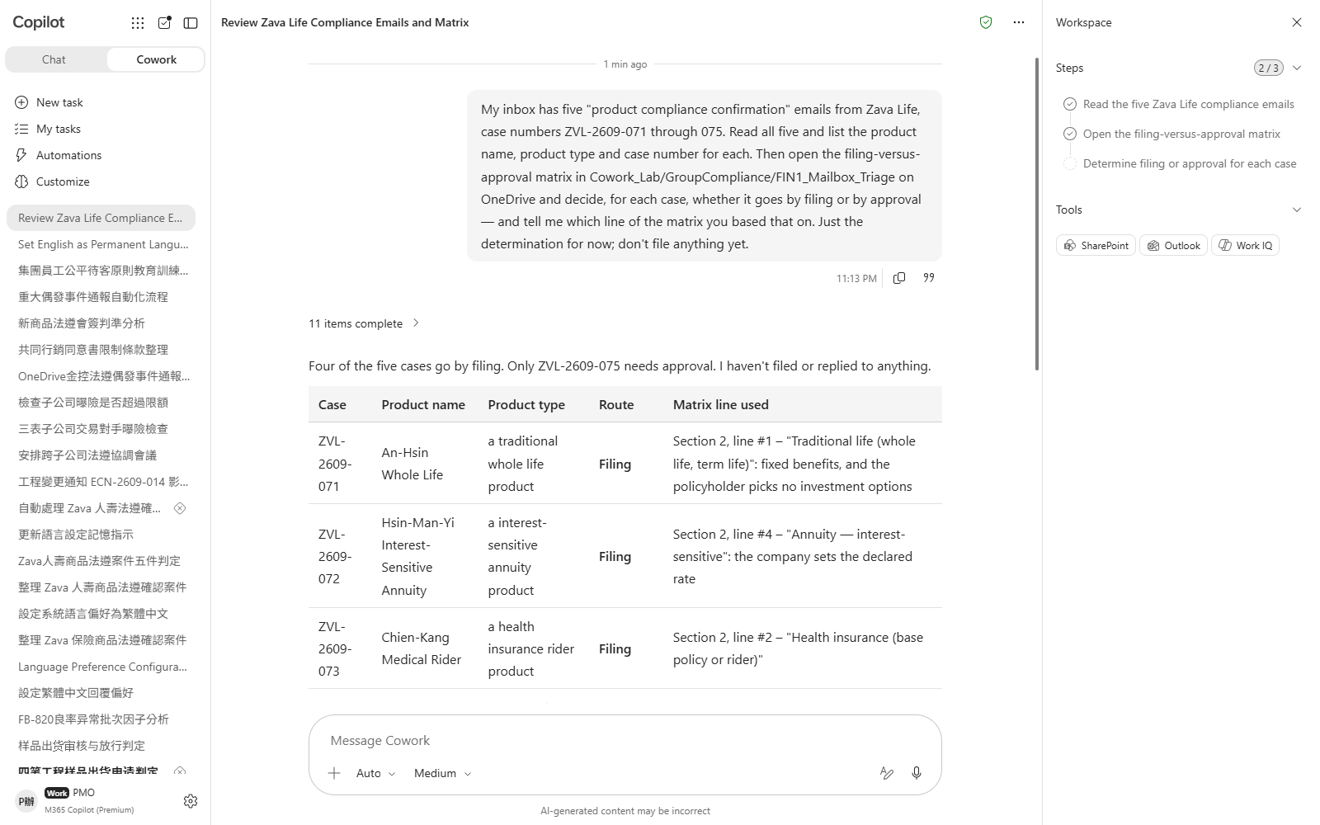
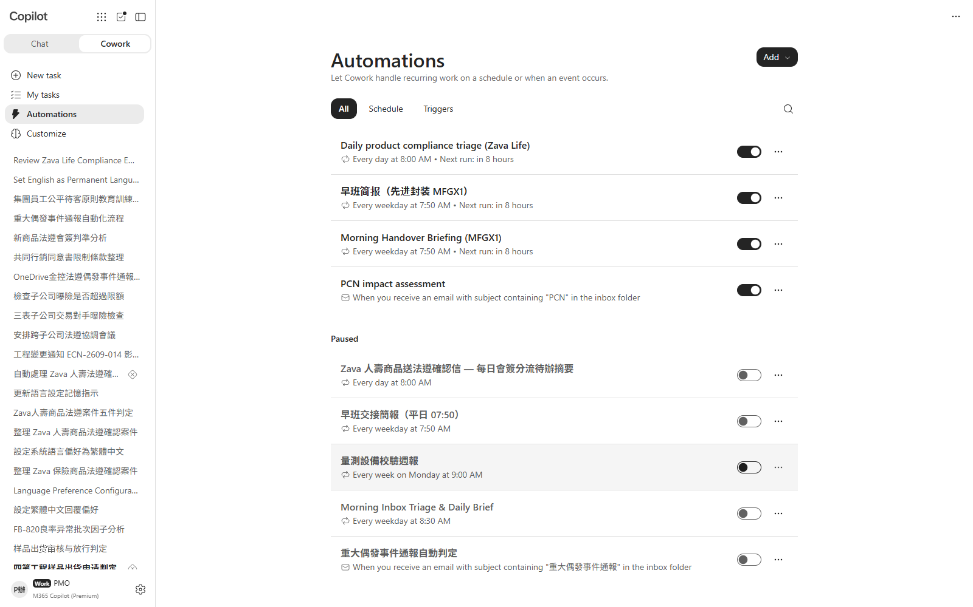

Scenario 01 · Live demo
What Cowork does, and what it produces
① Your input and prompt
② The result
Check the output
The determination rests on the product type, not the subject line — did it cite the specific line of the matrix?
Only one of the five needs a compliance opinion; the other four are filing only — did it avoid treating all five as work?
The deadline counts working days from the day after receipt and rolls over weekends — is the date it produced correct?
Microsoft 365 Copilot Cowork
9

Slide 11
Scenario 02
This year's fair-treatment-of-customers training needs slides, an awareness illustration, completion statistics and reminder emails — all in one go. The numbers come back at 94.0% group-wide, with every subsidiary above the threshold. Break it down one more level and the problem appears.
Agentic workflow
1
Build the training deck
Financial Holding HQ · Compliance & Risk
Nothing to upload — the material is in Cowork_Lab/GroupC…
Compliance Training: On Target Overall, Off Target Where It Matters
2
Have it generate an awareness illustration for the cover
Cowork has built-in image generation — just describe wha…
3
Compute the completion rate — and break it down far enough
⏱ ~20 min · Level ★★☆
Stay in the same session.。
PowerPoint
4
Apply the new-hire rule and see what moves
Image generation
Excel
This step is about whether it applies the exception clau…
Communications
Email
5
Send the reminder to the unit that fell short
Adaptive Cards
Look the recipient up in the compliance contact roster i…
Microsoft 365 Copilot Cowork
10

Slide 12
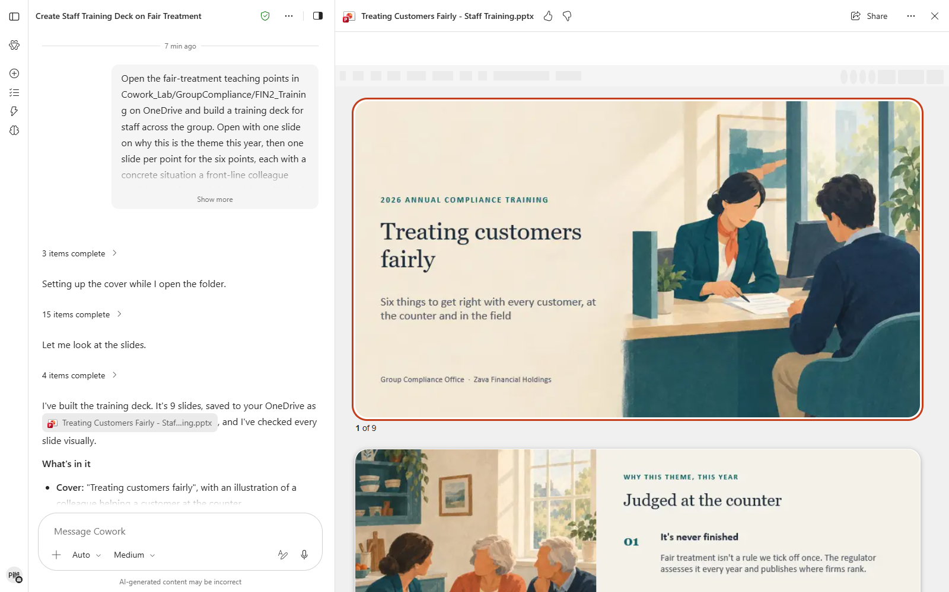
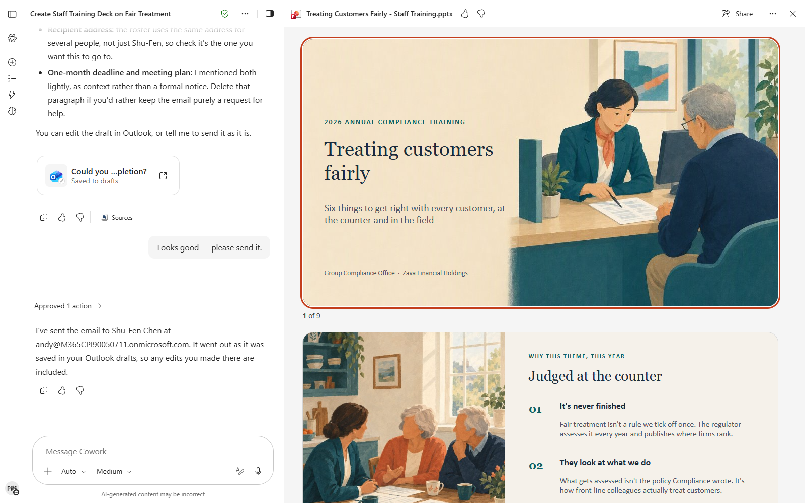

Scenario 02 · Live demo
What Cowork does, and what it produces
① Your input and prompt
② The result
Check the output
The group total and all four subsidiaries clear the threshold — did it stop there and call it a pass?
The shortfall sits at the Zava Life field agents level, not Zava Life as a whole — did it break the data down that far?
New hires come out of the denominator, not counted as completed — the two treatments give different answers
Microsoft 365 Copilot Cowork
11

Slide 13
Scenario 03
A quarterly coordination meeting needs the compliance heads of all four subsidiaries. Send four invitations straight off the roster and one person gets two of them — the investment trust's compliance head is the securities arm's compliance head. And one item on the agenda is precisely the kind that person cannot sit through, under the group's information barrier rules.
Financial Holding HQ · Compliance & Risk
Agentic workflow
The Quarterly Coordination Meeting That Cannot Be One Meeting
1
Work out who you are actually inviting
The compliance contact roster sits in the parent folder …
2
Read the agenda against the barrier rules
⏱ ~15 min · Level ★★★
This is the crux of the scenario — let it put the two do…
Scheduling
3
Find a slot that works for everyone
Calendar Management
It will check attendees' calendars — watch for anyone ou…
Enterprise Search
Word
4
Create the meetings and send the invitations
Email
This step really sends invitations; Cowork shows you the…
Microsoft 365 Copilot Cowork
12

Slide 14
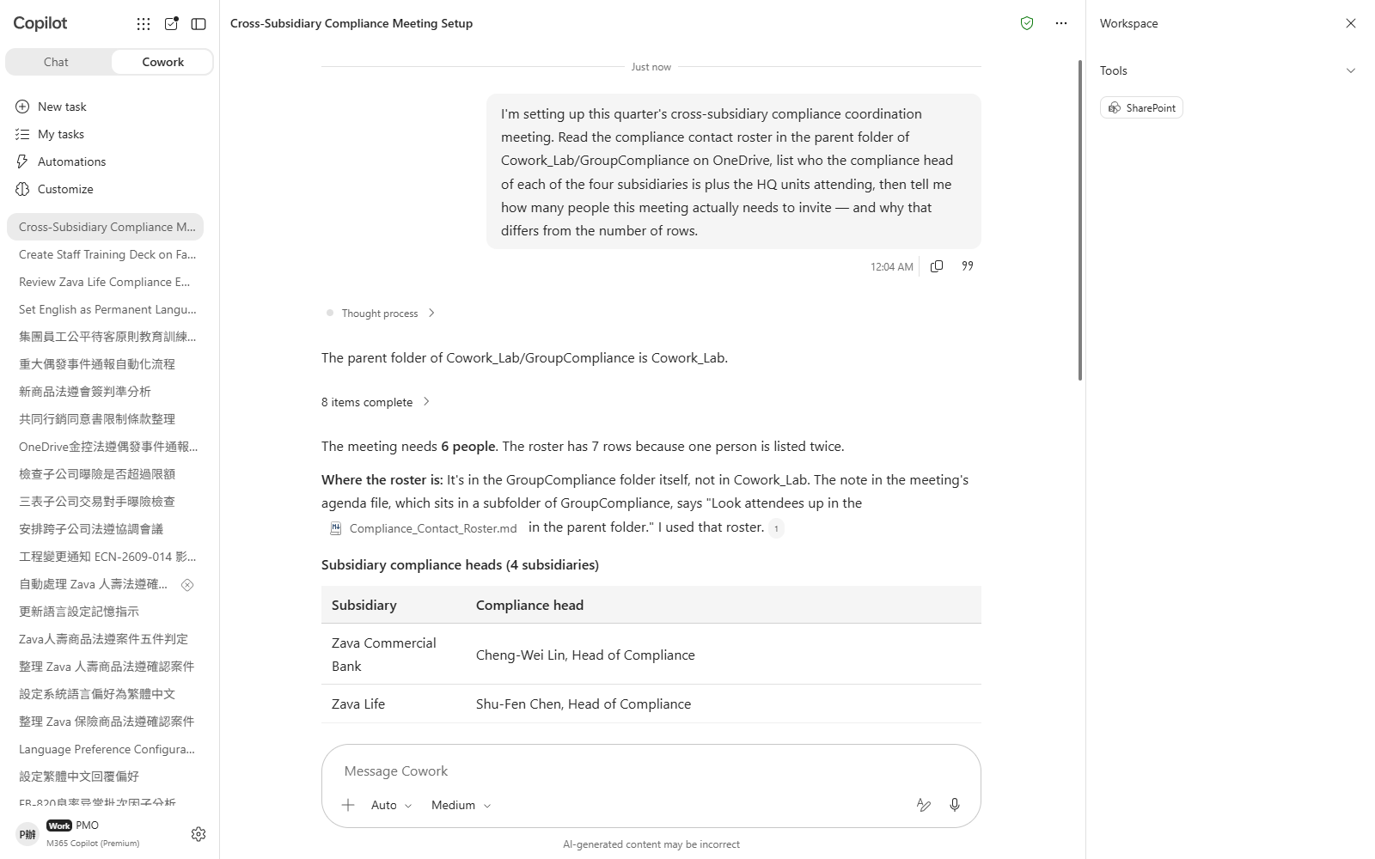
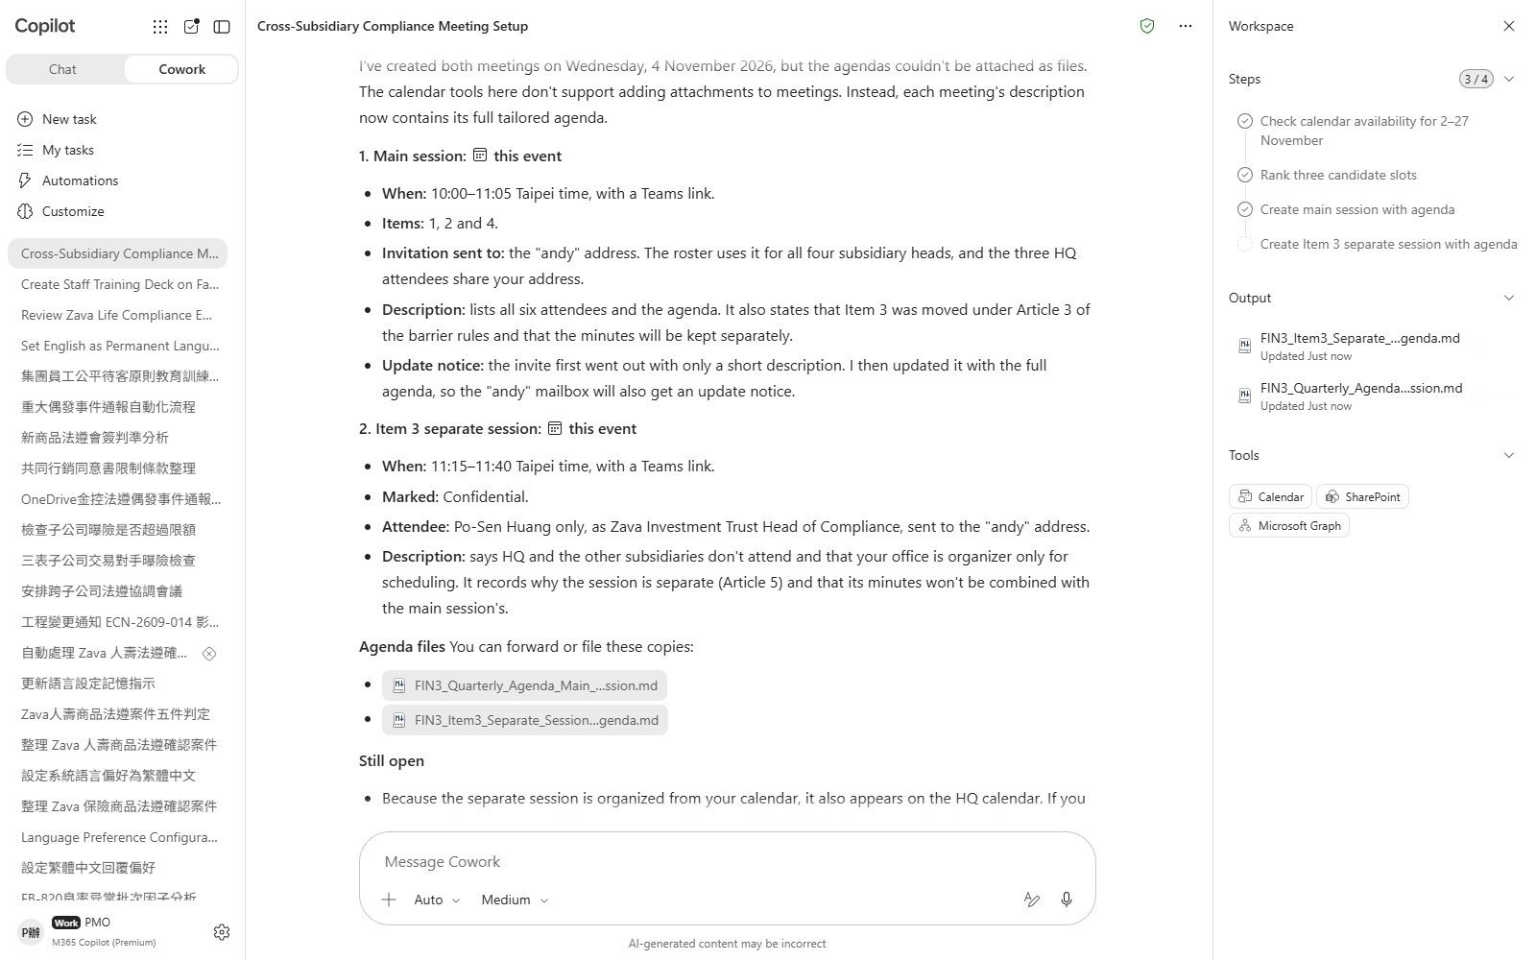

Scenario 03 · Live demo
What Cowork does, and what it produces
① Your input and prompt
② The result
Check the output
The roster has seven rows but six people — did it spot that one person holds two roles, rather than sending seven invitations?
The walled item is item 3, and the remedy is a separate session — not dropping that person from the whole meeting
One attendee is out for an entire day — did it rule that day out, or schedule over it?
Microsoft 365 Copilot Cowork
13

Slide 15
Scenario 04
The bank, the life company and the securities arm each send up their positions, and every one of them is inside its own limit. Map the three sheets onto the affiliation table and one customer group breaches. The instinct is to unwind the smallest line first — do that and you are still over.
Agentic workflow
Financial Holding HQ · Compliance & Risk
Upload the three sheets and check each subsidiary against its own limit
1
Group Exposure: Four Subsidiaries Within Limit, One Group Over
Drag all three xlsx files from the 上傳用 folder into the c…
2
Map to customer groups and compute the combined exposure
This is the heart of the scenario.。
⏱ ~20 min · Level ★★★
File upload
Excel
3
Ask which line actually fixes it
This step is about whether it assumes the smallest line …
Enterprise Search
4
Produce the workbook and the risk committee deck
Adaptive Cards
PowerPoint
Both outputs appear in the Output folder in the side pan…
Microsoft 365 Copilot Cowork
14

Slide 16
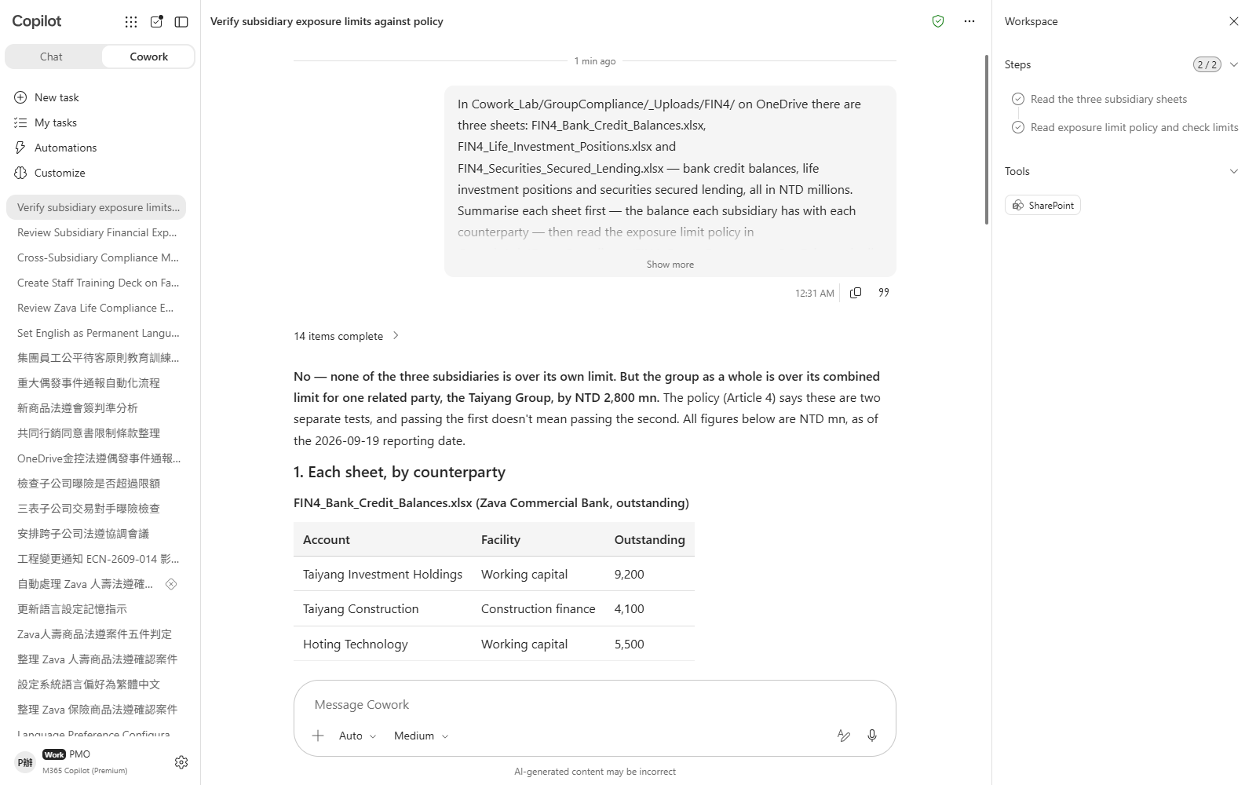
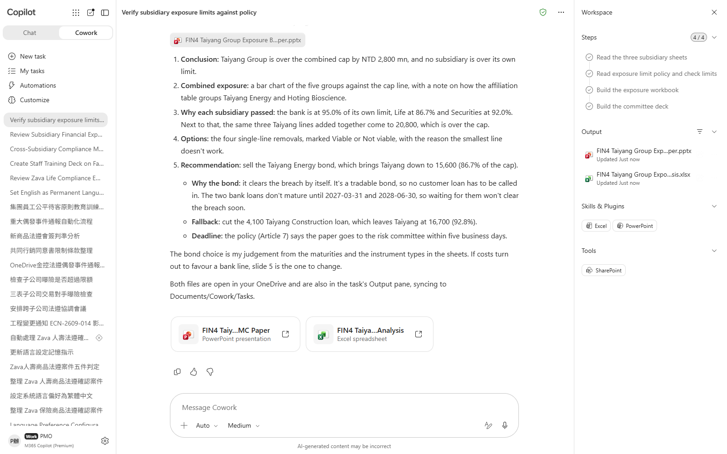

Scenario 04 · Live demo
What Cowork does, and what it produces
① Your input and prompt
② The result
Check the output
All three subsidiaries are individually within limit — did it establish that first before combining?
Grouping follows the affiliation table, not how similar the names look
The excess is larger than the smallest line — removing it leaves the group still over the cap. Did it notice?
Microsoft 365 Copilot Cowork
15

Slide 17
Scenario 05
The clock starts the moment a subsidiary's incident report arrives. The most prominent timestamp in the email is when the incident happened — but the statutory clock runs from when you became aware, and the two are a day and a half apart. And reporting to the regulator is not the only obligation here, because what leaked was customer personal data.
Financial Holding HQ · Compliance & Risk
Agentic workflow
Incident Reporting: The Two-Hour Clock Does Not Start Where You Think
1
Have it read the reporting procedure first
Don't send the incident email yet. This step is only abo…
2
Arm the event-driven task
⏱ ~18 min · Level ★★★
A Set up trigger? card appears showing When, Run in, Wha…
Event trigger
Email
3
Send the notification and watch the trigger fire
Adaptive Cards
Before sending, change the time of occurrence in the ema…
Calendar Management
4
Ask what it missed, then put the deadlines in the calendar
Enterprise Search
Continue in the session the trigger opened. Remember to …
Microsoft 365 Copilot Cowork
16

Slide 18
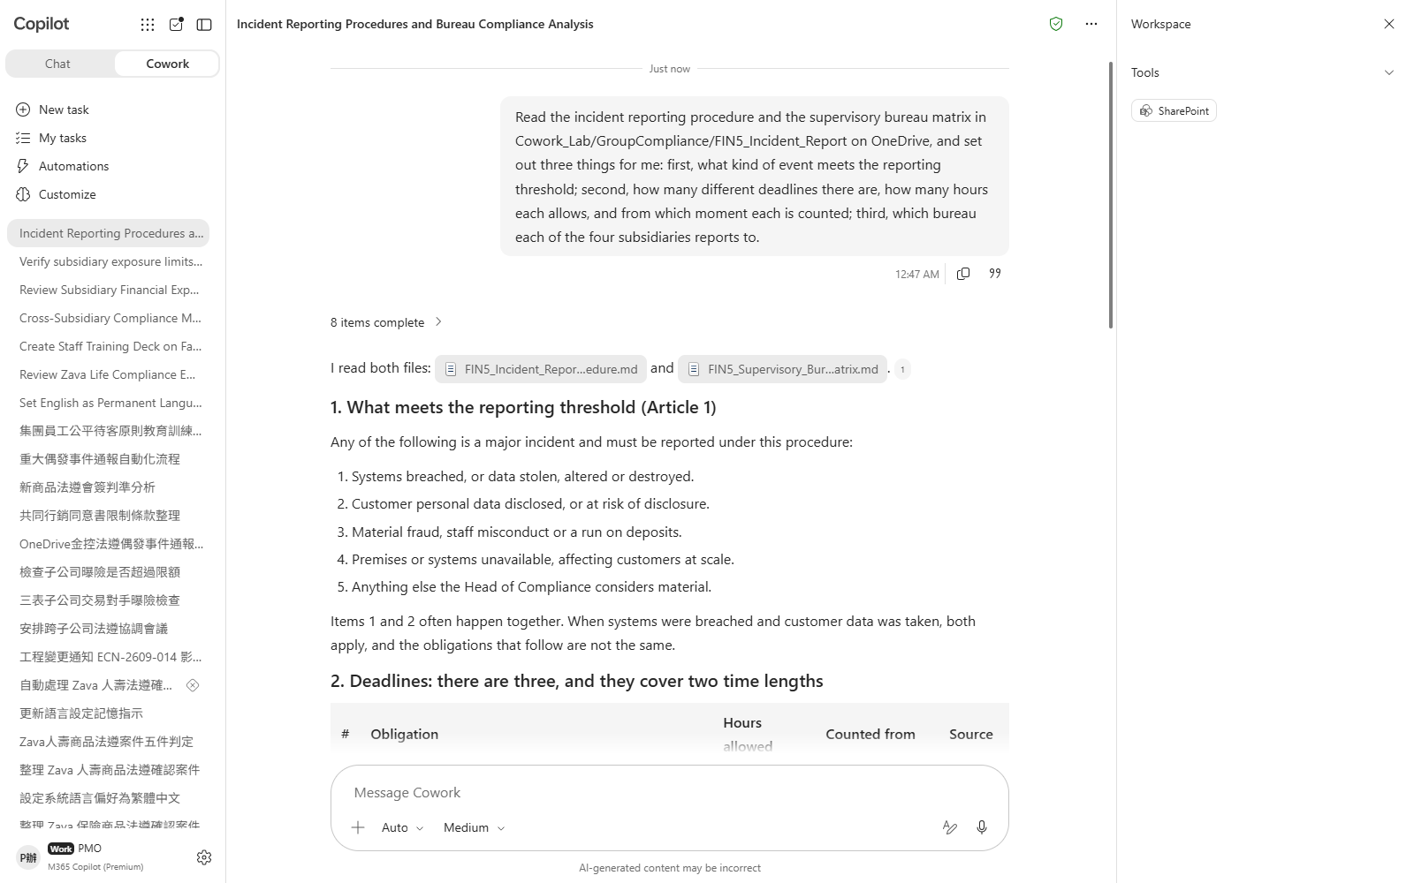
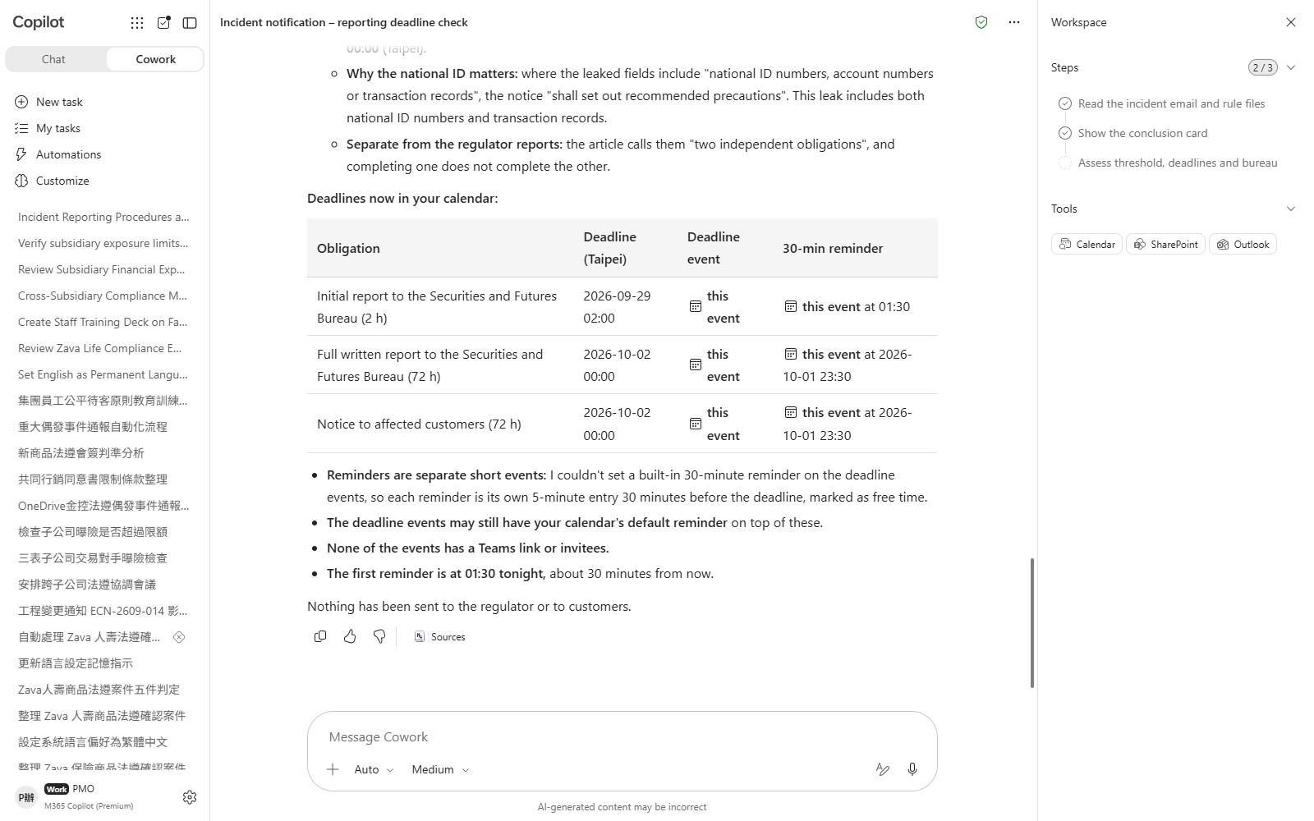

Scenario 05 · Live demo
What Cowork does, and what it produces
① Your input and prompt
② The result
Check the output
The clock runs from when you became aware, not when the incident happened — which timestamp did it use?
There is more than one obligation here — did it stop after the regulator one?
The two obligations have different audiences and separate clocks
Microsoft 365 Copilot Cowork
17

Slide 19
Scenario 06
The securities arm wants to cross-sell to bank customers and sends over a list, saying they have all signed the cross-marketing consent. They have. But consent has a scope — which data may be shared, which products may be marketed, and which subsidiaries may receive it are three separate questions.
Financial Holding HQ · Compliance & Risk
Agentic workflow
Cross-Marketing Lists: Consent Is Not a Yes/No Field
1
Establish what consent actually governs
Don't upload the list yet — let it go and find the rules…
2
Upload the list and check it line by line
⏱ ~18 min · Level ★★★
Drag 上傳用/FIN6_Campaign_List.csv into the chat.。
Enterprise Search
3
Probe the overlap and the ratio
File upload
Excel
This checks whether it treated the three dimensions as m…
Communications
Email
4
Produce the rejection detail and tell the requester
This step really sends an email; take the recipient from…
Microsoft 365 Copilot Cowork
18

Slide 20
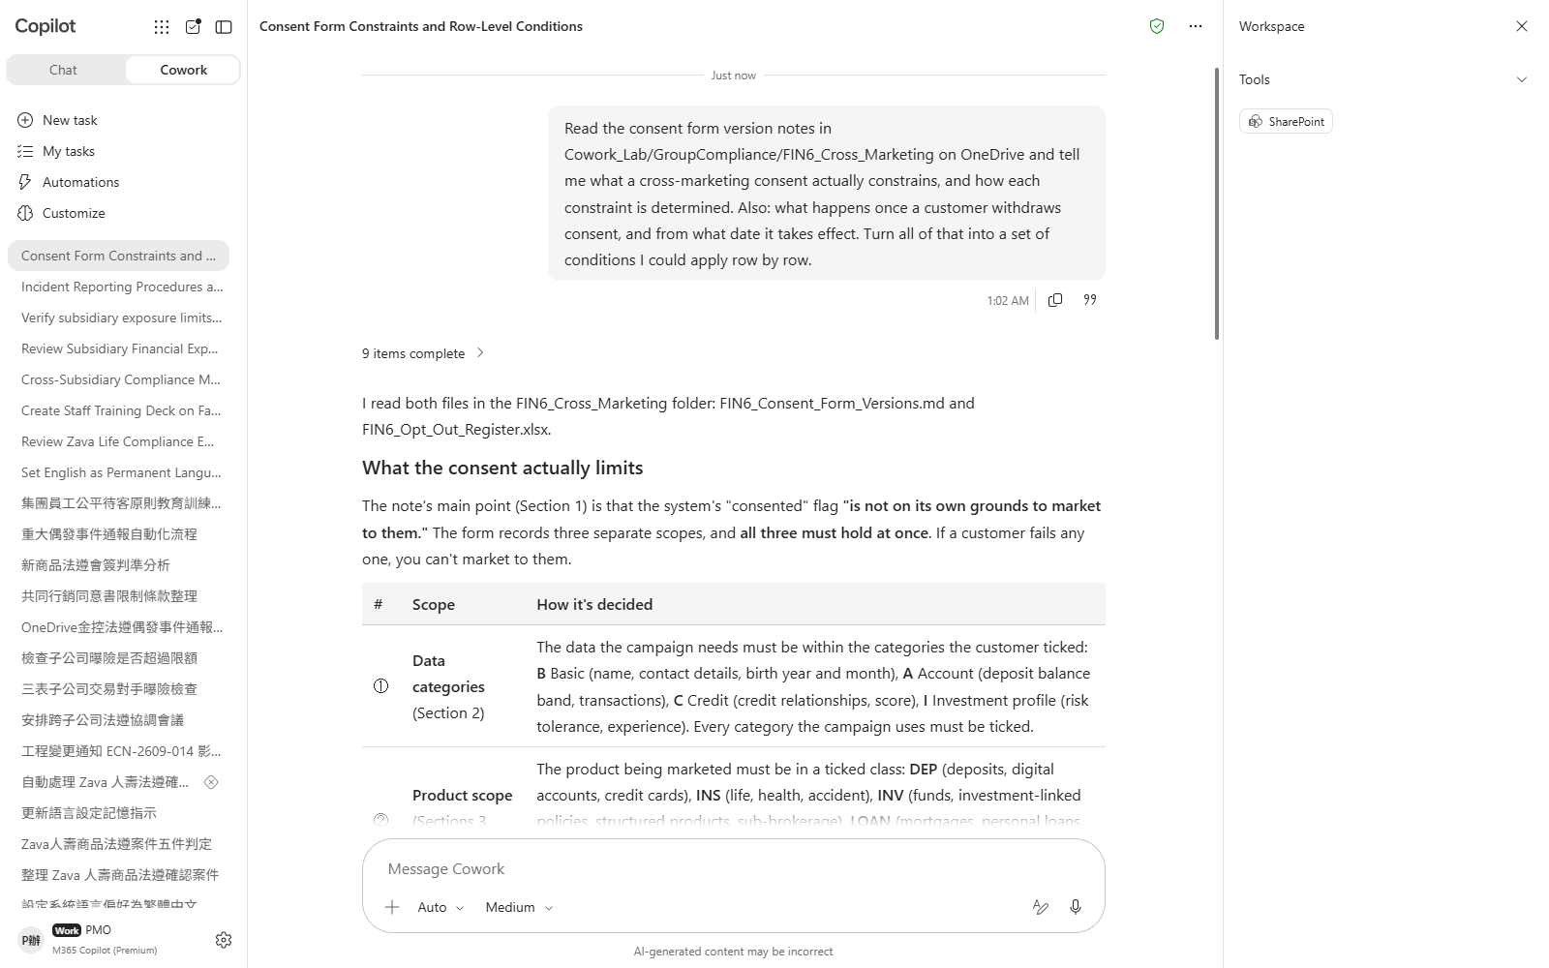
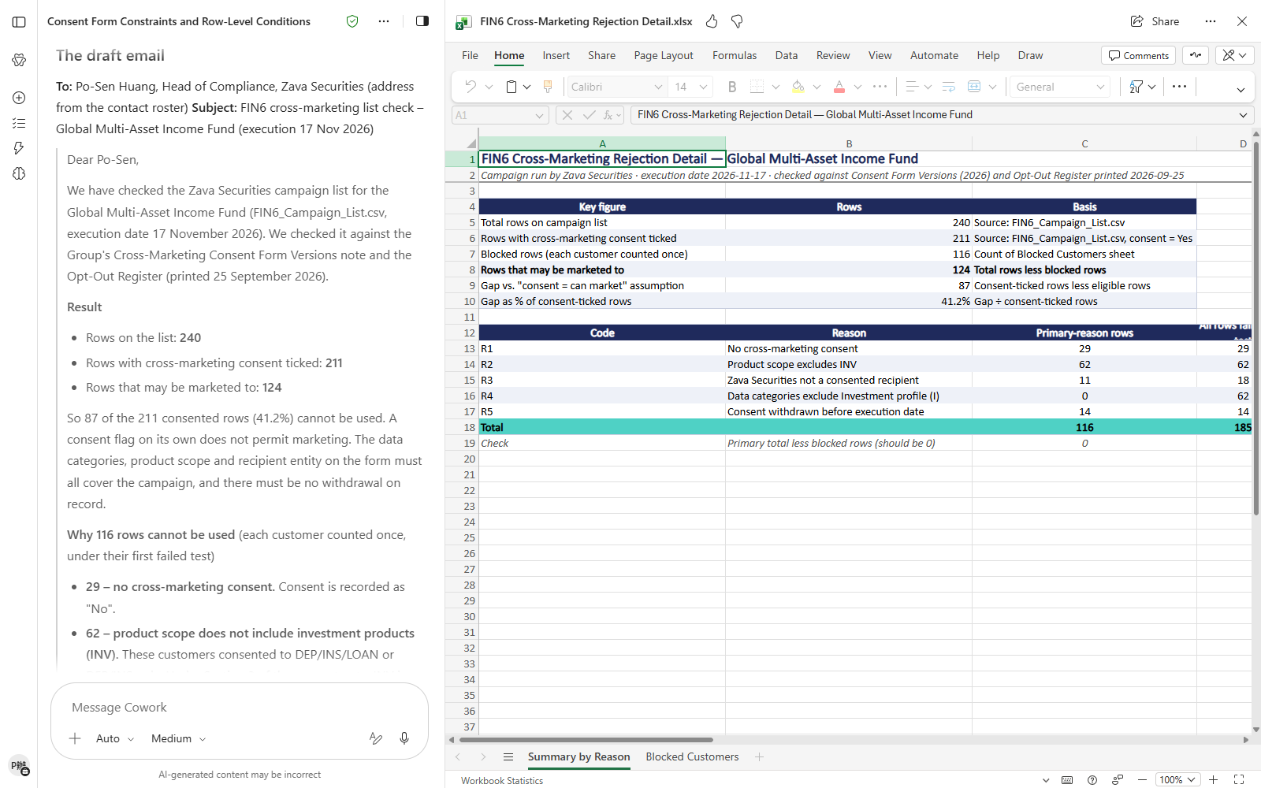

Scenario 06 · Live demo
What Cowork does, and what it produces
① Your input and prompt
② The result
Check the output
Consent has three dimensions to check separately, not one checkbox
The number with consent ticked and the number that may be marketed to are very different — did it keep them apart?
Some customers breach two restrictions at once — does the breakdown double-count them?
Microsoft 365 Copilot Cowork
19

Slide 21
Scenario 07
Every new product sign-off comes down to the same five checkpoints. Turn them into a skill and the business unit can run it themselves, so the compliance office stops being a human checklist.But how you build the skill decides what it misses — the business thinks in product categories, while the rules are written by channel.
Financial Holding HQ · Compliance & Risk
Agentic workflow
A Product Sign-off Skill, Built on Channels Rather Than Products
1
Work out which axis the criteria belong on
⚠️ Custom skills work on desktop and browser only — mobi…
2
Have it build the skill
⏱ ~20 min · Level ★★★
Skill names accept lowercase letters, digits and hyphens…
Custom skill
Skill Report
3
Read the Skill Report
Enterprise Search
Excel
Cowork evaluates a skill automatically whenever it is cr…
4
Test it against a real submission
First select New task on the left to start a fresh conve…
Microsoft 365 Copilot Cowork
20

Slide 22
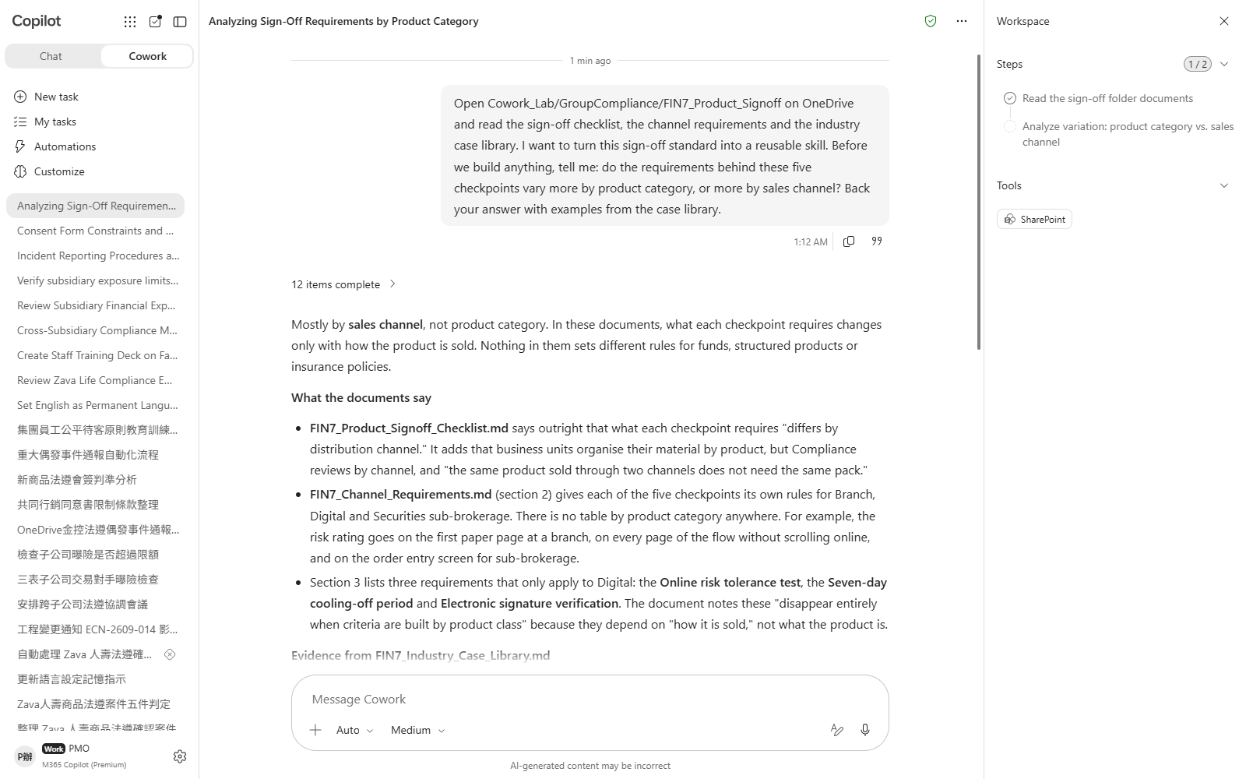
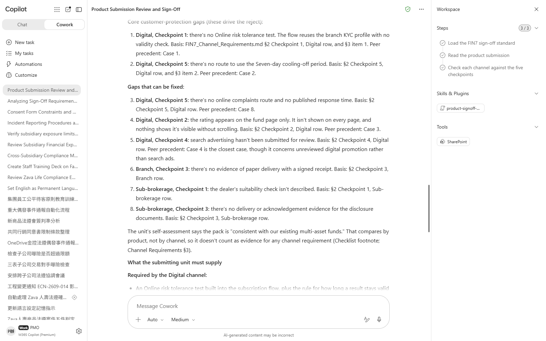

Scenario 07 · Live demo
What Cowork does, and what it produces
① Your input and prompt
② The result
Check the output
The criteria hang on channel, not product category — how is the skill organised?
The digital channel carries requirements the others do not — does the skill cover them?
Skill names allow only lowercase letters, digits and hyphens — did it handle that?
Microsoft 365 Copilot Cowork
21

Slide 23
MAKE IT YOURS
Extend it to your own work
Financial Holding HQ · Compliance & Risk
💡 Change the schedule to "only email me when there is an approval case; stay quiet otherwise" and see how it handles an empty result.
Financial Holding HQ · Compliance & Risk
💡 Ask it to cut the deck down to a field-agent-only version and see which points it keeps and which it drops.
Financial Holding HQ · Compliance & Risk
💡 Ask it to turn each meeting's agenda into a Word meeting notice and see how it words the reason for the split.
Financial Holding HQ · Compliance & Risk
💡 Ask "if eligible capital fell 10%, how many more customer groups would breach?" and watch how it runs the sensitivity.
Financial Holding HQ · Compliance & Risk
💡 Change the trigger to "when I'm @mentioned in a Teams channel about an outage" and see how the Set up trigger card changes.
Financial Holding HQ · Compliance & Risk
💡 Ask "if the campaign product were a time deposit instead, how many rows could we use?" and see whether it genuinely re-runs the scope test.
Financial Holding HQ · Compliance & Risk
💡 Feed it a product that only goes through the branch channel and check the skill correctly does not demand the digital-only items.
Microsoft 365 Copilot Cowork
22

Slide 24





TRUST & CONTROL
Automated — but you're still the decision maker
Approval before action
Medium/high-risk actions show a RISK-LEVEL; sending mail, posting to Teams or creating meetings all open as an editable preview and go out only after approval.
Scope you control
Don't-ask-again can be limited to a recipient, a domain, or always; tasks can be soft/hard paused, resumed or cancelled.
Automated tasks have guardrails too
Scheduled prompts and event-driven tasks have run-frequency limits and loop protection; they always run with the creator's permissions, and are recorded in the unified audit log alongside all other Cowork activity, under Microsoft Purview policy.
Know the limits
No access to local files, no deleting OneDrive/SharePoint files, no reading encrypted files; attachments under 200MB; custom skills and third-party plugins aren't validated by Microsoft, so review the output yourself. Microsoft explicitly lists it as unsuitable where accuracy must be guaranteed without human review.
Microsoft 365 Copilot Cowork
23

Slide 25


Start practising now
Cowork Playbook
aka.ms/CoworkPlaybook
Start with the scenario closest to your own work
Custom skills live in OneDrive at /Documents/Cowork/skills/ as SKILL.md (up to 50, 1MB each)
Model picker: Auto (default), GPT 5.5 Frontier, GPT 5.6 Sol/Terra, GPT 6 Astra, Opus 5, Claude Sonnet 5, Claude Fable 5.1
Effort: Light / Medium (default) / High / Extra High / Max — higher is more thorough, but slower and uses more credits
Want it to fire by itself? Set a scheduled prompt (up to 25) or an event-driven task (incoming mail / @mention) on the "Automations" page

Slide 26
Thank you
From asking to delegating — you set the standard, Cowork does the work.
Microsoft 365 Copilot Cowork · Training deck

