Slide 1
Advanced EF Topics

Slide 2
Overview
Inheritance
Migrations
Code Generation

Slide 3
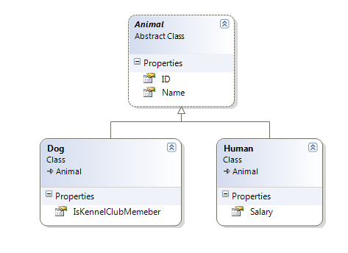
Inheritance

Slide 4
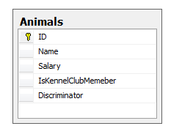
Table Per Hierarchy (TPH)
Default
One table
Requires nullable columns
Requires discriminator column

Slide 5
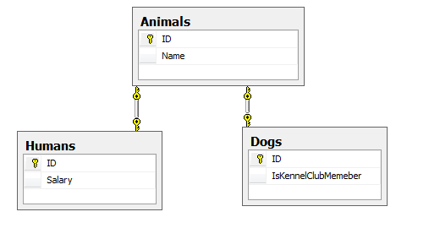
Table Per Type (TPT)
One table per type
Advantages: normalized with non null columns
Beware of joins
Requires explicit mapping (ToTable or [Table])

Slide 6
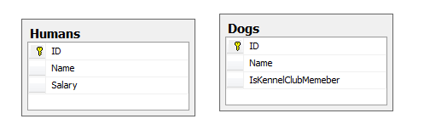
Table Per Concrete Type (TPC)
No joins
Requires more configuration
Associations can be tricky
No identity columns!

Slide 7
Other Entity Mappings
Entity splitting
Complex Types
Stored procedures with multiple resultsets

Slide 8
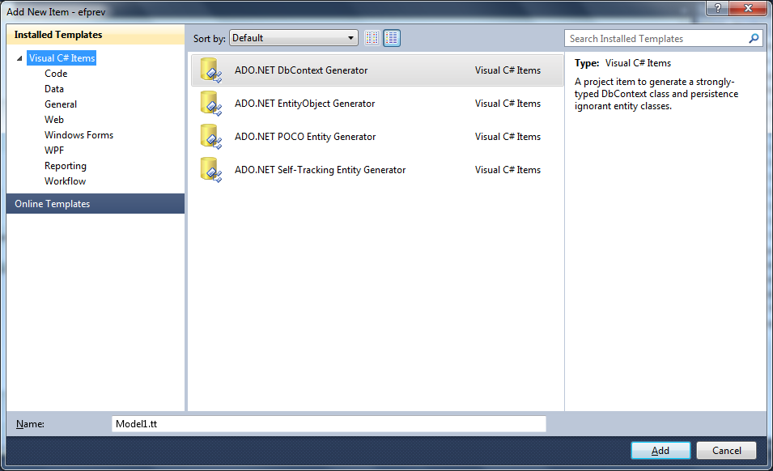
Code Generation Items & T4

Slide 9
Validations
System.ComponentModel.DataAnnotations
Required
MinLength
MaxLength
Regex
Custom

Slide 10
Migrations
Install-Package EntityFramwork.Migrations
Automatic migrations
Code based migrations
public class Settings : DbMigrationContext<MovieDb>
{
public Settings()
{
AutomaticMigrationsEnabled = false;
SetCodeGenerator<CSharpMigrationCodeGenerator>();
AddSqlGenerator<SqlConnection, SqlServerMigrationSqlGenerator>();
}
}

Slide 11
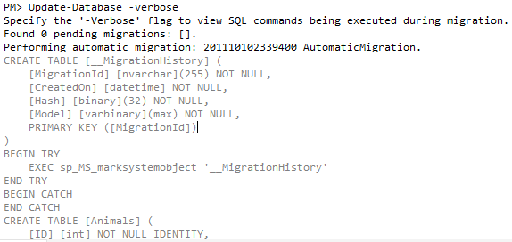
Update-Database
Can perform an automatic migration

Slide 12
Summary
EF Code First
Easy API
Conventions
Migrations

