Slide 1

An Introduction To Angular 2

Slide 2

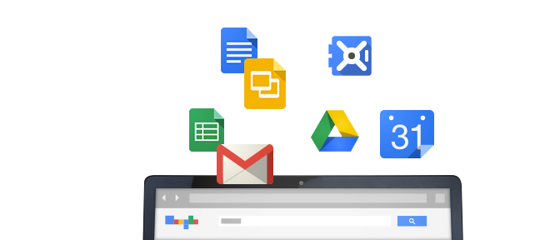
History
Started in 2009 @ Google
Built from experience with large web applications

Slide 3
Angular 2 Goals
Separation
of
Concerns
Testability
Extensibility
Forward
Looking

Slide 4

Getting Off The Ground
Our Code
Compile &
Package
Angular 2

Slide 5

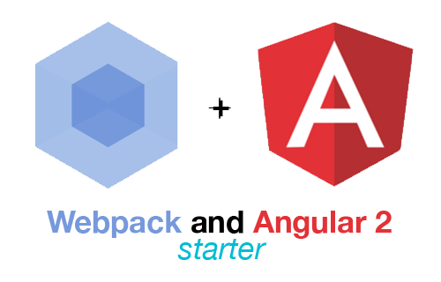
Getting Started Helpers

Slide 6
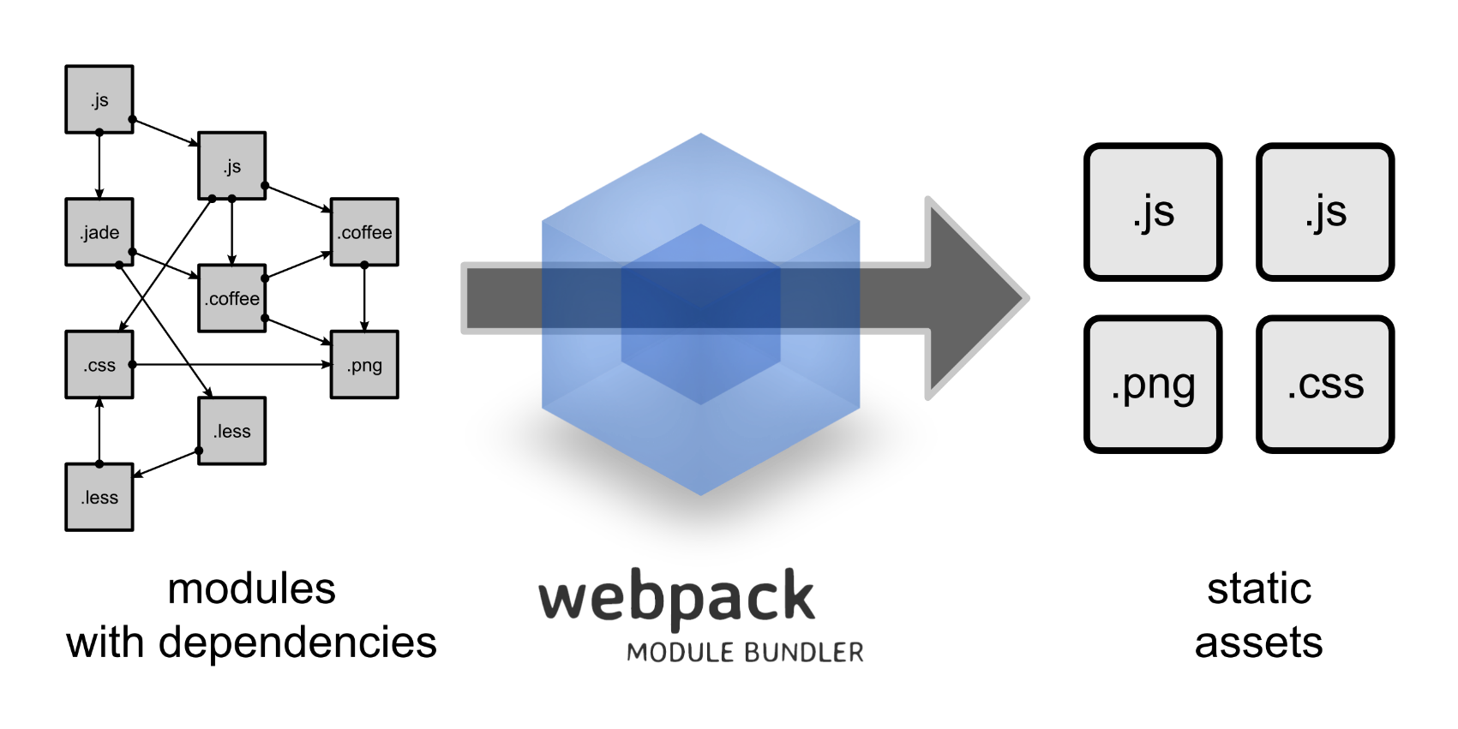
What’s Happening

Slide 7
Follow Along!
Clone https://github.com/odetocode/ngclass
npm install
npm start

Slide 8
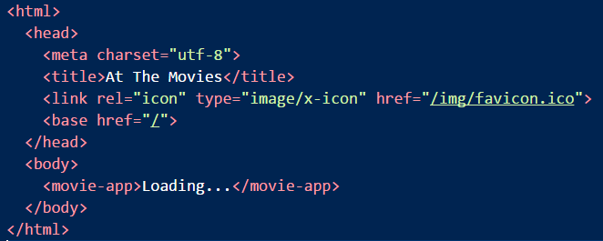
Shell Page

Slide 9
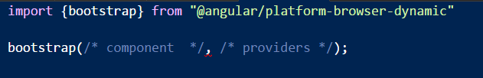
Bootstrapping

Slide 10
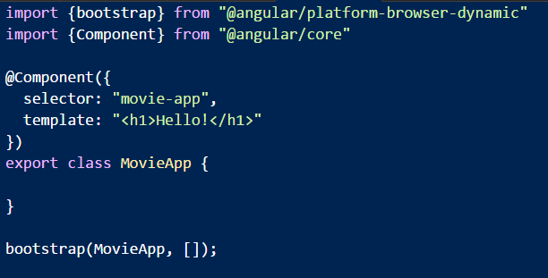
Components
Components define a custom HTML element
Data + behavior + template

Slide 11
What’s Being Loaded?
polyfills
es6-shim
reflect-
metadata
zonejs
vendor
angular
rx-js
app
my-code

Slide 12
Other Starting Points
Yeoman generators
generator-angular2
generator-angular2-gulp-webpack
Seed projects
angular2-seed (npm)
ng2-play (github:pkozlowski-opensource)
angular-starter (github:eladrk)
SystemJS versus Webpack

Slide 13
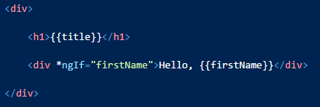
Directives
Directives extend HTML
Add behavior or change the appearance of the DOM
Angular compiles markup to process directives
You can build your own directives
In fact, this is encouraged

Slide 14
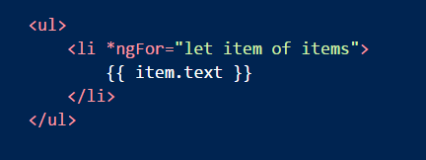
Templates
Responsible for presenting the model
Using directives and {{ interpolation }}

Slide 15
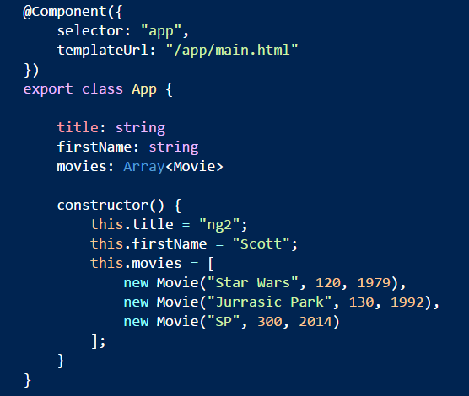
Models
Plain Old JavaScript (2015)
Component fields exposed for binding

Slide 16
Essence
<template>
Components
No direct DOM manipulation
Templates
No serious model manipulation
properties
events
@Component

Slide 17
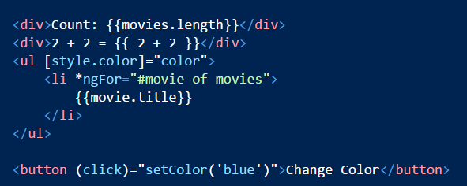
Template Syntax
Display text using {{expressions}}
Set properties using [expressions]
Handle events using (expressions)
[] () deal with properties, not attributes
Expressions limit side effects and global scope

Slide 18
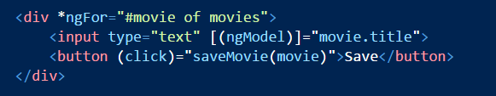
Inputs
Two way data binding and change notification

Slide 19
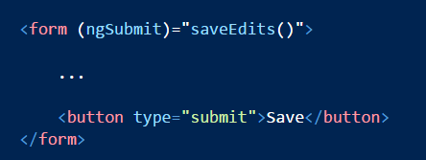
Forms
Support for validation and dirty flags
Use ngModel in combination with:
ngSubmit
ngControl
ngForm

Slide 20
Angular versus Unobtrusive JavaScript
Everyone is using JavaScript
Angular behaves the same across browsers
Expressions not evaluated in global scope

Slide 21
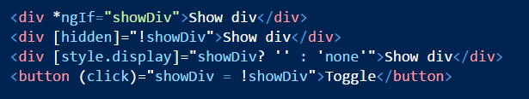
Hiding and Showing
Several approaches
Use *ngIf
Bind to the hidden property
Bind to the style.display property

Slide 22
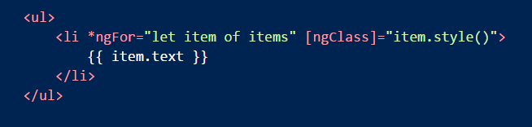
Styles
Use the ngClass directive
Adds class names for truthy values

Slide 23
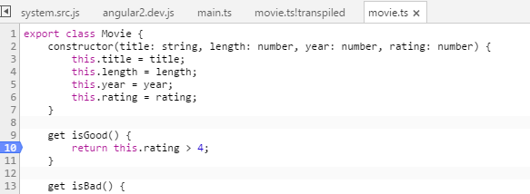
Debugging
Source maps let you step through TypeScript

Slide 24
Summary
Angular2 is an application framework
Similar to an MVVM design
Extensible, modular, testable

