Slide 1

Testing
expect(angular).toBe(testable)

Slide 2
Why?
JavaScript is dynamic
There is no help from a compiler
Other options available (TypeScript)
Testable code is generally well designed
SRP
DIP

Slide 3
How
Angular helps us avoid global state and singletons
Dependency injection
No need for “new” or namespaces
Angular helps with separation of concerns
Controllers don’t manipulate the DOM
Templates don’t contain application logic

Slide 4
Setup
Framework options
Qunit
Jasmine
Mocha
Runner options
Karma
Grunt
Chutzpah (Visual Studio)

Slide 5
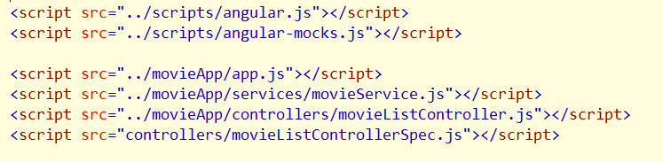
Help
ngMock (angular-mock.js )
Bootstrap modules
Test friendly injector method
Mock services

Slide 6
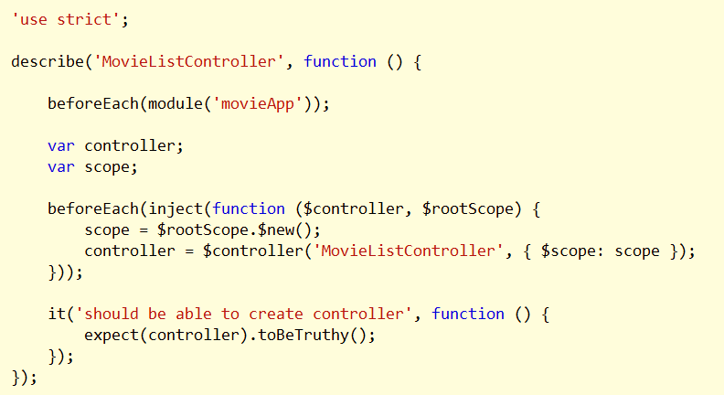
First Spec
Using module and inject to create controller

Slide 7
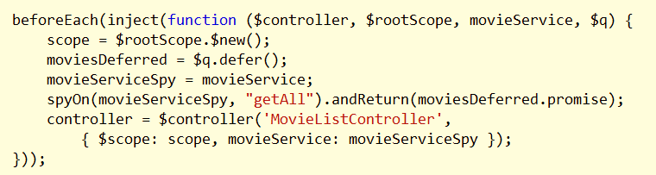
Mocking
Can mock any service
Jasmine provides spies

Slide 8
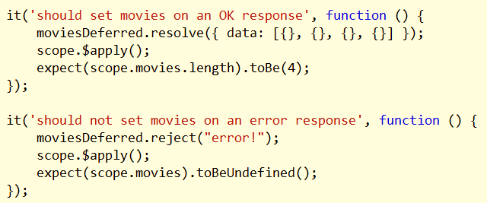
Working With Promises
Often easiest to create promises with $q
Return “controlled” promise from a spy, mock, or fake

Slide 9
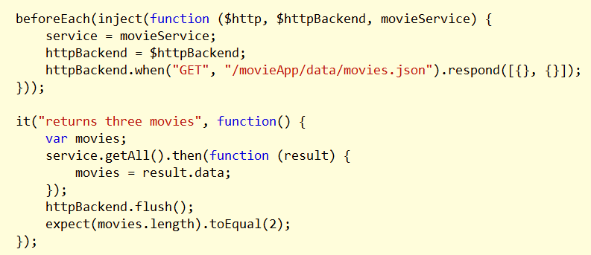
Testing HTTP Interaction
Use $httpBackend

Slide 10
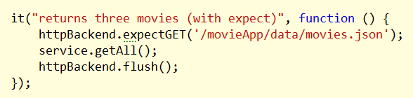
Expectations
Alternate style for $http interaction

Slide 11
Summary
Testability is a goal
Many options for frameworks, runners, and workflows

