Slide 1
Models

Slide 2
Model Binding
Default model binder maps request values to a CLR type
[FromBody] [FromQuery] [FromHeader] [FromRoute] …
public ActionResult OnPost(Employee employee)
{
// ...
}
public ActionResult EdOnPost(int id, string name,
DateTime hireDate)
{
// ...
}

Slide 3
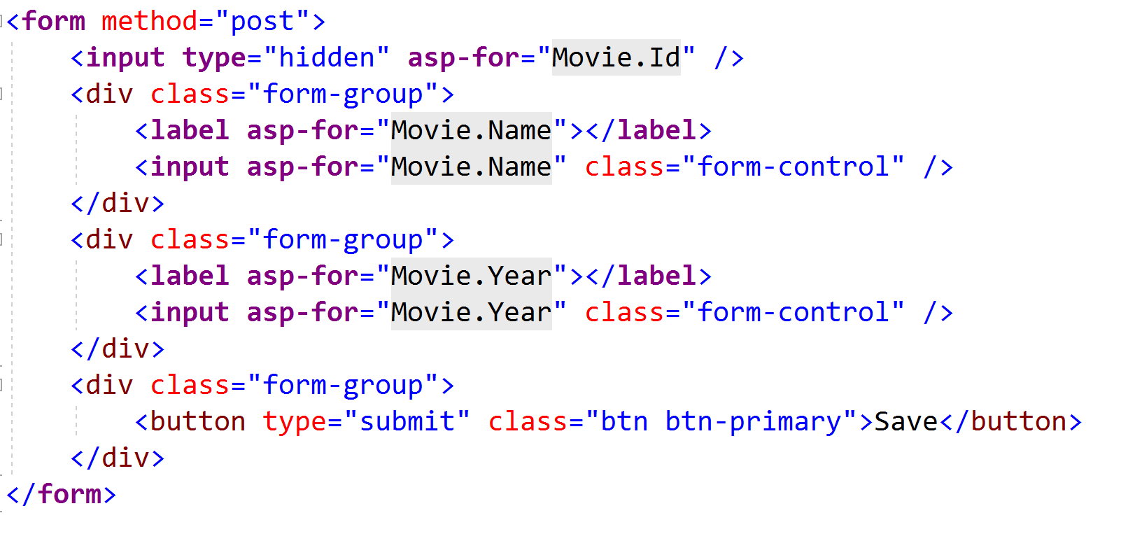
asp-for

Slide 4
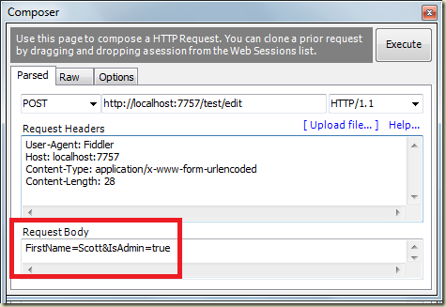
Model Binding Security
Beware of over-posting / mass assignment

Slide 5
Model Binding State
ModelState contains byproducts of model binding
Errors and attempted values
ModelState.IsValid
Did the model bind correctly?
Tag helpers use model state
Model state can override view model data
public void IndexAsync(string model)
{
if (ModelState.IsValid)
{
// commit...
return RedirectToAction("Index");
}
return View(model);
}

Slide 6
Data Annotations
Gives additional metadata for templates
public class UserEditModel { [ScaffoldColumn(false)] public int ID { get; set; } [DisplayFormat(NullDisplayText="No name")] public string Name { get; set; } [DisplayName("Joined")] [DisplayFormat(DataFormatString="{0:d}")] public DateTime JoinedOn { get; set; } }

Slide 7
Display / Edit Annotations
Attribute | Description
DisplayColumn | Specify the property of a model class for simple text display.
HiddenInput | Render value in a hidden input (when editing).
UIHint | Specify the name of the template to use for rendering.
DataType | Common templates (email, password, URL, currency)
ReadOnly | Specify a read-only property (for model binding).
DisplayFormat | Format strings and null display text
ScaffoldColumn | Turn off display and edit capabilities
DisplayName | Friendly name for labels
Required | Specify required properties (for model binding).

Slide 8
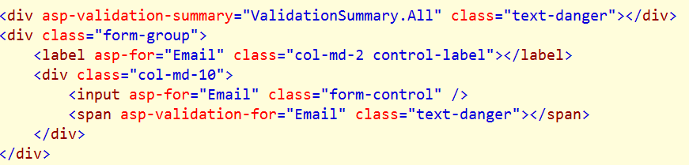
Validation Messages
ValidationMessage
Display property level validation errors
ValidationSummary
Display model level validation errors

Slide 9
Summary
Page Model
View Model
View

